Slide 1
HealthConnect Clinic
Using Data and AI to Reduce Missed Appointments
Final Project Presentation - Data Analytics Track
Adeleke Jubril Adedeji
AnalystLab Africa Experience Lab | HealthConnect Experience Lab

Slide 2
The Problem
HealthConnect Clinic is a fictional healthcare provider facing a common but costly challenge: patients missing their scheduled appointments.
51.2%
of all appointments in the dataset ended in a no-show
The project question:
“How can HealthConnect Clinic use data and AI to reduce missed appointments and improve the patient support experience?”
5,000
fictional, anonymised appointment records analysed
5 weeks
from problem understanding through final validation
HealthConnect Clinic — Final Presentation
2

Slide 3
My Contribution - Data Analytics Track
01
02
03
04
Explore & Prepare
Analyse & Develop KPIs
Validate & Integrate
Test & Refine
Reviewed the dataset against the data dictionary, checked data quality and identified the strongest early predictors of no-shows.
Built and calculated 5 core KPIs and investigated how booking lead time and prior no-show history interact.
Converted the strongest pattern into a validated composite risk score, confirmed with statistical testing and handed a feature file to Data Science.
Independently re-tested every finding with alternate methods, checked stability across patient segments and caught a real data-quality defect in a cross-track file.
Tools: Python (Pandas, NumPy, SciPy, scikit-learn), Matplotlib, Seaborn, Jupyter Notebook
HealthConnect Clinic — Final Presentation
3

Slide 4
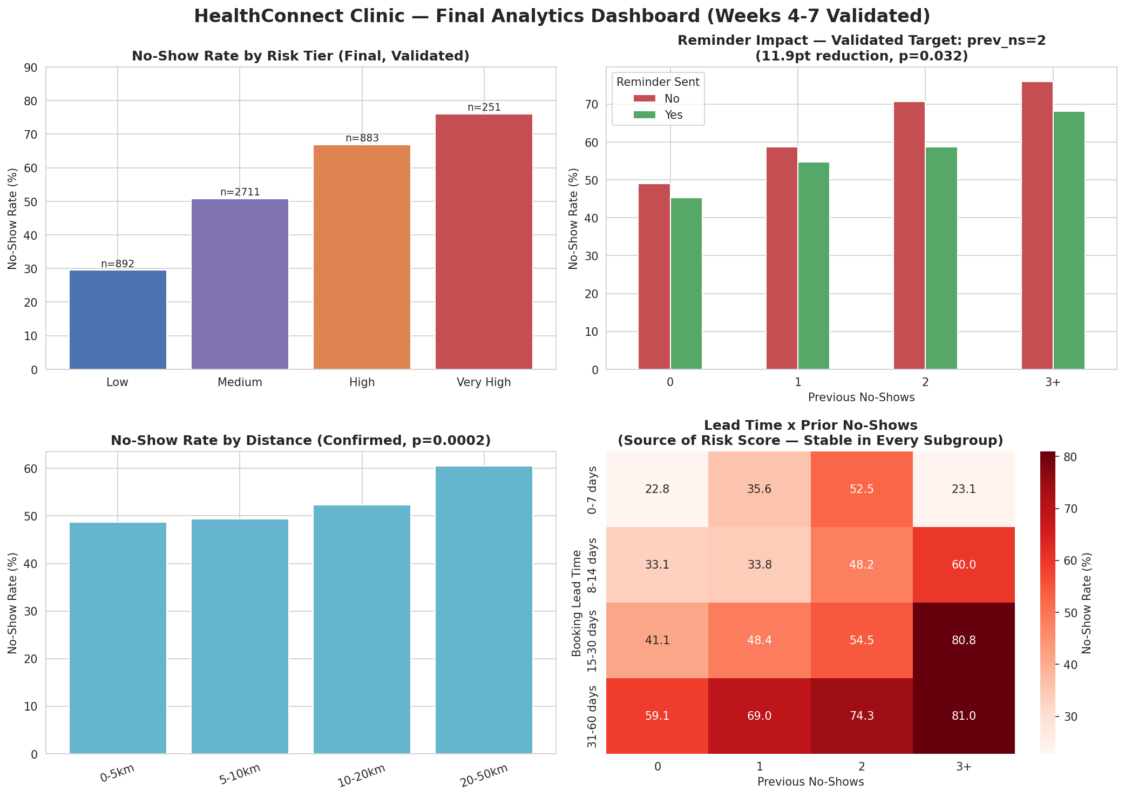
Key Results - Final Validated Dashboard
HealthConnect Clinic — Final Presentation
4

Slide 5
Two Findings That Changed the Recommendation
Targeted, not universal, reminders
Distance is a real access barrier
70.7% → 58.7%
60.5%
No-show rate with vs without a reminder, for patients with exactly 2 prior no-shows (p=0.032) the only patient group where reminders showed a statistically proven effect.
no-show rate for patients living 20-50km from the clinic, vs 48.7% for the closest patients (p=0.0002) confirmed under two independent binning methods and not explained by appointment type.
HealthConnect Clinic — Final Presentation
5

Slide 6
Cross-Track Collaboration - HC-POD
1
2
3
4
Provided
Tested
Found & Fixed
Received
A validated composite risk-score feature file, with an explicit recommendation to use raw features over the bucketed score for modelling (AUC 0.679 vs 0.658).
Actively tested the handoff file itself not just delivered it checking for nulls, duplicate keys, and internal consistency.
Discovered 86 unflagged missing values in the distance field. Added an explicit missing-data flag and re-exported a corrected file.
Confirmation that Data Science incorporated the risk interaction into their candidate model and adopted the corrected file for final training.
Track collaborated with: Data Science | Communication alone was not treated as sufficient — evidence is a corrected, re-tested file.
HealthConnect Clinic — Final Presentation
6

Slide 7
Testing, Refinement & Final Outcome
Test | Method | Result | Status
KPI reproducibility | Re-derived from raw data | Exact match to reported figures | Pass
Dashboard completeness | All records accounted for | 0 records dropped | Pass
Segment stability | Pattern holds in every subgroup | Monotonic in all age/type groups | Pass
Distance finding | Retest with quantile bins | Confirmed, p=0.0029 | Pass
Reminder finding | Retest with effect size | Largest effect at prev_ns=2 | Pass
Data Science handoff file | Null / duplicate / consistency check | 86 unflagged nulls found → fixed | Fixed & Re-tested
HealthConnect Clinic — Final Presentation
7

Slide 8
Business Value & Recommendations
1
Adopt the four-tier risk framework (Low/Medium/High/Very High) as the standard scheduling and outreach view.
2
Pilot targeted reminders specifically for patients with exactly 2 prior no-shows before any wider rollout.
3
Investigate transport-access support for patients in the 20-50km band.
4
Set up manual case management for the small (~5%), high-risk “Very High” tier.
5
Require explicit missing-data flags on any file handed between HealthConnect project tracks.
HealthConnect Clinic — Final Presentation
8

Slide 9
Limitations & Closing
Remaining limitations:
Key takeaway:
• Reminder-timing data (when, not just whether) is still unavailable.
A finding that looks solid as a percentage doesn't always survive independent retesting and validating cross-track artifacts, not just delivering them, is what catches real defects before they propagate.
• The smallest interaction cell (n=13) remains low-confidence.
• All validation is on the full dataset, not a held-out split.
Thank you.
Adeleke Jubril Adedeji - AnalystLab Africa Experience Lab

