Slide 1
The Text-Minder
Babysitting Your Language Model by Training with Semantic Constraints
Presenter : Jerry Ding (dalud)

Slide 2
Language Models and Their Uses
A language model learns the probability distribution of word or character sequences in a dataset.
As a PDF, they can generate data / compute perplexity / build classifiers / perform Bayesian inferences
Use cases:
Autocorrect / text completion
Projection to syntactically / stylistically accurate text
e.g. for QA, machine translation, conversational agents
Generating templates for further human refinement

Slide 3
Shortcomings of Language Models
Language contains a lot of entropy, i.e. “information”
Even with the perfect probability model, and even after conditioning on many things... There are still multiple valid output sentences. These can significantly differ, even in semantic content
Especially conversation / dialogue. Unlike QA, there isn't just one true response to your conversation partner.

Slide 4
GPT-2 Demo
"Oh, hey George! Haven't seen you in a long time. How's it been lately? I heard that you were looking for a new job in San Francisco."
"Haha, yeah we haven't met since graduation. Just hopping on the tech industry bandwagon like everyone else. I self-studied web dev stuff while I was in Virginia."
"Uhh, you were a mechanical engineer the past two years right? How's work? I heard it's tough for entry level positions."
Output #1:
"Yeah, I know what you mean. Work's been pretty hectic as a result of all the new company initiatives, and the new head of the company brought in a few new people who have a bunch of awesome projects under their belts.”
Output #2:
"Well, to tell you the truth, I wasn't sure. I mean, it's just so new here. My coworkers are all like, 'George, didn't you just quit? What the hell are you doing out here?'”
Output #3:
George scratched his head while wiggling his fingers in confusion. "Not exactly. I worked in both IT and Mechanical Engineering for a living for a couple of years. They aren't the most glamorous careers by any means, but...

Slide 5
Language Model Conditioning
Even when conditioning the model on past context... It's difficult to inject the right kinds of information to constrain the output of the language model
Can be undesirable even if the text is modeled well
Much more annoying when the language model makes glaring semantic errors

Slide 6
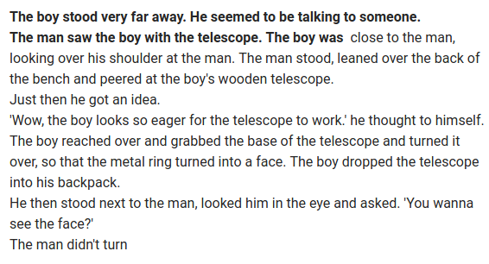
GPT-2 Conditioning

Slide 7
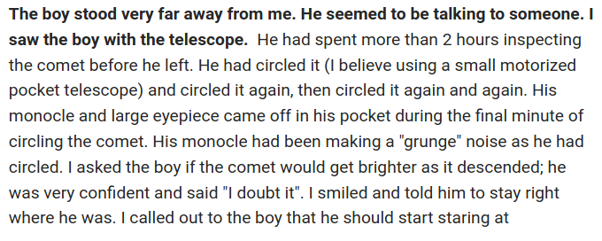
GPT-2 Conditioning

Slide 8
The Project Question
Is it possible to engineer a method of semantically constraining the output of the language model?
My claim:
One can significantly influence a language model by introducing a small and incomplete encoding of the semantic content desired in the output.

Slide 9
Relevant Prior Work
The task shares similarities with machine translation
Input sentence ≈ semantics desired in the output
But in MT, the injected information is a nearly complete characterization of the output
There is also a similarity to NLGen systems
But the motivation and data source is of a different nature
NLGen transforms machine data for human interpretability
My task: semantic encoding is made by user, and output is intended for communication with other agents

Slide 10
Semantic Constraints
Semantic encoding: a sequence of semantic constraints
Semantic constraints are simple, non-composable propositions built out of a small vocabulary
Basically, a heavily simplified written language
The constraint is that the above propositions should be inferable from the model's output sentence

Slide 11
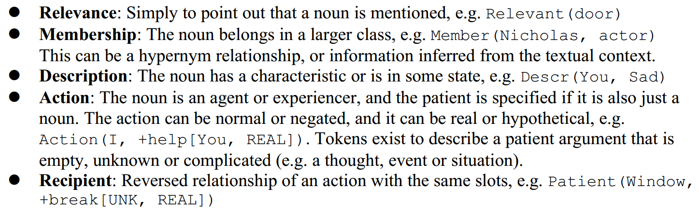
Semantic Constraints

Slide 12
Approach
Develop a representation for the semantic constraints
Design the grammar of the constraint language, i.e. define the abstract types, data structures, and their arguments
Build a small vocabulary for the tokens in the constraint language, making a trade-off between the simplicity of the language and the expressiveness of the constraints
[Much of this is already done]

Slide 13
Approach
Create an inference engine to produce semantic constraints from sentences
Create a function to map words (from a large vocabulary) to a set of terms in the reduced vocabulary (with similarity scores)
Parse each sentence with existing tools, e.g. TUPA
Write soft logic rules to infer properties of the words, based on the semantics between terms in the reduced vocabulary
Generate semantic constraints from the inferred properties
[Already did the first task]

Slide 14
Approach
Train the constrained language model
Generate semantic constraints from sentences in corpus
Obtain pretrained GPT-2 model, and add encoder / decoder layers around the trained portion
Train the model, using the machine-generated semantic constraints as training data for the conditioning process
Measure the text perplexity of the trained model vs. an unconditioned or less conditioned model

Slide 15
The Data
Using the OpenSubtitles dataset
Movie lines approximate conversation
Full dataset has 280M lines, took a subset of 3M lines
Will be using pre-trained GPT-2 medium size model
Used WordNet as an ontology for mapping words to the reduced vocabulary

Slide 16
Sources of Semantic Information
Manually created
Design of the constraint language
Creating the reduced vocabulary
Inference rules with the reduced vocabulary
Tuning parameters for the word mapper
Existing sources
WordNet for synonymy and ontology
Pretrained GPT-2 weights
GloVe vectors (only as a reference in making reduced vocab)

Slide 17
Appendix
Thoughts on the work done so far

Slide 18
Work so far: Thoughts
Fun exercise: manually extracting semantic constraints for example sentences
To test the expressiveness of the constraint language
Observation: even without composition, a simple language can encode a surprising amount of information

Slide 19
Work so far: Thoughts
Not easy: condensing down the vocabulary
Words don't nearly fit into an ontology
Common words are not very informative e.g. it's useless to group all concepts under “entity” / “object” / “abstraction”
K-means on word vectors do reveal interesting patterns. But the clusters aren't useful as primitive terms. Clusters often have mixed P.O.S. and antonyms

Slide 20
Work so far: Thoughts
Insightful: implementing the word mapper
This teaches a lot about the structure of WordNet
Discovering firsthand why word similarity is a difficult problem
Relationships across P.O.S are very sparse
Graph connectivity is low with just hypernym / hyponym relations, resulting in underestimated similarity between words
Can't tell whether two word senses are very similar, or totally different
No concept of prototypical meaning; words are often related via obscure synonyms or word senses
Lack of consistency: cannot rely on relationships existing between similar concepts even with the same P.O.S

Slide 21
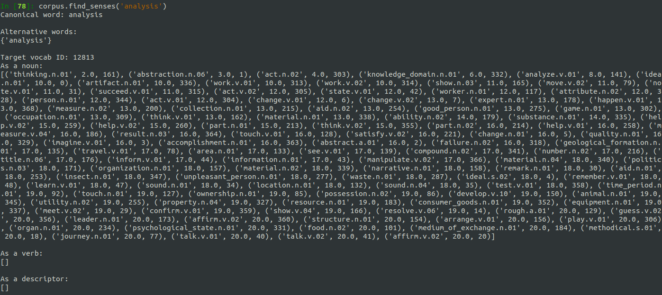
Word Mapper

