Slide 1


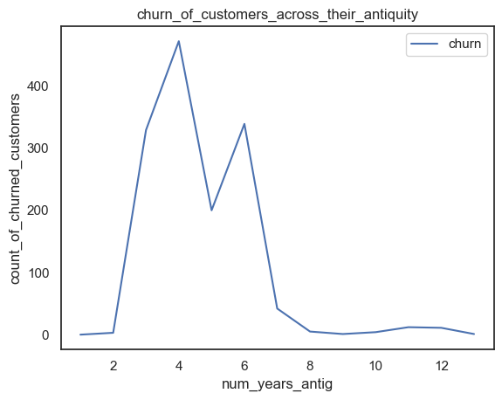
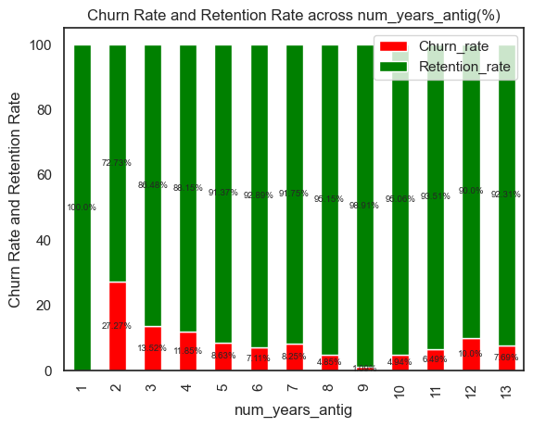
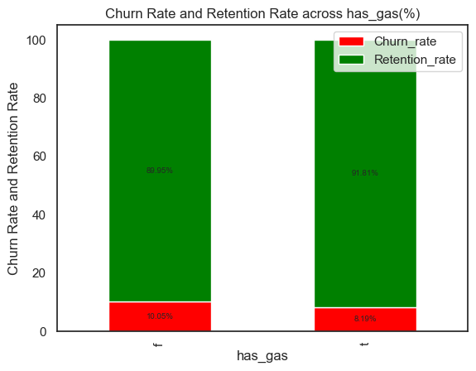
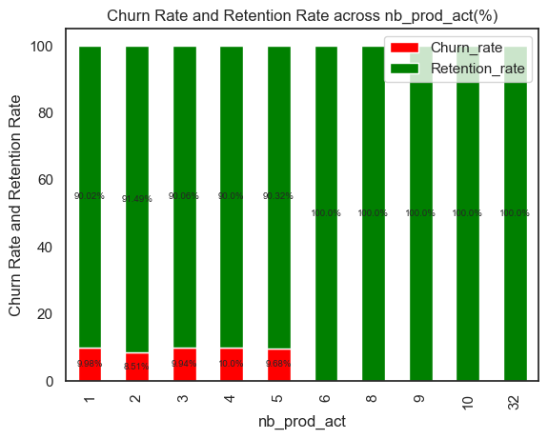
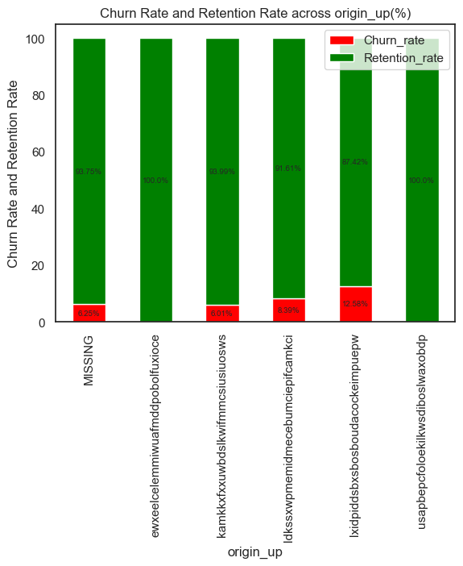
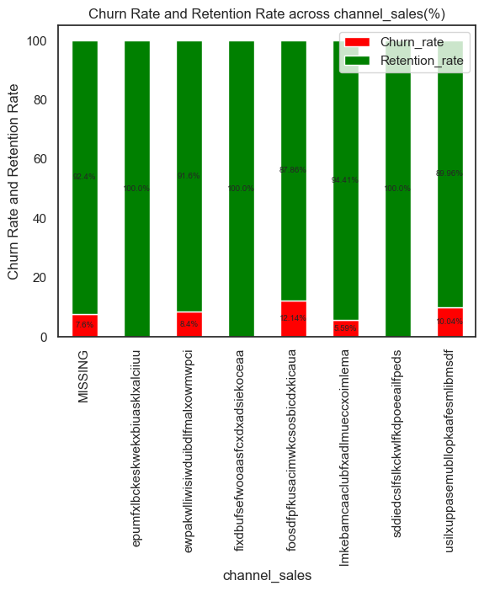
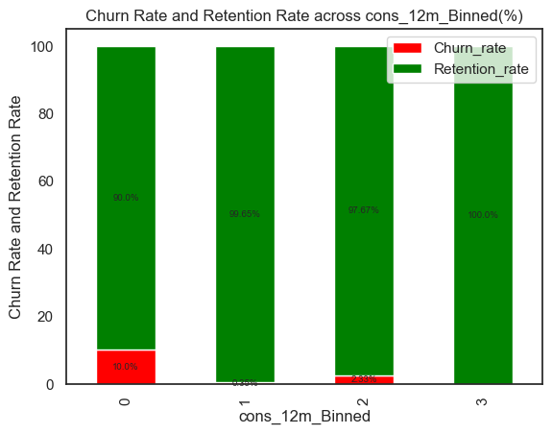
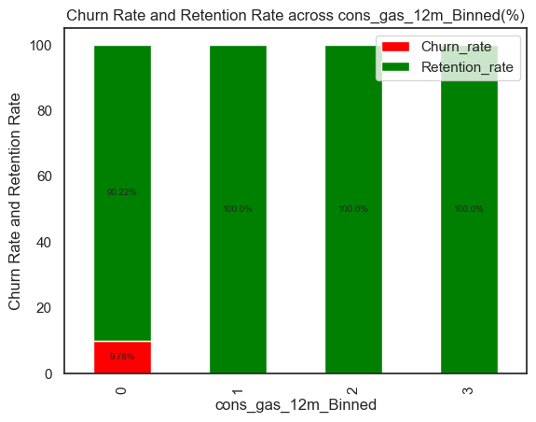
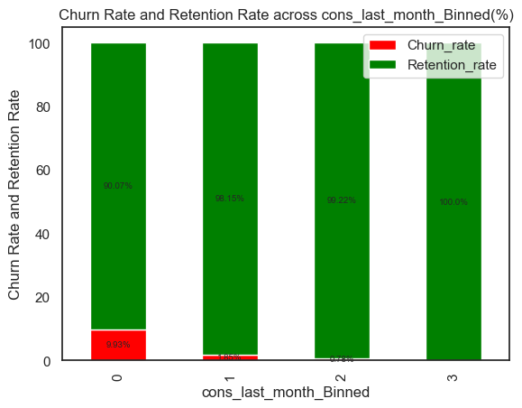
CHURN RATE
9.7%
ANTIQUITY OF THE CLIENT IN YEARS
NUMBER OF ACTIVE PRODUCTS AND SERVICES
THE PRICE SENSITIVITY WAS FOUND TO HAVE
NEGLIGIBE IMPACT ON CHURN RATE
NATURE OF CONSUMPTION OF THE CLIENT
SALES CHANNEL
CAMPAIGN FIRST SUBSCRIBED TO
IF A CLIENT IS A GAS CLIENT
FACTORS AFFECTING CHURN RATE

