Slide 1


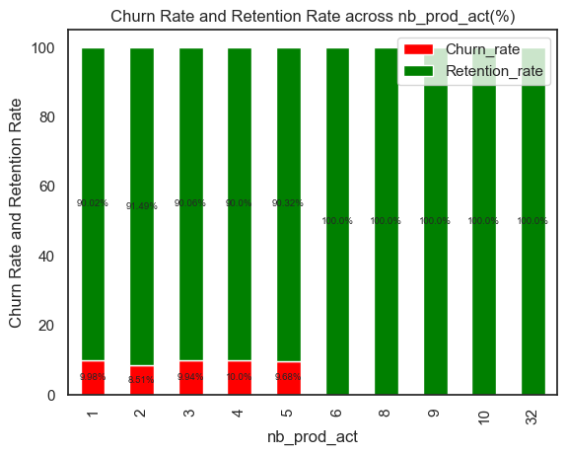
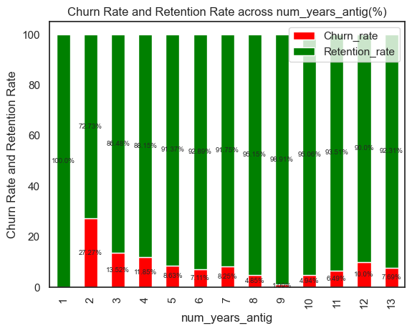
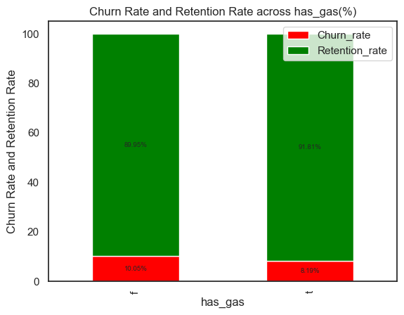
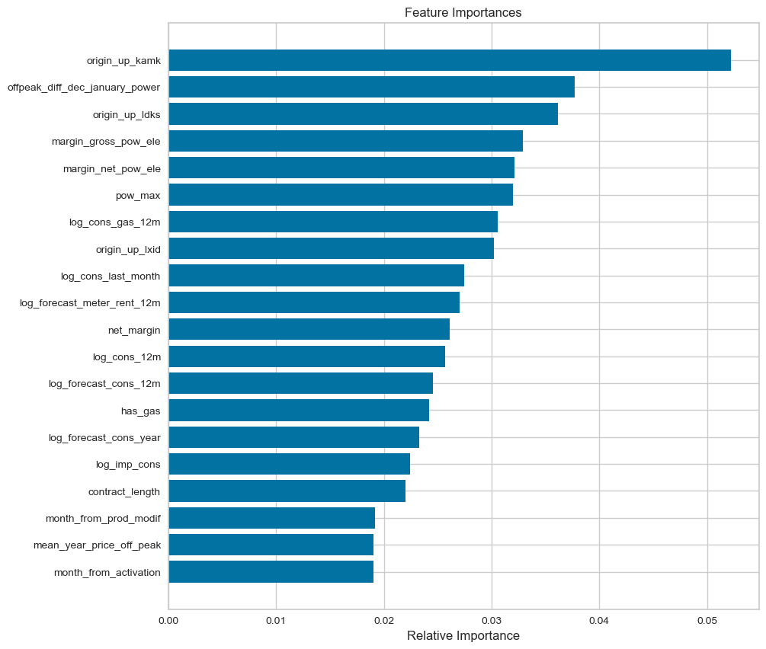
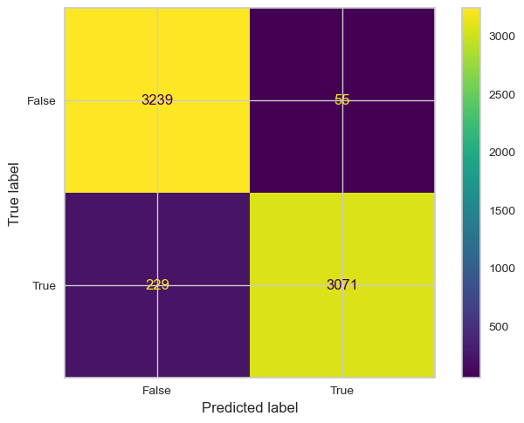
CHURN RATE
9.7%
PRICES OF POWER AND ENERGY
MODEL ACCURACY
CAMPAIGN CUSTOMER SUBSCRIBED TO
NATURE OF CONSUMPTION OF THE CLIENT
95%
SALES CHANNEL
CAMPAIGN FIRST SUBSCRIBED TO
IF A CLIENT IS A GAS CLIENT
MOST IMPORTANT FEATURES
NET MARGIN
POWER SUBSCRIBED
ENERGY SUBSCRIBED
GROSS & NET MARGIN ON POWER SUBSCRIPTION
NET MARGIN

