Slide 1



Software Architecture
Micromaster

Slide 2

Schedule
Start | Finish | Description
5:30 PM | 7:30 PM | Session 1
7:30 PM | 8:00 PM | Break
8:00 PM | 9:30 PM | Session 2

Slide 3
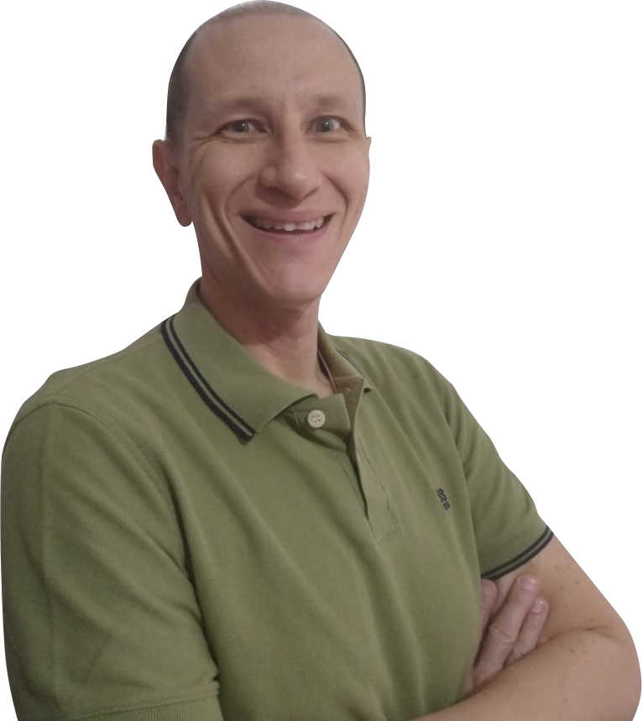
Presentation
Solutions Architect
DevOps Champion – Azure DevOps
QA Engineer
Support Engineer
Senior Developer
Technical Lead
IT Consultant
University Professor
Julio Robles
30 Years Experience

Slide 4

Presentación
Full Name
Company
Role / Position
Experience time
Cloud Knowledge
Location
Expectations

Slide 5


Requirements
AWS Account
Programming Fundamentals
Git / Git Account / Git Tools
Visual Editor (VS Code)

Slide 6

Start

