Slide 1



Software Architecture
Micromaster

Slide 2
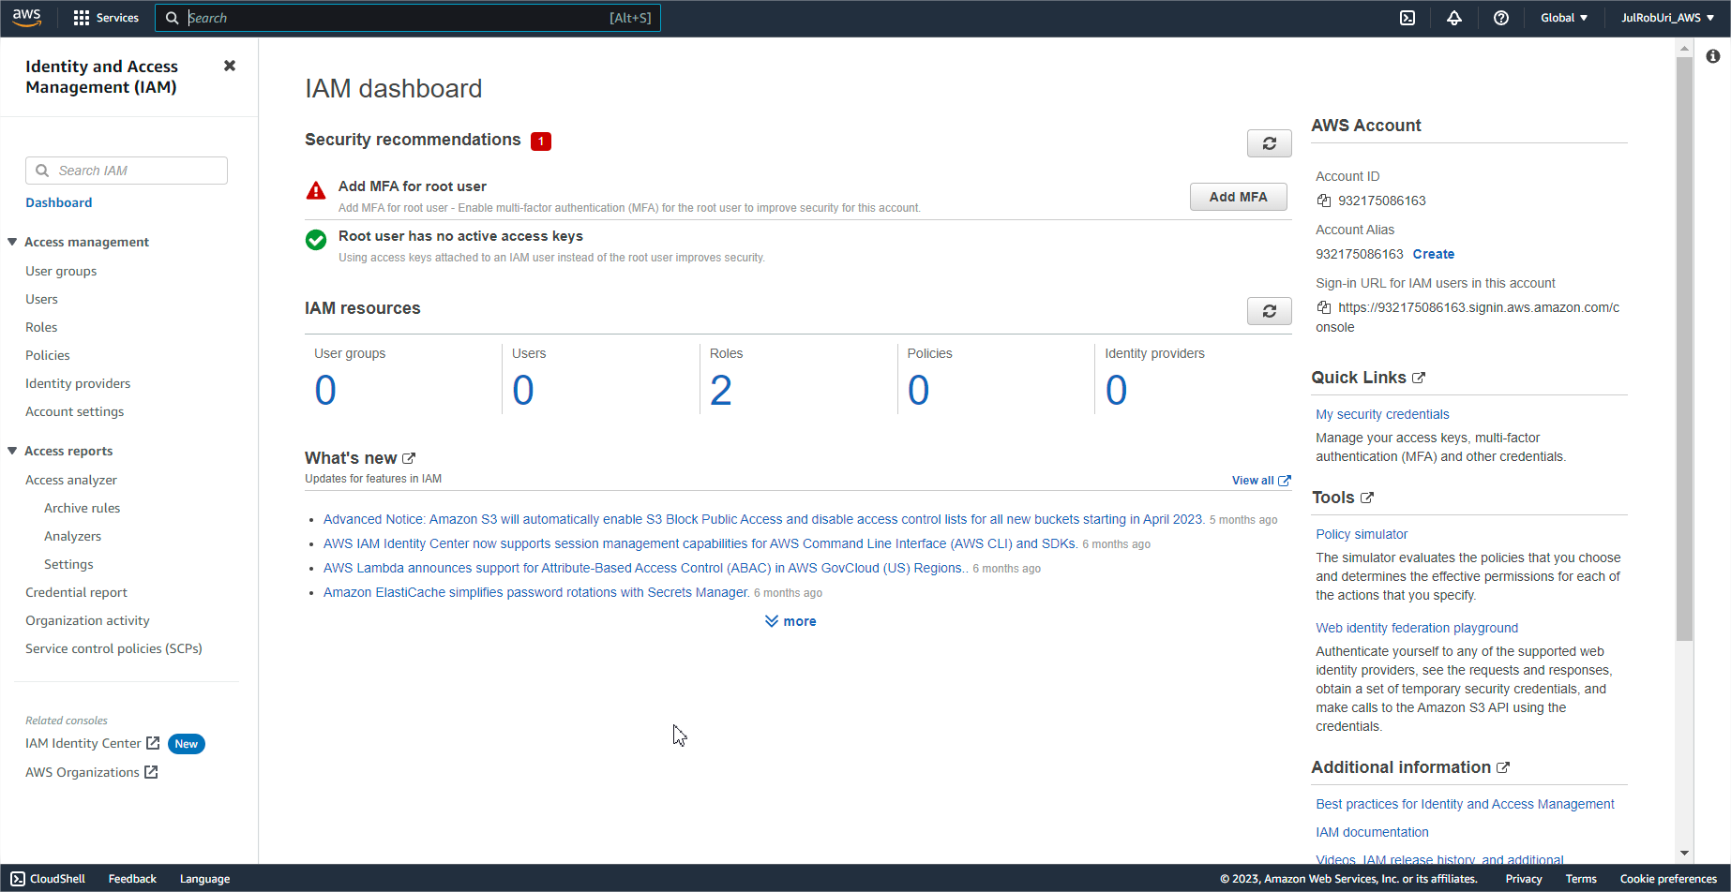
Identity and Access Management (IAM)

Slide 3

AWS Identity and Access Management (IAM)
AWS Identity and Access Management (IAM) enables you to manage access to AWS services and resources securely.
IAM gives you the flexibility to configure access based on your company’s specific operational and security needs.
You do this by using a combination of IAM features:
IAM users, groups, and roles
IAM policies
Multi-factor authentication

Slide 4
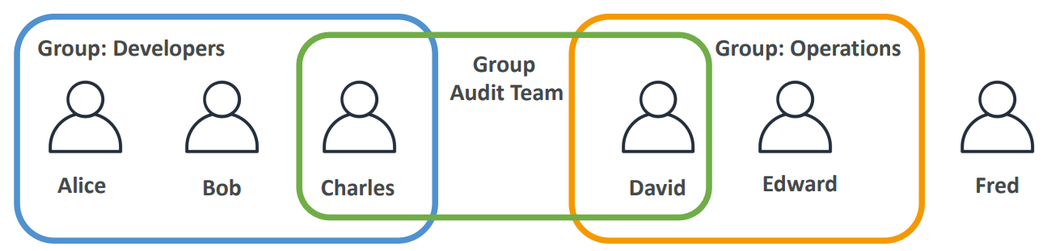
IAM: Users and Groups
IAM = Identity and Access Management, global service.
Root account = created by default, not to be used or shared
Users are people within your organization, and can be grouped
Groups only contain users, not other groups
Not all Users must belong to a group, and a user can belong to multiple groups

Slide 5
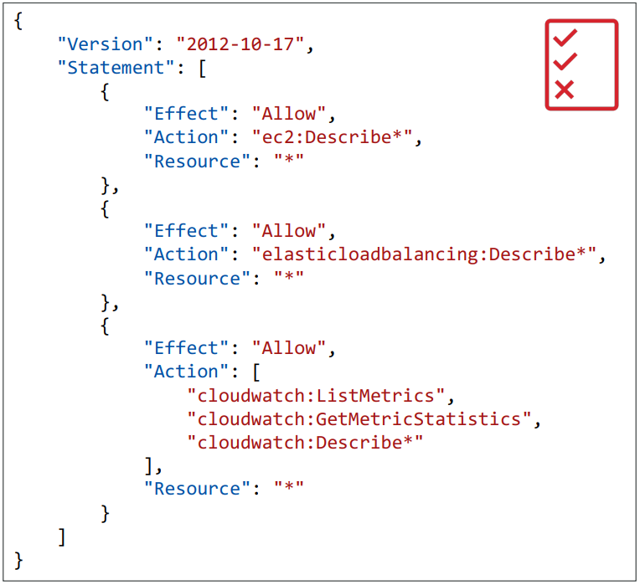
IAM: Policies
Policies = Grant permissions to users or groups. Policies are represented like a JSON document
In AWS you apply the least privilege principle
don’t give more permissions than user need

Slide 6

Practice – Create IAM User
Create IAM User
Create user: Admin
Provide user access to the AWS Management Console
Create an IAM user
Autogenerated Password
Users must create a new password at next sign-in
Set Permissions
Add User to group
Create Group: Administrators
AdministratorAccess (Full Access)
Select Group: Administrators
Create User
*** Copy Autogenerated Password ***
Return to users list

Slide 7
Practice – Access as IAM User
Access as IAM User
Go to Dashboard
Create Account Alias : julroburiaccount
Copy Sign-in URL for IAM users
Login with Admin Credentials
Change Password (AdminP4ssw0rd*2.023)
Review Console for this user

Slide 8
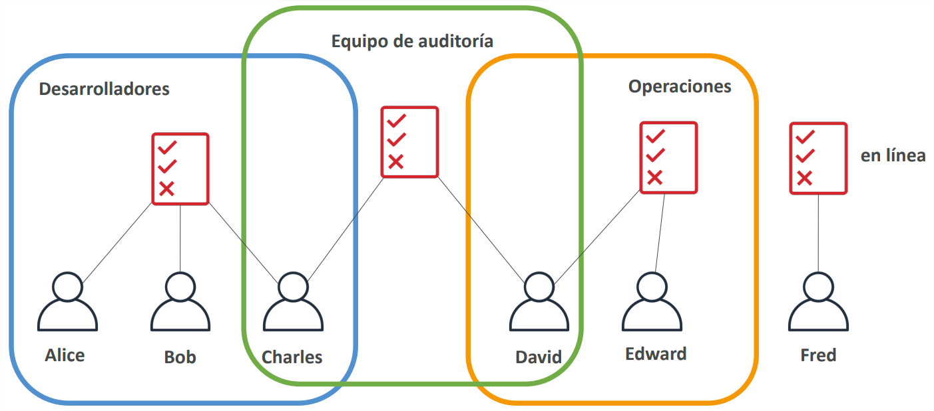
IAM: Policy Inheritance

Slide 9
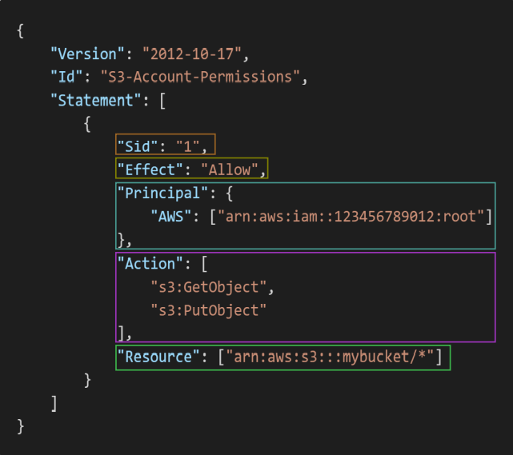
IAM: Policies Structure
Consists of
Version: policy language version (2012-10-17)
Id: an identifier for the policy (optional)
Statement: one or more individual statements (required)
Statements consists of
Sid: an identifier for the statements (optional)
Effect: whether the statements allow or denies access (Allow, Deny)
Principal: account/user/role to which this policy applied to
Action: list of actions this policy allow or denies
Resource: list of resources to which the actions applied to

Slide 10
Practice – Set Permissions (IAM Policies)
With Double View (Root and IAM User)
As IAM User select Users Option
As Root User
Select Group: Administrators
Remove user: Admin
As IAM User Check Access to Groups
As Root User (Users Option)
Select user: Admin
Add Permission
Attach Policies Directly
Search: IAMReadOnlyAccess and select it
Add Permissions
As IAM User (Refresh)
Try to create a new user and get the Error

Slide 11
Practice – Multiple Groups (Root)
Multiple Groups
Select Group: Administrators
Add user: Admin
Create New Group: Developers
Select User Admin
Search Permission: AWSCodeDeployFullAccess
Select it
Create Group
Go to Users and select user: Admin
Select Groups Tab and check the list

Slide 12
Practice – Policies (Root)
Policies
Search: IAMReadOnlyAccess
Select it and Expand (+) view the JSON data
Create Policy (Visual Option)
Search Service: IAM
Filter and add Actions: ListUsers, GetUser
Check the JSON data
Cancel the Creation
Reset IAM User (Admin)
Remove Group: Developers
Remove Permission: IAMReadOnlyAccess from Admin

Slide 13

IAM: Password Policies
Strong passwords = more security for your account
In AWS, you can set up a password policy:
Set a minimum password length
Require specific character types:
including capital letters
lowercase letters
numbers
non-alphanumeric characters
Allow all IAM users to change their own passwords.
Require users to change their password after a period of time (password expiration).
Prevent password reuse

Slide 14
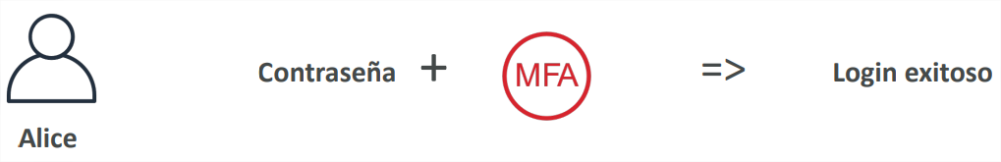
Multi Factor Authentication (MFA)
Users have access to your account and can possibly change settings or delete resources in your AWS account
You want to protect your root accounts and IAM users.
MFA = password you know + security device you own
Main benefit of MFA: if a password is stolen or hacked, the account is not compromised
Check the List of MFA Options and devices Here: https://aws.amazon.com/iam/features/mfa/

Slide 15
Practice – MFA (Root)
Account Settings
Password Policy (Edit)
Custom or Strong Password (New Password Policy)
Account Name (Title Bar)
Security Credentials
Assign MFA
Device Name (PersonaliPhone)
Authenticator App (Authy)
Scan QR Code
In Authy
Scan the QR Code
Enter the 2 MFA code Generated (wait for each one)
Assign MFA
Sign out and Sign in again to test

Slide 16
Ways to Access AWS
To access AWS, you have three options:
AWS Management Console (password protected + MFA)
AWS Command Line Interface (CLI) – protected by access keys
AWS Software Developer Kit (SDK) - for code: protected by keys access
Access keys are generated through the AWS console
Users manage their own access codes
Access codes are secret, like a password. don't share them
Access key ID != username
Secret access key != password

Slide 17
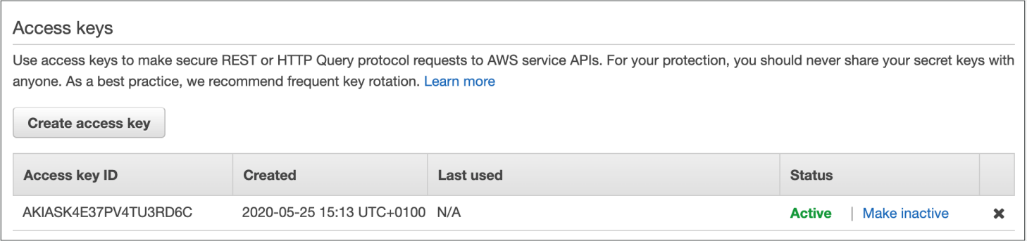
Access Keys (Samples)
Access key ID: AKIASK4E37PV4983d6C
Secret access key: AZPN3zojWozWCndIjhB0Unh8239a1bzbzO5fqkZq
Remember: do not share your access codes

Slide 18
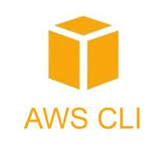
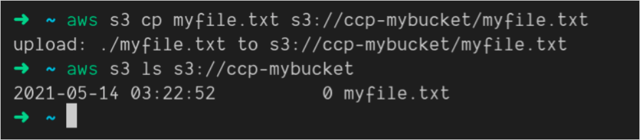
AWS Command Line Interface (CLI)
AWS CLI is a tool that allows you to interact with AWS services through commands in your command line shell
Direct access to the public APIs of AWS services
You can develop scripts to manage your resources
It is open source https://github.com/aws/aws-cli
Alternative to using the AWS Management Console

Slide 19

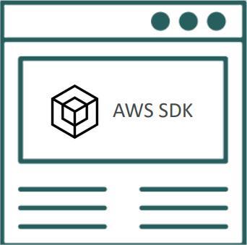
AWS Software Developer Kid (SDK)
AWS Software Development Kit (AWS SDK)
Specific APIs for each language (set of libraries)
Allows you to access and manage AWS services through programming
Integrated in the application
Supports:
SDKs (JavaScript, Python, PHP, .NET, Ruby, Java, Go, Node.js,C++)
Mobile SDKs (Android, iOS, ...)
SDKs for IoT devices (Embedded C, Arduino, ...)
Example: AWS CLI is built on top of the AWS SDK for Python
Your Application

Slide 20
Practice – AWS CLI – Installation and Access
Install AWS CLI
Installation Guide
Access (Admin)
Users/Security Credential
Access Keys (Create Access Key)
Command Line Interface (CLI)
Check (Understand the recommendations)
Next
Tag: Enable AWS CLI Access for Admin User
Create Access Key
Download csv file
Done

Slide 21
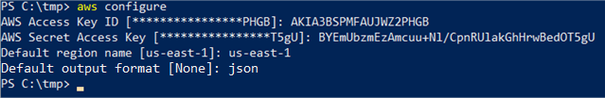
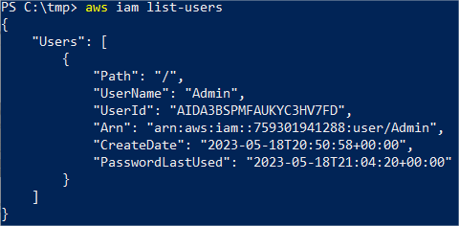
Practice – AWS CLI – Configuration and Use
Configuration (CMD/Powershell/Terminal)
aws configure
How to use it
aws iam list-users
AWS CLI Command Reference
AWS CLI: 10 Useful Commands You May Not Know

Slide 22
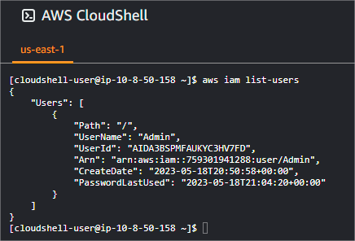
Practice – AWS Cloud Shell
AWS Cloud Shell
Search: CloudShell
aws iam list-users
CloudShell works in Region level, then could not be able in all regions.
There are more actions like download file or upload file

Slide 23
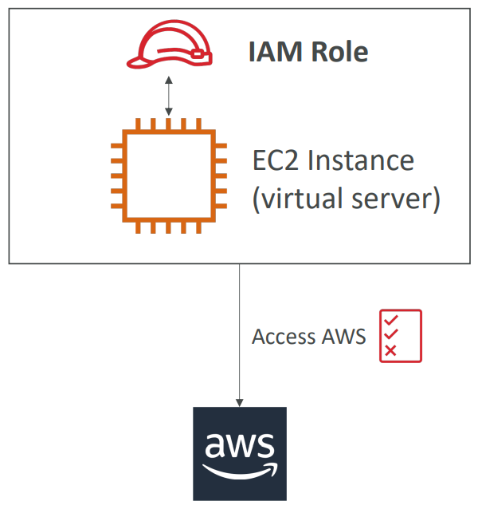
IAM: Roles To Services
IAM Roles apply for AWS services
AWS services will need to perform actions
An IAM role is an identity that you can assume to gain temporary access to permissions.
Common roles
EC2 Instance Roles
Lambda Functions Roles
Roles for CloudFormation

Slide 24
Practice – IAM Roles To Services
IAM/Roles
Create Role
AWS Service
EC2
Next
Filter: IAMReadOnlyAccess and select
Next
RoleName: ReadOnlyService
Create Role

Slide 25

IAM: Security Tools
IAM Credentials Report (account level)
A report that lists all the users in your account and the status of your various credentials
IAM Access Advisor (at user level)
Shows the service permissions granted to a user and when they are you last accessed those services
You can use this information to revise your policies

Slide 26
Practice – Security Tools
IAM Credentials Report
Access Report/Credential Report
Download Credential report
IAM Access Advisor
Users (Admin)
Access Advisor

Slide 27
Security Best Practices in IAM
Do not use the root account except for AWS account configuration
One physical user = One AWS user
Assign users to groups and assign permissions to groups
Create a strong password policy
Use and enforce the use of multi-factor authentication (MFA)
Create and use Roles to give permissions to AWS services.
Use access keys for programmatic access (CLI / SDK)
Review your account permissions with the IAM credentials report
Never share IAM users or access keys
https://docs.aws.amazon.com/IAM/latest/UserGuide/best-practices.html

Slide 28


Shared Responsibility Model in IAM
Conformity validation
Infrastructure (global network security)
Configuration and vulnerability analysis
Management and supervision of users, groups, roles and policies
Enable MFA on all accounts
Rotate all your keys frequently
Use IAM tools to apply the appropriate permissions
Analyze access patterns and review permissions

Slide 29
IAM: Summary
Users: mapped to a physical user, has a password for the AWS console
Groups: contains only users
Policies: JSON document that describes the permissions for users or groups
Roles – for EC2 instances or AWS services
Security: MFA + Password Policy
AWS CLI – Manage your AWS services using the command line
AWS SDK – Manage your AWS services using a programming language
Access Keys – Access AWS using the CLI or SDK
Audit: IAM Credential Reports and IAM Access Advisor

Slide 30

Questions?

Slide 31

Quiz: 04-IAM-Identity and Access Management

