Slide 1



Software Architecture
Micromaster

Slide 2
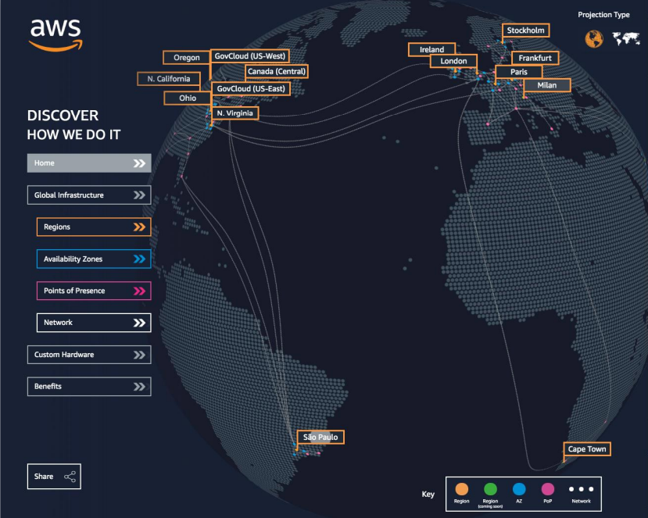
AWS Infrastructure
Regions
Availability Zones
Data Centers
Edge Locations
https://infrastructure.aws/
Notes:
AWS , es una infraestructura global y tiene centros de datos distribuidos por todo el mundo.
Debemos tener presente estos conceptos a la hora de seleccionar la Zona que mejor se ajuste a nuestras necesidades, ya sea por servicio, o por latencia o por

Slide 3
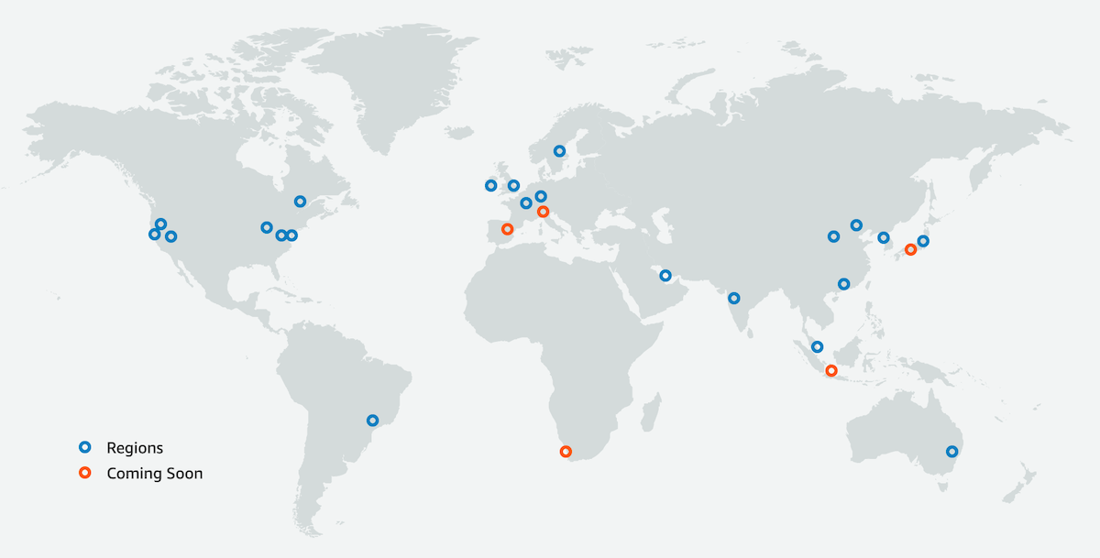
Regions
An AWS Region is a geographical area.
Data replication across Regions is controlled by you.
Communication between Regions uses AWS backbone network infrastructure.
Each Region provides full redundancy and connectivity to the network.
A Region typically consists of two or more Availability Zones.
Notes:
AWS has the concept of a Region, which is a physical location around the world where we cluster data centers.
We call each group of logical data centers an Availability Zone.
Each AWS Region consists of a minimum of three, isolated, and physically separate AZs within a geographic area.
Unlike other cloud providers, who often define a region as a single data center, the multiple AZ design of every AWS Region offers advantages for customers.
Each AZ has independent power, cooling, and physical security and is connected via redundant, ultra-low-latency networks.
AWS customers focused on high availability can design their applications to run in multiple AZs to achieve even greater fault-tolerance.
AWS infrastructure Regions meet the highest levels of security, compliance, and data protection.
AWS provides a more extensive global footprint than any other cloud provider, and to support its global footprint and ensure customers are served across the world, AWS opens new Regions rapidly.
AWS maintains multiple geographic Regions, including Regions in North America, South America, Europe, China, Asia Pacific, South Africa, and the Middle East.

Slide 4



Selecting Regions
Data governance, legal requirements
Proximity to the customers (Latency)
Services available within the Region
Cost (Vary by Region)

Slide 5

Quiz: 03-AWS Infrastructure

Slide 6

Questions?

