Slide 1



Software Architecture
Micromaster

Slide 2
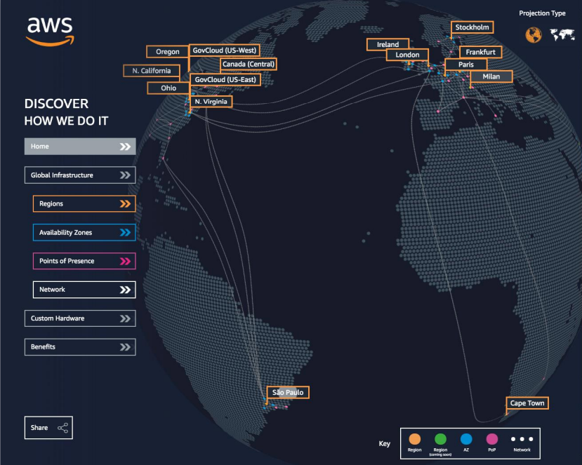
AWS Infrastructure
Regions
Availability Zones
Data Centers
Edge Locations/Points of Presense
https://infrastructure.aws/
Notes:
AWS , es una infraestructura global y tiene centros de datos distribuidos por todo el mundo.
Debemos tener presente estos conceptos a la hora de seleccionar la Zona que mejor se ajuste a nuestras necesidades, ya sea por servicio, o por latencia o por

Slide 3
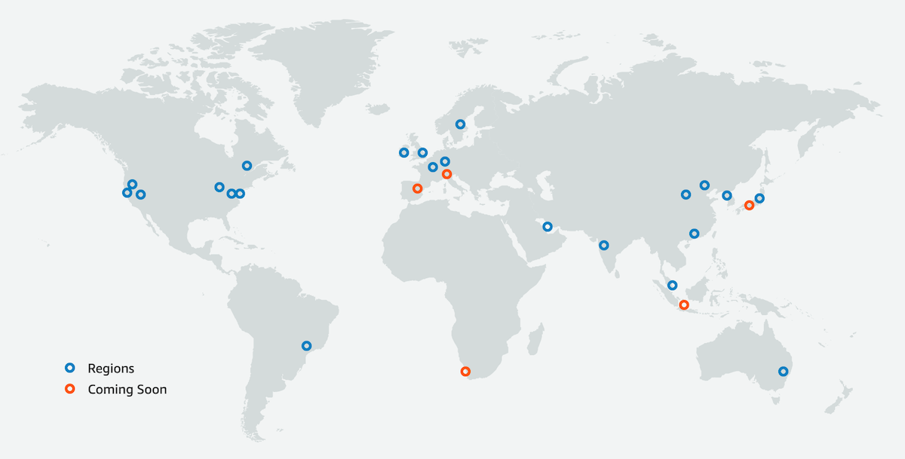
Regions
An AWS Region is a geographical area.
Data replication across Regions is controlled by you.
Communication between Regions uses AWS backbone network infrastructure.
Each Region provides full redundancy and connectivity to the network.
A Region typically consists of two or more Availability Zones.
Notes:
AWS has the concept of a Region, which is a physical location around the world where we cluster data centers.
We call each group of logical data centers an Availability Zone.
Each AWS Region consists of a minimum of three, isolated, and physically separate AZs within a geographic area.
Unlike other cloud providers, who often define a region as a single data center, the multiple AZ design of every AWS Region offers advantages for customers.
Each AZ has independent power, cooling, and physical security and is connected via redundant, ultra-low-latency networks.
AWS customers focused on high availability can design their applications to run in multiple AZs to achieve even greater fault-tolerance.
AWS infrastructure Regions meet the highest levels of security, compliance, and data protection.
AWS provides a more extensive global footprint than any other cloud provider, and to support its global footprint and ensure customers are served across the world, AWS opens new Regions rapidly.
AWS maintains multiple geographic Regions, including Regions in North America, South America, Europe, China, Asia Pacific, South Africa, and the Middle East.

Slide 4




Selecting Regions
Data governance,
Legal requirements
Proximity to the
Customers (Latency)
Services available
within the Region
Cost
(Vary by Region)
Notes:
Cumplimiento de los requisitos legales y de gobernanza de datos: los datos nunca salen de una región sin tu permiso explícito
Proximidad a los clientes: latencia reducida
Servicios disponibles en una región: los nuevos servicios y las nuevas funciones no están disponibles en todas las regiones
Precios: los precios varían de una región a otra y son transparentes en la página de precios del servicio

Slide 5
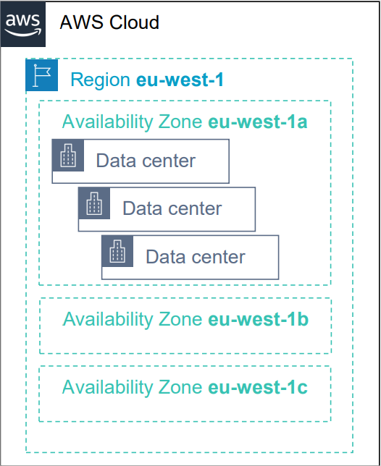
Availability Zones
Each Region has multiple Availability Zones.
Each Availability Zone is a fully isolated partition of the AWS infrastructure.
There are currently 69 Availability Zones worldwide
Availability Zones consist of discrete data centers
They are designed for fault isolation
They are interconnected with other Availability Zones by using high-speed private networking
You choose your Availability Zones.
AWS recommends replicating data and resources across Availability Zones for resiliency.
Notes:
Cada region tiene entre 3 y 6 Zonas de Disponibilidad
Cada zona de disponibilidad (AZ) tiene uno o varios centros de datos discretos con alimentación, red y conectividad redundantes (por lo general 3)
Están separadas unas de otras, de modo que están aisladas de las catástrofes
Están conectadas con redes de alto ancho de banda y latencia ultrabaja

Slide 6
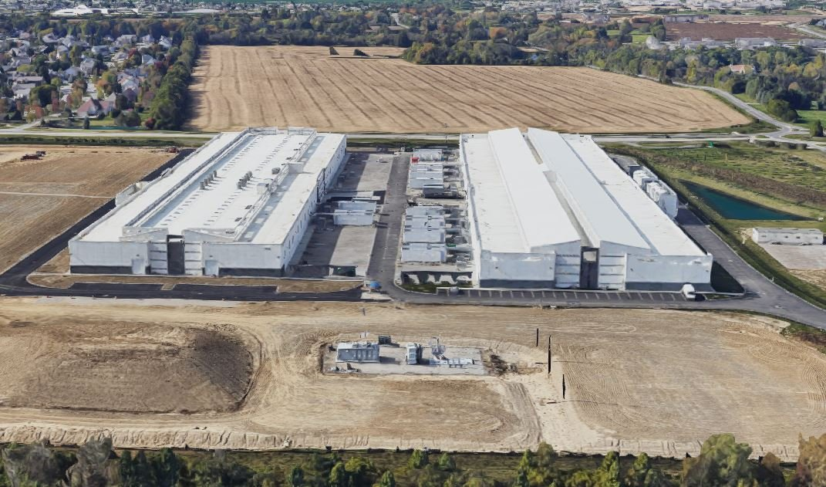

Data Centers
AWS data centers are designed for security.
Data centers are where the data resides and data processing occurs.
Each data center has redundant power, networking, and connectivity, and is housed in a separate facility.
A data center typically has 50,000 to 80,000 physical servers.

Slide 7
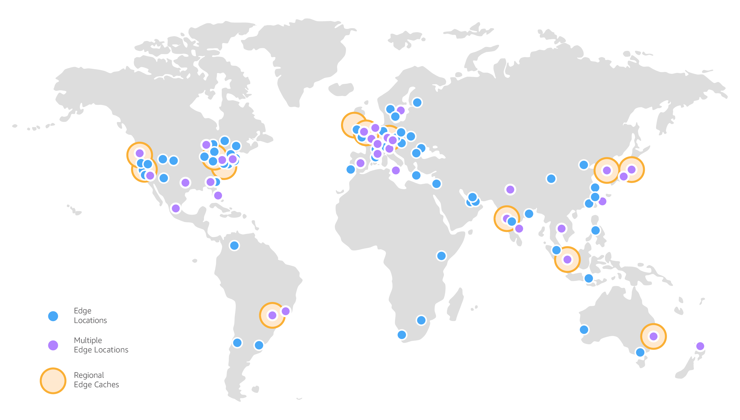
Edge Locations/Points of Presence
AWS provides a global network of 450+ Points of Presence locations
Consists of 13 regional edge caches in 90+ cities across 49 countries
Used with Amazon CloudFront
A global Content Delivery Network (CDN), that delivers content to end users with reduced latency
Regional edge caches used for content with infrequent access.
https://aws.amazon.com/cloudfront/features/

Slide 8
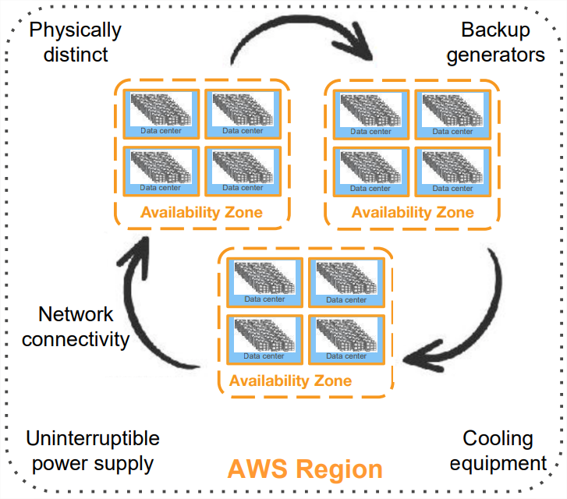
AWS Infrastructure features
Elasticity and scalability
Elastic infrastructure; dynamic adaption of capacity
Scalable infrastructure; adapts to accommodate growth
Fault-tolerance
Continues operating properly in the presence of a failure
Built-in redundancy of components
High availability
High level of operational performance
Minimized downtime
No human intervention

Slide 9

Keys takeaways
The AWS Global Infrastructure consists of Regions and Availability Zones.
Your choice of a Region is typically based on compliance requirements or to reduce latency.
Each Availability Zone is physically separate from other Availability Zones and has redundant power, networking, and connectivity.
Edge locations, and Regional edge caches improve performance by caching content closer to users.

Slide 10
Some Services
AWS global services:
Identity and Access Management (IAM)
Route 53 (DNS service)
CloudFront (Content Delivery Network)
WAF (Web Application Firewall)
Most AWS services are regional in scope:
Amazon EC2 (Infraestructura as a Servicie)
Elastic Beanstalk (Plataform as a Servicie)
Lambda (Function as a Servicie)
Rekognition (Software as a Servicie)
Regions Table:
https://aws.amazon.com/about-aws/global-infrastructure/regional-product-services

Slide 11
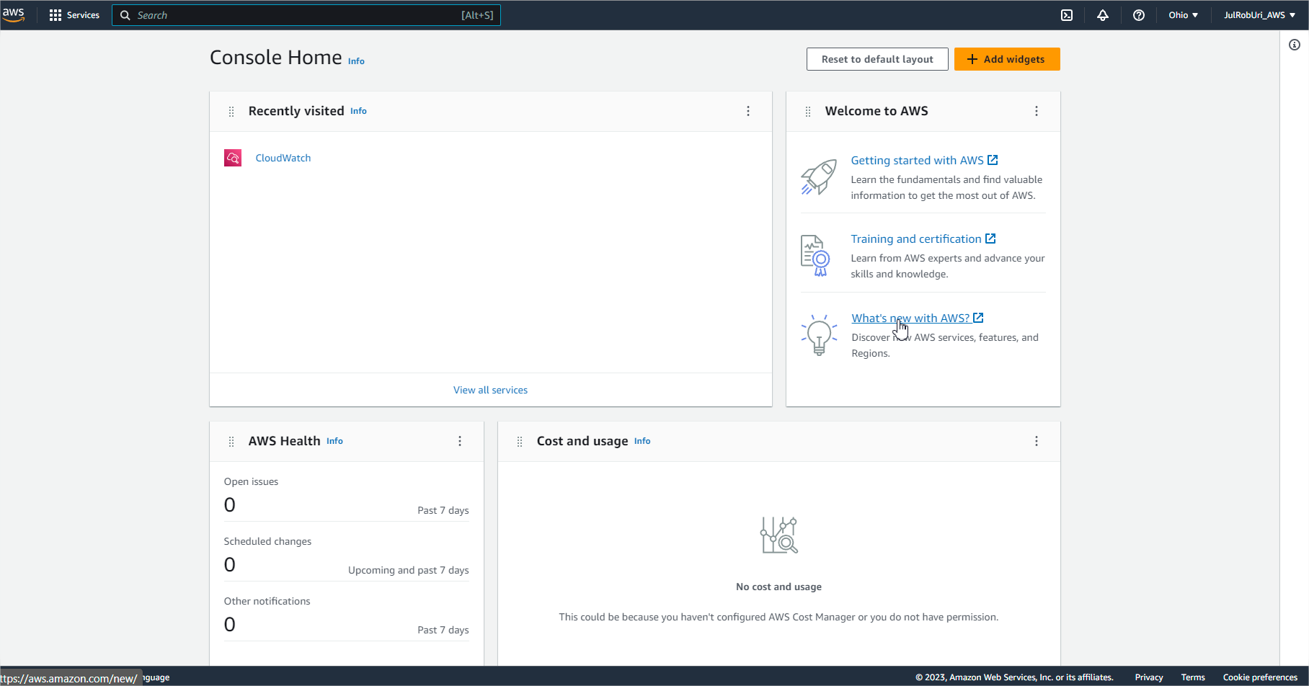
AWS Management Console Tour
https://aws.amazon.com/getting-started/hands-on/getting-started-with-aws-management-console/

Slide 12
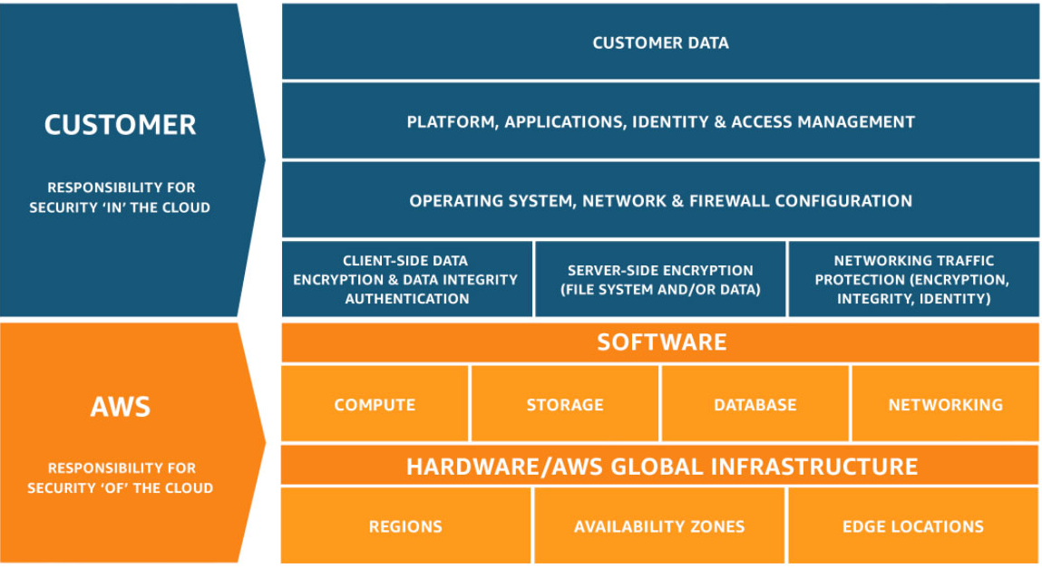
Shared Responsibility Model
Shared Responsibility Model - Amazon Web Services (AWS)
Notes:
Cliente = Responsable por la seguridad dentro del Cloud (Aplicación, los datos, etc.)
AWS = Responsable por la seguridad del Cloud (Infraestructura, Software y Plataforma de la Nube)

Slide 13
AWS Acceptable Use Policy
You may not use, or facilitate or allow others to use, the Services or the AWS Site:
for any illegal or fraudulent activity
to violate the rights of others
to threaten, incite, promote, or actively encourage violence, terrorism, or other serious harm
for any content or activity that promotes child sexual exploitation or abuse
to violate the security, integrity, or availability of any user, network, computer or communications system, software application, or network or computing device
to distribute, publish, send, or facilitate the sending of unsolicited mass email or other messages, promotions, advertising, or solicitations (or “spam”).
AWS Acceptable Use Policy (amazon.com)

Slide 14

Questions?

Slide 15

Quiz: 03-AWS Infrastructure

