Slide 1



Software Architecture

Slide 2

Software Architecture
The software architecture of a system is the set of structures needed to reason about the system, which comprises software elements, relations among them, and properties of both.
Software architecture is about arranging components of the system to best fit the desired quality attributes

Slide 3
Software Architecture
Architecture is set of Software Structures
Components => Abstract unit of S/w instruction & internal state which provides transformation of data.
Connectors => Communicate, cooperate among components
Configuration Topologies => Structure of Architectural relationships
Models => Architecture Styles
Focus on Structure
Anticipate expensive choices
Core decisions for high quality

Slide 4
Software Architecture
Architectural Structures and Views
A view is a representation of a coherent set of architectural elements, as written by and read by system stakeholders. It consists of a representation of a set of elements and the relations among them.
View is representation of Structure, Module structure is set of system modules, a module view is the representation of that structure.
A structure is the set of elements itself, as they exist in software or hardware.
Module structures => helps to identify primary responsibility of the module, other S/W elements in module and dependencies.
Component-and-connector structures => help to identify major executing components, shared data stores, replication, parallel executions
Allocation structures => infra elements; processer, deployments

Slide 5
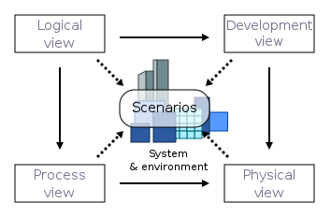
Software Architecture
4 + 1 View => used for describing the architecture of software systems.
Logical view: The logical view is concerned with the functionality that the system provides to end-users. UML diagrams are used to represent the logical view, and include class diagrams, and state diagrams.
Process view: The process view deals with the dynamic aspects of the system, explains the system processes and how they communicate, and focuses on the run time behavior of the system. The process view addresses concurrency, distribution, integrator, performance, and scalability, etc. UML diagrams to represent process view include the sequence diagram, communication diagram, activity diagram.
Development view: The development view illustrates a system from a programmer's perspective and is concerned with software management. This view is also known as the implementation view. UML Diagrams used to represent the development view include the Package diagram and the Component diagram.
Physical view: The physical view depicts the system from a system engineer's point of view. It is concerned with the topology of software components on the physical layer as well as the physical connections between these components. UML diagrams used to represent the physical view include the deployment diagram.
Scenarios: The description of an architecture is illustrated using a small set of use cases, or scenarios, which become a fifth view. The scenarios describe sequences of interactions between objects and between processes. They are used to identify architectural elements and to illustrate and validate the architecture design. They also serve as a starting point for tests of an architecture prototype. This view is also known as the use case view.
Conceptual
Physical
Functional
Non Functional

Slide 6
Software Architecture
Key Requirements
End user wants the system is fast, reliable and available.
Manager cares that the system is delivered on time
Leadership wants the system to contribute to Organization growth / value.
Security team cares the system is protected from malicious attacks
Support team wants the system is easy to understand to debug
Quality Attributes
Performance => wait before the spinning loading icon goes away
Availability, Usability, Modifiability, Portability, scalability
Security => does system has secure fortress
Deployability => easy to deploy new features
Not all can be achieved in system, we need to prioritize the x-bilities

Slide 7
Software Architecture
Why is Software Architecture important ?
An architecture will enable a system's driving quality attributes.
The decisions made in an architecture allow you to reason about and manage change as the system evolves.
The analysis of an architecture enables early prediction of a system's qualities.
A documented architecture enhances communication among stakeholders.
An architecture is the key artifact that allows the architect and project manager to reason about cost and schedule.
Architecture-based development focuses attention on the assembly of components, rather than simply on their creation.
An architecture can be the foundation for training a new team member.

Slide 8
Software Architecture
Streaming Apps
Performance
Availability
Usability
Banking Apps
Security
Availability

Slide 9
Software Architecture
Types of Architectures (per Wikipedia)
Multitier architecture
Model–view–controller
Domain-driven design
Blackboard pattern
Sensor–controller–actuator
Presentation–abstraction–control
Component-based
Monolithic application
Layered
Microservice Architecture
Pipes and filters
Database-centric
Blackboard
Rule-based
Event-driven aka implicit invocation
Publish-subscribe
Asynchronous messaging
Microkernel
Reflection
Client-server (multitier architecture exhibits this style)
Shared nothing architecture
Space-based architecture
Object request broker
Peer-to-peer
Representational state transfer (REST)
Service-oriented
Cloud computing patterns ^{[2]}
Monolithic
Layered
Microservices

Slide 10
Software Architecture
What Makes “Good” Architecture?
There is nothing like good / bad
Few Observations
The architecture should be documented using views
The architecture should be evaluated for its ability to deliver the system's important quality attributes.
The architect (or architecture team) should, on an ongoing basis, base the architecture on a prioritized list of well-specified quality attribute requirements.
The architecture should lend itself to incremental implementation.
The architecture should feature well-defined modules whose functional responsibilities are assigned on the principles of information hiding and separation of concerns.
The architecture should never depend on a particular version of a commercial product or tool

Slide 11
Software Architecture
Intro to UML => General-purpose, modeling language that is intended to provide a standard way to visualize the design of a system.
UML Attributes
Visual
Abstract
Descriptive
Standard
Support code generation
Supports reverse engineering
UML Design Elements
Models
Views
Diagrams
UML Models
Business System Models
External View
Internal View
IT System Model
Static View – structural elements
Dynamic View – elements relations / interactions
Diagrams
Component - describes all the components in the system and interfaces and how one component calls and all the components.
Class – describes which classes exist in the system, base, derived classes
Sequence – Indicates how one class calls another class and their order
State – State machines
Activity – high level procedures and the workflows
Layer – aggregate the classes and components and how they are called
Use Case – external actors interactions
Models
Views
Diagrams

Slide 12
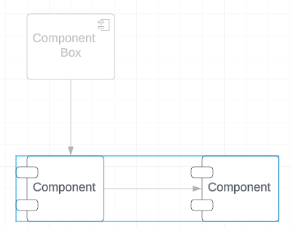
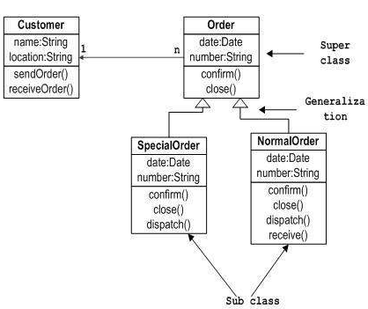
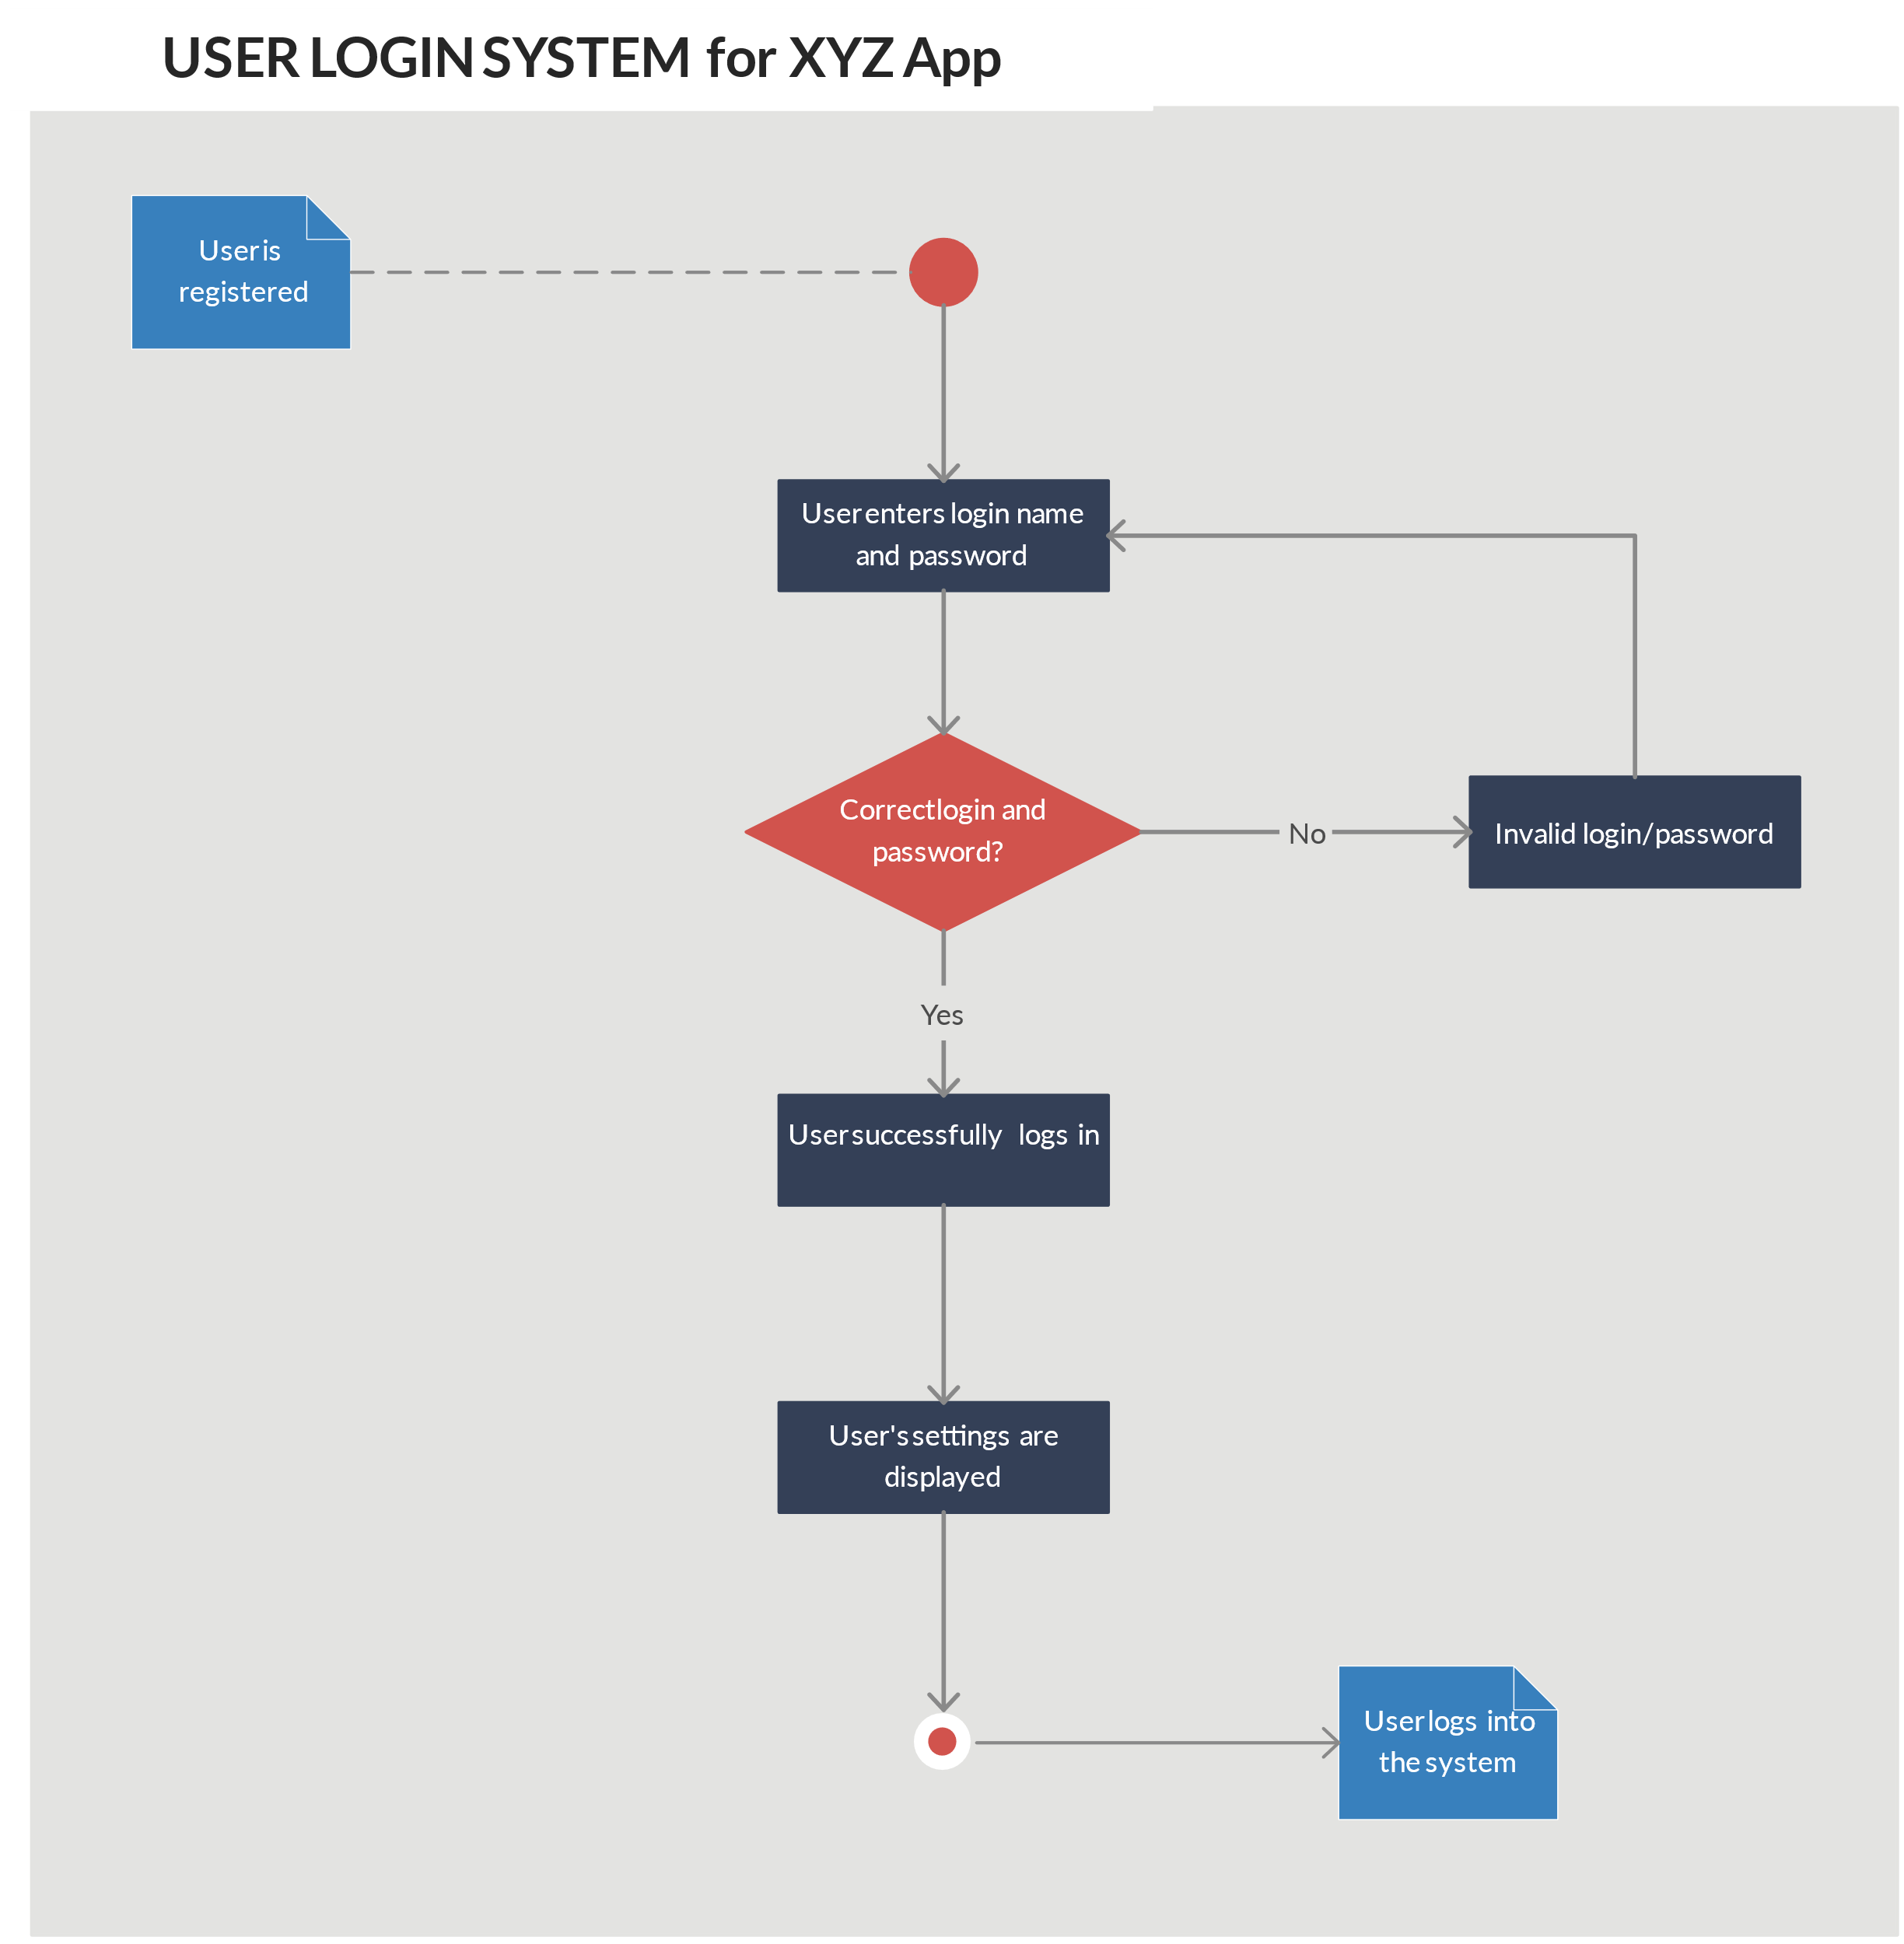
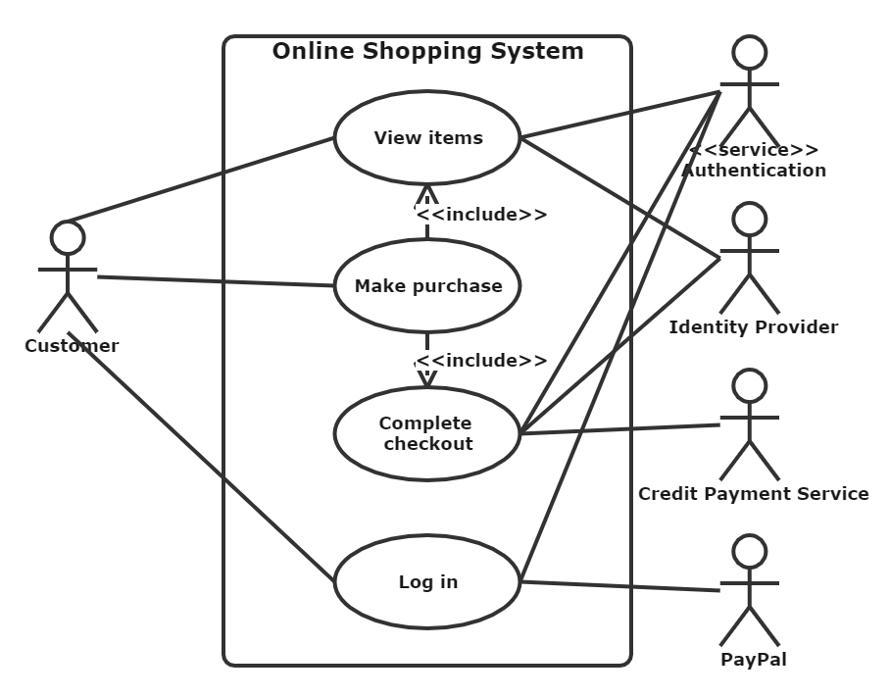
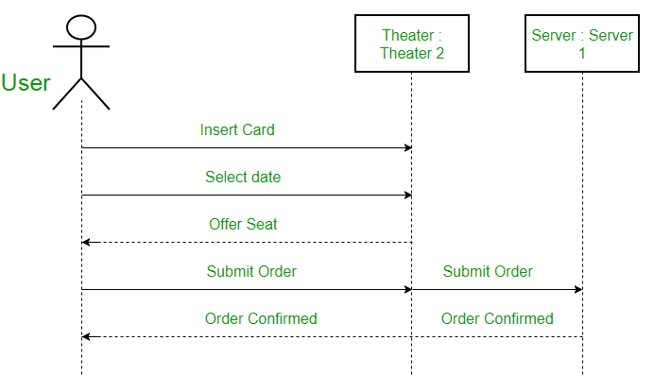
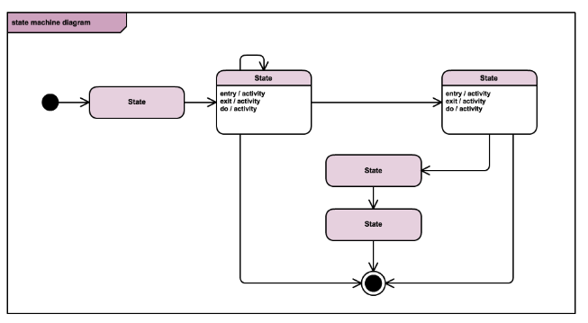
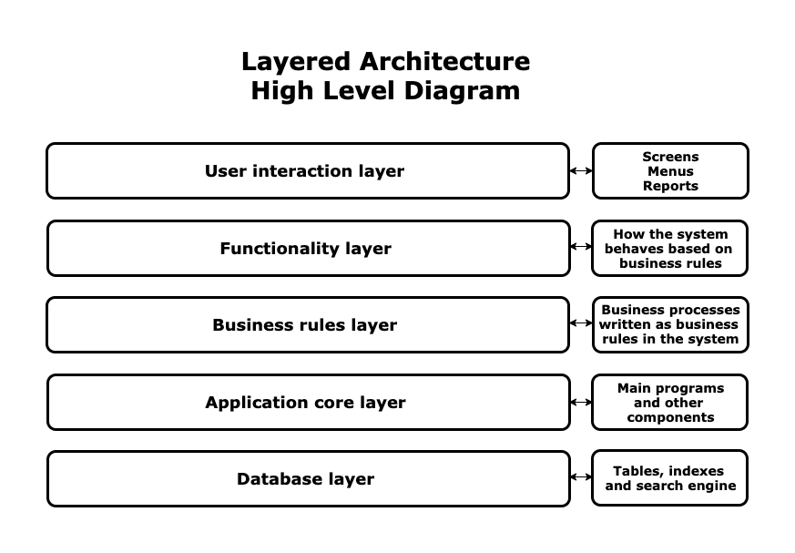
Software Architecture
Component | Class | Sequence | State | Activity | Layered | Use Case
Shows components | Shows methods, functions, associations, generalizations | Shows calling class, called method and return data type | Shows states and activities | Shows process or workflow Can show concurrent actions | Shows areas of concerns and references between areas | Shows actors and use cases, binds actors to use cases

Slide 13
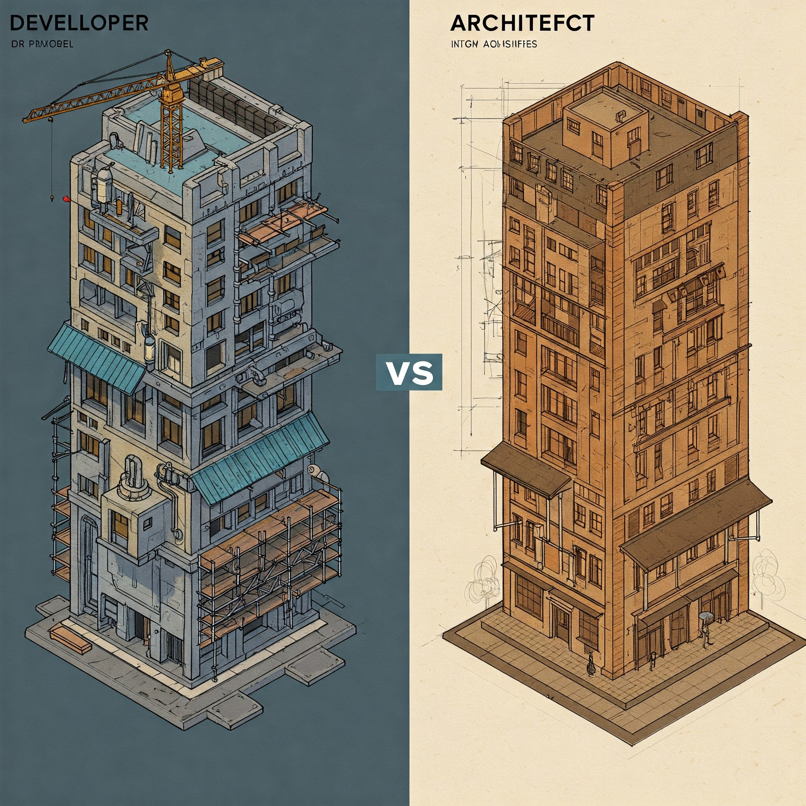
Software Architect
Developer knows What CAN be done
Architect Know What Should be done

Slide 14
Software Architect
Architect Responsibilities
Is to design system to achieve base requirements (Fast, Secure, Reliable, Easy to Maintain)
Code & Architect – Yes, it is good to have hands on exposure
Architectures Trustworthiness
Support Developers
Mindset
Deep understanding of business, learn inner parts of the business
Make familiar with weaknesses, strengths, competition and growth strategy
Define system Goals
Work for your client’s clients
Always keep in Mind what is it matters to the person you are talking to
Always think about the big picture

Slide 15
Software Architect
Architecture Process
Understand the system requirements => defined by BSAs
Understand NFRs => define technical & service level attributes, BSAs are not aware of this. These are really important.
Map the components => System Functionality & Communication
Select the Technology Stack => discuss with dev team; choose wisely
Design the Architecture => Heart of Architect work;
Create Architecture Document => Must be relevant for all participants
Support Development Team => Make sure Architecture is implemented
Identify actors who participate in every step of the process.

Slide 16
Software Architect
Please review Design Patterns; we covered this topic in earlier sessions

Slide 17
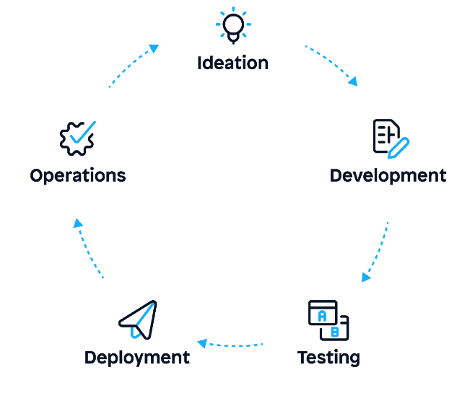
Agile Architecture
Agile SDLC => is the combination of iterative and incremental process models. Focuses on adaptability and client satisfaction by rapid delivery of product. Breaks down product into small incremental builds.
5 Stages of Agile SDLC
Ideation
Define goals; document requirements; prioritize tasks
Development
This phase includes all tasks of SDLC; Architecture; UX/UI design and coding.
1st iteration is longest of product
Testing
Testing functional features; addressing bugs and errors
Deployment => release of 1st iteration; product is live to clients
Operations => collect feedback and make improvements that can be release in future

Slide 18
Agile Architecture
Principles of Agile Architect
Value People
Communicate
Deliver working solutions
Maximize stakeholder values
Find solutions to meet Goals
Identify enablers for next features
Manage change and complexity
Document in Agile fashion

