Slide 1


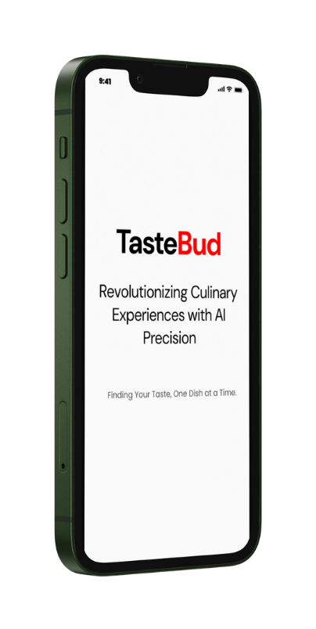

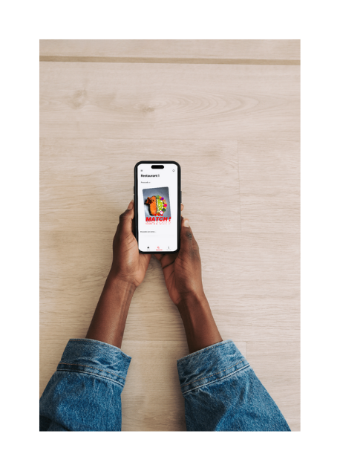

Discover Us
TasteBud is a personalized dining companion that helps you find dishes you'll love based on your unique tastes and dietary needs. Using advanced AI, it analyzes restaurant menus and recommends the best dishes tailored to your preferences—whether it’s your first time or you’re a regular diner.
Finding Your Taste, One Dish at a Time.
CONTACT US
322680212
@tastebud
contact@tastebud.co
Cra. 100 #11-60, Ciudad Jardín, Cali, Valle del Cauca

Slide 2
Context
This project focuses on the design and implementation of a gastronomic recommendation system aimed at improving the user experience when selecting dishes in restaurants. The proposed system utilizes advanced machine learning techniques to analyze individual user preferences and generate personalized recommendations based on both consumption history and the intrinsic characteristics of the dishes.
This project addresses fundamental challenges in contemporary recommendation systems, such as the cold start problem, data scarcity, and the need for explainability, by proposing solutions tailored to the gastronomic domain. The findings of this study are relevant to researchers in the field of recommendation systems, professionals in the food industry interested in enhancing the customer experience, and developers seeking to implement personalized algorithms in environments with specific domain constraints.

Slide 3
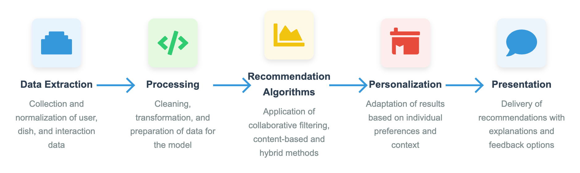
Flow

Slide 4
Functional Requirements
ID | Description | Detail | Stakeholders
FR01 | Personalized Recommendations Generation | The system must analyze the user’s preference history and generate a list of recommended dishes ordered by estimated relevance. | End Users, Researchers, Algorithm Developers
FR02 | Capture of Explicit Feedback | The system must allow users to rate consumed dishes on a defined scale and record specific preferences (like/dislike). | End Users, Data Analysts, Researchers
FR03 | User Profile Management | The system must create and maintain preference profiles for each user, updating them with each new interaction. | End Users, System Administrators, Data Scientists
FR04 | Incorporation of New Dishes | The system must be able to integrate new dishes into the catalog and start recommending them based on their characteristics, without any prior rating history. | Restaurants, Developers, Researchers
FR05 | Recommendation Explanation | The system must provide clear justifications on why a specific dish has been recommended (e.g., “Recommended because you liked dish X” or “Contains your favorite ingredients”). | End Users, Researchers, UX Designers

Slide 5
Non-Functional Requirements
ID | Description | Detail | Stakeholders
NFR01 | Performance | The system must generate recommendations in under 2 seconds to ensure a smooth experience, even with a catalog of thousands of dishes. | End Users, Developers, System Administrators
NFR02 | Scalability | The architecture must support significant increases in the number of users and dishes without notable performance degradation. | Developers, System Administrators, Researchers
NFR03 | Data Privacy | The system must ensure the protection of user preference data, complying with applicable data protection regulations. | End Users, Legal Advisors, Data Protection Officers
NFR04 | Maintainability | The recommendation algorithm’s code must be modularized and documented to facilitate understanding, debugging, and future evolution. | Developers, Researchers, System Maintainers
NFR05 | Accuracy | The system must achieve evaluation metrics above a defined threshold (e.g., Precision@10 > 0.7, NDCG > 0.65) on validation datasets. | End Users, Researchers, Algorithm Developers

Slide 6




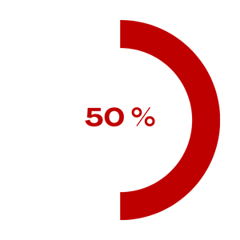





How TasteBud Works
Why You’ll Love TasteBud
Ready to Find Your Perfect Dish?
Upload or Find the Menu
Take the guesswork out of dining. With TasteBud, finding the perfect dish is just a tap away. Try TasteBud today and make every meal an experience to remember!
With our easy access to menu feature, upload the restaurant's menu if it’s not already on TasteBud. TasteBud takes it from there.
Personalized
Dining Experience
We Analyze the Menu
TasteBud’s smart AI dives into the menu, categorizing dishes and identifying ingredients to make it easy for you to find what suits your taste.
Save up to 50% of time deciding on a dish
Effortless
Decision Making
Get Recommendations Tailored to You
With a quick scan, TasteBud suggests dishes that fit your profile, helping you choose with confidence.
Gets Better
Every Time
Enjoy your Food!
Don’t stress with the menu.
Over 90% accuracy in dish recommendations tailored to user preferences
Share Your Feedback
Dietary Support
After your meal, rate the dish and the recommendation. This enhances future recommendations

Slide 7
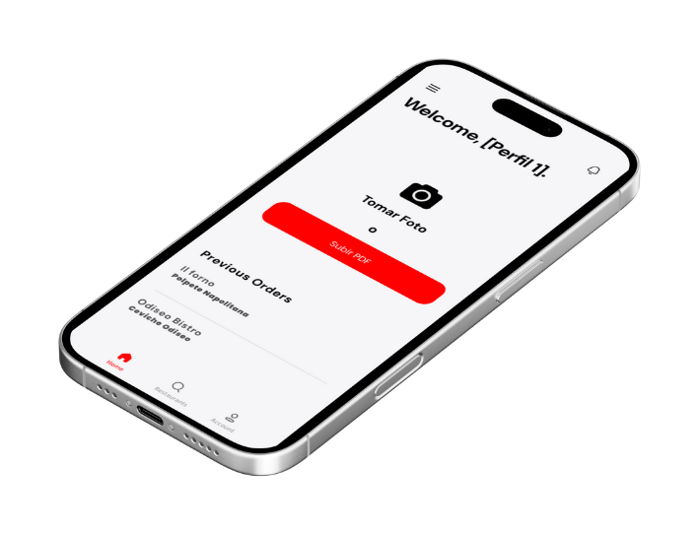
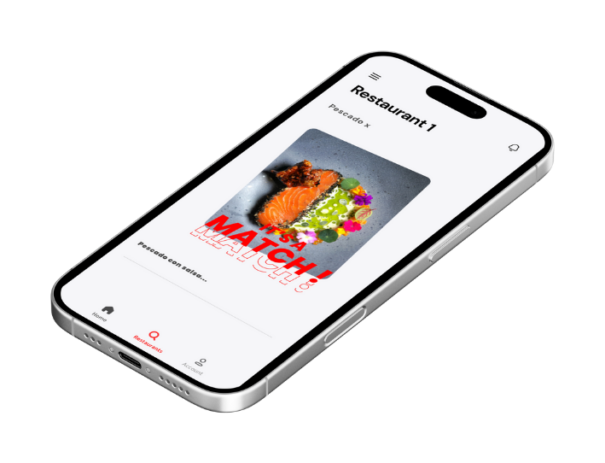
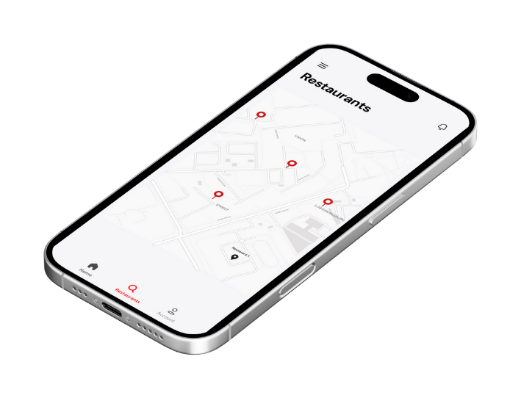
Finding Your Taste, One Dish at a Time.

