Slide 1

Gustavo Adolfo Camargo Pienda

Slide 2
Agenda
Logic View
Component View
Process View
Physical View
Scenario View

Slide 3
Logic View
The activity diagram represents the logical architecture of the gastronomic recommendation system, showing the complete flow from user authentication to recommendation delivery and refinement. This flow incorporates essential components for a robust recommendation system:
The architecture implements a hybrid approach combining collaborative filtering and content-based filtering, addressing critical challenges such as cold start, recommendation diversity, and continuous learning. The flow is designed to adapt to different data scenarios and optimize recommendations based on user interactions.
The system prioritizes user feedback (both explicit and implicit) to continuously update profiles and improve model accuracy. It also incorporates critical performance checks that trigger retraining when necessary, ensuring the system evolves with changing preference patterns.

Slide 4
Catalog
UML Element | Description | Related Elements
Initial Node | Represents the starting point of the activity flow | Connected to Login activity
Activity | Represents a step where an action is performed (e.g., "Login", "Collect Initial Preferences") | Connected by control flows to other activities or decision nodes
Decision Node | Diamond-shaped element representing a point where the flow branches based on conditions (e.g., "Existing User?", "Sufficient Data?") | Connected to multiple outgoing paths marked with conditions
Control Flow | Arrows connecting elements, showing the sequence of execution | Connects all elements in the diagram
Fork Node | Black bar representing the splitting of flow into parallel activities | Connects to "Calculate User Similarity" and "Encode Dishes" activities
Join Node | Black bar representing the synchronization of parallel flows | Joins paths from "Predict Ratings" and "Compute Feature Vectors"
Merge Node | Diamond shape that brings together multiple alternative paths | Joins paths before "Apply Post-Processing Filters"
Final Node | Circle with dot inside representing the end of a flow | Connected from "Process Completion"

Slide 5
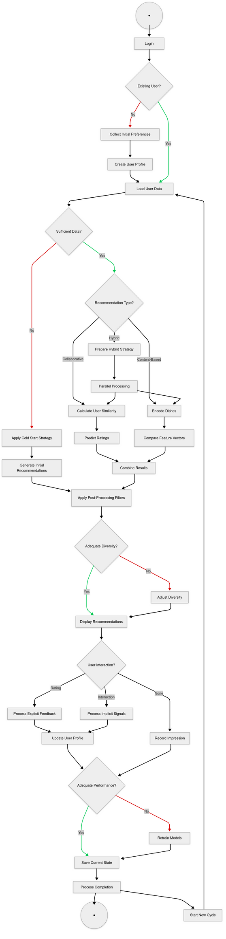
continues

Slide 6
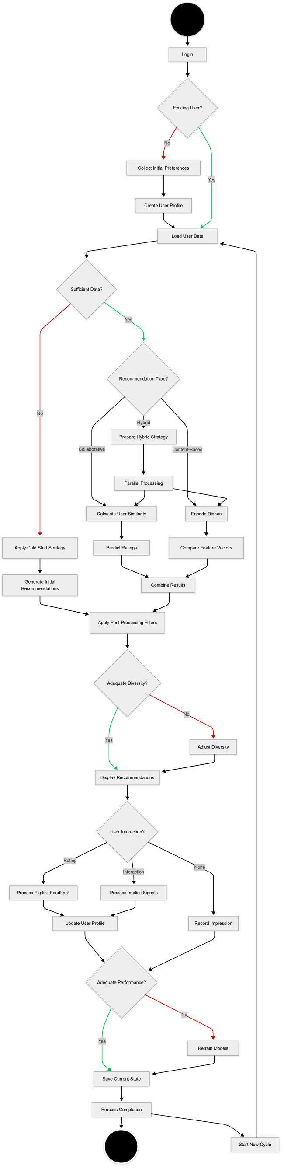

Slide 7
Component View
The component diagram represents the architectural structure of the recommendation system, displaying the key services, their internal components, and the communication protocols between them. This architecture follows a microservices approach, where discrete functional components are isolated into dedicated services that communicate through well-defined interfaces.
The diagram illustrates a modular system designed around separation of concerns, with specialized services handling specific aspects of the recommendation workflow. The central Recommendation Service contains the core algorithmic components responsible for generating personalized recommendations, while supporting services manage user profiles, ratings collection, authentication, and dish catalog data.
The architecture emphasizes scalability and maintainability through loose coupling between services. This design allows individual components to be developed, optimized, and scaled independently, which is particularly important for recommendation systems that may need to process large volumes of user interaction data while maintaining responsive performance.

Slide 8
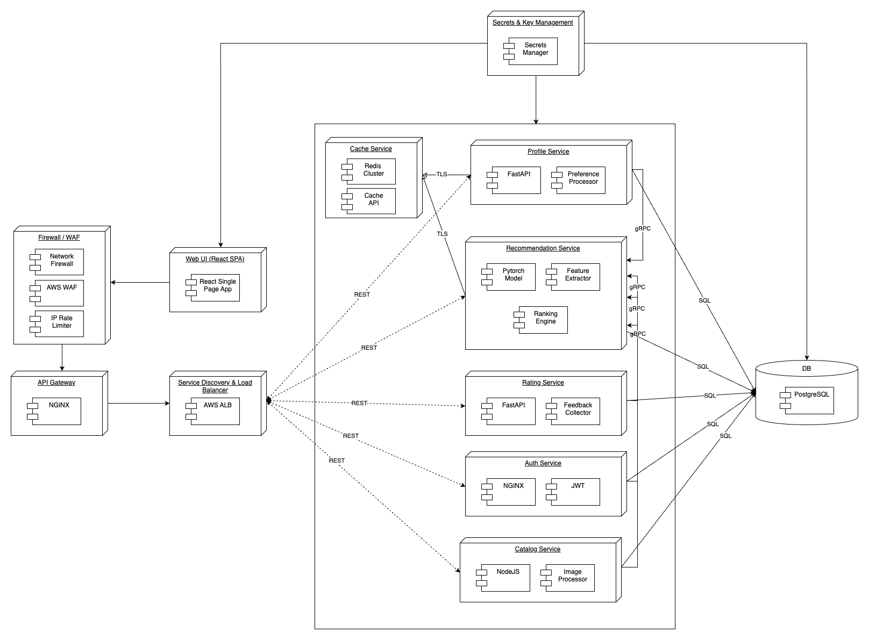

Slide 9
Catalog
UML Element | Description | Related Elements
Component | Modular units of the system (e.g., "Profile Service", "Recommendation Service") | Contains other components; connected via interfaces
Sub-Component | Internal components within a service (e.g., "PyTorch Model", "Feature Extractor") | Contained within larger components
Interface | Communication points between components (represented by connecting lines with protocol labels) | Connects components through REST, gRPC, SQL, HTTPS
Dependency | Relationship showing one component relies on another (shown as dashed arrows) | Connects Web UI to API Gateway; API Gateway to services
Containment | Hierarchical relationship showing components inside other components | Main services containing sub-components
Node | Physical system like "DB" containing PostgreSQL | Connected to services via SQL interfaces
Communication Path | Protocol-labeled connections (e.g., "REST", "gRPC", "SQL") | Indicates how components interact
Package | Outer box representing system boundary | Contains all the microservices

Slide 10
Process View
The sequence diagram illustrates the temporal flow of interactions between components in the recommendation system, specifically focusing on two main scenarios: "Existing User Requests Recommendations" and an "Alternative Path: New User Onboarding." This diagram provides a comprehensive view of the runtime behavior of the system, showing how information flows between objects and the sequence of method calls that occur during recommendation generation.
The diagram effectively demonstrates the sophisticated interaction patterns required for a hybrid recommendation system, showing how different filtering approaches (collaborative, content-based) are executed in parallel and then combined. It also highlights how the system handles the critical "cold start" problem through an alternative path for new users with no rating history.
The process view reveals the system's emphasis on modularity, with clear separation of responsibilities between components. This separation enables parallel processing of different recommendation strategies and facilitates the combination of results into a coherent final recommendation set. The diagram also shows the feedback loops that enable continuous improvement of the recommendation model based on user interactions.

Slide 11
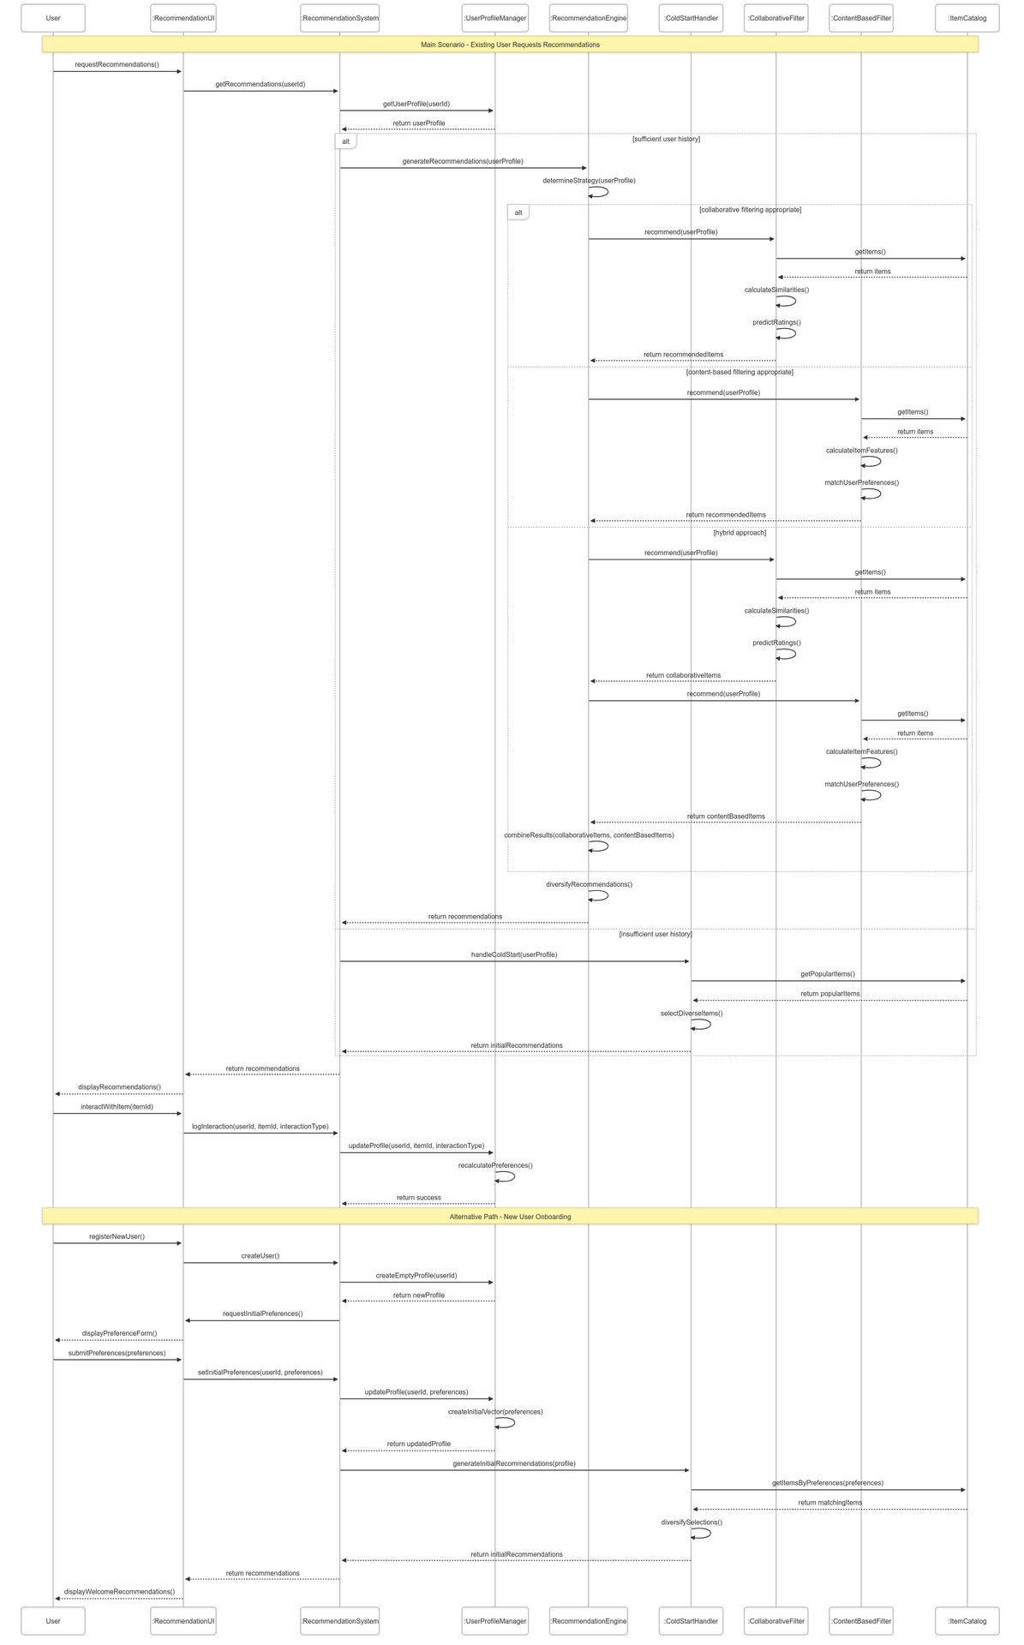

Slide 12
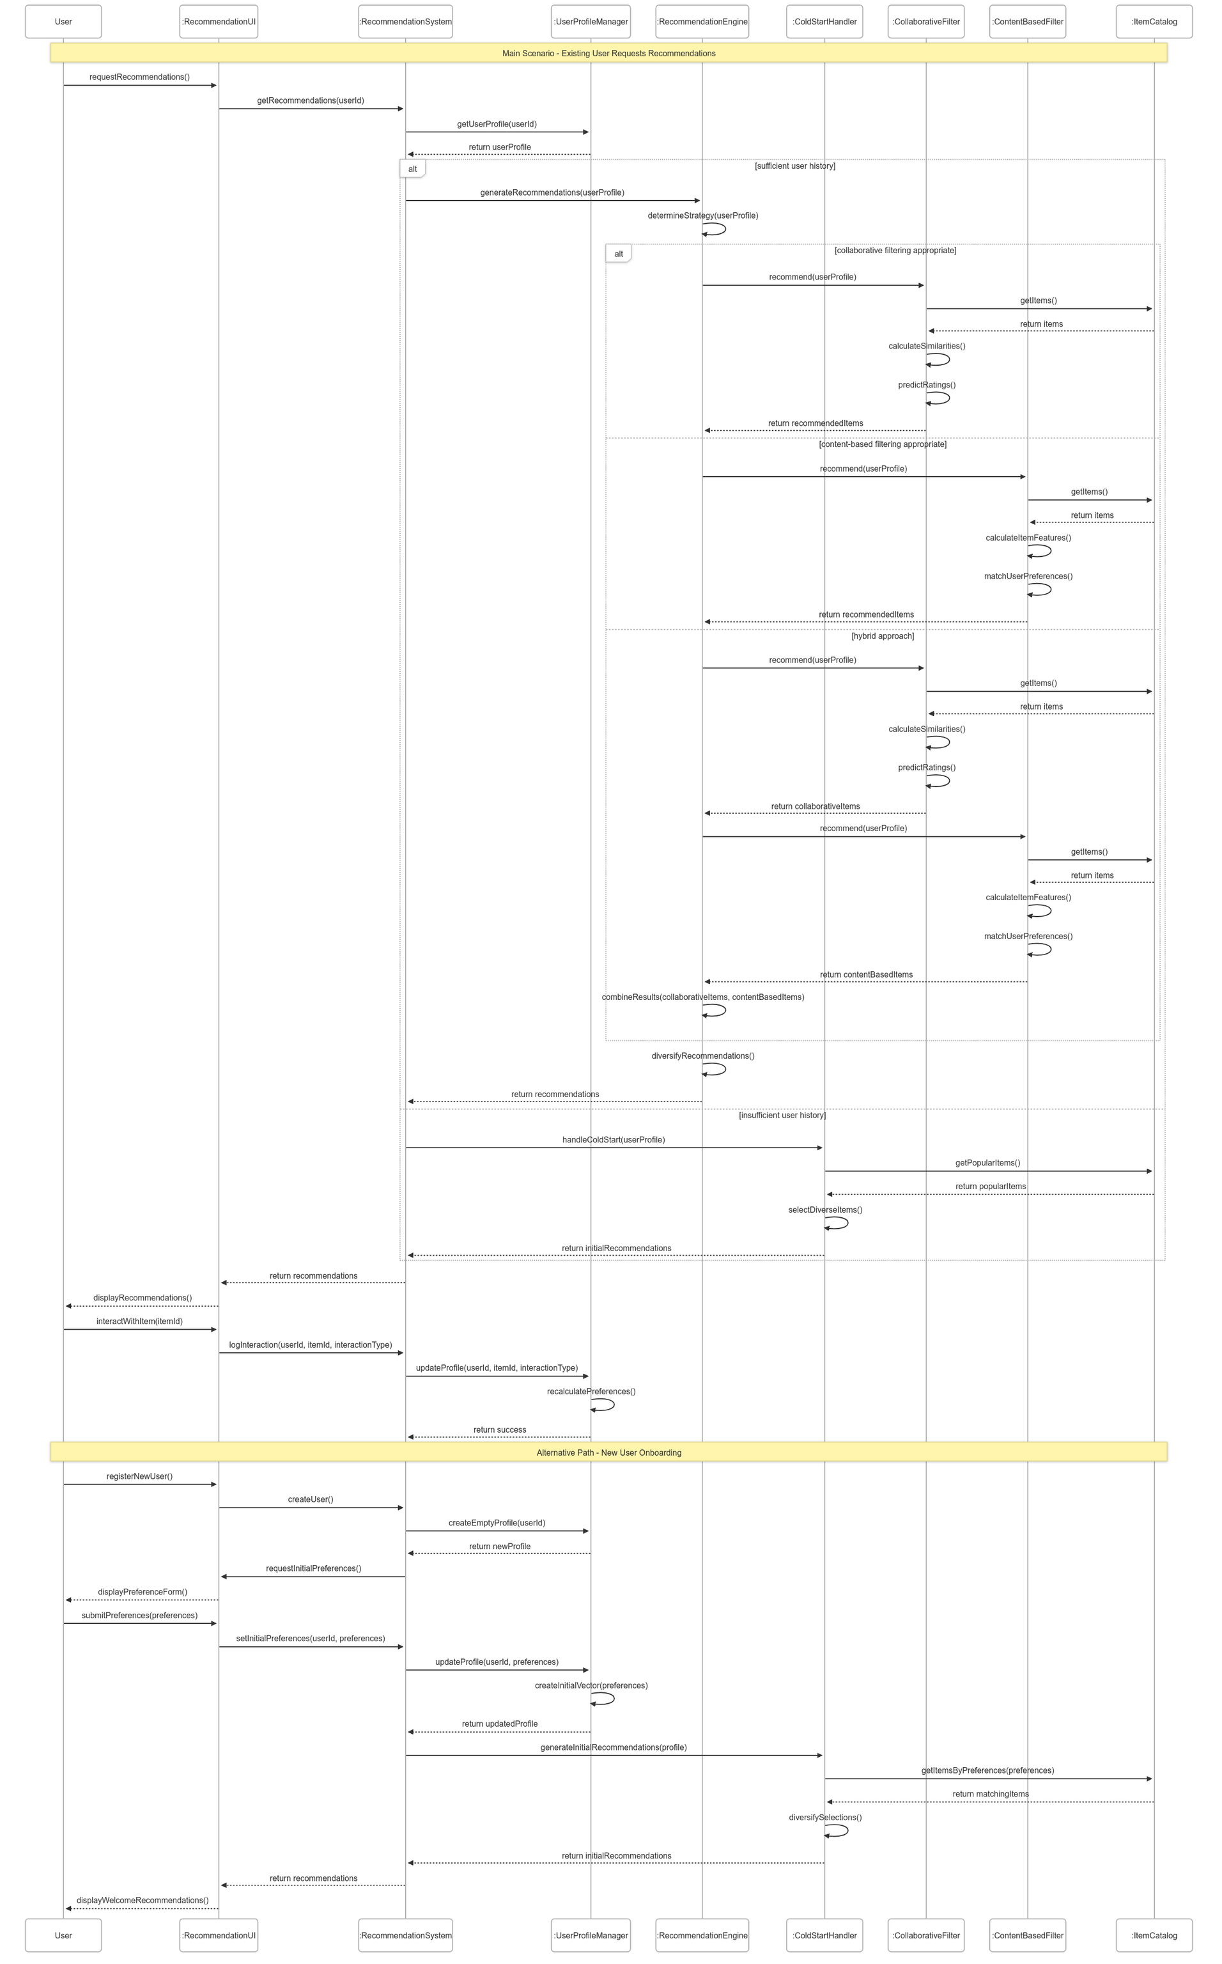

Slide 13
Catalog
UML Element | Description | Examples in Diagram
Lifeline | Vertical dashed line representing an object's lifetime | User, RecommendationUI, RecommendationSystem, etc.
Actor | Special object representing a user or external system | User (implied at the start of the sequence)
Activation Bar | Thin rectangle on a lifeline showing when an object is active | Multiple bars along each lifeline during message processing
Message | Arrow between lifelines representing communication | requestRecommendations(), getRecommendations(), etc.
Return Message | Dashed arrow showing return values | return userProfile, return recommendations, etc.
Self Message | Arrow that starts and ends at the same lifeline | determineRecommendationType(), matchAndRank(), etc.
Combined Fragment | Rectangle containing conditional interactions | Alternative Path: New User Onboarding
Guard Condition | Constraint that must be true for the sequence to execute | [insufficient user history]
Note | Rectangular comment providing additional information | "collaborative filtering approach", "content-based filtering approach", "hybrid approach"

Slide 14
Physical View
The deployment diagram illustrates the physical architecture of the recommendation system, showing how software components are distributed across hardware infrastructure and the network protocols used for communication between these components. The architecture follows a multi-tier approach, with clear separation between front-end clients, API gateway, application services, and data storage.
The system is designed with a modern cloud-native architecture, using containerization (Kubernetes) for the application services and specialized data services for different types of storage requirements. The physical view demonstrates how the recommendation system addresses key non-functional requirements such as scalability, performance, and security through its distributed deployment strategy.
The three-tier architecture (Front-tier, Back-tier, and Data-tier) provides isolation between components that face different security concerns and performance requirements. Notably, the recommendation service employs gRPC for high-performance communication, which is particularly important for the computationally intensive recommendation algorithms that need to process large volumes of data while maintaining low latency.

Slide 15
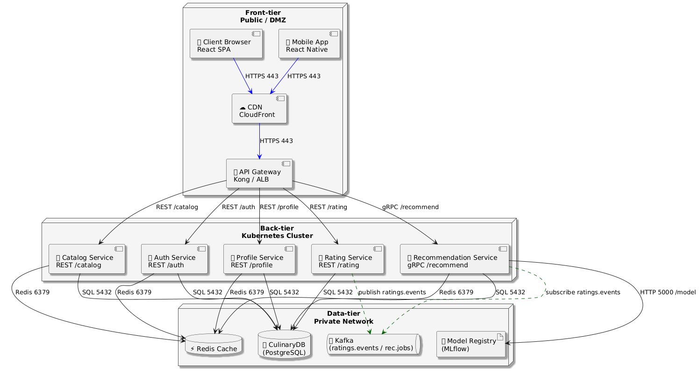

Slide 16
Catalog
UML Element | Description | Examples in Diagram
Node | Physical processing resource where components are deployed | Front-tier, Back-tier Kubernetes Cluster, Data-tier
Artifact | Physical piece of information used or produced by the system | Client Browser React SPA, Mobile App React Native
Device | Physical hardware element | Implied in the different tiers
Communication Path | Connection between nodes or devices | HTTPS 443, REST endpoints, gRPC connections
Component | Deployable module of the system | Catalog Service, Recommendation Service, etc.
Interface | Set of operations that characterize the behavior of an element | REST /catalog, gRPC /recommend
Dependency | Relationship showing one element requires another | Services depending on Redis Cache and PostgreSQL
Deployment Specification | Parameters that define how artifacts are deployed | Implied in the protocols and ports

Slide 17
Scenario View
The use case diagram represents a high-level view of the recommendation system's functionality from a user perspective, illustrating the core scenarios that the system supports. This diagram effectively captures the main interactions between actors (User, Content Provider) and the system, emphasizing the primary goal of delivering personalized dish recommendations while highlighting the specialized scenarios that enhance the recommendation experience.
The diagram demonstrates how the system addresses key recommendation challenges through dedicated use cases, such as cold start handling, recommendation diversity, and explanation provision. These specialized scenarios are modeled as extensions to the core recommendation functionality, indicating that they are conditional enhancements to the primary use case.
The central "Receive Personalized Dish Recommendations" use case represents the system's fundamental purpose, with supporting technical processes like profile processing, algorithm execution, and contextual filtering shown as included behaviors. This organization reflects how the technical aspects of recommendation generation are abstracted away from the user-facing scenarios, maintaining a clear separation between functional and technical concerns.

Slide 18
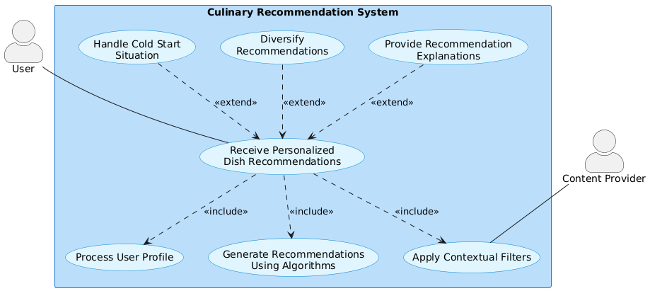

Slide 19
Catalog
UML Element | Description | Examples in Diagram
Actor | External entity that interacts with the system | User, Content Provider
Use Case | Specific functionality provided by the system | Receive Personalized Dish Recommendations, Handle Cold Start Situation
System Boundary | Box containing the use cases, representing system scope | Culinary Recommendation System
Association | Communication between actor and use case | Lines connecting User to use cases
Extend Relationship | Optional behavior that extends a base use case | «extend» from specialized scenarios to the main recommendation use case
Include Relationship | Required behavior that is included in a base use case | «include» from main use case to supporting processes
Generalization | Inheritance relationship between actors or use cases | Not shown in this diagram

