Slide 1

INDUCTION MACHINE: STATOR INTER-TURN FAULT DIAGNOSIS
EE461: STEEEng
PROGRESS PRESENTATION 1
GROUP MEMBERS: JIUTA TAMATA (S11146508)
LITILI WAISALE (S11136630)
Date: 13 – October – 2022

Slide 2
STATOR INTER-TURN FAULT
The SITF is described as the shorting between turns of the stator winding causing the production of additional current in the circuit.
Open problems
Major financial loss and production delays to the industry.
Faults inside the stator, or in the stator windings, usually go unnoticed.
Mechanical related fault.
Causes:
Winding Insulations
Unbalanced Stator current and voltages
Oscillation in torques
Excessive Vibration
Overheating

Slide 3
OBJECTIVES
Data acquisition
Perform frequency analysis for experimental data set
Exploratory Analysis of data using Principal Component Analysis and Curvilinear Component Analysis.
Classification of faults using Neural and Non-Neural based techniques.

Slide 4
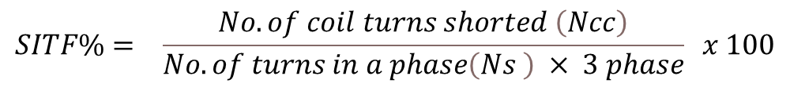
DATASET DISCUSSION
IM Simulink model containing the SITF simulation data
Data sampling rate of 5kHz ,30000 individual samples were obtained for the three phases
Varied Load at 0%, 75% and 100%.
$$SITF\%= \frac{No. of coil turns shorted \left(Ncc\right)}{No. of turns in a phase\left(Ns \right) × 3 phase} x 100$$
Table 1. Class labels
Fault Class | Fault Severity | Inter-turn shorted
1 | Healthy | 0
2 | 0.3% | 1
3 | 0.7% | 2
4 | 1.05% | 3
5 | 2.1% | 6

Slide 5

RESULTS
$$CFF → f_{s} \left(\frac{m}{p} \left(1−s\right)±k\right) , 2f_{s}$$
FAST FOURIER TRANSFORM – SIMULATED THREE PHASE CURRENT DATA
GRID CONNECTED IM
Figure 1. FFT plot for grid connected IM

Slide 6
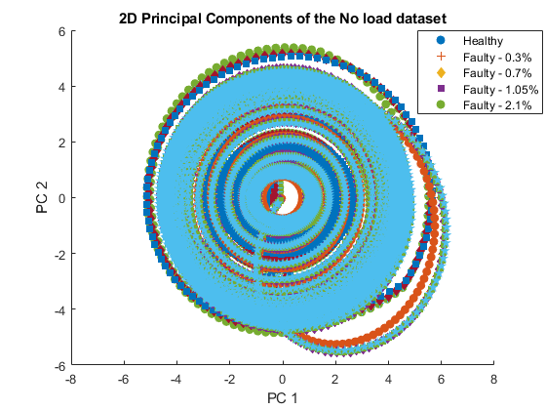
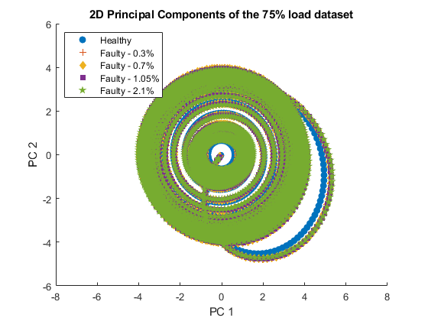
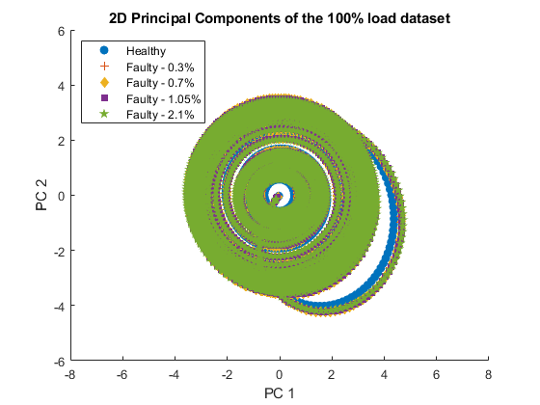
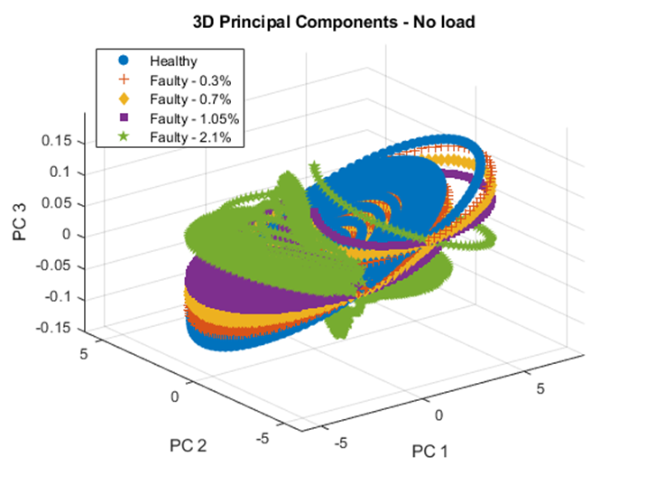
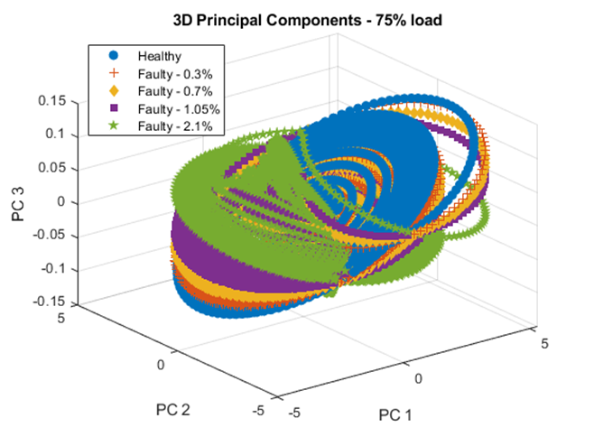
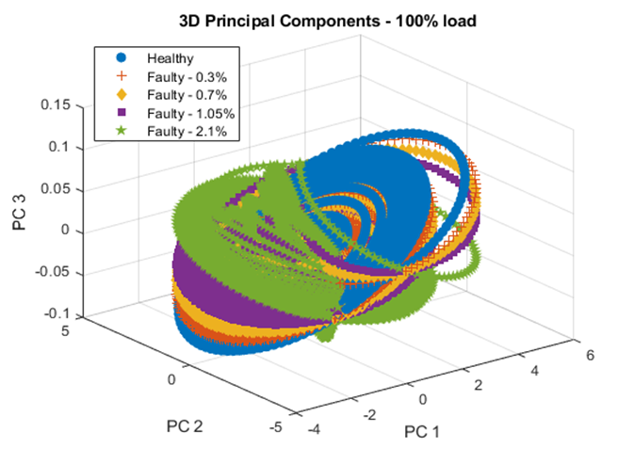
RESULTS
PRINCIPAL COMPONENT ANALYSIS (PCA) – 2D and 3D Plots
Notes:
The above figures are illustrating the 2 dimensional and 3 dimensional views of the PCA analysis plots.
observation noted is that the IM model with the healthy and faulty scenarios showcase the Principal component plot’s surface area being shrunk and the different data points clustered more on top of each other as the loading for the IM increases.
All the five sets (healthy data and data with four different fault severities) of data points are elliptical in nature when visualizing the PC1 (first PC) versus PC2 (second PC) axes. Looking at the PC1 and PC3 (third PC) axes, the healthy elliptical plot is approximately 30° from the PC3’s positive axis. This angle increases even further as the models are subjected to higher loads.
On the other hand, the faulty model’s elliptical plots with respect to the healthy plots seem to tilt closer to the PC3’s positive axis and faulty plot’s angle in the PC3’s negative axis seem to move further away.
The main point noted from both the 2D and 3D PCA analyses is that the data points of a faulty model rotates in a clockwise direction about the PC2’s axis as the SITF severity is incremented.
PCA is also able to demonstrate the “elliptical” shape when it comes to the SITF. Note the PCA plot is also able to reflect the load change, it is also able to reveal SITF severity variation through its 3D plots.

Slide 7
Pareto Chart Analysis
Pareto plots are estimators of intrinsic dimensionality, and they rank dimensions in a descending order of variance.
95% of variance is explained on the first two components.
Principal component 1 is of greater importance than the second because it represents a large portion of the cumulative variance.
Notes:
Undoubtedly, all components of the dataset are significant, however for the sake of classifications some form of dimensionality reduction must be applied to minimize training computation time and mitigate chances of overtraining the model.

Slide 8
Future Work
Use other Dimensionality Reduction (DR) technique to reflect on the load change.
Choose the simplest tool for classification
https://github.com/Judah8?tab=repositories

