Slide 1
Introduction to Git and GitHub
Workshop Lead: Eric Huang
Facilitator: Judah Zammit
September 23rd 2026

Slide 2
Outline for this workshop:
Intro to Git and Version Control Systems
Basic Git functions
Advanced Git functions
Working with GitHub
Miscellaneous Features
Conclusions

Slide 3
Hands-on Activities:
Quick Review Polls
Git/GitHub exercises
What you will need:
GitHub Desktop App and GitHub Account
Text editor
UNIX-based Command Line (time-allowing)

Slide 4
What you WILL learn
Basic theory and features behind Git and GitHub
How to manage local and remote repositories
What you will NOT learn
How to code
Data Analysis Pipelines

Slide 5


Slide 6
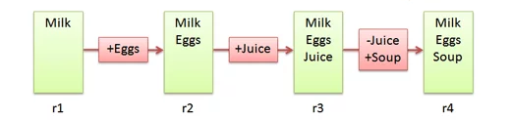
Version Control Systems
Document changes
Unlimited “undo” button
Allow for multiple collaborators
Groceries.txt
Notes:
Source: https://betterexplained.com/articles/a-visual-guide-to-version-control/

Slide 7

Git
A type of version control system
Open-source
The industry standard tool
Designed for:
  Speed
  Simple design
  Non-linear development (branching)
  No centralized “truth”
  Handle large projects efficiently

Slide 8


Git was created by Linus Torvalds, the same person who started the Linux kernel.
After only a few months of development, he handed the "maintainer" torch to Junio Hamano, a Japanese software engineer who had been a major contributor from the start.

Slide 9
What can Git do?
Can track any file but works best for pure text files (.txt,.R,.py etc.)
  Can track and display changes in pure text files
Cannot display for binary files (e.g.: Word/PowerPoint)
  Still useful for storing such files, just cannot use all of Git’s features
Markdown and LaTeX can be used instead of these binary files

Slide 10
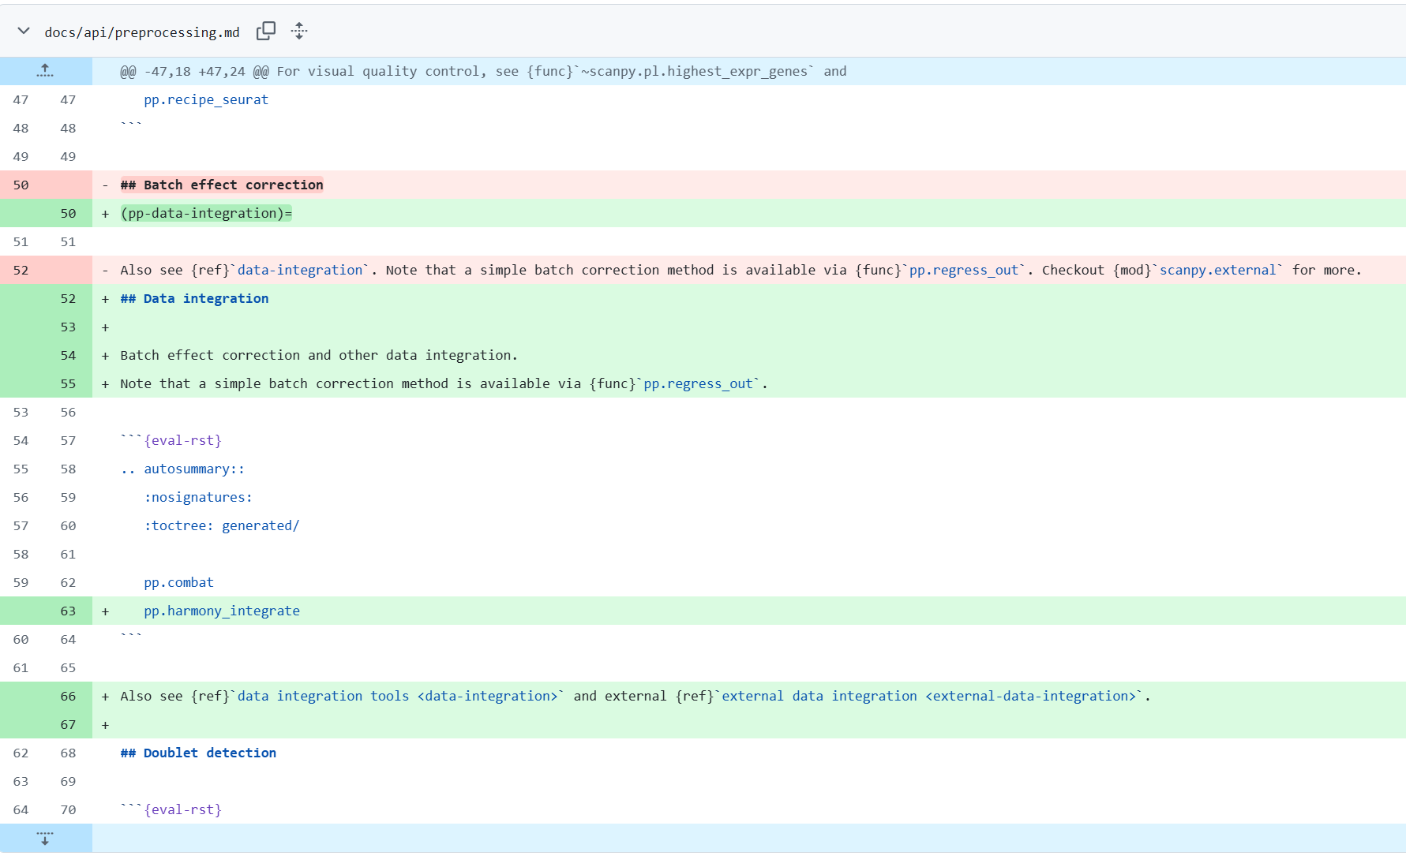

Slide 11
Git vs. GitHub
A version control system
  Each project is a repository
Works locally and remotely
Is open-source
A server that hosts Git repositories
  Biggest host of open-source projects!
A cloud-based service
Owned by Microsoft (2018)

Slide 12
Terminology: Working directory vs. Git Repository
Working directory is your project folder
Git Repository is a hidden folder stored inside your working directory
  Contains the necessary tracking of changes (Git history)

Slide 13
Terminology: Staging Area
Rough draft area
Track changes without adding it to history
Terminology: Commit
Direct checkpoint to add to history
Used when a change is complete

Slide 14
Git Repository
Git Pipeline
Working
Directory
Staging
Area
Local Repository
Add
Commit
Code.py
*New*
Code.py
*New*
Code.py
*New*
Code.py
TRACKED
Code.py
*Modified*
Code.py
*Modified*
Code.py
*Modified*
Notes:
https://www.google.com/url?sa=i&url=https%3A%2F%2Fcourses.csail.mit.edu%2F6.S194%2F13%2Flessons%2F03-git%2Fgit-commands-and-metaphors.html&psig=AOvVaw0eLwNte0CymnSwNKJIL7Zi&ust=1654357234965000&source=images&cd=vfe&ved=0CAwQjRxqFwoTCLifgozPkfgCFQAAAAAdAAAAABAk

Slide 15
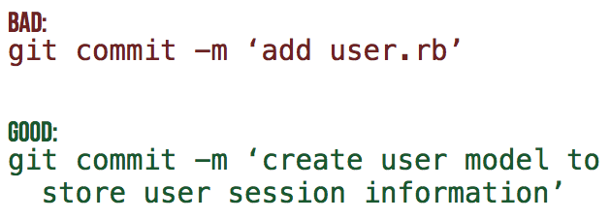
Commit Messages
Every commit MUST have an attached message
Identifies what changes have been made and why
[filename added/changed ; what change ; why]
Notes:
Need an activity here

Slide 16
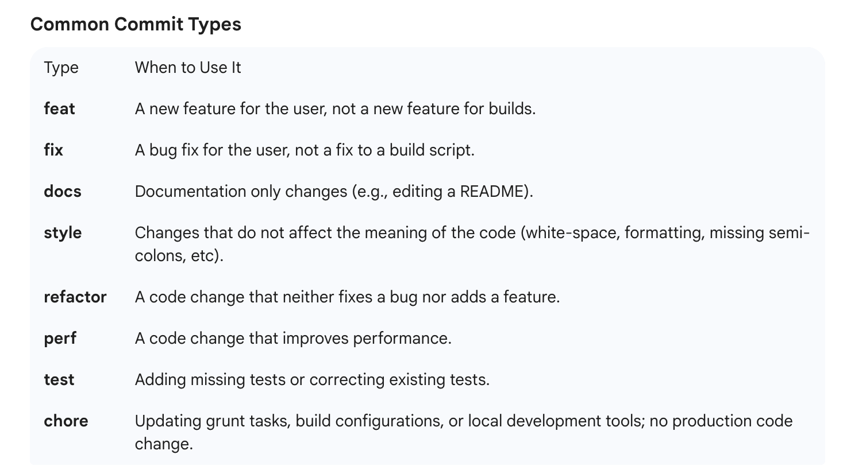
Notes:
Need an activity here

Slide 17
Poll #1
T/F – Both untracked and modified files must be added to the staging area before being committed
T/F - GitHub is a type of Version Control System
T/F – The repository keeps track of changes by storing a new version of each file at each commit
Notes:
T
Staging Area
F

Slide 18
Summary
Untracked or modified files are first added to the staging area
Changes that have been staged can then be committed to the local repository
Commits can then be used to revert or keep track of what changes have been made

Slide 19
Part II – Basic Git Features

Slide 20
Activity #0 – Initialize a Git Repository
Notes:
Make a new git repo through desktop App
Add a file to the directory
Return to desktop app and track the file
Create it, edit it, move it, remove it

Slide 21
Activity #0 – Initialize a Git Repository
Create a new Git Repository (File → new repo OR “create a new repository on your hard drive”)
Open the generated project folder, what do you see?
Notes:
Make a new git repo through desktop App
Add a file to the directory
Return to desktop app and track the file
Create it, edit it, move it, remove it

Slide 22
Activity #1 – Create and track a Text File with Git
Notes:
Make a new git repo through desktop App
Add a file to the directory
Return to desktop app and track the file
Create it, edit it, move it, remove it

Slide 23
Activity #1 – Create and track a Text File with Git
Create a text file (or code script) in the project folder
Add + commit the file to track it.
Look at your commit history to see your commit!
Modify the file and commit the changes. Try and make informative commit messages!
Notes:
Make a new git repo through desktop App
Add a file to the directory
Return to desktop app and track the file
Create it, edit it, move it, remove it

Slide 24
Activity #2 – Revert a file to a previous commit
Notes:
Edit your text file with an error
Go to desktop app and reset the file to the previous commit
Repeat BUT this time commit it
Revert changes of the commit

Slide 25
Activity #2 – Revert a file to a previous commit
Make an unwanted change to your file
Use your staging area to discard the changes
Make another unwanted change and commit it
Now use your commit history to revert the commit!
Notes:
Edit your text file with an error
Go to desktop app and reset the file to the previous commit
Repeat BUT this time commit it
Revert changes of the commit

Slide 26
Poll #2
T/F – After initialisation, a project folder becomes a git repository
T/F – After making a commit, you cannot revert to a previous version of your repository
Is it possible for two commits to have the same ID?
Notes:
T
F
No

Slide 27
Part III – Advanced Git Features

Slide 28
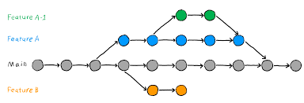
What if you want to test out a new feature without affecting your current version of the code?
What if you want to collaborate with others on separate features?
Branching

Slide 29
What is a Branch?
A specific “timeline” of your commit history
Implement new features without disrupting the release code
New Feature
Debugged New Feature
Dev
Initial Commit
Debug Commit
Release 1.0.0
Patched Release
Release
1.0.1
Main

Slide 30
Activity #3 – Create a new branch
Notes:
Create new branch and make changes

Slide 31
Activity #3 – Create a new branch
Click the “current branch” button and select “new branch”
Make changes to your file in the new branch and commit it
Switch back to the main branch and open the file, what do you notice?
Notes:
Create new branch and make changes

Slide 32
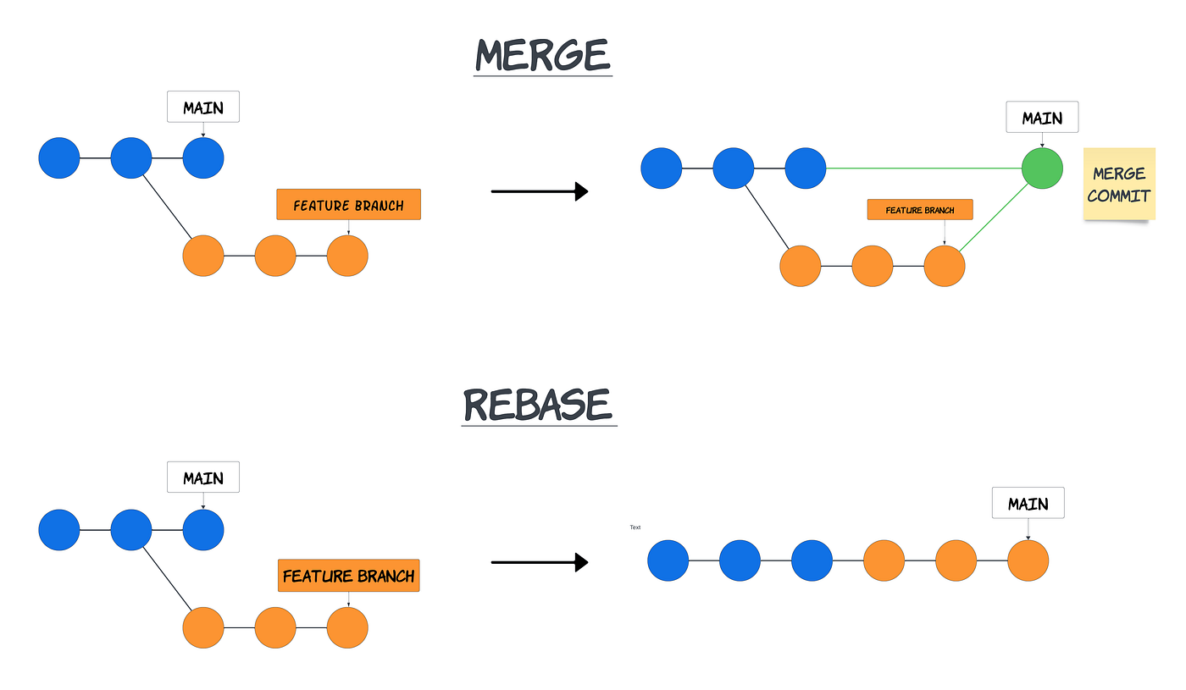
Now that your test feature works, you might want to make it part of your official release
Merge/Rebase

Slide 33
What is a Merge?
Action that will “merge” the commits from one branch into another
New Feature
Debugged New Feature
New Feature + Patch
Dev
Release 1.0.0
Patched Release
Release 1.1.0
Main

Slide 34
Activity #4.1 – Merging Branches

Slide 35
Activity #4.1 – Merging Branches
Switch to the main branch
Open the branch menu
Select the “choose a branch to merge into main” button and select your second branch.
Compare the branches again, the file should now be identical in both!

Slide 36
Rebasing
Rewrites the target branch’s commit history to add other commits directly
Useful for updating dev branches with new main
New Feature
Debugged New Feature
Dev
Release 1.0.0
Patched Release
New
Feature
Patched
Release
Debugged New Feature
Main

Slide 37
Activity #4.2 – Rebasing Branches

Slide 38
Activity #4.2 – Rebasing
Create a new branch and commit some changes
Switch back to main and create a new change
Go back to the newly created branch
Open the branch menu and rebase off of main
Notes:
Create new branch and make changes

Slide 39
Conflicts
If branches have competing commits, git will raise a conflict and not be able to merge/rebase
Can occur if:
Both branches edit the same line
Both added a file of the same name
One branch edited a file, the other deleted it

Slide 40
Activity #5 – Resolving Conflicts

Slide 41
Activity #5 – Resolving Conflicts
In both branches, make a change on the same line and commit it
Try and merge your second branch into the main
When the merge conflict occurs, open the text file and resolve the issue
Try to merge again
Look at your commit history, how is your resolved merge shown in the commit?

Slide 42
Poll #3
What is the purpose of a merge/rebase?
T/F – Merging branches with changes in the same file will ALWAYS create a merge conflict
How could we prevent conflicts from occurring?
Notes:
Make a more streamlined commit history
F
Use different files

Slide 43
Summary
Branches can be used to develop new features without affecting a previous, viable version of your code
Merges or Rebases can be used to combine the commits of two different branches
Conflicts prevent branches from being combined

Slide 44
Part IV – Hosting Projects on GitHub

Slide 45
GitHub Interface
Notes:
On this slide I can just open GitHub and explore the different features and options

Slide 46
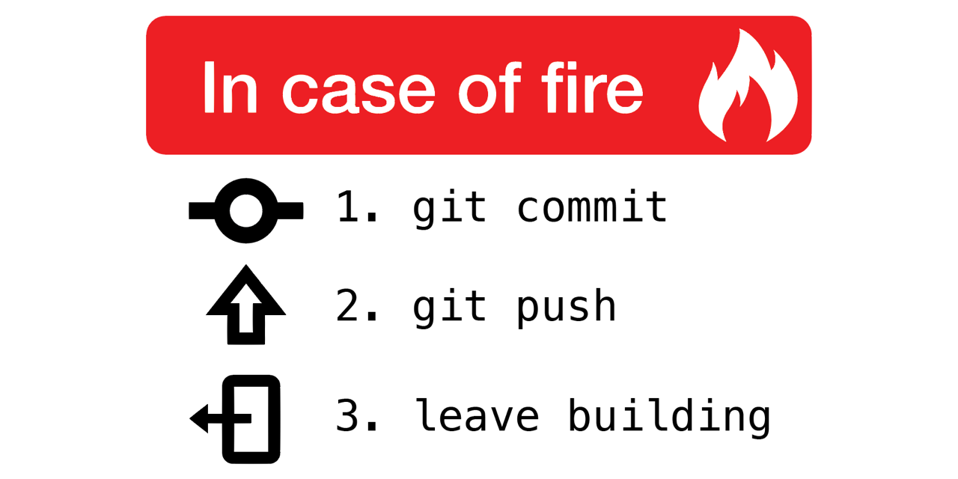
Why use remote repositories like GitHub?
Backup for your code
  Can access the repository from anywhere
Collaborations
  Easy to keep track of changes made by you and collaborators
Open Science
  Easy to access, download and use others’ code
  Easy to discuss with users of your code

Slide 47
Pushing and Pulling
Push: Updates your remote repository with recent commits from your local repository
Pull: Updates your local repository with recent commits from your remote repository

Slide 48
Local-Remote Pipeline
Working
Directory
Staging
Area
Local Repository
Remote Repository
Add
Commit
Code.py
*New*
Code.py
*New*
Code.py
*New*
Code.py
TRACKED
Notes:
https://www.google.com/url?sa=i&url=https%3A%2F%2Fcourses.csail.mit.edu%2F6.S194%2F13%2Flessons%2F03-git%2Fgit-commands-and-metaphors.html&psig=AOvVaw0eLwNte0CymnSwNKJIL7Zi&ust=1654357234965000&source=images&cd=vfe&ved=0CAwQjRxqFwoTCLifgozPkfgCFQAAAAAdAAAAABAk

Slide 49
Local-Remote Pipeline
Working
Directory
Staging
Area
Local Repository
Remote Repository
Pull
Push
Code.py
*New*
Code.py
*New*
Code.py
*Modified*
Code.py
TRACKED
Code.py
*Modified*
Code.py
*Modified*
Notes:
https://www.google.com/url?sa=i&url=https%3A%2F%2Fcourses.csail.mit.edu%2F6.S194%2F13%2Flessons%2F03-git%2Fgit-commands-and-metaphors.html&psig=AOvVaw0eLwNte0CymnSwNKJIL7Zi&ust=1654357234965000&source=images&cd=vfe&ved=0CAwQjRxqFwoTCLifgozPkfgCFQAAAAAdAAAAABAk

Slide 50
Activity #6 – Pushing commits to GitHub

Slide 51
Activity #6 – Pushing commits to GitHub
Click the “Publish Repository” button
Now open your GitHub account in the browser and find your repository. See if your commit history is the same as in your local repo.

Slide 52
Activity #7 – Pulling Commits from GitHub

Slide 53
Activity #7 – Pulling Commits from GitHub
From the GitHub website, open your file and select the edit option
Make a change to the file and commit it.
Return to the desktop app and do Repository -> Pull
Look at your commit history and your file, what do you see?

Slide 54
Create a local copy of a GitHub Repository
“Cloning”
Usually done to use published code
  Reproduce results
  Use code on a dataset of interest
Creates a direct link to the original repository
  Anything changes you push will affect the original repository
  Any changes in the original repo can be pulled into your clone

Slide 55
Cloning a Repository
Working
Directory
Local Repository
Remote Repository
Clone
Code.py
*New*
Code.py
*New*
Code.py
*Modified*
Code.py
*Modified*
Code.py
*Modified*
Notes:
https://www.google.com/url?sa=i&url=https%3A%2F%2Fcourses.csail.mit.edu%2F6.S194%2F13%2Flessons%2F03-git%2Fgit-commands-and-metaphors.html&psig=AOvVaw0eLwNte0CymnSwNKJIL7Zi&ust=1654357234965000&source=images&cd=vfe&ved=0CAwQjRxqFwoTCLifgozPkfgCFQAAAAAdAAAAABAk

Slide 56
Activity #8 – Clone a Repository
- Find a GitHub repo that interests you and clone it!

Slide 57
Activity #8 – Clone a Repository
Go to the GitHub website and search for a repo that interests you.
Copy the repo’s URL
In the Desktop App, do File → Clone a repository and paste the URL. (or on command line do `git clone URL`)
Open the cloned repo and explore!
Alternatively can check my GitHub page to clone

Slide 58
Contributing to a Shared Repo
Repo owner can add ‘collaborators’ with push privileges
Collaborators can then push changes from their cloned copy of the repo
ALWAYS make changes in a NEW BRANCH
  Avoids merge conflicts and errors/bugs entering main branch

Slide 59
Activity #9.1 – Contribute to a shared repo
- Work in teams to contribute to a shared repository

Slide 60
Example Activities (Data Analysis // Database curation) are stored in ‘Exercises’ folder for this workshop’s repo.
  https://github.com/ehuan2/IntroToGitHub
Task – as a team, create a remote repo and collaborate to extend it using pull requests.
  One user will create a base repo
  The repo owner will add other members as repo collaborators
  Make your changes in a separate branch and push the changes to the remote repository
Notes:
Note: in future share zip files for projects to reduce fork #

Slide 61
Contributing to projects
We saw earlier that we can create merge conflicts
How can we regulate this when working in teams?
  What if our ‘team’ can be anyone from the community?
Forks & Pull Requests

Slide 62
Create a remote copy of a GitHub Repository
“Fork”
Usually used to contribute to published code
  Can then edit the forked repository locally
  Can then push local changes to your forked copy
  When your changes are done, you can make a pull request to add your changes to the original repo
Much safer way to contribute to source code

Slide 63
Forking a Repository
All on GitHub
You
Collaborator
Working
Directory
Local Repository
Forked Remote Repository
Original Remote Repository
Code.py
*New*
Code.py
*New*
Code.py
*New*
Code.py
*New*
Clone
Fork
Code.py
*Modified*
Code.py
*Modified*
Code.py
*Modified*
Code.py
*Modified*
Push
Pull Req.
Notes:
https://www.google.com/url?sa=i&url=https%3A%2F%2Fcourses.csail.mit.edu%2F6.S194%2F13%2Flessons%2F03-git%2Fgit-commands-and-metaphors.html&psig=AOvVaw0eLwNte0CymnSwNKJIL7Zi&ust=1654357234965000&source=images&cd=vfe&ved=0CAwQjRxqFwoTCLifgozPkfgCFQAAAAAdAAAAABAk

Slide 64
Activity #9.2 – Fork a Repo and make a Pull Request
- Fork the repo I made for this course and add a text file to it. Then, make a pull request!

Slide 65
Activity #9.2 – Fork a Repo and make a Pull Request
Open the link in chat to access the repo I made.
  https://github.com/ehuan2/GitHub_Practice_Repo
Click the “fork” button
Clone your forked copy to your computer and add a text file with one thing you have learned today. Commit the file.
Push the commit to your forked repo.
On the GitHub website. Look at your forked repo and select the “create Pull Request” button

Slide 66
Poll #4
What command lets you update your remote repo with local changes?
T/F - Cloning a repository is the best way to contribute new features to someone else’s repository
T/F – You will always be able to push changes from a cloned repo to the original
What is the advantage of using a Pull Request prior to merging changes from a contributor?
Notes:
Push
F
F
Control over additions

Slide 67
Summary
GitHub provides a framework to store and document code
Push/Pull commands allow you to transfer commits between local and remote repositories
Forks/Pull Requests help manage code contributions

Slide 68
Important: Using GitHub is NOT a replacement for good communication:
Ensures everyone is using the latest version of a file
Helps keep track of what changes were made and by who
Good Practices:
Have certain user(s) in charge of approving Pull Requests
Set a standard format for commit messages
Be descriptive in Pull Request comments

Slide 69
Part V – Miscellaneous Features

Slide 70
Using Git on the Command Line

Slide 71
Using the Command Line:
Direct interaction with Git
Allows you to use Git on an HPC server (e.g: ComputeCanada)
Provides more tools than third-party software
But:
Can have a steep learning curve depending on experience with UNIX

Slide 72
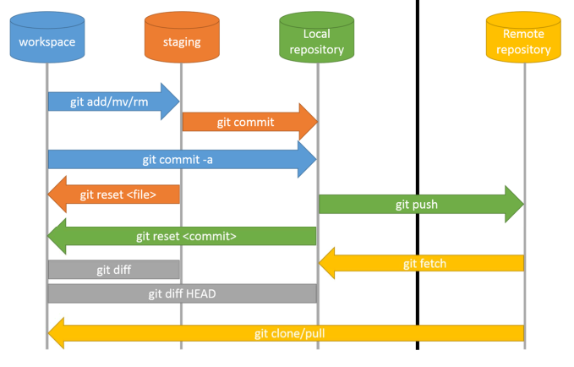

Slide 73
Activity #10 – Initialize Repo with git commands
Open Command Line and switch to Desktop: cd Desktop/
Make a new directory: mkdir Git_Practice
Initialize git repository: git init
Check the status of your repository: git status

Slide 74
Activity #11 – Commit a new file with git commands
Create a new txt file in the repo with vim or through your text editor
From the command line, check your repo status: git status (do you see the new file?)
Stage the new file: git add file_name
Check your repo status: git status
Commit the file: git commit –m “Commit Message”
Check your repo status: git status
Check your Commit History: git log
Rename your branch: git branch –M main

Slide 75
Activity #12 – Create a new branch
Check your current branches: git branch
Create new branch: git branch new_branch_name
Check your current branches: git branch
Switch to new branch: git checkout new_branch_name
Edit your file and commit it
Check your commit history: git log

Slide 76
Activity #13.1 – Revert a Modification/Commit
Make a change to a file
Check the repo status: git status
Restore the previous version of file: git restore file_name
Make the change again, but stage it this time: git add file_name
Unstage the file: git reset file_name

Slide 77
Activity #13.2 – Revert a Modification/Commit
Make a change and commit it
  git add file_name
  git commit –m “commit message”
Get the commit ID from your commit history: git log
Revert your current commit: git revert commit_id
Check your file: have the changes been reverted?

Slide 78
Activity #14.1 – Push to Remote Repository
On the GitHub website, click on your profile in the top right corner and select “settings”
Select “Developer settings” at the bottom of the page
Under the “Personal access tokens” menu, click generate new token.
Select the “repo” scope and generate token.
SAVE the token somewhere (or you will have to make a new one)

Slide 79
Activity #14.2 – Push to Remote Repository
On the GitHub website, create a new repository
  Do NOT create a README file
  Copy paste the repo’s URL
In the command line, link your local and remote repo: git remote add origin URL
Push your main branch: git push -u origin main
Check your remote repo: are the files there?

Slide 80
Part VII – Conclusion

Slide 81
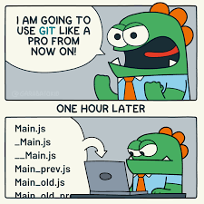
What have we learned?
What VCS, Git, and GitHub are
Why they are so useful
How to undertake basic tasks in a local and remote repository
How services like GitHub improve code collaboration and Open Science

Slide 82
What next?
Practice makes perfect!
  Track your hobby projects
  Track your research
  Use open-access code or software from publications
  Consider trying Git on the command line

Slide 83
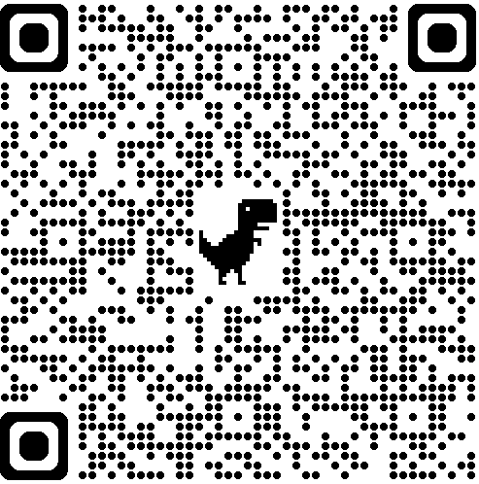
Workshop Feedback QR Code

Slide 84
Image Sources
https://betterexplained.com/articles/a-visual-guide-to-version-control/
https://github.com/torvalds
https://github.com/gitster
https://github.com/qw3rtman/git-fire
https://walkingrandomly.com/?p=6653

