Slide 1
IGDB
Internet Game Database
web scraping • data manipulation • data visualization • exploratory analysis

Slide 2
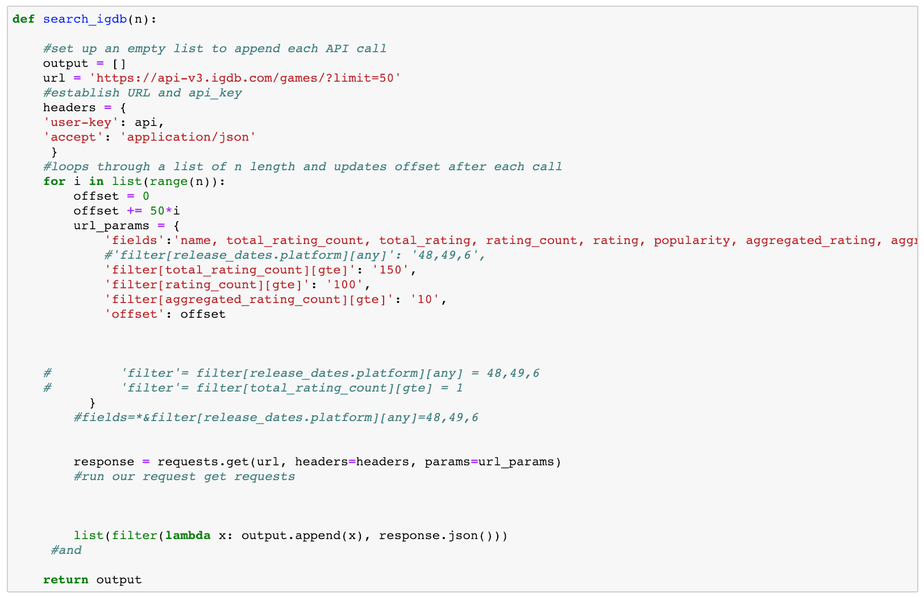
Setting up, using the igdb api + a big issue we ran into

Slide 3
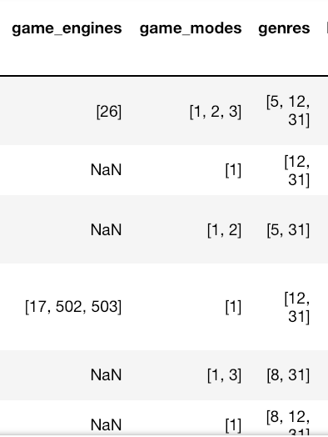
Another issue we ran into!

Slide 4
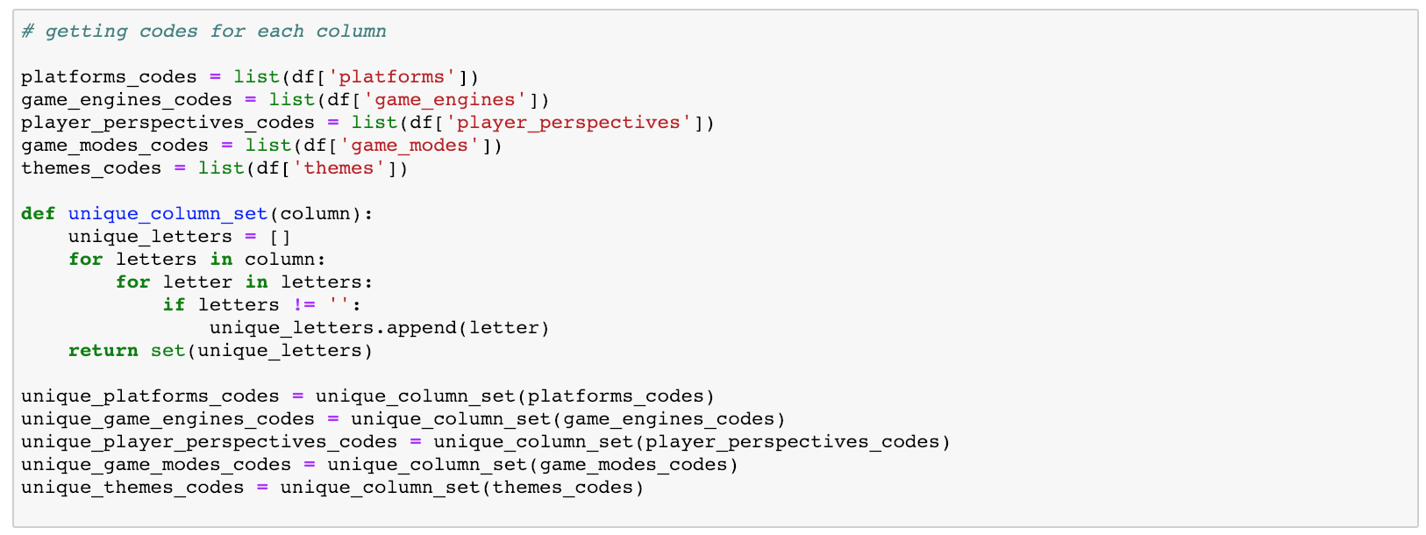
How we resolved it!

Slide 5
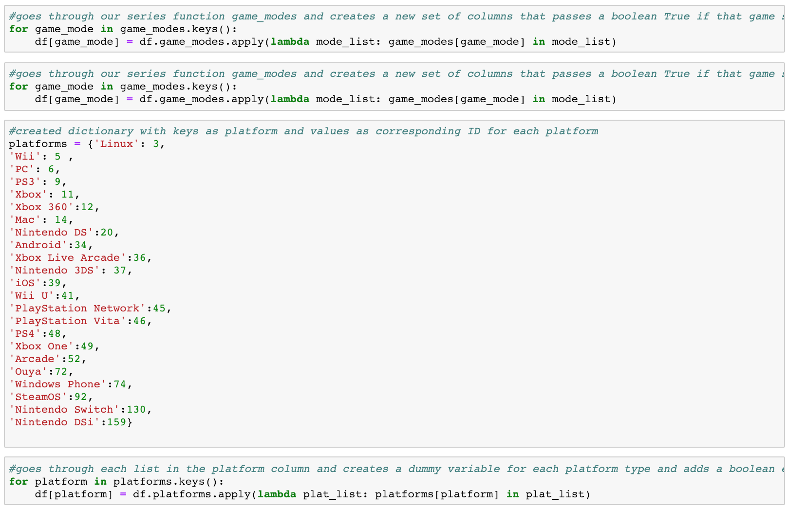
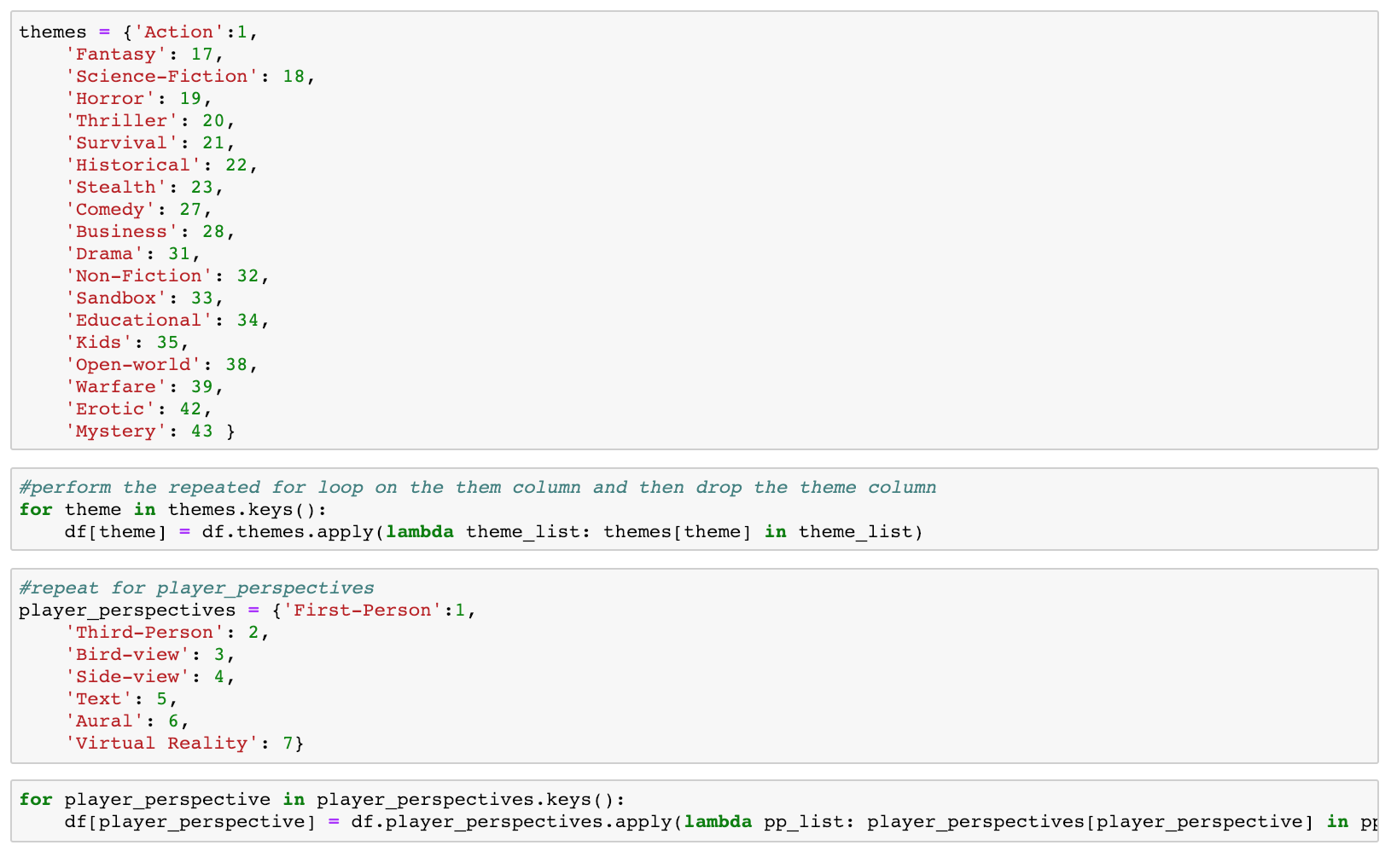
How we continued to resolve it!

Slide 6
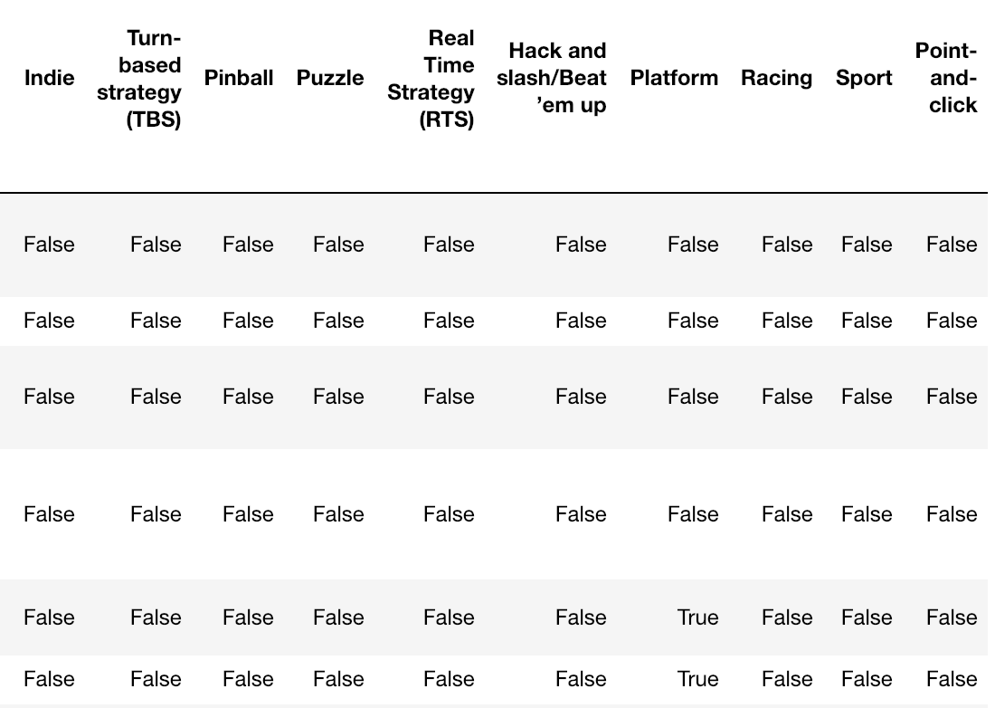
What it looked like after the changes..

Slide 7
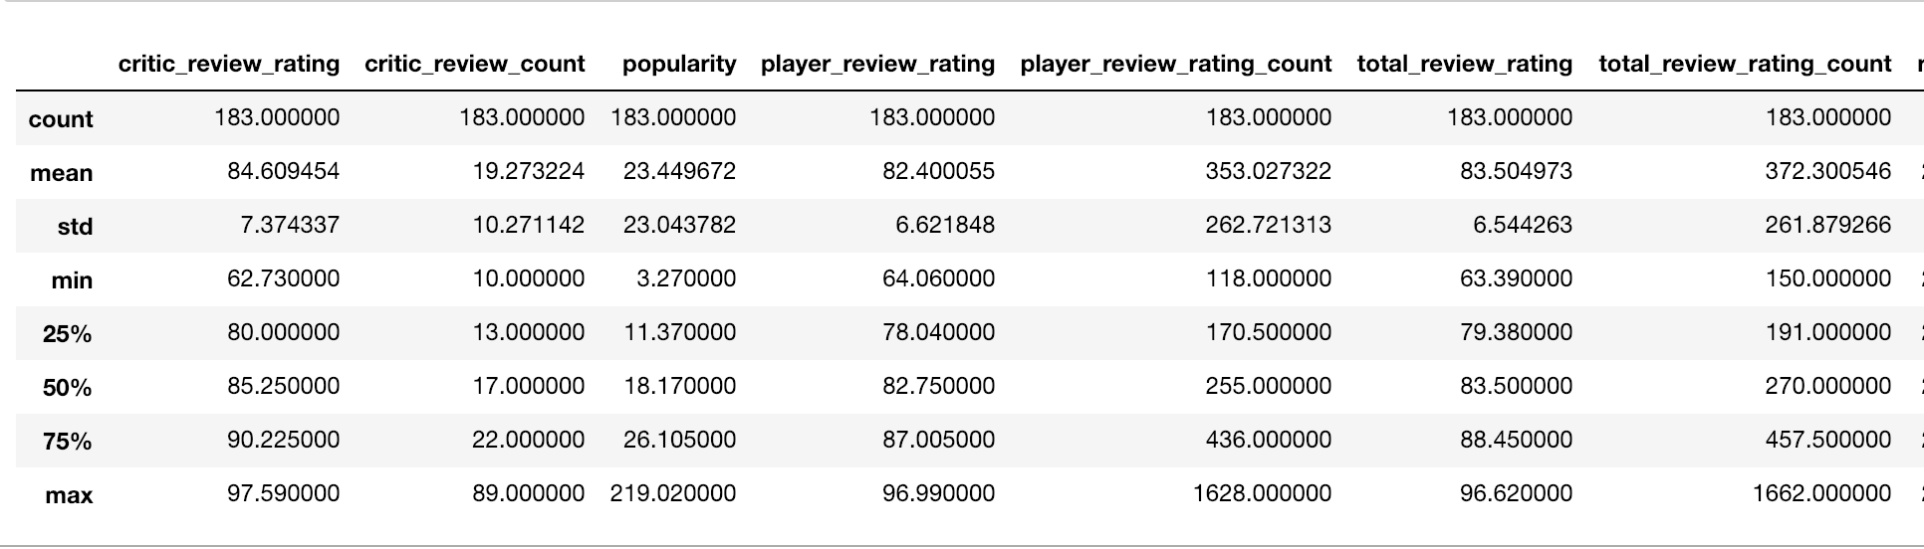
Summary Statistics

Slide 8
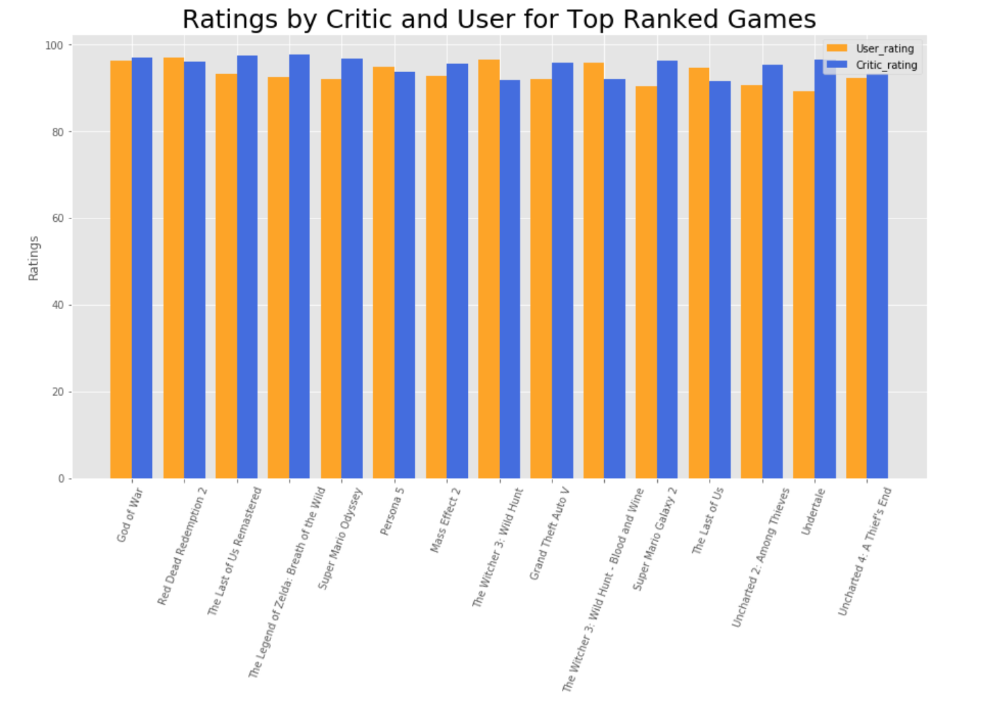
Do critics and users agree that these games should be top 10?

Slide 9
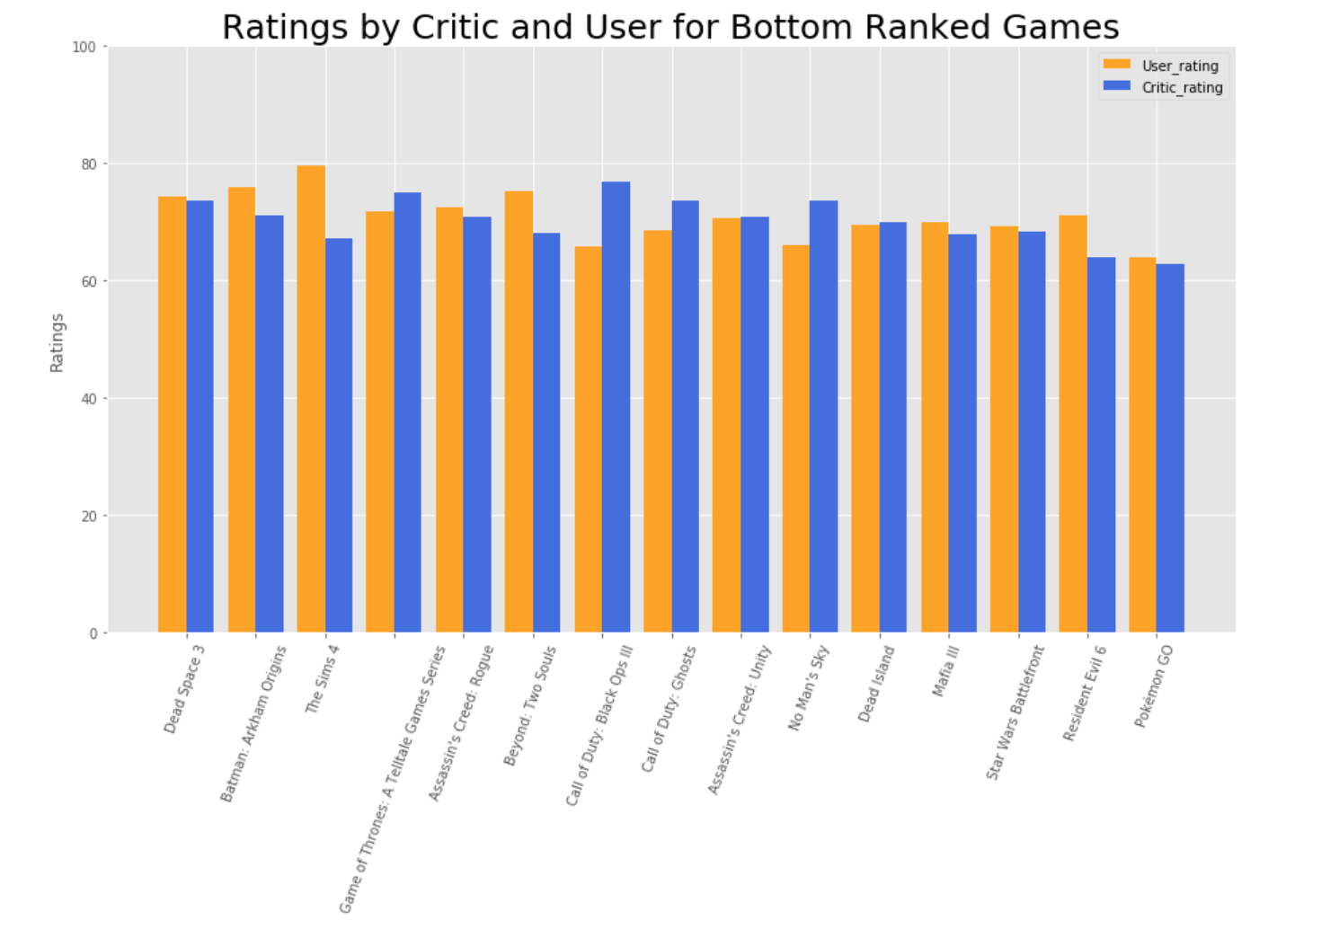
Do critics and users agree that these games should be the bottom 10 of the top 200 list?

Slide 10
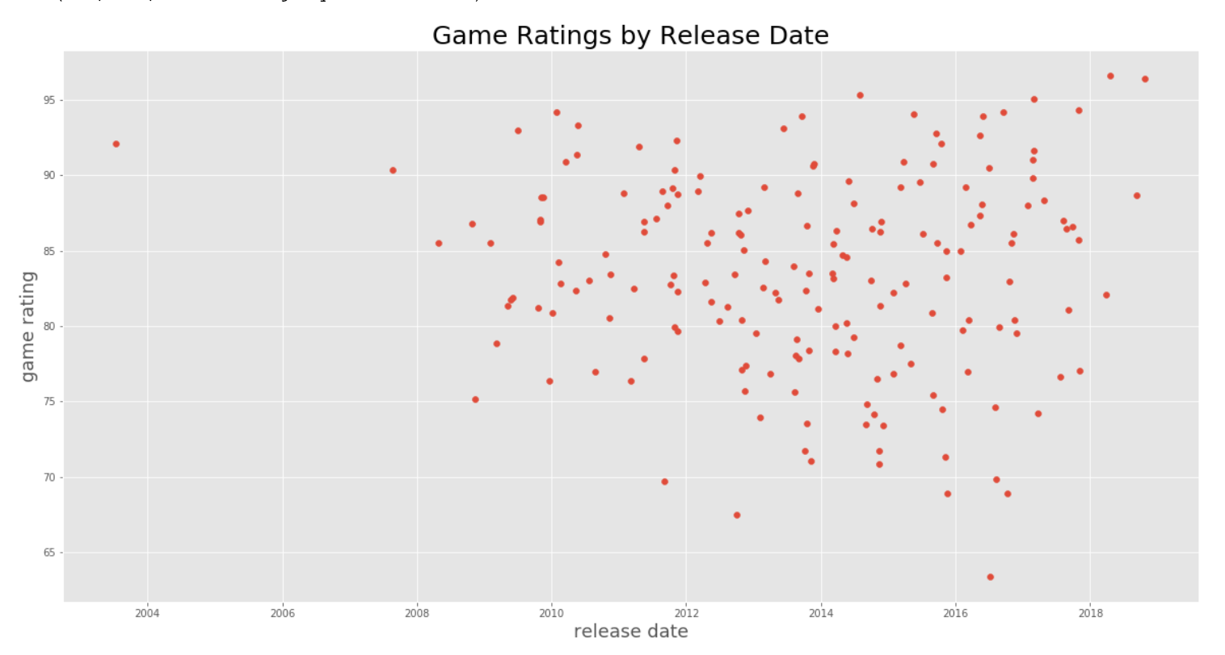
are video games getting better or worst over TIME?

Slide 11
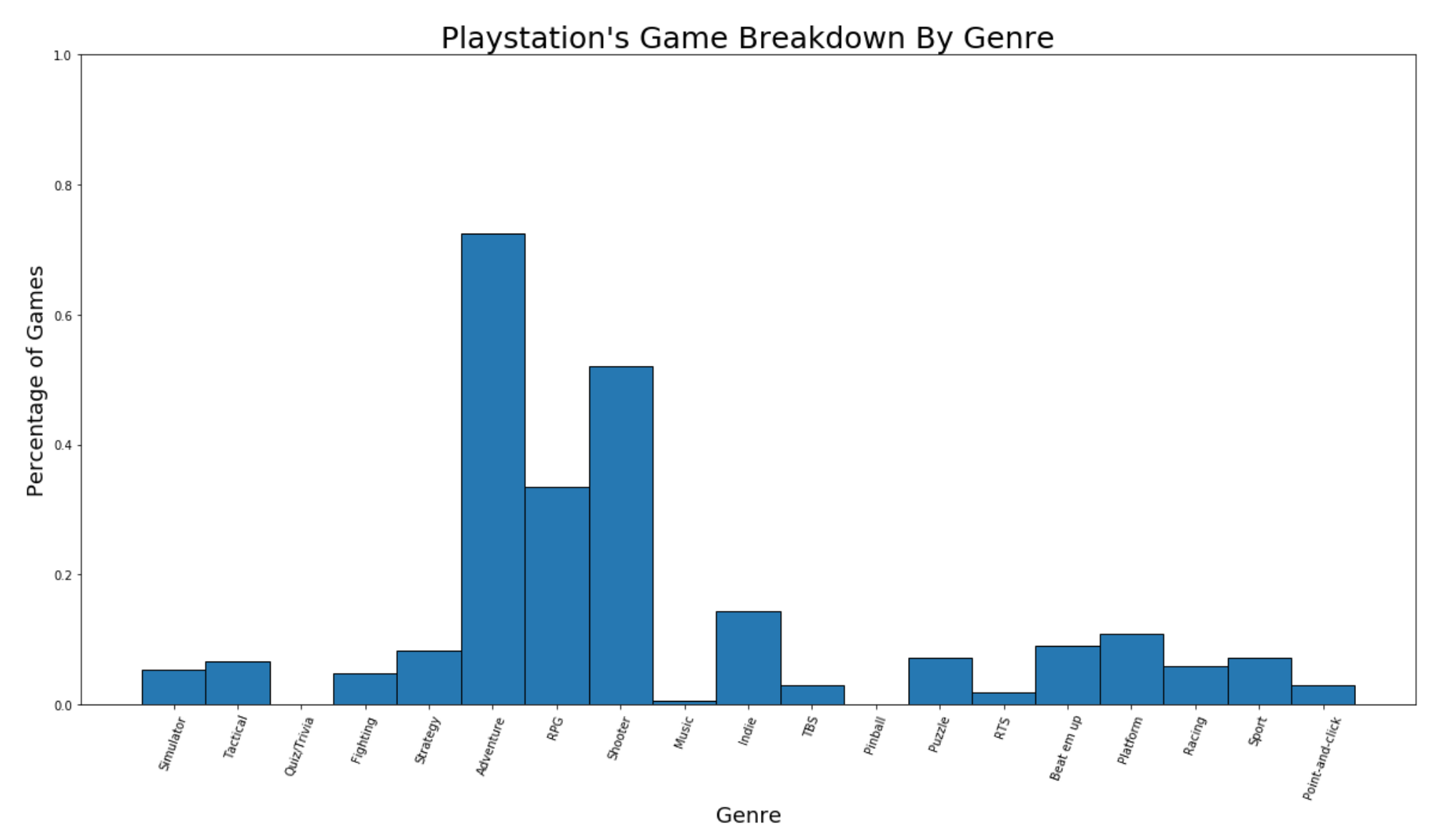
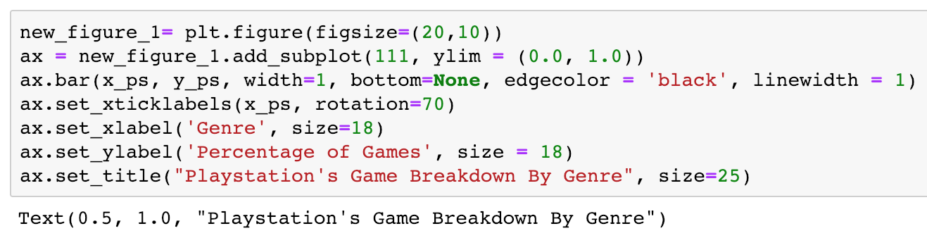
What is the percentage of games that Sony makes for each genre

Slide 12
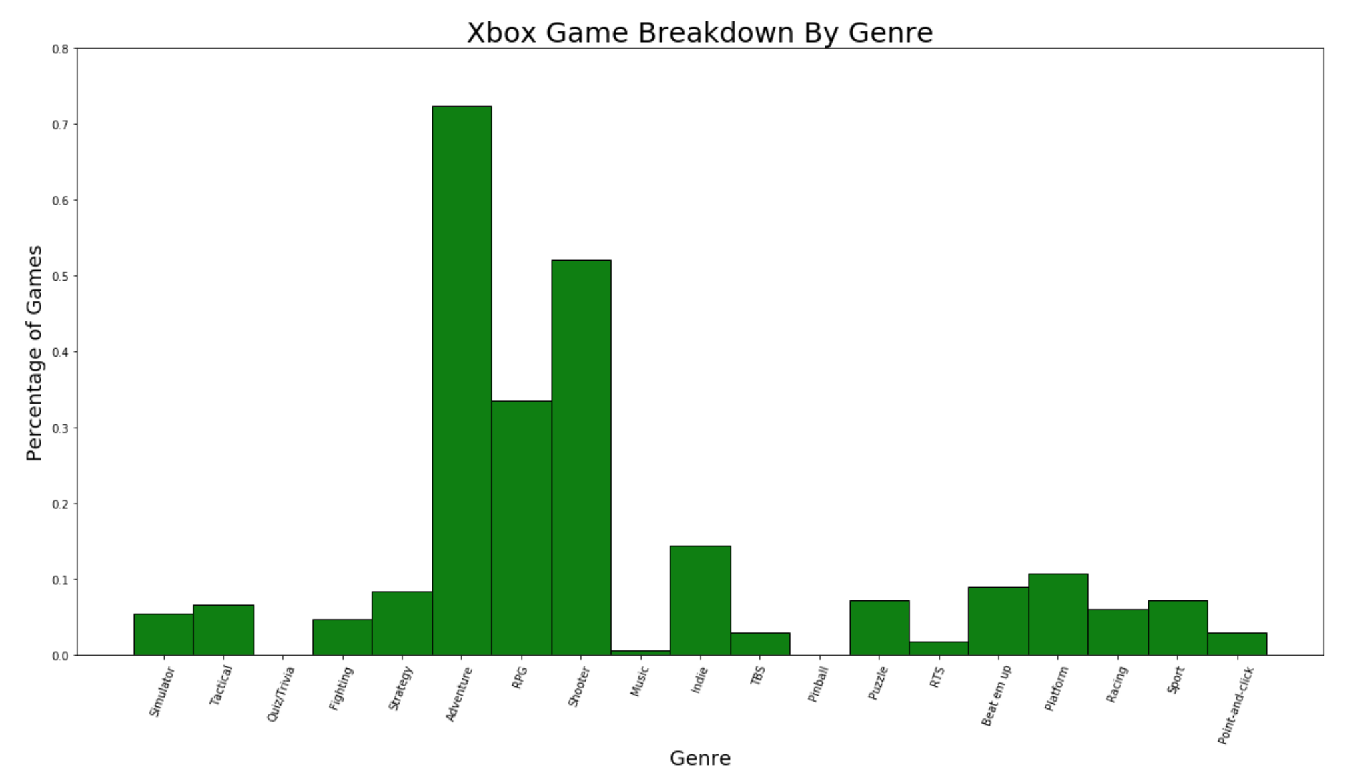
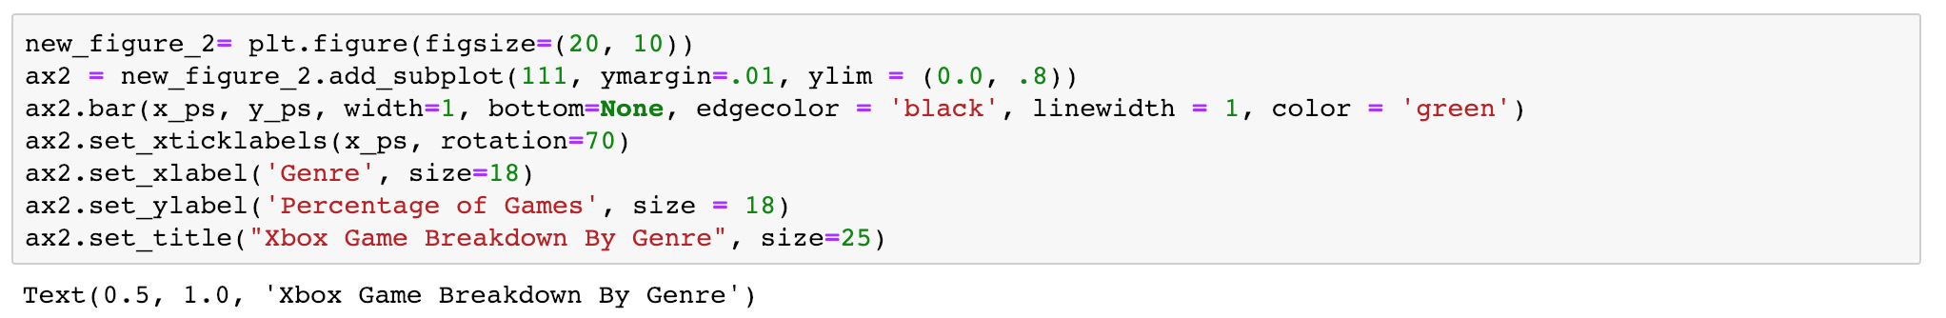
What is the percentage of games that Microsoft makes for each genre

Slide 13
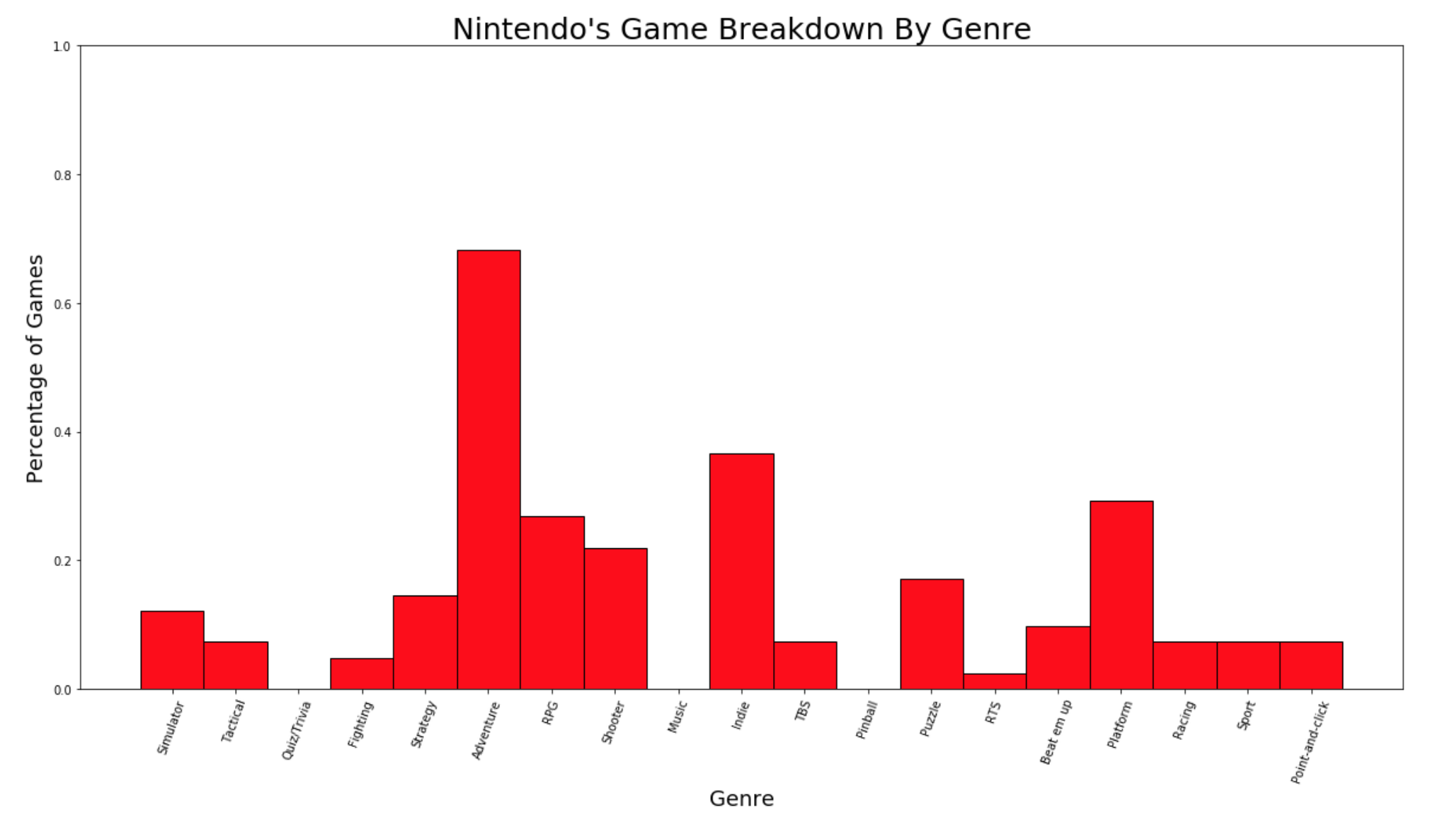
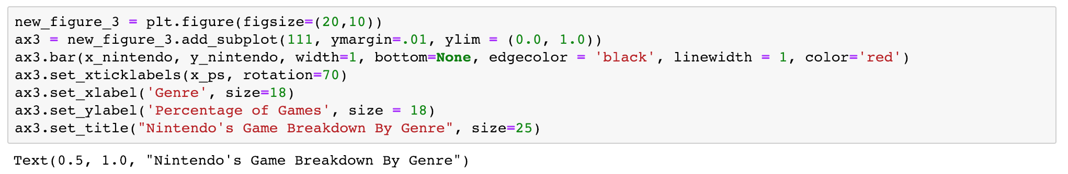
What is the percentage of games that Nintendo makes for each genre

Slide 14
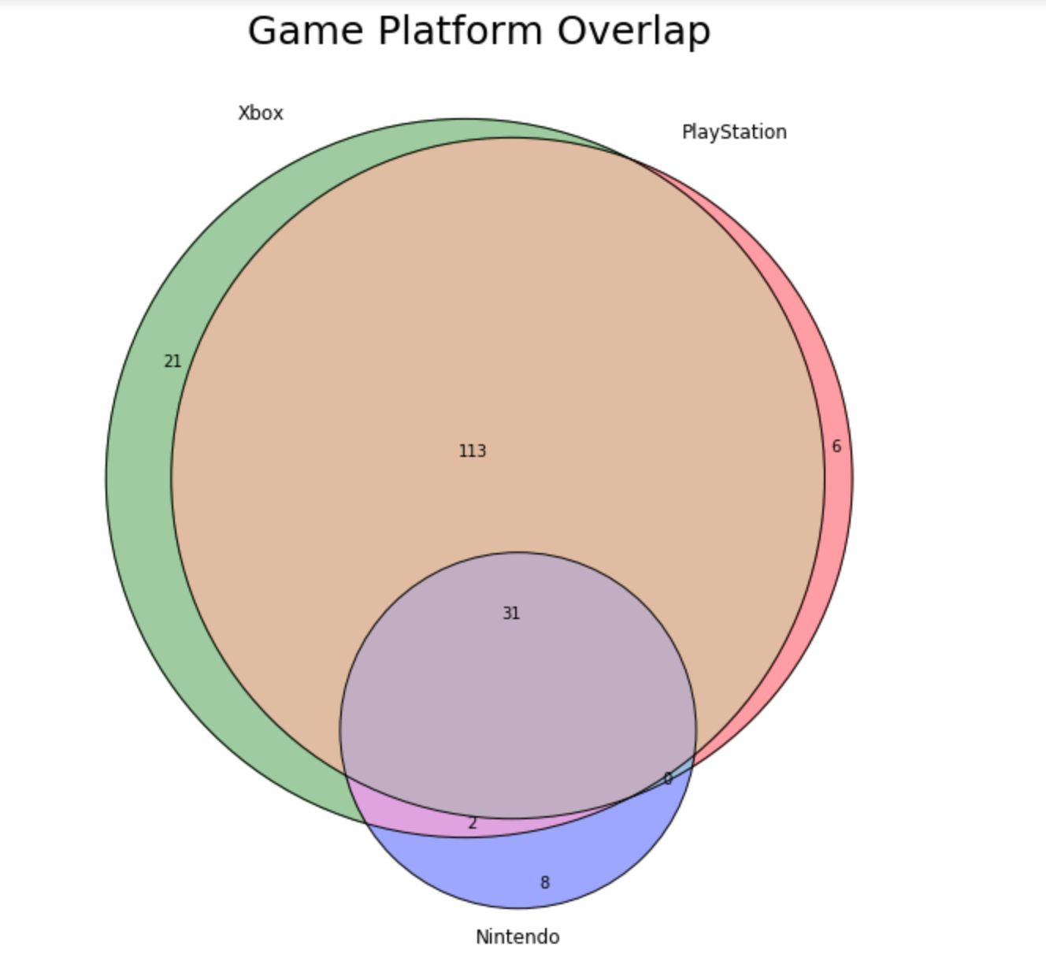
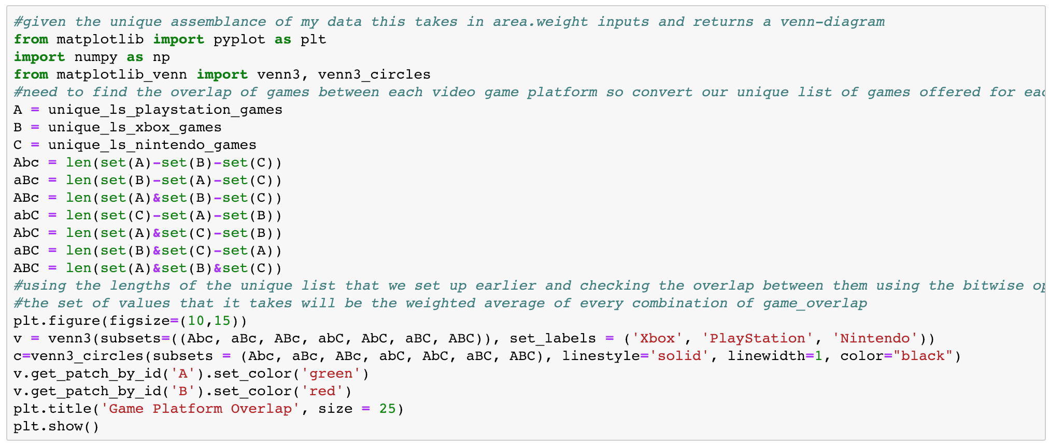
Examining the overlap of unique games amongst the big 3 video game platforms

