Slide 1
GPP Exam: Zombie AI

Slide 2
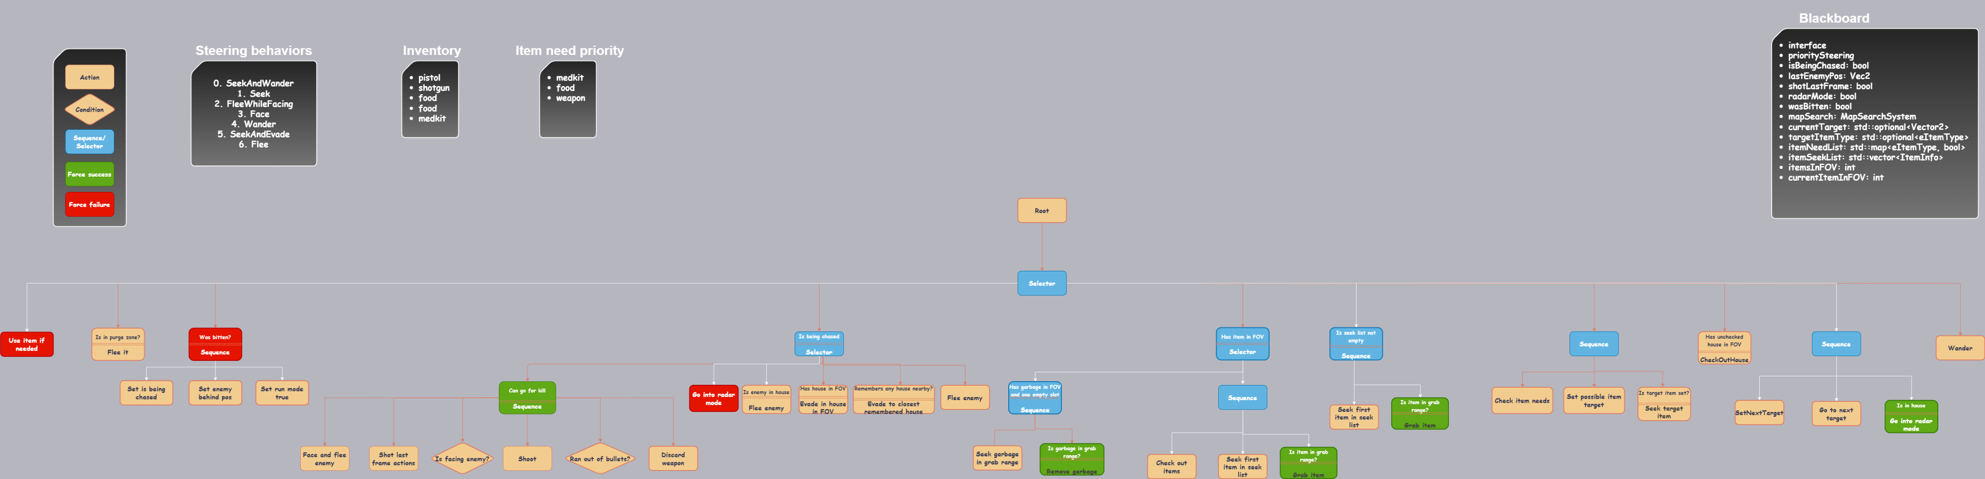
Decision Making
Check this link
There are also 3 versions of the diagram in the main folder called BT.drawio: a .drawio, .png and .svg

Slide 3
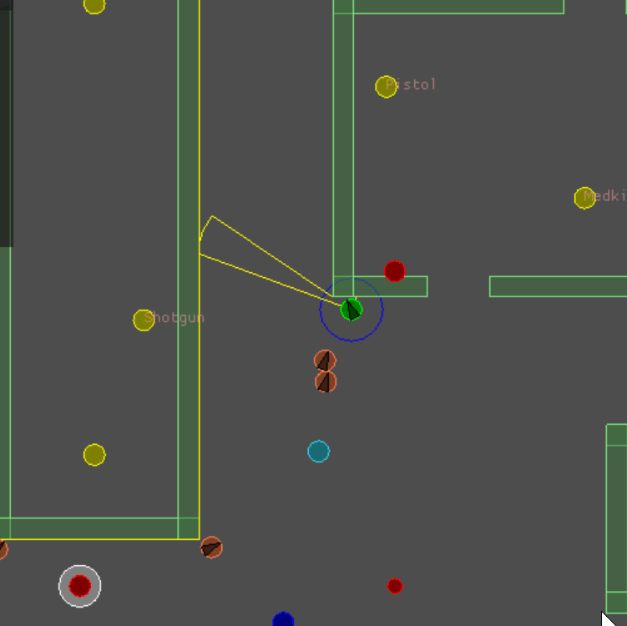
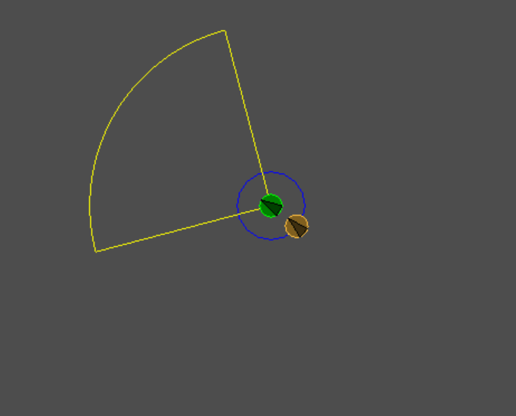
Enemy handling
If the agent gets bitten, I will start a “chase mode”, set the last seen enemy pos as directly behind the agent and sprint till I’m out of stamina.
The chase mode gets triggered when I see an enemy as well and will reset after 5 seconds of not seeing any enemy.
While in a chase, if I have a weapon, I will face the enemy while moving away and shoot if I’m facing him. A rifle is preferred when there are multiple enemies. Once I shoot, I check if I still have ammo, and if I don’t, the weapon is discarded.
If I don’t have a weapon, I go into radar mode (rotate around) while trying to evade as such: if the enemy is not inside a house, I will try to flee to one corner of the closest house I see/know. Otherwise, I just flee.

Slide 4
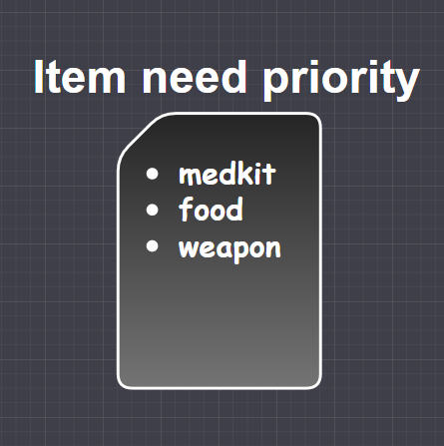
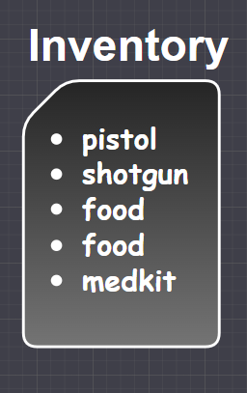
Inventory
If I have items in FOV, I first check if there is any garbage that can be discarded (so, if there is garbage in sight and I have an inventory slot empty).
Then, I go through all the items in my FOV and I decide whether I have an open slot for the item and I should pick it up, or If I should remember its location.
I have a const map<eItemType, int> with my used inventory layout.
I have a const vector for a priority item list. It’s used to decide which item is more important. I constantly keep track of which items I don’t have (thus, need). If there is an item that I need and know the location of, I’ll go fetch it.
At the start of each frame I check if I should use any of the items I have (e.g. if I have food(4) and my energy is <6, I will use the item). After being used it’s discarded.

Slide 5
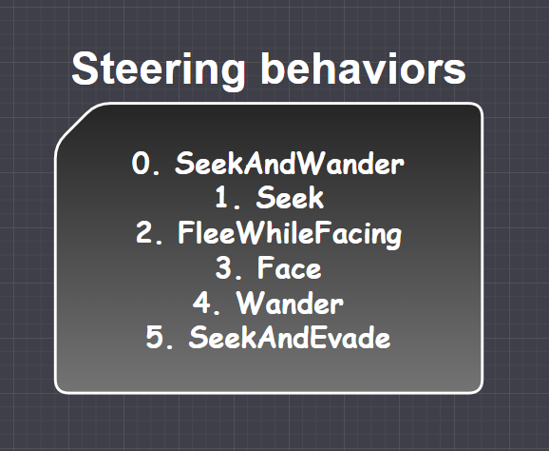
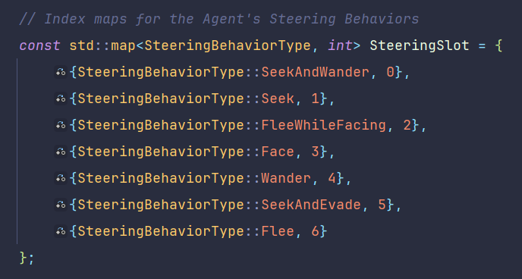
Movement - Steering
I use a base priority steering movement composed of the steering behaviors on the right. I keep track of each behavior’s index using the const map shown on the right.
Some of them are simple behaviors, others are blended (e.g. SeekAndWander)
I manage every behavior through the main priority behavior using methods like SetTargetForIndex() and SetValidSteeringIdx()

Slide 6
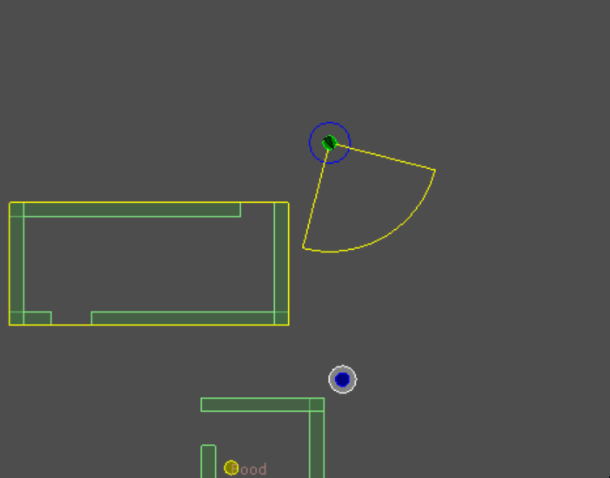
Movement - Exploration
I use a separate class for managing exploration. It consists of multiple layers:
House targets: these are the targets that are added inside a house when I find one. They are by default in the 4 corners of the house, but for narrower houses I only do one/two targets. They are the first ones my agent will check. They can be seen on the right as the yellow circles.
Village targets: they are added right outside the corners of the houses I find, and are used for discovering neighboring houses. They are the second ones my agent will check, and are drawn in blue.
Inner radius targets: targets in a cross shape in a smaller radius around the center. Used for finding the center village. They are the third ones checked, drawn in red.
Outer radius targets: targets along a circle set at different angle steps. They are used to find the outer villages. They are the last ones checked, drawn in green.
Some target points get filtered out if they are inside a house that has already been found.
Village and house numbers are remembered to check if they reached the max value.

Slide 7
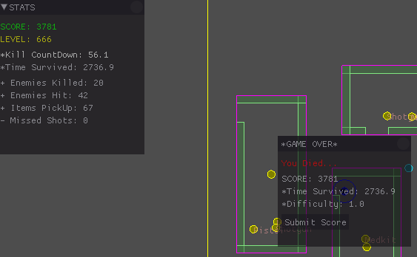
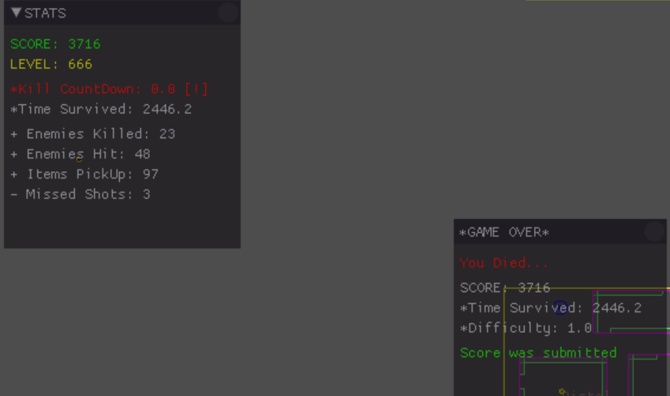
High Score

