Slide 1


Capstone Project
on
Airbnb New York City Dataset
Student Name | SIS ID
Pragadeesh R.C | O7HSA9OFQ8
Manoj Kumar B | BW9R5YUU6W
Jude Praveen Raj J | NEYO3435LA
Siva Vikram | X0MDVLOLL5
Shoba Palaksha | HK2QFT4WBK
Kannan V | EQX2GFLHRT

Slide 2
Table of Contents
About Airbnb
Advantages of Airbnb
Optimal Dataset Features
About the Dataset
EDA and Inference
Results without Feature Engineering
Results with Feature Engineering
Data Insights
Conclusion

Slide 3

Airbnb, Inc. is an online marketplace for arranging or offering lodging, primarily homestays, or tourism experiences. The company does not own any of the real estate listings, nor does it host events; it acts as a broker, receiving commissions from each booking. The company is based in San Francisco, California, United States.
The company was conceived after its founders put an air mattress in their living room, effectively turning their apartment into a bed and breakfast, in order to offset the high cost of rent in San Francisco; Airbnb is a shortened version of its original name, AirBedandBreakfast.com.

Slide 4
New York city (NYC) has an extremely active Airbnb market with more than 48,000 listings as of August in the 2019 calendar year (this corresponds to a rental density of 48000 rentals per 468 square miles, which equates to 102 rentals per square mile). This project focuses on the gleaning patterns and other relevant information about Airbnb listings in NYC.
To be more specific, the goals of this projects are to answer questions such as:
how are rental properties distributed across the neighborhoods of NYC (there are 221 neighborhoods);
how do prices vary with respect to neighborhoods, rental property types and rental amenities;
more importantly, how well can machine learning models can be trained to predict Airbnb rental prices using features such as rental property type, the number of people a rental can accommodate, the number of available beds, and so forth.

Slide 5
The Advantages of Airbnb:
Wide Selection
Airbnb hosts list many different kinds of properties—single rooms, a suite of rooms, apartments, moored yachts, houseboats, entire houses, even a castle—on the Airbnb website.
Free Listings
Hosts don't have to pay to list their properties. Listings can include written descriptions, photographs with captions, and a user profile where potential guests can get to know a bit about the hosts.
Hosts Can Set Their Own Price
It's up to each host to decide how much to charge per night, per week or per month.
Customizable Searches
Guests can search the Airbnb database—not only by date and location, but by price, type of property, amenities, and the language of the host. They can also add keywords (such as "close to the Louvre") to further narrow their search.

Slide 6
Additional Services
In recent years Airbnb has expanded its offerings to include experiences and restaurants. Besides a listing of available accommodations for the dates they plan to travel, people searching by location will see a list of experiences, such as classes and sightseeing, offered by local Airbnb hosts. Restaurant listings also include reviews from Airbnb hosts.
Protections for Guests and Hosts
As a protection for guests, Airbnb holds the guest's payment for 24 hours after check-in before releasing the funds to the host.
For hosts, Airbnb's Host Guarantee program "provides protection for up to $1,000,000 in damages to covered property in the rare event of guest damage, in eligible countries."

Slide 7
Optimal Dataset Features
neighbourhood_group_cleansed
property type
room type
accommodates
bathrooms
bedrooms
beds
security deposit
cleaning fee
guests included
minimum nights
number_of_reviews
review_scores_cleanliness
review_scores_checkin
review_scores_location
require_guest_profile_picture
calculated_host_listings_count
price_per_person

Slide 8
About the Dataset
Attribute information:
This dataset has around 48,377 observations in it with 106 columns and it is a mix between categorical and numeric values.
In These 106 columns, 40 Columns provide a very rich amount of information for deep data exploration we can do on this dataset. We do already see some missing values, which will require cleaning and handling of NaN values. Later, we may need to continue with mapping certain values to ones and zeros for predictive analytics.
In our case, missing data that is observed does not need too much special treatment. Looking into the nature of our dataset we can state further things: columns "name" and "host_name" are irrelevant and insignificant to our data analysis, columns "cleaning_fee" and "security_deposit" need very simple handling.
Label Encoding can be done to convert categorical features into numerical features

Slide 9
Columns [Price, extra_people, security_deposit, cleaning_fee] can be treated by removing the string variables and convert it into float dtype.
Columns [last_scraped, first_review, last_review, host_since] can be converted it into datetime dtype.
Calculating [List_duration] by Subtracting [last_review - first_review]
Calculating [hosting duration] by Subtracting [last_review - host_since]
Calculating [price_per_person] by Dividing [price - accommodates]
Calculate [Distance] from Latitude and Longitude
Distance - Calculate distance by using the latitude and longitude of the center point of New York.
And by Subtracting it with the hotel_latitude and hotel_longitude using Distance Formula.

Slide 10
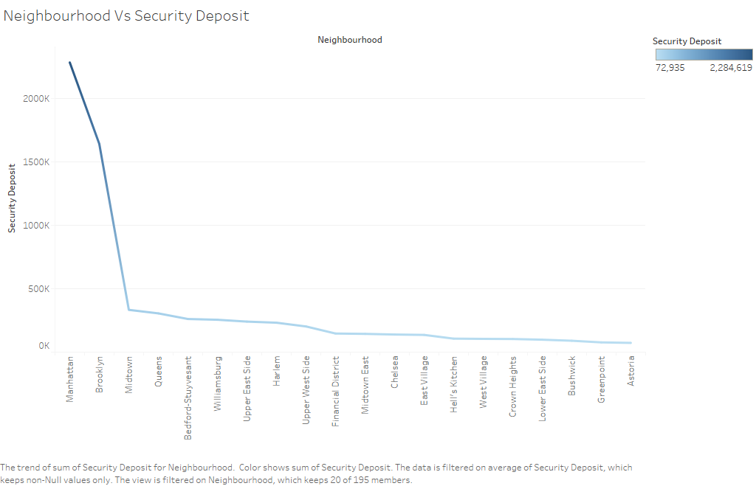
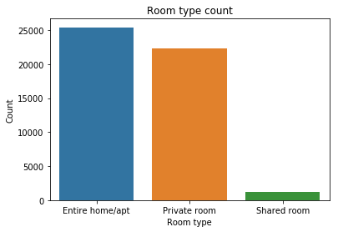
EDA and Inference
Neighborhood Vs Security Deposit
Where Manhattan and Brooklyn collect High Security Deposit.
Most of the Listings are Entire Home/apartments and private rooms

Slide 11
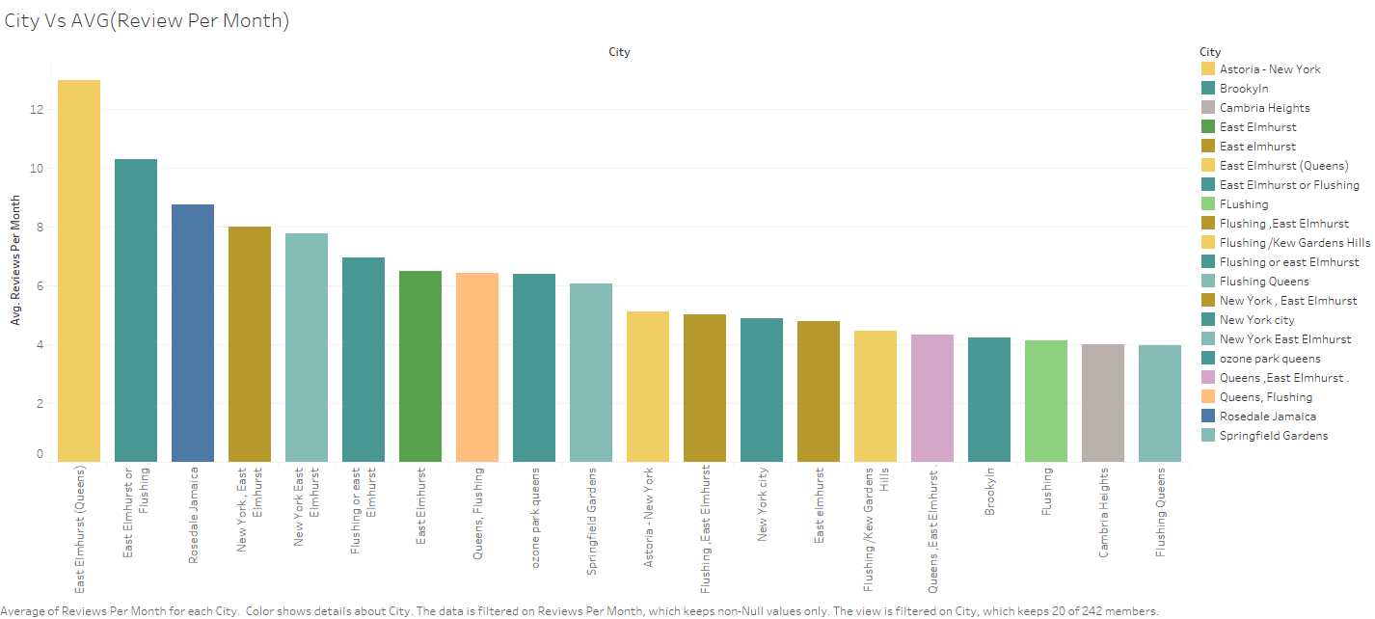
City Vs Average Review Per Month
Where Astoria and Brookyln receives highest No.of.Reviews.

Slide 12
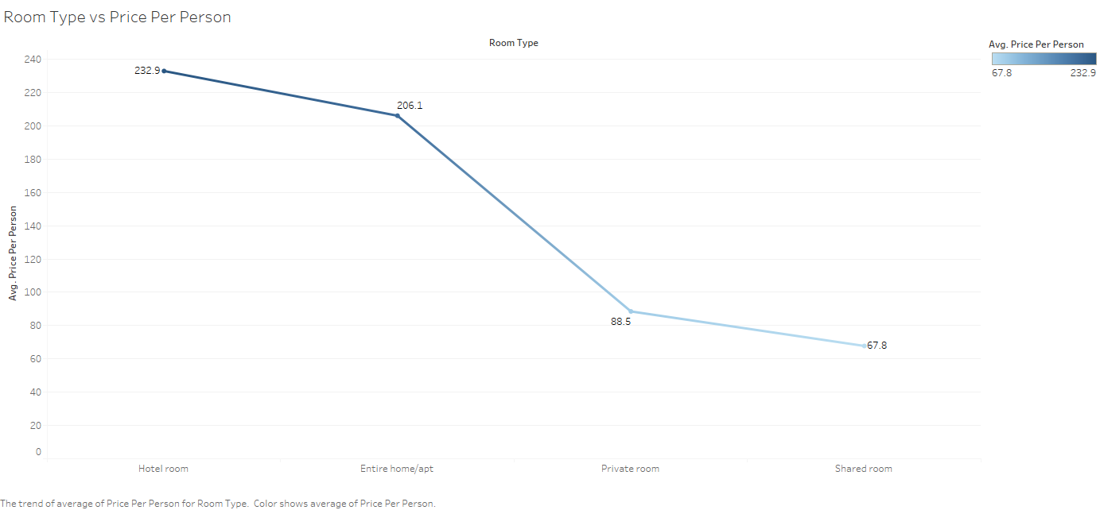
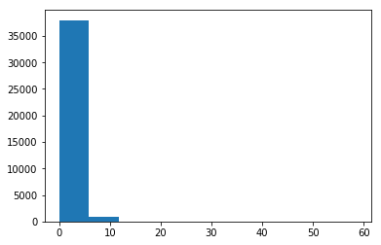
Almost 95% of them have reviews per month less than 10
Room Type Vs Price Per Person Where
Hotel Room And Entire home/apt is High Priced.

Slide 13
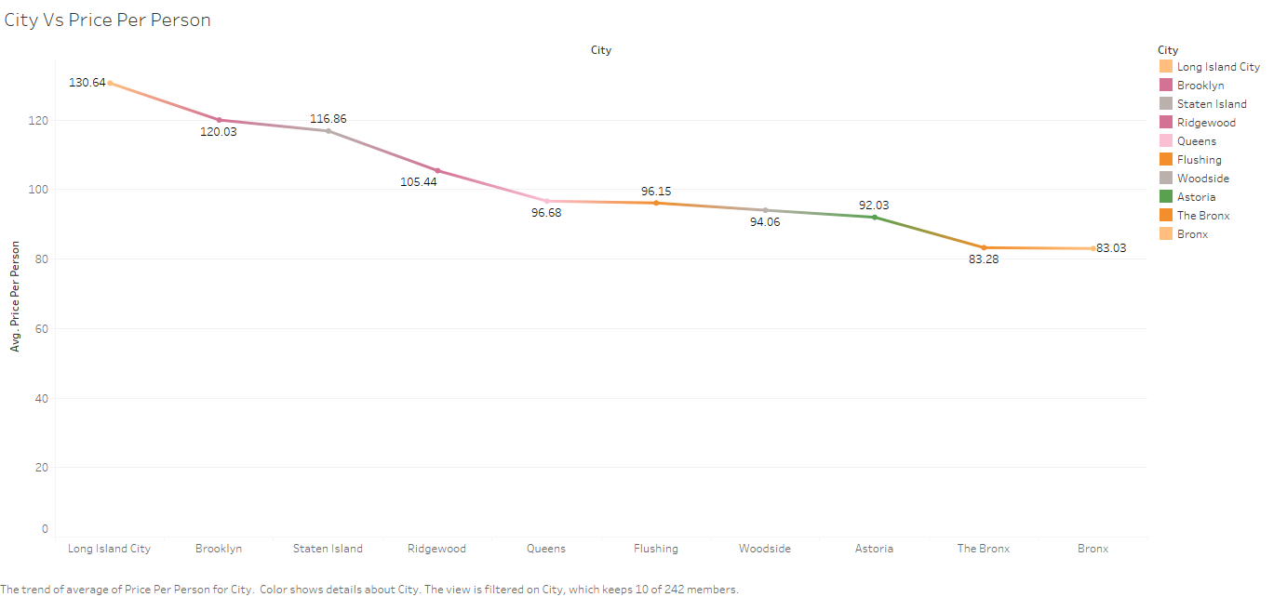
City Vs Price Per Person
Where, Long Island City and Brooklyn has the highest Cost Per Person

Slide 14
Results without Feature Engineering
The model performance for training set R2 score is 0.698782957074438
The model performance for testing set R2 score is 0.7899394341859203
Algorithms | R2 Score / Training | Adj R2 Score / Testing
OLS Model | 0.732 | 0.732
Algorithms | Scores
Ridge | 0.662
Lasso | 0.722
GridSearchCV (DT) | 0.522
GridSearchCV (RF) | 0.581

Slide 15
Results without Feature Engineering
Algorithms | DT | Bagging/ADA Tree | Linear Reg | Bagging/ADA Linear Reg | Ridge | Bagging /ADA Ridge | Lasso | Bagging /ADA Lasso
Bagging | 0.10 | 0.24 | 0.66 | 0.66 | 0.66 | 0.70 | 0.66 | 0.67
ADABoost | 0.10 | 0.10 | 0.66 | -1.09 | 0.66 | -0.78 | 0.66 | -1.64
Algorithms | Scores
XG Boost | 0.924
Bagging(DTR) | 0.847
ADABoost(DTR) | 0.872
Bagging(RFR) | 0.933

Slide 16
Results with Feature Engineering
The model performance for training set R2 score is 0.698782957074438
The model performance for testing set R2 score is 0.7899394341859203
Algorithms | R2 Score / Training | Adj R2 Score / Testing
OLS Model | 0.732 | 0.732
With Selected Features OLS Model | 0.729 | 0.728
Algorithms | Scores
Ridge | 0.757
Lasso | 0.722
GridSearchCV (DT) | 0.521
GridSearchCV (RF) | 0.678

Slide 17
Results with Feature Engineering
Algorithms | DT | Bagging/ADA Tree | Linear Reg | Bagging/ADA Linear Reg | Ridge | Bagging /ADA Ridge | Lasso | Bagging /ADA Lasso
Bagging | 0.10 | 0.23 | 0.66 | 0.63 | 0.66 | 0.63 | 0.66 | 0.67
ADABoost | 0.10 | 0.13 | 0.66 | -1.13 | 0.66 | -1.02 | 0.66 | -1.63
Algorithms | Scores
XG Boost | 0.891
Bagging(DTR) | 0.828
ADABoost(DTR) | 0.857
Bagging(RFR) | 0.930

Slide 18
Data Insights
Price of Most of the Listings are $105 - $150.
2. Price of Shared room is lower than private room and entire house/ apartment
3. price of Rooms in Manhattan and Brooklyn boroughs are more than the rooms in boroughs
4. 75% of people spend 5 nights
5. There is a 50% chance that the rooms will be available for at least 45 days
6. Manhattan has Highest number of listings
7. Brooklyn has more Number of listings after Manhattan
8. Most of the Listings are Entire Home/apartments and private rooms

Slide 19
9. 95% of them have reviews per month less than 10
10. Most(75%) of the host listing count are less than 50
11. Bronx has less number of night stays as compared to other
12. Where Manhattan and Brooklyn collect High Security Deposit.
13. Where Astoria and Brooklyn receives highest No.of.Reviews.
14. Hotel Room And Entire home/apt is High Priced.
15. Long Island City and Brooklyn has the highest Cost Per Person

Slide 20
Business Recommendation
By Using this Airbnb New York dataset we are predicting that the price suggested by Airbnb is cost effective or expensive.
Thus XG Boost Performs Better With and Without Feature Engineering.

Slide 21
Thank You

