Slide 1




Jude Praveen Raj.J Loyola College
AN EVOLUATION OF WIRELESS NETWORK AND OVERVIEW OF MANET

Slide 2
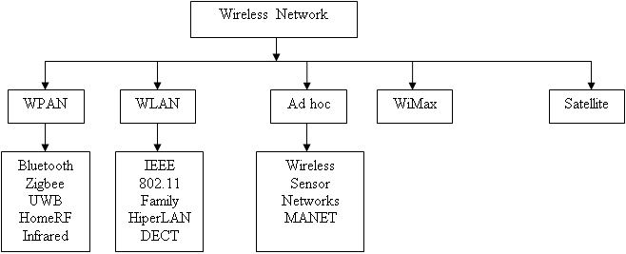
INTRODUCTION
In recent days the most important development in the field of telecommunication network is wireless communication. The term telecommunication gives the following areas are:
Voice communications
Data communications
Radio systems
Navigational systems
Mobile networks
Fixed networks
Broadcast networks
And the personal area network

Slide 3
Types of Wireless Sensor Network
The telecommunication divided into three different eras based on evolution is:
From Homer to Marconi from year 1800 to 1900
From Marconi to Telstar from year 1901 to 1970
The Internet and Mobile Communications 1970 to till date
Different types of wireless standard are introduced are Wireless-Fidelity (WiFi, IEEE 802.11) [1-3], Bluetooth (IEEE 802.15.1) [4], Ultra Wide Band (UWB, IEEE 802.15.3) [5], Zigbee (IEEE 802.15.4) [6] and worldwide Interoperability for Microwave Access (WiMax, IEEE 802.16) [7] etc. The above technologies are used in various devices like mobile phone and laptops are connected to different network. The wireless communication is divided into two types are infrastructure based wireless network and infrastructure less wireless network.
Infrastructure wireless network are deal with the help of wire and wireless backbone infrastructure. Infrastructures less wireless network are deal without base station. Hence in this network the wireless devices are communicated to each other through point-point connections. The Infrastructure less network can be divided into two types are senor network and mobile ad hoc network. Table 1 provides the difference between the infrastructure based wireless network and infrastructure less network using different parameters.

Slide 4
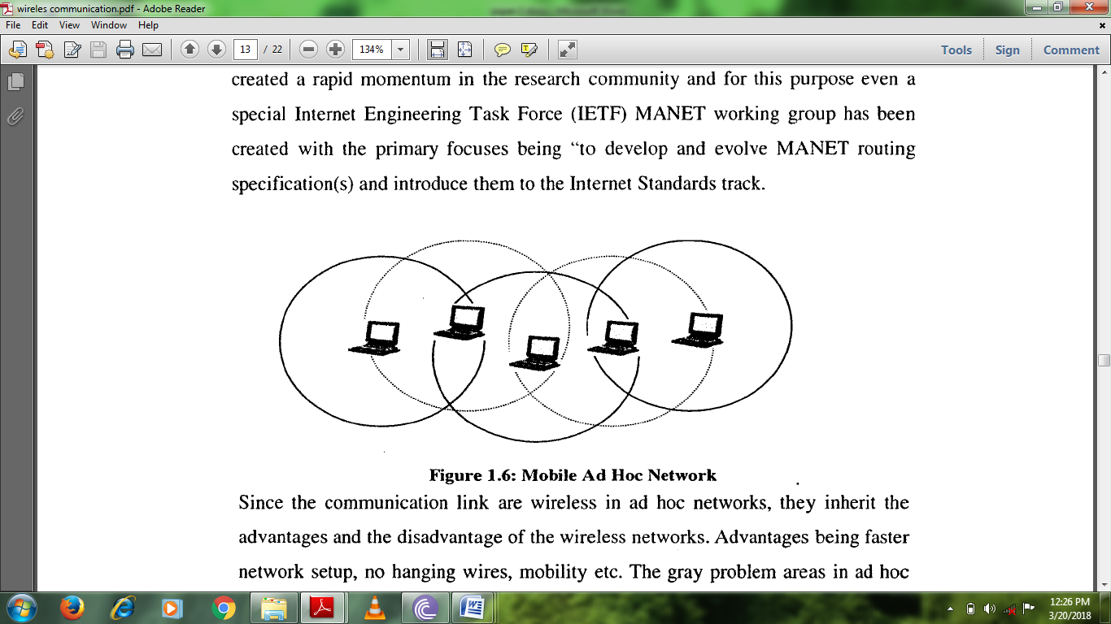
Senor Network: It consists of group sensor and spread over geological area. An example for sensor network is the measurement of air pollution. The interaction of human is not possible in sensor networks.
Mobile ad hoc network: Recent years several research activities are introduced for exchanging the node in Mobile Ad Hoc Network (MANET).
Each node in a MANET works as both a host and router for transmission and receiving a data and also maintains the information in the time of exchanging the nodes. MANET is one of the wireless communications and it didn’t need any other help from other devices, thus it can operate without exiting infrastructure and other mobile user. The idea behind the MANET is based on multihop wireless networking
Mobile Ad hoc Network:

Slide 5
APPLICATION OF MANET
Some of the application of Mobile ad hoc network is given below:
Military services: The most common application of MANET is military services in which the installation of any fixed infrastructure is not possible in the inhospitable terrains or enemy territories. The required communication is given by MANET to this environment in no time. Here, the mobile nodes are considered by soldiers. The MANET support the network to remain connected even though the soldiers move freely. The coordination of military objects and the personnel in the battlefield is also another application. The message passed by the leader of a soldier group to the entire soldier in the group with the secure and reliable routing protocol.
Emergency Services: These arise as a result of natural disasters when the entire communications infrastructure is in disarray (for example, Tsunamis, hurricanes, earthquake etc.) where restoring communications quickly is essential. By using ad hoc networks, an infrastructure could be set up in hours instead of days/weeks required for wire-line communications
Education: Ad hoc communication is needed in meetings or lectures in education area such as university, virtual classroom and campus settings.
Sensing and Gaming: In MANET, sensor network is an important one in which mobility is generally not considered. The battery power is an important factor in sensor. Each sensor consists of transceiver, a small microcontroller and an energy source. The information is captured by the sensor from other devices and it transports the data to the central monitor. The main function of the sensor is to sense the environmental condition such as temperature, pressure, humidity etc. In this condition, the intended information is collected by ad hoc network. The mobility is situated into the sensor network where the behavior of tornados, patient in the hospital is studied.
Personal Area Networking: The devices like laptops, PDAs mobile phone are personal communicating, it share the data among one another by a network called Personal Area Network (PAN). The PAN has a short range of communication and it used for ad hoc communication among the devices or for connecting to a backbone network.

Slide 6
Protocol Layer Issue in MANET
The protocol layer issues in MANET are given below:
The Application Layer: The application layer of MANET performs all the service as in OSI or TCP/IP and also it provides services for location-based.
Presentation Layer: The presentation layer in MANET such as Network Virtual Terminal (NVT), AppleTalk Filing Protocol (AFP), and Server Message Block (SMB).
Session Layer: The session layer is used to exchange the data between application processes such as session flow control and error checking.
Transport Layer: The transport layer aims is to supports the integrity of data packet, end-to-end error free. The protocol in the transport layer may be connection-oriented or connectionless.
Network layer and Routing: A number of researches have attention towards network layer. The route between the nodes is finds and maintained by number of protocols. The link state and distance vector are the basic routing algorithm in wireless network, it faces many problems are given below and cannot be used for MANET environment.

Slide 7
Protocol Layer Issue in MANET
Data Link Layer: The data link layer is partitioned into MAC and LLC sub-layer of OSI model. The channel access and link maintenance are protected or maintained by MAC and LLC sub layer. The LLC layer is also responsible for synchronization, framing data unit, error detection and flow control.
Physical Layer: The physical layer is responsible for operating frequency range, operating temperature range, channel switch time, modulation scheme, synchronization of time, symbol coding and power requirement.

Slide 8
ROUTING IN MANET
Routing is an important function is to transfer the data between wireless nodes. Basically, routing security provides problem in routing security that is not trivial to solve (Deng et al, 2002) . The key factor of routing is exchange the routing information, finds the optimal path between the source and destination node through different metrics and path maintenance.
In MANET, routing faces additional problems and challenged compared to routing process in wired network with fixed infrastructure. In wireless network, the router is act by each wireless node and participants in the routing protocol. Therefore the true relationship between the participating devices is given by routing process. The problem of routing is further aggravated by limiting factors such as rapidly changing topologies, high power consumption, low bandwidth and high error rates.
The unique characteristic of ad hoc network is triggered by below mentioned challenges for design a routing protocol.
Multicast routing protocol
Multicast routing protocols
Tree based routing protocol
Mesh based routing protocol

Slide 9
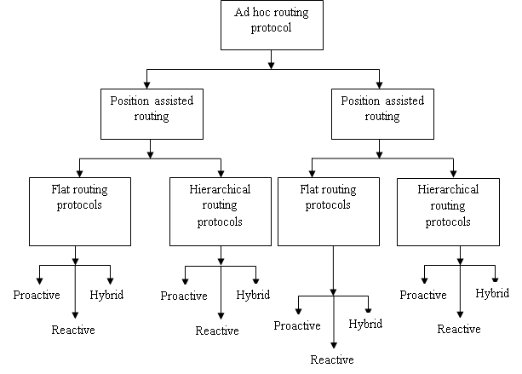
AD HOC ROUTING PROTOCOL

Slide 10
Conclusion
The rapid development in the field of wireless communication provides different application in mobile application. The mobile devices provide self-creating and self organizing wireless network called MANET in wireless communication. This paper gives the potential application of MANET and discusses the enabling technology of MANET. This paper shows the several aspects of MANET and evolution of wireless communication.

