Slide 1
Experience: Large-scale Cellular Localization for Pickup Position Recommendation at Black-hole
Shuli Zhu¹, Lingkun Li¹, Xuyu Wang², Changcheng Liu³, Yuqin Jiang³, Zengwei Huo³,
Hua Chai³, Jiqiang Liu¹, Dan Tao¹, Ruipeng Gao^{1*}
¹Beijing Jiaotong University
²Florida International University
³DiDi
*Corresponding Author
ACM MobiCom 2023
Madrid, Spain

Slide 2




Motivation
Accurate pickup service
Ride-hailing platforms, like DiDi, Uber, and Lyft
Pickup location
Connection between drivers and passengers utilizing passengers’ location
Why cellular? Why not GPS or Wi-Fi?
A remarkable observation in DiDi platform
Over 68,000 daily travel orders (~2% of the total) originate from locations with no GPS signals or no pre-collected Wi-Fi fingerprint data
Black-hole
Passengers rely solely on cellular localization
No GPS signals, no pre-collected WiFi fingerprint data, and no dedicated hardware deployment
e.g., subway stations, underground parking structures, and large shopping malls

Slide 3
Challenge
Accurate and scalable cellular localization for pickup service
at a large scale in the industry

Slide 4
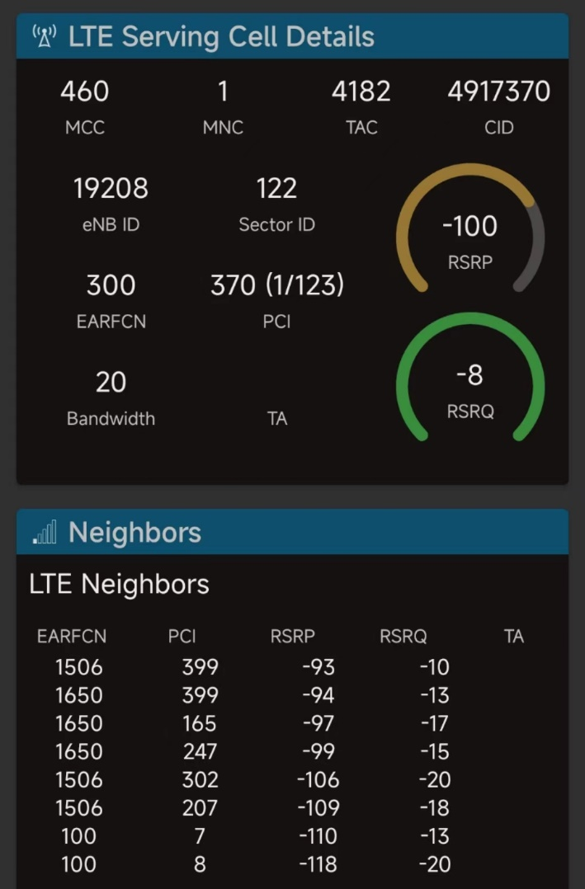
Cell Tower Measurements
User Measurement Data in LTE/NR networks from smartphones
Serving tower details (take 4G LTE as an example)
Mobile Country Code (MCC)
Mobile Network Code (MNC)
Tracking Area Code (TAC)
Cell ID (CID)
E-UTRA Absolute Radio Frequency Channel Number (EARFCN)
Physical Cell Identifier (PCI)
Reference Signal Received Power (RSRP)
Reference Signal Received Quality (RSRQ)
Neighboring towers
Only EARFCN, PCI, RSRP, and RSRQ

Slide 5
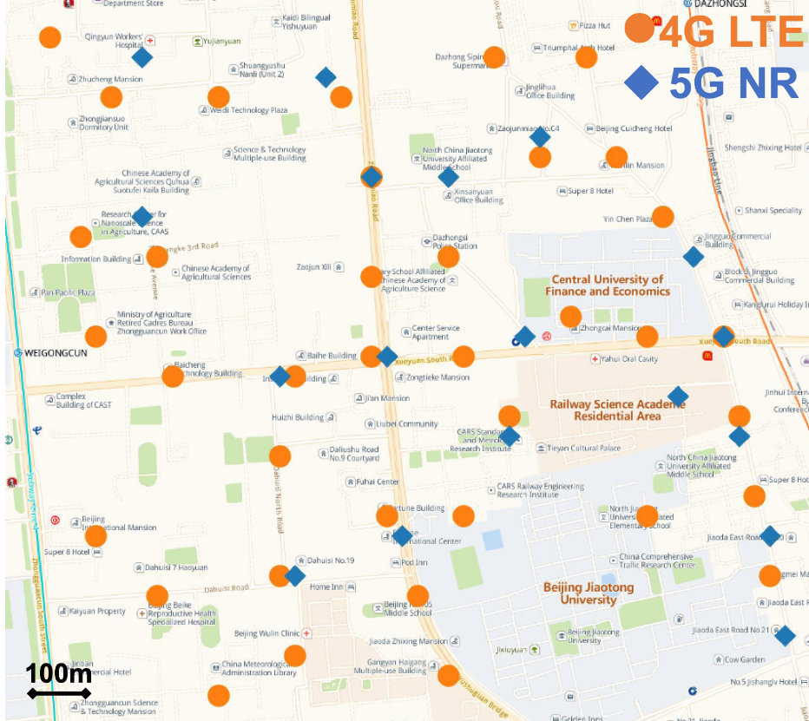
Cell Tower Augmentation
Challenges in cellular localization
Sparse cell towers
 | 1 Tower | 2 Towers | 3 Towers | >3 Towers
4G LTE | 44.82% | 4.83% | 7.68% | 42.67%
5G NR | 53.48% | 2.68% | 5.50% | 38.34%
Urban area of 4 km², Beijing

Slide 6
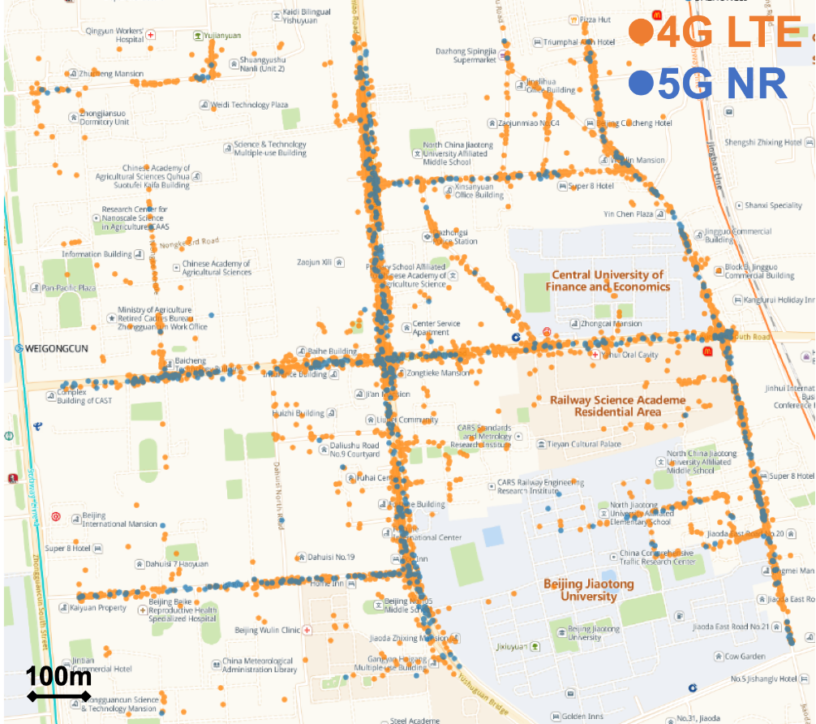
Cell Tower Augmentation
Challenges in cellular localization
Sparse cell towers
Unbalanced user fingerprints

Slide 7
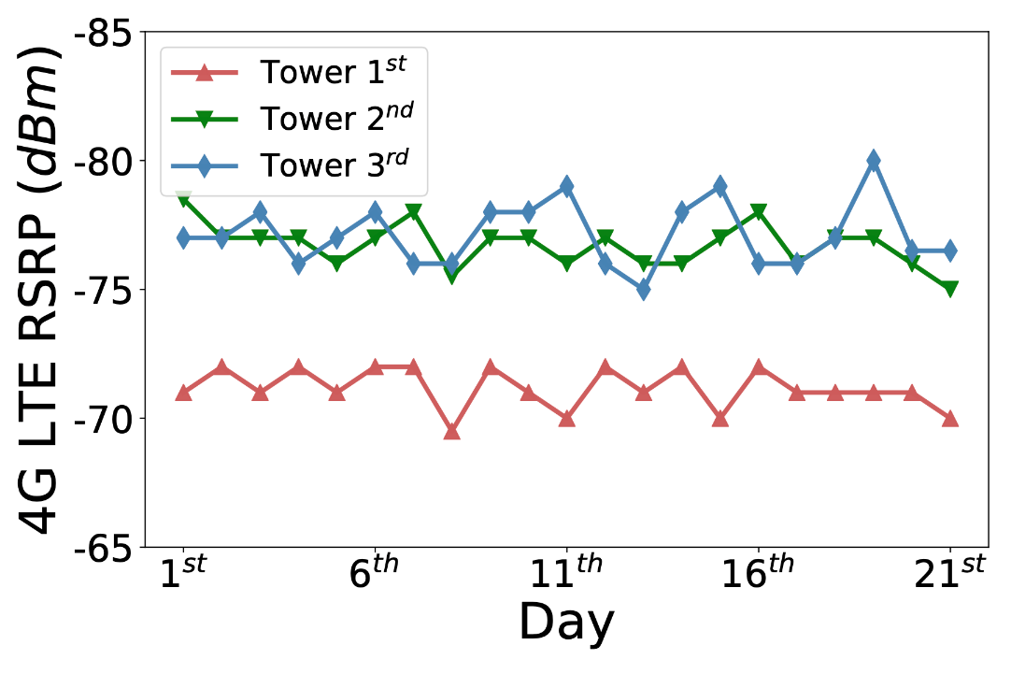
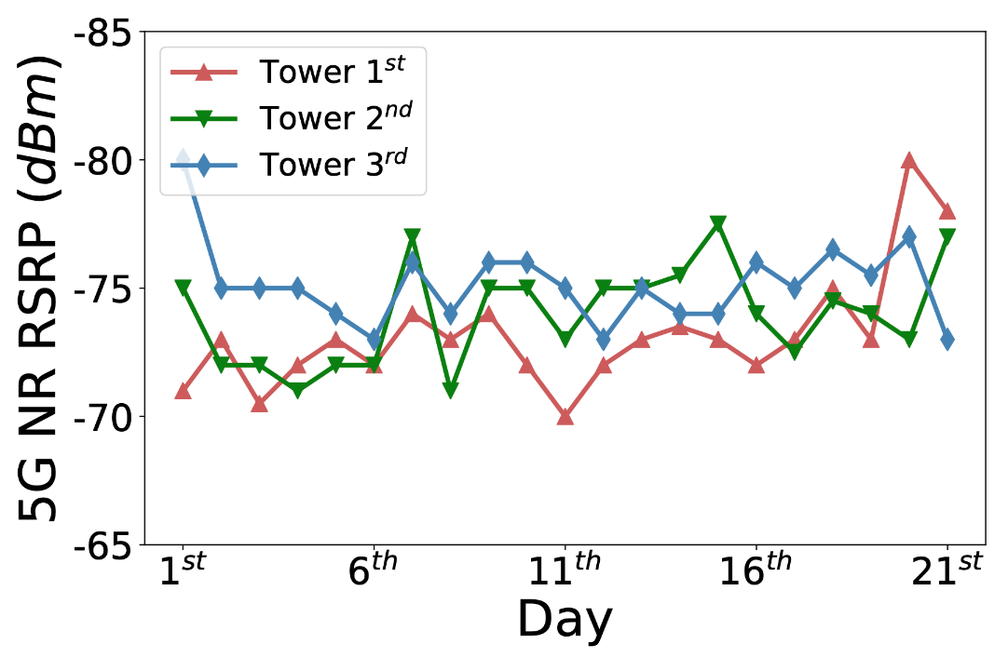
Cell Tower Augmentation
Challenges in cellular localization
Sparse cell towers
Unbalanced user fingerprints
Temporal variations

Slide 8
Cell Tower Augmentation
Augmented cell towers as a primitive
PCI & EARFCN
They are present in both serving tower and neighboring towers
We adopt the pair (PCI, EARFCN) as the unique index for “augmented” towers
With augmentation, the number of augmented towers are twice than the amount of primary towers

Slide 9
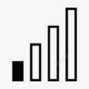
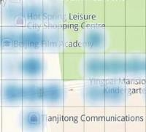
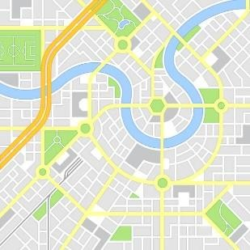
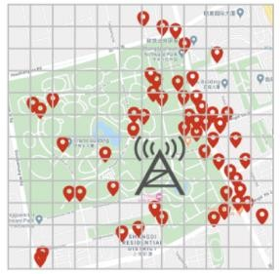







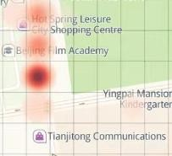
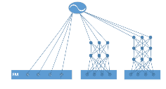


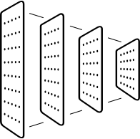



System Overview
Fingerprint Set Construction
Pickup Recommendation
Cellular signature
User popularity
Outdoor
Receptive region
DeepFM model
Pickup position
Real Time Localization
Candidates
Black-hole
Candidate region
Feature map
CNN

Slide 10
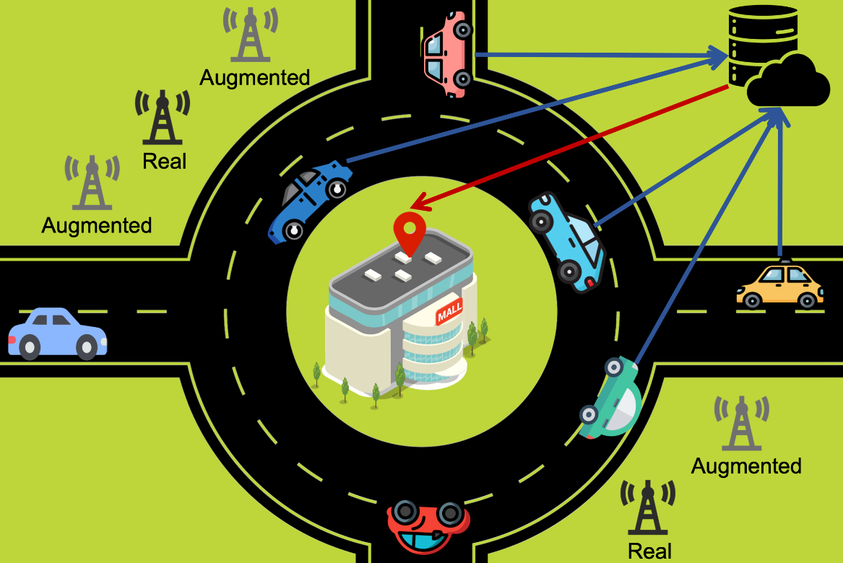
Fingerprint Set Construction
Data collection process
Outdoor trajectories
Geo-tag (accurate GPS location) with associated cellular information
We do NOT use INDOOR trajectories

Slide 11
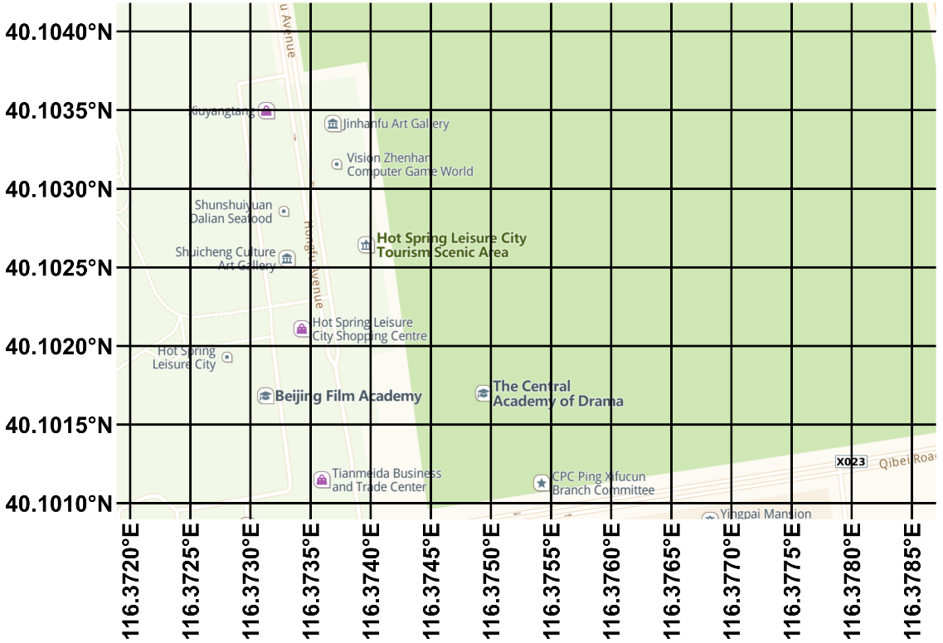
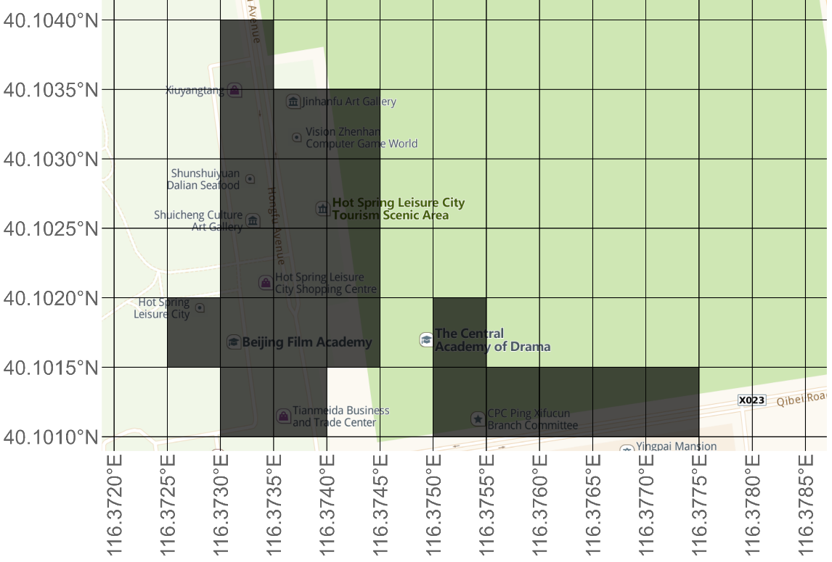
Fingerprint Set Construction
Four-step construction process
Map grid partitioning
Receptive region production

Slide 12
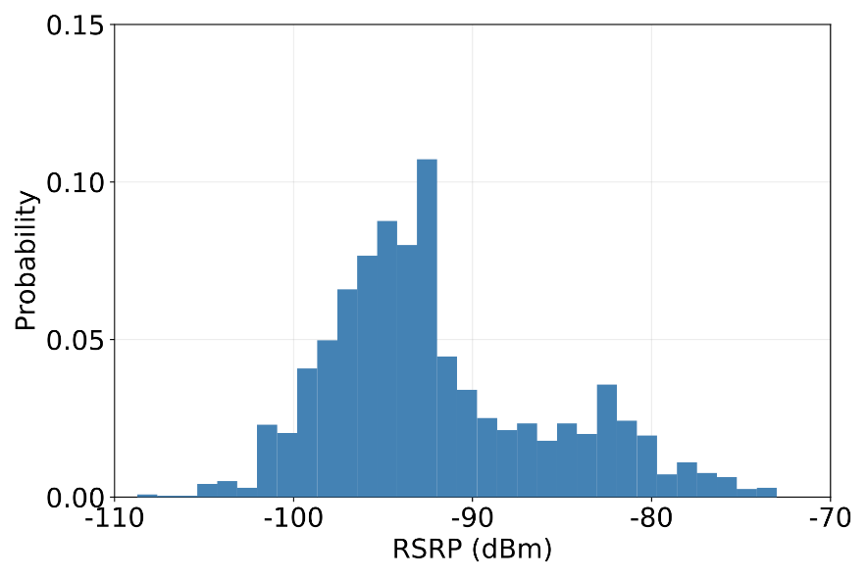
Fingerprint Set Construction
Four-step construction process
Map grid partitioning
Receptive region production
Cellular signature representation
Bucket-based Storing Mechanism not Gaussian distribution
We store cellular signatures as an INT64 integer for each grid cell

Slide 13
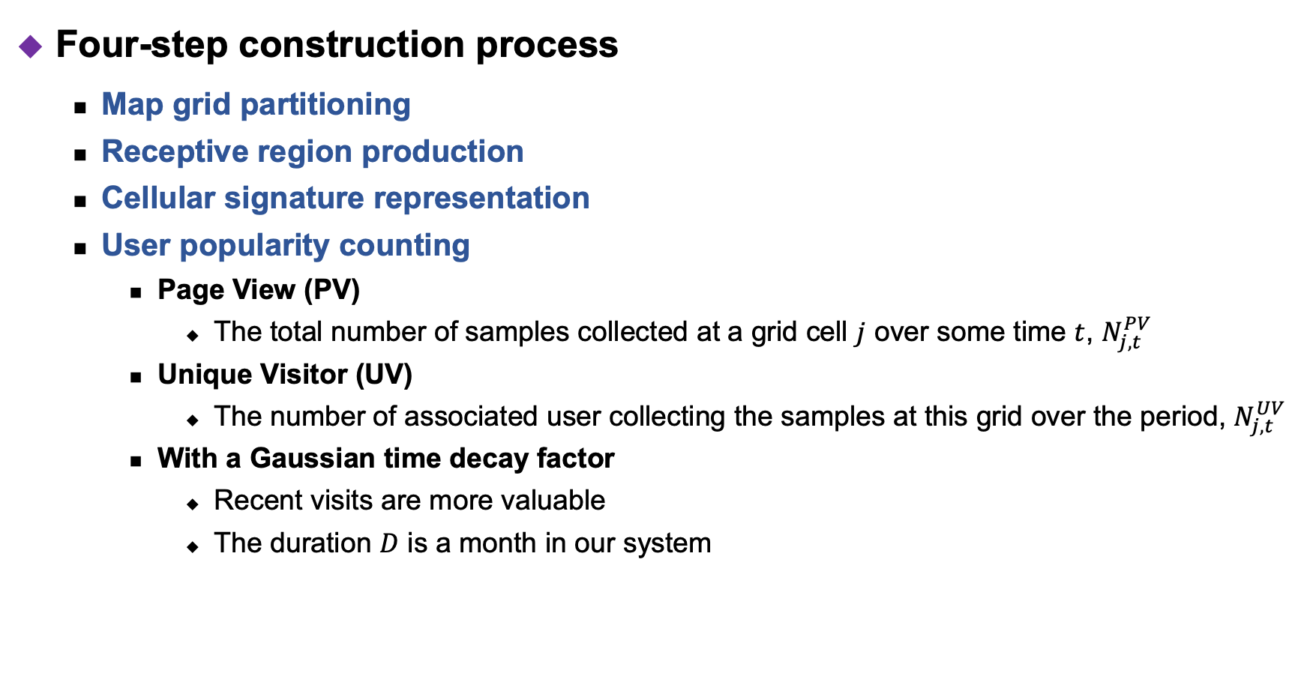
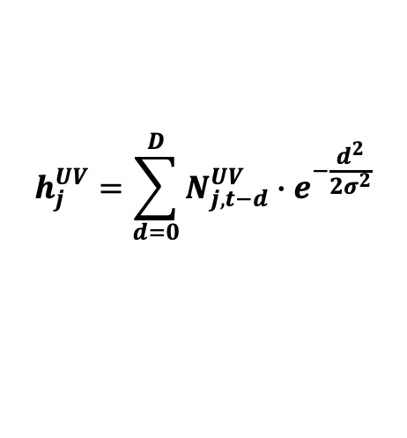
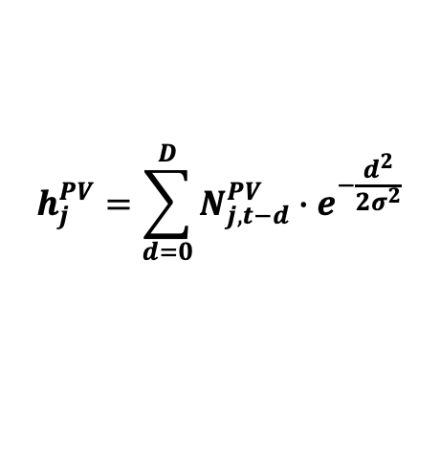
Fingerprint Set Construction
Four-step construction process
Map grid partitioning
Receptive region production
Cellular signature representation
User popularity counting
Page View (PV)
The total number of samples collected at a grid cell $j$ over some time $t$, $N_{j,t}^{PV}$
Unique Visitor (UV)
The number of associated user collecting the samples at this grid over the period, $N_{j,t}^{UV}$
With a Gaussian time decay factor
Recent visits are more valuable
The duration $D$ is a month in our system
$$h_{j}^{PV}=\sum_{d=0}^{D}{N_{j,t−d}^{PV}∙e^{−\frac{d^{2}}{2σ^{2}}}}$$
$$h_{j}^{UV}=\sum_{d=0}^{D}{N_{j,t−d}^{UV}∙e^{−\frac{d^{2}}{2σ^{2}}}}$$

Slide 14
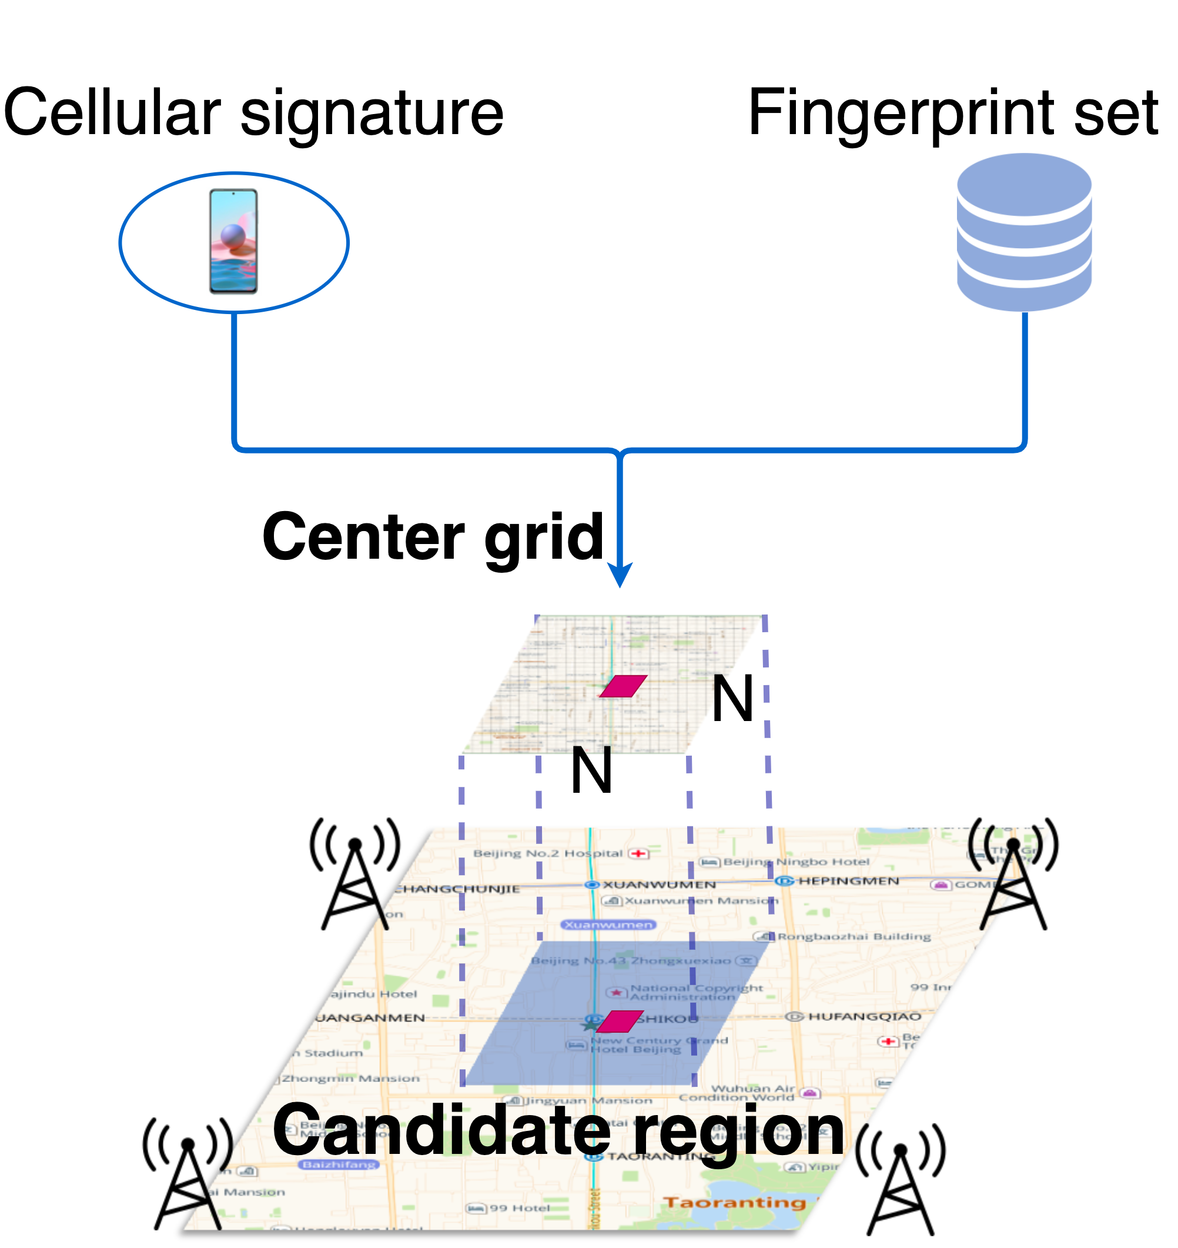
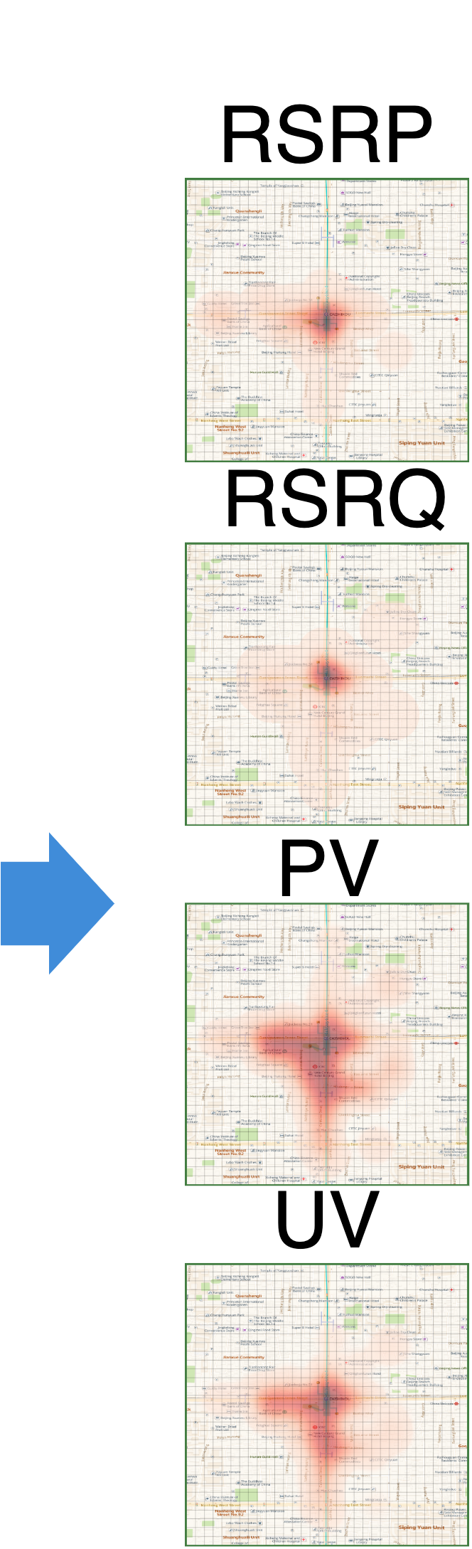
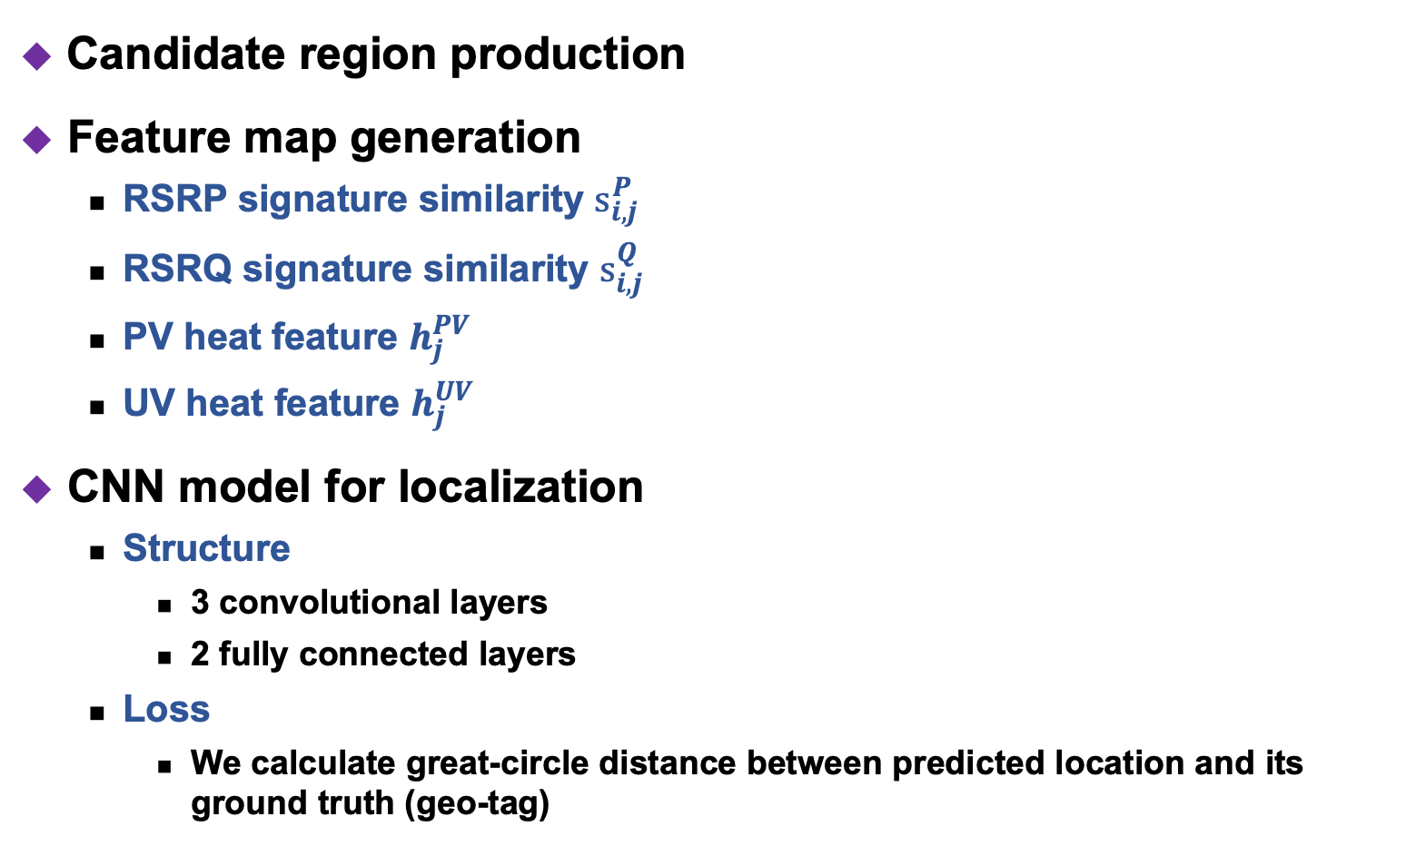
Real Time Localization
Candidate region production
Feature map generation
RSRP signature similarity $s_{i,j}^{P}$
RSRQ signature similarity $s_{i,j}^{Q}$
PV heat feature $h_{j}^{PV}$
UV heat feature $h_{j}^{UV}$
CNN model for localization
Structure
3 convolutional layers
2 fully connected layers
Loss
We calculate great-circle distance between predicted location and its ground truth (geo-tag)

Slide 15
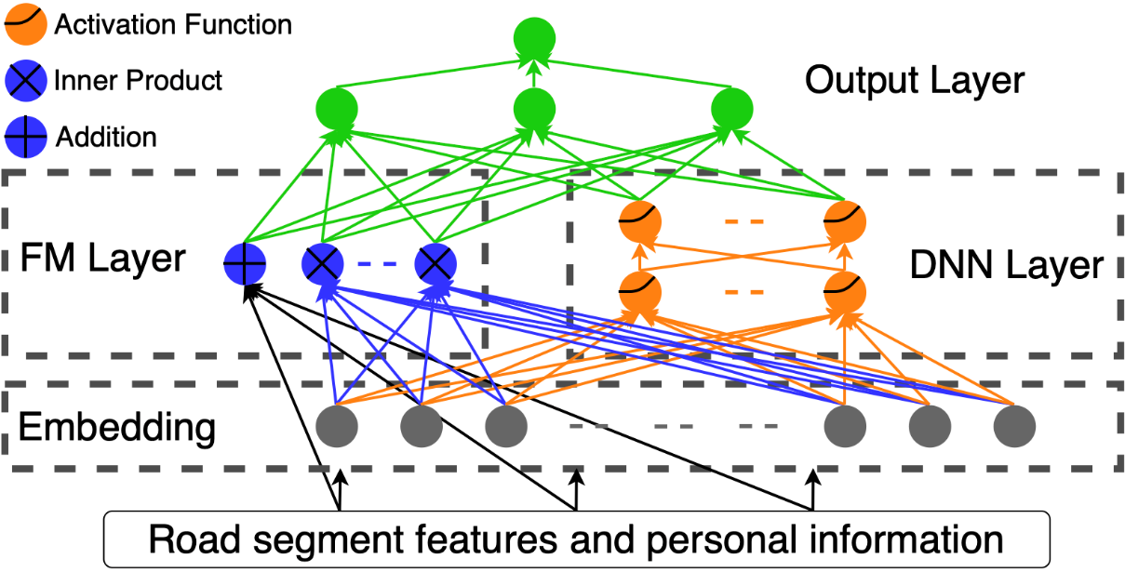
Pickup Recommendation
Road discretization
Candidate estimation
Customized recommendation
Stage 1: Pairwise ranking instead of binary classification
Stage 2: Deep neural model
DeepFM model
Pickup position
Candidates

Slide 16
Evaluation: Data Set Collection
Past 2 years
~50M orders, ~13M devices
918 brands, and ~9300 models of smartphones
4541 cities in China
Only focusing on Android platform
iOS provides its built-in cellular localization service

Slide 17
Evaluation Metrics
Pickup position error
The distance between recommended and actual pickup positions
Over-30-meters ratio
The ratio of the pickup position error higher than 30 meters
Cancel ratio
The passengers cancel the order
Call ratio / Long call ratio
Call between passengers and drivers
Long call means the duration exceeds 60s
Pickup Position Error | 0~30m | 30~50m | 50~100m | >100m
Call Ratio | 17.76% | 33.28% | 48.28% | 69.87%
Long Call Ratio | 0.74% | 4.30% | 10.61% | 27.08%

Slide 18
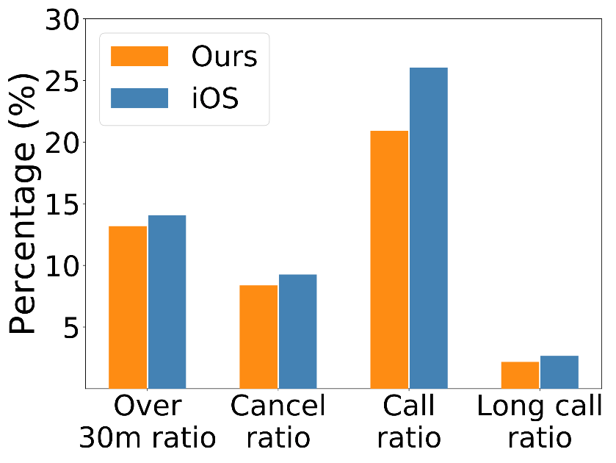
Overall Performance
Compared with iOS
iOS advantages (Our)
System-level privilege (Application-level)
Homogeneous environment ( Numerous manufacturers)
Compared with alternatives
DCCP, DeepLoc
NBL, GMM, CID
Compared with DMM
Precision increased by 9.43%
Recall increased by 8.41%

Slide 19
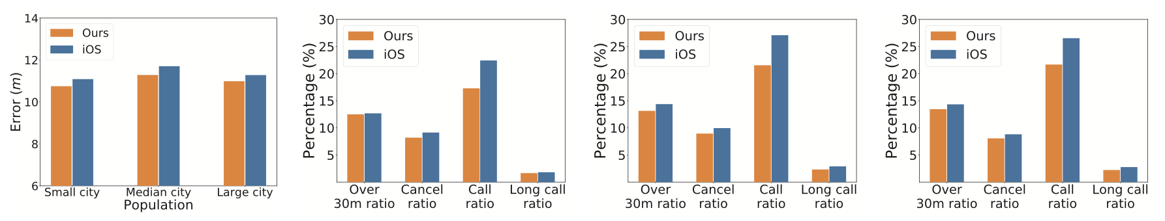
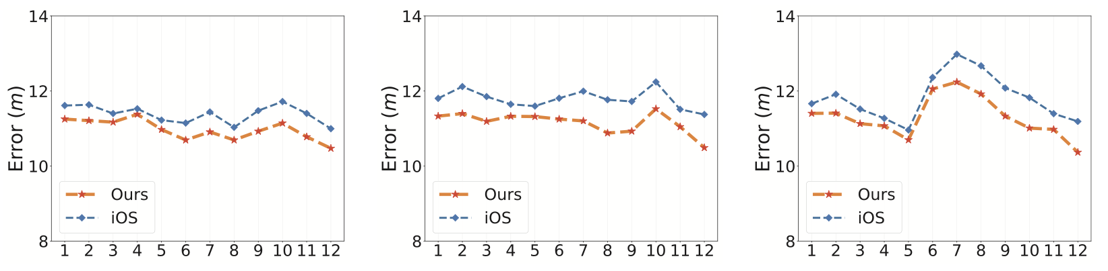
Evaluation Details (1/4)
Performance across different scale of cities
Performance among 12 months at three typical cities

Slide 20
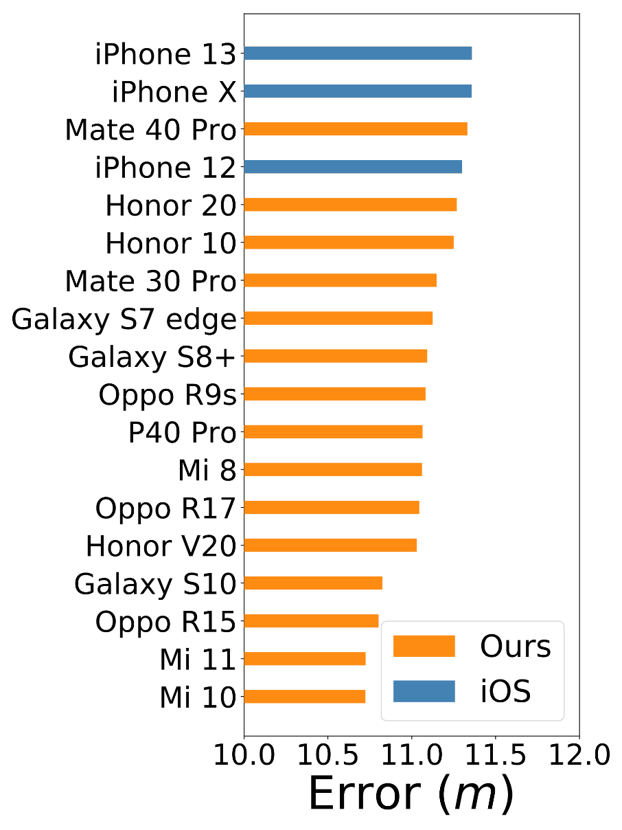
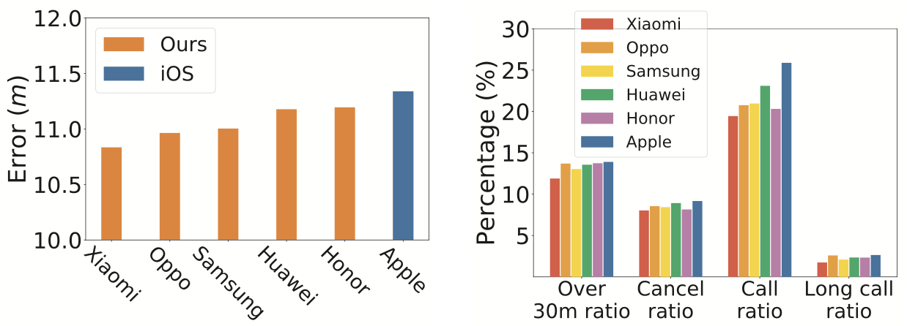
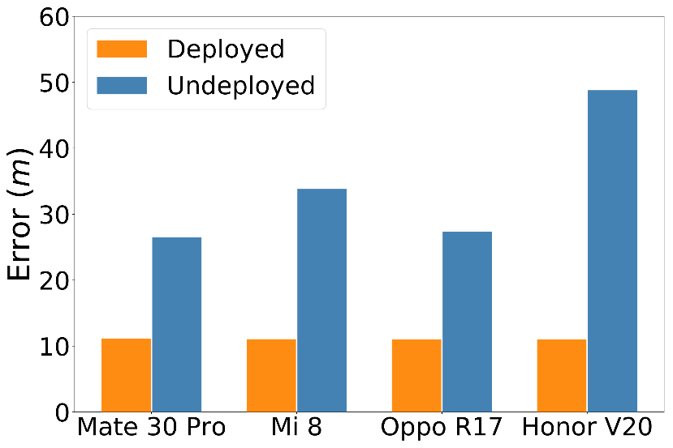
Evaluation Details (2/4)
Performance of different phone brands and models

Slide 21
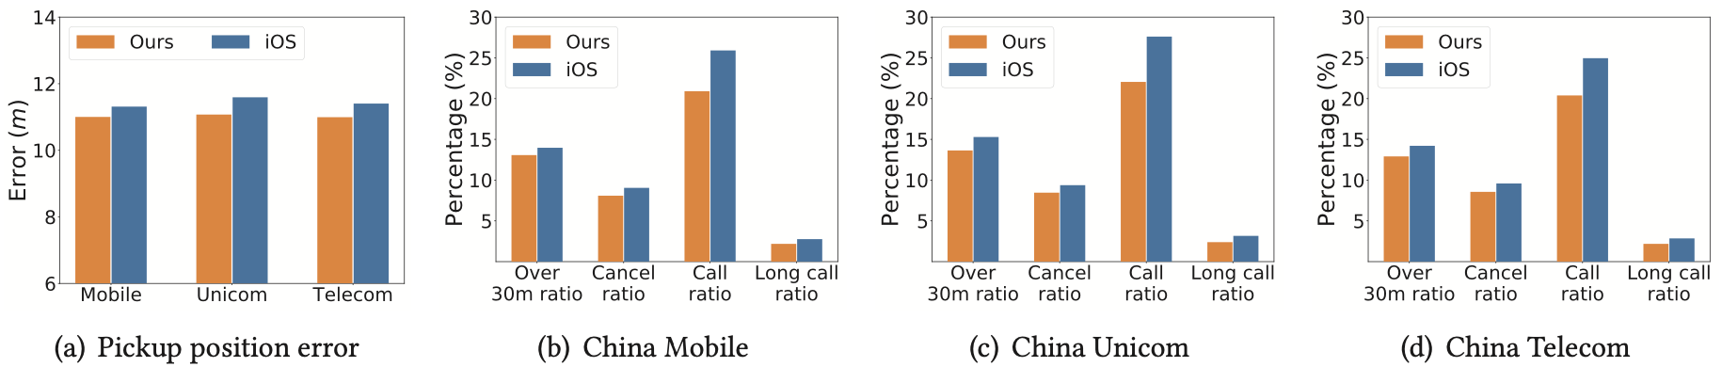
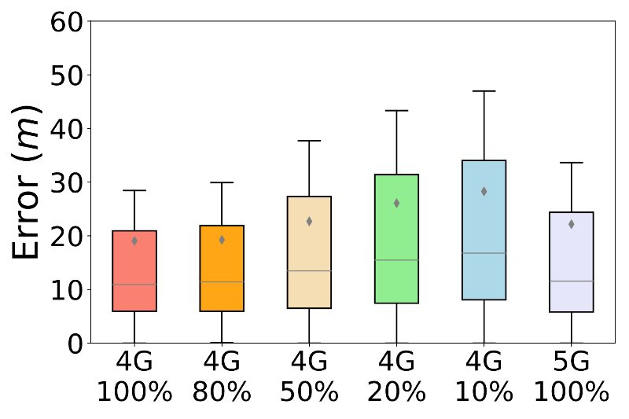
Evaluation Details (3/4)
Performance across different service providers
Comparison between 4G LTE and 5G NR
4G LTE network with different fingerprint density

Slide 22
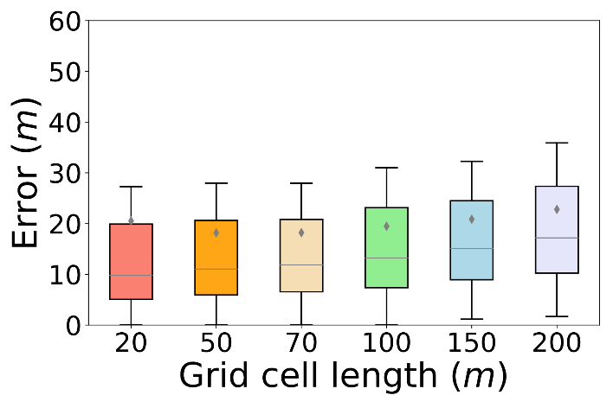
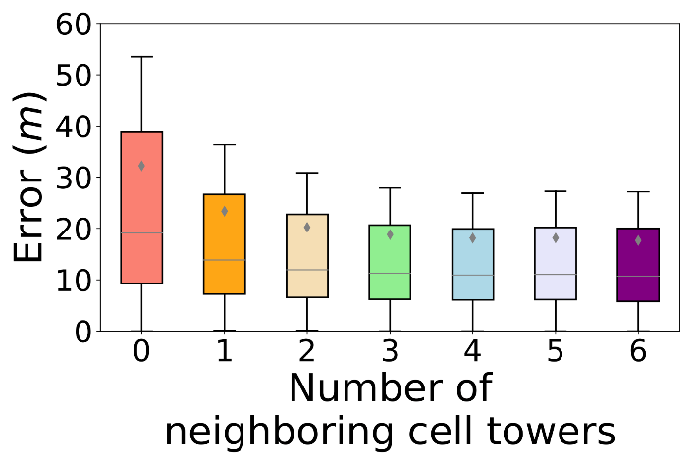
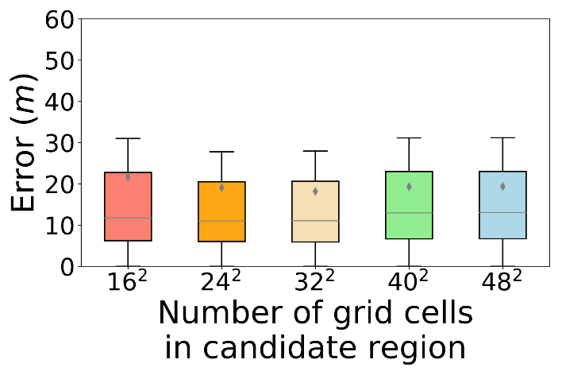
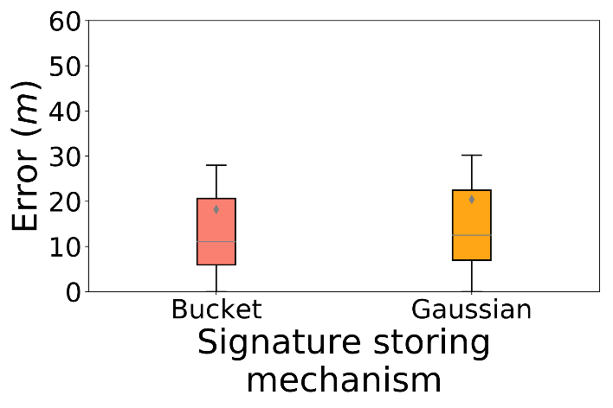
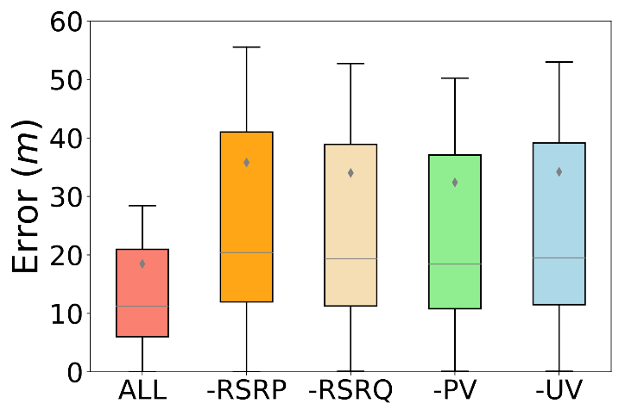
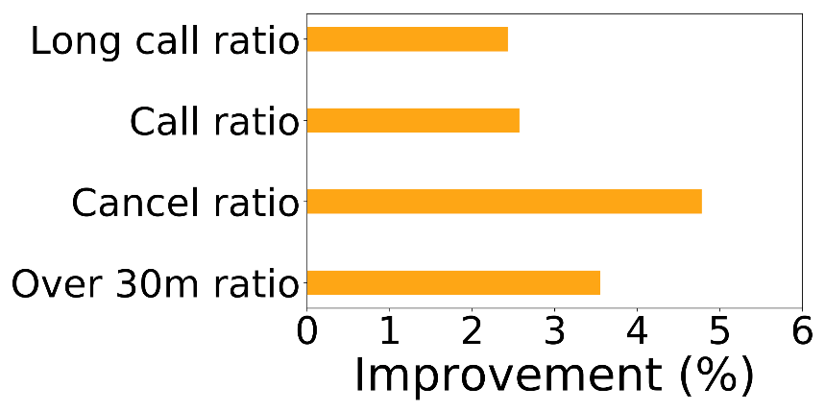
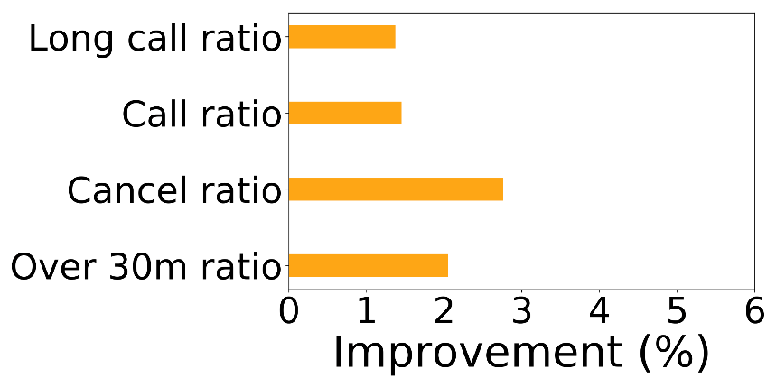
Evaluation Details (4/4)
Effect of localization hyper-parameters
CNN features and recommendation stage comparison

Slide 23
Conclusion
Summary
Practical Deployment and Evaluation
A dataset of 50 million travel orders across 13 million devices, spanning 4,541 cities
Novel Crowdsensing Approach
No need for labor-intensive indoor fingerprint collection
New Service Metrics for Large-scale Evaluation
Pickup position error, over-30-meters ratio, cancel ratio, and call ratio
Future work
Abnormal cell towers detection
Anomaly detection by Generative Adversarial Networks (GAN)

Slide 24
Thanks!
Q & A

