Slide 1
DDB Midterm Report
Leader: Puyun Hu
Members: Changqing Miao, Yanran Zhang
November 21(st), 2022

Slide 2
Work Assignment
Puyun Hu
Design and Implementation of Distributed Network System.
Changqing Miao
Intergrate works from Hu and Zhang.
Yanran Zhang
Design and Implementation of SQL-Parser.

Slide 3
Distributed Network Design
CLI
cmd@python
Send SQL string to Parser.
Parser
Parse SQL into SQLs on different fragments.
Execute SQLs through RPC@Seastar.
Assemble the results.
Local Database:
Sqlite@cpp
node0
node1
node2
node3
CLI
CLI
CLI
CLI
TCP
Parser
Parser
Parser
Parser
RPC
Local DB
Local DB
Local DB
Local DB

Slide 4
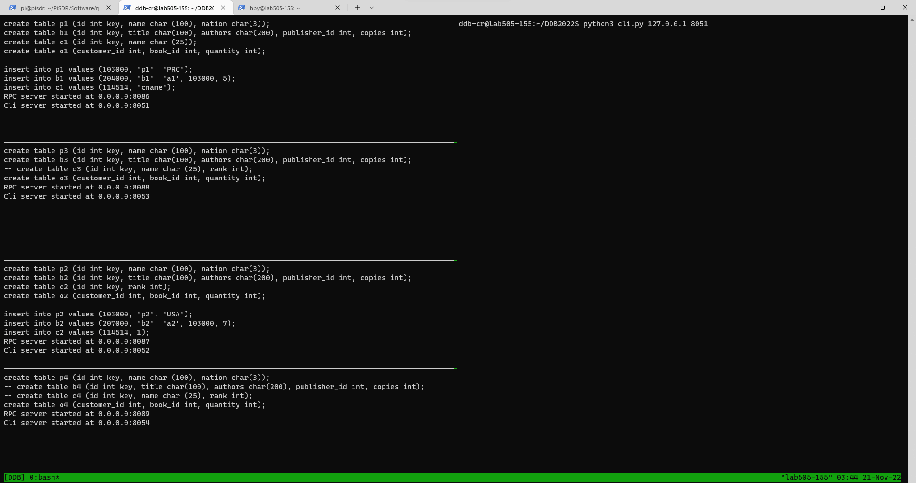
Example
Horizontal Fragment:
b1: (204000, ‘b1’, ‘a1’, 103000, 5);
b2: (207000, ‘b2’, ‘a2’, 103000, 7);
Vertical Fragment:
c1: (114514, ‘cname’);
c2: (114514, 1);

Slide 5
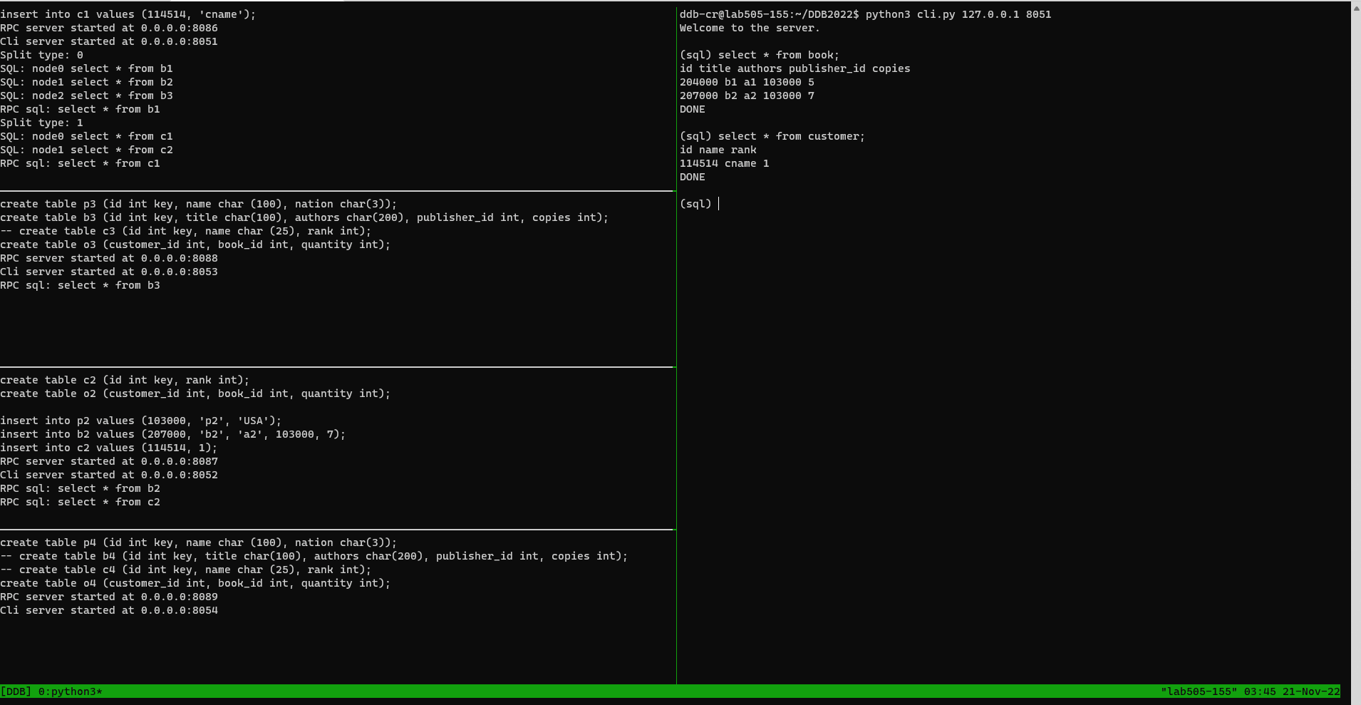
Example
Correct SQL execution on:
- Different sites.
- Different fragments.
Recieved correct result.

Slide 6
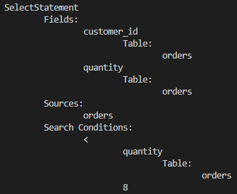
SQL-Parser Design
SQL-Parser
Adopt git@github.com:hyrise/sql-parser.git for basic design
Given a SQL query
E.g select orders.customer_id, orders.quantity from orders where orders.quantity < 8;

Slide 7
SQL-Parser Design
SQL-Parser
Target1: Import and allocate data by sql-like statements
E.g. create table
Target2: Find required fragments by parsing a select statement
Input: a select statement
Output: a set of required fragments
Target3: Generate query tree (plan)
Undone

Slide 8
SQL-Parser Design
SQL-Parser
Assumptions:
Attributes are formatted as <table>.<column>
E.g. orders.customer_id
In where clause, each condition is a triple
E.g. orders.quantity < 8
The mapping of primary key and foreign key is unique

Slide 9
SQL-Parser Design
SQL-Parser
Target1: Import and allocate data by sql-like statements
Normal Statements: Execute directly, parsed by the hyrise/sql-parser
Create Fragment Statements
Fragment properties
Create Fragment Statement
SQL-Parser
Python Script
Execute normal sql statement
Handle
metadata
Publisher1
Publisher2
Normal Statement
（E.g. create table）
Publisher.txt
Local Database
Publisher3
Publisher4

Slide 10
SQL-Parser Design
SQL-Parser
Target1: Import and allocate data by sql-like statements
Normal Statements: Execute directly, parsed by the hyrise/sql-parser
Create Fragment Statements
E.g. create <v/h>fragment <frag_name> [by <columns>] from <tables> [where <conditions>] on <site_name>
Horizontal / Vertical fragmentation use different statements
Extract <parameter> by parsing string
Convert into valid select statement and parse
Horizontal: select * from <tables> [where <conditions>]
Vertical: select <columns> from <tables>

Slide 11
SQL-Parser Design
SQL-Parser
Target2: Find required fragments by parsing a select statement
Input: a select statement
Output: a set of required fragments
SELECT-Parse
Divide into: select caluse, from caluse, where caluse
map<string, map<string, vector<ExprTriple> > > FT; // 表名-分片名-分片条件：三元组vector
map<string, int> howToFrag; // 表名-分片方式
map<string, string> primaryKey; // 表名-主键
map< pair<string, string>, set< pair<string,string> > > keyMap; // 主键-外键映射关系，双向 (table, clomun) -> (table, clomun)

Slide 12
SQL-Parser Design
SQL-Parser
select caluse
Find all the selected attibutes
vector< pair<string, string> > select_attributes;
from caluse
Find all involved tables
vector<string> tables;
Initialize a set of fragments for iteration
Horizontal tables: choose all fragments
Vertical tables: choose fragment according to select caluse

Slide 13
SQL-Parser Design
SQL-Parser
where caluse: filter useless fragments
Use triple to present each condition
Consider three situations:
Value comparison
E.g book.id > 105000
String equation
E.g publisher.nation = ‘PRC’
Attribute connection
E.g book.id = orders.book_id
// 运算表达式 A op B 三元组
// 我们假设左操作数一定为Table.Column类型
struct ExprTriple {
// 左操作数
int leftValType; // 0 - number, 1 - string, 2 - table.attribute
string leftTable;
string leftColumn;
// 操作符
int opType;
// 右操作数
int rightValType;
int rightVal;
string rightStr;
string rightTable;
string rightColumn;
};

Slide 14
SQL-Parser Design
SQL-Parser
Target2: Find required fragments by parsing a select statement
Select Statement
Involved Fragments
Generate
Fragment properties
Create Fragment Statement
SQL-Parser
Python Script
Execute normal sql statement
Handle
metadata
Publisher1
Publisher2
Normal Statement
（E.g. create table）
Publisher.txt
Local Database
Publisher3
Publisher4

Slide 15
SQL-Parser Design
SQL-Parser
Target3: Generate query tree (plan)
Undone
Select Statement
Involved Fragments
Something
Query Tree (Plan)
Generate
Fragment properties
Create Fragment Statement
SQL-Parser
Python Script
Execute normal sql statement
Handle
metadata
Publisher1
Publisher2
Normal Statement
（E.g. create table）
Publisher.txt
Local Database
Publisher3
Publisher4

Slide 16
Thank you
Q&A

