Slide 1

Brick Breaker
By Dart Monarch

Slide 2
Problem
People often need short, engaging activities to pass time and prevent feelings of restlessness and monotony.
Solution
Like many games, brick breaker can serve as a form of entertainment and stress relief, providing an enjoyable way to unwind and relax.

Slide 3

PACT Framework
People
Activities
Context
Technology

Slide 4
Student elementary to college people who likes to kill their boredom. Employers work in private or government agencies who likes to lessen their stress or boredom, normal people Unemployed and professionals who experience bored
PACT Framework
People

Slide 5
The players engage of playing the brick breaker game which involves controlling a paddle to bounce a ball and break bricks. Playing the game challenge to lessen the stress and boredom of the user, the app provides user-friendly interface that can accommodate all the users that will download the app.
PACT Framework
Activities

Slide 6
The game can be installed on a gadget with low ROM, allowing for accessibility on a variety of devices.
PACT Framework
Context
It can be played offline, ensuring that entertainment even in areas with limited connectivity.
The game's simple design enhances its accessibility and ease of use for all players

Slide 7
- App is suitable for all who download the app from kids to adult - User-friendly interface - Figma - Flutter framework
PACT Framework
Technology

Slide 8
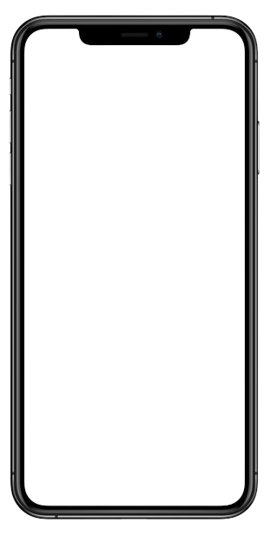
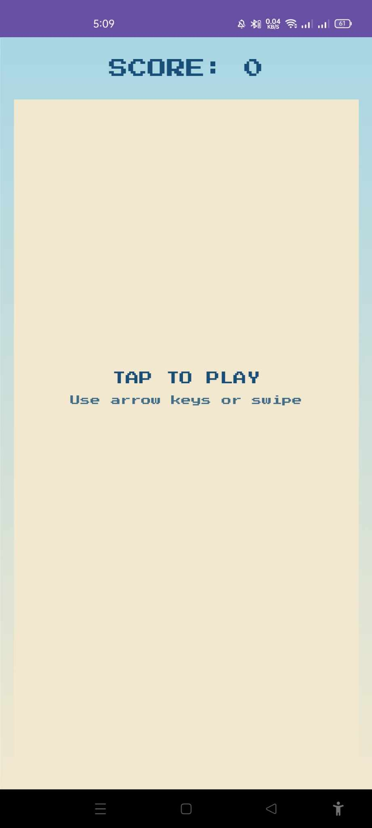
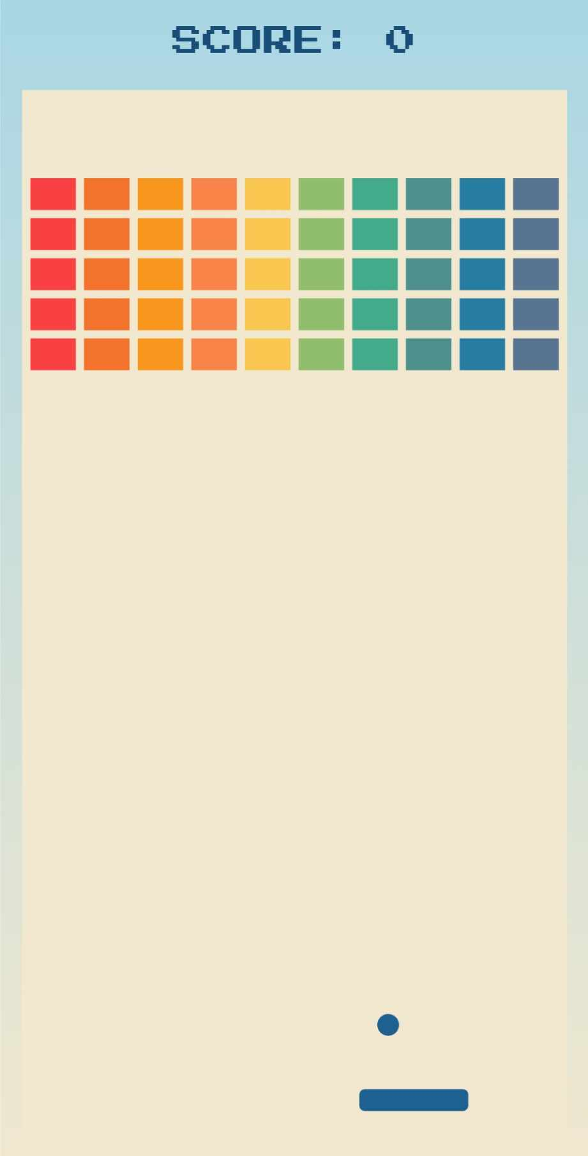
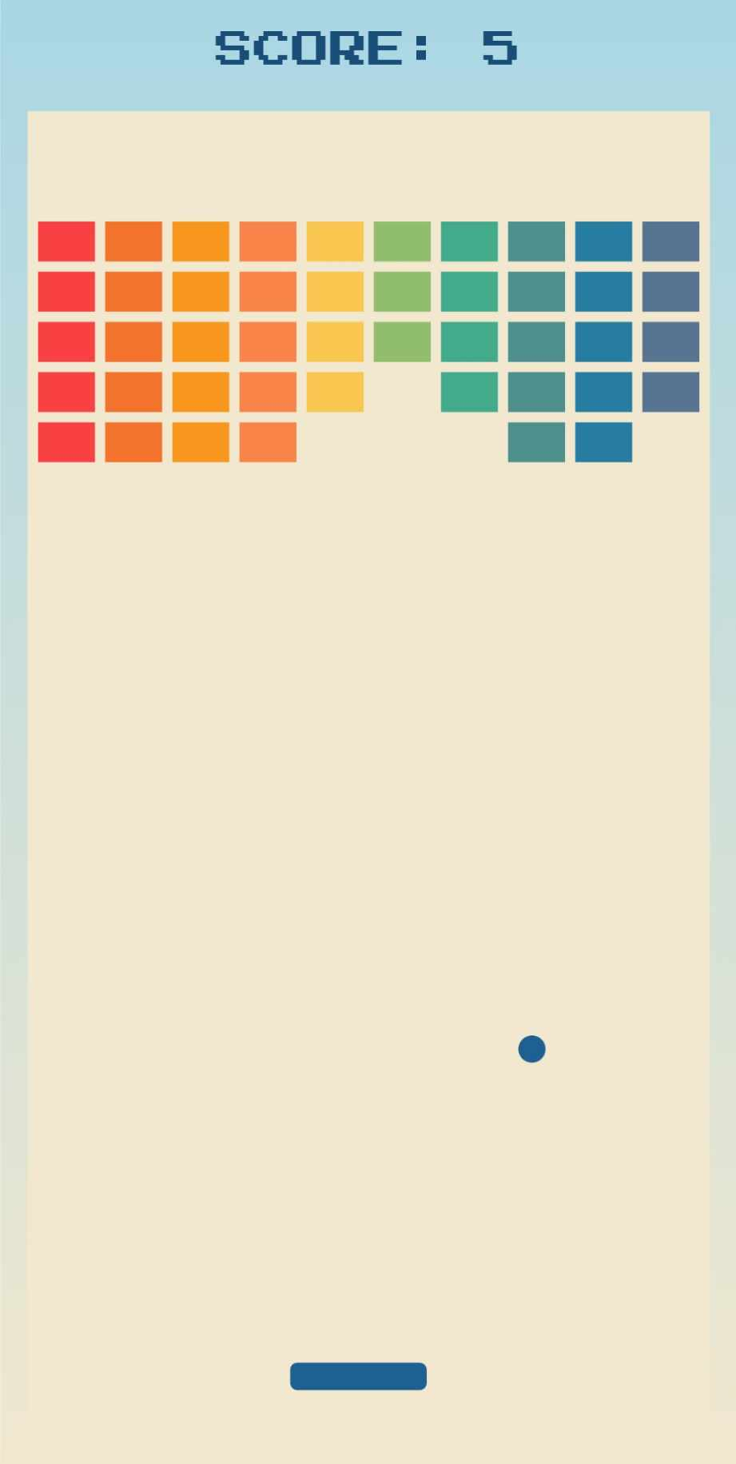
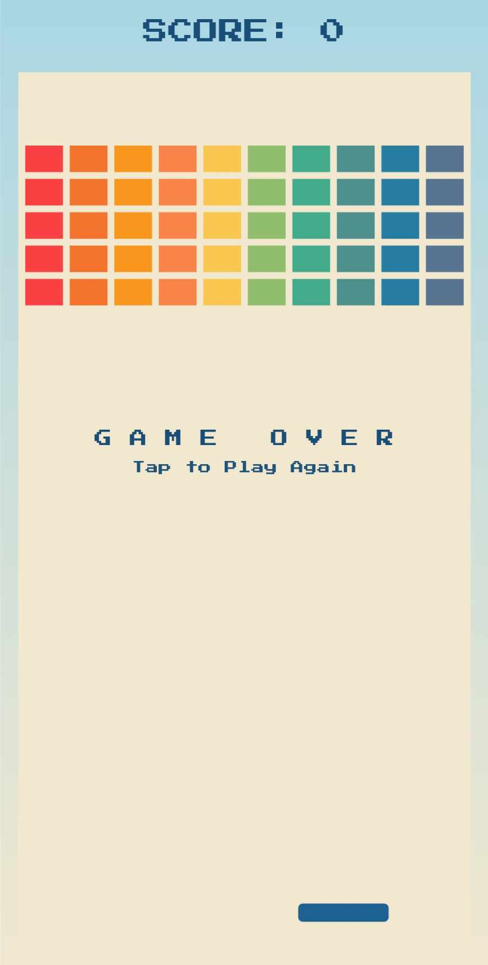
Figma Layout

Slide 9
Demonstration

Slide 10
Thank You

