Slide 1
Cloud Native Fundamental Project
Judith Edhogbo

Slide 2
Introduction
Speaker: Judith Edhogbo
Objective:to create a CRUD (Create Read Update Delete) application using all the concepts and skills acquired in the first six weeks in QA academy.
Solution: Recipe Collection web application

Slide 3
content
Planning
Technologies used
Demonstration
Future work
Summary
Q&A

Slide 4
Planning
Judith Edhogbo

Slide 5
Requirements
planning
Jira board
Clear Documentation
Risk Assessment
Relational database
Functional application in Java
Front-end website and integrated API
Fully designed tests
Version Control System
CI server
Application deployed to a cloud-based virtual machine

Slide 6
MOSCOW approach
planning
Must Have
CRUD functionality at least for the recipes
Database
Circle CI
App running on a virtual machine spinning in the Google Cloud Platform
Clear documentation and planning
Should Have
Multiple html pages
Wont have
User login feature
Advance design on the front end

Slide 7
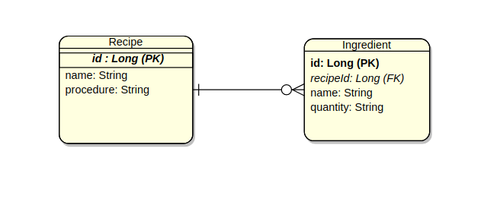
planning
Recipes Collection

Slide 8
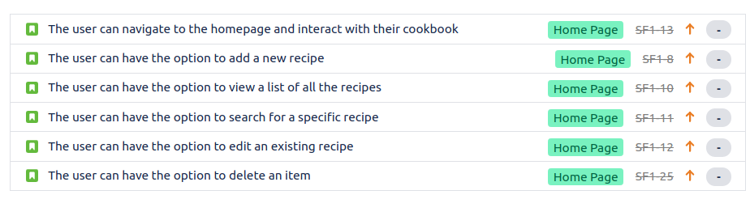
Jira Board
planning
The planning of the project was essential in order to meet the MVP (Minimum Viable Product). The project tracking tool used was a Jira board which allows to produce epics which have user stories with tasks related to them

Slide 9
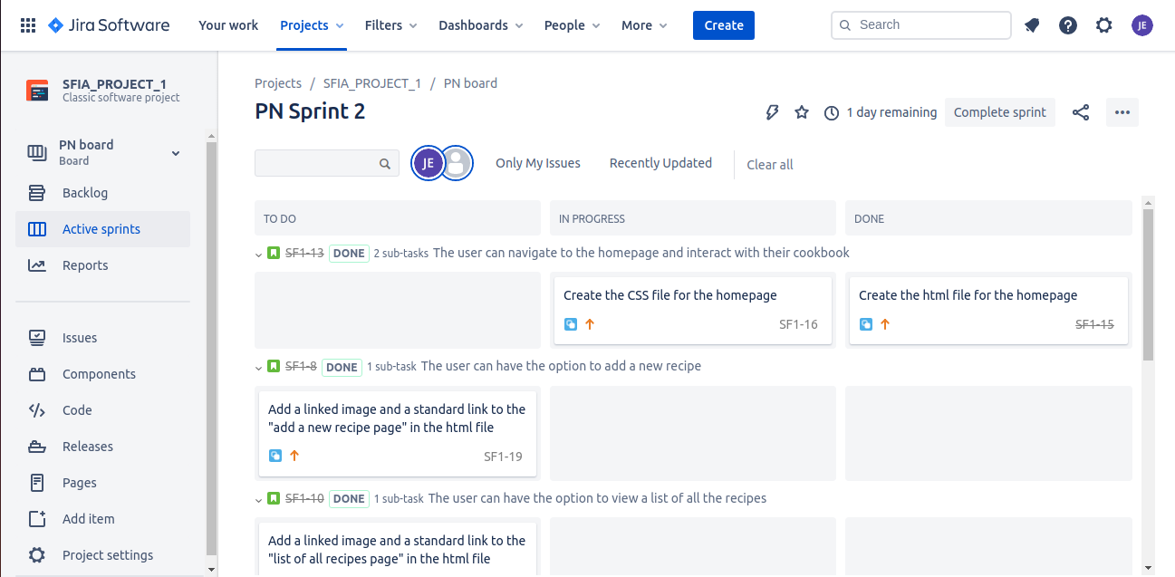
Jira board
planning
In order to interact with the tasks dynamically, "sprints" were created. These are a good way to keep track of the progress of the project because it allows to classify the tasks as "to do", "in progress" or done.

Slide 10
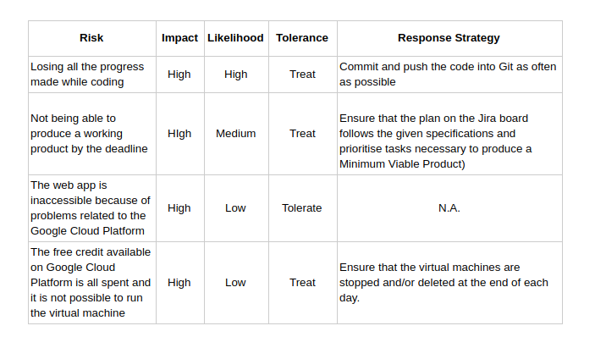
Risk assessment
planning
In order to avoid unexpected issues from happening, a risk assessment table was produced that showed potential threats to the project and the mitigation strategy chosen.

Slide 11
Technologies used
Judith Edhogbo

Slide 12
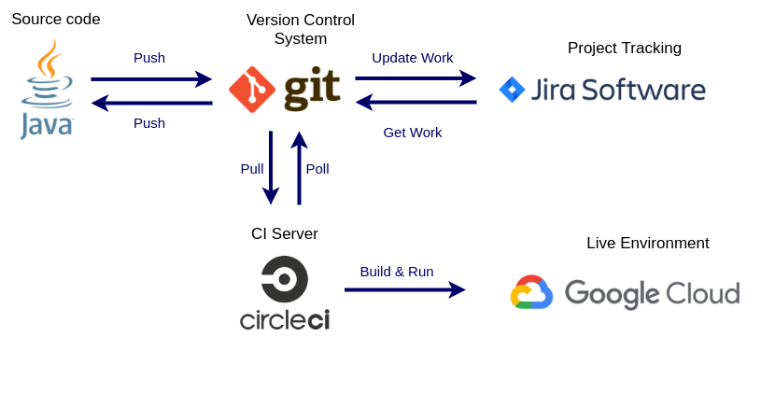
Technologies used
CI pipeline
The following figure shows which technologies were used and the relationship between them.
https://github.com/JudithEdh/QA-Fundamental_Project
https://judithedh.atlassian.net/secure/RapidBoard.jspa?rapidView=1&view=planning&selectedIssue=SF1-22&issueLimit=100

Slide 13
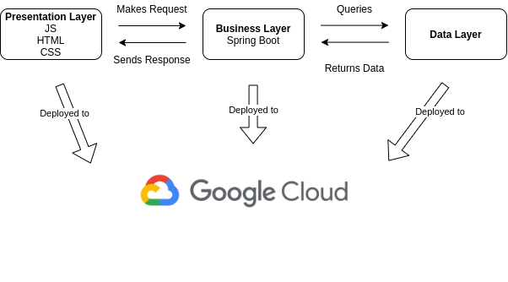
Technologies used
Multi-Tier architecture

Slide 14
Demonstration
Judith Edhogbo

Slide 15
Demonstration
Circleci
Website
Build
Deploy
CRUD Recipe
CRUD Ingredients
Circle CI deploys app into vm
Circleci
The website becomes accessible
Homepage

Slide 16
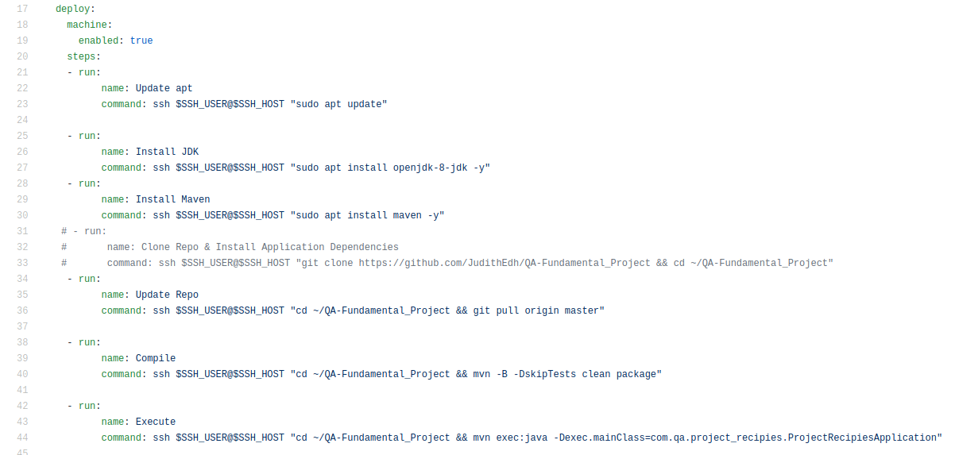
.yml file
Demonstration

Slide 17
Summary
What went well for the project: application running fully integrated in Circle CI
What didn't go so well for the project: not enough interaction with the Jira board
What could you have done differently: do not wait to understand everything before planning the project
Best things you learned from this project: with some hard-work and good planning, even the most complex task can be overcomed
Cloud native Fundamental Project
Judith Edhogbo

Slide 18
Future work
Improved graphics
At the moment, the web application looks basic so the design aspect of the web-pages could be improved.
Extra functionality
Creating a shopping list that can be downloaded based on the ingredients of a recipe
User login

Slide 19
Thank you for listening

Slide 20
Q&A
Judith Edhogbo

