Slide 1
Match
Gap
A C G T C
A T – T C
Sequence 1
Sequence 2
Mismatch

Slide 2
A C G T C
A T – T C
Sequence 1
Sequence 2
1 -1 -1 +1 +1 = 1

Slide 3
BLOSUM 45
PAM 250
BLOSUM 62
PAM 160
BLOSUM 80
PAM 100
More divergent
Less divergent

Slide 4
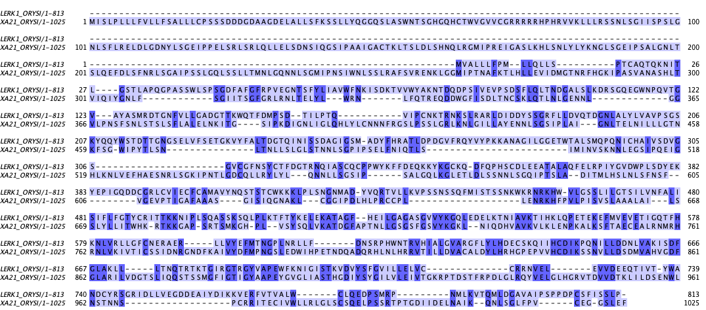
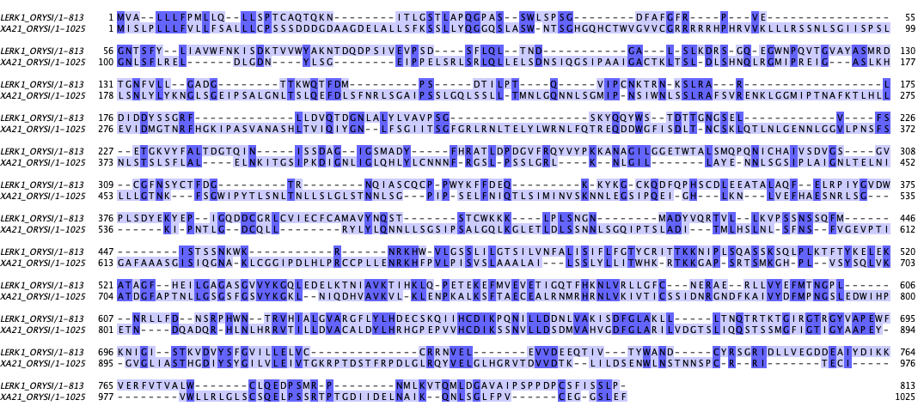
A
B

Slide 5
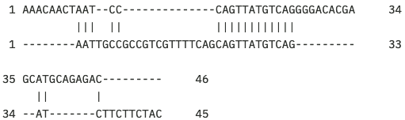

Global alignment
Local alignment
Notes:
AAACAACTAATCCCAGTTATGTCAGGGGACACGAGCATGCAGAGAC
AATTGCCGCCGTCGTTTTCAGCAGTTATGTCAGATCTTCTTCTAC

