Slide 1

Larana, nc.
About
Process
Tools
Applications
Project Plus

Slide 2

Our Team
Cahaya Dewi
Juliana Silva
Estelle Darcy
Aaron Loeb

Slide 3
Problem Statement
“Learning environments that encourage interaction improve student engagement.”
•Student engagement plays a key role in learning success and skill development
•Education is shifting from traditional teaching to interactive, technology-based learning environments
•It is not clearly proven whether these interactive methods actually improve student engagement
•Therefore, it is important to analyze the relationship between learning environment and student engagement

Slide 4

Objectives
•To analyze the relationship between learning environment and student engagement
•To evaluate the impact of interactive learning on student participation and performance
•To statistically test whether interactive environments improve engagement
•To use data analysis techniques to support the research findings

Slide 5
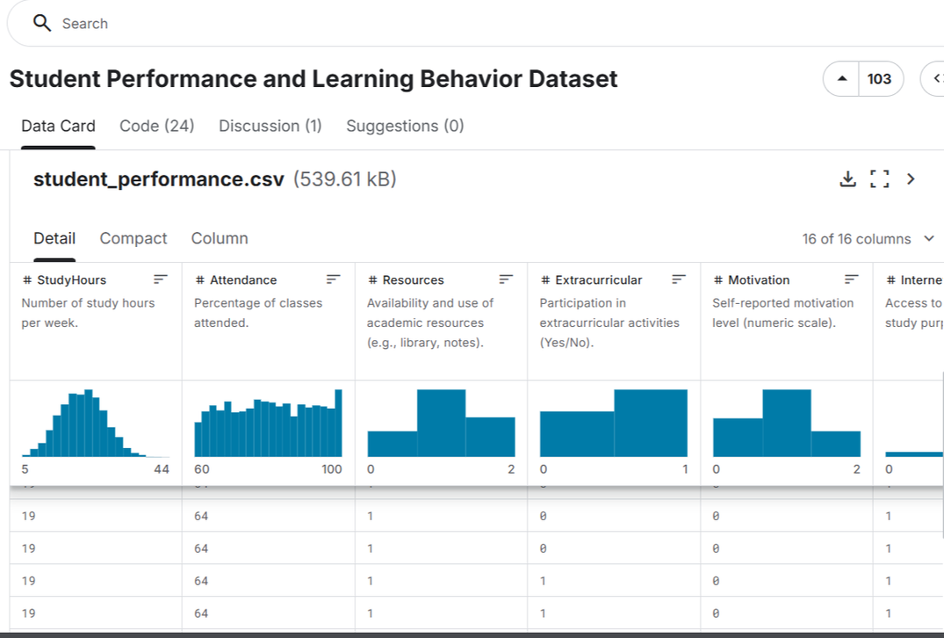
Data Collection
•The dataset was obtained from Kaggle as secondary data
•It was already collected in a structured and reliable format
•The dataset includes relevant variables such as engagement score, participation rate,
and teaching method
•Secondary data was used to save time and support statistical analysis efficiently

Slide 6
Data Preprocessing
•Loaded and imported the dataset into R for analysis
•Cleaned column names into a standard format for easier processing
•Converted categorical variables into factors (e.g., gender, teaching method)
•Identified and separated numeric variables for statistical analysis
•Created learning_environment_score by combining key environment factors
•Removed constant variable (no variation) to improve analysis accuracy
•Checked for missing values and duplicates (none found)
•Used summary statistics and boxplots to understand data distribution

Slide 7
Descriptive Analysis
Histogram:
•Engagement score ranges from 50–100 and shows clustered distribution (not normal)
Histogram:
•Participation rate ranges from ~50–105, also shows non-normal clustered pattern
Histogram:
•Assignment completion time ranges from 20–60 minutes, showing variation in performance
Boxplot:
•Engagement and completion time show wide spread
•Learning environment score is stable (~2.0–3.0) with low variation

Slide 8
Scatter Plot:
•Participation vs Engagement → very strong positive relationship
•Completion Time vs Engagement → strong negative relationship
Group Comparison (Boxplot):
•Teaching methods show similar engagement levels (no major difference)
Q-Q Plot:
•Data is not normally distributed
About
Process
Tools
Applications

Slide 9
Inferential Analysis
t-test :
•Compared engagement between teaching methods
•No significant difference (p = 0.8047 > 0.05)
•Used Spearman correlation (data not normal):
•Participation → very strong positive relationship with engagement
•Completion time strong negative relationship with engagement
•Learning environment → moderate positive relationship
•Independent Variable Selection:
•Selected variables based on correlation strength and research relevance
•Key variables: participation rate, completion time, learning environment

Slide 10
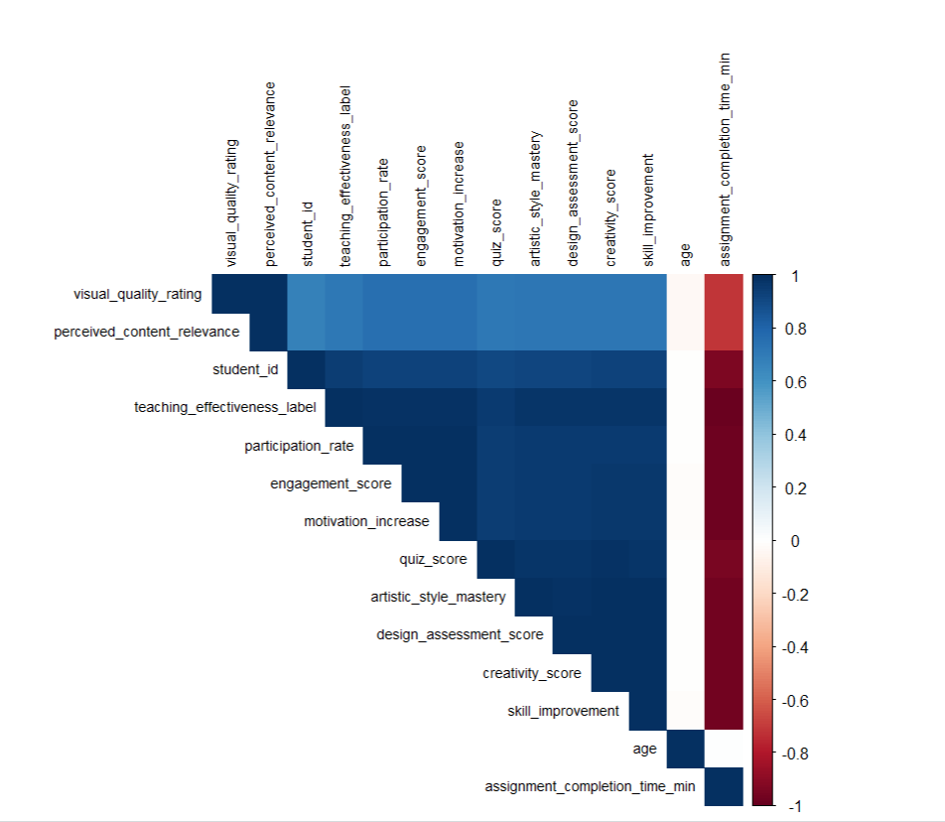
•Built multiple linear regression models
•Participation = strongest positive predictor
•Completion time = significant negative predictor
•Learning environment = smaller but significant effect
•Model explain ~99% variation (R² ≈ 0.99)
•Effect size (Cohen’s d) shows teaching method has negligible impact
•Mediation analysis (key finding)
Learning environment affects engagement mainly through:
Participation
Completion time
Larana, Inc.
Process
Tools
Applications

Slide 11
Predictive Model
•Used Linear Regression, Random Forest, and SVM models
•Data was split into 80% training and 20% testing
•Model performance evaluated using RMSE (prediction error)
•Results:
•Linear Regression → RMSE ≈ 1.29
•Random Forest → RMSE ≈ 1.22
•SVM → RMSE ≈ 1.22 (best model)
Built predictive models to estimate student engagement using key variables
•Learning environment score
•Participation rate
•Assignment completion time

Slide 12

Results
Teaching Method Effect
No significant difference between AIGC and Traditional
p-value = 0.8047 (> 0.05) → Not significant
Correlation Results
Participation vs Engagement → ρ ≈ 0.99 (very strong positive)
Completion Time vs Engagement → ρ ≈ -0.88 (strong negative)
Learning Environment vs Engagement → ρ ≈ 0.49 (moderate positive)
Regression Results
Participation coefficient ≈ +0.87 (strong positive effect)
Completion time coefficient ≈ -0.15 (negative effect)
Learning environment coefficient ≈ +0.41 (small positive effect)
Model accuracy: R² ≈ 0.9935 (99.35%)

Slide 13
Effect Size
Cohen’s d ≈ 0.009 → negligible effect of teaching method
Best predictive model: SVM(RMSE ≈ 1.22, highest accuracy)
Student engagement is mainly influenced by:
Participation (strong positive)
Completion time (strong negative)
Learning environment improves engagement:
Indirectly through participation and efficiency
Teaching method alone has no significant impact
Overall, the research confirms:
• Interactive learning environments improve student engagement mainly through interaction factors

Slide 14
Final Decision
Hypothesis
H₀ (Null Hypothesis):
Learning environments that encourage interaction do not improve student engagement
H₁ (Alternative Hypothesis):
Learning environments that encourage interaction improve student engagement

Slide 15
Results:
Results:
Teaching method shows no significant difference
(p = 0.8047) → method alone does not affect engagement
Participation has a very strong positive effect
Higher participation = higher engagement (ρ ≈ 0.99)
Completion time has a strong negative effect
More time = lower engagement (ρ ≈ -0.88)
Learning environment has a positive effect
Better environment = better engagement (ρ ≈ 0.49)
Model explains about 99% of engagement (R² ≈ 0.99)

Slide 16
Since the results show that interaction and learning environment significantly improve engagement,
we reject H₀ (no improvement) and accept H₁ (improvement exists), concluding that interactive learning environments improve student engagement

Slide 17
Conclusion
•Student engagement is mainly influenced by participation and interaction
•The learning_environment_score was created by combining key factors (teaching method, feedback, adaptive content, visual quality, relevance) to represent environment quality
•This learning environment shows a positive impact on engagement
•Teaching method alone is not a significant factor
•Interactive environments increase participation and improve efficiency
•Overall, interactive learning environments enhance student engagement

Slide 18
THANK YOU

