Slide 1
Spectrum Sensing using Improved Energy Detector (IED)
Presentation by
R.Sudharsana(31510106102) ECE-B
R.Tharini(31510106109) ECE-B
Supervisor :Ms. K.Muthumeenakshi M.E., (Ph.D)
Assistant Professor

Slide 2
Overview
Objectives
Motivation
Modified Energy Detector(MED)
Improved Energy Detector(IED)
Future Work Plans

Slide 3
Objective
To improve the performance of Classical Energy Detector (CED) for efficient spectrum utilization.

Slide 4
Motivation
Significant underutilization of the radio spectrum.
Cognitive radio is a prognosticating technology which primarily aims at improving spectrum utilization efficiency.
Spectrum sensing is a crucial component to the Cognitive radio. Hence, our focus is to improve the performance of spectrum sensing.

Slide 5
Work done in first Review
Analysis on various spectrum sensing methods.
Work done on classical energy detector(CED) -analysis and comparison of the theoretical and practical performance of CED

Slide 6
Classical Energy Detector
The spectrum sensing can be formulated as binary hypothesis testing problem as
H₀ : y(n) = u(n) , n=1,2,3,……,N
H₁ : y(n) = s(n) + u(n) , n=1,2,3,……,N
where
H₀ indicates the absence of Primary User.
H₁ indicates the presence of Primary User.

Slide 7
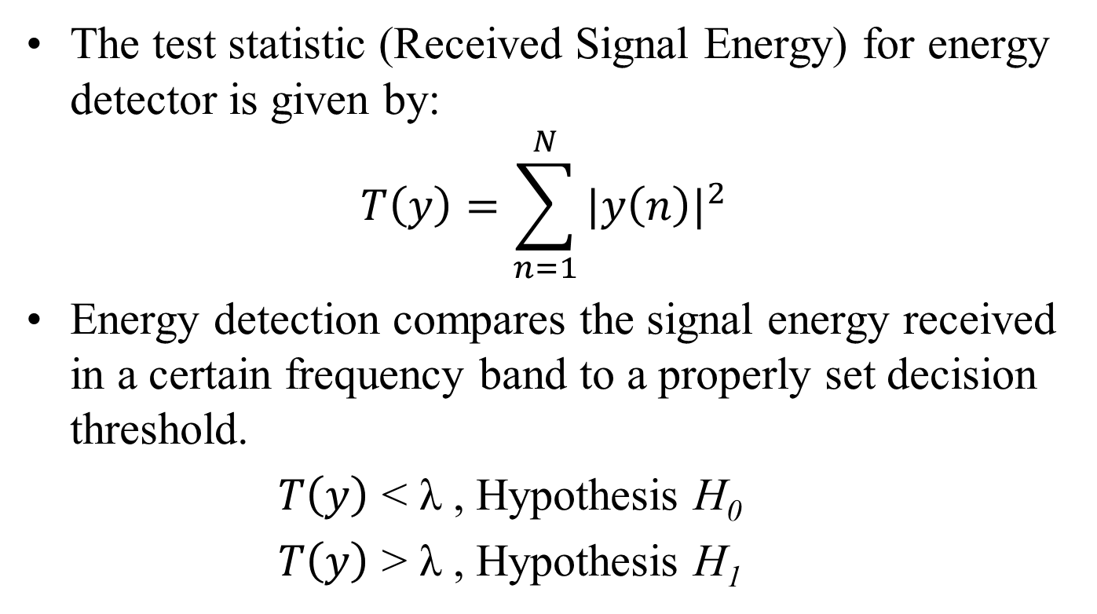
Classical Energy Detector
The test statistic (Received Signal Energy) for energy detector is given by:
$$T\left(y\right)=\sum_{n=1}^{N}{{|y\left(n\right)|}^{2}}$$
Energy detection compares the signal energy received in a certain frequency band to a properly set decision threshold.
$T\left(y\right)$ < λ , Hypothesis H₀
$T\left(y\right)$ > λ , Hypothesis H₁

Slide 8
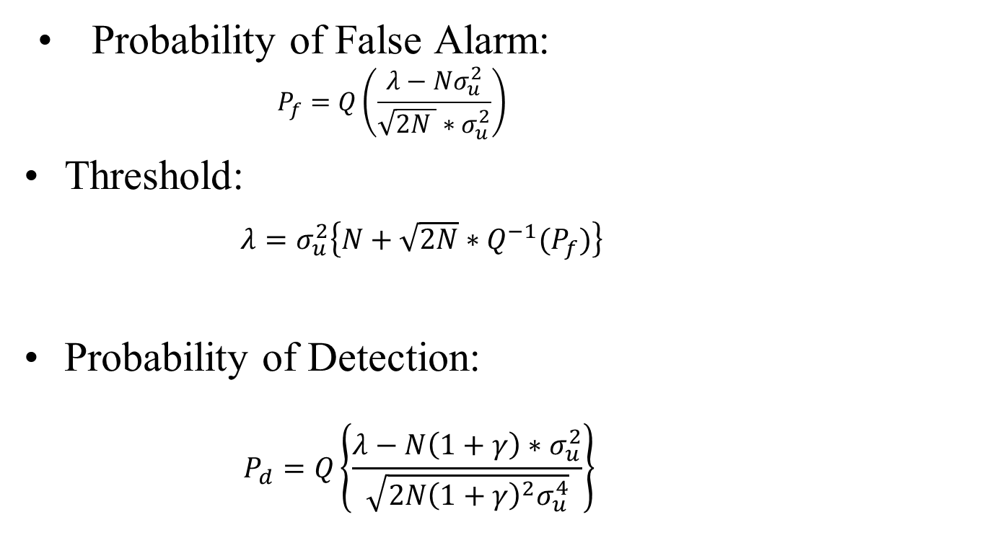
Classical Energy Detector contd…
Probability of False Alarm:
$$P_{f}=Q\left(\frac{λ−{Nσ}_{u}^{2}}{\sqrt{2N }∗σ_{u}^{2}}\right)$$
Threshold:
$λ=σ_{u}^{2}\left\{N+\sqrt{2N}∗Q^{−1}(P_{f})\right\}$
Probability of Detection:
$$P_{d}=Q\left\{\frac{λ−N\left(1+γ\right){∗σ}_{u}^{2}}{\sqrt{2N{\left(1+γ\right)}^{2}σ_{u}^{4}}}\right\}$$

Slide 9
After first Review
Worked on Modified Energy Detector(MED).
Worked on Improved Energy Detector(IED).

Slide 10
Modified energy detector
The performance of the CED scheme might be improved if the misdetections caused by instantaneous signal energy drops could be avoided. This motivates the development of the MED scheme.

Slide 11
Block Diagram for CED and MED
CED
Quantized Input
Square and Sum
Decision
Spectrum occupied / unoccupied
MED
Quantized Input
Square and Sum
Decision
Spectrum occupied / unoccupied
Average Value of L sensing events
Energy Queue of last L sensing events

Slide 12
Modified energy detector contd…
Operating principle:
MED maintains an updated list of the test statistics value of the last L sensing events and an average test statistic value is computed with which the threshold is compared and the decision is made .
Advantage:
Prevention of declaration of a busy channel as an idle channel and thus interference is reduced.

Slide 13
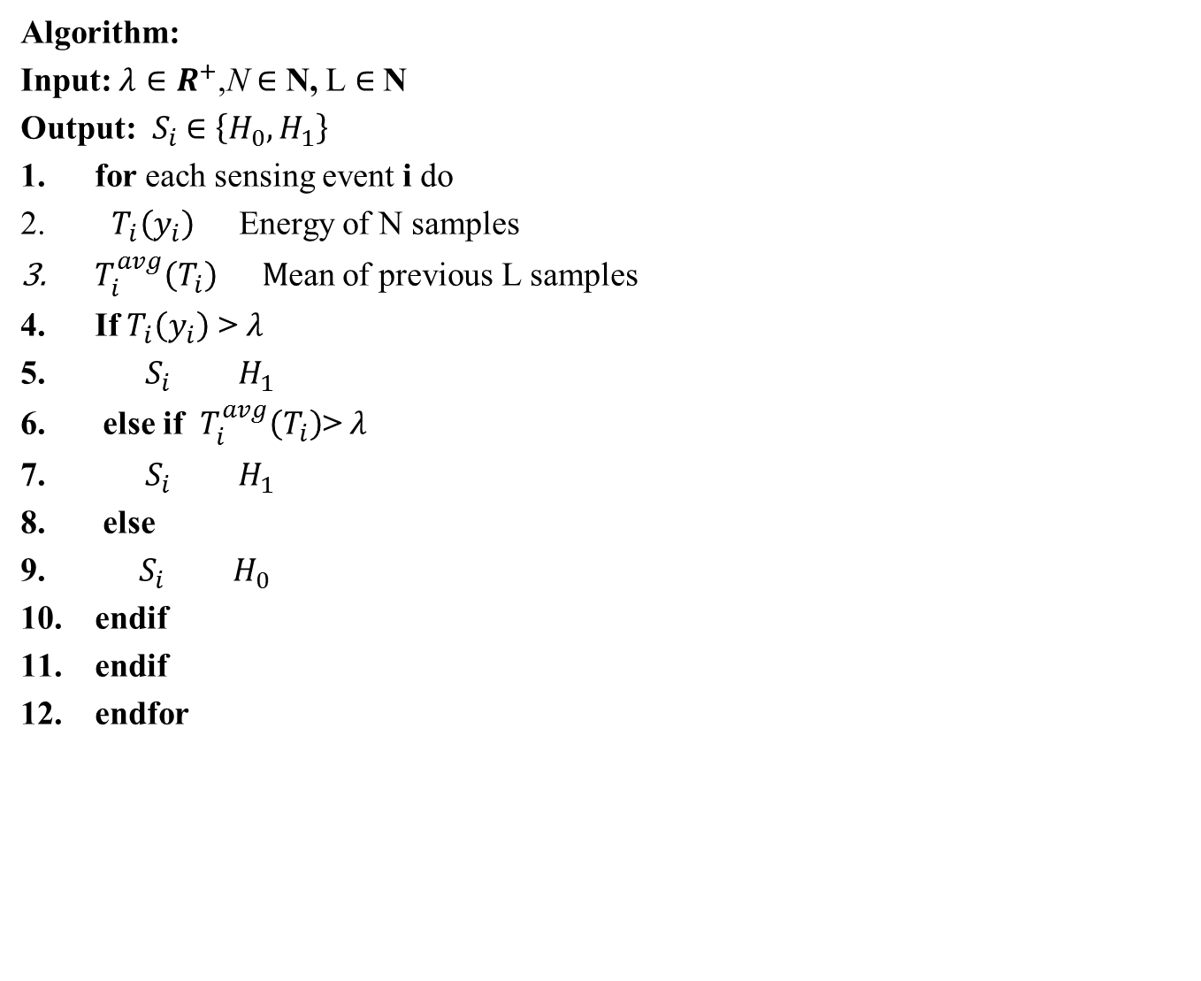
Modified energy detector contd…
Algorithm:
Input: $λ∈R^{+}$,N $∈$ N, L $∈$ N
Output: $S_{i}$ $∈$ $\left\{H_{0},H_{1}\right\}$
for each sensing event i do
$T_{i}\left(y_{i}\right)$Energy of N samples
$T_{i}^{avg}\left(T_{i}\right) M$ean of previous L samples
If $T_{i}\left(y_{i}\right)$ > $λ$
$S_{i} H_{1}$
else if $T_{i}^{avg}\left(T_{i}\right)$> $λ$
$S_{i} H_{1}$
else
${ S}_{i} H_{0}$
endif
endif
endfor

Slide 14
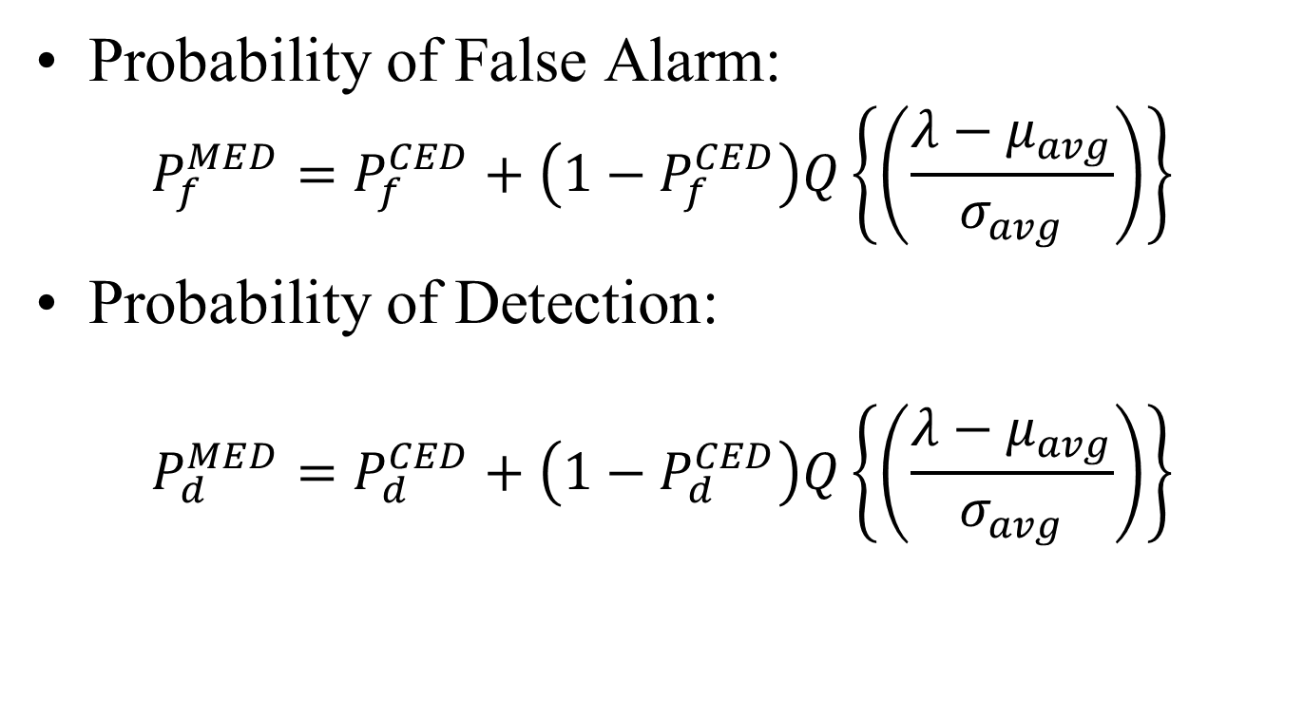
Modified Energy Detector contd…
Probability of False Alarm:
$$P_{f}^{MED}=P_{f}^{CED}+\left(1−P_{f}^{CED}\right)Q\left\{\left(\frac{λ−μ_{avg}}{σ_{avg}}\right)\right\}$$
Probability of Detection:
$$P_{d}^{MED}=P_{d}^{CED}+\left(1−P_{d}^{CED}\right)Q\left\{\left(\frac{λ−μ_{avg}}{σ_{avg}}\right)\right\}$$

Slide 15
Theoretical ROC Performance between CED and MED
SNR=-13dB,Power Level=-116dBm,N=1000

Slide 16
Modified energy detector contd…
Conclusion:
Thus, MED reduces the amount of misdetections which results in an improved probability of detection compared to CED but the probability of false alarm increases to a greater extent resulting in degraded ROC curve.

Slide 17
Improved energy detector
Objective:
The IED proposal is expected to improve the false alarm performance of the MED algorithm while still improving the detection performance of the CED

Slide 18
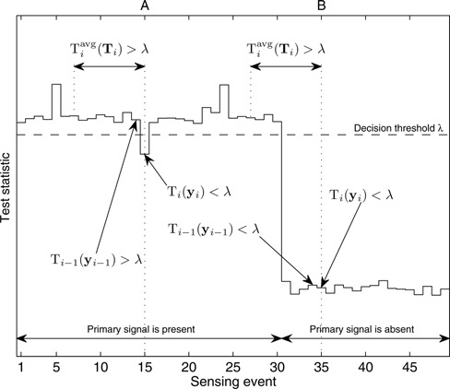
Improved energy detector contd…

Slide 19
Improved energy detector contd…
Operating principle:
MED maintains an updated list of the test statistics value of the last L sensing events and an average test statistic value is computed with which the threshold is compared and the decision is made . IED in addition to the comparison with the average values makes comparison of the threshold with the previous test statistic value

Slide 20
Block Diagram for IED
Quantized Input
Square and Sum
Decision
Spectrum occupied / unoccupied
Average Value of L sensing events
Energy Queue of last L sensing events
Software Required: Matlab 2010a(Version 7.10.0.499)

Slide 21
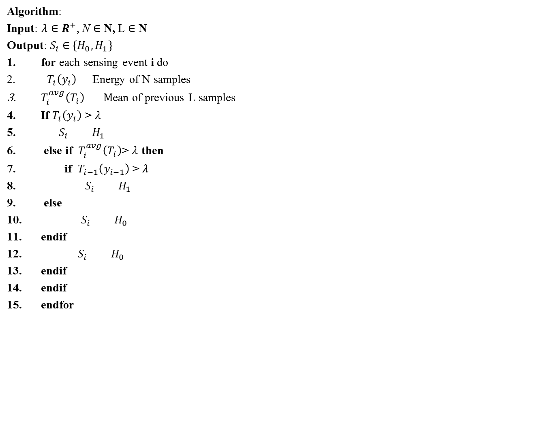
Improved energy detector contd…
Algorithm:
Input: $λ∈R^{+}$, N $∈$ N, L $∈$ N
Output: $S_{i}$ $∈$ $\left\{H_{0},H_{1}\right\}$
for each sensing event i do
$T_{i}\left(y_{i}\right)$Energy of N samples
$T_{i}^{avg}\left(T_{i}\right) M$ean of previous L samples
If $T_{i}\left(y_{i}\right)$ > $λ$
$S_{i} H_{1}$
else if $T_{i}^{avg}\left(T_{i}\right)$> $λ$ then
if $T_{i−1}\left(y_{i−1}\right)$ > $λ$
$S_{i} H_{1}$
else
${ S}_{i} H_{0}$
endif
${ S}_{i} H_{0}$
endif
endif
endfor

Slide 22
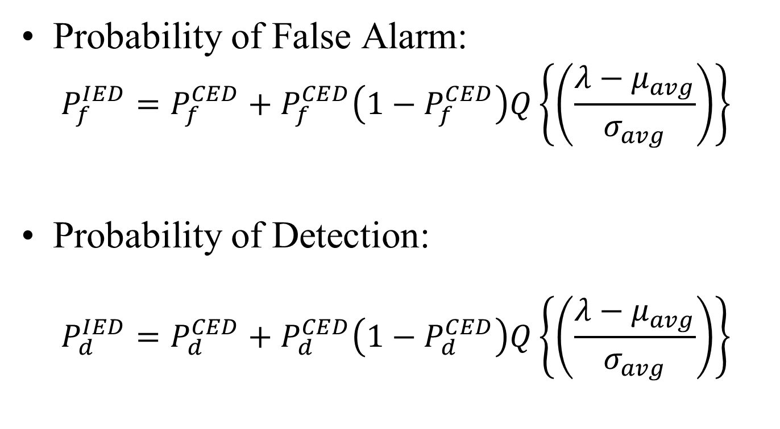
Improved Energy Detector contd…
Probability of False Alarm:
$$P_{f}^{IED}=P_{f}^{CED}+P_{f}^{CED}\left(1−P_{f}^{CED}\right)Q\left\{\left(\frac{λ−μ_{avg}}{σ_{avg}}\right)\right\}$$
Probability of Detection:
$$P_{d}^{IED}=P_{d}^{CED}+P_{d}^{CED}\left(1−P_{d}^{CED}\right)Q\left\{\left(\frac{λ−μ_{avg}}{σ_{avg}}\right)\right\}$$

Slide 23
Theoretical ROC Performance between CED and IED
SNR=-12dB,Power Level=-116dBm,N=1000

Slide 24
Theoretical ROC Performance between CED, MED and IED
SNR=-12dB,Power Level=-116dBm,N=1000

Slide 25
SNR Vs Pd comparison for CED and IED

Slide 26
SNR Vs Pd comparison for CED, MED and IED

Slide 27
Improved energy detector contd…
Conclusion:
Thus, the IED algorithm improves the detection performance of the CED algorithm at the expense of a false alarm probability degradation. Such degradation, however, is not as significant as the MED scheme, resulting in the improved ROC curve

Slide 28
Noise uncertainty
Noise uncertainty in spectrum sensing will make the detector unreliable due to ”SNR walls”. So , a double
threshold method is proposed to improve the detection performance under noise uncertainty.
Principle:
Each secondary user will use a two-thresholds detector for local detection. The thresholds are chosen according to the noise uncertainty at each secondary user.

Slide 29
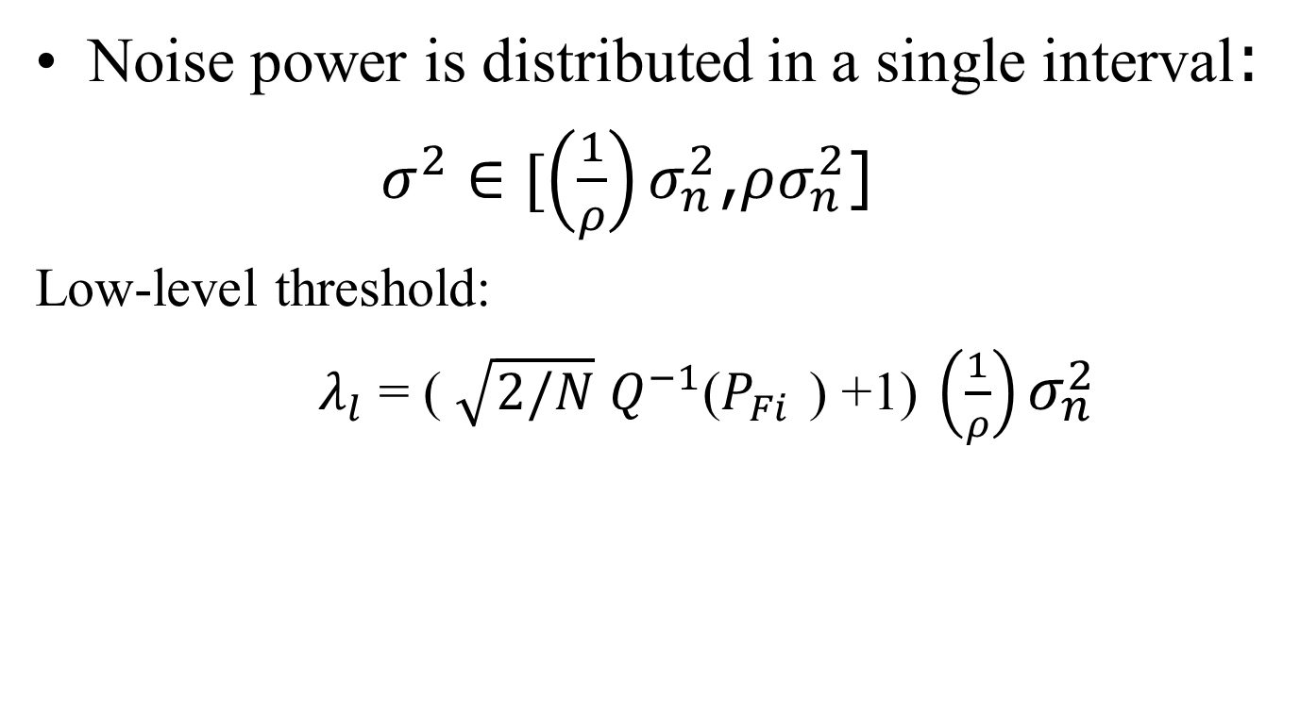
CED for noise uncertainty
Noise power is distributed in a single interval:
$σ^{2}∈[\left(\frac{1}{ρ}\right)σ_{n}^{2}$,$ρσ_{n}^{2}$]
Low-level threshold:
$λ_{l}$ = ( $\sqrt{2/N}$ $Q^{−1}$($P_{Fi }$) +1) $\left(\frac{1}{ρ}\right)σ_{n}^{2}$

Slide 30

CED for noise uncertainty
High-level threshold:
$λ_{h}$ = ( $\sqrt{2/N}$ $Q^{−1}$($P_{Fi }$) +1)$ρσ_{n}^{2}$
Probability of detection:
$P_{d}$=Q($\frac{λ−σ_{n}^{2}(1+γ)}{\sqrt{2/N}σ_{n}^{2}(1+γ)}$)

Slide 31
CED Under Noise Uncertainty Environment
SNR=-12dB, del=0.1dB,BW=6MHz,N=1000, 1000 Monte Carlo Times

Slide 32
Noise uncertainty
Conclusion:
Implementing the adaptive threshold algorithm results in improvement of the detection performance under noise uncertainty.

Slide 33
Future Work

Slide 34
References
Ian F. Akyildiz, Won-Yeol Lee, Mehmet C. Vuran, Shantidev Mohanty, ”NeXt generation/dynamic spectrum access/cognitive radio wireless networks: A survey”, Computer Networks (Elsevier), vol. 50, no. 13, pp. 2127-2159, September 2006.
López-Benítez. M, Casadevall. F, "Improved energy detection spectrum sensing for cognitive radio," IET Communications, vol.6, no.8, pp. 785-796, May 2012.
Deepa, B., Anand Padmanabha Iyer, and Chandra R. Murthy. "Cyclostationary-based architectures for spectrum sensing in IEEE 802.22 WRAN." Global Telecommunications Conference (GLOBECOM 2010), 2010 IEEE. IEEE, 2010.

Slide 35
References Contd…
Mohammad, M.H.; Haw Cui Wen; Ismail, M., "Matched filter detection technique for GSM band," Telecommunication Technologies (ISTT), 2012 International Symposium on , vol., no., pp.271,274, 26-28 Nov. 2012.
Ying-Chang Liang; Yonghong Zeng; Peh, E.C.Y.; Anh Tuan Hoang, "Sensing-Throughput Tradeoff for Cognitive Radio Networks," Wireless Communications, IEEE Transactions on , vol.7, no.4, pp.1326,1337, April 2008.

Slide 36
Thank You

