Slide 1
Big Data Technology ProjectProject

Slide 2
Project Overview
Our project is an exploration into various facets of technology and tools, aiming to leverage their advantages while navigating the encountered challenges. This venture comprises a diverse set of components, each meticulously chosen to contribute to our project's success.

Slide 3
Advantages and Challenges:
Throughout the project, we've uncovered numerous advantages in the technologies and tools we employed, enhancing our efficiency and productivity. Simultaneously, we've encountered challenges that have tested our problem-solving abilities, fostering growth and learning within our team.

Slide 4
Technology and Tool Stack:
To realize our project's goals, we've assembled a comprehensive technology and tool stack. This stack encompasses a range of software and hardware components, each serving a distinct purpose in our project's ecosystem

Slide 5
Advantages and Challenges:
Throughout the project, we've uncovered numerous advantages in the technologies and tools we employed, enhancing our efficiency and productivity. Simultaneously, we've encountered challenges that have tested our problem-solving abilities, fostering growth and learning within our team.

Slide 6
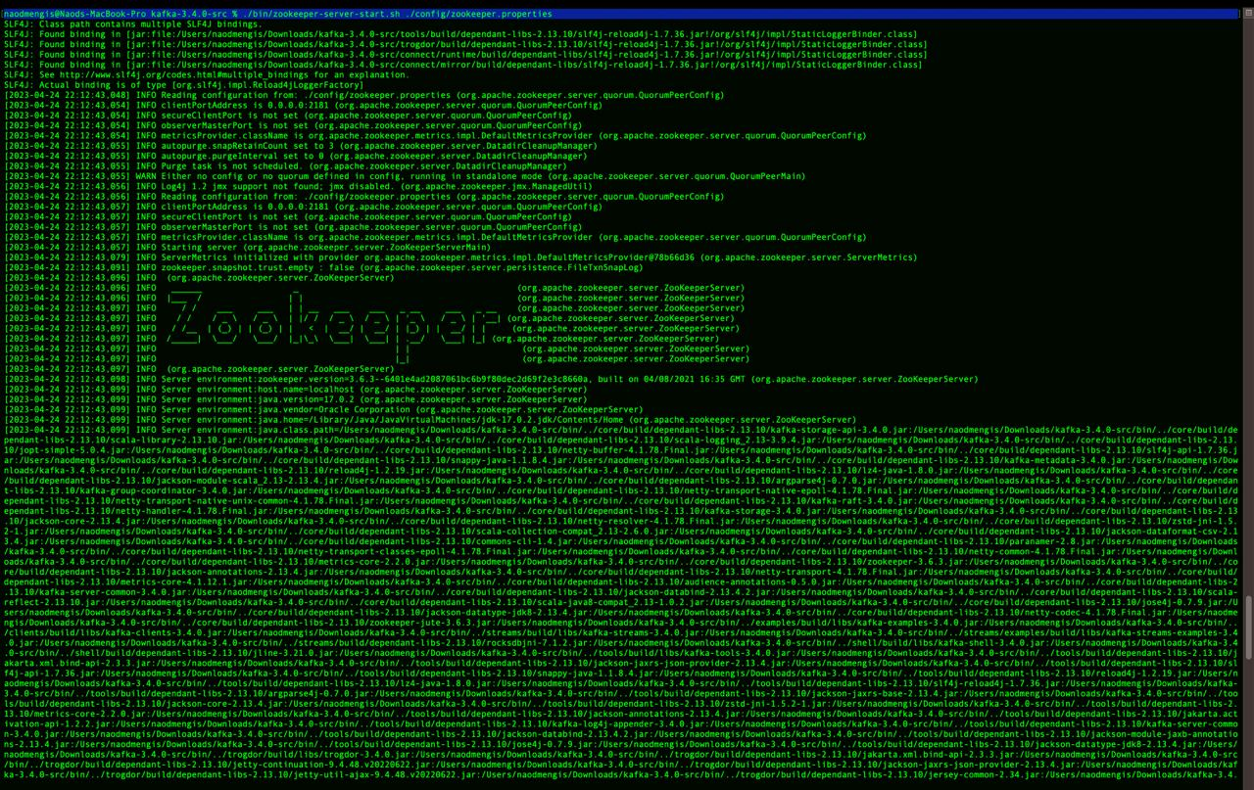
Zoo keeper Terminal

Slide 7
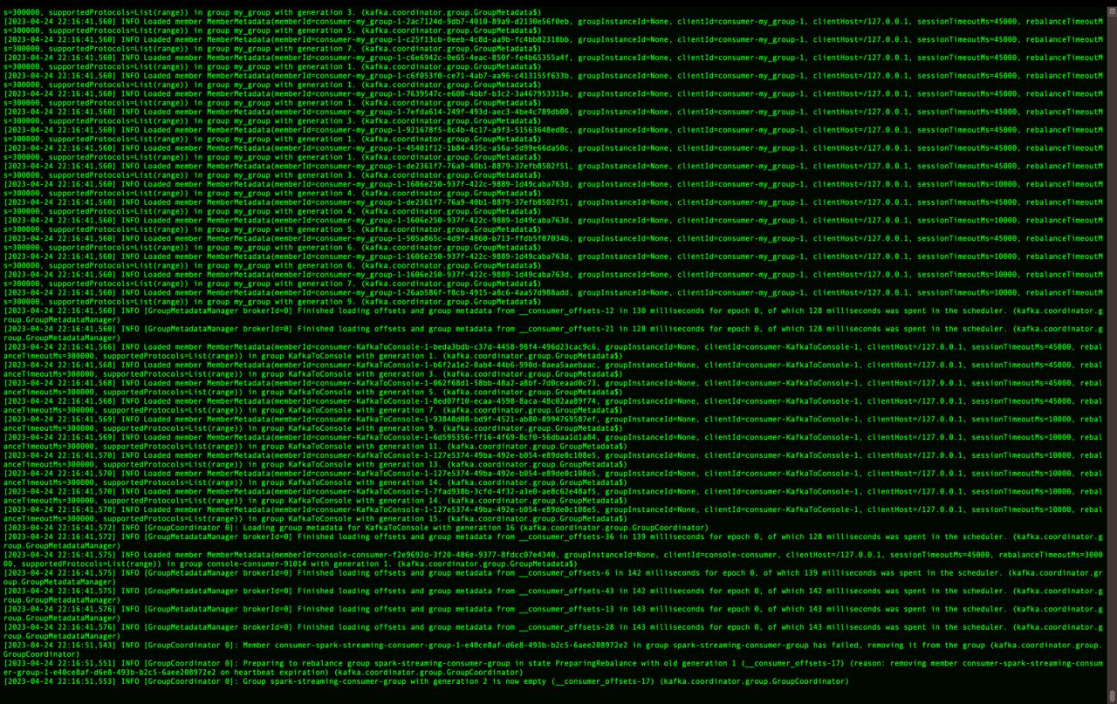
Kafka Terminal

Slide 8
Spark Streaming
Spark Streaming, built on Apache Spark, offers scalable, high-throughput, and fault-tolerant stream processing for real-time data. It uses the same programming model as batch processing in Spark, supporting data sources like Kafka, Flume, and HDFS, with features like windowed operations and fault tolerance. It's a potent foundation for real-time data stream tools and applications..

Slide 9
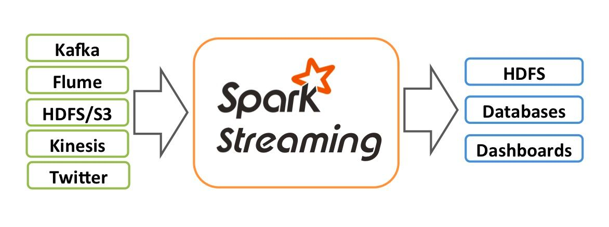
Architecture Stream high-level overview of the architecture implemented. We have data streaming in from Kafka, which is consumed by Spark Streaming. Spark Streaming processes the data in real-time, and the results are stored in Hive for later analysis.

Slide 10
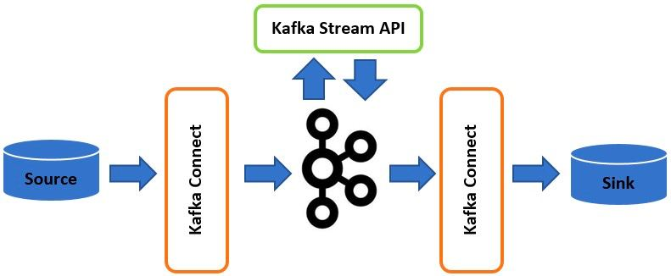
We connected Spark Streaming to a Kafka topic. Spark Streaming then consumes the data from the topic using the Kafka direct stream approach.

Slide 11
We connected Spark Streaming to Hive using a SparkSession object to enable support for the Hive data warehouse.
+-----------------------------------------------+
| Spark Streaming |
| (Direct Stream from Kafka) |
+-----------------------------------------------+
|
|
v
+----------------------------------------------+
| SparkSession |
| (Configured with Hive Metastore) |
+----------------------------------------------+
|
|
v
+------------------------------------------------+
| Hive Metastore |
| (Manages Metadata about Tables) |
+------------------------------------------------+
|
|
v
+-------------------------------------------------+
| Hive Data Warehouse |
| (Stores Hive Table Data) |
+-------------------------------------------------+

Slide 12
Spark SQL
Spark SQL is a module in Apache Spark that enables SQL-based structured data processing, functioning as a distributed SQL query engine. It seamlessly combines relational and procedural processing through declarative DataFrames, optimizing performance for broader user accessibility. Key concepts include the Language API, DataFrame API, and DataSource API. Its advantages include integration, compatibility, standard connectivity, uniform data access, and superior performance and scalability.
-

Slide 13
Apache Hive
Apache Hive is a tool that provides a data warehousing and SQL-like query language for Hadoop,
Efficient storage and process large data
Works with Hadoop
Hive limitation
- launch MapReduce Job
- Lag Performance
- no resume capability
hard drop encrypted database

Slide 14



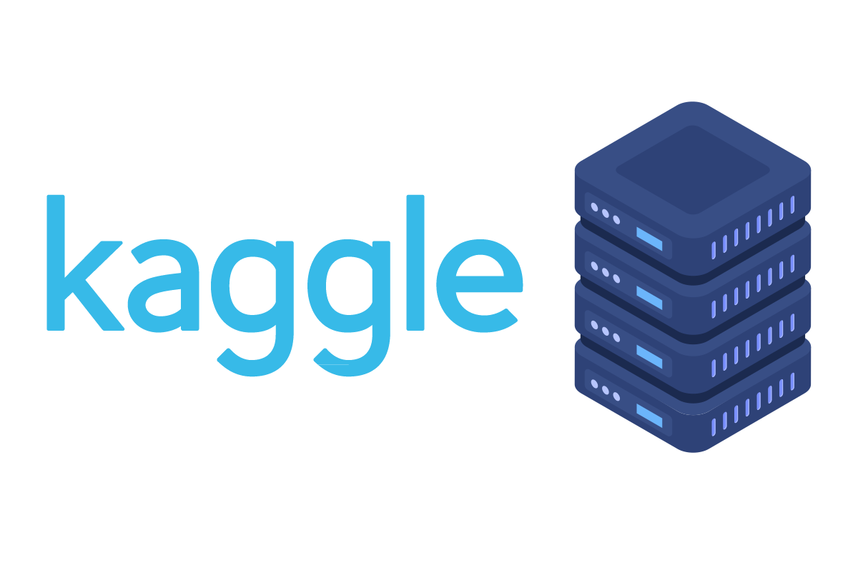



Our Data Streaming pipeline
Data to be streamed

