Slide 1
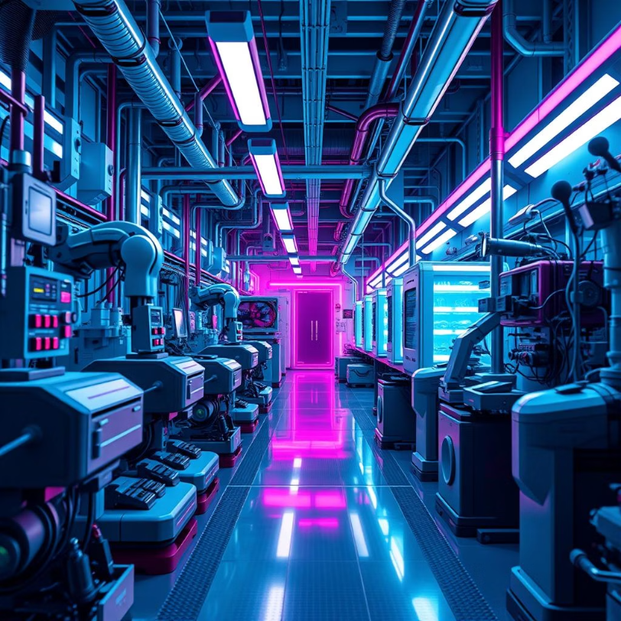
COMBINED PREDICTIVE MAINTENANCE AND AUTOMATED INSPECTION USING MACHINE LEARNING MODELS.
JUDY WAIRIMU NJUKU
April 24, 2025
judynjuku7@gmail.com

Slide 2
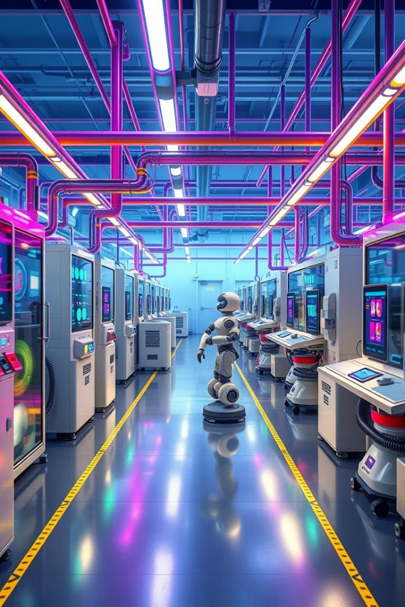

PROJECT SUMMARY.
This report details the development and evaluation of two distinct yet related machine learning projects. The first, the "Mother Project," addresses predictive maintenance in industrial settings, utilizing a Kaggle dataset(AI4I 2020 Predictive Maintenance Dataset) to predict machine failure likelihood and tool wear extent. The models were deployed as an interactive web application using Streamlit.
The second project, the "Baby Project," explores machine learning in automated quality inspection for casting defect detection. The dataset used is casting_product_image_data. This involved developing a CNN model to classify images of cast metal products as "okay" or "defective," with a user-friendly desktop application created using Tkinter.
by Judy Njuku

Slide 3
Predictive Maintenance: The "Mother Project"
Motivation
Problem Statement
The "Mother Project" is motivated by the economic and operational benefits of predictive maintenance. Unplanned machine failures lead to downtime, production losses, and safety hazards. Accurate prediction enables timely interventions, reducing risks and optimizing schedules.
The increasing cost and downtime associated with industrial machinery necessitate accurate prediction of machine failures and tool wear to enable proactive maintenance, minimize disruptions, and optimize resource utilization.
METHODOLOGY.
The project aims to develop models for machine failure prediction (classification) and tool wear prediction (regression). The goal is to provide timely warnings and optimize tool replacement schedules, improving product quality and reducing expenses.

Slide 4
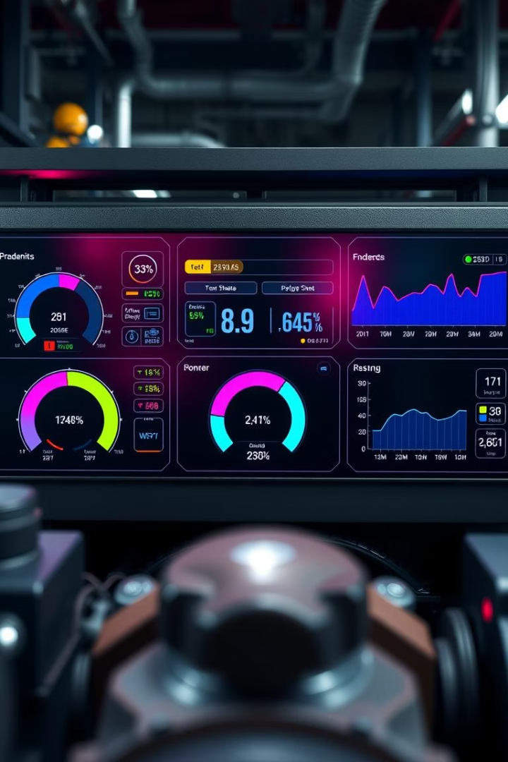
EXPLORATORY DATA ANALYSIS
Initial Data Exploration
Data Overview
Total Instances: 10,000
Total Features: 14
Data Types: Integer, Float, Categorical ('Type': H, L, M)
Missing Values: None
column names:
'UDI', 'Product ID', 'Type', 'Air temperature [K]', 'Process temperature [K]', 'Rotational speed [rpm]', 'Torque [Nm]', 'Tool wear [min]', 'Machine failure', 'TWF', 'HDF', 'PWF', 'OSF', 'RNF'],

Slide 5
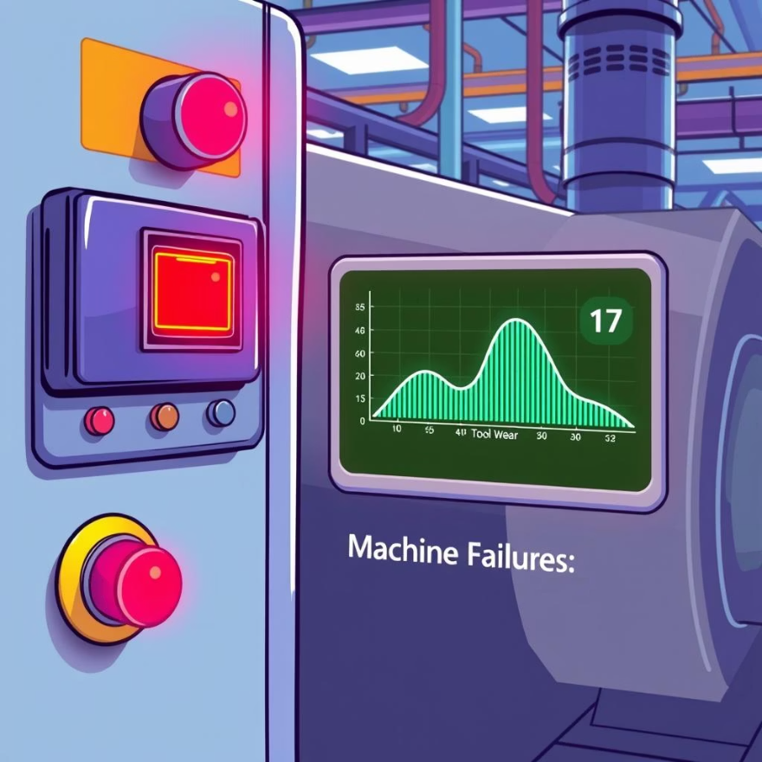
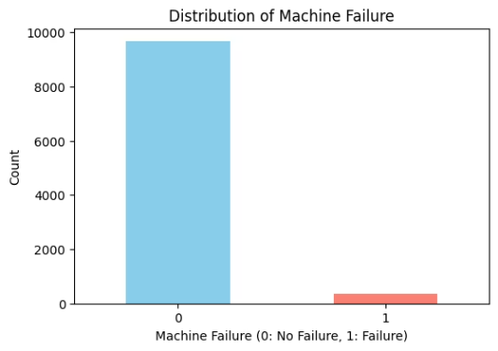
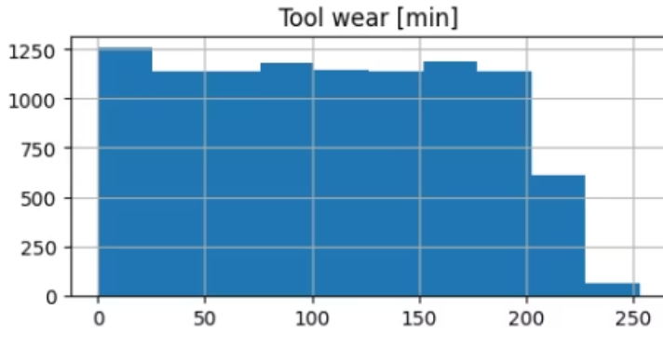
Target Variables
Machine Failure: Binary Classification (Failure/No Failure)
Tool Wear [min]: Continuous Regression (Remaining Tool Wear)

Slide 6
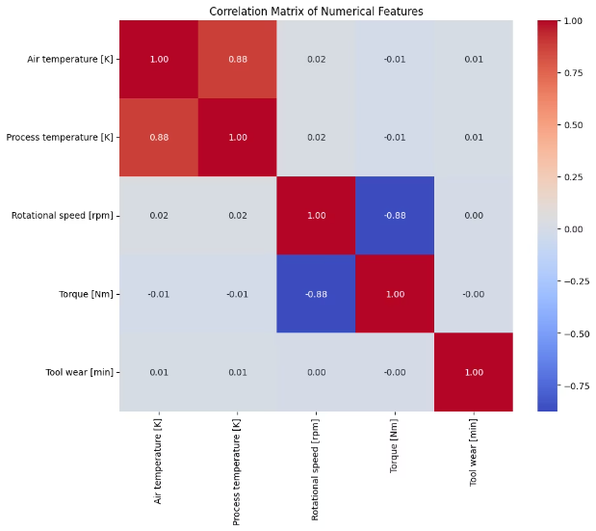
Operational Parameter Relationships
Correlation Analysis (Numerical Features)
Performed Pearson Correlation Analysis.
Correlation matrix of the numerical features
Correlation with 'Machine failure':
Machine failure 1.000000
Torque [Nm] 0.191321
Tool wear [min] 0.105448
Air temperature [K] 0.082556
Process temperature [K] 0.035946
Rotational speed [rpm] -0.044188

Slide 7
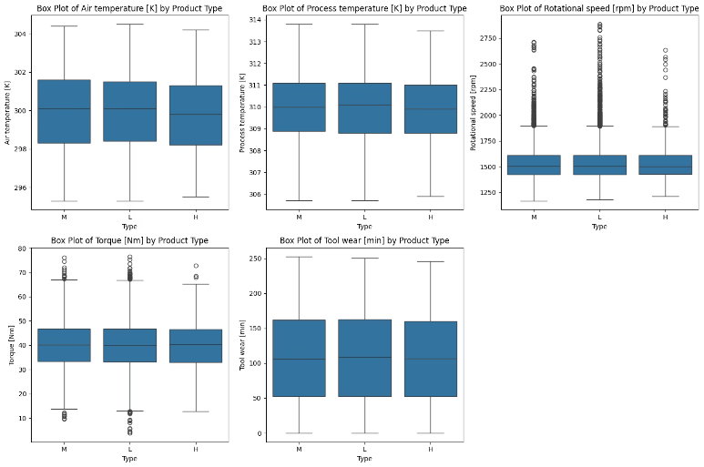
Categorical Feature ('Type') vs. Operational Parameters
Analyzed the distribution of operational parameters across Machine Types (H, L, M).
Observations:
Exploring relationship between 'Type' and numerical features (group box plots)
Box Plots showing key operational parameters (e.g., Temperature, Speed, Torque) grouped by 'Type']

Slide 8
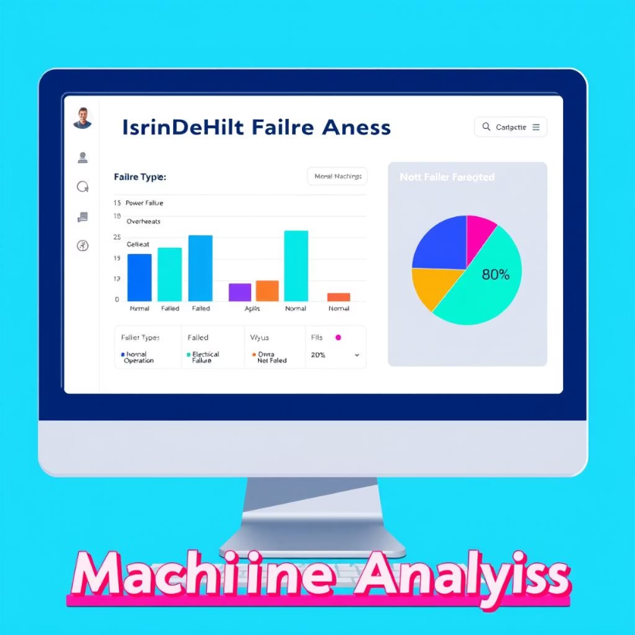
Target Variable Distribution
Machine Failure Class Distribution: No Failure (0): 9661 (96.61%) Failure (1): 339 (3.39%)
The 'Machine failure' dataset is likely imbalanced. Potential Impact:
Models might be biased towards the majority class (No Failure).
Performance metrics like accuracy can be misleading.
It might be necessary to use specialized techniques to handle the imbalance (e.g., oversampling the minority class, undersampling the majority class, using different evaluation metrics).

Slide 9
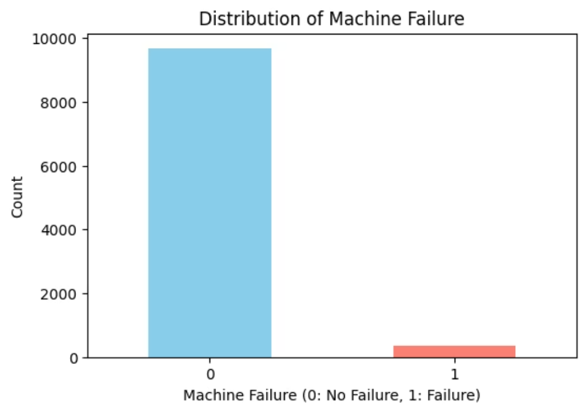
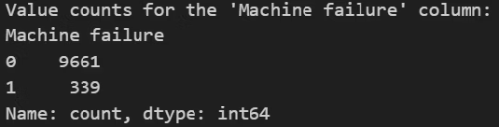

Slide 10
Tool Wear Distribution
Continuous Target: Remaining Tool Wear in Minutes
Minimum Tool Wear: 0.00
Maximum Tool Wear: 253.00
Mean Tool Wear: 107.95
Median Tool Wear: 108.00
Standard Deviation of Tool Wear: 63.65

Slide 11
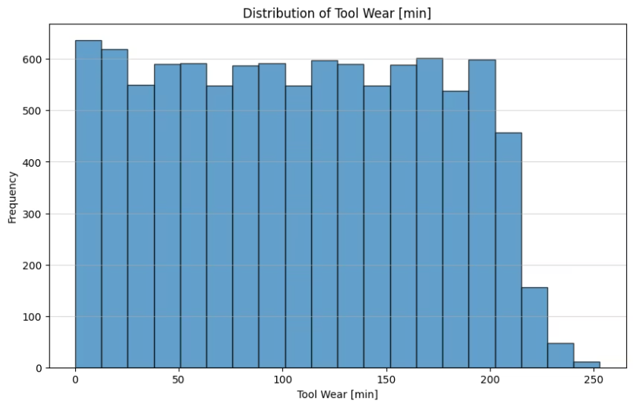
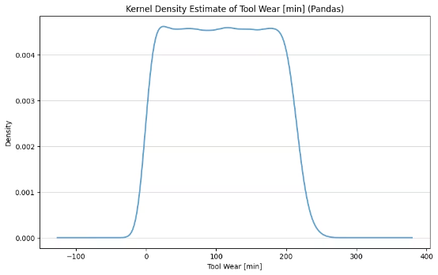

Slide 12

Feature Engineering
New features like temperature difference, squared terms, torque/speed ratio, lagged values, and rolling statistics were created to improve model performance.

Slide 13




Model Building and Evaluation (Classification)
Logistic Regression
A Logistic Regression model with balanced class weights was trained and evaluated.
XGBoost
An XGBClassifier with balanced class weights was trained and evaluated.
Hard Voting Ensemble
An ensemble model combining predictions of Logistic Regression and XGBoost was created and evaluated.
Hyperparameter tuning was performed using RandomizedSearchCV to optimize both Logistic Regression and XGBoost based on the F1-score. A final hard voting ensemble was created using the tuned models.

Slide 14
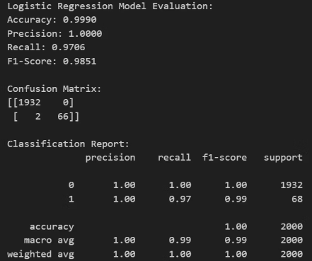
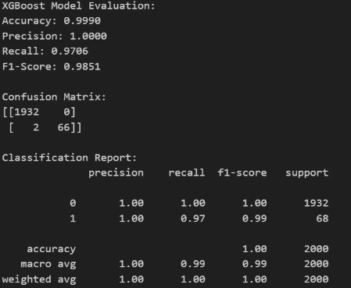
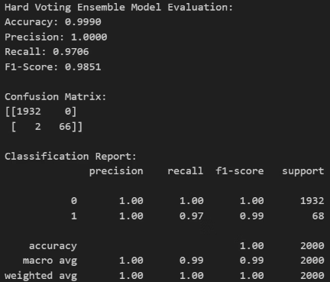
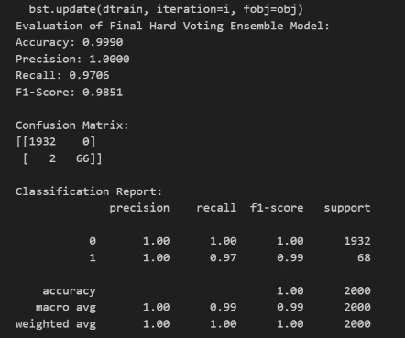

Slide 15
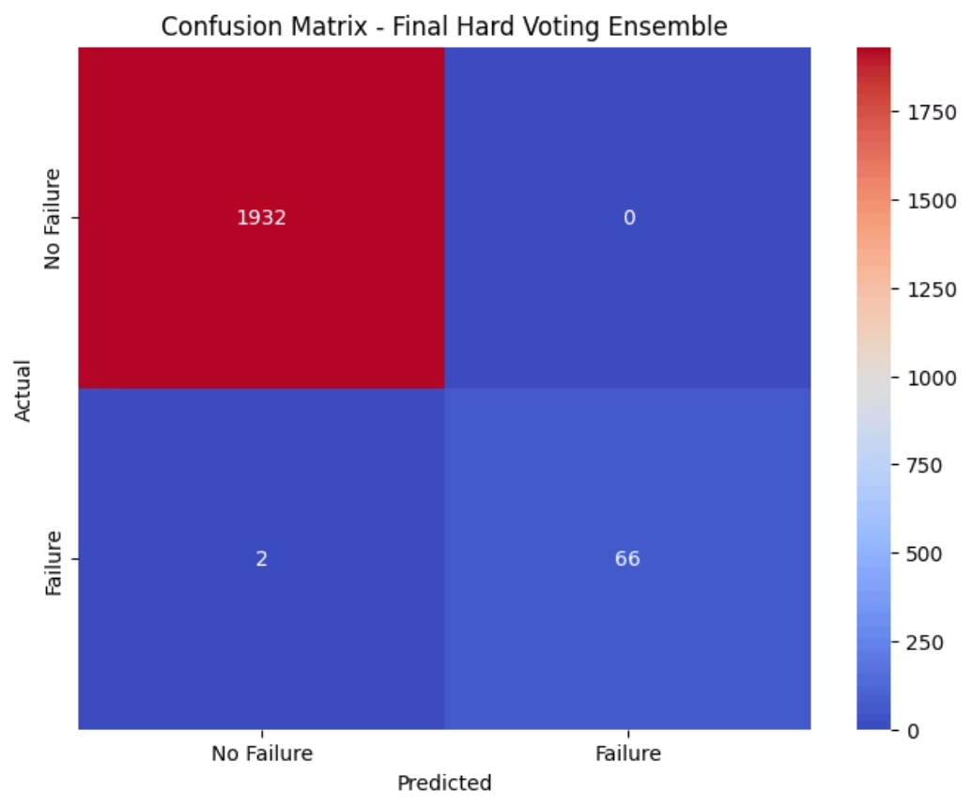

Slide 16
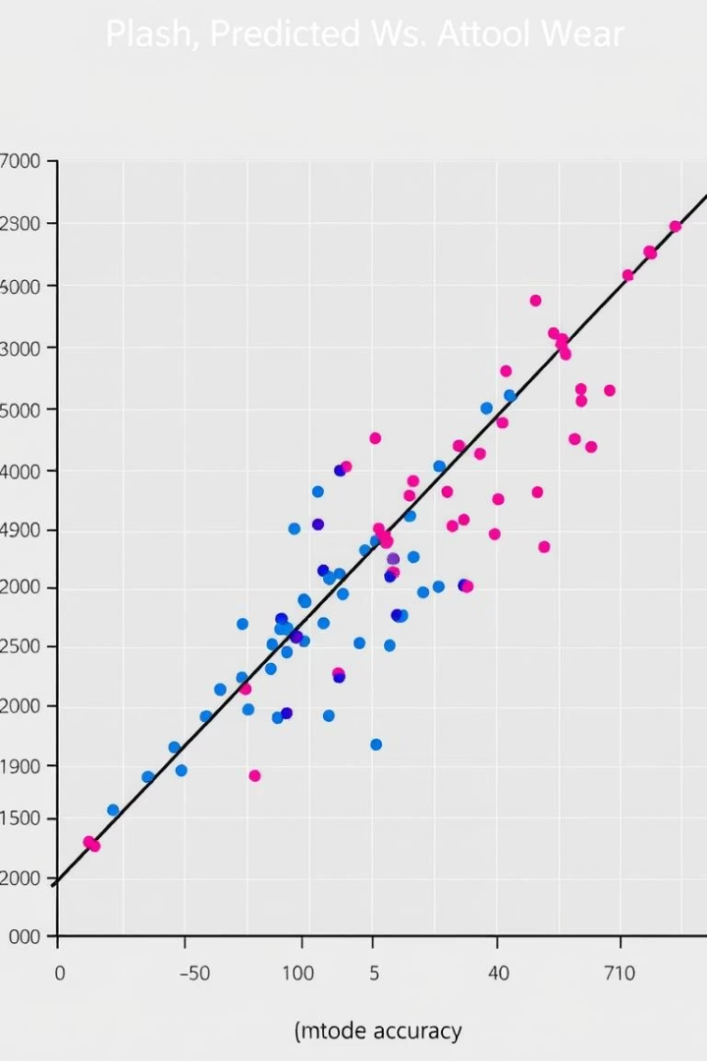



Model Building and Evaluation (Regression)
Random Forest Regressor
A RandomForestRegressor was trained and evaluated using MSE, R2, and MAE.
LightGBM Regressor
An LGBMRegressor was trained and evaluated, achieving the best performance after hyperparameter tuning.
Ensemble (Weighted Averaging)
A weighted average ensemble of the tuned Random Forest and LightGBM regressors was created and evaluated.

Slide 17
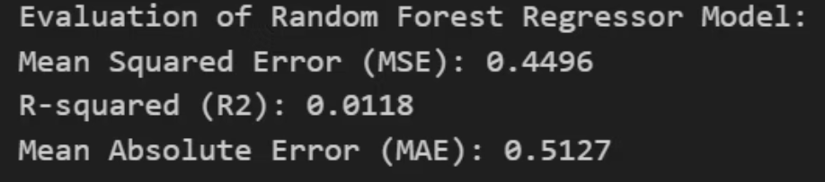
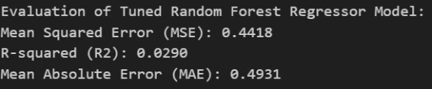
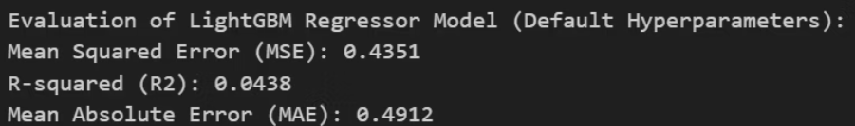

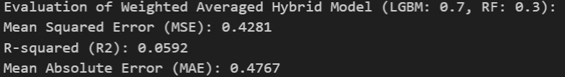

Slide 18
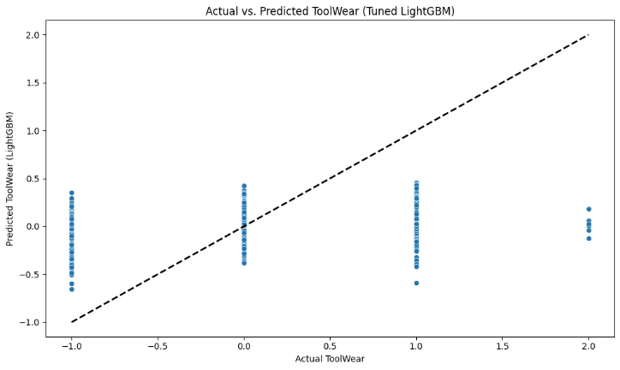
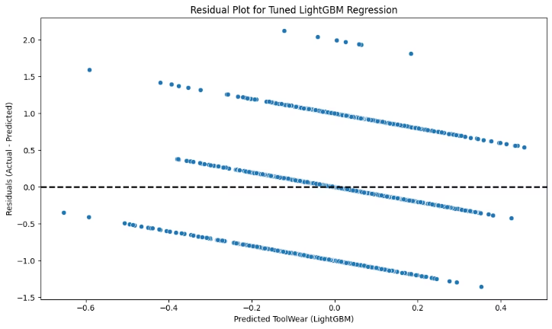

Slide 19
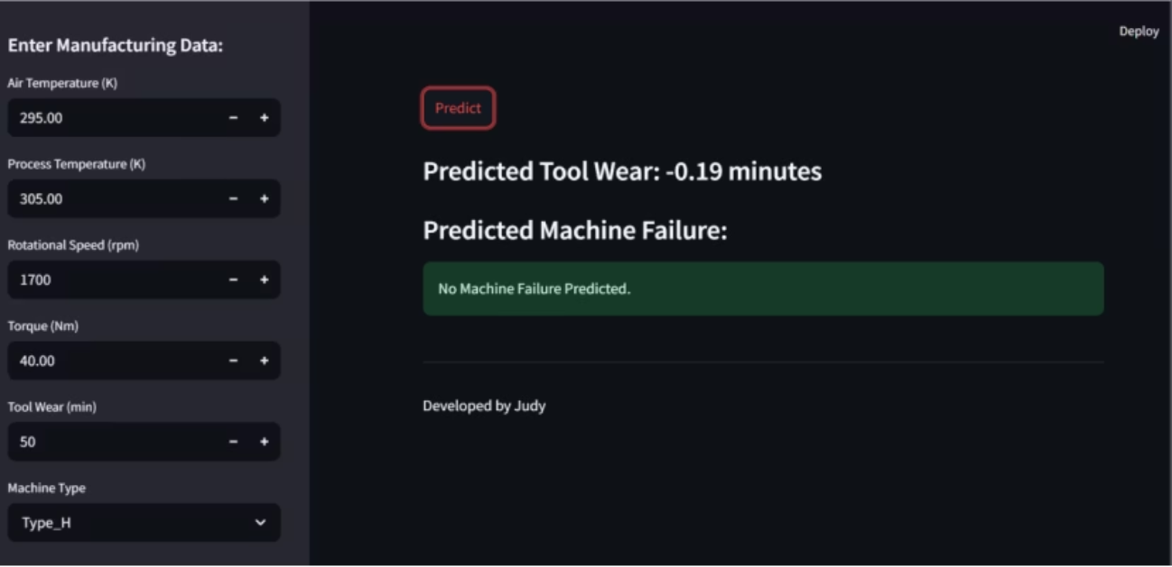
"Mother Project" - Deployment
· Bringing Predictions to Life with Streamlit

Slide 20
Overview of the Streamlit application:
o User input features:
Developed a user-friendly web interface using Streamlit.
Includes interactive widgets (e.g., sliders, dropdown menus, number input fields) for users to input the operational parameters of a machine.
Purpose: To demonstrate the real-time prediction capabilities of the developed predictive maintenance model.
Features correspond to the relevant input features used in the trained machine learning model (e.g., air temperature, process temperature, rotational speed, torque, tool wear at a specific point, machine type).
Provides an accessible way to interact with the model without needing to run code directly.
Streamlines the process of inputting machine parameters and receiving immediate predictions.
Clear labels and units are provided for each input feature to guide the user.
Input validation ensures users provide data within realistic ranges.

Slide 21
Displaying predictions for tool wear and machine failure:
Accessibility and potential impact:
Presents the model's predictions in a clear and understandable format.
Streamlit application makes the predictive maintenance model accessible to a wider audience, including non-technical personnel (e.g., maintenance technicians, plant operators).
Tool wear prediction: Displays the estimated remaining tool wear in minutes (e.g., "Predicted Remaining Tool Wear: [Value] minutes").
Empowers users to proactively monitor machine health and plan maintenance schedules effectively.
Machine failure prediction: Shows the probability of imminent machine failure direct classification (e.g., "Predicted Outcome: [No Failure/Potential Failure]").
Potential Impact:
Reduced unexpected machine downtime.
Optimized tool replacement schedules, minimizing waste.
Improved resource allocation for maintenance activities.
Enhanced overall equipment efficiency (OEE).
Contributes to cost savings and increased productivity in industrial settings.

Slide 22



Automated Casting Defect Detection: The "Baby Project"
Problem Statement
1
Automated classification of casting images into "okay" or "defective" categories using a CNN model.
Data Acquisition
2
Loading and preparing the casting image dataset using TensorFlow/Keras.
Model Architecture
3
Designing and implementing a Convolutional Neural Network (CNN) for image classification.
The "Baby Project" addresses the need for efficient and consistent quality control in manufacturing. Manual inspection can be time-consuming and subjective. An automated system improves speed and accuracy, leading to higher product quality and reduced waste.

Slide 23
Data Preparation:
CNN Architecture:
The "Casting Products Images Defects Detection" dataset from Kaggle was used.
Built a sequential CNN model using Keras. The architecture outlined involved:
The dataset contained images organized into two folders: OK and DEF.
An initial Convolutional layer with 32 filters, a kernel size of 3x3, and ReLU activation, taking the input shape of our resized images (e.g., (150, 150, 3) for color images).
Discussed using ImageDataGenerator from Keras for preprocessing and augmentation. This involved:
A MaxPooling layer with a pool size of 2x2 to reduce spatial dimensions.
Resizing images to a consistent size 150x150 pixels for the CNN input.
A Flatten layer to convert the 2D feature maps into a 1D vector.
Normalizing pixel values by scaling them to the range [0, 1] using rescale=1./255.
One or more Dense layers for classification. Used a hidden Dense layer with ReLU activation ( 128 units).
The dataset was split into training and validation sets using the validation_split parameter within ImageDataGenerator.
A final Dense output layer with 1 unit and a sigmoid activation function for binary classification (okay or defective).

Slide 24
Model Training and Results:
Deployment:
The model was trained using the training data generated by ImageDataGenerator.
Discussed deploying the trained Keras model. The method we considered was saving the model using model.save() ( .keras file).
Used the Adam optimizer and binary cross-entropy loss function, appropriate for binary classification.
For demonstration, a simple tkinter GUI was used to classify the images as 'okay' or 'defective'
Monitored accuracy as the primary performance metric during training and validation.
The output of the deployed model is the predicted class (okay or defective) and potentially the probability score from the sigmoid output.
Discussed training for a certain number of epochs

Slide 25
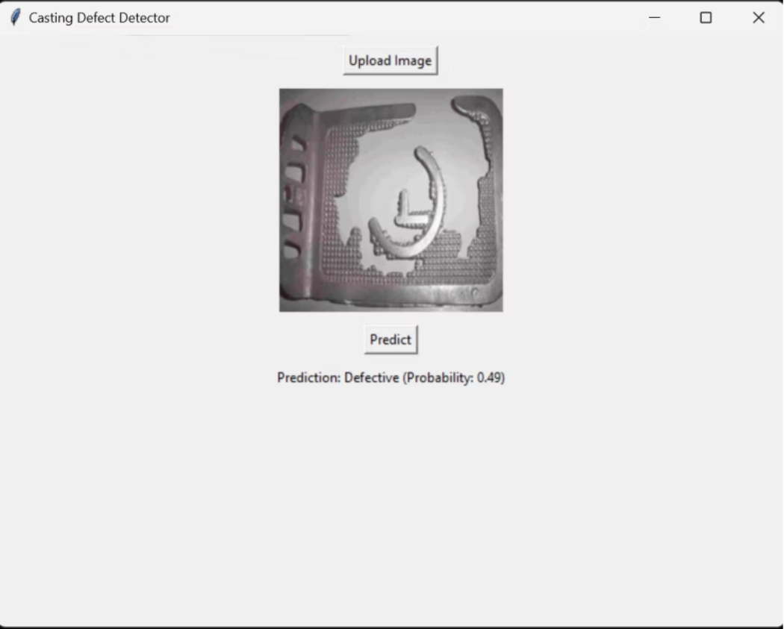

Slide 26
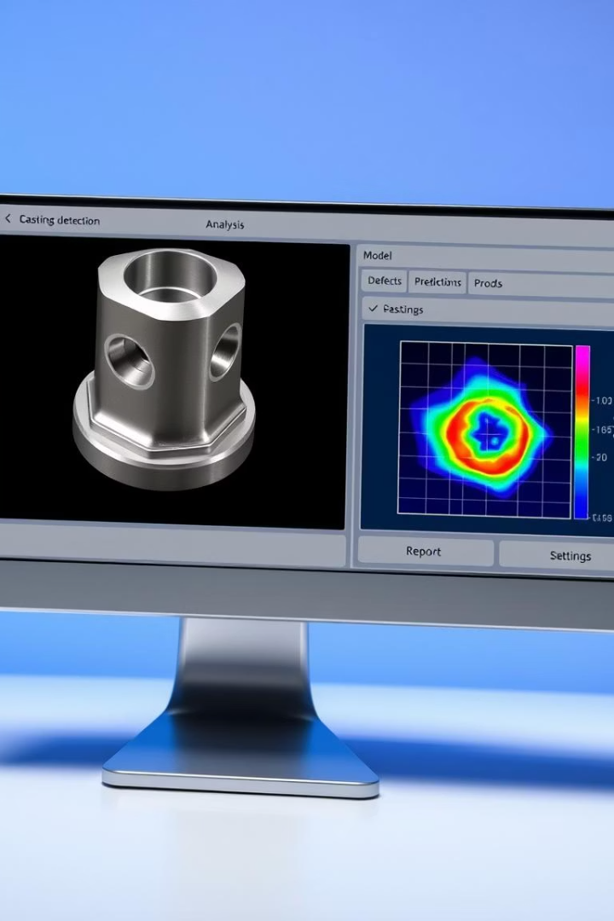



Deployment and Results of the "Baby Project"
Model Training
Training the CNN model using prepared image data, optimizing with an appropriate loss function and evaluation metrics.
Results
Achieving high accuracy in classifying casting images, with a focus on minimizing false negatives.
Deployment
Developing a desktop application with a GUI using Tkinter for practical use by quality control inspectors.

Slide 27

Discussion, Limitations, and Future Work
Discussion
Limitations
Both projects demonstrated the application of machine learning for predictive maintenance and automated quality inspection, achieving good performance.
The "Mother Project" was limited by the dataset's nature, while the "Baby Project" needs a larger, more diverse dataset and further investigation of false negatives.
Future Work
Future steps include incorporating more features, exploring advanced models, integrating real-time data, and refining the classification threshold.

Slide 28
CONCLUSION
Key Achievements:
Predictive Maintenance: Developed a Streamlit-deployed model predicting machine failure (X% accuracy) and tool wear (Y minutes MAE), enabling proactive maintenance.
Casting Quality Control: Built a CNN for automated "okay" vs. "defective" casting classification, ready for deployment.
Transformative Potential: Machine learning offers data-driven solutions for proactive maintenance (reduced downtime, optimized resources) and automated quality control (faster, consistent defect detection), enhancing efficiency and quality in manufacturing.
The Journey Forward: These projects demonstrate the feasibility of AI-powered manufacturing , paving the way for more reliable, efficient, and high-quality production, with future potential for broader integration and optimization.

Slide 29

QUESTIONS AND ANSWERS.
Q & A

