Slide 1


A Complete Clinic Management System

Slide 2

M2ComSys Inc.
M2ComSys Inc. is a Software Development and IT- enabled services company dealing with diverse application development for various business and professions.
The crux of our solutions are conceptualized and devised for Health care industry.
Our software development team operates with highly skilled, enterprising and multidisciplinary professionals from various spheres of expertise.

Slide 3
Introduction
DoktorWare is a complete automated solution to healthcare clinics.
It coordinates and integrates all the inherent activities involved in the management and running of a healthcare clinic.
DoktorWare also consolidates Prescription Refills, Laboratory Order Processing, and other adjunct activities.
Provide HL7 and EDI integration (Claim sending)

Slide 4
Advantages
Reduces cost involved in medical transcription by providing prescription facility directly from Doctor’s Desktop Module.
Reduces the requirement of coding personnel in the Clinic.
Bills generated are automatically sent to the insurance company, in return reduces number of billing personnel.
Provide HL7 and EDI integration (Claim sending).

Slide 5
Server Hardware Requirements
Intel Pentium IV - 2 GHz or higher/any other compatible processor
1 GB RAM or higher
Minimum 40 GB HDD space.

Slide 6
Server Software Requirements
Microsoft Windows 2000 Advanced Server with FAX service enabled
Microsoft Word 2000
TCP/IP
Internet Explorer 5.0 or higher
RDBMS (SQL Server 2000 or Later)

Slide 7
Client Hardware Requirements
Intel Pentium II 300 MHz or higher/any other compatible processor
64MB RAM or higher
Multimedia installed
Display resolution 800x 600 pixels, recommended
Minimum 2 GB HDD space

Slide 8
Client Software Requirements
Microsoft windows 2000 or later
Internet Explorer 5.0 or higher
ODBC for Microsoft Access
Word 2000 or later
Windows Media Player 6.0 or later

Slide 9
DoktorWare Modules
Reports
DoktorWare
Transcription System
Web Interface
Billing
Personnel Management
Doctors Desktop/PDA Integration
Auto Dialer
Nurse Station
Reception

Slide 10
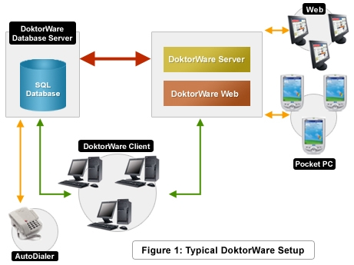

Slide 11

Reception

Slide 12
Reception
Phone calls
Placer
Online (appointment request)
Walk In
Appointment
Booking
Insurance details
Patient information
Contact information
Register patient
Referral Details
Visit Details
To
Selected
Doctor
Emergency
Appointment Fixing

Slide 13
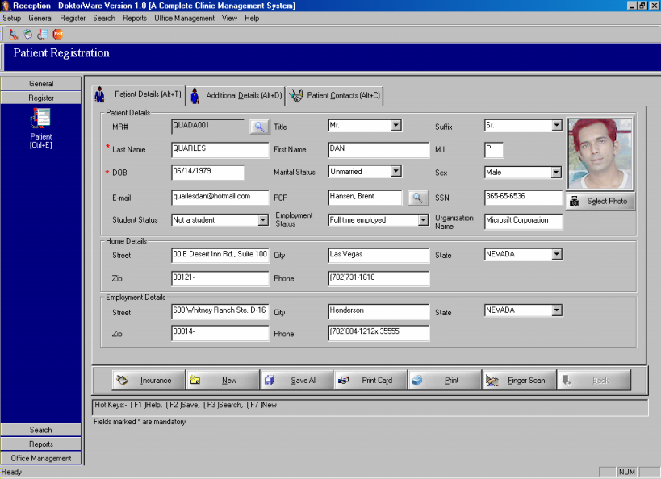
Reception
The patient registration module handles patient registration process. Along with patient information, print out of patient identity card with unique bar code can also be taken.

Slide 14
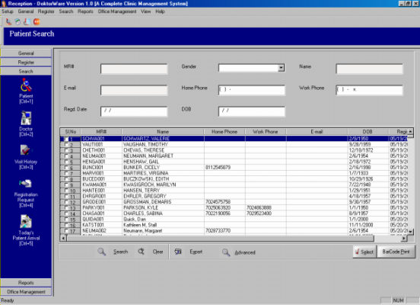
Reception
Facilitate search of Patient,Doctor, Visit History Registration request and Patient Arrival. It also provides various search options for simplifying the search.

Slide 15
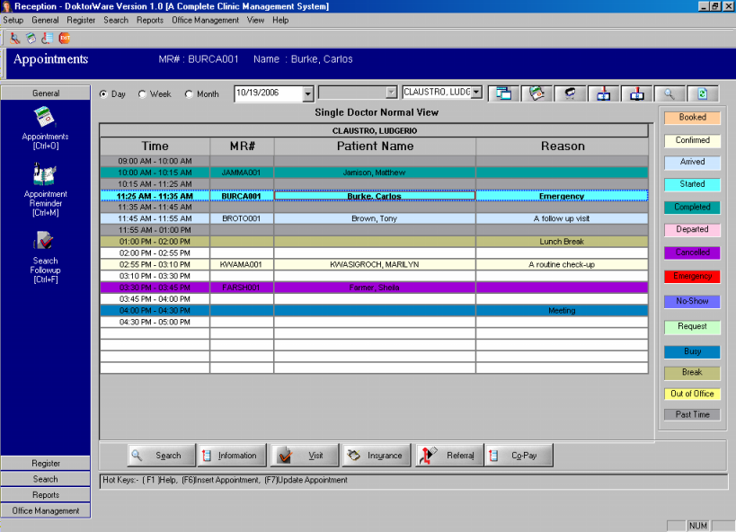
Reception
This screen allows you to fix appointment for consultation on daily, monthly or weekly basis.
The request for registration can be processed online.
Color-coded appointments
No-show/Cancelled appointment tracking
Conflict Notification

Slide 16
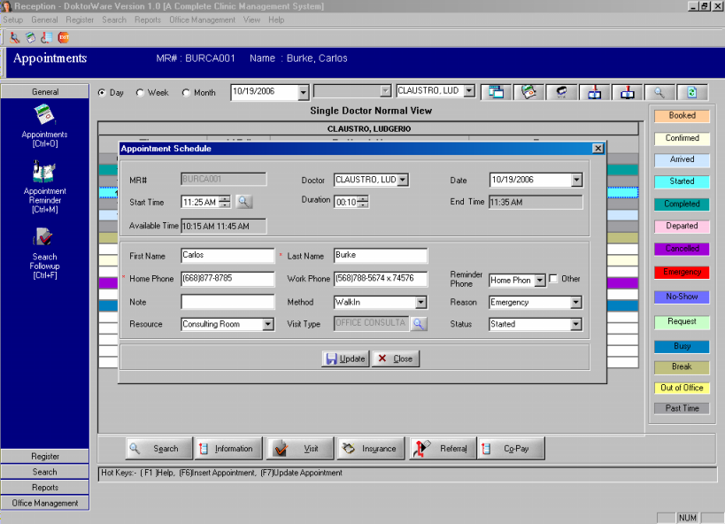
Reception
This screen allows you to fix appointment by searching free hours.
Color-coded appointments
No-show/Cancelled appointment tracking
Conflict Notification

Slide 17
Auto Dialer

Slide 18
Auto Dialer
Auto Dialer put a call to the patient in the number provided by the patient at the time of appointment fixing.
Remind the patient about the scheduled date and time of his appointment two days prior to the appointment date
In case of no response, the message will be stored in the answering machine if activated

Slide 19
Nurse Station

Slide 20
Nurse Station
Phone calls
Placer
Online (appointment request)
Walk In
Appointment
Booking
Insurance details
Patient information
Contact information
Register patient
Referral Details
Vital Signs
Social History
Family History
Visit Details
To
Selected
Doctor
Emergency
Appointment Fixing

Slide 21
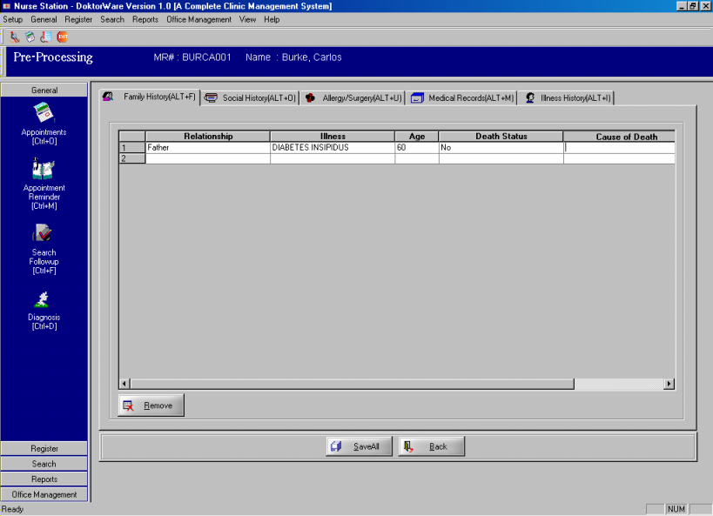
Nurse Station
Performs all functions of the Reception module
Facilitates nurses to enter the pre-processing details of the patient

Slide 22

Nurse Station
Though Nurse Station performs all functions of Reception Module, it also facilitates the nurse to enter all the medical details of a patient. Medical details involves Vital Signs, Family and Social History, Medical Record, Allergy/Surgery etc.

Slide 23

Doctors Desktop and PDA Integration

Slide 24
Doctors Desktop
Appointment scheduler/viewer
View medical records
View past visit history
Prescribe and print prescriptions
Order for external laboratory and diagnostic tests
Dictation/ Review interface
Dictation and Prescription writing using mainly i-Paq
CPT codes
ICD-9-CM codes for diagnosis.

Slide 25
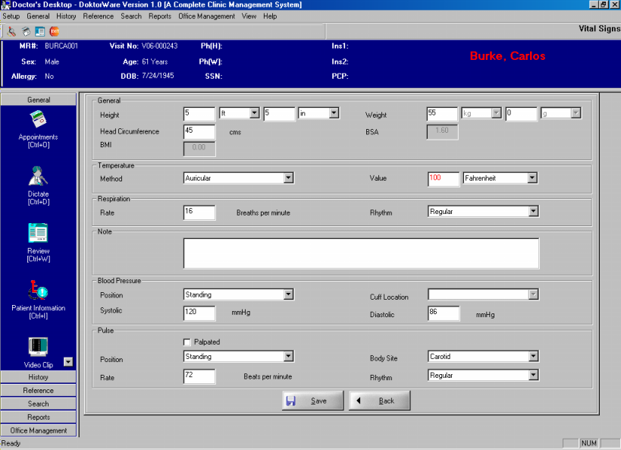
Doctors Desktop
Doctor can view the patient’s vital signs as entered in the reception module.

Slide 26
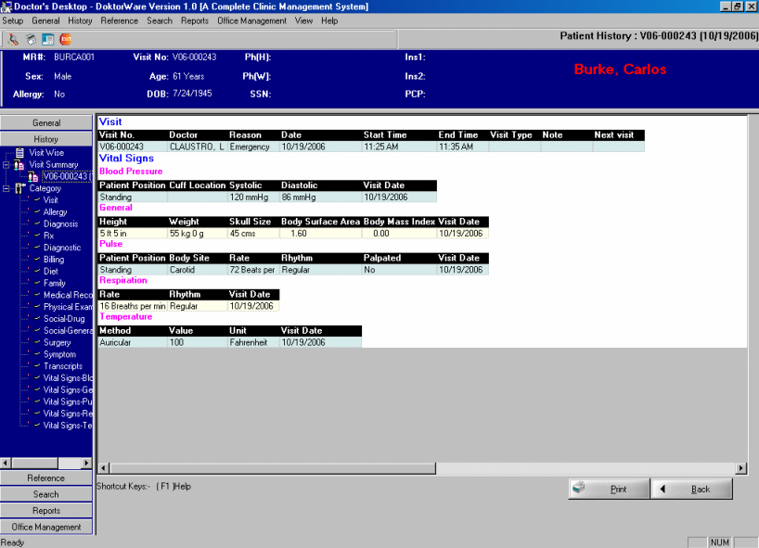
Doctors Desktop
This screen contains information on the past medical history and treatments. Either the full history or visit wise details or category wise details can be viewed.

Slide 27
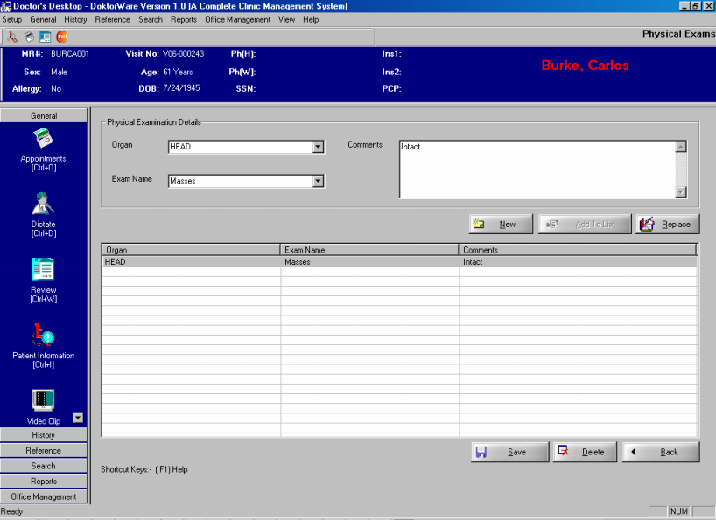
Doctors Desktop
Subjective information, Physical examinations, Diagnosis and Recommendations may be entered as part of the medical record.

Slide 28
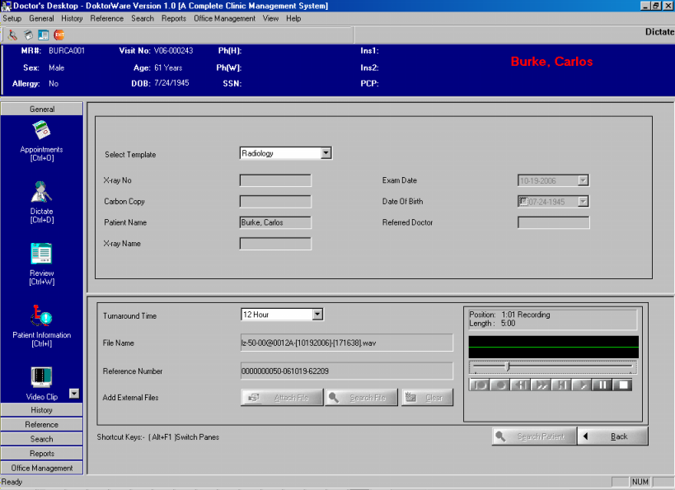
Doctors Desktop
Doctors can dictate and send the file for transcription

Slide 29
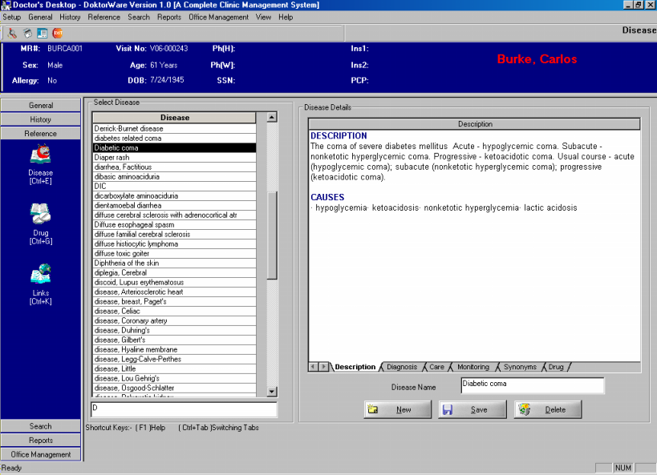
Doctors Desktop
Doctors can have the details of disease, its symptoms, diagnosis details, from the Reference for disease.

Slide 30
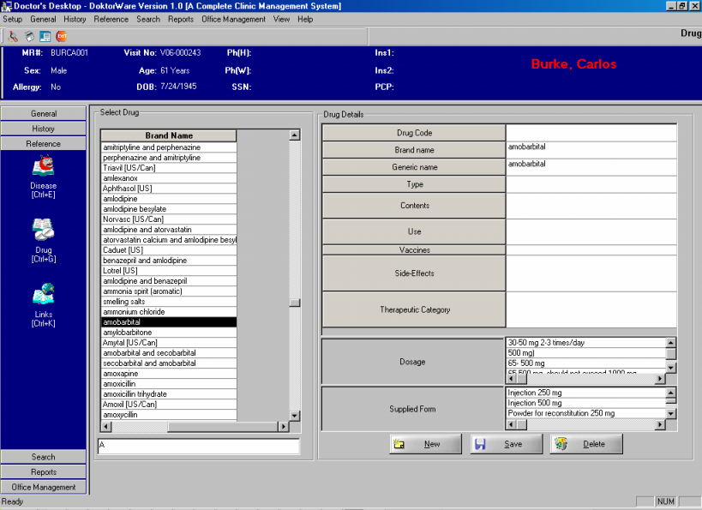
Doctors Desktop
Reference for drugs allow doctors to view as well as add new drugs.
Similarly Reference Links enable the doctor to have a list of various links for reference.

Slide 31
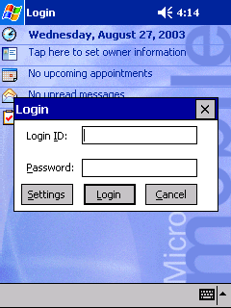
Doctors Desktop :-PDA
Doctor can login by entering his username and password.

Slide 32
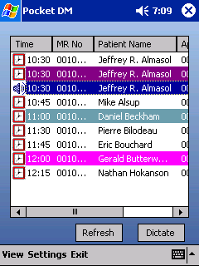
Doctors Desktop :-PDA
Doctor can download and view his/her appointments.

Slide 33
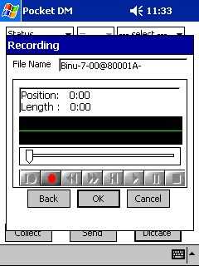
Doctors Desktop :-PDA
Record dictations in wave format. These dictations are stored inside Pocket PC to be sent for transcription

Slide 34
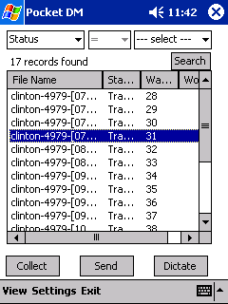
Doctors Desktop :-PDA
Files can be searched based on its
Status
Work Type,
Dictation Date
Patient Name
Medical Record Number
Visit Number. The ‘Search’ button can be used for querying the file information.

Slide 35
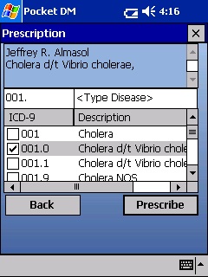
Doctors Desktop :-PDA
Diseases can be selected against the corresponding ICD9 codes

Slide 36
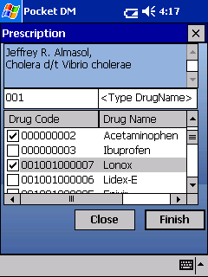
Doctors Desktop :-PDA
The drugs can be prescribed after the patient’s assessment

Slide 37
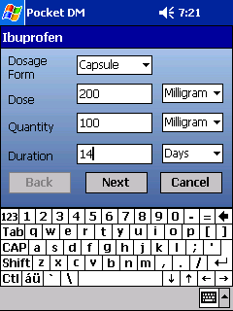
Doctors Desktop :-PDA
Dosage form, Quantity and Duration can be entered as per the prescription

Slide 38
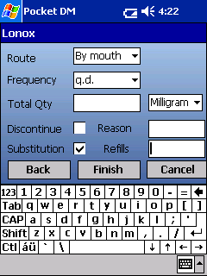
Doctors Desktop :-PDA
Doctor can mention about the method, frequency and total quantity of drug intake

Slide 39

Personnel Management

Slide 40
Personnel Management
Register employees
Audit Trial Viewer
Coordinate leaves

Slide 41
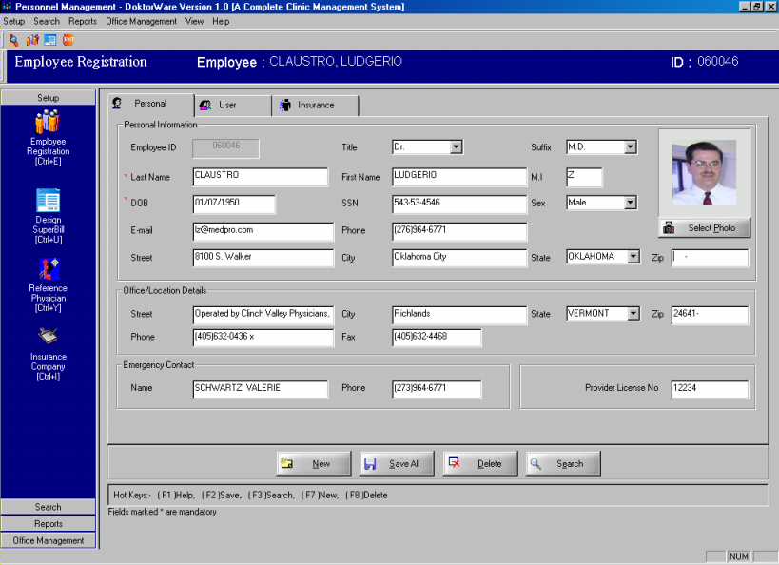
Personnel Management
This module
enables the user to add, delete or edit employee details.

Slide 42
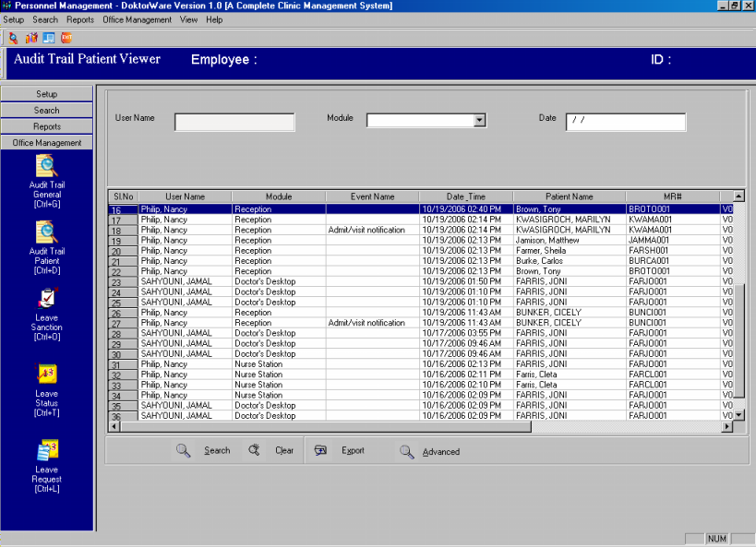
Personnel Management
Through this screen it is possible for the administrator to have a view of the various operations done by different users.Each and every operation in the system can be stored for administrative purpose.

Slide 43
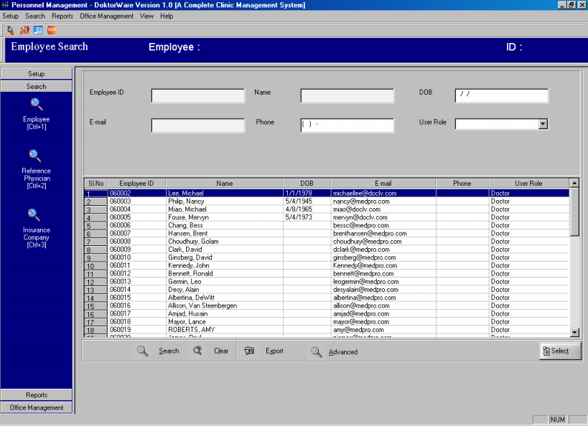
Personnel Management
Search employees using various search criteria.

Slide 44

Billing

Slide 45
Billing
The patient billing module facilitates billing, payment operations and provides automatic posting of charges related to different services.
Billing conforms to CPT.
Facilitates sending of claims using EDI.

Slide 46
Billing
Generate bills based on predefined charges for treatment and services
Mode of payment – cash, credit or debit cards
Consolidated bill generation
Submit Insurance claim using EDI
(Electronic Data Interchange)

Slide 47
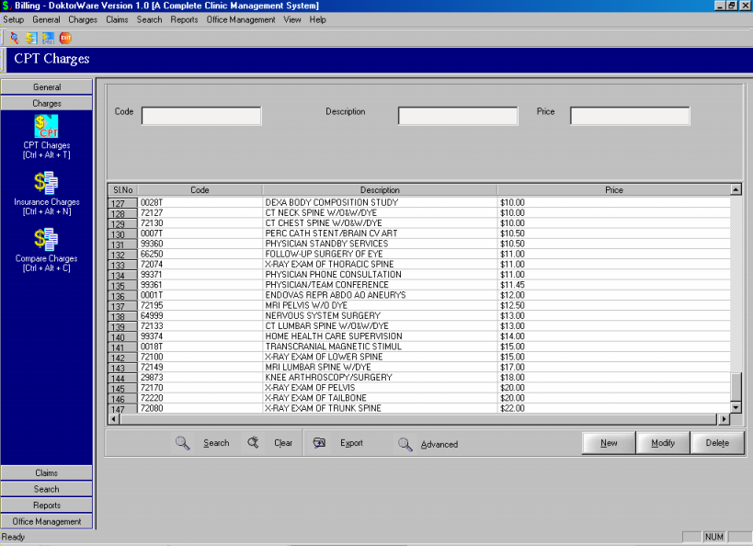
Billing
This module set charge for a CPT code, which can be filtered by Service and Specialization

Slide 48
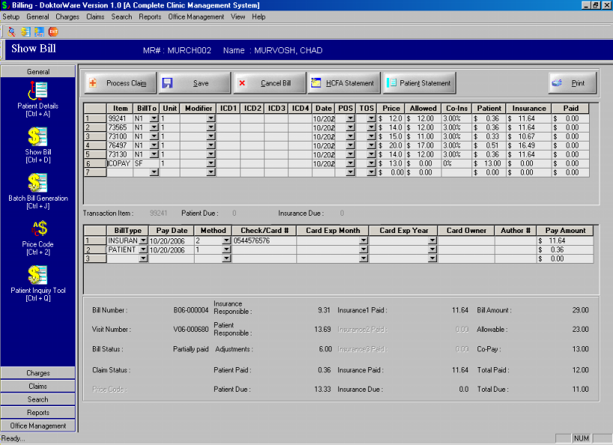
Billing
The bill generated can be viewed and payments can be collected.
The Claims for Insurance payment can be printed or sent as EDI file.

Slide 49
Web Interface

Slide 50
Web Interface
DoktorWare provides web interface for online appointment request,, online patient registration and patient interaction with doctors through mail.

Slide 51
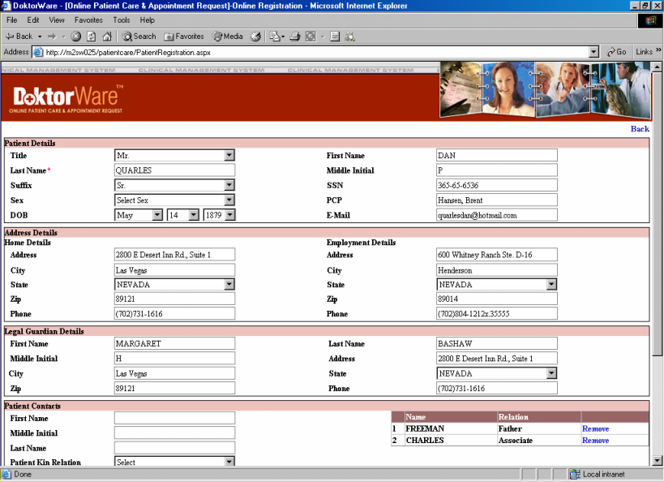
Web Interface
The patient can put his request for registration with details such as demographic information, insurance details,contact information etc online.

Slide 52
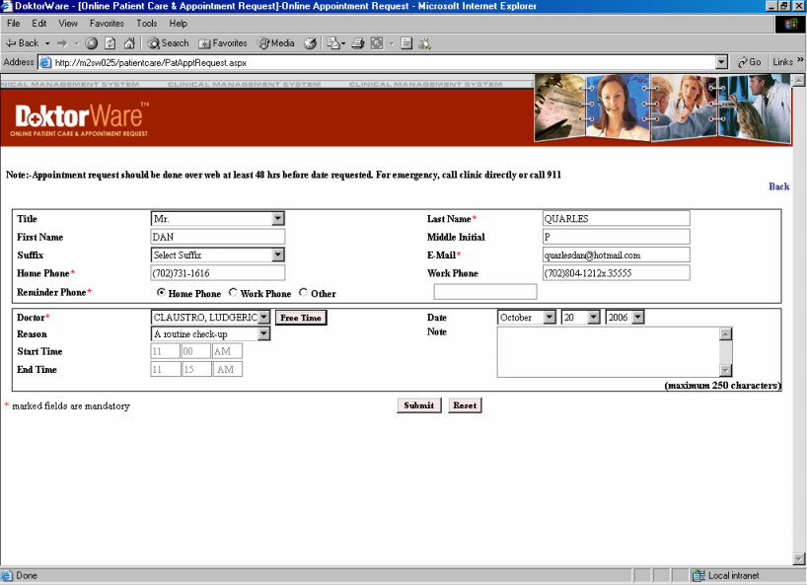
Web Interface
New patients can request for appointment through this interface.

Slide 53
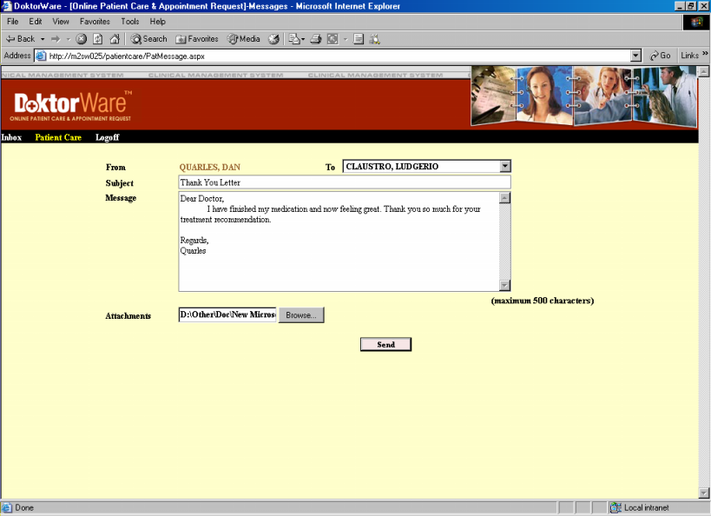
Web Interface
Registered patients can view the messages by doctors and also send back replies or message.

Slide 54
Transcription System

Slide 55
Transcription System
Integrated within DoktorWare, leading to consolidation of care and reduction in costs.
Compatible with third party transcription systems.

Slide 56
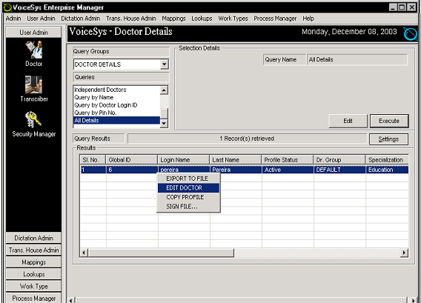
Transcription System
Allows users to edit transcription specific information related to a doctor

Slide 57
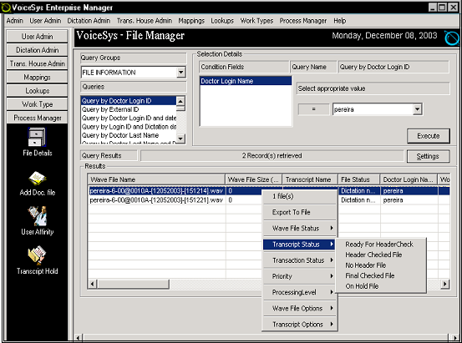
Transcription System
Enables users to manage flow of files in the system

Slide 58
Reports

Slide 59
Reports – System Specific
Daily productivity reports.
Graphical representation of the number of appointments made and time taken for each.

Slide 60
Reports – Patient Specific
SOAP format visit summaries
Past medical histories
Prescription profiles
Registration ID cards
Laboratory orders

Slide 61
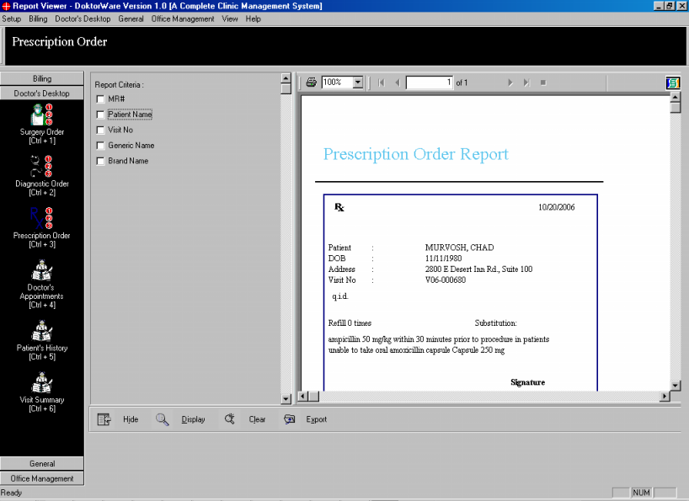
Reports
Report module generates mainly three types of reports, Billing Report and Surgery Report, and Prescription Order report. The screen indicates prescription report.

Slide 62
Security
System wide security to address Privacy & Security compliance for HIPAA.
User password controlled and administrator controlled modular access.

Slide 63
Advantages
Complete interfacing of all clinic functions allowing for better coordinated patient care.
Perpetual tracking of patients, employees and medical records for more accurate information management.
Integration of transcription system leading to cost minimization.
Consolidation of activities leading to efficient time management.

Slide 64
Client Support
Onsite initial staff training and installation support.
Product version updates provided on as needed basis.
Support and maintenance services provided on demand.

Slide 65
Conclusions
DoktorWare is a completely secure, confidential, interactive and effective management system for your healthcare facility, which is maintained by a 24/7 technical support team to meet all your requirements.

Slide 66
Corporate Office
M2ComSys Inc.
811 Grier Dr., Suite D
Las Vegas, NV 89119
Phone: (702)-733-8781
Fax: (702)-733-7961
M2 Software Developments & Exports (P) Ltd.
M2 Building
Technopark Campus
Trivandrum
Phone : 0091- 471- 3950581
e-mail: m2info@m2comsys.com
www.m2india.com

