Slide 1
CURRICULUM
VITAE
PRESENTATION TEMPLATE

Slide 2
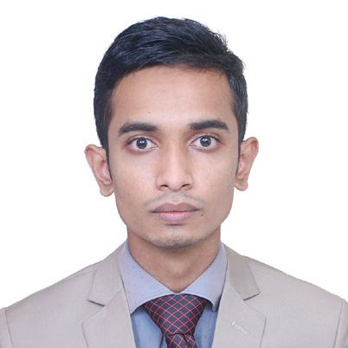
PERSONAL PROFILE
JUEL AHMED
Office Attendent

Slide 3
EDUCATION HISTORY
Murari Chand College Bachelor of Applied Science - BASc · (January 2020 - February 2025)

Slide 4
SKILLS
Typing: Office Associate at Shahjalal University of Science and Technology
Email:
Office Associate at Shahjalal University of Science and Technology
General Office Work:
Office Associate at Shahjalal University of Science and Technology

Slide 5
WORK EXPERIENCE
2016 - Now
Office Attentent
Office Of The Vice Chancellor
Shahjalal University of Science and Technology

Slide 6
LANGUAGES
Bangla
90 %
English
70 %
Hindi
80 %

Slide 7
Contact Me
PHONE NUMBER
+8801728827497
EMAIL
juelahmed373@gmail.com
JUEL AHMED

Slide 8
THANKS

