Slide 1

Tidyverse Day 1!
Shady and Meg
April 2026

Slide 2

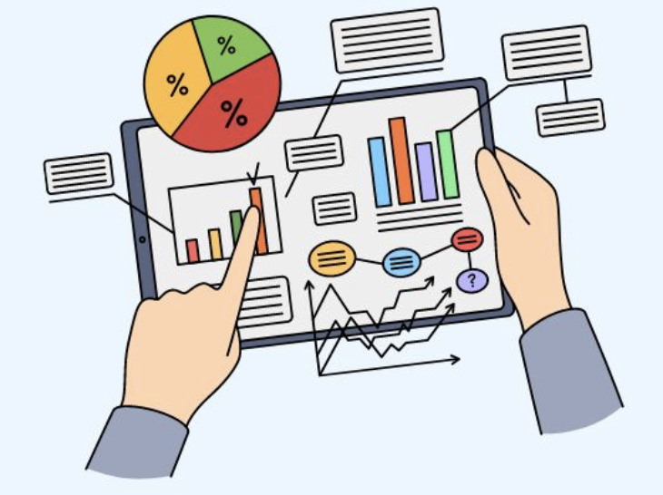
Monday
Wednesday
What is tidy data?
Data types + structures review
5-10min break
Cleaning up a real dataset
Day 1 brief review
Data formatting
Applications of tidy data
Real dataset analysis

Slide 3
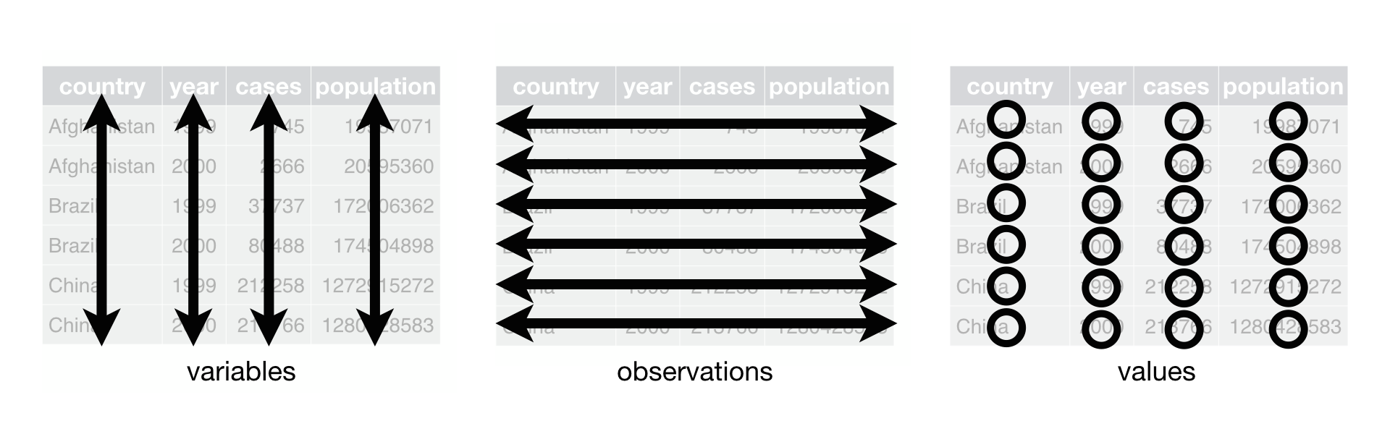
What is tidy data?
“a standardized, structured format for organizing datasets to make analysis, visualization, and manipulation easier”
Three main rules:
Each variable is a column
Each observation is a row
Each cell represents a single value
Notes:
Narratively cover the word picture thing

Slide 4

Common ‘untidy’ data characteristics
Column headers are values, not variable names.
Multiple variables are stored in one column.
Variables are stored in both rows and columns.
Multiple types of observational units are stored in the same table.
A single observational unit is stored in multiple tables.
Tidy datasets are all useable; untidy datasets are unusable in their own ways
Notes:
But untidy data is not useless! → move that sentence to after example!!

Slide 5
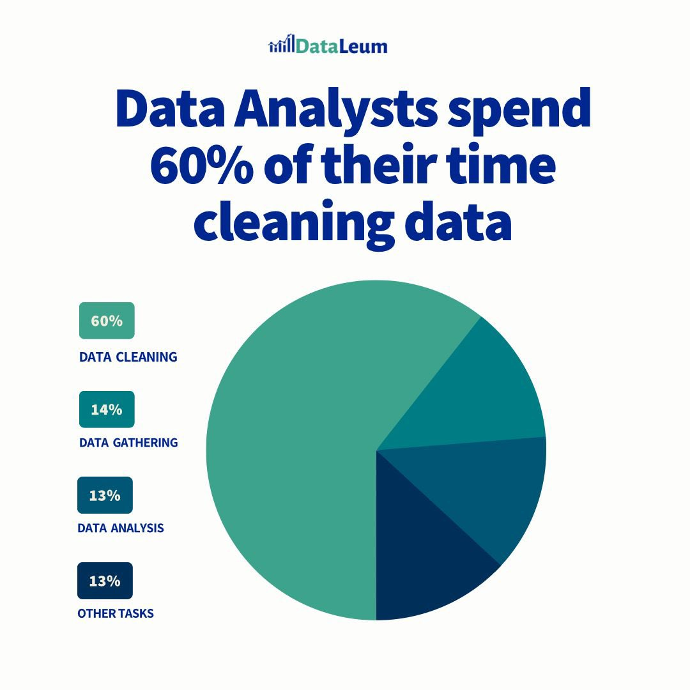
Why do we want a tidy dataset?
Easier to analyze:
Some R commands expect data to be formatted tidily
Some statistics require data to be formatted a certain way
Easier to plot
To produce a desired plot, you must know how to format your data for that plot

Slide 6
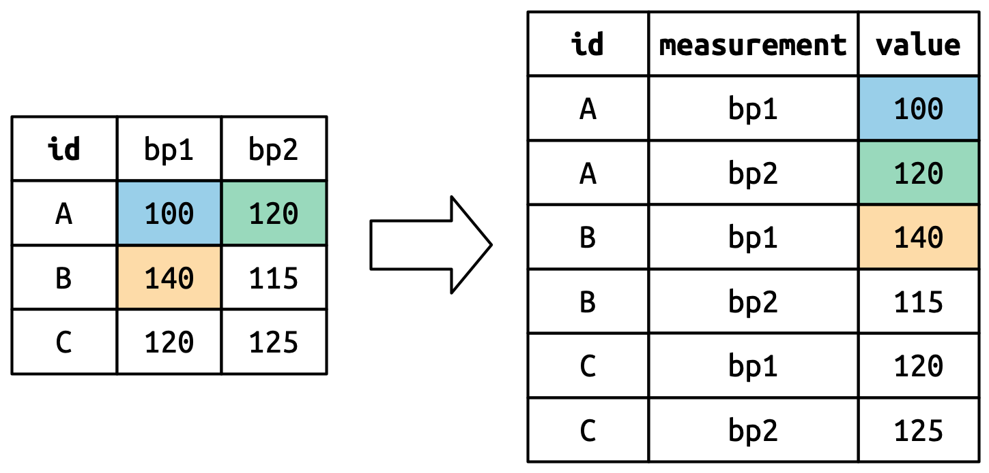
Having tidy data from the get-go
Sometimes, data must be collected in non-tidy ways
Think about what you want to analyze and how to format your data to answer it – before data collection begins!
Reformat data to tidy guidelines

Slide 7
Sooo…. Tidy data is…normal data?
These concepts might seem obvious, but there are differences
all tidy data is normal data but not all normal data is tidy data!
Most data you encounter will be untidy because:
Most people haven’t heard of it, and you can’t easily deduce the rules yourself
Data is often organized to help with other items (data entry, quick look, etc.) rather than analysis

Slide 8
Data types
Logical
Numeric
Double
Integer
Character
Factor
Divide into groups to define each of these. What are examples of each type?
(3min)
Notes:
Have students look up what these are with people nearby

Slide 9
Data types
Logical: boolean indicator data type; 0,1 or FALSE, TRUE
Numeric: general number; 0.111, 3, 400
Double: default type of numeric; 0.002, 1.20 (1 is also stored as double)
Integer: specific type of numeric; 1L, 4L
Character: string of letters, characters, words; “hello”, “Y”, “,”, “3”
Factor: meaningful categories with levels; “Strain A”, “Strain B”, “Strain C”

Slide 10
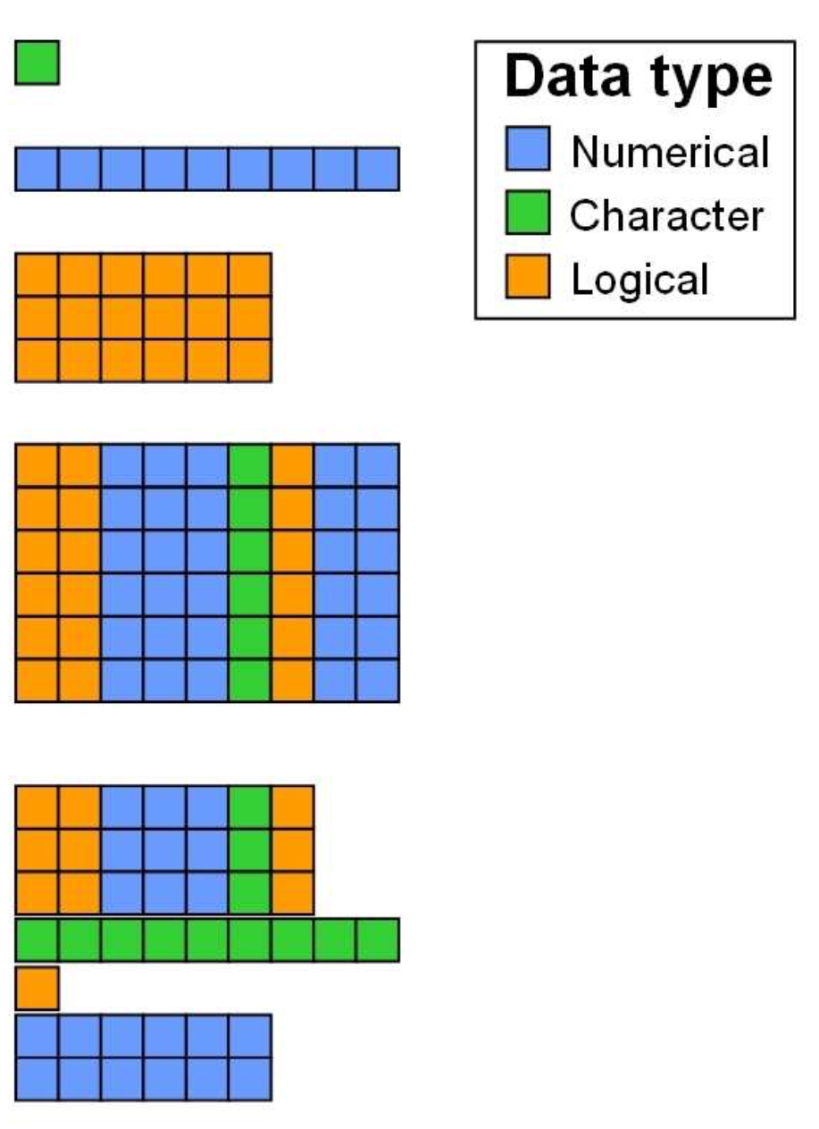
Scalar
One value, one data type
Vector
One dimension, one data type
Matrix
Two dimensions, one data type
Dataframe
Two dimensions, multiple data types (by columns)
List
Multiple dimensions, multiple data types

Slide 11
Data frames
header row
ID | Class | Age | Score | Score_C
0001 | “Johnson” | 27 | 4.3 | “B”
0098 | “Johnson” | 24 | 5.0 | “A”
0070 | “Sydney” | 22 | 2.4 | “D”
rows
columns

Slide 12
Data frames
ID | Class | Age | Score | Score_C
0001 | “Johnson” | 27 | 4.3 | “B”
0098 | “Johnson” | 24 | 5.0 | “A”
0070 | “Sydney” | 22 | 2.4 | “D”
Q1. What is each column’s data type?
Q2. If we were to make one of these a factor, which would we do?
– discuss with someone nearby –

Slide 13
Functions to filter / summarize data frames
filter(df, [condition])
Choose rows that match a condition
select(df, [list of columns to keep])
Choose desired columns
summarise(df, [columns])
Get summary statistics
group_by(df, c([columns]))
Artificially group rows by desired variables
Notes:
Also specify here that some packages share the same function name as dplyr::select so you have to use the :: operator to pull the dplyr version of select

Slide 14
Functions to filter / summarize data frames (examples)
filter(data, genotype == “A”)
select(data, name, age)
summarise(data, num = n(), meanA = mean(age))
group_by(data, c(age, class))

Slide 15
Functions to modify data frames
mutate(df, colName = [how to create])
Create new column from existing columns
Joining (e.g., inner_join, left_join, right_join, anti_join)
Merge two data frames based on unique, identifying columns
Change data types (e.g., as.numeric, as.character, factor, as.Date)
Force data conversion
arrange
Sort data in ascending/descending order based on desired column(s)

Slide 16
Functions to modify data frames (examples)
mutate(data, mcRate = rate / mass)
inner_join(data1, data2, by = “ID”) #matches ID present in both data 1 and 2
as.numeric(data$age)
factor(data$class,
levels = c(“johnson”, “hemmerlein”, “kuster”),
labels = c(“J”, “H”, “K”)) #renames class levels and orders them how you want
arrange(data, ID, age) #sorts by ID then by age, ascending for both

Slide 17
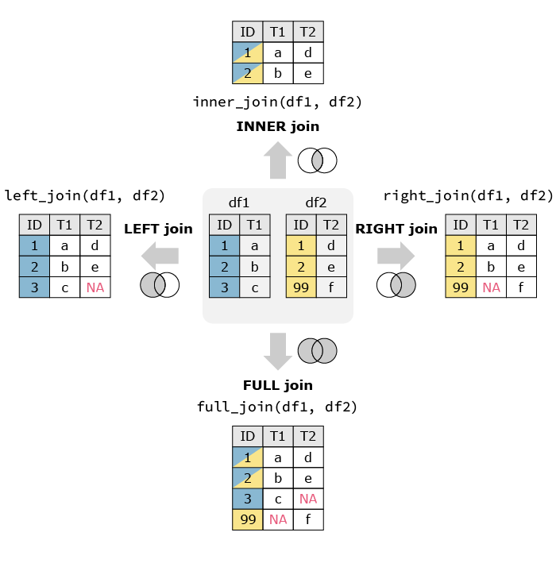
Note on joins:
2 or more data frames
A unique identifier column
ANTI join
anti_join(df1, df2, by = “ID”)
ID | T1
3 | c

Slide 18
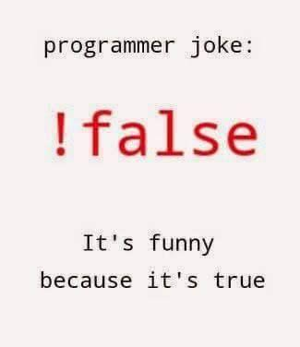
Note on logical tests:
Is A equal to B?
A == B
Is A greater than B?
A > B
Is A greater than or equal to B?
A >= B
Is A not equal to B?
A != B
Is A in my vector myVector?
A %in% myVector

Slide 19

5-10min break

Slide 20
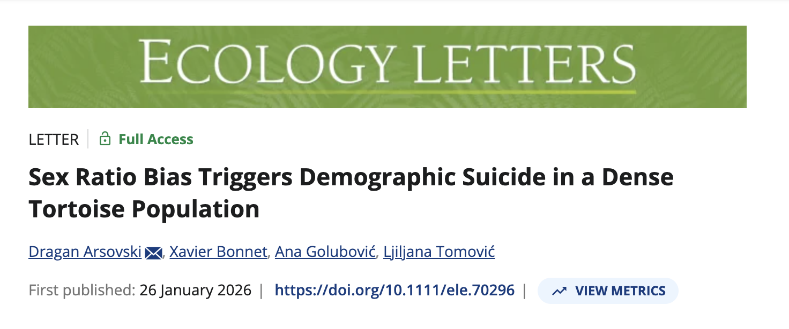
Dataset Introduction

Slide 21
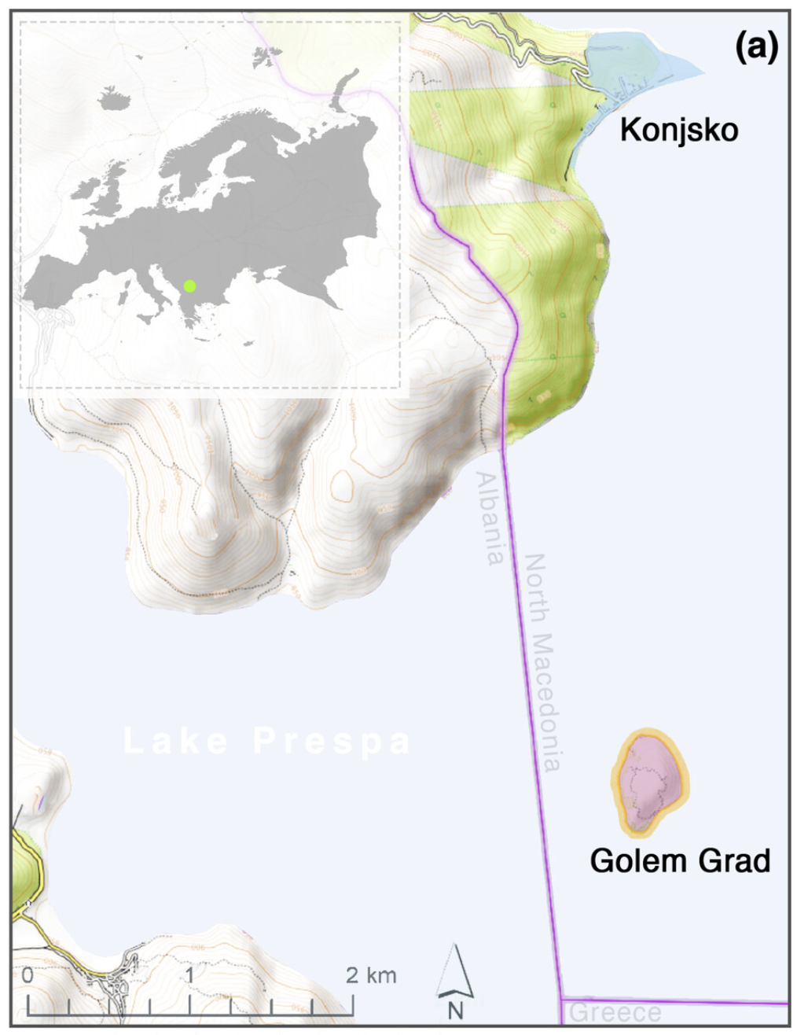
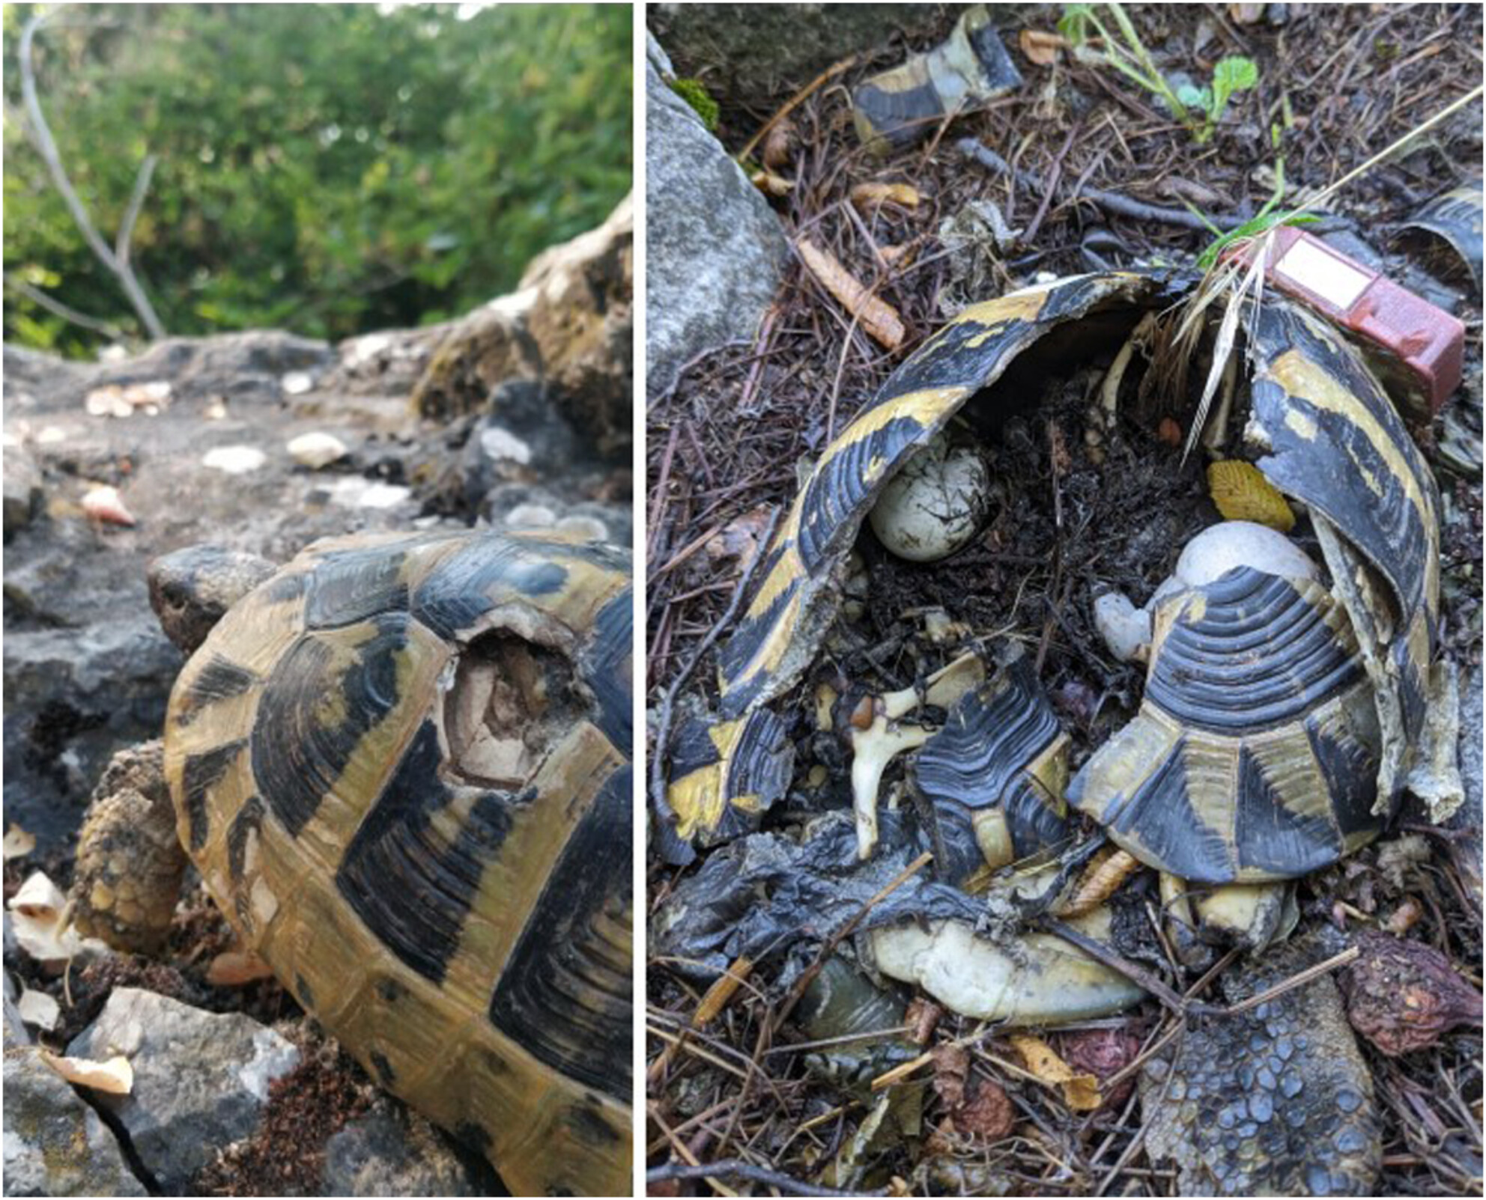
Island tortoises & sex bias
Near even sex ratio
Extinction vortex: process through which species becoming increasingly in danger of extinction, exacerbated by environmental, demographic, and genetic characteristics
Beach
More males
Hermann’s tortoise from Golem Grad injuries from cliff falls
Very few females
Notes:
Both images from https://onlinelibrary.wiley.com/doi/10.1111/ele.70296 manuscript “Sex Ratio Bias Triggers Demographic Suicide in a Dense Tortoise Population”

Slide 22
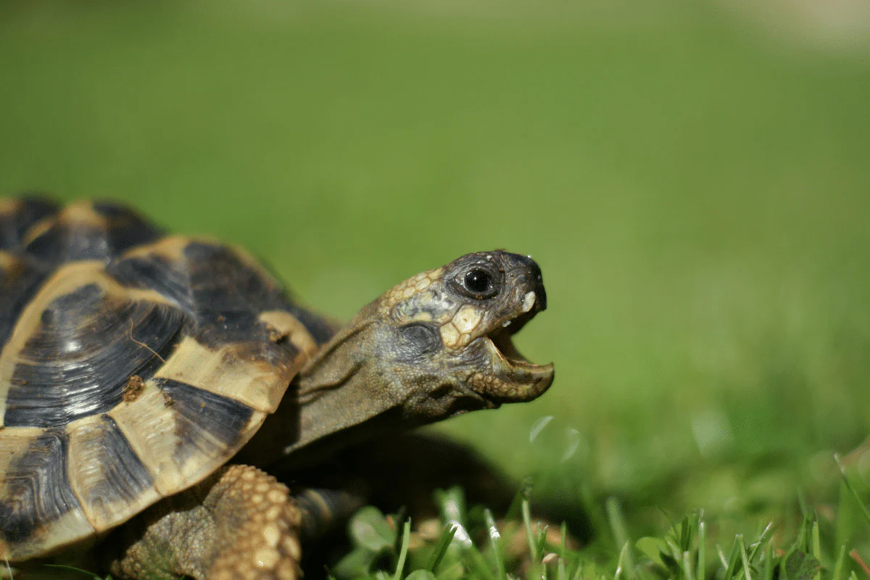
Dataset variables
SCL: carapace length (length of top of the shell)
BM: body mass
Year: year of capture
Season: season of capture
Loc: where the tortoise was captured from
BCI: body condition
Year_recode: year of study duration tortoise was captured in
Notes:
Image sourced from https://homeandroost.co.uk/

Slide 23
Okay let’s get going!
First, create a new directory (folder) specific for this week’s class
Then, download the .Rmd for Day 1 and put it in that folder
Download the zipped data file & move the (unzipped) folder to the class dir: https://figshare.com/articles/journal_contribution/Sex_ratio_bias_triggers_demographic_suicide_in_a_dense_tortoise_population/30752687
Open the .Rmd in R

Slide 24
Tidyverse Day 2!
Shady and Meg
April 2026

Slide 25
Monday
Wednesday
What is tidy data?
Data types + structures review
5-10min break
Cleaning up a real dataset
Day 1 brief review
Data formatting
Applications of tidy data
Real dataset analysis

Slide 26
Last class
Defined tidy data
Learned data types (logical, numeric)
Learned functions to clean up a dataset
Filter, select, summarise
Mutate, joining, as.functions
Joining
Generated cleaned dataset for island turtles
Nice!

Slide 27
Data types
Logical: boolean indicator data type; 0,1 or FALSE, TRUE
Numeric: general number; 0.111, 3, 400
Double: default type of numeric; 0.002, 1.20 (1 is also stored as double)
Integer: specific type of numeric; 1L, 4L
Character: string of letters, characters, words; “hello”, “Y”, “,”, “3”
Factor: meaningful categories with levels; “Strain A”, “Strain B”, “Strain C”

Slide 28
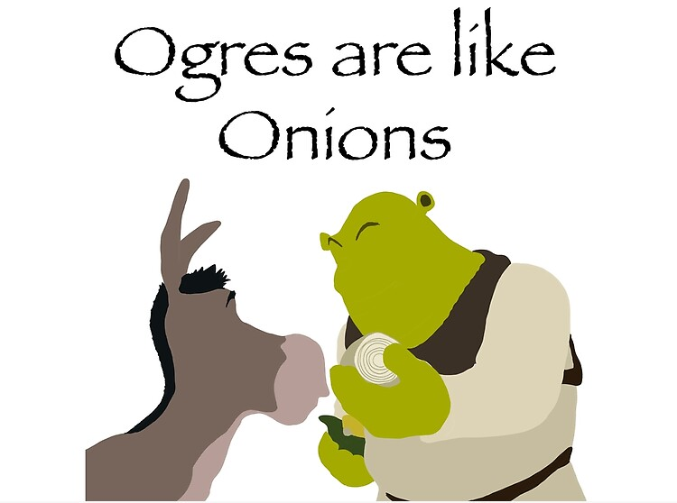
Factors have levels
Ordered visualization: allows for re-ordering on plots
Proper modeling: statistical testing requires at least one factor with categorical variables
ex) the impact of locality on egg size (egg size ~ locality)
Setting a reference group: important for statistical testing in which you want a reference group
ex) the effect of treatment on cell count (cell count ~ treatment)
you’d want ‘saline control’ as a reference, rather than ‘Drug A’

Slide 29

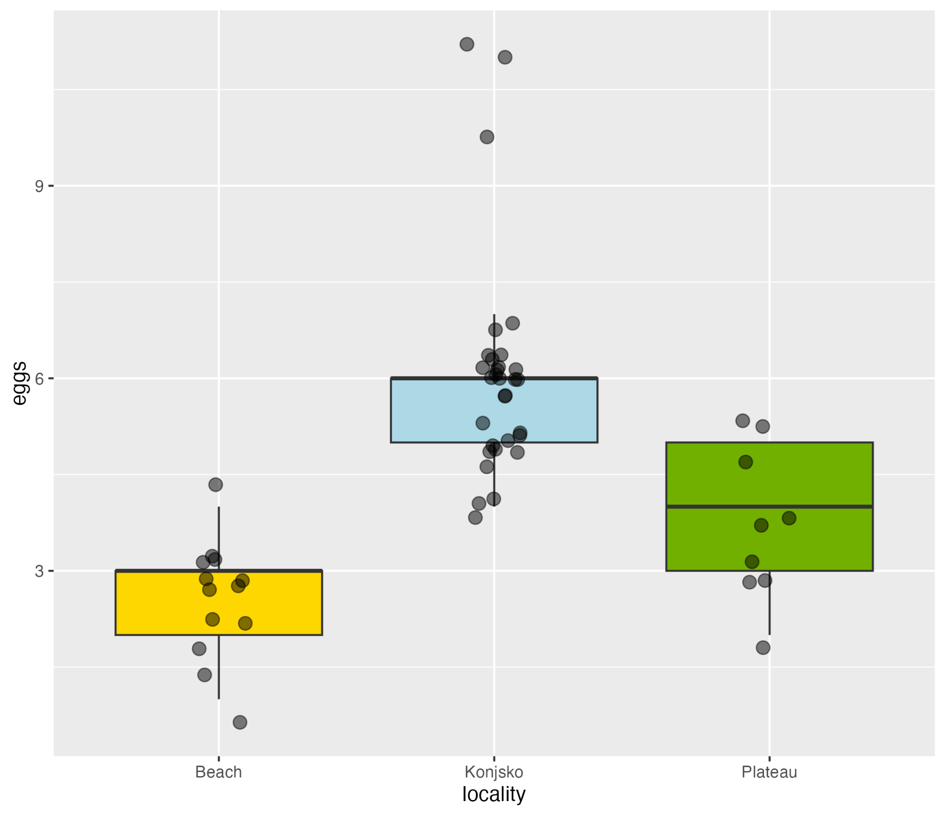
Re-leveling and re-coding factors
class(df$column)
df$column = as.factor(df$column)
levels(df$column)
df = df %>%
mutate(column =
fct_relevel(column, "A", "C", "B")
df = df %>%
mutate(column =
fct_recode(column,
“New_name1” = "Old_name1",
“New_name2” = "Old_name2",
“New_name3” = "Old_name3")

Slide 30
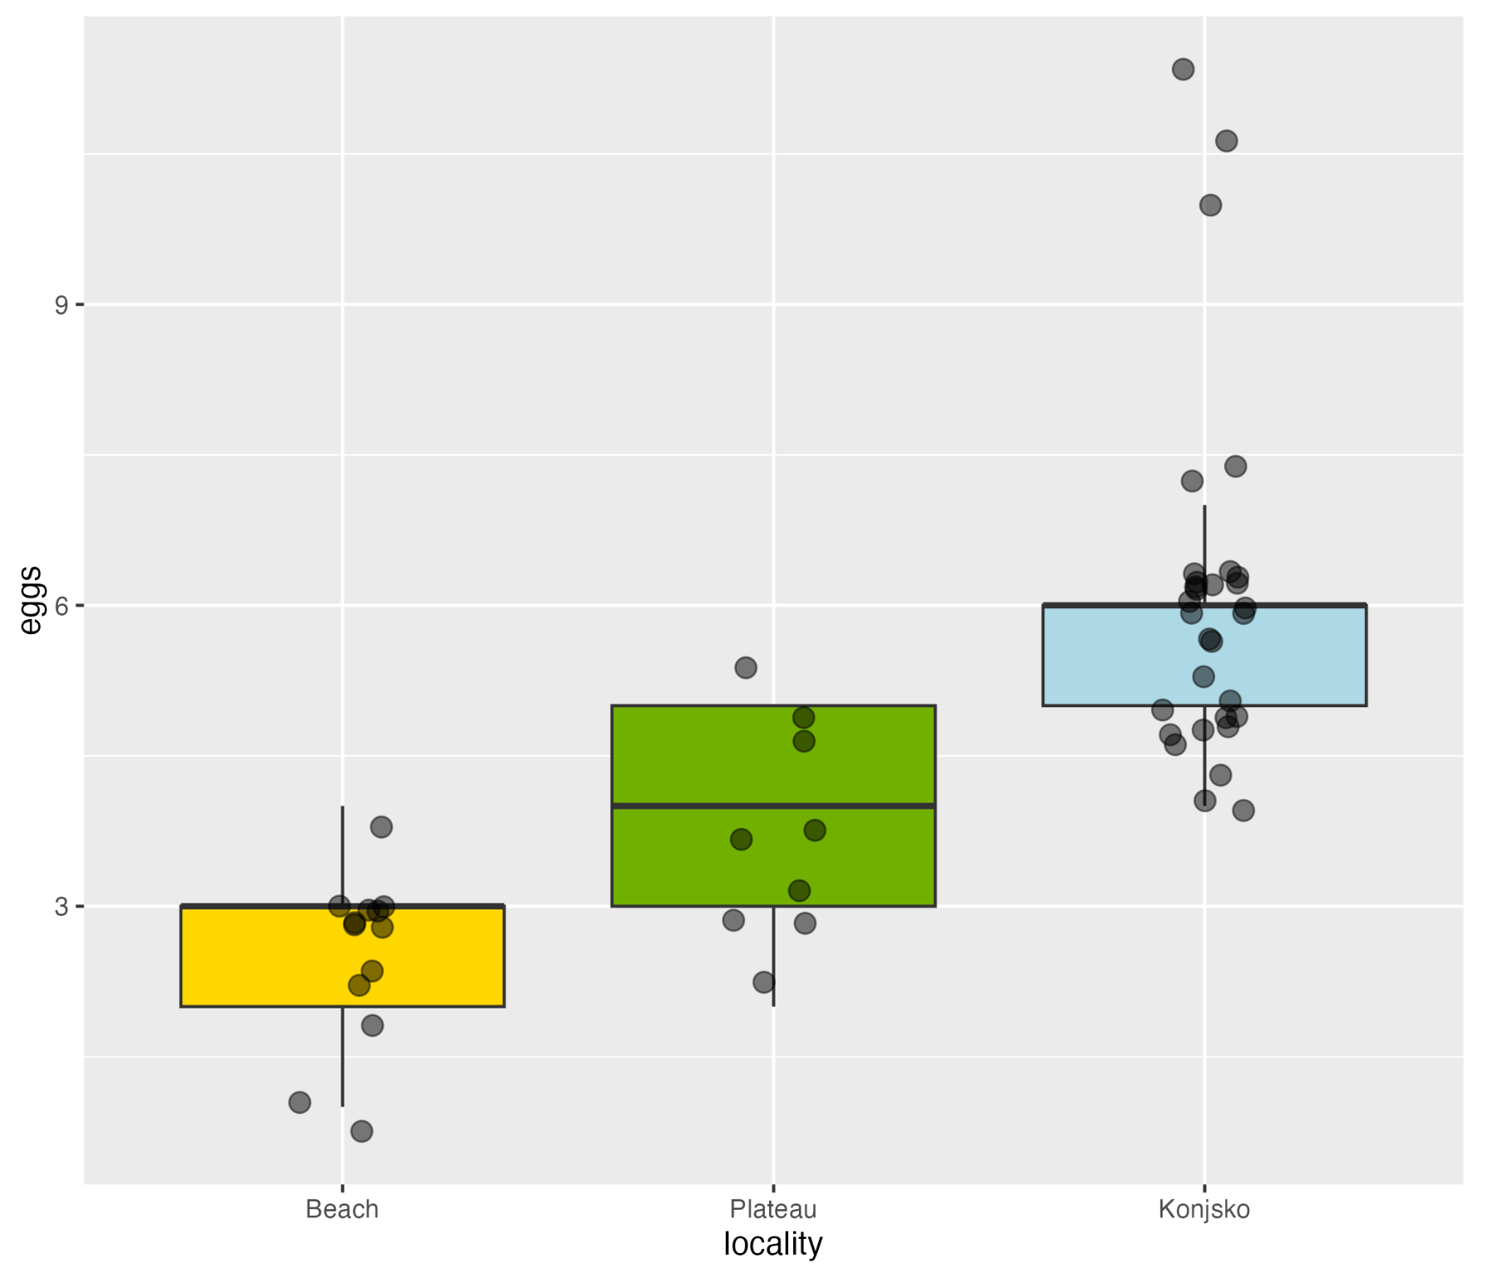
Re-leveling factors (example)
class(clutch_size$locality)
clutch_size$locality = as.factor(clutch_size$locality)
levels(clutch_size$locality)
clutch_size = clutch_size %>%
mutate(locality = fct_relevel(locality,
"Beach",
"Plateau",
"Konjsko")))

Slide 31
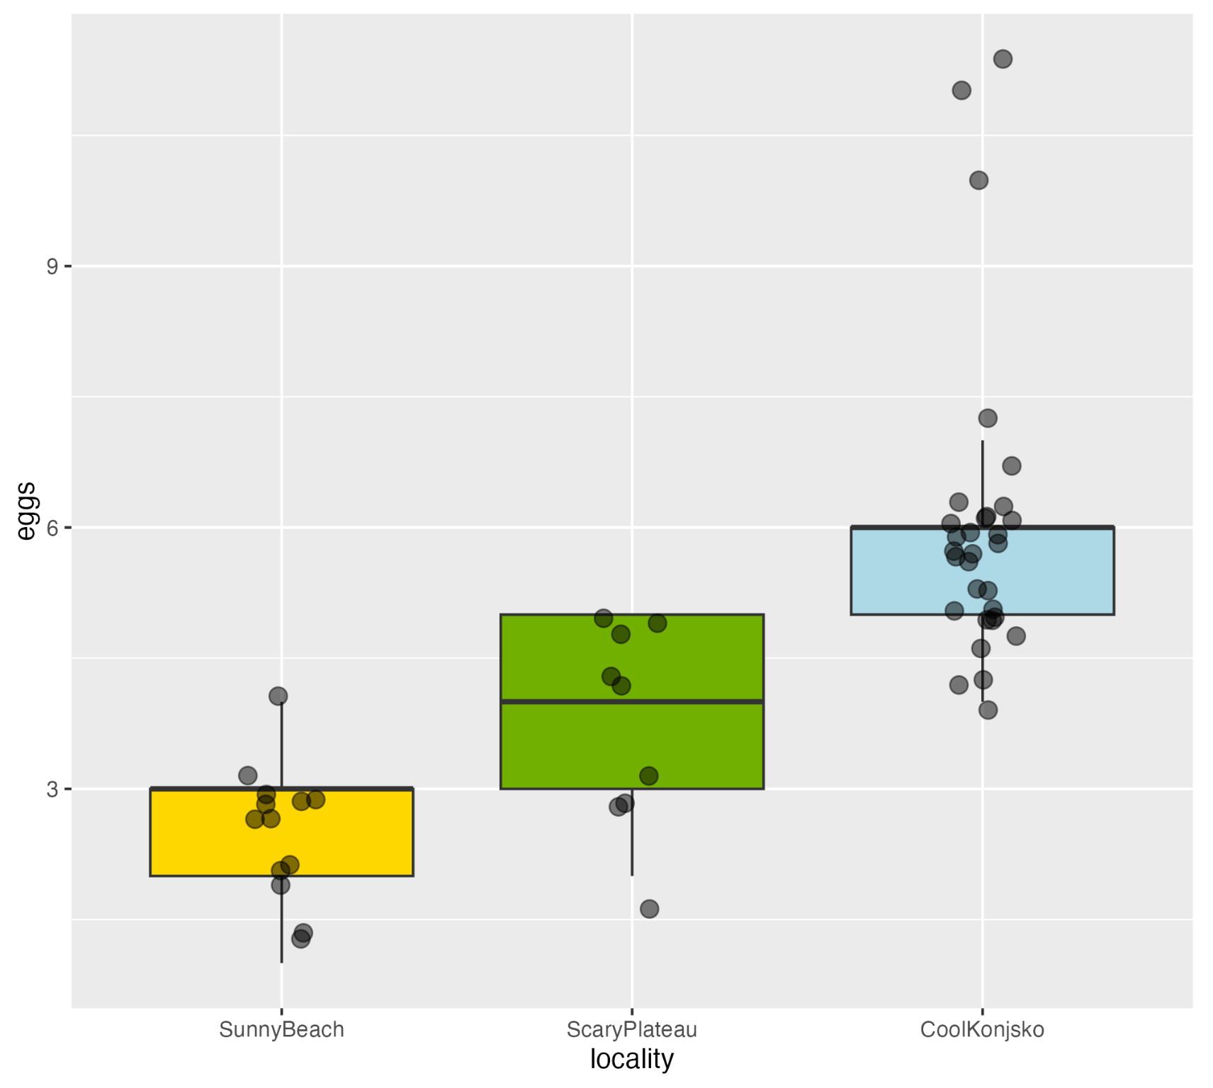
Re-coding factors (example)
clutch_size = clutch_size %>%
mutate(locality = fct_recode(locality,
"SunnyBeach" = "Beach",
"ScaryPlateau" = "Plateau",
"CoolKonjsko" = "Konjsko"))

Slide 32
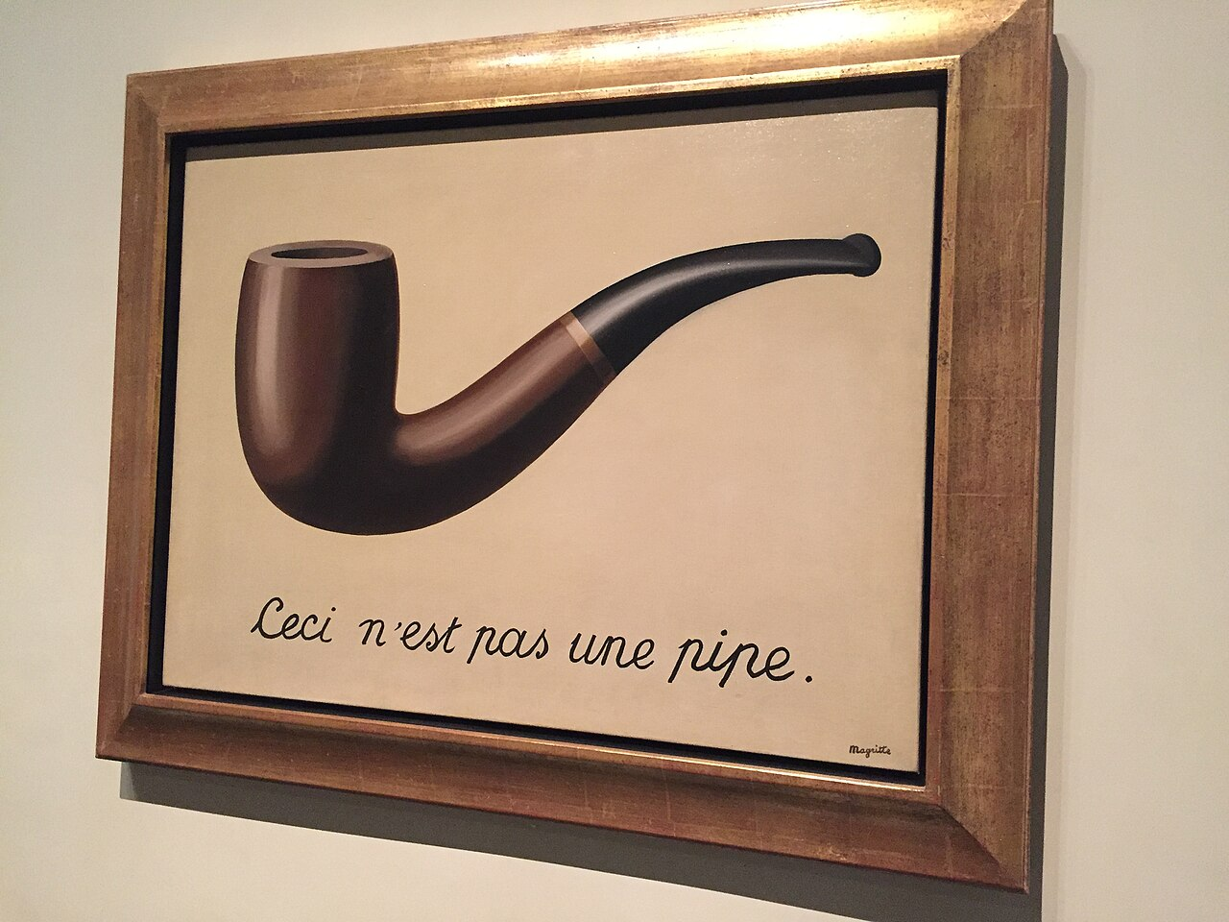

Piping
Treachery of Images (1929) Rene Magritte
clutch_size = clutch_size %>%
mutate(locality = fct_relevel(locality,
"Beach",
"Plateau",
"Konjsko")))
Magrittr package

Slide 33
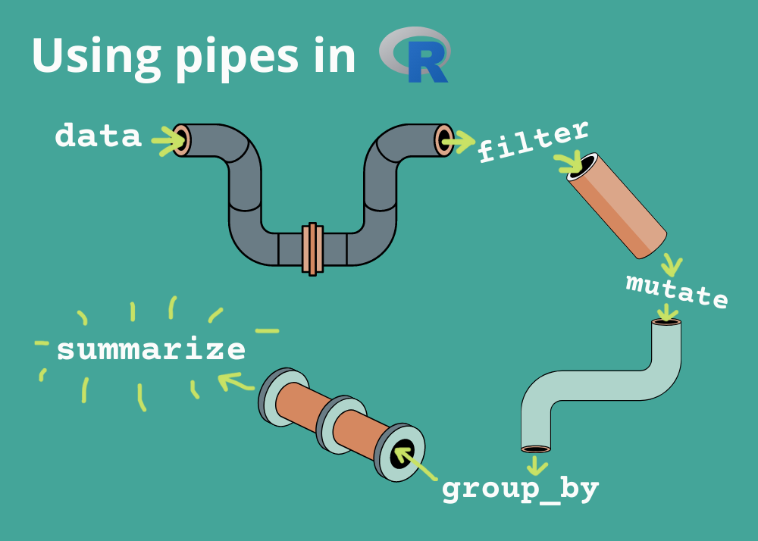
Why use piping?
Structuring sequences of data operations left-to-right (as opposed to from inside and out)
Avoiding nesting function calls
Minimizing the need for local variables and function definitions
Making it easy to add steps anywhere in the sequence of operations

Slide 34
Many local variables
Tortoise_body_condition_selected =
select(tortoise_body_condition, -c(...1, res, log_BCI, loc_sex_cohort))
Tortoise_body_condition_selected_grouped =
group_by(Tortoise_body_condition_selected, ind)
Tortoise_body_condition_selected_grouped_arranged =
arrange(Tortoise_body_condition_selected_grouped, year_recode,
.by_group = TRUE)

Slide 35
Nested coding
Tortoise_body_condition_selected_grouped_arranged =
dplyr::arrange(
dplyr::group_by(
dplyr::select(
tortoise_body_condition,
-c(...1, res, log_BCI, loc_sex_cohort)),
ind),
year_recode, .by_group = TRUE)

Slide 36
Piped code example
Tortoise_body_condition_cleaned =
tortoise_body_condition %>%
select(-c(...1, res, log_BCI, loc_sex_cohort)) %>%
group_by(ind) %>%
arrange(year_recode, .by_group = TRUE)

Slide 37
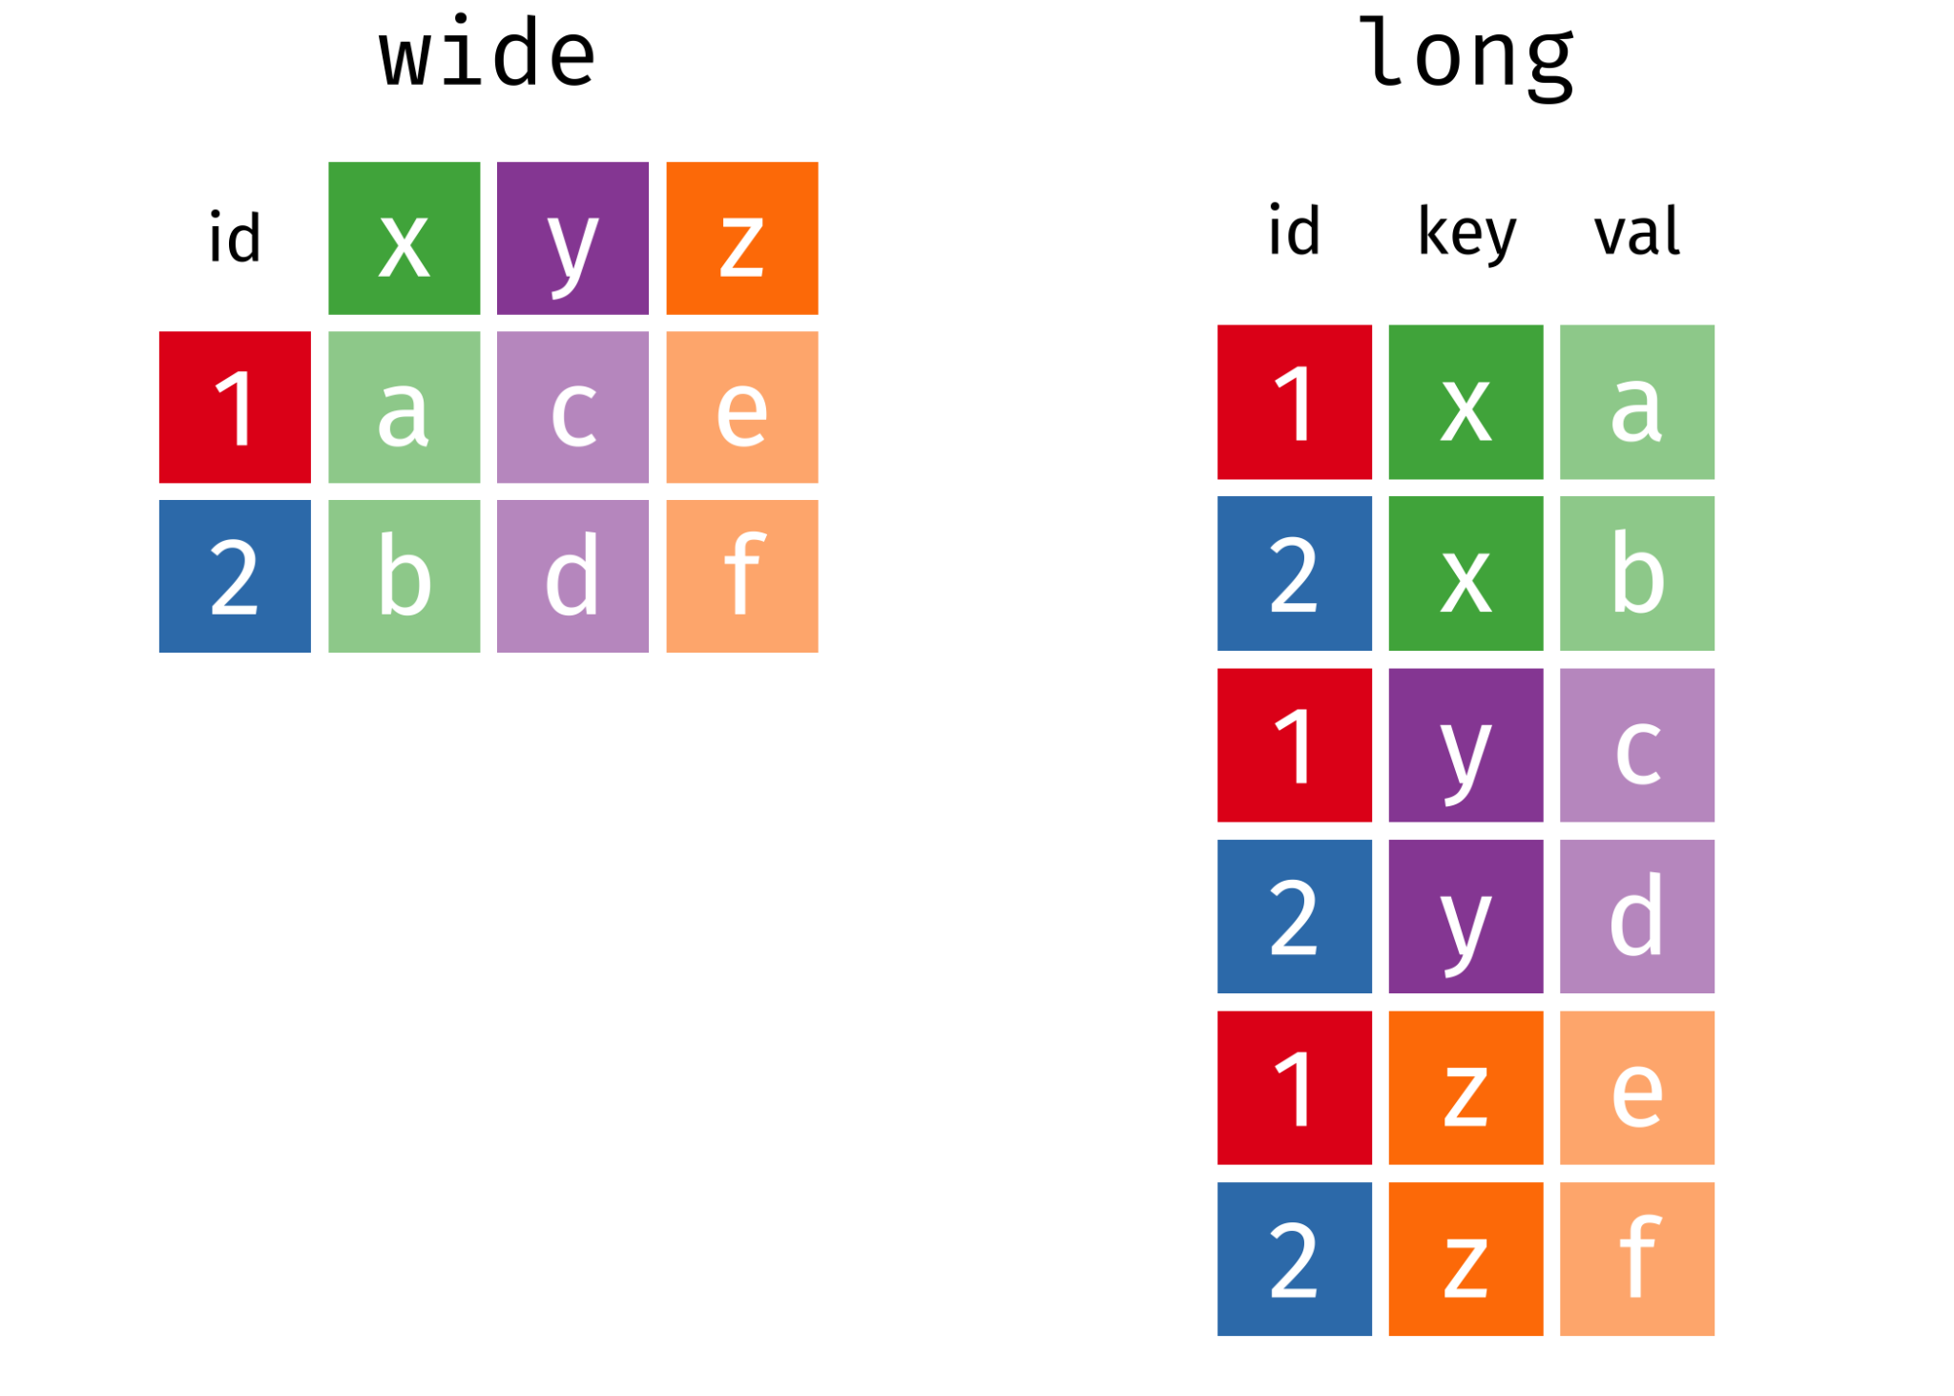
Wide vs long format data

Slide 38
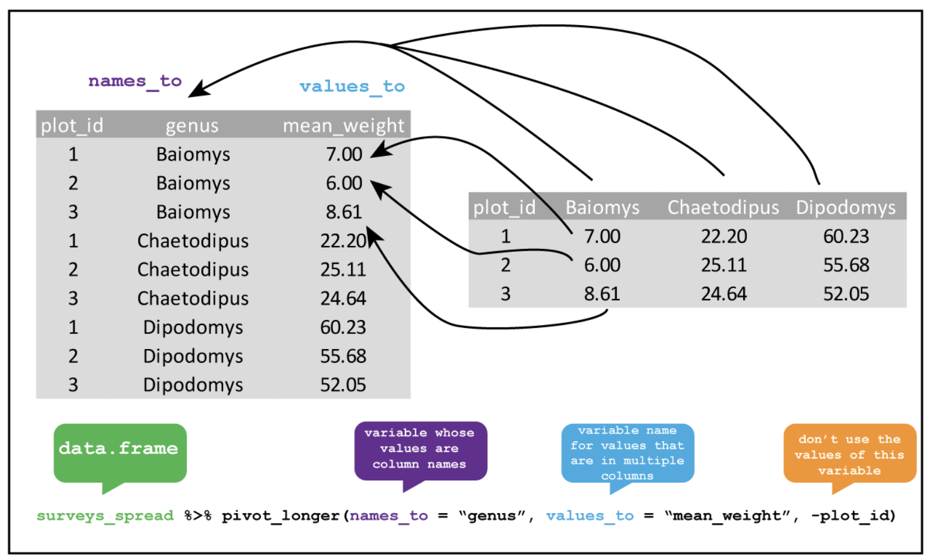
Pivot longer

Slide 39
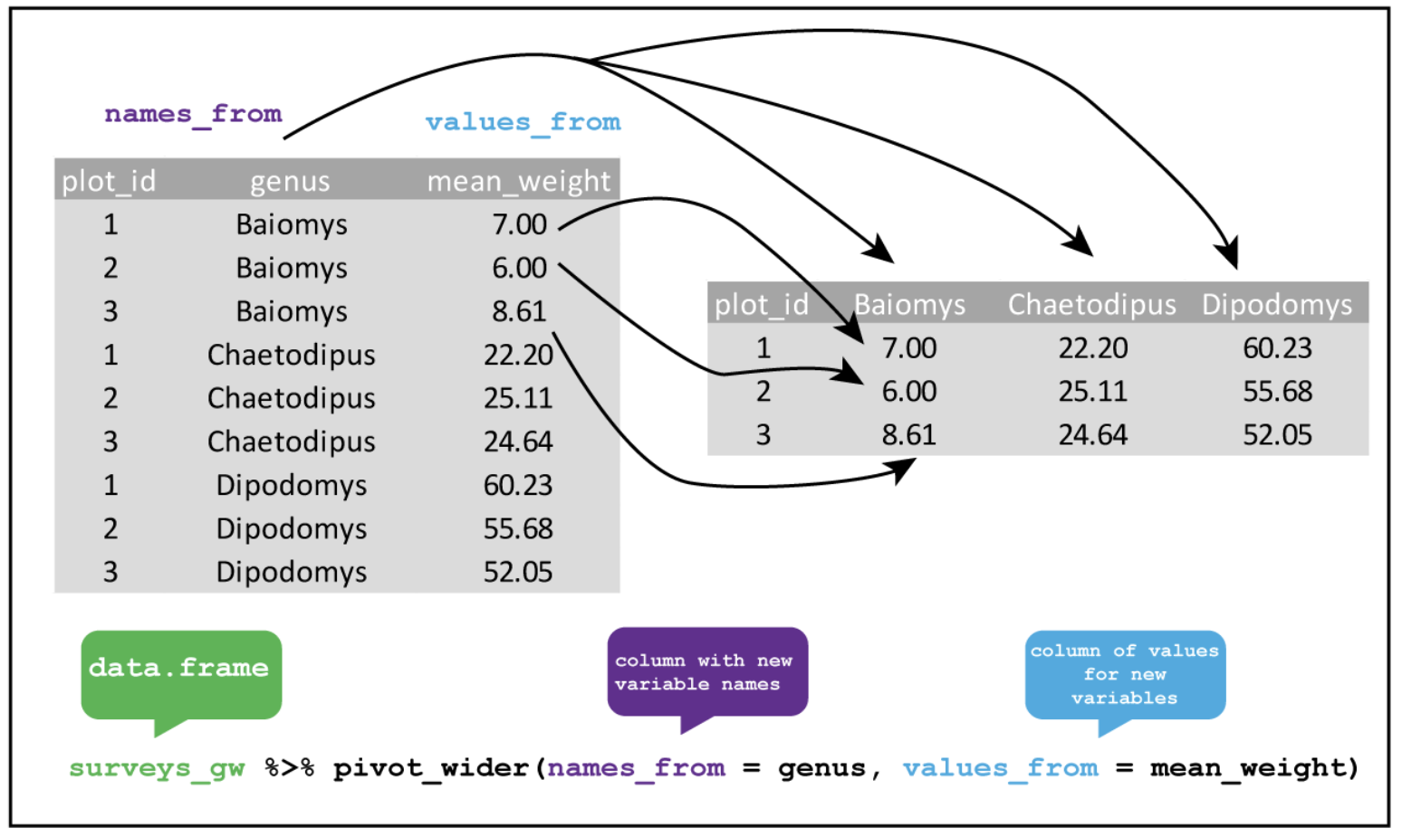
Pivot wider

Slide 40

5-10min break

Slide 41
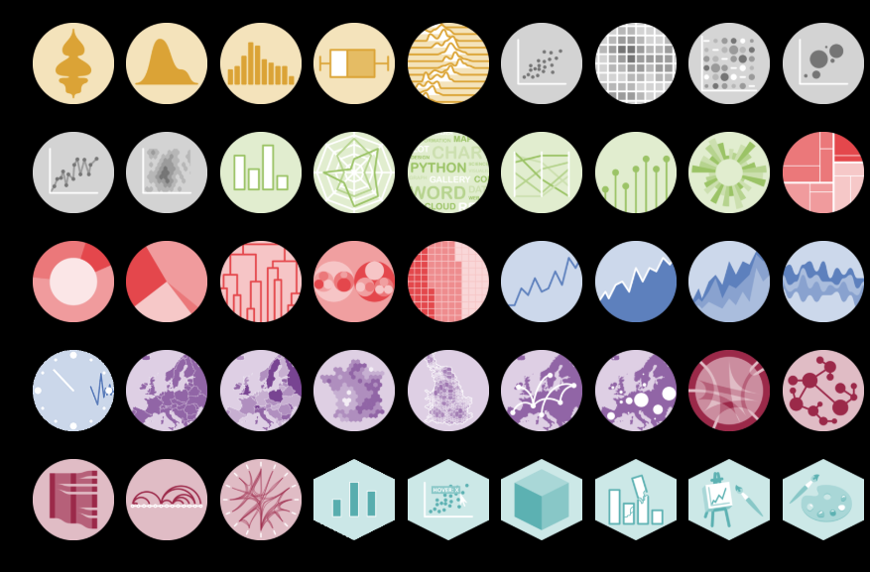
Application of tidy data
https://r-graph-gallery.com/

Slide 42
Island tortoises & sex bias
Near even sex ratio
Extinction vortex: process through which species becoming increasingly in danger of extinction, exacerbated by environmental, demographic, and genetic characteristics
Beach
More males
Hermann’s tortoise from Golem Grad injuries from cliff falls
Very few females
Notes:
Both images from https://onlinelibrary.wiley.com/doi/10.1111/ele.70296 manuscript “Sex Ratio Bias Triggers Demographic Suicide in a Dense Tortoise Population”

Slide 43
Questions of interest
Does it seem easier to recapture male or female tortoises?
Do recaptures happen more often in spring or summer?
Between the springs of 2016 and 2017, did the turtles grow differently based on locality?

Slide 44
Okay let’s get going!
Open the tidyR-Day2.Rmd in R
Read in cleaned data from last class!

Slide 45
Want to learn more?
Tidyverse Datacamp Cheat Sheet
R Project Tidydata Intro
Tidy Tuesday Github
Advanced Tidyverse by the National Socio-Environmental Synthesis Center
Examples of Tidy & Non-tidy Data

