Slide 1

Enaml GUIs Made Easy A DSL for Declarative User Interfaces

Slide 2
Basic MVC Concept
Enaml makes this Easy™
Person View
First Name
Last Name
Conversion
Validation
Person Model
class Person:
first_name = String
last_name = String

Slide 3
Some Existing Approaches
Visual Studio®
Xcode®
Qt Designer®
XML-based markup
.Net backing code
Bind to properties
Markup is translated
No markup
Obj-C backing code
Bind to properties
Code is generated
XML markup
C++ backing code
Bind to signals/slots
Markup is interpreted
Enaml
Python-based markup language
Strict superset of the Python language
Bind to arbitrary Python expressions
Markup is dynamically executed
Python

Slide 4
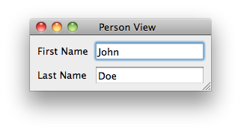
Show Me The Code!
# model.py
from traits.api import HasTraits, Str
import enaml
class Person(HasTraits):
first_name = Str
last_name = Str
# view.enaml
enamldef View(MainWindow):
attr person
title = ‘Person View’
Form:
Label:
text = ‘First Name’
Field:
value := person.first_name
Label:
text = ‘Last Name’
Field:
value := person.last_name
if __name__ == ‘__main__’:
john = Person(first_name=‘John’,
last_name=‘Doe’)
with enaml.imports():
from view import View
view = View(person=john)
view.show()

Slide 5
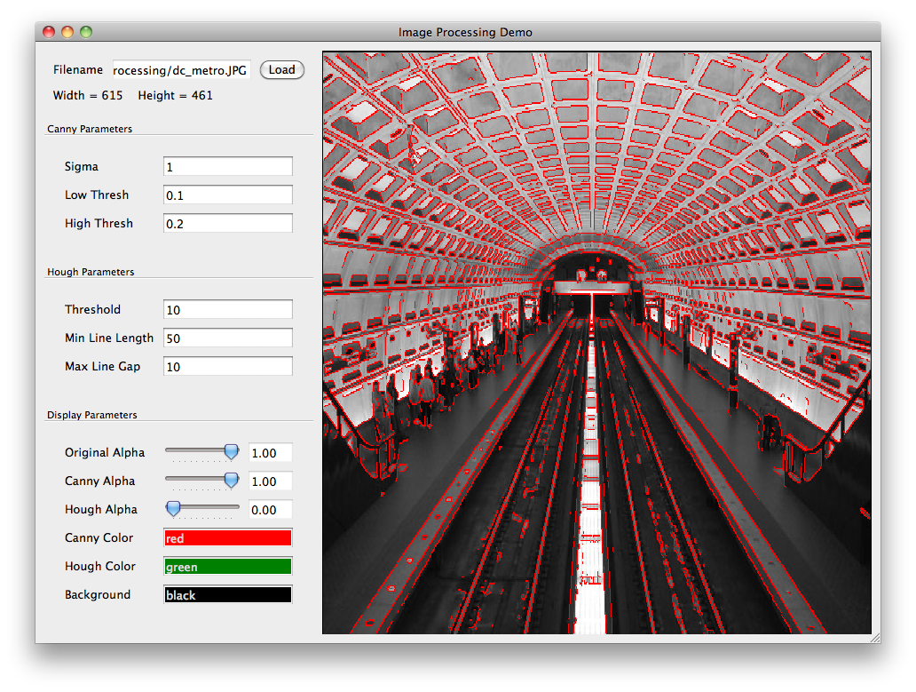
Application Example ~150 LOC

Slide 6
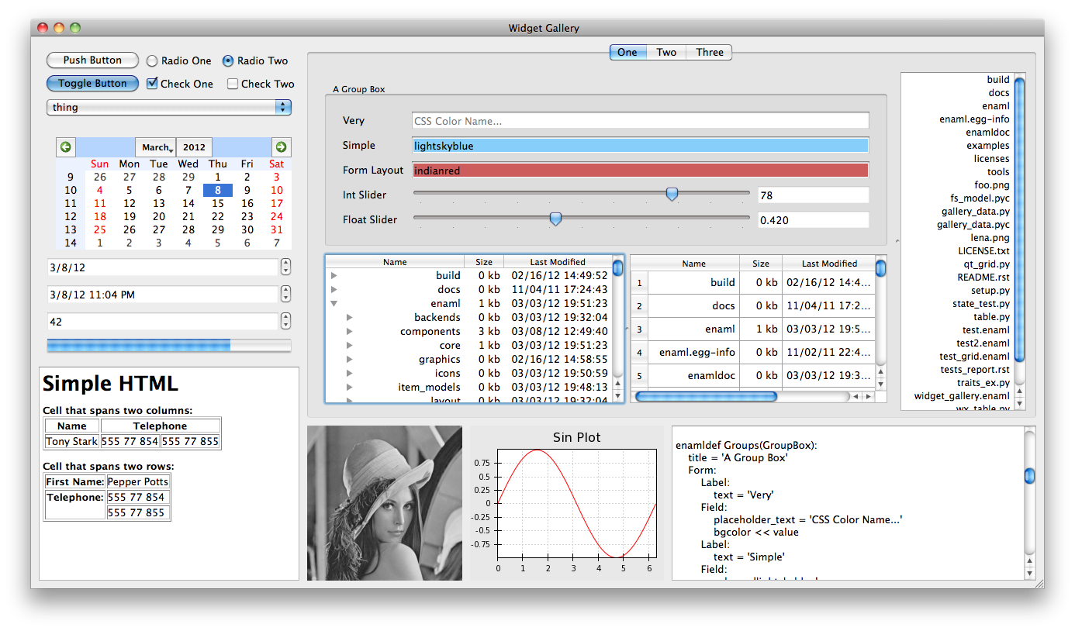
Widget Gallery ~150 LOC

Slide 7

Preview App ~200 LOC

Slide 8
Language Structure
Enaml is a strict superset of Python
Any valid Python (2.x) file is a valid Enaml file
Enaml extends the Python language with the keyword enamldef
The enamldef keyword begins a block of Enaml code which extends Python’s standard grammar and scoping rules

Slide 9
Language Structure
Enaml components are trees with dynamic bindable attributes
The root of a component derives from another root or a builtin Enaml component and defines a new usable component type

Slide 10
Language Structure
enamldef CustomField(Field):
pass
enamldef ReallyCustomField(CustomField):
pass

Slide 11
Language Structure
Tree branches are instances of tree roots or built-in components.
Tree leaves are identical to tree branches but have no children.
The distinction between branches and leaves is only conceptual, but some components do not allow children to be added to them.

Slide 12
Language Structure
enamldef MyContainer(Container):
CustomField:
pass
ReallyCustomField:
pass
Container:
Field:
pass
PushButton:
pass
RadioButton:
pass

Slide 13
Language Structure
Roots and branches are customized by binding to their attributes
enamldef Main(Window):
title = ‘Window Title’
Field:
value = ‘Field Value’

Slide 14
Language Structure
Roots can by further customized by declaring new attributes and events
enamldef Main(Window):
attr model
event custom_event
title = ‘Window Title’
Field:
value = model.value

Slide 15
Language Structure
The grammar of declaring an attr or an event supports four different forms
(event|attr) <name>
(event|attr) <name>: <type>
(event|attr) <name> <binding>
(event|attr) <name>: <type> <binding>

Slide 16
Attribute Binding
Enaml provides five different operators which can be used to bind Python expressions to component attributes.
These operators provide very powerful introspection and dependency tracking
Each binding operator has its own behavioral semantics as well as restrictions on what form the RHS expression may take.

Slide 17
Attribute Binding - Default
The default operator =
Left associative
Single eval, no introspection
RHS can be any expression

Slide 18
Attribute Binding – Default
enamldef Main(Window):
attr message = "Hello, world!"
Container:
Label:
text = message

Slide 19
Attribute Binding - Subscription
The subscription operator <<
Left associative
Evals and assigns when invalid
RHS can be any expression

Slide 20
Attribute Binding - Subscription
import math
enamldef Main(MainWindow):
title = 'Slider Example'
Form:
Label:
text = 'Log Value'
Field:
value << math.log(val_slider.value)
read_only = True
Slider:
id: val_slider
tick_interval = 50
maximum = 1000
minimum = 1

Slide 21
Attribute Binding - Update
The update operator >>
Right associative
Pushes value on change
RHS must be assignable expression

Slide 22
Attribute Binding - Update
from traits.api import HasTraits, Str, on_trait_change
class Person(HasTraits):
name = Str
@on_trait_change('name')
def print_name(self):
print 'name changed', self.name
enamldef Main(Window):
attr person = Person()
Container:
Field:
value >> person.name

Slide 23
Attribute Binding - Delegation
The delegation operator :=
Bi-Directional
Pushes and pulls values
RHS must be assignable expression

Slide 24
Attribute Binding - Delegation
from traits.api import HasTraits, Str, on_trait_change
class Person(HasTraits):
name = Str(‘John’)
@on_trait_change('name')
def print_name(self):
print 'name changed', self.name
enamldef Main(Window):
attr person = Person()
Container:
Field:
value >> person.name
Field:
value := person.name

Slide 25
Attribute Binding - Notification
The notification operator ::
Right associative
Executes code on change
RHS can be any arbitrary Python code except for def, class, return, yield

Slide 26
Attribute Binding - Notification
from traits.api import HasTraits, Str, on_trait_change
class Person(HasTraits):
name = Str
@on_trait_change('name')
def print_name(self):
print 'name changed', self.name
enamldef Main(Window):
attr person = Person()
Container:
Field:
value >> person.name
value :: print ‘simple statement’
value ::
for i in range(10):
print ‘complex statement’, i

Slide 27
Attribute Binding – Dependencies
Enaml introspecting operators are extremely robust
They can track almost any dependency in an expression
This allows the user to not worry about manually hooking up notifiers; it’s all automatic.

Slide 28
Attribute Binding - Dependencies
Field:
id: boss_info
value << boss(school.classroom[class_id].teacher.id).info
Function Returns
Locals
Indexing
Attribute Access
( getattr works too! )

Slide 29
Attribute Binding - Dependencies
List comprehensions work too!
Field:
value << ', '.join([person.name for person in people])
This binding will automatically track the name of every person in the list of people, as well as the contents of the list of people itself.

Slide 30
Layout System
Layout systems in GUI toolkits typically fall into two categories:
They don’t exist and the developer is responsible for laying out widgets
They use some form of nested box model
Given the choice, #2 is preferable, but nested box models can be painful
We can do better

Slide 31
Layout System - Constraints
Enaml uses a constraints based layout system
Constraints are specified as symbolic linear expressions of components
This allows the convenience and ease of nested box models, but also the power and flexibility of manual layout

Slide 32
Layout System - Constraints
Internally, Enaml uses the Cassowary linear constraint solver to do the heavy lifting in C++
OSX 10.7 now uses the same library
Enaml provides convenience factories for auto generating constraints for the most common cases
Constraints allow us to layout the ui in ways that are not typically possible

Slide 33
Questions?

