Slide 1

OpenShift 4.x Architecture Workshop
for IBM Architects
Welcome and Intro
Sept 2019

Slide 2

About Me
Alfred Bach
Technical Partner Enablement Manager
Living in Austria near by Vienna
4 Years with Red Hat
Coming from CA and SUSE/NOVELL
abach@redhat.com

Slide 3
About you ?

Slide 4


Agenda Day 1
Welcome, Intro
Red Hat and OpenSource
OpenShift - the platform for great ideas
Break
OpenShift Architecture (OCP 3.11 / 4.x and differences to ICP)
End Day One

Slide 5
Agenda Day 2
CoreOS and OpenShift 4.x
Moving on from Docker. The new container framework
HandsOn "Build a Container with Buildah"
Break
Live Demo
HandsOn OpenShift 4.x „Build an App with OpenShift“
Lunch Break
OpenShift Platform Installation (3.11 and 4.x)
Break
Istio Service Mesh
Container Native Virtualisation
Modern Registry Management (QUAY)
API Management (3Scale)
End of Day Two

Slide 6
Agenda Day 3
Running Containerised Workloads on OpenShift (IBM CloudPak, MS, ...)
Break
Roadmap what's new, what's coming
Lunch Break
How to stay up to date and deliver this workshop locally
(open discussion)
End of Day 3

Slide 7
Company Overview

Slide 8

THE WORLD’S LEADING PROVIDER OF OPEN SOURCE, ENTERPRISE I.T. SOLUTIONS
MORE THAN
S&P
~12,000
500
THE FIRST
90%
$2
of the
EMPLOYEES
COMPANY
FORTUNE
BILLION
500
OPEN
SOURCE
COMPANY
use
95
35
NYSE
RED HAT
RHT
PRODUCTS &
SOLUTIONS*
OFFICES
COUNTRIES
IN THE WORLD

Slide 9
HOW WE GOT HERE
1993
FOUNDED
2012
RED HAT STORAGE RELEASED
1999
IPO
OPENSHIFT ENTERPRISE RELEASED
2002
FIRST RELEASE OF ENTERPRISE LINUX
2013
RED HAT OPENSTACK PLATFORM RELEASED
2006
JBOSS ACQUIRED
2014
CENTOS JOINS RED HAT
2009
RED HAT VIRTUALIZATION RELEASED
INKTANK (CEPH), ENOVANCE (OPENSTACK), & FEEDHENRY (MOBILE) ACQUIRED
RED HAT ADDED TO S&P 500 INDEX
2015
ANSIBLE ACQUIRED
2011
CLOUDFORMS & OPENSHIFT RELEASED
2016
$2 BILLION IN REVENUE
$1 BILLION IN REVENUE
3SCALE ACQUIRED
2017
CODENVY ACQUIRED, PERMABIT ACQUIRED
2018
COREOS ACQUIRED

Slide 10
OpenSource

Slide 11
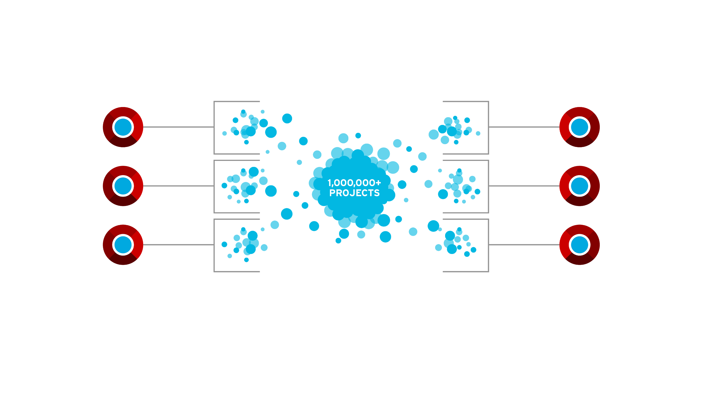
PRODUCT DEVELOPMENT MODEL
PARTICIPATE
INTEGRATE
STABILIZE
We participate in and create community-powered upstream projects.
We integrate upstream projects, fostering open community platforms.
We commercialize these platforms together with a rich ecosystem of services and certifications.

Slide 12
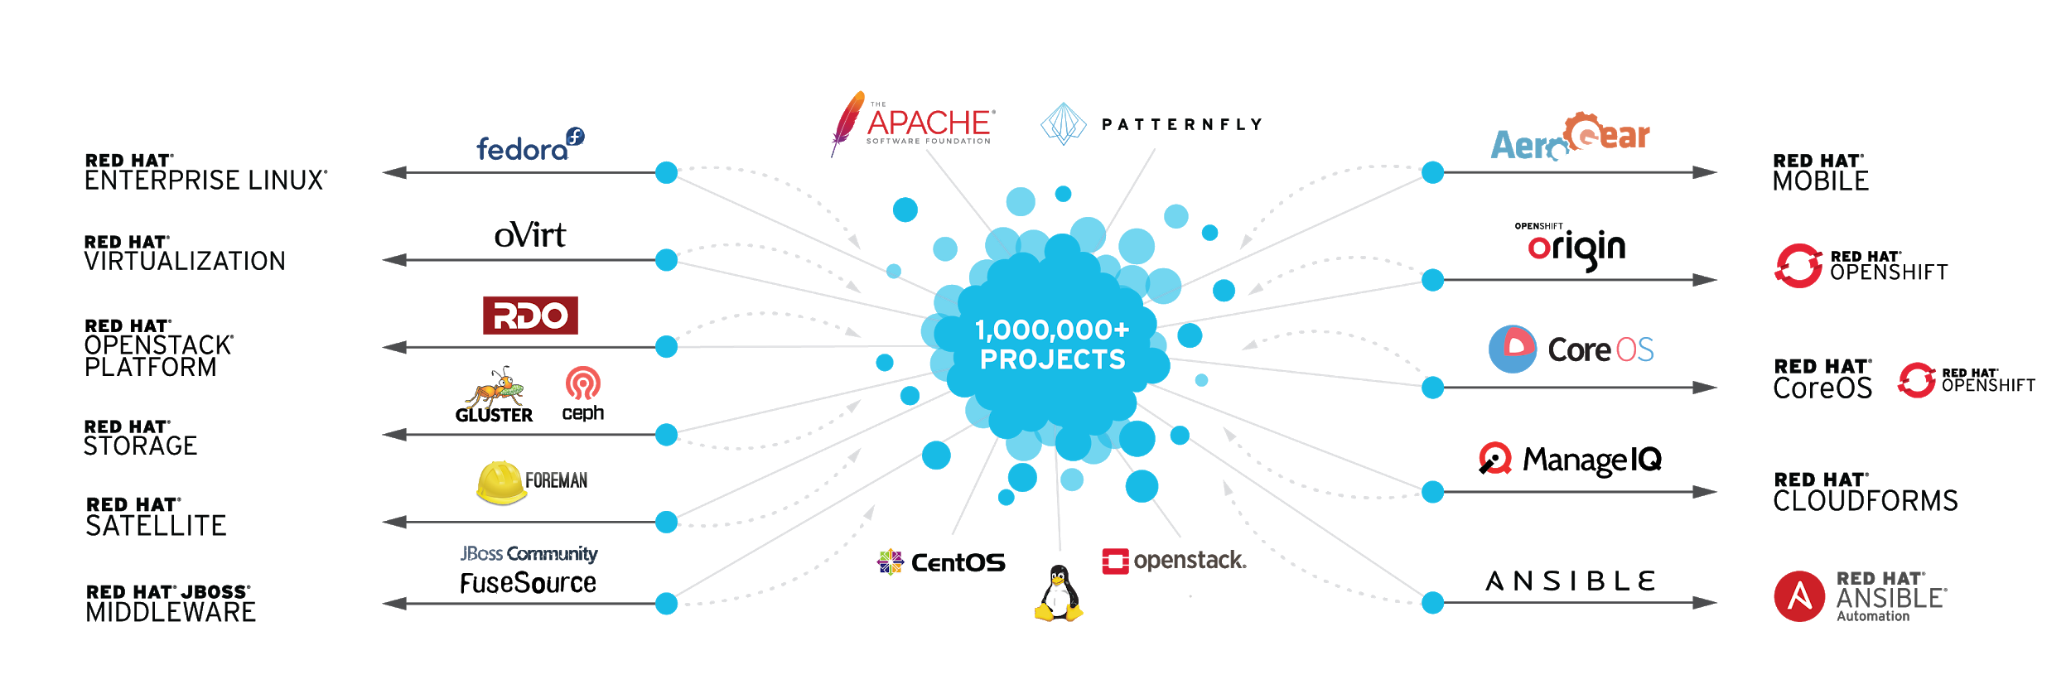
FROM COMMUNITIES TO ENTERPRISE
*
*

Slide 13
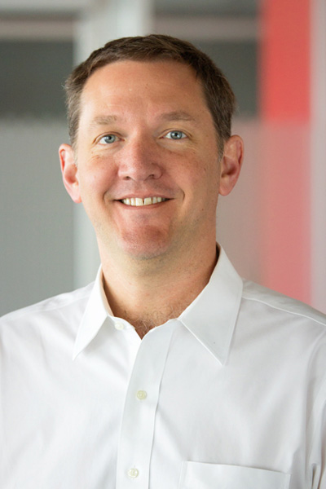
We take this massive innovation happening in open communities and deliver it in a safe, secure, reliable way so enterprises can consume it in their traditional infrastructure.
JIM WHITEHURST
President & CEO, Red Hat

Slide 14
The value of subscriptions

Slide 15

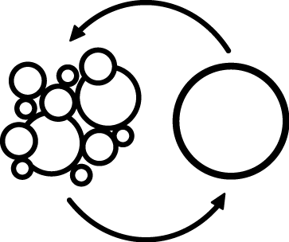






A RED HAT SUBSCRIPTION
DELIVERS CONTINUOUS VALUE EVERY DAY
CUSTOMER PORTAL
KNOWLEDGE
SECURITY
CERTIFICATIONS
SUPPORT
LIFE CYCLE
ASSURANCE
access.redhat.com/subscription-value

Slide 16
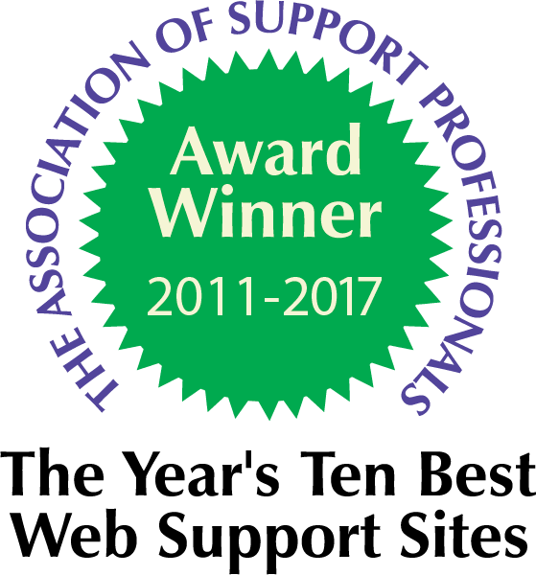
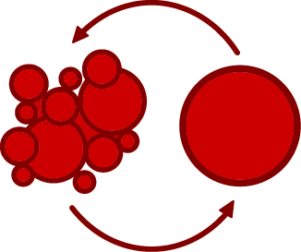




RED HAT CUSTOMER PORTAL
Your one place for subscription resources—from product documentation and upgrades to intelligent tools, security updates, and technical support.
PRODUCT DOCUMENTATION
TOOLS AND SOLUTIONS
SECURITY UPDATES
SUPPORT SERVICES
SUBSCRIPTION MANAGEMENT
access.redhat.com

Slide 17



KNOWLEDGEBASE
We’ve published thousands of solutions in our community-driven knowledgebase so you can learn from others, resolve issues yourself, and proactively manage your systems.
EXPERTISE
Red Hat Certified Engineers
EXPERIENCE
1,000,000+ resolved issues
GUIDANCE
60,000+ technical solutions
access.redhat.com/search/#/knowledgebase

Slide 18



PRODUCT SECURITY
Red Hat’s stable code is backed by a dedicated team of engineers who monitor, identify, and address risks to protect you and your customers’ data from meaningful security concerns.
VULNERABILITY
RESPONSES
SECURITY TOOLS
CVE DATABASE
access.redhat.com/security/

Slide 19





SUPPORT
If you need to open a support case, it will be routed to a product specialist. Resolutions enable future updates to our products, making you an active participant in improving open source technology.
SUPPORT CASES
Get answers quickly
LIVE CHAT
With support engineers
CALL OR EMAIL
With a support expert
access.redhat.com/support

Slide 20

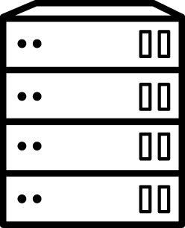


CERTIFICATIONS
Red HatⓇ engineers collaborate with a large ecosystem of partners to ensure your third-party solutions are tested, supported, and certified to perform with Red Hat technologies.
CERTIFIED
HARDWARE
CERTIFIED
SOFTWARE
CERTIFIED
CLOUD PROVIDERS
access.redhat.com/ecosystem

Slide 21




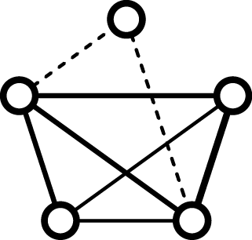

ASSURANCES
Red Hat's Quality Assurance team works closely with our product development teams and provides the final engineering check before our open source products are released to customers and partners.
ACCEPTANCE
FUNCTIONALITY
REGRESSION
INTEGRATION
PERFORMANCE TESTING
red.ht/open-source-assurance-agreement

Slide 22
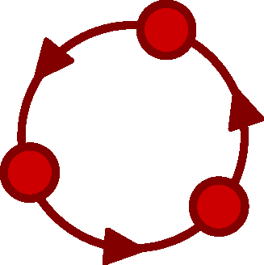



LIFE CYCLE
Red Hat subscriptions are not tied to a specific version, but cover the entire life cycle of the product. Our longer life cycles mean more choice, flexibility, and ease of planning.
NO LOCK IN
FLEXIBILITY
REDUCED COSTS
access.redhat.com/support/policy/update_policies/

Slide 23
THE VALUE OF A RED HAT SUBSCRIPTION
ACCESS TO & ADVOCACY FOR THE THINGS YOU NEED
ACCESS
ADVOCACY
Open source enterprise software
Visibility & influence over
Red Hat® Enterprise Linux® roadmap
Emerging open source technologies
Open source community leadership
10+ years supported life cycle
Hardware, software, &
cloud provider partnership
Support & expertise
Security resources
Security needs

Slide 24
Thank you !

