Slide 1
OpenShift 4.x Architecture Workshop
OpenShift Container Platform (OCP)
Advanced Architecture
July 2019

Slide 2
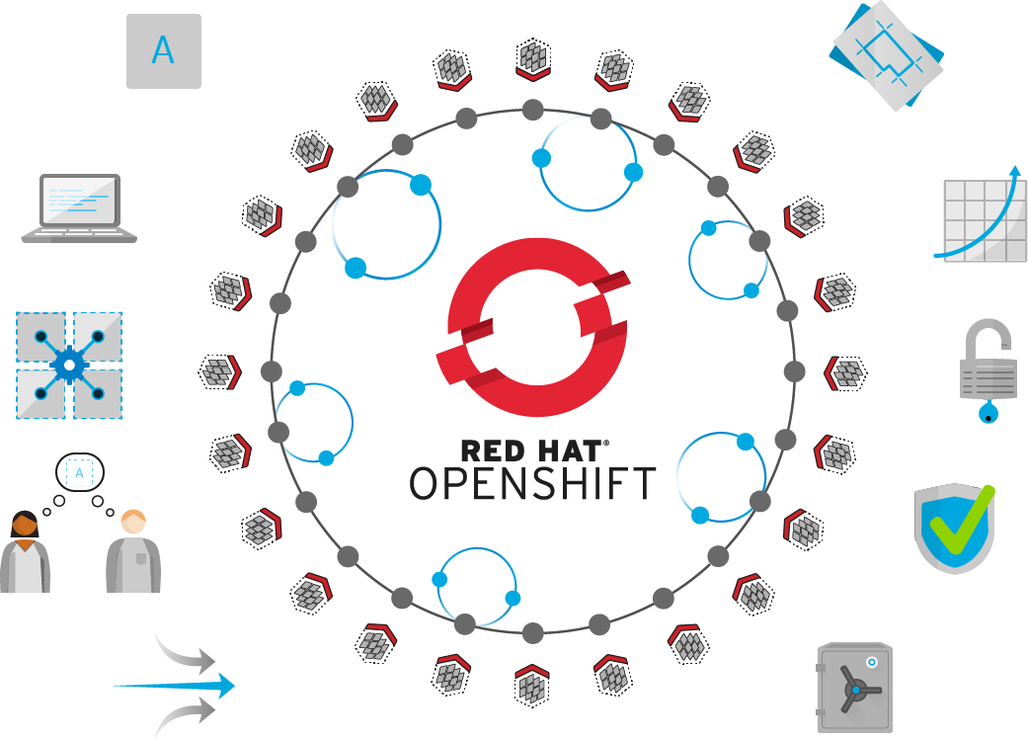

Self-Service
Standards-based
Multi-language
Web-scale
Automation
Open Source
Collaboration
Enterprise Grade
Multi-tenant
Secure
Notes:
Red Hat helps organizations develop, deploy, and manage existing and container-based applications seamlessly across physical, virtual, and public cloud infrastructures.
Built on proven open source technologies, OpenShift helps application development and IT operations teams modernize applications, deliver new services, and accelerate development processes.
OpenShift Container Platform provides developers with an optimal platform for provisioning, building, and deploying applications and their components in a self-service fashion. With automated workflows like our source-to-image (S2I) process, it is easy to get source code from version control systems into ready-to-run, docker-formatted container images.
OpenShift IT operations a secure, enterprise-grade Kubernetes that provides policy-based control and automation for applications. Cluster services, scheduling, and orchestration provide load-balancing and auto-scaling capabilities. Security features prevent tenants from compromising other applications or the underlying host. And because OpenShift can attach persistent storage directly to containers, IT organizations can run both stateful and stateless applications on one platform.

Slide 3
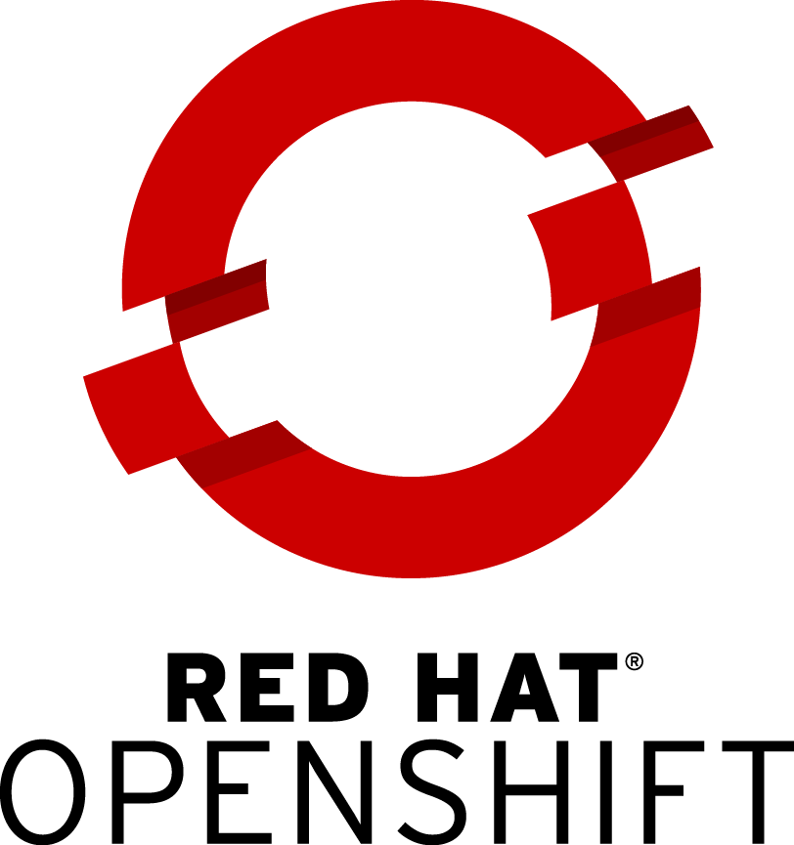
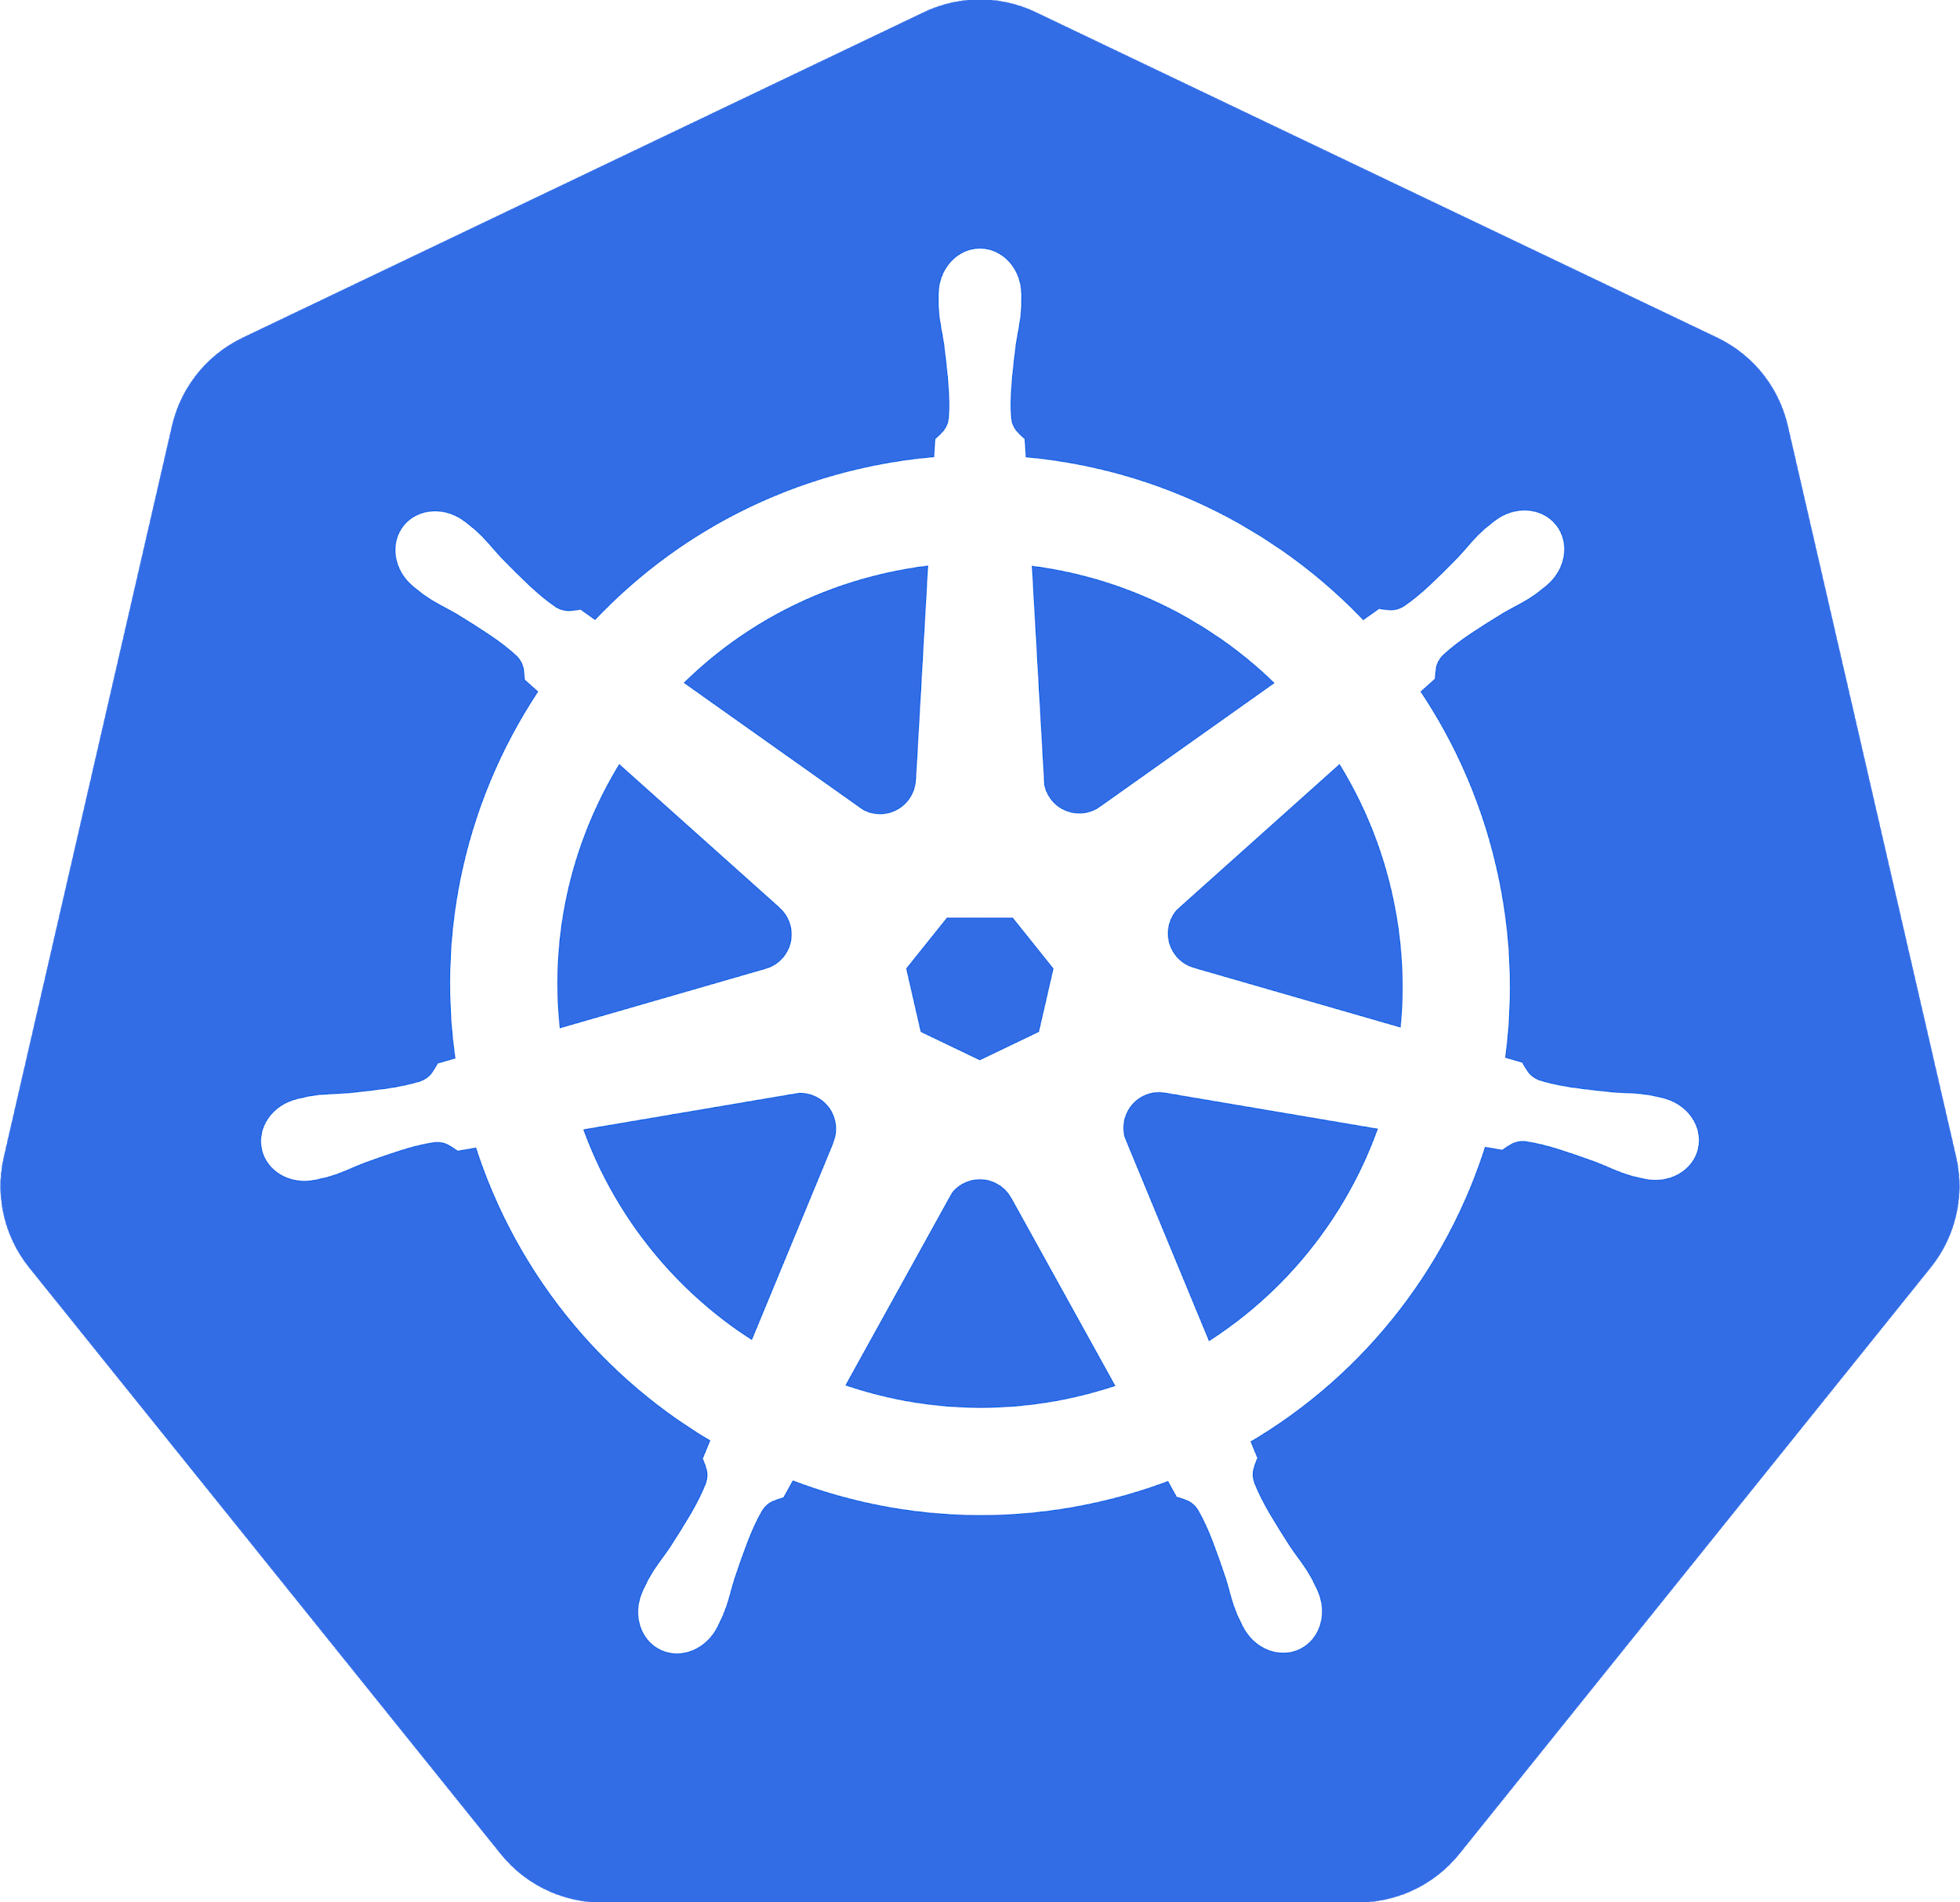



OPENSHIFT CONTAINER PLATFORM
ANY
CONTAINER
APPLICATION LIFECYCLE MANAGEMENT
CONTAINER ORCHESTRATION AND MANAGEMENT (KUBERNETES)
ENTERPRISE CONTAINER HOST
ANY
INFRASTRUCTURE
Laptop
Datacenter
OpenStack
Amazon Web Services
Microsoft Azure
Google Cloud

Slide 4
OPENSHIFT CONTAINER PLATFORM
Application Services
Cluster Services
Developer Services
Middleware, Service Mesh, Functions, ISV
Metrics, Chargeback, Registry, Logging
Dev Tools, Automated Builds, CI/CD, IDE
Automated Operations
Kubernetes
Red Hat Enterprise Linux or Red Hat CoreOS
Best IT Ops Experience
CaaS
PaaS
Best Developer Experience
Notes:
Running containers and Kubernetes in production takes more than just a hardened distribution of Kubernetes. It also requires:
A secure, enterprise-grade Linux container host. Red Hat Enterprise Linux is the most trusted Linux OS in the Fortune 500, while Red Hat CoreOS is an immutable, minimal OS with a tiny, tiny attack surface. Depending on your needs, both offer a scalable, trusted base for your container stack.
Once you have Kubernetes, you also need to manage everything that hooks into it. Kubernetes provides Container Networking and Storage Interfaces (CNI, CSI), but OpenShift comes with networking and (for an add-on), an integrated storage solution, along with support for validated networking and storage plugins. Openshift also provides lifecycle management for these components, consoles for operators and developers, and considers security throughout the entire lifecycle. And with CoreOS, we’re bringing in automated operations, updating these components can happen in the background, while your team focuses on other tasks.
Validated integrations: https://access.redhat.com/articles/2176281
OpenShift offers Cluster Services that are essential to enterprise operation: a private container registry, built-in logging and metrics, and metering and chargeback capabilities so you can manage multiple teams.
For a Container-as-a-service experience, the OpenShift Service Catalog and Kubernetes operators allow teams to easily provision and consume a variety of services, whether they’re private to your organization, from a public cloud like AWS, or an ISV like MongoDB. And with the forthcoming addition of operators, these can make real-time decisions automatically for your application and cluster as well.
For a more Platform-as-a-service experience, OpenShift also wraps in a rich developer experience. Our Source-to-image (S2I) capability automatically builds container images based on the changes to application logic your developers commit, while Image Streams can perform a new action (including deployment) once a new version of a container is created.
Altogether, Openshift is a complete platform for building, deploying, and intelligently managing Kubernetes applications in production.

Slide 5


















OPENSHIFT ARCHITECTURE
ROUTING LAYER
SERVICE LAYER
RED HAT
ENTERPRISE LINUX
NODE
NODE
NODE
PERSISTENT
STORAGE
SCM
(GIT)
MASTER
C
C
API/AUTHENTICATION
c
CI/CD
C
C
C
DATA STORE
RHEL
RHEL
RHEL
SCHEDULER
NODE
NODE
NODE
REGISTRY
EXISTING AUTOMATION TOOLSETS
HEALTH/SCALING
C
C
C
C
C
RHEL
RHEL
RHEL
PHYSICAL
VIRTUAL
PRIVATE
PUBLIC
HYBRID
Notes:
Speaker:
* This is a high level architecture diagram of the OpenShift 3 platform. On the subsequent slides we will dive down and investigate how these components interact within an OpenShift infrastructure.
Discussion:
* Set the stage for describing the OpenShift architecture.
Transcript:
OpenShift has a complex multi-component architecture. This presentation is usable to help prospects understand how the components work together.

Slide 6
Cotainer Concepts Overview

Slide 7
A container is the smallest compute unit
CONTAINER

Slide 8
containers are created from container images
CONTAINER IMAGE
CONTAINER
BINARY
RUNTIME

Slide 9
container images are stored in an image registry
IMAGE REGISTRY
CONTAINER IMAGE
CONTAINER IMAGE
CONTAINER IMAGE
CONTAINER
CONTAINER IMAGE
CONTAINER IMAGE
CONTAINER IMAGE
Notes:
OpenShift has a built-in image registry to store images and and also deploy from the registry
Upstream registries like Docker Hub and Red Hat registry can also be used with OpenShift. They are in fact by default configured so when an image is not available in the built-in registry, it will be search for in the upstream registries.

Slide 10
an image repository contains all versions of an image in the image registry
IMAGE REGISTRY
myregistry/frontend
myregistry/mongo
frontend:latest
frontend:2.0
frontend:1.1
frontend:1.0
mongo:latest
mongo:3.7
mongo:3.6
mongo:3.4
CONTAINER IMAGE
CONTAINER IMAGE

Slide 11
containers are wrapped in pods which are units of deployment and management
POD
POD
CONTAINER
CONTAINER
CONTAINER
IP: 10.1.0.11
IP: 10.1.0.55
Notes:
A pod (as in a pod of whales or pea pod) is a group of one or more containers, with shared storage/network, and a specification for how to run the containers. A pod’s contents are always co-located and co-scheduled, and run in a shared context. A pod models an application-specific “logical host” - it contains one or more application containers which are relatively tightly coupled. In a pre-container world, they would have executed on the same physical or virtual machine.
Containers within a pod share an IP address and port space, and can find each other via localhost
Applications within a pod also have access to shared volumes, which are defined as part of a pod and are made available to be mounted into each application’s filesystem.

Slide 12
pods configuration is defined in a deployment
POD
POD
POD
image name
replicas
labels cpu memory
storage
CONTAINER
CONTAINER
CONTAINER
DEPLOYMENT
Notes:
The desired state of deployed pods is defined as a deployment
A deployment defines how many instances of a pod should be deployed, how much cpu and memory should be allocated to it, what persistent volumes and configuration objects should be available to the pods and more
Deployments also are able to manage the transition of deploying one version of the container image to another which controlling the exact details of transition such as rolling updates, rollback, etc.

Slide 13
OpenShift Architecture

Slide 14
YOUR CHOICE OF INFRASTRUCTURE
PHYSICAL
VIRTUAL
PRIVATE
PUBLIC
HYBRID
Notes:
Speaker:
* From bare metal physical machines to virtualized infrastructure, or in private or certified public clouds, OpenShift is supported anywhere that Red Hat Enterprise Linux is.
* This includes all the supported virtualization platforms - RHEV, vSphere or Hyper-V.
* Red Hat’s OpenStack platform and certified public cloud providers like Amazon, Google and more are supported, too.
* You can even take a hybrid approach and deploy instances of OpenShift Container Platform across all of these infrastructures.
Discussion:
* Show the flexibility of deploying OpenShift
* Technically only x86 platforms are supported.
Transcript:
OpenShift is fully supported anywhere Red Hat Enterprise Linux is. Hybrid deployments across multiple infrastructures can be achieved, but many customers are still adopting OpenShift inside their existing, traditional virtualized environments.

Slide 15
NODES RHEL INSTANCES WHERE APPS RUN
NODE
NODE
NODE
RHEL
RHEL
RHEL
NODE
NODE
NODE
RHEL
RHEL
RHEL
PHYSICAL
VIRTUAL
PRIVATE
PUBLIC
HYBRID
Notes:
Speaker:
* OpenShift has two types of systems. The first are called nodes.
* Nodes are instances of RHEL 7 or RHEL Atomic with the OpenShift software installed.
* Ultimately, Nodes are where end-user applications are run.
Discussion:
* The Nodes are what the Masters will orchestrate - you will learn about Masters shortly.
* Nodes are just instances of RHEL or Atomic.
* OpenShift’s node daemon and other software runs on a node.
Transcript:
OpenShift can run on either RHEL or RHEL Atomic. Nodes are just instances of RHEL or Atomic that will ultimately host application instances in containers.

Slide 16


APPS RUN IN CONTAINERS
NODE
NODE
NODE
Container Image
C
C
c
C
C
C
Container
RHEL
RHEL
RHEL
NODE
NODE
NODE
C
C
C
C
Pod
C
RHEL
RHEL
RHEL
Notes:
Speaker:
* Application instances and application components run in linux containers. Linux container technologies are lightweight mechanisms for isolating running processes so that they are limited to interacting with only their designated resources. Many application instances can be running in containers on a single host without visibility into each others' processes, files, network, and so on.
* Containers in OpenShift are based on Docker-formatted container images. An image is a binary that includes all of the requirements for running a single container. Container images can be thought of as a packaging technology.
* Each OpenShift Node can run many containers
* A Pod is one or more containers deployed together as if they were deployed on one host and encapsulates storage resources and a unique network IP. Pod is the smallest unit that can be defined, deployed, and managed in OpenShift. A Pod might consist of either a single container or a small number of containers that are tightly coupled and that share resources.
Discussion:
* A node’s capacity is related to the memory and CPU capabilities of the underlying “hardware”
Transcript:
All of the end-user application instances and application components will run inside linux containers on the nodes. RHEL instances with bigger CPU and memory footprints can run more containers.Speaker: * Application instances and application components run in linux containers. Linux container technologies are lightweight mechanisms for isolating running processes so that they are limited to interacting with only their designated resources. Many application instances can be running in containers on a single host without visibility into each others' processes, files, network, and so on. * Containers in OpenShift are based on Docker-formatted container images. An image is a binary that includes all of the requirements for running a single container. Container images can be thought of as a packaging technology. * Each OpenShift Node can run many containers * A Pod is one or more containers deployed together as if they were deployed on one host and encapsulates storage resources and a unique network IP. Pod is the smallest unit that can be defined, deployed, and managed in OpenShift. A Pod might consist of either a single container or a small number of containers that are tightly coupled and that share resources. Discussion: * A node’s capacity is related to the memory and CPU capabilities of the underlying “hardware” Transcript: All of the end-user application instances and application components will run inside linux containers on the nodes. RHEL instances with bigger CPU and memory footprints can run more containers.

Slide 17
PODS ARE THE UNIT OF ORCHESTRATION
NODE
NODE
NODE
C
C
c
C
C
C
RHEL
RHEL
RHEL
NODE
NODE
NODE
C
C
C
C
C
RHEL
RHEL
RHEL
Notes:
Speaker:
* While app components run in Docker containers, the “unit” that OpenShift is orchestrating and managing is called a Pod
* In this case, a Docker image is the executable or runnable components, and the container is the actual running instance with runtime and environment parameters
* One or more containers make up a Pod, and OpenShift will schedule and run all containers in a Pod together
* Complex applications are made up of many Pods each with their own containers, all interacting with one another inside an OpenShift environment
Discussion:
* OpenShift consumes Docker Images and runs them in containers wrapped by the meta object called a Pod.
* The Pod is what OpenShift schedules, manages and runs.
* Pods can have multiple containers but there are not many well-defined use cases
* Services, described soon, are how different application components are “wired” together. Different application components (eg: app server, db) are not placed in a single Pod
Transcript:
OpenShift can use any native Docker image, and schedules and runs containers in a unit called a Pod. While Pods can have multiple containers, generally a Pod should provide a single function, like an app server, as opposed to multiple functions, like a database and an app server. This allows for individual application components to be easily scaled horizontally.

Slide 18
MASTERS ARE THE CONTROL PLANE
RED HAT
ENTERPRISE LINUX
NODE
NODE
NODE
MASTER
RHEL
RHEL
RHEL
NODE
NODE
NODE
RHEL
RHEL
RHEL
PHYSICAL
VIRTUAL
PRIVATE
PUBLIC
HYBRID
Notes:
Speaker:
* The other type of OpenShift system is the Master
* Masters keep and understand the state of the environment and orchestrate all activities on the Nodes
* Masters are also instances of RHEL or Atomic, and multiple masters can be used in an environment for high availability
* Masters can be treated like any nodes and have apps deployed on them. However it is recommended to dedicate Masters to management processes and mark them as non-schedulable for application containers.
* Masters have four primary jobs or functions
Discussion:
* The OpenShift Master is the orchestrator of the entire OpenShift environment.
* The OpenShift Master knows about and maintains state within the OpenShift environment.
* Just like Nodes, Masters run on RHEL or Atomic
* You will discuss the four primary functions of the Master in the next slides
Transcript:
Just like Nodes, the OpenShift Master is installed on RHEL or Atomic. The Master is the orchestration and scheduling engine for OpenShift, and is responsible for knowing and maintaining the state of the OpenShift environment. The Master has four primary functions which you will now describe.

Slide 19
API AND AUTHENTICATION
RED HAT
ENTERPRISE LINUX
NODE
NODE
NODE
MASTER
API/AUTHENTICATION
RHEL
RHEL
RHEL
NODE
NODE
NODE
RHEL
RHEL
RHEL
PHYSICAL
VIRTUAL
PRIVATE
PUBLIC
HYBRID
Notes:
Speaker:
* The Master provides the single API that all tooling and systems interact with. Everything must go through this API.
* All API requests are SSL-encrypted and authenticated. Authorizations are handled via fine-grained role-based access control (RBAC)
* The Master can be tied into external identity management systems, from LDAP and AD to OAuth providers like GitHub and Google
Discussion:
* All requests go through the Master’s API
* The Master evaluates requests for both AuthentacioN (AuthN - you are who you say you are) and AuthoriZation (AuthZ - you’re allowed to do what you requested)
* The Master can be tied into external identity management systems like LDAP/AD, OAuth, and more
* Apache modules can also be used for authentication in front of the API
Transcript:
The Master is the gateway to the OpenShift environment. All requests must go through the Master and must be both authenticated and authorized. A wide array of external identity management systems can be the source of authentication information in an OpenShift environment.

Slide 20
DESIRED AND CURRENT STATE
RED HAT
ENTERPRISE LINUX
NODE
NODE
NODE
MASTER
API/AUTHENTICATION
DATA STORE
RHEL
RHEL
RHEL
NODE
NODE
NODE
RHEL
RHEL
RHEL
PHYSICAL
PHYSICAL
VIRTUAL
VIRTUAL
PRIVATE
PRIVATE
PUBLIC
PUBLIC
HYBRID
HYBRID
Notes:
Speaker:
* The desired and current state of the OpenShift environment is held in the data store which includes all objects such as builds, deployments, services, routes, etc
* The data store uses etcd, a distributed key-value store and stores the persistent master state while other components watch etcd for changes to bring themselves into the desired state.
* Other things like the RBAC rules, application environment information, and non-application-user-data are kept in the data store
Discussion:
* etcd holds information about the desired and current state of OpenShift
* Additionally, user account info, RBAC rules, environment variables, secrets, and many other bits of OpenShift information are held in the data store
* More generally, any OpenShift data object is stored in etcd
Transcript:
Etcd is another of the critical components of the OpenShift architecture. It is the distributed key-value data store for state and other information within the OpenShift environment. Reads and writes of information generally are going to hit the data store.

Slide 21
INTEGRATED CONTAINER REGISTRY
RED HAT
ENTERPRISE LINUX
NODE
NODE
NODE
MASTER
API/AUTHENTICATION
DATA STORE
RHEL
RHEL
RHEL
RHEL
RHEL
NODE
NODE
NODE
REGISTRY
RHEL
RHEL
RHEL
PHYSICAL
VIRTUAL
PRIVATE
PUBLIC
HYBRID
Notes:
A container registry is a service for storing and retrieving Docker-formatted container images. A registry contains a collection of one or more image repositories.
OpenShift Container Platform provides its own internal registry for managing container images.
Red Hat also provides a registry at registry.access.redhat.com for subscribers which is called Red Hat Container Catalog
OpenShift can deploy images from the integrated image registry as well as Red Hat Container Catalog, Docker Hub and any other registry the customer might be using
OpenShift Container Platform registry can also be installed separately as a stand-alone container image registry.

Slide 22
ORCHESTRATION AND SCHEDULING
RED HAT
ENTERPRISE LINUX
NODE
NODE
NODE
MASTER
API/AUTHENTICATION
DATA STORE
RHEL
RHEL
RHEL
RHEL
RHEL
SCHEDULER
NODE
NODE
NODE
REGISTRY
RHEL
RHEL
RHEL
PHYSICAL
VIRTUAL
PRIVATE
PUBLIC
HYBRID
Notes:
Speaker:
* The scheduler portion of the Master is the specific component that is responsible for determining Pod placement
* The scheduler takes the current memory, CPU and other environment utilization into account when placing Pods on the various nodes
Discussion:
* The scheduler is responsible for Pod placement
* Current CPU, Memory and other environment utilization is considered during the scheduling process
Transcript:
The OpenShift scheduler uses a combination of configuration and environment state to determine the best fit for running Pods across the Nodes in the environment.

Slide 23
PLACEMENT BY POLICY
RED HAT
ENTERPRISE LINUX
NODE
NODE
NODE
MASTER
C
C
API/AUTHENTICATION
c
C
C
DATA STORE
RHEL
RHEL
RHEL
SCHEDULER
NODE
NODE
NODE
REGISTRY
RHEL
RHEL
RHEL
PHYSICAL
VIRTUAL
PRIVATE
PUBLIC
HYBRID
Notes:
Speaker:
* The real-world topology of the OpenShift deployment (regions, zones, and etc) is used to inform the configuration of the scheduler
* Administrators can configure complex scenarios for scheduling workloads
Discussion:
* The scheduler is configured with a simple JSON file in combination with node labels to carve up the OpenShift environment to make it look like the real world topology
Transcript:
The topology of the real-world environment is used by platform administrators to determine how to configure the scheduler and the Node labels.

Slide 24
AUTOSCALING PODS
RED HAT
ENTERPRISE LINUX
NODE
NODE
NODE
MASTER
C
C
API/AUTHENTICATION
c
C
C
DATA STORE
RHEL
RHEL
RHEL
SCHEDULER
NODE
NODE
NODE
REGISTRY
HEALTH/SCALING
RHEL
RHEL
RHEL
PHYSICAL
VIRTUAL
PRIVATE
PUBLIC
HYBRID
Notes:
Speaker:
* The Master is responsible for monitoring the number of pods and automatically scaling them as desired
* Pods can be manually scaled stating the number of pods that should be running
* Pods can also be autoscaled based on metrics collected from the pods (cpu utilization) within the boundary of minimum and maximum number of pods that is configured for the autoscaler

Slide 25
SERVICE DISCOVERY
SERVICE LAYER
RED HAT
ENTERPRISE LINUX
NODE
NODE
NODE
MASTER
C
C
API/AUTHENTICATION
c
C
C
C
DATA STORE
RHEL
RHEL
RHEL
SCHEDULER
NODE
NODE
NODE
REGISTRY
HEALTH/SCALING
C
C
C
C
C
RHEL
RHEL
RHEL
PHYSICAL
VIRTUAL
PRIVATE
PUBLIC
HYBRID
Notes:
Speaker:
* OpenShift’s service layer enables application components to easily communicate with one another
* The service layer provides for internal load balancing as well as discovery and code reusability
Discussion:
* The service layer is used to connect application components together
* OpenShift automatically injects some service information into running containers to provide for ease of discovery
* Services provide for simple internal load balancing across application components
Transcript:
OpenShift’s service layer is how application components communicate with one another. A front-end web service would connect to database instances by communicating with the database service. OpenShift would automatically handle load balancing across the database instances. Service information is injected into running containers and provides for ease of application

Slide 26
PERSISTENT DATA IN CONTAINERS
SERVICE LAYER
RED HAT
ENTERPRISE LINUX
NODE
NODE
NODE
PERSISTENT
STORAGE
MASTER
C
C
API/AUTHENTICATION
c
C
C
C
DATA STORE
RHEL
RHEL
RHEL
SCHEDULER
NODE
NODE
NODE
REGISTRY
HEALTH/SCALING
C
C
C
C
C
RHEL
RHEL
RHEL
PHYSICAL
VIRTUAL
PRIVATE
PUBLIC
HYBRID
Notes:
Speaker:
* Applications are only as useful as the data they can manipulate.
* Docker containers are natively ephemeral - data is not saved when containers are restarted or created.
* OpenShift provides a persistent storage subsystem that will automatically connect real-world storage to the right Pods, allowing for stateful applications to be used on the platform.
* A wide array of persistent storage types are usable, from raw devices (iSCSI, FC) to enterprise storage (NFS) to cloud-type options (Gluster/Ceph, EBS, pDisk, etc)
Discussion:
* OpenShift’s persistent volume system automatically connects storage to Pods
* The persistent volume system allows stateful apps to be used on the platform
* OpenShift provides flexibility in the types of storage that Pods can consume
Transcript:
OpenShift’s persistent volume system allows end users to consume a wide array of storage types to enable stateful applications to be run on the platform. Whether OpenShift is running locally in the datacenter or in the cloud, there are storage options that can be used.

Slide 27
ROUTING AND LOAD-BALANCING
ROUTING LAYER
SERVICE LAYER
RED HAT
ENTERPRISE LINUX
NODE
NODE
NODE
PERSISTENT
STORAGE
MASTER
C
C
API/AUTHENTICATION
c
C
C
C
DATA STORE
RHEL
RHEL
RHEL
SCHEDULER
NODE
NODE
NODE
REGISTRY
HEALTH/SCALING
C
C
C
C
C
RHEL
RHEL
RHEL
PHYSICAL
VIRTUAL
PRIVATE
PUBLIC
HYBRID
Notes:
Speaker:
* Not every consumer of applications exists inside the OpenShift platform. External clients need to be able to access things running inside OpenShift
* The routing layer is a close partner to the service layer, providing automated load balancing to Pods for external clients
* The routing layer is pluggable and extensible if a hardware or non-OpenShift software router is desired
Discussion:
* The OpenShift router runs in pods on the platform itself, but receives traffic from the outside world and proxies it to the right pods
* The router uses the service endpoint information to determine where to load balance traffic, but it does not send traffic through the service layer
* The router is built with HAProxy, but is a pluggable solution. Red Hat currently supports F5 integration as another option.
Transcript:
OpenShift’s routing layer provides access for external clients to reach applications running on the platform. The routing layer runs in Pods inside OpenShift, and features similar load balancing and auto-routing around unhealthy Pods as the Service layer.

Slide 28
ACCESS VIA WEB, CLI, IDE AND API
ROUTING LAYER
SERVICE LAYER
RED HAT
ENTERPRISE LINUX
NODE
NODE
NODE
PERSISTENT
STORAGE
SCM
(GIT)
MASTER
C
C
API/AUTHENTICATION
c
CI/CD
C
C
C
DATA STORE
RHEL
RHEL
RHEL
SCHEDULER
NODE
NODE
NODE
REGISTRY
EXISTING AUTOMATION TOOLSETS
HEALTH/SCALING
C
C
C
C
C
RHEL
RHEL
RHEL
PHYSICAL
VIRTUAL
PRIVATE
PUBLIC
HYBRID

Slide 29
Networking

Slide 30
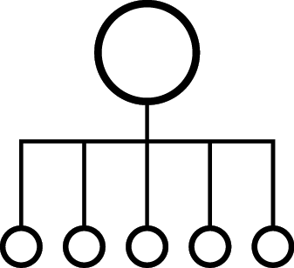

OPENSHIFT NETWORKING
Built-in internal DNS to reach services by name
Split DNS is supported via DNSmasq
Master answers DNS queries for internal services
Other name servers serve the rest of the queries
Software Defined Networking (SDN) for a unified cluster network to enable pod-to-pod communication
OpenShift follows the Kubernetes Container Networking Interface (CNI) plug-in model
Notes:
OpenShift SDN can be configured to use Flannel instead of Open vSwitch. This is useful if running OpenShift Container Platform within a cloud provider platform that also relies on SDN, such as OpenStack, and you want to avoid encapsulating packets twice through both platforms.
OpenShift supports NuageSDN plugin up to and including the CNI plugin. NuageSDN itself is supported by Nuage.

Slide 31

OPENSHIFT NETWORKING
NODE 172.16.1.10
NODE 172.16.1.20
POD 10.1.2.2
POD 10.1.2.4
VxLAN Overlay Network
POD 10.1.4.2
POD 10.1.4.4
IP Network
Notes:
Pods are connected via an overlay network which enables IP-per-Pod networking and direct pod-to-pod communication
The Pod IPs are independent of the physical network the OpenShift Nodes are connected to

Slide 32
OPENSHIFT NETWORK PLUGINS
OPENSHIFT
KUBERNETES CNI
OpenShift SDN
(OVS)
OpenShift
SDN
(OVN*)
Flannel**
Nuage
Tigera
Calico & CNX
Juniper
Contrail
Cisco
Contiv & Contiv-ACI
Big Switch
VMware
NSX-T
kuryr-
k8s
Open Daylight (CNI & Kuryr)
Default in OCP 4.1
Fully Supported
Validated
In-Progress
RH-OSP
Neutron
Plugin
With OSP 14
Notes:
For more details refer to OpenShift Third-Party SDN Statement of Support and FAQ [INTERNAL] https://pnt.redhat.com/pnt/p-7489293/OpenShift_Thi...-Oct-2017.pdf

Slide 33
OPENSHIFT SDN
FLAT NETWORK
All pods can communicate with each other across projects
MULTI-TENANT NETWORK
Project-level network isolation
Multicast support
Egress network policies
NETWORK POLICY (Default)
Granular policy-based isolation
PROJECT A
PROJECT B
PROJECT C
DEFAULT NAMESPACE
NODE
NODE
✓
POD
POD
POD
POD
POD
POD
POD
POD
Multi-Tenant Network
Notes:
When the multi-tenant plugin is enabled, a cluster administrator can define egress firewall policies to limit the external addresses that some or all pods can access from within the cluster, so that for example
A pod can only talk to internal hosts, and cannot initiate connections to the public Internet.
A pod can only talk to the public Internet, and cannot initiate connections to internal hosts (outside the cluster).
A pod cannot reach specified internal subnets/hosts that it should have no reason to contact.

Slide 34
OPENSHIFT SDN - NETWORK POLICY
PROJECT A
PROJECT B
Example Policies
Allow all traffic inside the project
Allow traffic from green to gray
Allow traffic to purple on 8080
8080
✓
POD
POD
5432
POD
POD
apiVersion: extensions/v1beta1
kind: NetworkPolicy
metadata:
name: allow-to-purple-on-8080
spec:
podSelector:
matchLabels:
color: purple
ingress:
- ports:
- protocol: tcp
port: 8080
✓
POD
POD
✓
✓
POD
POD
Notes:
The ovs-networkpolicy plug-in allows project administrators to configure granular isolation policies using NetworkPolicy objects.
A network policy is a specification of how groups of pods (using labels) are allowed to communicate with each other and other network endpoints
By default, all projects are able to access pods in all other projects. The project to be isolated must first be configured to opt in to isolation by setting the proper annotation on its Namespace object, and then creating NetworkPolicy objects indicating the incoming connections to be allowed.
For further details on network policies, refer to this presentation: https://schd.ws/hosted_files/kccncna17/46/ahmetb%20KubeCon%202017%20NA%20%E2%80%93%20Network%20Policies.pdf

Slide 35
services provide internal load-balancing and service discovery across pods
BACKEND SERVICE
172.30.170.110
role: backend
POD
POD
POD
POD
CONTAINER
CONTAINER
CONTAINER
CONTAINER
10.140.4.44
10.110.1.11
10.120.2.22
10.130.3.33
role: frontend
role: backend
role: backend
role: backend
Notes:
A service is a grouping of pods that are running on the cluster based on a set of labels (selector). Services provide important features that are standardized across the cluster: internal load-balancing, service discovery between applications, and features to support zero-downtime application deployments.
Backing pods can be added to or removed from a service arbitrarily while the service remains consistently available, enabling anything that depends on the service to refer to it at a consistent address.
Services are assigned an IP address and port pair that, when accessed, proxy to an appropriate backing pod.

Slide 36
apps can talk to each other via services
Invoke Backend API
BACKEND SERVICE
172.30.170.110
role: backend
POD
POD
POD
POD
CONTAINER
CONTAINER
CONTAINER
CONTAINER
10.140.4.44
10.110.1.11
10.120.2.22
10.130.3.33
role: frontend
role: backend
role: backend
role: backend

Slide 37
BUILT-IN SERVICE DISCOVERY INTERNAL LOAD-BALANCING
SERVICE
Name: payroll-frontend
IP: 172.10.1.23
Port: 8080
app=payroll
role=frontend
POD
POD
POD
app=payroll
app=payroll
role=frontend
role=frontend
app=payroll
version=1.0
version=1.0
role=backend
Notes:
A service is a grouping of pods that are running on the cluster based on a set of labels (selector). Services provide important features that are standardized across the cluster: internal load-balancing, service discovery between applications, and features to support zero-downtime application deployments.
Backing pods can be added to or removed from a service arbitrarily while the service remains consistently available, enabling anything that depends on the service to refer to it at a consistent address.
Services are assigned an IP address and port pair that, when accessed, proxy to an appropriate backing pod.
On the slide, the service is configured to discover pods and load-balance traffic between pods that have both app=payroll and role=frontend labels set
OpenShift has a built-in DNS so that the services can be reached by the service DNS as well as the service IP/port. In this example, service can be reach by the DNS name “payroll-frontend” without specifying the IP. This simplifies service discovery for applications since the service name tends to be constant across environments (dev, test, prod, etc) during the service lifecycle.
In order to reach a service by name across namespaces, one can use <service>.<pod_namespace>.svc.cluster.local

Slide 38
BUILT-IN SERVICE DISCOVERY INTERNAL LOAD-BALANCING
SERVICE
Name: payroll-frontend
IP: 172.10.1.23
Port: 8080
app=payroll
role=frontend
POD
POD
POD
POD
app=payroll
app=payroll
app=payroll
role=frontend
role=frontend
role=frontend
app=payroll
version=2.0
version=1.0
version=1.0
role=backend
Notes:
When a new pod is deployed on the cluster with the same labels as the service selector, it is automatically added to the list of endpoints load-balanced by the service. If one of the pod gets removed, the service immediately removes it from the list of endpoints and does not send traffic to it anymore.
Service selector allows load-balancing between multiple versions of the application pods (version=1.0 and version=2.0) in order to achieve A/B testing and other deployment patterns out-of-the-box
On the slide, the service is configured to discover pods and load-balance traffic between pods that have both app=payroll and role=frontend labels set. Since both v1 and v2 of the frontend pods are deployed and have those labels set, ⅓ of the traffic would be to sent to the frontend v2 to achieve canary release or A/B testing for example.

Slide 39

ROUTE SPLIT TRAFFIC
Split Traffic Between Multiple Services For A/B Testing, Blue/Green and Canary Deployments
ROUTE
90% traffic
10% traffic
SERVICE A
SERVICE B
App A
App A
App B
App B

Slide 40
EXTERNAL TRAFFIC TO A SERVICE ON A RANDOM PORT WITH NODEPORT
NodePort binds a service to a unique port on all the nodes
Traffic received on any node redirects to a node with the running service
Ports in 30K-60K range which usually differs from the service
Firewall rules must allow traffic to all nodes on the specific port
CLIENT
connect 192.10.0.10:31421
192.10.0.11:31421
192.10.0.12:31421
SERVICE
INT IP: 172.1.0.20:90
POD 10.1.0.1:90
POD
10.1.0.2:90
POD
10.1.0.3:90
NODE 192.10.0.10
NODE 192.10.0.11
NODE 192.10.0.12
Notes:
NodePort allow exposing non-standard ports for a service on all nodes in the cluster
If the node receiving the traffic doesn't have the target service running, the traffic is redirected to a node which has the pod running
While it is easier to configure than external IPs and Ingress (prev slide), it is a wasteful use of scarce port resources and it requires more privileges.

Slide 41
EXTERNAL TRAFFIC TO A SERVICE ON ANY PORT WITH INGRESS
Access a service with an external IP on any TCP/UDP port, such as
Databases
Message Brokers
Automatic IP allocation from a predefined pool using Ingress IP Self-Service
IP failover pods provide high availability for the IP pool
CLIENT
connect 200.1.0.10:90
SERVICE
EXT IP: 200.1.0.10:90
INT IP: 172.1.0.20:90
POD 10.1.0.1:90
POD
10.1.0.2:90
POD
10.1.0.3:90
NODE 192.10.0.10
NODE 192.10.0.11
NODE 192.10.0.12
Notes:
External IP allows assigning an external IP to a service so that client outside of the OpenShift cluster can connect to services inside the Openshift cluster (e.g. database, JMS broker) on that port. This is particularly useful for services that are running on ports other than 80/433, otherwise router is a more suitable alternative. It is also useful when the client needs to know a specific IP for the service in order to open firewalls or while-list it in their own system.
Each external IP address is guaranteed to be assigned to a maximum of one service. This ensures that each service can simply expose its chosen ports regardless of the ports exposed by other services.
The external IP address itself is not managed by the underlying Kubernetes infrastructure and must be maintained and provided by a cluster administrator. Managing external IPs is not convenient since application users cannot create external IP addresses themselves, and must work with cluster administrators to allocate an address for their usage. There is also no protections in place to restrict the usage of a particular external address configured within the cluster.
Ingress IP self-service is a functionality within OpenShift to streamline the allocation of External IP’s for accessing to services in the cluster. Cluster administrators can designate a range of addresses using a CIDR notation which allows an application user to make a request against the cluster for an external IP address. When a service is configured with the type LoadBalancer, an External IP address will be automatically assigned from the designated range.
Ingress is supported for non-cloud clusters. For cloud (GCE, AWS, and OpenStack) clusters, cloud provider’s load balancer service can be used to automatically deploy a load balancer to target the service’s endpoints.
The IP failover pods are responsible for providing the external IP range (Virtual IPs) and would run on one or more of the nodes (more than one for high availability) in the cluster or they can just run on the HAProxy (router) nodes.
The OpenShift cluster administrator must ensure that the external IP address pool terminates at one or more nodes in the cluster.

Slide 42
CONTROL OUTGOING TRAFFIC
SOURCE IP WITH EGRESS ROUTER
POD
NODE IP1
EXTERNAL SERVICE
Whitelist: IP1
POD
EGRESS SERVICE INTERNAL-IP:8080
EGRESS
ROUTER POD IP1
POD
Notes:
Egress router runs a service that redirects (proxies) traffic to a specified remote server, using a private source IP address that is not used for anything else. The service allows pods to talk to servers that are setup to only allow access from whitelisted IP addresses. When deploying an egress router, an IP address from the physical network that the node itself is on is reserved by the cluster administrator to be used by the egress router.
Application pods access the external service using the egress service on the service internal IP address or service name. The egress service redirects the traffic to the egress routers which in turn send the traffic to the external service with the egress IP (reserved on the node it’s running on) as the source IP. The external service accepts the traffic since the source IP (egress router IPs) is whitelisted.

Slide 43


ROUTING AND EXTERNAL LOAD-BALANCING
Pluggable routing architecture
HAProxy Router
F5 Router
Multiple-routers with traffic sharding
Router supported protocols
HTTP/HTTPS
WebSockets
TLS with SNI
Non-standard ports via cloud load-balancers, external IP, and NodePort

Slide 44
routes add services to the external load-balancer and provide readable urls for the app
ROUTE app-prod.mycompany.com
> curl http://app-prod.mycompany.com
BACKEND SERVICE
POD
POD
POD
CONTAINER
CONTAINER
CONTAINER
Notes:
A router uses the service selector to find the service and the endpoints backing the service. When both router and service provide load balancing, OpenShift Container Platform uses the router load balancing. A router detects relevant changes in the IP addresses of its services and adapts its configuration accordingly
A built-in router comes with OpenShift however it can be replaced by external load-balancers like F5

Slide 45


ROUTE EXPOSES SERVICES EXTERNALLY
EXTERNAL TRAFFIC
ROUTER
SERVICE
INTERNAL TRAFFIC
POD
POD
POD
Notes:
A route exposes a service at a host name, like www.example.com, so that external clients can reach it by name.
DNS resolution for a host name is handled separately from routing. Admin may have configured a DNS wildcard entry that will resolve to the node that is running the OpenShift Container Platform router
Pods running on OpenShift, don’t need to go through the routing layer and can interact with each other directly through the services.
After the router discovers the Pod endpoints via the service, it sends the Pod traffic directly to those endpoints and bypasses the service layer

Slide 46
OPENSHIFT SDN - OVS PACKET FLOW
Container to Container on the Same Host
NODE
POD 1
veth0 10.1.15.2/24
br0 10.1.15.1/24
vxlan0
eth0
POD 2
192.168.0.100
veth1 10.1.15.3/24

Slide 47
OPENSHIFT SDN - OVS PACKET FLOW
Container to Container on the Different Hosts
NODE 1
POD 1
veth0 10.1.15.2/24
br0 10.1.15.1/24
vxlan0
eth0
192.168.0.100
NODE 2
POD 2
veth0 10.1.20.2/24
br0 10.1.20.1/24
vxlan0
eth0
192.168.0.200

Slide 48
OPENSHIFT SDN - OVS PACKET FLOW
Container Connects to External Host
Container to Container on Different Hosts
NODE 1
External Host
POD 1
veth0 10.1.15.2/24
br0 10.1.15.1/24
tun0
eth0
192.168.0.100

Slide 49
OpenShift Monitoring / Clustering

Slide 50
AUTO-HEALING FAILED PODS
RED HAT
ENTERPRISE LINUX
NODE
NODE
NODE
MASTER
API/AUTHENTICATION
c
DATA STORE
C
C
C
RHEL
RHEL
RHEL
SCHEDULER
NODE
NODE
NODE
HEALTH/SCALING
c
C
C
RHEL
RHEL
RHEL
Notes:
Speaker:
* The Master is responsible for monitoring the health of Pods, and for automatically scaling them as desired
* Users configure Pod probes for liveness and readiness
* Currently pods may be automatically scaled based on CPU utilization
Discussion:
* The Master handles checking the health of pods by executing the defined liveness and readiness probes
* Probes can be easily defined by users
* Autoscaling is available today against CPU only
* The next slides will depict a health event for you to describe
Transcript:
The OpenShift Master is capable of monitoring application health via user-defined Pod probes. The Master is also capable of scaling out Pods based on CPU utilization metrics.

Slide 51

AUTO-HEALING FAILED CONTAINERS
RED HAT
ENTERPRISE LINUX
NODE
NODE
NODE
MASTER
API/AUTHENTICATION
c
DATA STORE
C
C
C
RHEL
RHEL
RHEL
SCHEDULER
NODE
NODE
NODE
HEALTH/SCALING
c
C
C
RHEL
RHEL
RHEL
Notes:
Speaker:
* What happens when the Master sees that a Pod is failing its probes?
* What happens if containers inside the Pod exited because of a crash or other issue?
Discussion:
* Here you are describing the beginning of how the Master detects failures and remediates them
Transcript:
This first slide allows you to ask the question “What happens when…?”. The next slide will describe the remediation process for failed Pods.

Slide 52
AUTO-HEALING FAILED CONTAINERS
RED HAT
ENTERPRISE LINUX
NODE
NODE
NODE
MASTER
API/AUTHENTICATION
c
DATA STORE
C
C
C
RHEL
RHEL
RHEL
SCHEDULER
NODE
NODE
NODE
HEALTH/SCALING
c
C
C
RHEL
RHEL
RHEL
Notes:
Speaker:
* The Master will automatically restart Pods that have failed probes or possibly exited due to container crashes.
* Pods that fail too often are marked as bad and are temporarily not restarted.
* OpenShift’s service layer makes sure that it only sends traffic to healthy Pods, maintaining component availability -- all orchestrated by the Master automatically.
Discussion:
* The Master will restart Pods that are determined to be failing, for whatever reason.
* The Service layer is automatically updated with only healthy Pods as endpoints.
* All of this is done automatically.
* Pods that continually fail are not restarted for a while. This is a “crash loop back-off”.
Transcript:
The OpenShift Master is capable of remediating Pod failures automatically. It manages the traffic through the Service layer to ensure application availability and handles restarting Pods, all automatically and without any user intervention.

Slide 53

AUTO-HEALING FAILED CONTAINERS
RED HAT
ENTERPRISE LINUX
NODE
NODE
NODE
MASTER
API/AUTHENTICATION
c
DATA STORE
C
C
C
RHEL
RHEL
RHEL
SCHEDULER
NODE
NODE
NODE
HEALTH/SCALING
c
C
C
RHEL
RHEL
RHEL
Notes:
Speaker:
* When a node fails, master sees that the pod is failing its probes
* It is essential the same process as when a pod fails for other reasons

Slide 54
AUTO-HEALING FAILED CONTAINERS
RED HAT
ENTERPRISE LINUX
NODE
NODE
NODE
MASTER
API/AUTHENTICATION
c
c
DATA STORE
C
C
C
RHEL
RHEL
RHEL
SCHEDULER
NODE
NODE
HEALTH/SCALING
C
C
RHEL
RHEL
Notes:
* The Master will automatically restart Pods that had been scheduled on the failed node, on other healthy nodes that have enough capacity
* OpenShift’s service layer makes sure that it only sends traffic to healthy Pods, maintaining component availability -- all orchestrated by the Master automatically.

Slide 55
OpenShift persistent Storage

Slide 56
PERSISTENT STORAGE
Persistent Volume (PV) is tied to a piece of network storage
Provisioned by an administrator (static or dynamically)
Allows admins to describe storage and users to request storage
Assigned to pods based on the requested size, access mode, labels and type
NFS
OpenStack Cinder
iSCSI
Azure Disk
AWS EBS
FlexVolume
GlusterFS
Ceph RBD
Fiber Channel
Azure File
GCE Persistent Disk
VMWare vSphere VMDK
NetApp Trident*
Container Storage Interface (CSI)**
* Shipped and supported by NetApp via TSANet
** Tech Preview
Notes:
OpenShift Container Platform leverages the Kubernetes persistent volume (PV) framework to allow administrators to provision persistent storage for a cluster. Using persistent volume claims (PVCs), developers can request PV resources without having specific knowledge of the underlying storage infrastructure.
OpenShift Container Platform supports a growing list of storage plugins for using various storage solutions.
Note that high-availability of storage in the infrastructure is left to the underlying storage provider.

Slide 57
PERSISTENT STORAGE
POOL OF PERSISTENT VOLUMES
register PV
iSCSI PV
Ceph RBD PV
NFSPV
NFSPV
NFSPV
GlusterFS
PV
Admin
PROJECT
Pod
Pod
Pod
create claim
User
claim
claim
claim
Notes:
Administrators define a pool of Persistent Volumes (PV) which are backed by network storage solutions like NFS, iSCSO, AWS EBS, etc and make them globally available in the OpenShift cluster.
Users within their projects can create a Persistent Volume Claim (PVC) in order to request a PV to be available within their pods. In the pod definition, a developer can refer to the PVC and mount the requested persistent volume inside the pod at an arbitrary path.
If a pod gets restarted, OpenShift mounts the same persistent volume into the pod again so that the pod data is available. PVs outlive the containers that were using them.

Slide 58
DYNAMIC VOLUME PROVISIONING
Slow Azure-Disk
Azure Provisioner
define StorageClass
Fast AWS-SSD
AWS Provisioner
Admin
Fastest NetApp-Flash
provision
NetApp Provisioner
PV
Pod
OpenShift
PV Controller
create claim: Fastest
bound
User
claim
Notes:
Dynamic provisioning allows provisioning persistent volumes on-demand when users request it rather than admins predefining them in advance
StorageClass is a blueprint of how to provision persistent volumes on a network storage. OpenShift provides a set of provisioners that determine what volume plugins should be used for provisioning the volumes. OpenShift also supports third-party plugins that are not part of Kubernetes, such as NetApp Trident
Admins creates a catalog of StorageClasses available in the OpenShift cluster. StorageClass names are arbitrary names to communicate their characteristics
Users can create a Persistent Volume Claim and specify the name of a StorageClass to instruct OpenShift on the type of persistent volume that should be provisioned for the them

Slide 59
Thank you !

