Slide 2
System User And Role
The different users have their own unique roles.
Each role can operate one module or even more.
Even in the same module, different roles has different authorities.

Slide 3
System User And Role Table
User | Role
administrator (관리자) | admin
president (사장) | admin
director (이사) | admin
Head of department (부장) | admin
teamLeader (팀장) | teamAdmin
employee (일반직원) | generalAdmin
Problems
How many kinds of users in ERP system?
How many kinds of roles in ERP system?

Slide 4
Sys_user and Sys_role
메뉴(Menu) | 모듈(Module) | Role
 |  | admin | teamAdmin | generalAdmin
SiteManagement (사이트관리) | 공지사항(NotificationManagement) | √
 | 직원정보 및 권한 관리 (adminManagement) | √
 | 걸래처 정보 관리(contractManagment) | √
ProductionControl (생선관리) | 발주정보 관리 (orderManagement) | √
 | 생산의뢰 정보관리(productionRequestManagement) | √
재고 및 수선 관리 (inventory management) | 재고현황 관리 (currentInventoryManagement) | √
 | 선장 관리 (alteringManagement) | √
A/S | A/S정보관리 (asInformationManagement) | √
 | A/S현황 조회(asStatusSearchManagement) | √
 | 고객 질의 관리(customerQandAManagement) | √
영업자재물류관리 (marketingAndRawMaterialControl) | 납품단가관리(unitPriceManagement) | √
 | 원부자재발주내역관리(rawMaterialPriceManagement) | √
 | 임가공비발주내역관리(laborCostManagement) | √
 | 다자인실구매내역관리(designOfficeShoppingCostManagement) | √
 | 기타부대비용내역관리(etcCostManagement) | √
 | 입고내역 및 청구내역 관리 (stockOutInInformationManagement) | √
 | 손익현황 조회(accountingStatusSearchManagement) | √
각종 보고사 (report) | 업무협조(assistanceRequestReportManagement) | √
 | 인수증(invoiceReportManagement) | √
 | 포장라벨(packageLabelReportManagement) | √

Slide 5
sys_user
User:

Slide 6
sys_role
Role:

Slide 7
sys_user_role

Slide 8
sys_permission

Slide 9
role_permission

Slide 10
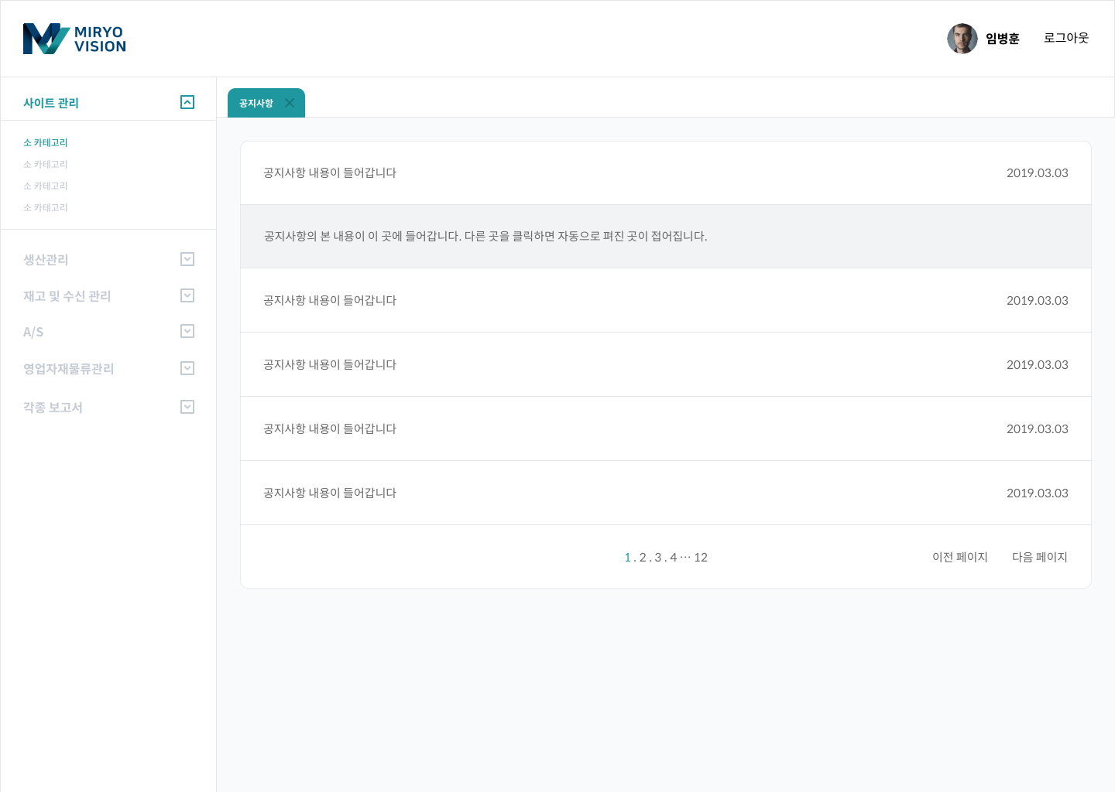
NotificationManagement 공지사항

