Slide 1
Minimalist Hepatitis Clinical Case
Here is where your presentation begins

Slide 2
Contents of this template
Here’s what you’ll find in this Slidesgo template:
A slide structure based on a clinical case presentation, which you can easily adapt to your needs. For more info on how to edit the template, please visit our blog or read our FAQs.
An assortment of graphic resources that are suitable for use in the presentation can be found in the alternative resources slides.
A thanks slide, which you must keep so that proper credits for our design are given.
Two resources slide, where you’ll find links to all the elements used in the template.
Instructions for use.
Final slides with:
The fonts and colors used in the template.
A selection of illustrations. You can also customize and animate them as you wish with the online editor. Visit Storyset to find more.
More infographic resources, whose size and color can be edited.
Sets of customizable icons of the following themes: general, business, avatar, creative process, education, help & support, medical, nature, performing arts, SEO & marketing, and teamwork.
You can delete this slide when you’re done editing the presentation.

Slide 3
Table of contents
01
02
03
About the patient
Discussion
Diagnosis
04
05
Treatment
Patient monitoring
You can describe the topic of the section here
You can describe the topic of the section here
You can describe the topic of the section here
You can describe the topic of the section here
You can describe the topic of the section here

Slide 4
Table of contents
01
02
About the patient
Diagnosis
03
04
Treatment
Patient monitoring
You can describe the topic of the section here
You can describe the topic of the section here
You can describe the topic of the section here
You can describe the topic of the section here

Slide 5
Introduction
You can give a brief description of the topic you want to talk about here. For example, if you want to talk about Mercury, you can say that it’s the smallest planet in the entire System

Slide 6
Introduction
You can give a brief description of the topic you want to talk about here. For example, if you want to talk about Mercury, you can say that it’s the smallest planet in the entire System

Slide 7
01
About the patient
You can enter a subtitle here if you need it

Slide 8
01
About the patient
You can enter a subtitle here if you need it

Slide 9
Identifying information
Mars
Jupiter
Saturn
Despite being red, Mars is a very cold place, not hot
It’s a gas giant and the biggest planet in the Solar System
Saturn is a gas giant and it’s composed of hydrogen and helium

Slide 10
Identifying information
Mars
Jupiter
Despite being red, Mars is a very cold place, not hot
It’s the biggest planet of them all and named after a god

Slide 11
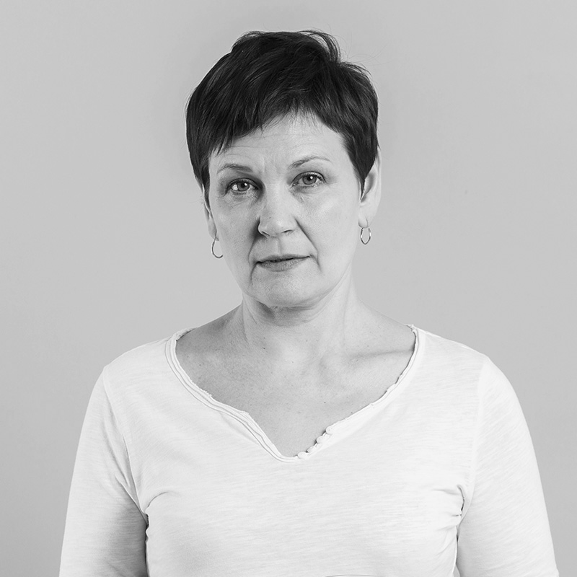
Patient medical history
2005
Jupiter is a gas giant and the biggest in the Solar System
2008
Despite being red, Mars is a very cold place, not hot
Age
25
2012
Gender
Female
Saturn is a gas giant and has several rings
Location
Madrid, Spain

Slide 12
Patient medical history
Allergies: None
Location: NY
Age: 25
1st term
2nd term
3rd term
Gender: Male
Jupiter is a gas giant and the biggest in the Solar System
Despite being red, Mars is a very cold place, not hot
Saturn is a gas giant. It’s composed of hydrogen

Slide 13
Patient medical history
Allergies: None
Location: NY
Age: 25
Gender: Male
70%
30%
Mercury
Inflammation
Mercury is the closest planet to the Sun
Despite being red, Mars is a cold place

Slide 14
Awesome words

Slide 15
Awesome words

Slide 16
Systems’ review
Mars
Mercury
Jupiter
Saturn
Despite being red, Mars is a cold place. The planet is full of iron oxide dust
Mercury is the closest to the Sun and the smallest one in the Solar System
Jupiter is a gas giant and the biggest planet in the Solar System
Saturn is a gas giant. It has rings and it’s composed of hydrogen

Slide 17
Systems’ review
Mars
Mercury
Jupiter
Saturn
Neptune
Despite being red, Mars is a cold place
Mercury is the smallest planet
Jupiter is the biggest planet of them all
Saturn is a gas giant and has several rings
It’s the farthest planet from the Sun

Slide 18
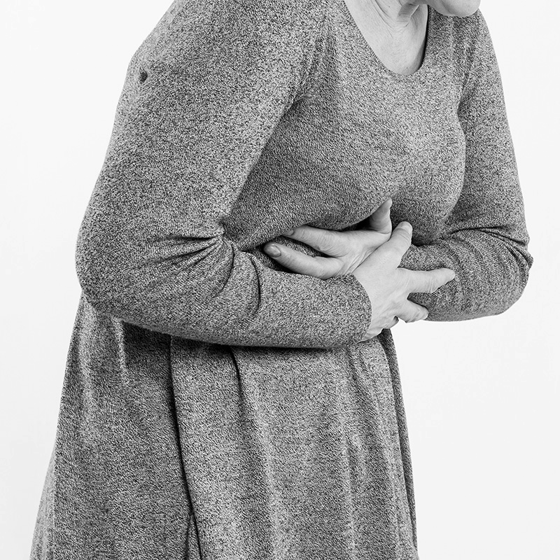
Physical examination
Saturn
Mars
Jupiter
Saturn is the ringed planet. It’s composed of hydrogen
Despite being red, Mars is a surprisingly cold place
It’s a gas giant and the biggest planet

Slide 19
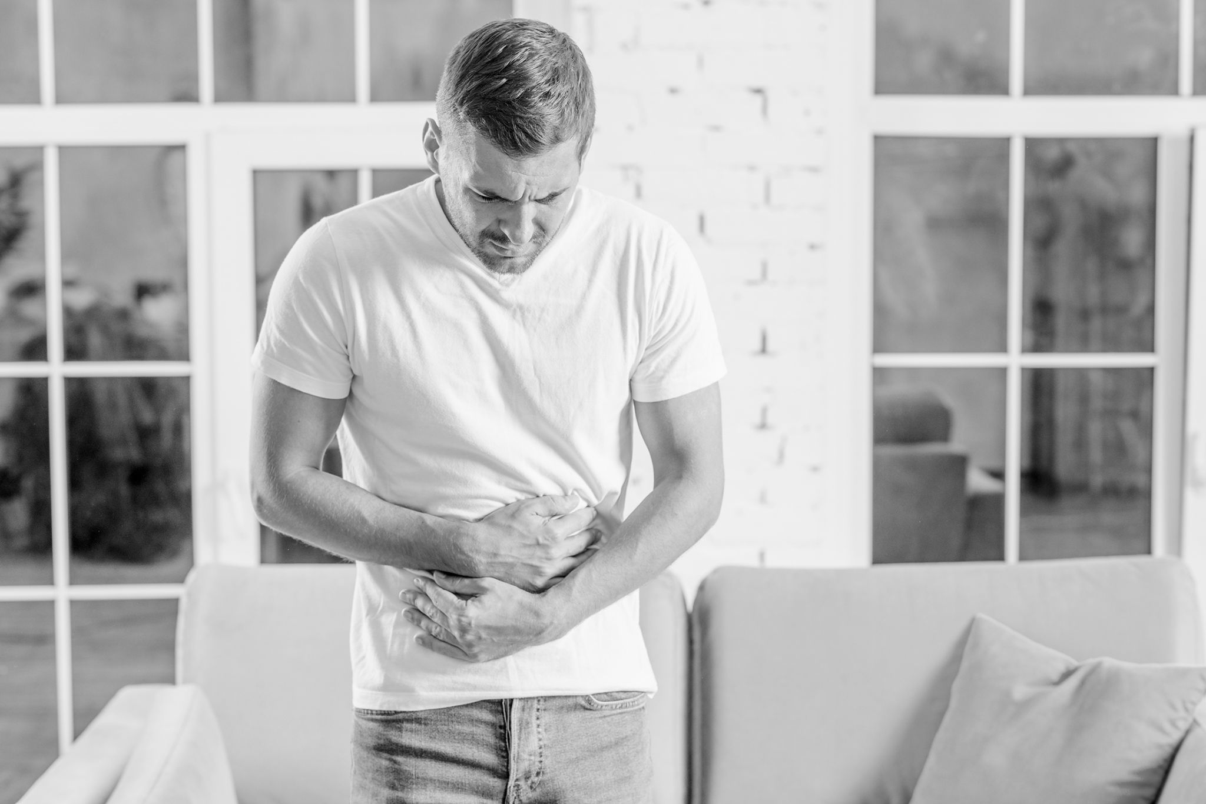
Physical examination
Venus
Mercury
Mars
Neptune
Venus is the second planet from the Sun. It’s really hot
It’s the closest planet to the Sun and the smallest one
Despite being red, Mars is actually a cold place
It’s the farthest planet from the Sun and is a cold place

Slide 20
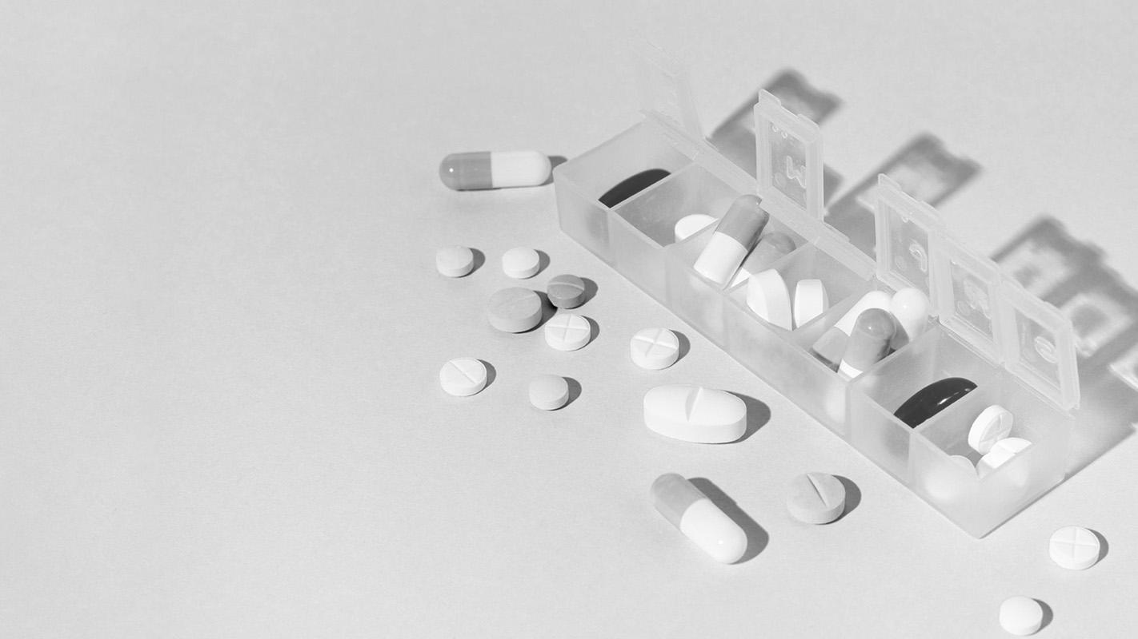
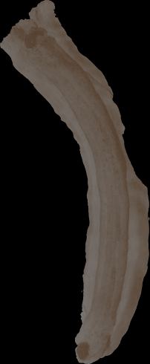


A picture is worth a thousand words

Slide 21
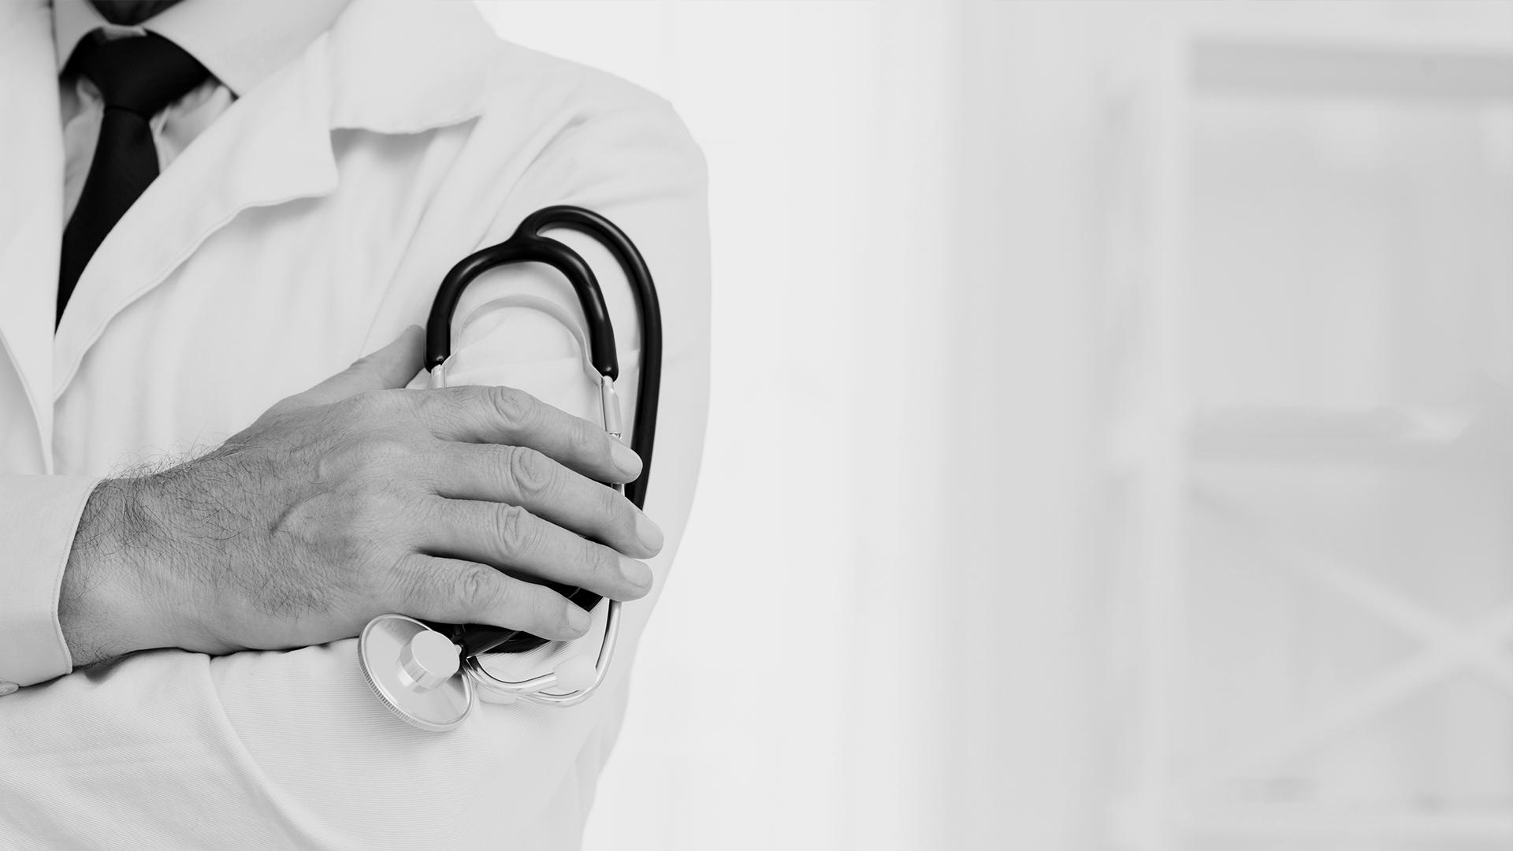
A picture is worth a thousand words

Slide 22
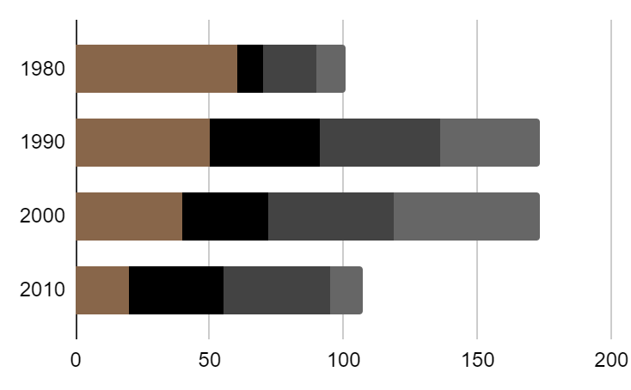
Evolution
Mercury
Venus
Mars
Jupiter
Mercury is the smallest planet
Venus has a nice name, but it’s hot
To modify this graph, click on it, follow the link, change the data and paste the new graph here, replacing this one. You can see how to modify the graph here
Despite being red, Mars is cold
Jupiter is the biggest planet

Slide 23
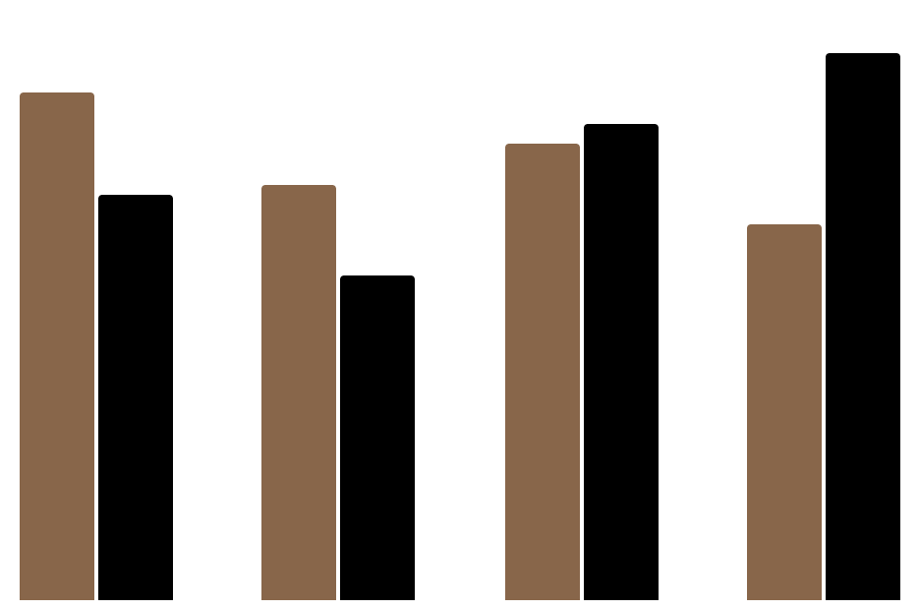
Evolution
Mercury
Venus
2018
2019
2020
2021
Mercury is the smallest planet
Venus has a nice name, but it’s hot
To modify this graph, click on it, follow the link, change the data and paste the new graph here, replacing this one. Learn how to modify the graph here

Slide 24

Prevalence
10%
30%
25%
35%
Mercury is the smallest planet
Venus has a nice name, but it’s hot
Despite being red, Mars is cold
Jupiter is the biggest planet
To modify this graph, click on it, follow the link, change the data and paste the new graph here, replacing this one. Learn how to modify the graph here

Slide 25
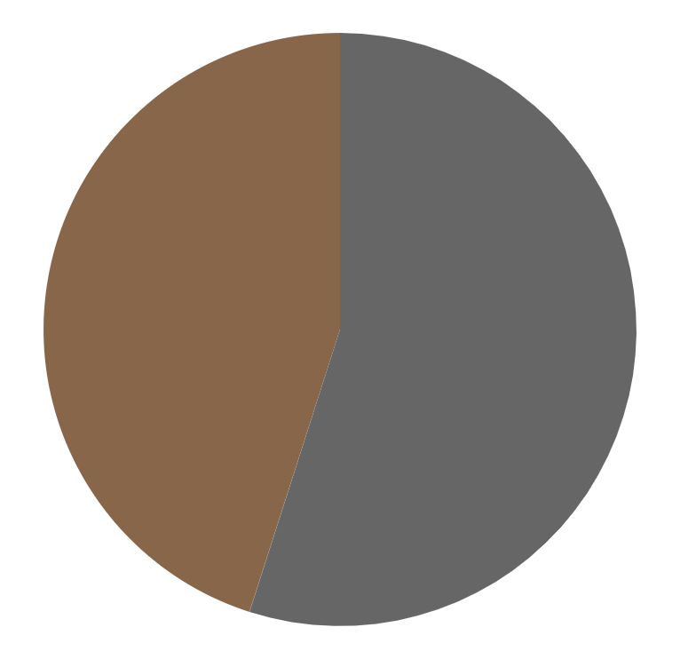
Prevalence
45%
55%
Mars
Jupiter
Despite being red, Mars is cold
Jupiter is the biggest planet
Follow the link in the graph to modify its data and then paste the new one here. For more info, click here

Slide 26
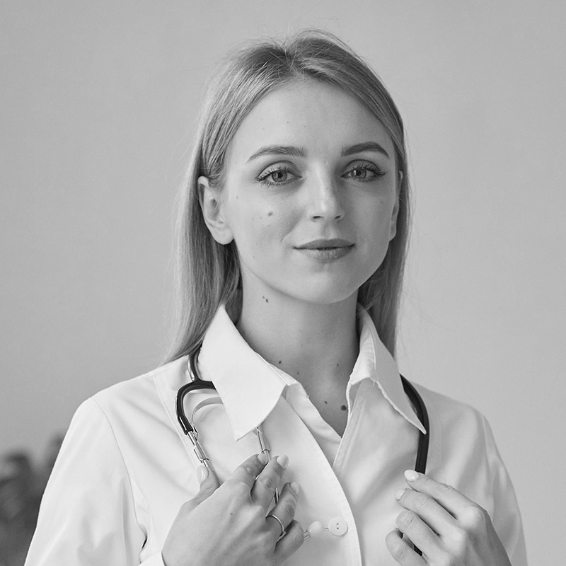
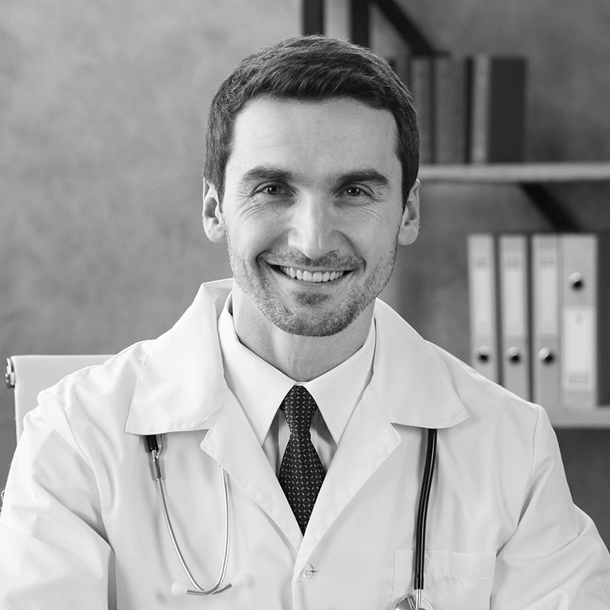
Discussion
Dr. Jenna Doe
Dr. John James
“Despite being red, Mars is a cold place, not hot. It’s full of iron oxide dust, which give its reddish cast”
“Jupiter is a gas giant and the biggest in the Solar System. It’s the fourth-brightest object in the sky”

Slide 27
Discussion
Mercury
Mars
Venus
Mercury is the smallest planet
Despite being red, Mars is cold
Venus has a nice name, but it’s hot

Slide 28
150,000
Big numbers catch your audience’s attention

Slide 29
754,000
Big numbers catch your audience’s attention

Slide 30
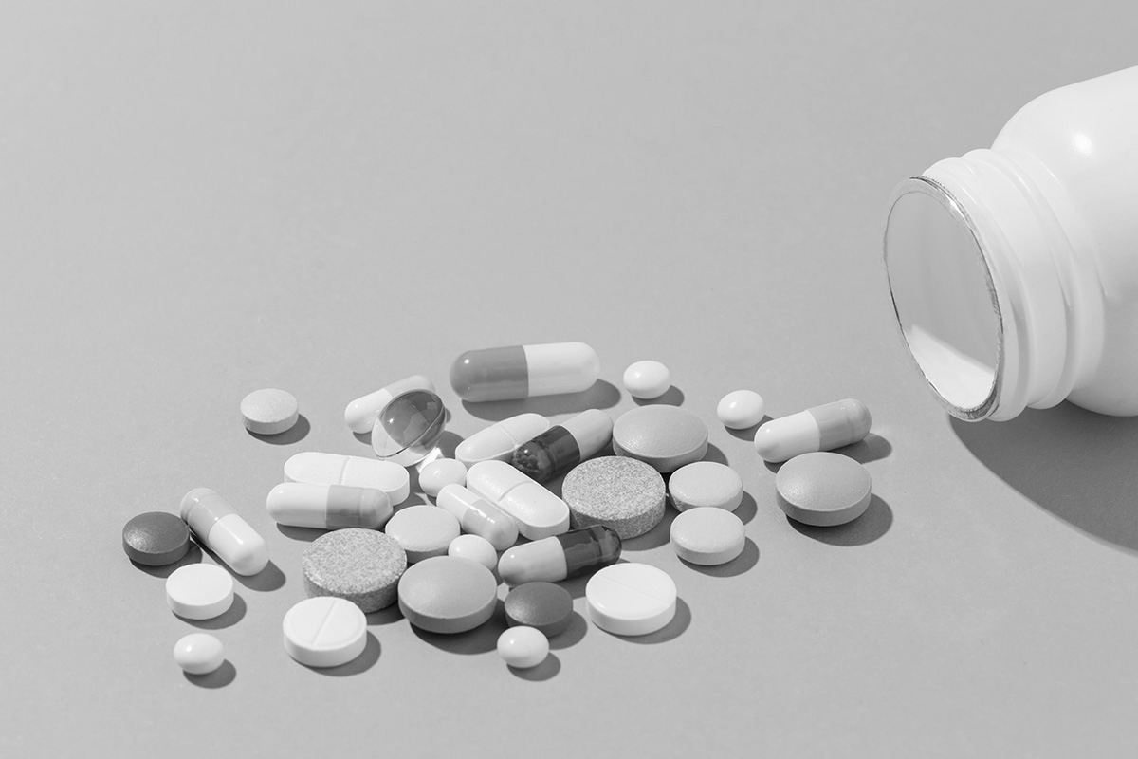
Discussion summary
Mercury is the closest planet to the Sun and the smallest one in the Solar System—it’s only a bit larger than the Moon. The planet’s name has nothing to do with the liquid metal

Slide 31
Discussion summary
Mercury is the closest planet to the Sun and the smallest one in the Solar System—it’s only a bit larger than the Moon. The planet’s name has nothing to do with the liquid metal

Slide 32
02
Diagnosis
You can enter a subtitle here if you need it

Slide 33
Comparison
 | Jupiter | Mercury | Venus | Mars
 | No | No | Yes | Yes
 | Yes | Yes | Yes | Yes
 | Yes | No | Yes | Yes
 | No | Yes | Yes | No
 | No | Yes | Yes | No

Slide 34
Comparison
 | John S | Frank M | Mike M | Danny F
Mercury
Mars
Saturn

Slide 35
Diagnosis
Mercury
Venus
Mars
Jupiter
Saturn
Neptune
Mercury is the smallest planet of them all
Venus has a nice name, but it’s hot
Despite being red, Mars is a cold place
Jupiter is a gas giant and the biggest planet
Saturn is composed mostly of hydrogen
Neptune is the farthest planet from the Sun

Slide 36
Diagnosis
#1
#2
Mercury
Venus
It’s the closest planet to the Sun and the smallest one
Venus is the second planet from the Sun. It’s hot there

Slide 37
Higher incidence
35%
10%
Jupiter is the biggest planet
Saturn is composed mostly of hydrogen
40%
15%
Mercury is the smallest planet
Venus has a nice name, but it’s hot

Slide 38
Most affected areas
New Delhi
New York
Jupiter is the biggest planet
Saturn is the ringed planet
N’Djamena
Santiago
Mercury is the smallest planet
Venus has a nice name, but it’s hot

Slide 39
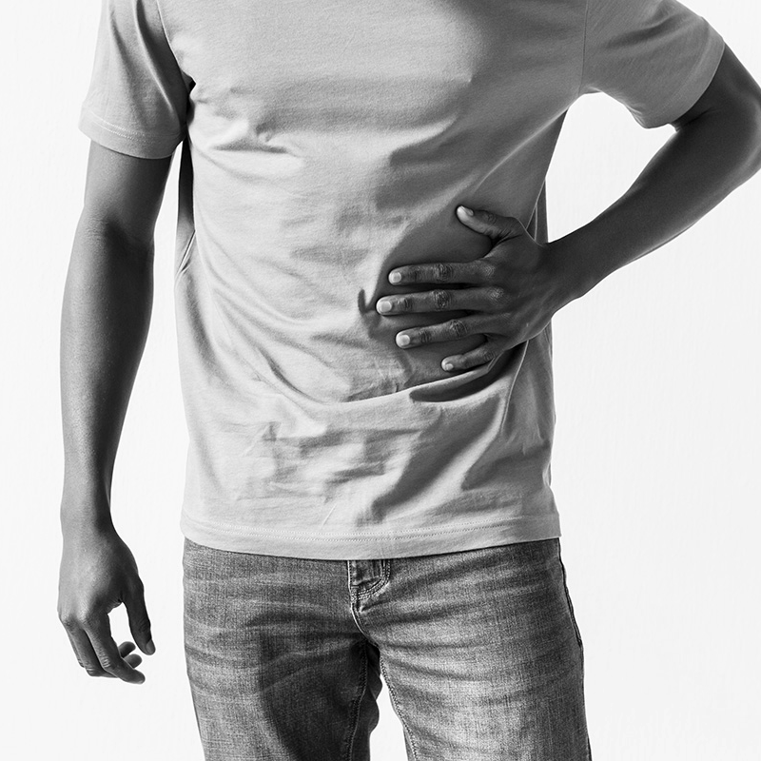
Treatment
Mars
Jupiter
Despite being red, Mars is a cold place full of iron oxide dust
Jupiter is a gas giant and the biggest planet in the Solar System

Slide 40

Treatment
Jupiter
Venus
Saturn
Mars
Jupiter is the biggest planet of them all
Venus has a nice name, but it’s hot
Saturn is a gas giant with rings
Despite being red, Mars is very cold

Slide 41
Patient monitoring
Week 1
Week 2
Week 3
Week 4
Mercury is the smallest planet of them all
Venus has a nice name, but it’s terribly hot
Saturn is mostly composed of hydrogen
Despite being red, Mars is actually cold place

Slide 42
Stages of hepatitis
01
02
03
First stage
Second stage
Third stage
Jupiter is the biggest planet
Venus has a nice name, but it’s hot
Saturn is the ringed planet

Slide 43
Contraindications & indications
You can describe the treatment contraindication here
You can describe the treatment contraindication here
You can describe the treatment contraindication here
You can describe the treatment indication here
You can describe the treatment indication here
You can describe the treatment indication here

Slide 44
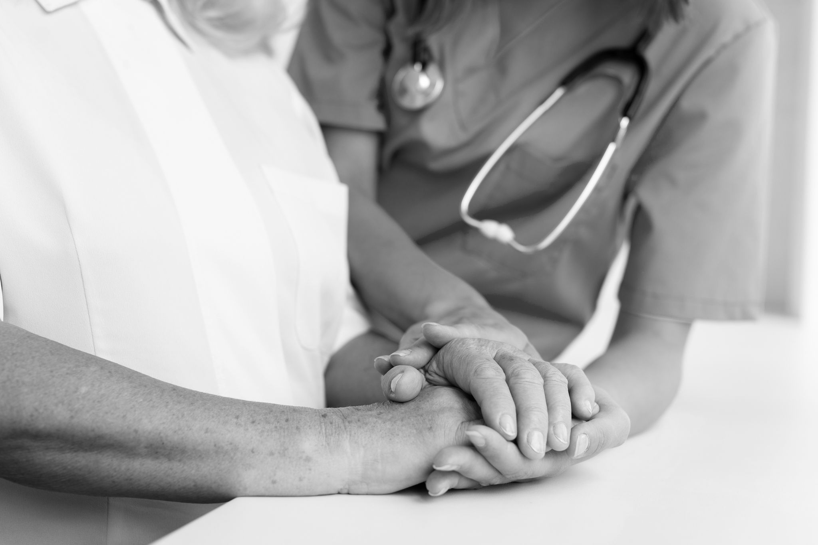
Contraindications
You can describe the treatment contraindication here
You can describe the treatment contraindication here
You can describe the treatment contraindication here

Slide 45
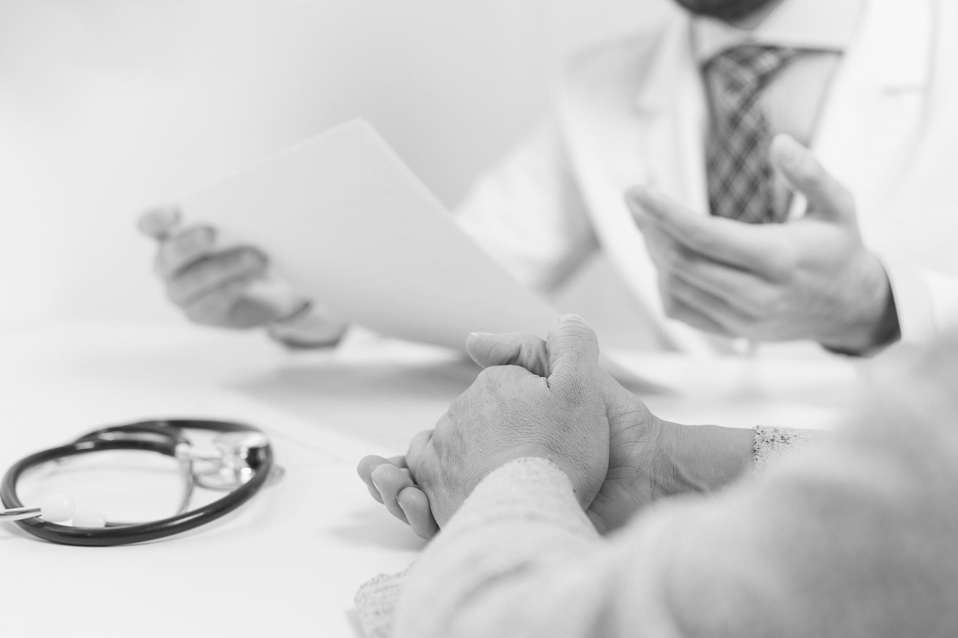
Indications
You can describe the treatment indication here
You can describe the treatment indication here
You can describe the treatment indication here

Slide 46
Post-prevention
Mars
Despite being red, Mars is a cold place
Jupiter
Saturn
Jupiter is the biggest planet of them all
Saturn is composed mostly of hydrogen
Mercury
Venus
Mercury is the smallest planet
Venus has a nice name, but it’s hot

Slide 47
Post-prevention
Jupiter
Mercury
Mars
Jupiter is the biggest planet of them all
It’s a small planet close to the Sun
Despite being red, Mars is a cold place

Slide 48
9h 55m 23s
333,000
386,000 km
Jupiter's rotation period
The Sun’s mass compared to Earth’s
Distance between Earth and the Moon

Slide 49
35%
30%
Venus
Earth
15%
20%
Mercury
Mars
Venus has a very beautiful name
Earth is the planet where we all live on
Mercury is the smallest planet of them all
Despite being red, Mars is very cold

Slide 50
Case timeline
Day 2
Day 4
Venus has a very beautiful name
Jupiter is the biggest planet
Day 1
Day 3
Day 5
Mercury is the smallest planet
Earth is where we all live on
Despite being red, Mars is very cold

Slide 51
Case timeline
Earth is where we all live on
Venus has a very beautiful name
01
02
03
04
Mercury is the smallest planet
Despite being red, Mars is very cold

Slide 52
Conclusions
Mercury is the closest planet to the Sun and the smallest one in the Solar System—it’s only a bit larger than the Moon. The planet’s name has nothing to do with the liquid metal

Slide 53
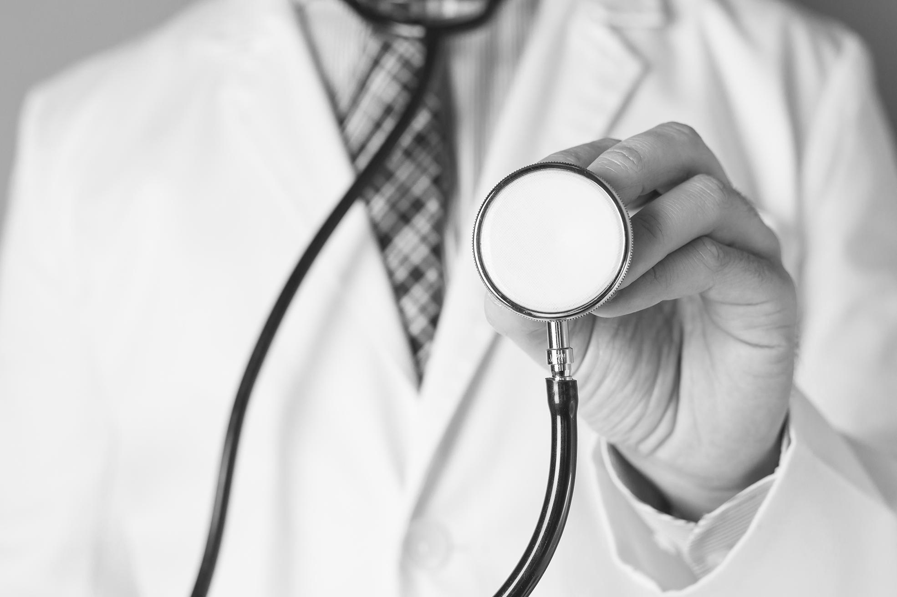
Conclusions
Mercury is the closest planet to the Sun and the smallest one in the Solar System—it’s only a bit larger than the Moon. The planet’s name has nothing to do with the liquid metal

Slide 54
References
AUTHOR (YEAR). Title of the publication. Publisher
AUTHOR (YEAR). Title of the publication. Publisher
AUTHOR (YEAR). Title of the publication. Publisher
AUTHOR (YEAR). Title of the publication. Publisher
AUTHOR (YEAR). Title of the publication. Publisher
AUTHOR (YEAR). Title of the publication. Publisher

Slide 55
References
AUTHOR (YEAR). Title of the publication. Publisher
AUTHOR (YEAR). Title of the publication. Publisher
AUTHOR (YEAR). Title of the publication. Publisher
AUTHOR (YEAR). Title of the publication. Publisher
AUTHOR (YEAR). Title of the publication. Publisher
AUTHOR (YEAR). Title of the publication. Publisher

Slide 56
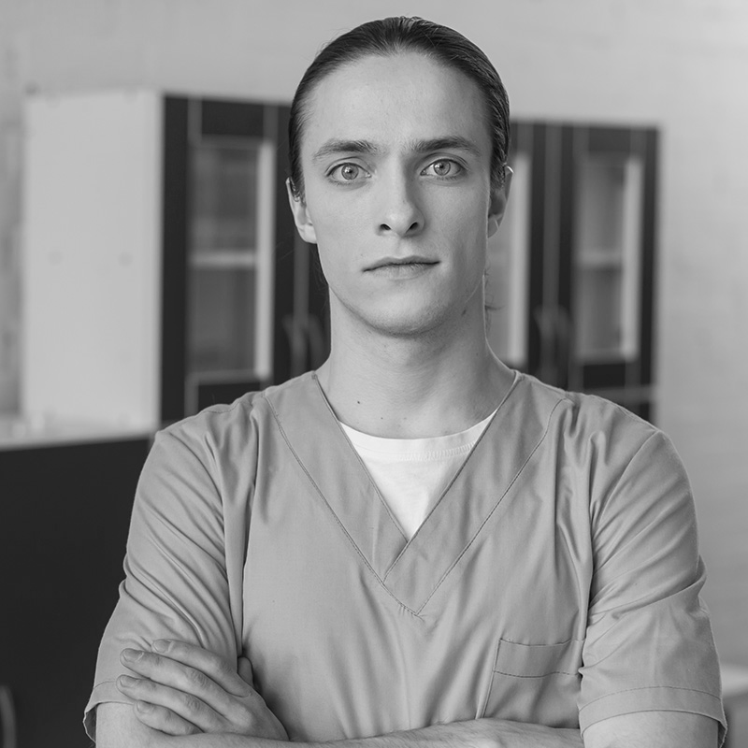
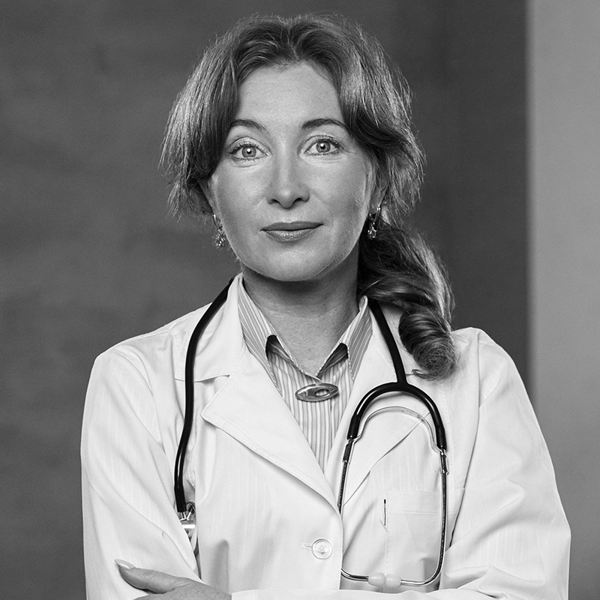
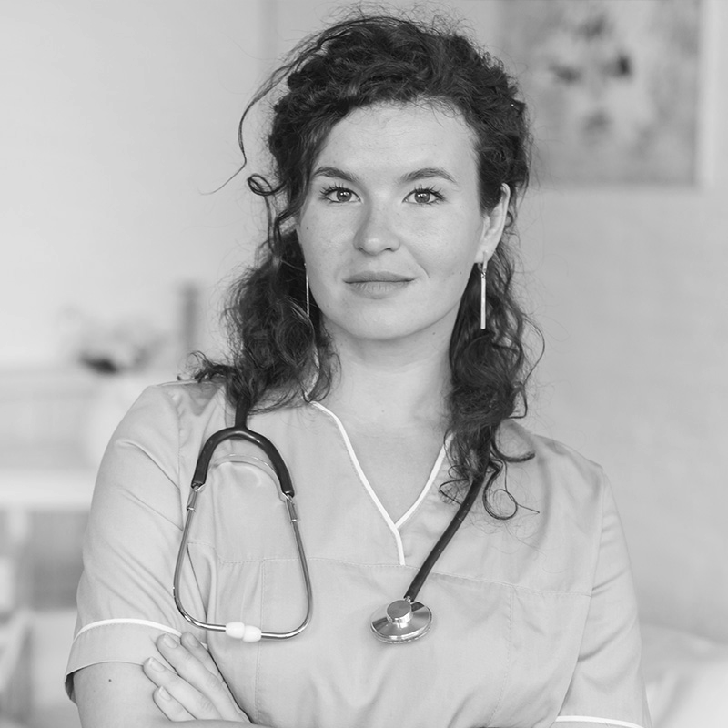
Our team
John James
Jenna Doe
Jane Patterson
You can speak about this person here
You can speak about this person here
You can speak about this person here

Slide 57

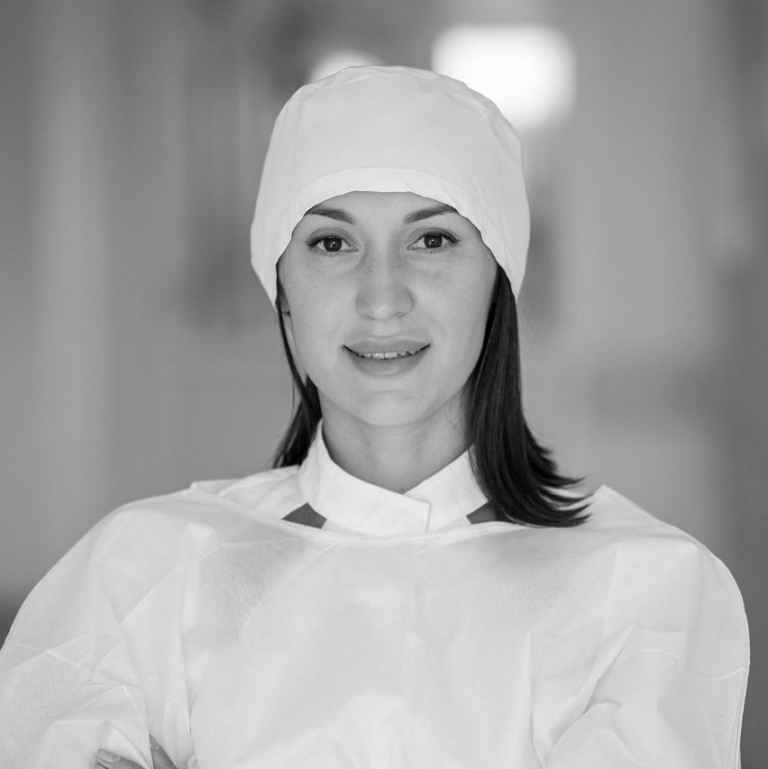
Our team
Phil Smith
Grace Gold
You can speak about this person here
You can speak about this person here

Slide 58
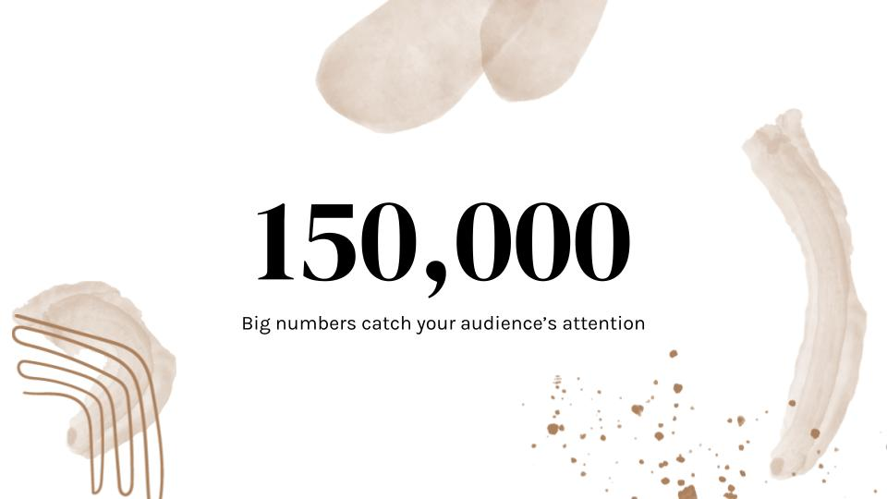
Online support
You can replace the image on the screen with your own work. Just right-click on it and select “Replace image”

Slide 59
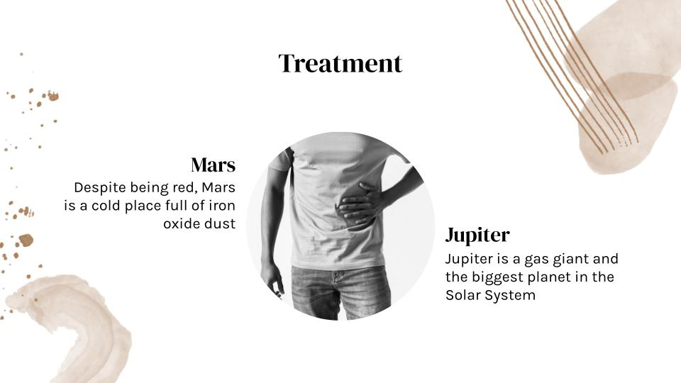
Laptop device
You can replace the image on the screen with your own work. Just right-click on it and select “Replace image”

Slide 60

Mobile website
You can replace the image on the screen with your own work. Just right-click on it and select “Replace image”

Slide 61
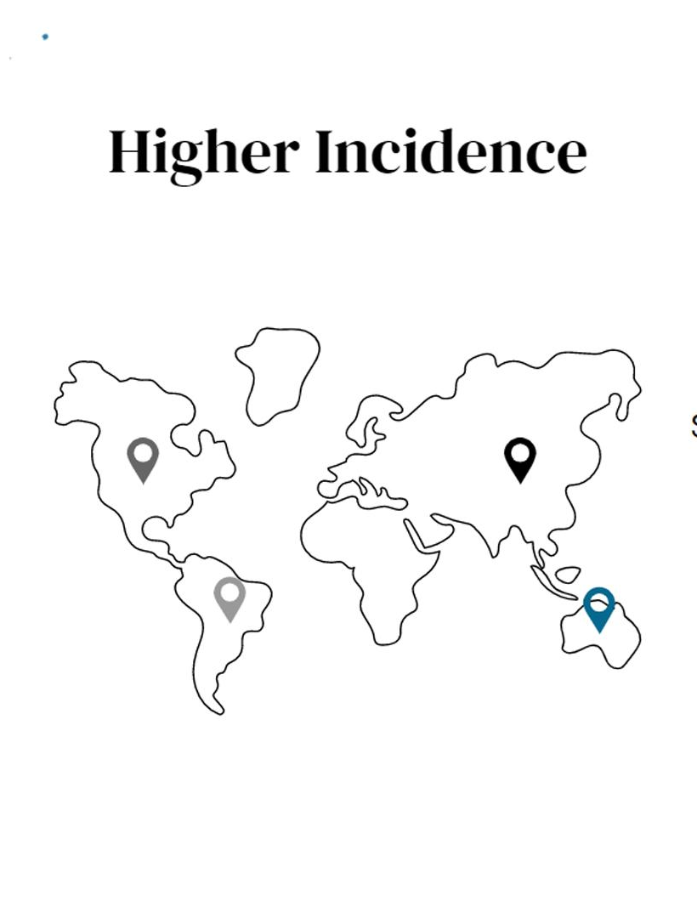
Tablet app
You can replace the image on the screen with your own work. Just right-click on it and select “Replace image”

Slide 62
Thanks
Does anyone have any questions?
addyouremail@freepik.com
+91 620 421 838
yourwebsite.com
Please keep this slide for attribution

Slide 63
Healthcare icon pack

Slide 64



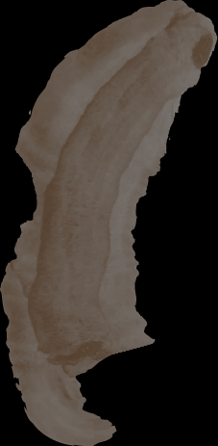



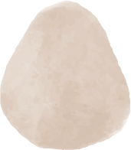
Alternative resources
Here’s an assortment of alternative resources whose style fits the one of this template:

Slide 65
Alternative infographics elements

Slide 66
Alternative resources
Icons
Healthcare Icon Pack
Photos
Hardworking nurse with surgical mask
Close up doctors taking care of patient top view
Doctor examining hand of patient
Woman doctor putting her pandemic equipment
Doctor giving medical prescription
Doctor holding stethoscope on arm looking at camera
Confident elderly doctor in office
Mid section of woman having stomach ache
High angle female and male nurse
Doctor wearing face mask at the clinic

Slide 67
Resources
Did you like the resources on this template? Get them for free at our other websites
Vectors
Colorless watercolor cover collection
Colorless abstract cover collection
Photos
Senior woman with medical problems
Man with medical problems
Senior woman taking pills
Pills box on yellow background
Medium shot smiley man wearing coat
Front view of covid recovery center female doctor with stethoscope
Front view of female physician with stethoscope
Male nurse with arms crossed
Portrait of young female nurse standing in front of senior woman sitting on wheel chair
High angle minimal medicinal pills assortment

Slide 68
Resources
Photos
Doctor holding stethoscope with copy-space
Cheerful young doctor making notes
Portrait of pretty doctor at the hospital
Portrait of a doctor holding stethoscope for physical examination
American Shot man with pain
Young man suffering from stomach ache
Man lying on sofa having sever stomach ache
Doctor and old woman holding hands close-up
Close-up of a doctor in his office discussing medical report with patient

Slide 69
Instructions for use (free users)
In order to use this template, you must credit Slidesgo by keeping the Thanks slide.
You are allowed to:
Modify this template.
Use it for both personal and commercial purposes.
You are not allowed to:
Sublicense, sell or rent any of Slidesgo Content (or a modified version of Slidesgo Content).
Distribute this Slidesgo Template (or a modified version of this Slidesgo Template) or include it in a database or in any other product or service that offers downloadable images, icons or presentations that may be subject to distribution or resale.
Use any of the elements that are part of this Slidesgo Template in an isolated and separated way from this Template.
Delete the “Thanks” or “Credits” slide.
Register any of the elements that are part of this template as a trademark or logo, or register it as a work in an intellectual property registry or similar.
For more information about editing slides, please read our FAQs or visit our blog:
https://slidesgo.com/faqs and https://slidesgo.com/slidesgo-school

Slide 70
Instructions for use (premium users)
In order to use this template, you must be a Premium user on Slidesgo.
You are allowed to:
Modify this template.
Use it for both personal and commercial purposes.
Hide or delete the “Thanks” slide and the mention to Slidesgo in the credits.
Share this template in an editable format with people who are not part of your team.
You are not allowed to:
Sublicense, sell or rent this Slidesgo Template (or a modified version of this Slidesgo Template).
Distribute this Slidesgo Template (or a modified version of this Slidesgo Template) or include it in a database or in any other product or service that offers downloadable images, icons or presentations that may be subject to distribution or resale.
Use any of the elements that are part of this Slidesgo Template in an isolated and separated way from this Template.
Register any of the elements that are part of this template as a trademark or logo, or register it as a work in an intellectual property registry or similar.
For more information about editing slides, please read our FAQs or visit our blog:
https://slidesgo.com/faqs and https://slidesgo.com/slidesgo-school

Slide 71
Fonts & colors used
This presentation has been made using the following fonts:
DM Serif Display
(https://fonts.google.com/specimen/DM+Serif+Display)
Karla
(https://fonts.google.com/specimen/Karla)
#000000
#ffffff
#88664a

Slide 72

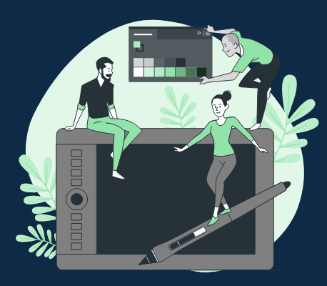



Storyset
Create your Story with our illustrated concepts. Choose the style you like the most, edit its colors, pick the background and layers you want to show and bring them to life with the animator panel! It will boost your presentation. Check out how it works.
Pana
Amico
Bro
Rafiki
Cuate

Slide 73
Use our editable graphic resources...
You can easily resize these resources without losing quality. To change the color, just ungroup the resource and click on the object you want to change. Then, click on the paint bucket and select the color you want. Group the resource again when you’re done. You can also look for more infographics on Slidesgo.

Slide 76
JANUARY
FEBRUARY
MARCH
APRIL
MAY
JUNE
PHASE 1
Task 1
Task 2
PHASE 2
Task 1
Task 2
JANUARY
FEBRUARY
MARCH
APRIL
PHASE 1
Task 1
Task 2

Slide 79
...and our sets of editable icons
You can resize these icons without losing quality.
You can change the stroke and fill color; just select the icon and click on the paint bucket/pen.
In Google Slides, you can also use Flaticon’s extension, allowing you to customize and add even more icons.

Slide 80
Educational Icons
Medical Icons

Slide 81
Business Icons
Teamwork Icons

Slide 82
Help & Support Icons
Avatar Icons

Slide 83
Creative Process Icons
Performing Arts Icons

Slide 84
Nature Icons

Slide 85
SEO & Marketing Icons

Slide 86


