Slide 1
POWERED BY TYPESENSE
LaundroStat
FRESH
START
Clean clothes. Friendly competition.
A hosted social laundry showcase for Purdue University West Lafayette.
RECENCY + CONSISTENCY
MERP
Marcus Withers · Eddie Wuerthele · Rupika Chakka · Pritham Singh
Student-built synthetic demo · Not affiliated with or endorsed by Purdue, University Residences, CSC ServiceWorks, CSCPay, or Typesense.
LaundroStat
01

Slide 2
THE PROBLEM
Laundry is easy to put off.
Dorm laundry is repetitive, inconvenient, and usually done alone.
01
A chore with no shared routine
When the routine slips, friends have no respectful way to coordinate a laundry day or offer a little encouragement.
02
Private behavior invites bad assumptions
03
Accountability often feels like a call-out
What if laundry felt more social—and a little more fun?
SYNTHETIC SHOWCASE · NO LIVE CSC CONNECTION
LaundroStat
02

Slide 3
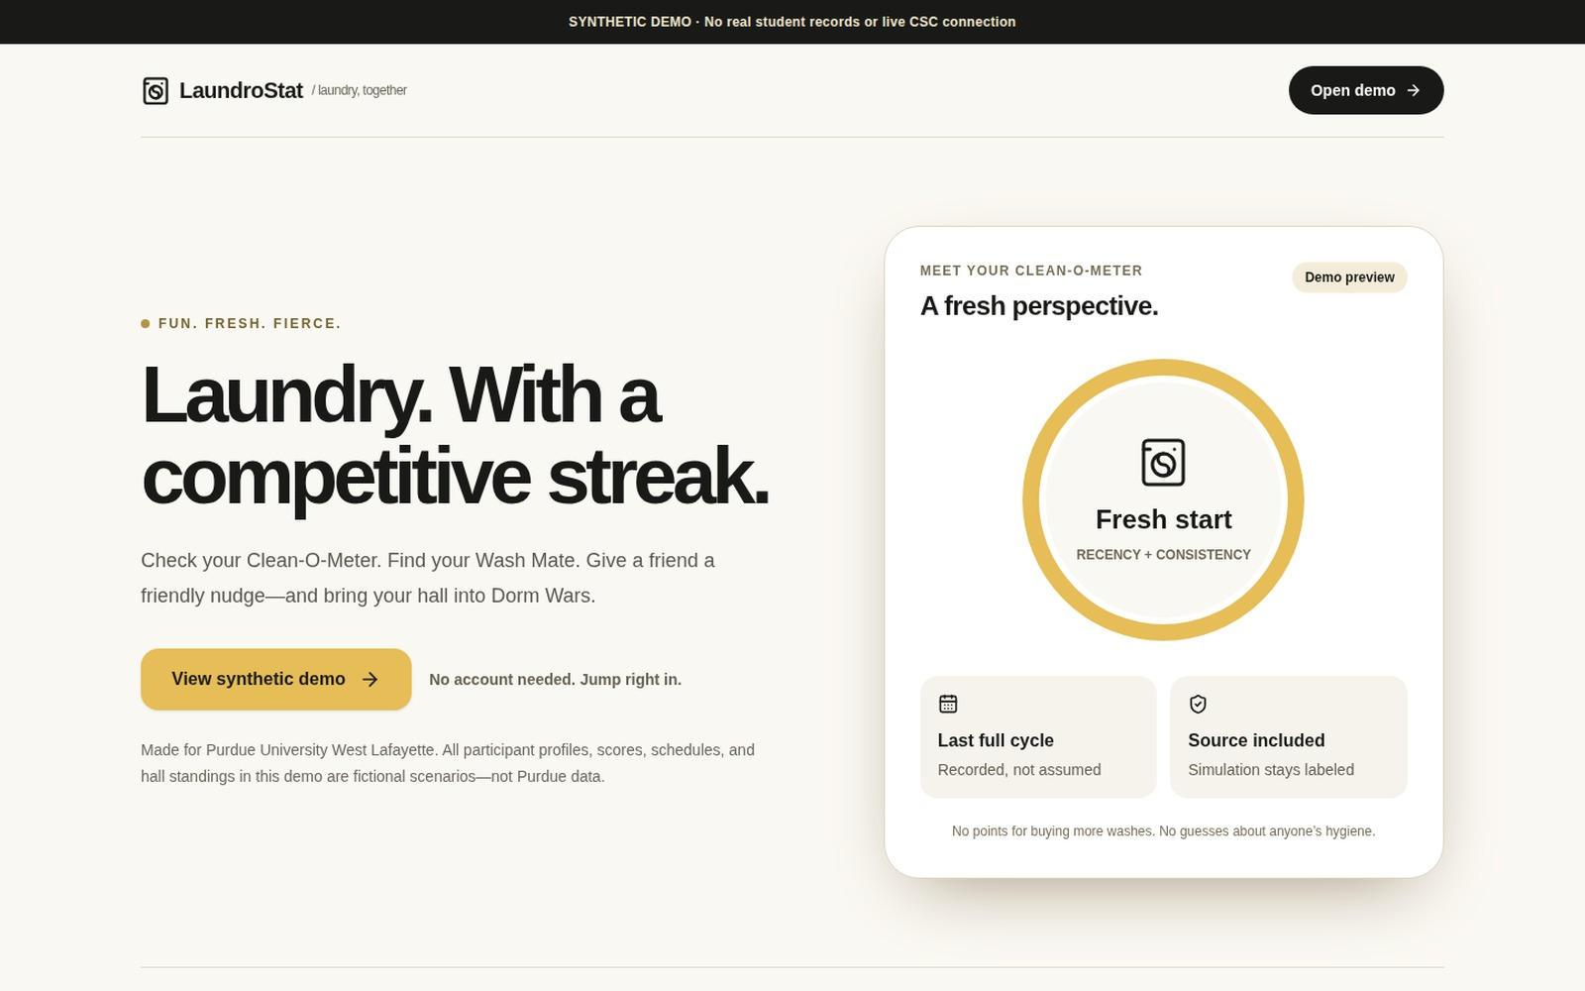
THE IDEA
Turn laundry into a social routine.
One simple loop: understand your routine, find support, and bring your hall along.
01
Check
See your Clean-O-Meter.
02
Match
Find a Wash Mate.
03
Encourage
Send a consenting friend a preset nudge.
04
Compete
Join Squeaky/Stinky Squads and Dorm Wars.
FICTIONAL PARTICIPANTS · REAL HOSTED INTERACTIONS
SYNTHETIC SHOWCASE · NO LIVE CSC CONNECTION
LaundroStat
03

Slide 4
THE PRODUCT
One routine. Five ways to play.
Clean-O-Meter
Friendly nudges
Wash Mates
Recorded recency + consistency, with the source shown.
Search consenting friends by recorded activity period.
Match overlapping usual laundry days and time windows.
Squeaky / Stinky
Dorm Wars
Playful top and bottom eligible user squads.
Normalized synthetic residence-hall averages.
HOSTED DEMO · Isolated actions save to the browser session or presentation account.
SYNTHETIC SHOWCASE · NO LIVE CSC CONNECTION
LaundroStat
04

Slide 5
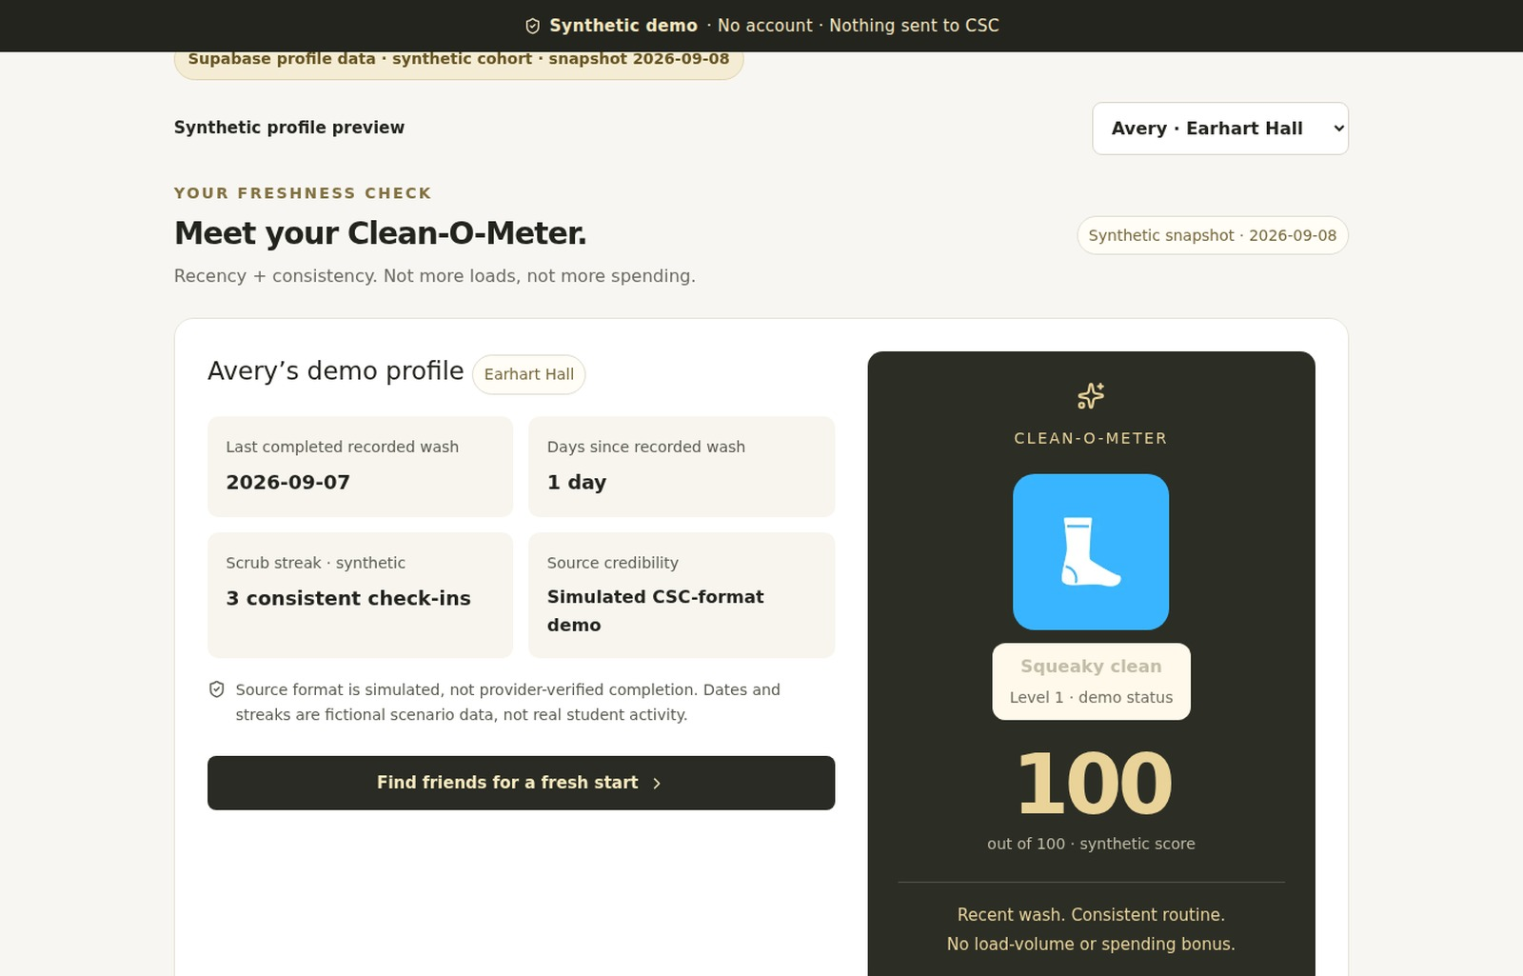
THE SCORE
Meet the Clean-O-Meter.
A transparent demo model—not a hygiene judgment.
100 − (4 × days since recorded wash)
+ (2 × scrub streak)
• Scrub streak is capped at 6.
• Final score is bounded from 0 to 100.
• Unknown or incomplete tracking gets no score.
• More loads, money, and claimed weight never buy points.
ILLUSTRATIVE DEMO · NOT POLICY, PROVIDER MEASUREMENT, OR HYGIENE JUDGMENT
SYNTHETIC SHOWCASE · NO LIVE CSC CONNECTION
LaundroStat
05

Slide 6
TRUST BY DESIGN
Fair by design.
The rules make the game legible without turning private behavior into spectacle.
EQUAL FOOTING
PRIVATE BY DEFAULT
Recency and consistency—not purchase volume or load count.
Private, nonconsenting, and unknown profiles stay out of rankings.
CLEAR RANKS
NORMALIZED HALLS
Ties share ranks. Squeaky and Stinky groups never overlap.
Dorm Wars divides by the eligible synthetic roster—not building capacity.
Every score keeps its source context visible.
SYNTHETIC SHOWCASE · NO LIVE CSC CONNECTION
LaundroStat
06

Slide 7
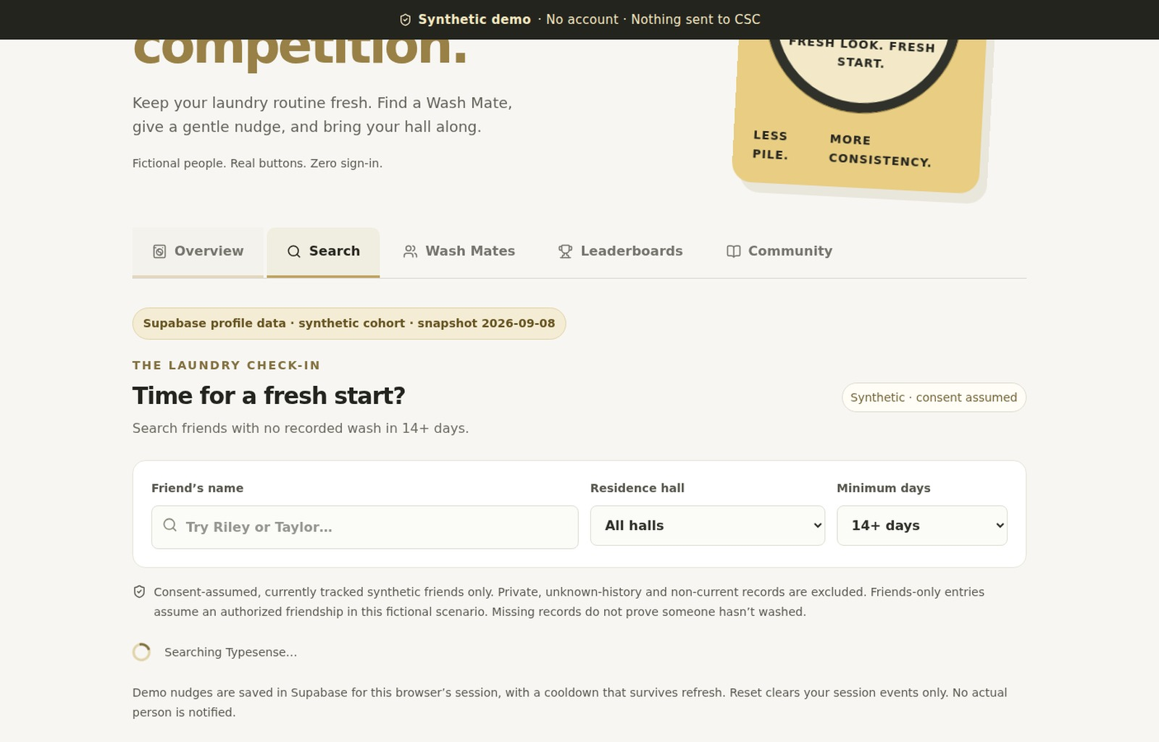
THE SOCIAL LAYER
Encouragement, not exposure.
A respectful nudge loop
1
Search consenting synthetic friends
2
Filter by no recorded wash in the selected period
3
Send one preset “fresh start” nudge
4
Respect the 72-hour recipient cooldown
5
Save privately to the session or demo account
NO REAL PERSON IS NOTIFIED
SYNTHETIC SHOWCASE · NO LIVE CSC CONNECTION
LaundroStat
07

Slide 8
ARCHITECTURE
How the hosted demo works
Provider-backed synthetic workflows with explicit consent and data boundaries.
LOAD
Browser
→
Next.js 16
→
Supabase synthetic data
SEARCH
Friend filters
→
Typesense Cloud
→
Supabase consent recheck
SAVE
Preset action
→
Server-only handler
→
Private session/account event
NO LIVE CSC/CSCPAY · NO QR OR VIBRATION SENSOR · NO WEIGHT OR CYCLE/PHOTO VERIFICATION
SYNTHETIC SHOWCASE · NO LIVE CSC CONNECTION
LaundroStat
08

Slide 9
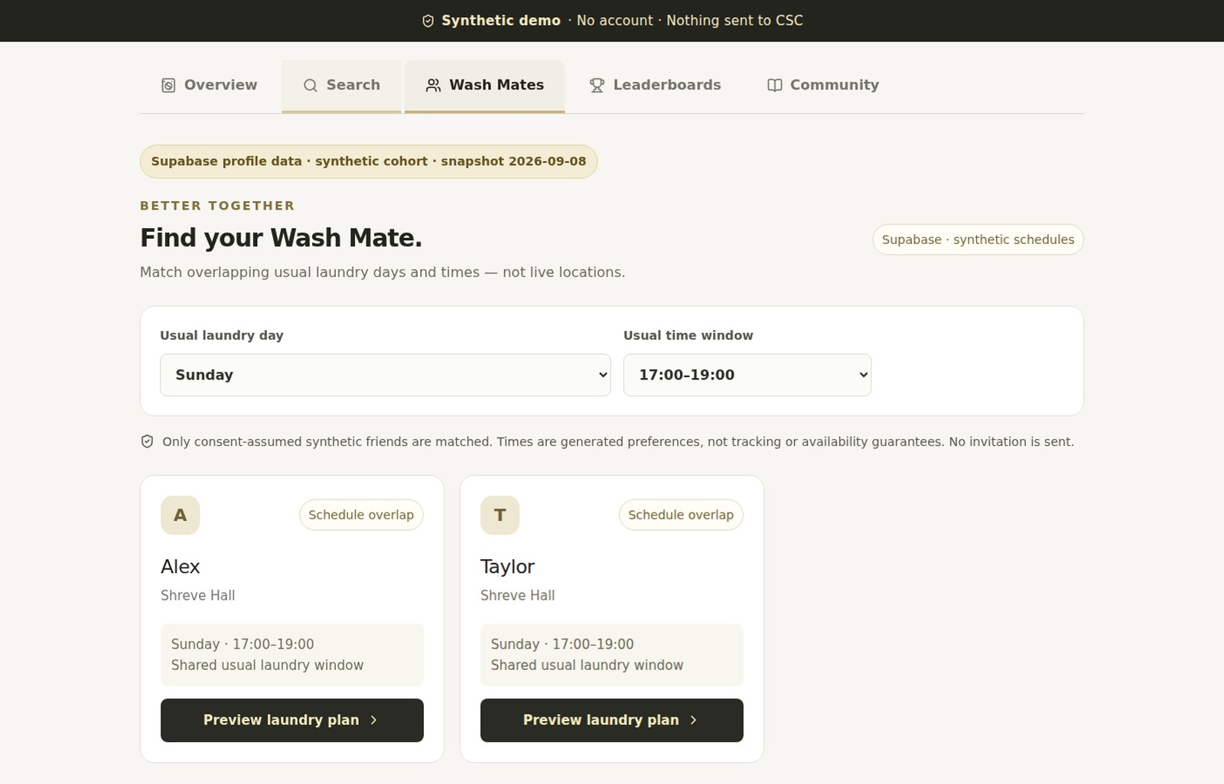
BETTER TOGETHER
Find your Wash Mate.
Coordinate a shared routine—not a live location.
How matching works
• Choose your usual laundry day.
• Select a general time window.
• Find consenting synthetic friends with overlap.
• See why each schedule matches.
Coarse fictional preferences—
not observed student movement.
SYNTHETIC SHOWCASE · NO LIVE CSC CONNECTION
LaundroStat
09

Slide 10
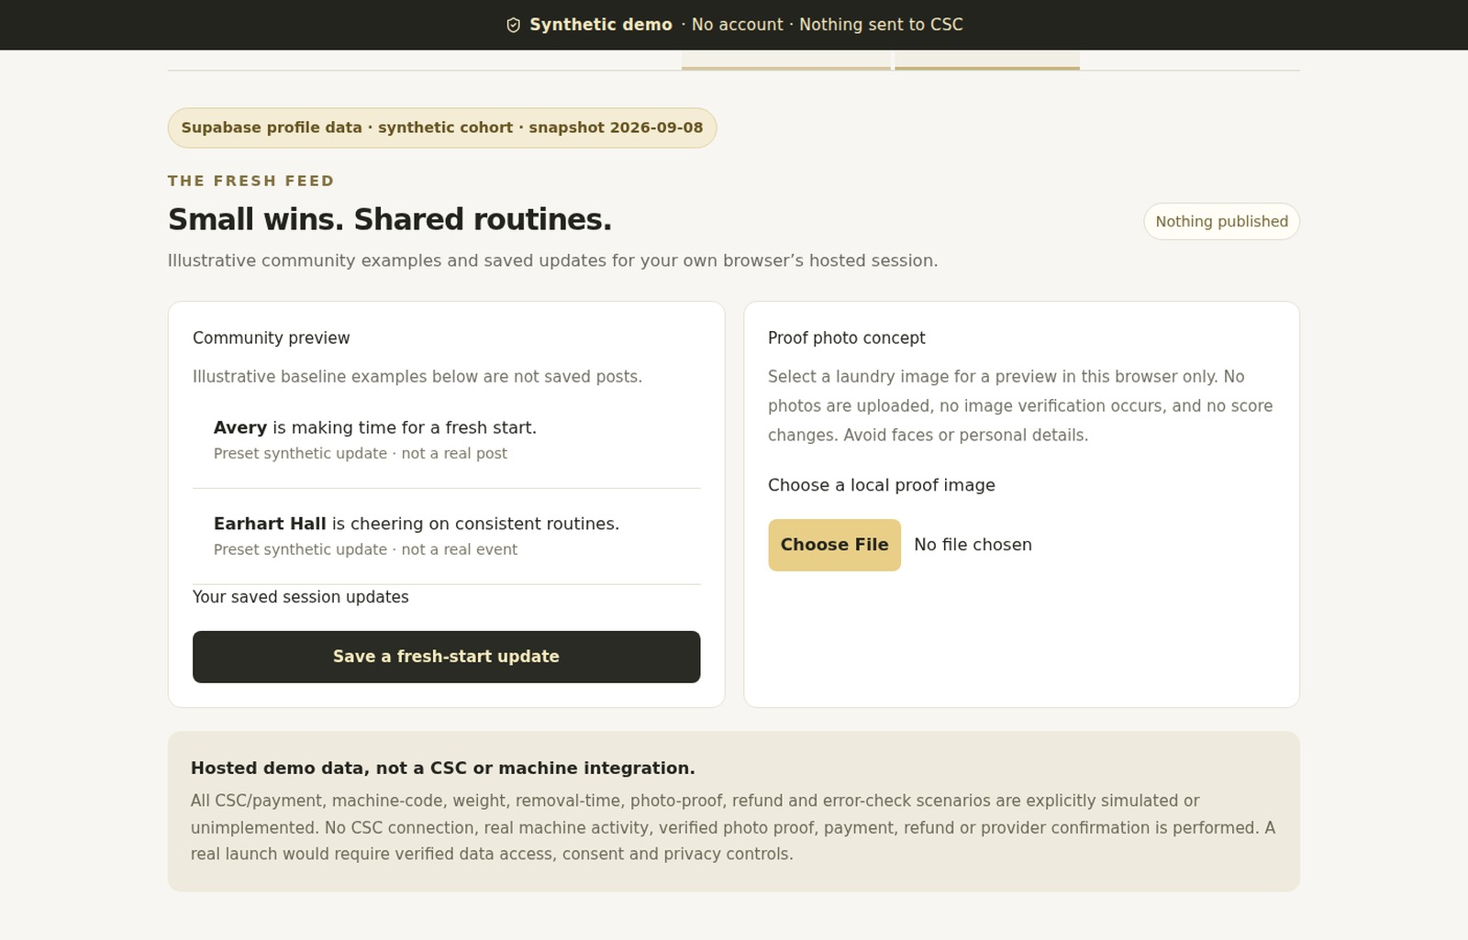
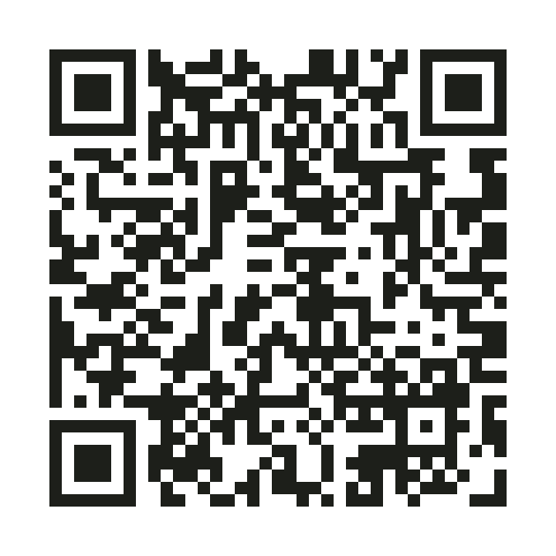
LIVE DEMO
Let’s see LaundroStat in action.
The public showcase needs no account. An optional demo account saves synthetic actions across sign-ins.
→
01
Clean-O-Meter
→
02
Friend Search
→
03
Wash Mates
→
04
Squeaky/Stinky + Dorm Wars
Fictional people. Real buttons. Nothing sent to CSC.
05
Community
laundrostat.vercel.app/demo
SYNTHETIC SHOWCASE · NO LIVE CSC CONNECTION
LaundroStat
10

Slide 11
THE STACK
Built as a real hosted product demo.
EXPERIENCE
INFRASTRUCTURE
SEARCH + QUALITY
Next.js 16
React 19
TypeScript
Tailwind CSS 4
Vercel
Supabase / PostgreSQL
Server-only handlers
RLS + privilege controls
Typesense Cloud
Supabase revalidation
Vitest
Playwright
REAL INFRASTRUCTURE · SYNTHETIC PARTICIPANTS · NO LIVE CSC INTEGRATION
SYNTHETIC SHOWCASE · NO LIVE CSC CONNECTION
LaundroStat
11

Slide 12
WHAT’S NEXT
From showcase to responsible pilot.
Validate the human need before adding more technical surface area.
01
INTERVIEWS
Validate the idea with real student interviews.
02
OPT IN
Add opt-in participant onboarding and privacy controls.
03
AUTHORIZE
Pursue written authorization from housing and laundry providers.
04
INTEGRATE
Use verified machine events only through an approved data source.
05
PILOT
Pilot with one small residence-hall group before campus expansion.
SYNTHETIC SHOWCASE · NO LIVE CSC CONNECTION
LaundroStat
12

Slide 13
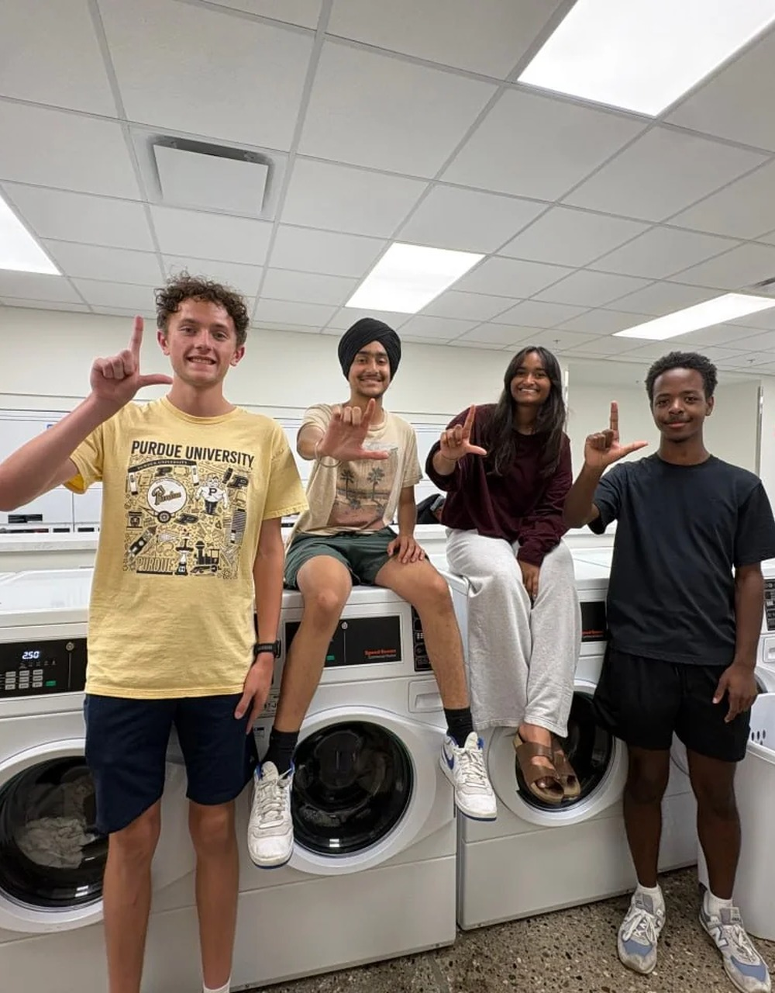
MERP
Thank you.
Fresh habits. Friendly competition.
Marcus Withers
Eddie Wuerthele
Rupika Chakka
Pritham Singh
TRY IT · launderstat.vercel.app/demo
CODE · github.com/JugPanda/Launder-Board
Student-built synthetic showcase · Not affiliated with or endorsed by Purdue, University Residences, CSC ServiceWorks, CSCPay, or Typesense.
LaundroStat
13

Slide 14
LIVE SYNTHETIC DEMO
What’s your LaundroStat?
Scan to explore the Clean-O-Meter, Wash Mates, and Dorm Wars.
laundrostat.vercel.app/demo
LaundroStat
14

