Slide 1

Big Data Analysis Pipeline
Jugal Gajjar Saptorshee Nag Kaustik Ranaware Saurabh S R Michael Womack

Slide 2
Introduction
The Problem We are trying to solve:
Provide an interface to track content performance across social media platforms. In this case, we used Youtube but it could be further expanded to show multiple platforms, which would be great for any company trying to manage a vast social media presence.
Goal:
To build an end-to-end big data processing pipeline using Scala, capable of efficiently ingesting, storing, processing, and analyzing large datasets to generate actionable insights.
Enable real-time data processing for fast decision-making, and ensure scalability and fault-tolerance for handling large-scale data.

Slide 3
Technology That Will Be Used
Scala
Apache Spark
HDFS (Hadoop Distributed File System)
Spark SQL/DataFrames
MySQL Workbench
Grafana

Slide 4
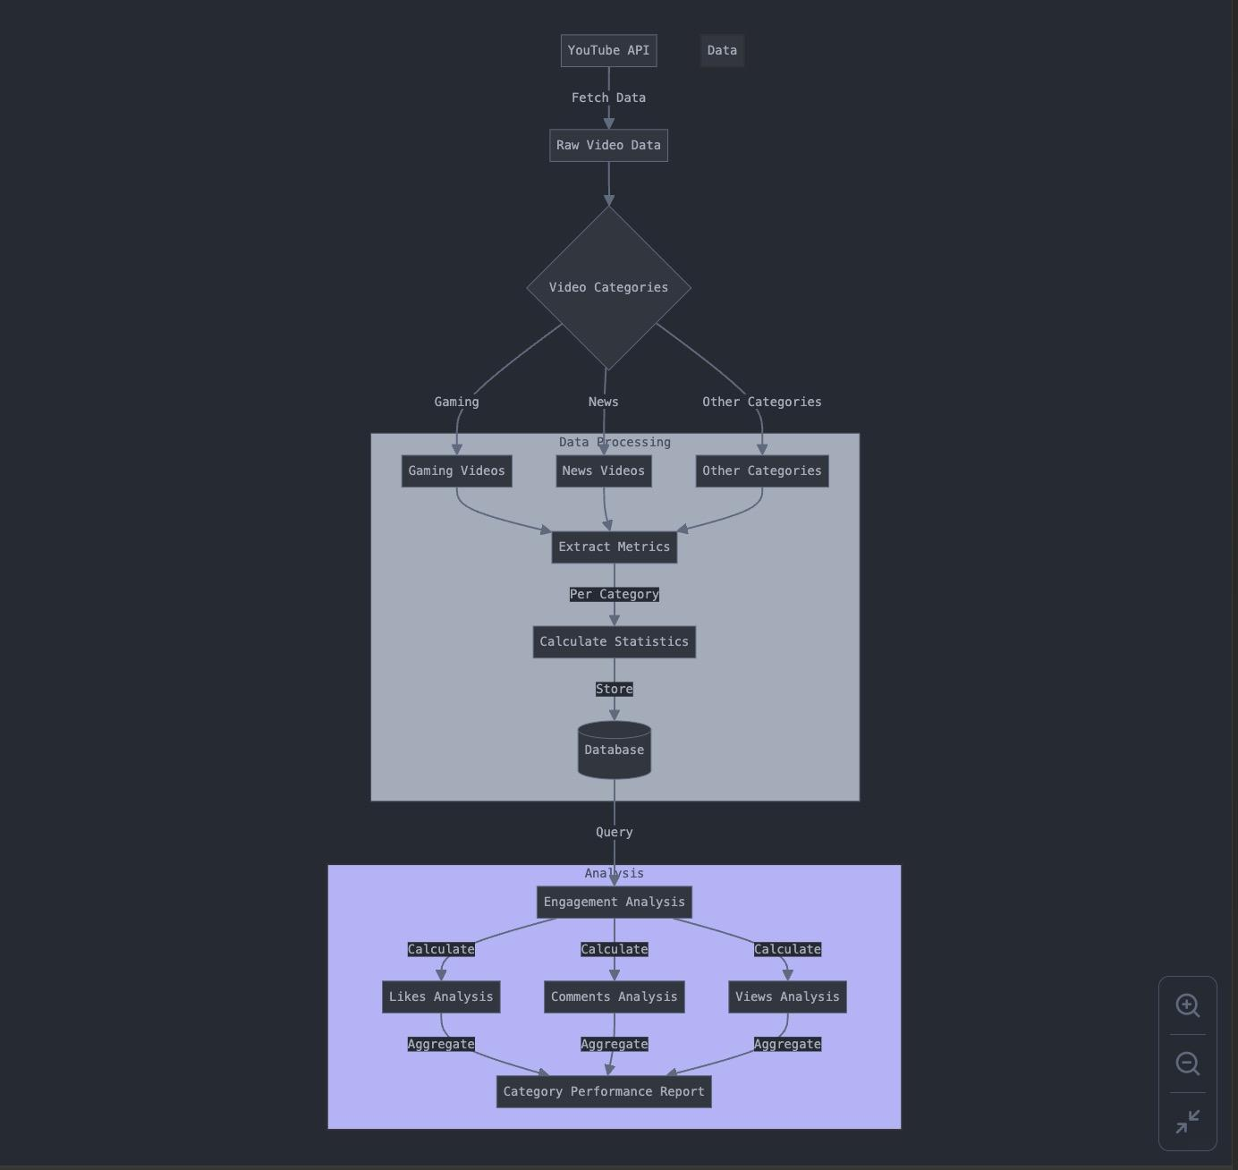
Flow Chart
Fetch Stages
Data Processing Stage
Analysis

Slide 5
Demo

Slide 6
Thank You!

