Slide 1

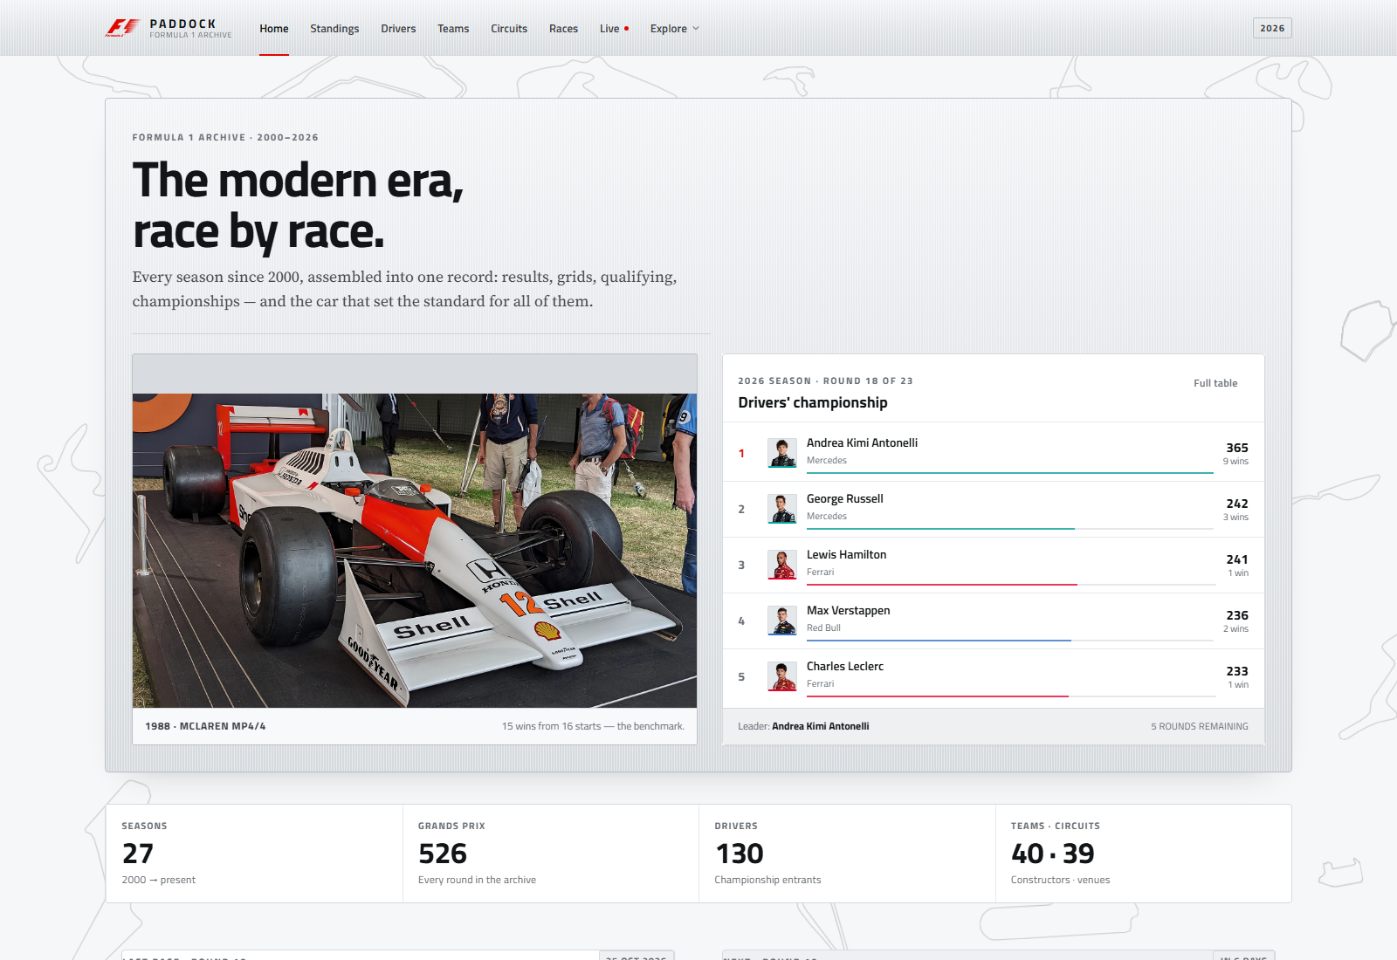
FET PROJECT
2000 → 2026
PADDOCK
Every season since 2000.
Every lap since 2023.
A brushed-silver Formula 1 archive built with Angular 21 and Material 3. The complete 2000–2026 dataset meets OpenF1 session replay, live timing and telemetry.
JUGAL PATEL · KRISH PATEL · PAAVAN SHARMA
HOME · MP4/4 HERO · 2026 TOP FIVE · 526 RACES
24162581032 · 24162581017 · 24162581052
FET · SEMESTER 5
PADDOCK · FORMULA 1 ARCHIVE
01 / 15
Notes:
Opening: Paddock is a complete redesign of the F1 stats app. The archive now runs to 26 October 2026, the interface is a single brushed-silver editorial theme, and OpenF1 supplies everything from 2023 onward.

Slide 2
THE BRIEF
The old app knew a lot. It showed very little.
A full data archive sat behind a front end that was hard to read, hard to navigate and out of date.
01
02
03
Fragmented experience
Data without context
Stuck in the past
Nine pages with different visual rules, inconsistent spacing and no clear path from a season to a race to a driver.
Raw result tables. No career totals, no championship picture, no comparison tools, no telemetry.
The archive stopped at 2024 and the current generation of cars had no live or replay layer.
THE GOAL
One coherent product: a calm, fast, 2000-onward archive with a real live layer — shipped end to end in one pass.
PADDOCK · FORMULA 1 ARCHIVE
02 / 15
Notes:
Frame the redesign: the archive was already rich, but the product was not. The goal was cohesion, reach and a quieter visual system, not just a reskin.

Slide 3
PRODUCT
One paddock, eleven screens.
Every route shares one silver system, and every table drills into a profile or a race.
27
526
10,954
11
SEASONS BUNDLED
ARCHIVED RACES
RACE RESULTS
SCREENS
/
Home
/races/:id
Race detail
MP4/4 hero, 2026 board, latest and next race
Classification, qualifying and season context
/standings
Standings
/live
Live timing
Drivers' and constructors' tables, leader logic
OpenF1 replay, timing tower and telemetry
/drivers
Drivers
/history
History
Searchable grid with career profile dialogs
Wikipedia-style eras, rivalries and records
/constructors
Teams
/rivalry
Rivalry
Real logos or typographic crests, title years
Any two drivers, career totals and shared seasons
/circuits
Circuits
/credits
Credits
39 layouts, searchable map and detail panel
Every image, its source and its licence
/races
Races
Season calendar, podiums and year switcher
PADDOCK · FORMULA 1 ARCHIVE
03 / 15
Notes:
Scope: eleven routes, including the new credits page. The archive holds 27 seasons, 526 races and 10,954 results after the 2026 reconciliation.

Slide 4
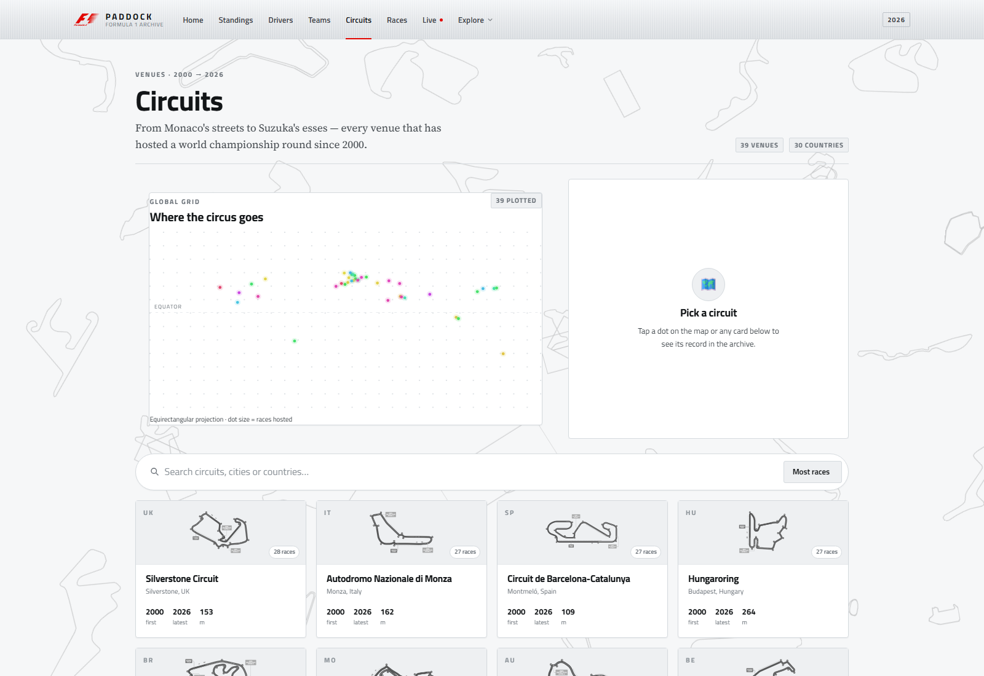
DESIGN LANGUAGE
Brushed silver, one red signal.
A flat editorial system, not a dark dashboard. One theme, hairline rules, and type doing the work.
One theme, no toggle
Silver is the only surface. Dark mode, glass and glow were deleted, not restyled.
Flat panels
One .panel primitive: matte surface, hairline border, 2–4 px radius, one soft shadow.
Two typefaces
Titillium Web for UI and headlines, Source Serif 4 for the long-form history.
Red as a signal
F1 mark, active nav rule, P1 and one primary action per view. Never a background.
Maps as field
Thirty distinct black outlines at 20% ink cover the full canvas; ten on mobile, none under reduced motion.
PADDOCK · FORMULA 1 ARCHIVE
04 / 15
Notes:
Design: silver surfaces, 2–4 px radii and hairline rules. Red appears only on the F1 mark, the active nav rule, P1 and one primary action. The circuits page shows the flat panel and layout-image treatment.

Slide 5
ARCHITECTURE
A small front end with a clear spine.
Standalone Angular components, signals for state, and two services that own all data access.
SHELL
app.ts · navbar · router outlet · floating circuit layer
KEY DECISIONS
— Lazy routes
Every page except Home is a separate chunk.
PAGES
home · standings · drivers · teams · circuits · races · race detail · live · history · rivalry · credits
— Indexed CSVs
Parse once, derive careers and standings in memory.
— shareReplay
SHARED UI
panel · page header · stat tile · driver avatar · team badge · track background · charts
One HTTP request per archive file and OpenF1 call.
— Rate limited
3 req/s token bucket protects the OpenF1 free tier.
CORE
CSVDataService · OpenF1Service · models · config · utils
— Typed end to end
Strict TypeScript models for archive and OpenF1.
PADDOCK · FORMULA 1 ARCHIVE
05 / 15
Notes:
Architecture: the shell holds navigation and the floating map layer; pages are lazy; shared components keep the visual language consistent; two services own data. No backend is required at runtime.

Slide 6
DATA
Two sources. One continuous timeline.
The archive gives depth and precision; OpenF1 gives recency and live detail.
2000 → 2026
2023 → TODAY
Bundled archive
OpenF1 API
Ergast-style CSVs, pruned in the browser build.
Session replay, timing and telemetry.
→
· 130 drivers · 40 teams · 39 circuits
· Sessions · meetings · drivers · positions
· 526 races · 10,954 results · 9,968 qualifying
· Intervals · laps · stints · pit stops
· Final or current standings for all 27 seasons
· Weather · race control · car data
· ~1.3 MB total, loaded locally, indexed once
· 3 req/s cap with cache + token bucket
2026 is reconciled to round 18 of 23 (26 October 2026). An unfinished season shows a leader — never a champion.
PADDOCK · FORMULA 1 ARCHIVE
06 / 15
Notes:
Data: the archive is trimmed at build time and indexed at runtime. 2025 and 2026 come from Jolpica, including the new Audi, Cadillac and Madring entries. OpenF1 is the live layer.

Slide 7
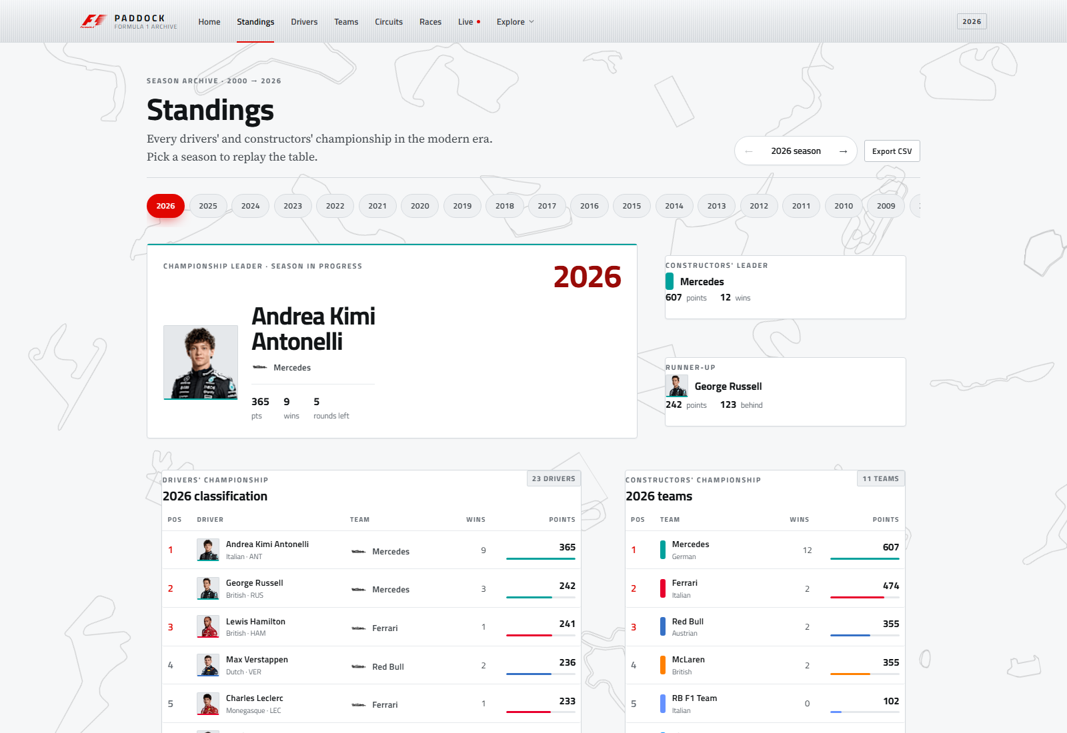
SCREENS
The season at a glance.
Home and standings share one hierarchy: context first, numbers second, detail one click away.
HOME
STANDINGS
MP4/4 hero, 2026 top five, archive totals, latest and next race.
Drivers' and constructors' tables, with a leader card for an unfinished season.
PADDOCK · FORMULA 1 ARCHIVE
07 / 15
Notes:
Two flagship screens. Home answers 'what is happening'; standings answers 'who is ahead and by how much'. Both use the same panel, type scale and red-on-silver hierarchy.

Slide 8
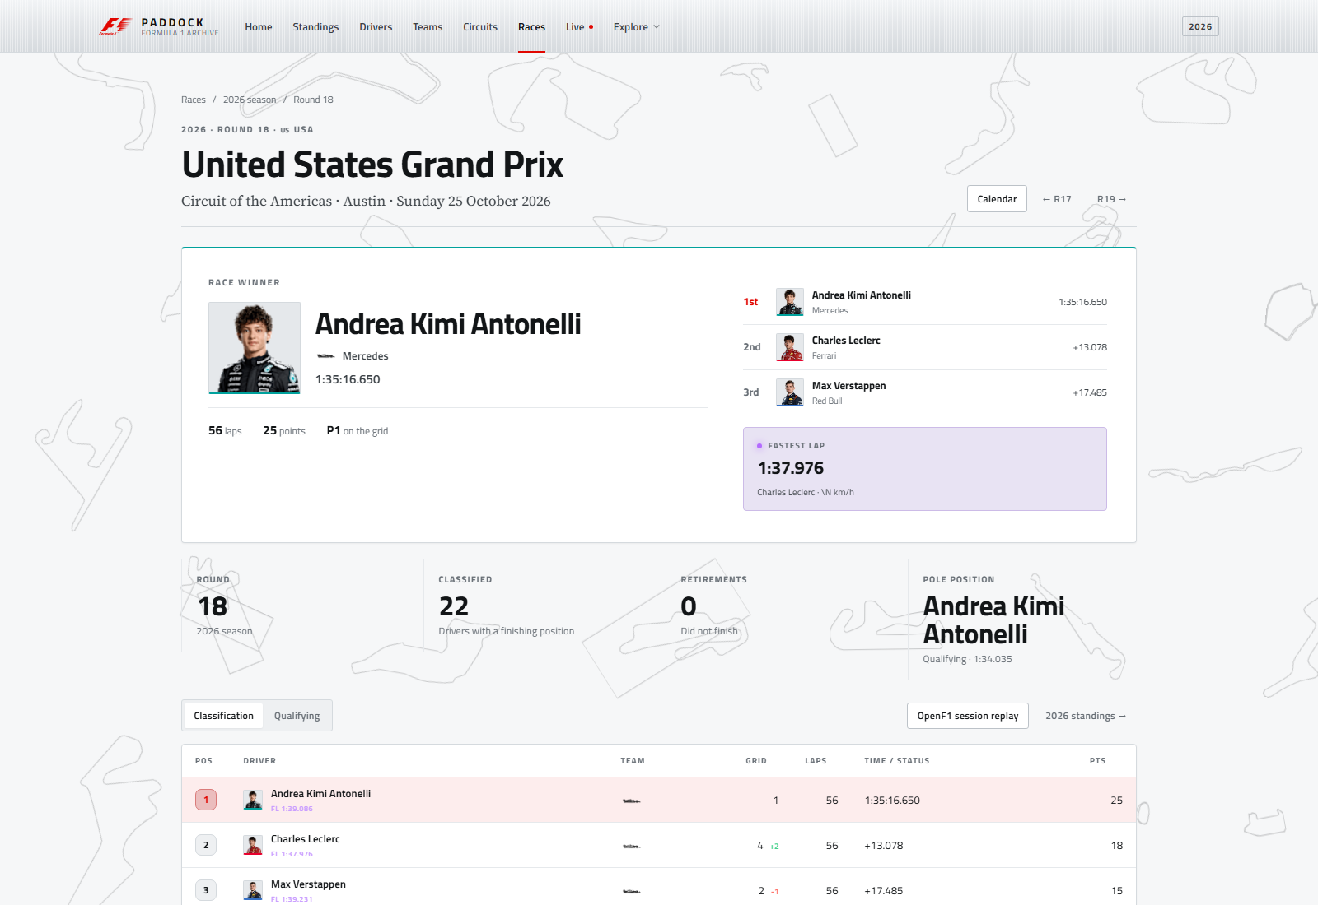
RACE DETAIL
Every race gets a proper story.
A classification page turns a row in a CSV into a readable race report.
Winner hero
A 2 px team-colour rule, podium, race time and grid drop.
Fastest lap
Driver, lap time and top speed in one card.
Classification
Grid delta, laps, time/status, points and FL tag.
Qualifying
Q1 / Q2 / Q3 tab with the full session order.
Context
Circuit, season stats and previous/next round.
PADDOCK · FORMULA 1 ARCHIVE
08 / 15
Notes:
Race detail links the result back to the season, the circuit and the driver, and exposes qualifying that used to be invisible. Team colour is a 2 px rule, not a background.

Slide 9
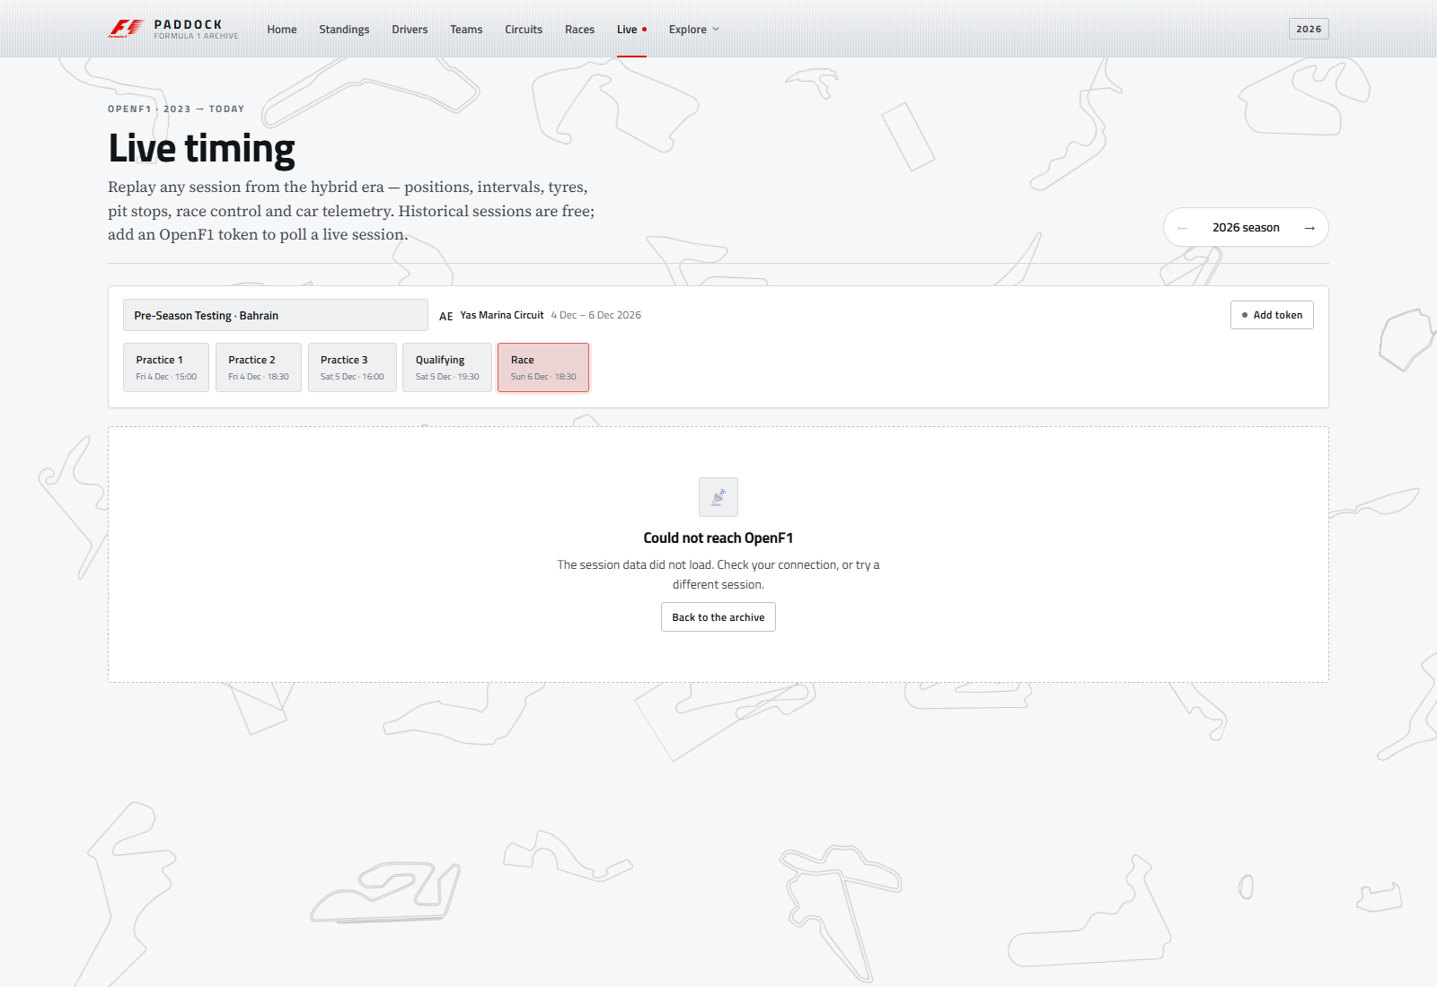
LIVE TIMING
Replay today. Poll live when you have a token.
OpenF1 data drives a timing tower, race control, weather and a windowed telemetry trace.
Timing tower
Position, gap, interval, laps, last/best, tyre age, pit stops.
Race control
Flag-coloured message feed with lap and timestamp.
Telemetry
Speed, gear, DRS and gear changes for one lap only.
Safe by default
Polling off until a bearer token is stored locally.
PADDOCK · FORMULA 1 ARCHIVE
09 / 15
Notes:
Live is replay-first because OpenF1's free tier is historical. A paid token can be pasted into the page to enable 15-second polling; it stays in the browser. Telemetry is fetched per driver, per lap.

Slide 10
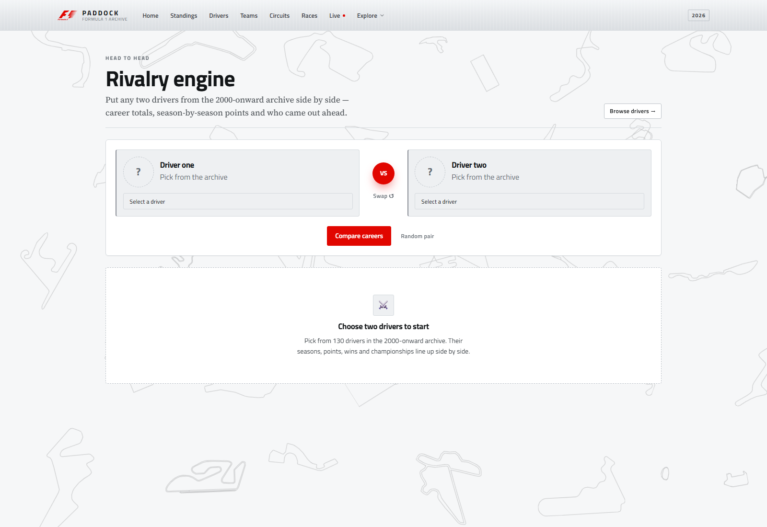
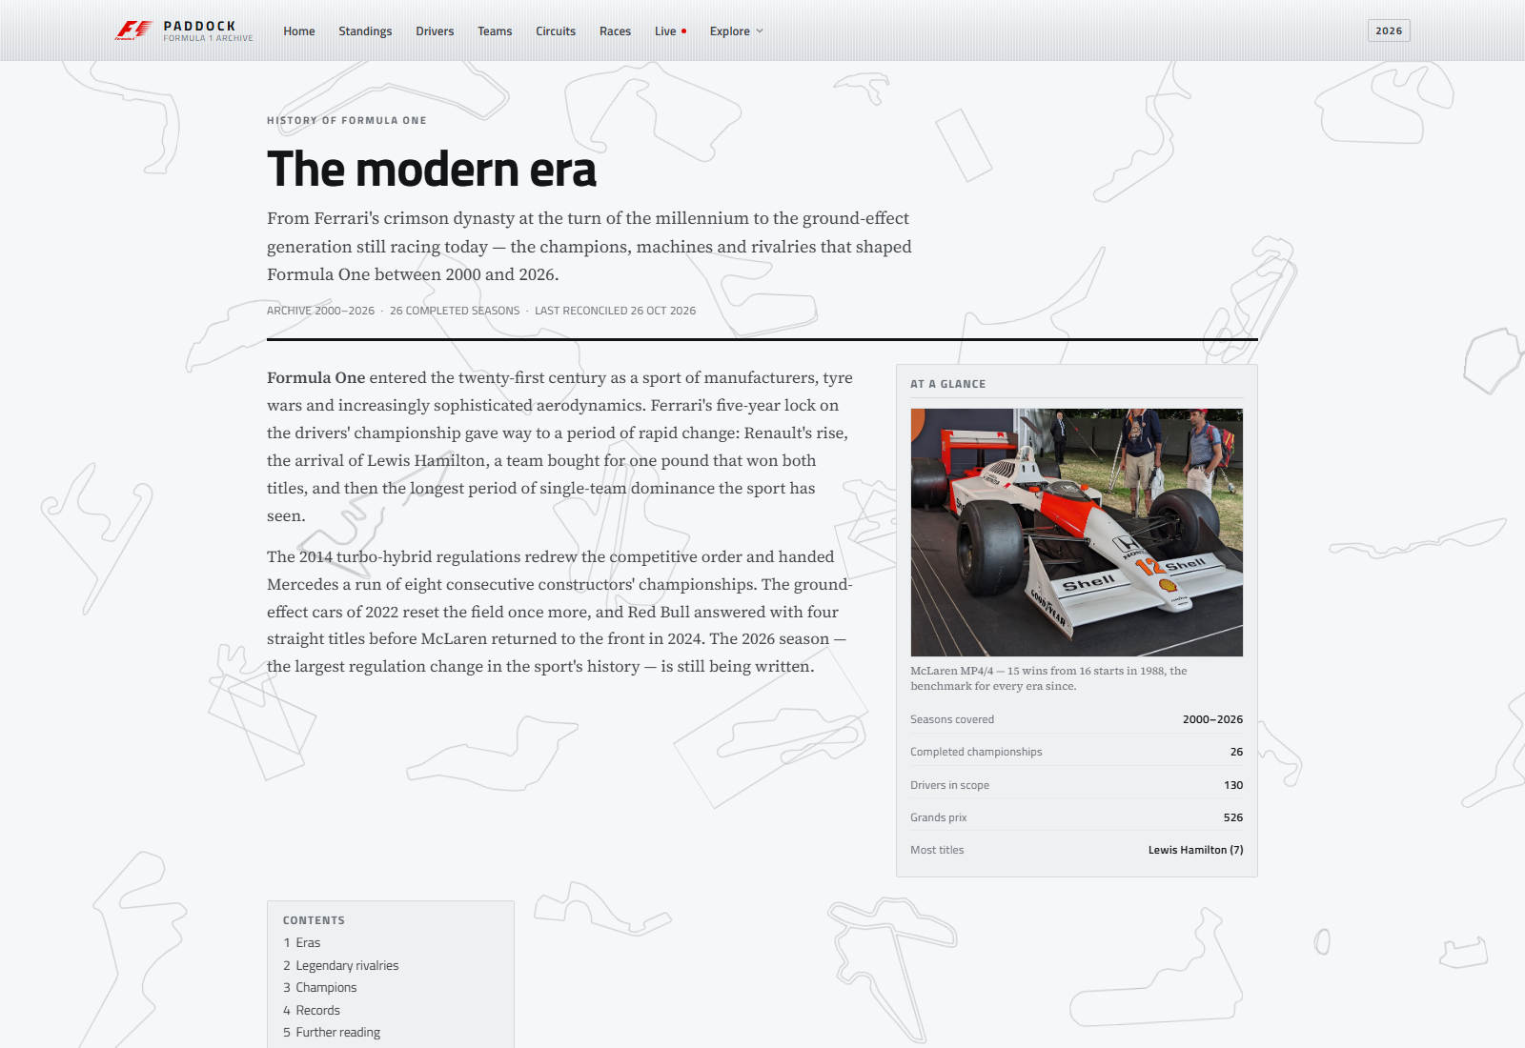
ANALYSIS
The archive becomes an argument.
Records, eras and head-to-head comparisons are computed from the same rows that power the tables.
Rivalry engine
History article
Any two of 130 drivers. Career totals, points trajectory, shared seasons and a head-to-head score.
Wikipedia-style lead, infobox, five eras, four rivalries, champions table and records.
PADDOCK · FORMULA 1 ARCHIVE
10 / 15
Notes:
The analysis layer is where the archive earns its keep: comparisons, eras and records are derived live, so they stay correct when the data changes. /timeline now redirects to /history.

Slide 11
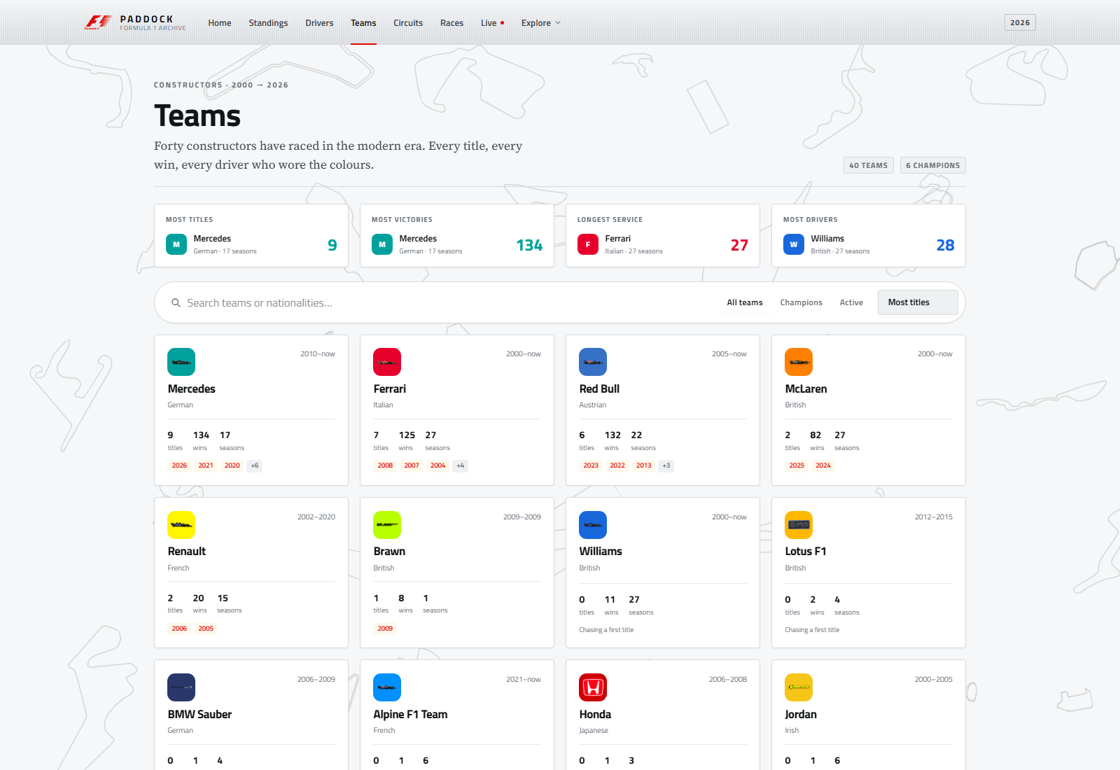
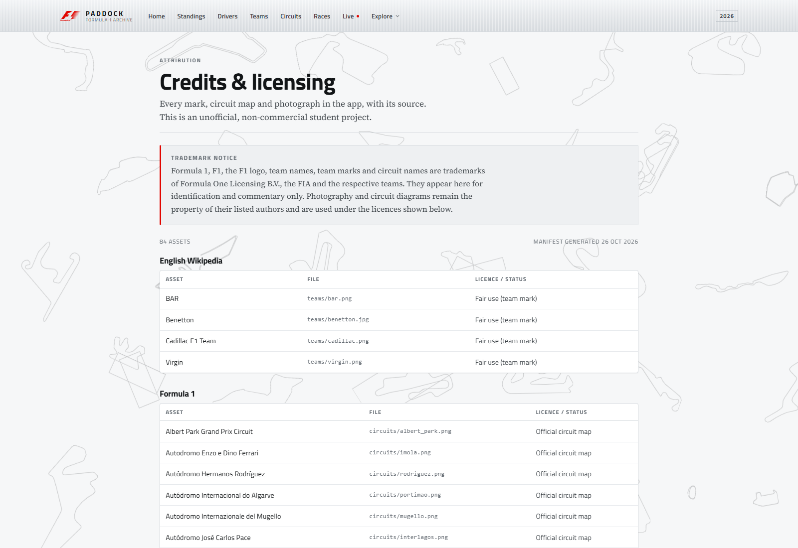
IMAGERY
Every team and every circuit has an image.
Real marks where they can be licensed, designed fallbacks where they cannot — and credit for all of it.
35 of 40
39 of 39
28
9
TEAM LOGOS
CIRCUIT MAPS
DRIVER PORTRAITS
ARCHIVE PHOTOS
Five defunct teams render a typographic crest.
Every venue resolves to its official layout image.
OpenF1 headshots; earlier drivers keep monograms.
MP4/4, Hunt–Lauda, Senna and more, credited in-app.
PADDOCK · FORMULA 1 ARCHIVE
11 / 15
Notes:
The generated manifest lists only files that exist, so a missing asset never becomes a broken image. Five historic teams use crests, and every image is attributed on /credits with a trademark notice.

Slide 12
QUALITY
Fast, accessible, and honest about limits.
The build is lean, the interface is keyboard-friendly, and the app says when data is unavailable.
580 kB
154 kB
10
3 req/s
INITIAL RAW BUNDLE
INITIAL TRANSFER
LAZY ROUTES
OPENF1 BUDGET
PERFORMANCE
ACCESSIBILITY
RESILIENCE
· Route-level code splitting
· Semantic headings and captions
· Skeletons instead of blank screens
· Archived CSVs indexed once
· Labelled controls and tab states
· Designed empty and error states
· shareReplay on every request
· Visible focus and keyboard nav
· Crest fallback for missing logos
· Budgets enforced in angular.json
· Reduced motion / transparency
· Flag fallback for missing maps
PADDOCK · FORMULA 1 ARCHIVE
12 / 15
Notes:
Quality: the production initial bundle is 580 kB raw, or 154 kB over the wire. Every page except Home is lazy. Third-party glyphs and missing images always have a designed fallback.

Slide 13
DELIVERY
Clone. Install. Run.
No database, no API key and no build step for the bundled archive.
QUICK START
WHAT SHIPS
cd frontend
App
11 routes · silver editorial · responsive
npm install
npm start
Archive
2000–2026 · 1.3 MB · pruned CSVs
# production
Live
OpenF1 replay + optional token polling
npm run build
Images
35 logos · 39 maps · 28 portraits · 9 photos
# full data refresh
Docs
README.md · README.docx · README.pdf
npm run data:build
npm run assets:fetch
Deck
f1-presentation.pptx · .pdf
npm run outlines:build
PADDOCK · FORMULA 1 ARCHIVE
13 / 15
Notes:
Delivery: the front end runs on its own. The prune, sync, asset and outline scripts are reproducible, and the docs and deck ship with the repo.

Slide 14
NEXT
Known edges. Clear next moves.
The product is complete for this scope, and the boundaries are deliberate.
BOUNDARIES
NEXT
2026 is still running
Sprint + lap data
18 of 23 rounds are complete. The app labels the current leader and lists no 2026 champion.
Add sprint results and lap-by-lap archive data for deeper race analysis.
Portraits start in 2023
Favourites + sharing
OpenF1 only lists modern headshots. Earlier drivers keep the designed monogram.
Persist favourite drivers and shareable comparison links.
Live needs a token
Caching layer
OpenF1's free tier is historical. Real-time polling requires a paid subscription.
A small server cache for OpenF1 would make live pages instant for everyone.
Some marks cannot be licensed
More era photography
Five defunct teams use a typographic crest instead of a logo.
Extend the credited archive photo set beyond the nine key moments.
PADDOCK · FORMULA 1 ARCHIVE
14 / 15
Notes:
Be explicit about limits. They are not failures: they reflect data contracts. The next moves are natural extensions, not fixes.

Slide 15
CLOSING
THANK YOU
The paddock is open.
Questions, laps, or a debate about the 2021 finale — all welcome.
JUGAL PATEL · KRISH PATEL · PAAVAN SHARMA
24162581032 · 24162581017 · 24162581052 · FET
localhost:4200
openf1.org · angular.dev
PADDOCK · FORMULA 1 ARCHIVE
15 / 15
Notes:
Close: thank you. Invite questions about the silver design system, the 2026 data reconciliation or the OpenF1 integration.

