Slide 1

by JUGAL PATEL

Slide 2

F1 Racing Stats Web Application
Jugal Patel
24162581032
FET Subject Project

Slide 3
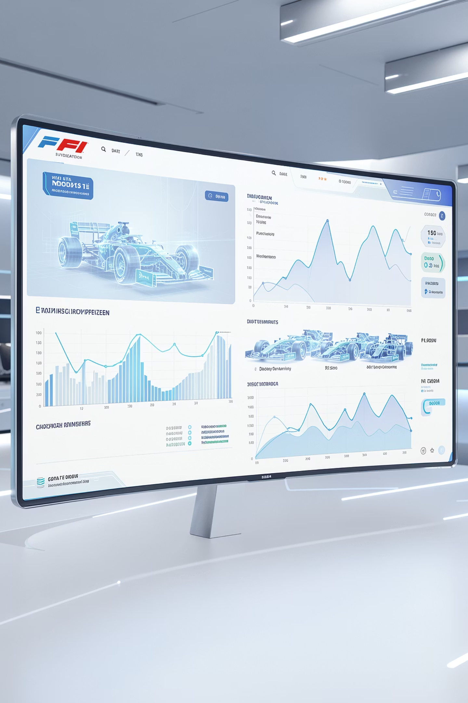
Project Overview
The F1 Racing Stats Web Application is designed to be the ultimate digital companion for Formula 1 enthusiasts and data analysts. This full-stack web application offers:
Comprehensive tracking of real-time driver and constructor standings.
Detailed race results, including lap times, pit stop data, and incident summaries.
An extensive archive of historical data covering past seasons, circuits, and legendary drivers.
An intuitive, responsive interface for exploring performance trends and statistics.

Slide 4

Technology Stack
Our F1 Racing Stats Web Application is built on a modern, robust, and scalable technology stack designed for high performance and maintainability.
Angular
Node.js
Dynamic user interfaces for an interactive frontend experience.
Efficient and scalable server-side operations and application runtime.
Express
MongoDB
Robust API development and server management framework.
Flexible NoSQL database for structured and unstructured F1 data.

Slide 5
Database Schema
Our F1 Racing Stats Web Application organizes data across several key MongoDB collections, designed for efficient storage and retrieval of racing information.
1
2
3
Driver
Race
Result
driverId
name
nationality
team
points
raceId
name
circuit
date
season
resultId
driverId
raceId
position
points

Slide 6
REST API Routes
Our application exposes a comprehensive set of RESTful API endpoints for interacting with F1 racing data, designed for seamless integration and robust data retrieval.
Endpoint
Description
GET /api/drivers
Get all drivers
GET /api/drivers/:id
Get driver by ID
GET /api/races
Get all races
GET /api/races/:id
Get race details
GET /api/results
Get race results
POST /api/results
Create new result
GET /api/standings
Get current standings

Slide 7

Key Features
Data Importing
Seamlessly import F1 data from various external sources.
Race Results
View detailed race results, including lap times, pit stops, and incident summaries.
Standings Tracking
Monitor real-time driver and constructor championship standings.
Historical Data
Access an extensive archive of past seasons, circuits, and legendary driver statistics.
Performance Analytics
Analyze in-depth driver and team performance trends with visual insights.
Responsive Design
Enjoy a consistent and optimized experience across desktop, tablet, and mobile devices.

Slide 8

Project Architecture
Show directory layout as a hierarchical structure:

Slide 9
Development Journey
Our project followed a structured development process, ensuring robust design, efficient implementation, and comprehensive testing from concept to deployment.
Planning & Requirements
Defined project scope, core features, and user stories.
Database Design
Structured MongoDB schemas for efficient data storage.
Backend Development
Built robust Node.js and Express APIs for data handling.
Frontend Development
Crafted interactive user interfaces with Angular.
Testing & Integration
Ensured seamless functionality and component compatibility.
Deployment & Documentation
Launched the application and provided comprehensive guides.

Slide 10

Application Interface
There was an error generating this image
There was an error generating this image
There was an error generating this image
There was an error generating this image

Slide 11
Future Roadmap
Our commitment to continuous improvement means we have an exciting roadmap of enhancements designed to elevate the F1 Racing Stats experience even further.
Real-time Data Updates
Advanced Analytics
Implement live race data streaming for instant updates on standings, lap times, and events as they unfold.
Integrate machine learning models to provide predictive analytics, such as potential race outcomes and driver performance trends.
Mobile App
Social Features
Develop dedicated native iOS and Android applications to offer a seamless and optimized experience on mobile devices.
Introduce interactive social elements, allowing users to comment on races, share insights, and connect with other F1 fans.
API Documentation
Performance Optimization
Provide comprehensive Swagger/OpenAPI documentation for our REST API, enabling third-party developers to build on our platform.
Continuously optimize backend and frontend performance through advanced caching strategies and database indexing for faster data access.

Slide 12
Conclusion & Acknowledgments
This project has successfully delivered a robust F1 Racing Stats Web Application, demonstrating the power of modern web technologies to provide a comprehensive and engaging experience for Formula 1 enthusiasts. Its successful implementation reflects dedicated effort and effective application of full-stack development principles.
We extend our sincere gratitude to our professors and examiners for their invaluable guidance, support, and constructive feedback throughout this journey.
Key learnings included mastering the integration of Angular, Node.js, Express, and MongoDB, alongside achieving significant technical achievements in data handling, API development, and responsive UI design.
Thank you for your time and consideration.
Project Repository: GitHub

