Slide 1
Sustainable Development Goals (SDG's)
J.Yashaswi
9 B

Slide 2
What are sdg's?
SDG is the abbreviation of Sustainable Development Goals, otherwise known as Global Goals.
These goals were adopt in the year 2015 to ensure the end of poverty, protect the plant, safety and prosperity of the people.
The main goal of the SDG is to achieve a better and sustainable future for all.

Slide 3
How many sdg's do we have?
We have 17 SDG's, they are as follows
No poverty 9. Industry, innovation and infrastructure
No hunger 10. Reduced inequality
Good health and well-being 11. Sustainable cities and communities
Quality education 12. Responsible consumption and production
Gender equality 13. Climate action
Clean water and sanitation 14. Life below water
Affordable and clean energy 15. Life on land
Decent work and economic growth 16. Peace, justice and strong intuition
17. Partnership For The Goals

Slide 4
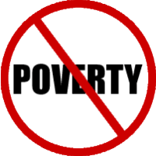

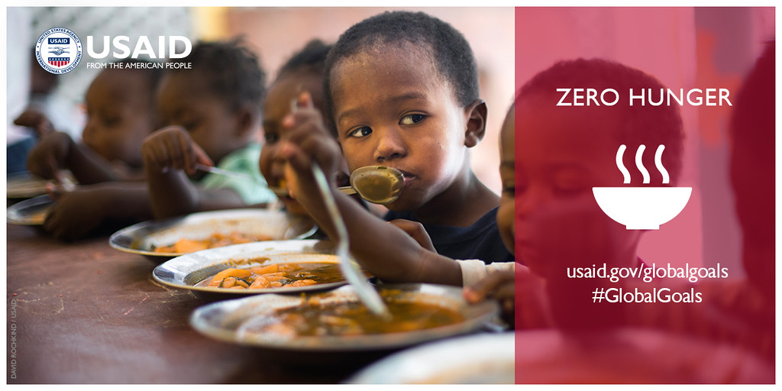
What are the 5 most important sdg's
No Poverty: End poverty in all its forms everywhere.
Zero Hunger: End hunger, achieve food security and improved nutrition.
Quality Education: Ensure inclusive and equitable quality education and promote lifelong learning opportunities for all.

Slide 5


.
4. Good health and well-being: Ensure healthy lives and promote well-being for all at all ages.
5. Climate action: Take urgent action to combat climate change and its impacts by regulating emissions and promoting developments in renewable energy

Slide 6


