Slide 1
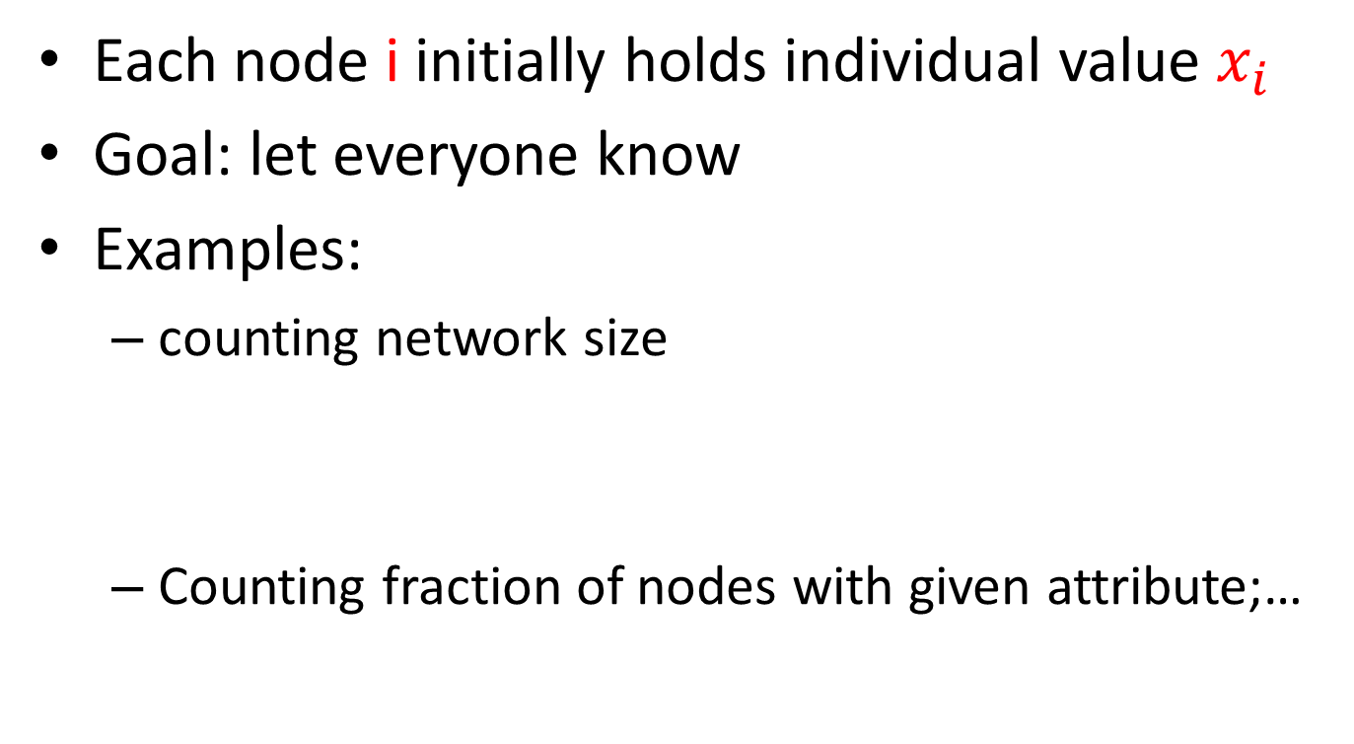
Distributed computation of aggregates: averaging
Each node i initially holds individual value $x_{i}$
Goal: let everyone know
Examples:
counting network size
Counting fraction of nodes with given attribute;…

Slide 2
Local averaging procedure
Each node i contacts node j at rate where
e.g. if nodes i, j are neighbors and otherwise
Upon contact, update of local estimates:
Denote by L the Laplacian matrix:

Slide 3
Local averaging procedure (continued)
Facts: Laplacian is non-negative definite and such that
Let denote second smallest eigenvalue of ; then for all
Hence for all
[Proof: whiteboard]

Slide 4
A corollary
For fixed , any , w.h.p.
Where
[whiteboard]

Slide 5
Computing aggregates—second method [Mosk-Aoyama & Shah]
Each node maintains running estimate
At rate contacts node where
Update:
All nodes hold common value by time
By previous analyses, for regular graph, w.h.p.

Slide 6
Computing aggregates—second method [Mosk-Aoyama & Shah]
Application: initialize independently each
→
Perform times in parallel with independent initial values
Nodes form estimate
By time nodes’ estimate:

Slide 7
Relating graph parameters: isoperimetric constant & spectral gap
Graph Laplacian
→ Infinitesimal generator of continuous time random walk on
Spectral gap : 2nd smallest eigenvalue of
Let : largest node degree of
→
Cheeger’s inequality ( see [Mohar, the Laplacian spectrum of graphs])
Case of -regular graph:

Slide 8
Relating graph parameters: spectral gap & mixing time of random walks [Aldous-Fill; Levin-Peres-Wilmer, Markov chains & mixing times]
Variation distance between two discrete distributions on
Interpretation: for two distributions one can generate
such that :
For continuous time, reversible Markov process with infinitesimal generator
where stationary distribution, 2nd smallest eigenvalue of

Slide 9
Mixing times
Similar results for discrete time chains
Mixing time:
→
Example: K samples of continuous time random walk on G at
Coincide with iid uniform samples on G with probability

Slide 10
Estimating graph size, 3rd method: « Birthday paradox » approach
Pick nodes iid uniformly at random from graph till same node appears twice → steps
Repeat K times to obtain
Form estimate
Verifies:
(whiteboard: weak convergence of T and variance bound)

Slide 11
Comparing methods: numbers of node-to-node communications (to achieve moderate accuracy)
Methods 1&2: about nd communications per time unit
Method 1:
Method 2:
Method 3:
Cheaper, but only one node informed (estimate not broadcast)

