Slide 1
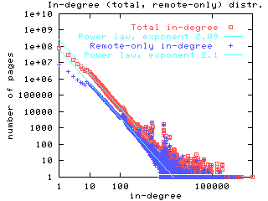
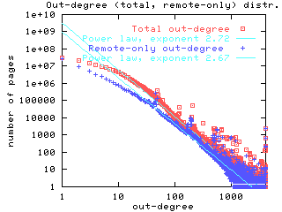
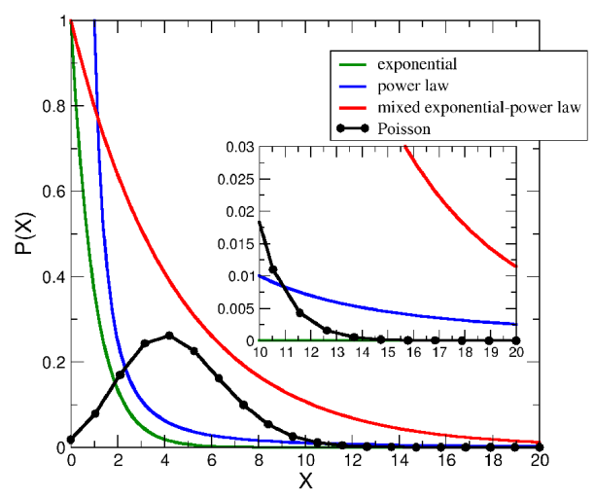
Power law random graphs

Slide 2
Power law random graphs
Loose definition: distribution is power-law if
Over some range of values for some exponent
Examples
Degree distributions of graphs (web, « hollywood », protein interaction,…)
Individual wealth
City sizes
…

Slide 3
Barabasi-Albert « scale-free » random graphs
So-called preferential attachment construction
Initial graph:
At time t, new node attached to by edge
Where « anchor point » chosen according to
Where : degree of in and

Slide 4
Result:
Barabasi-Albert random graph is power-law with exponent
More precisely for fixed , nb of degree nodes in verifies
Where for large
[Proof: whiteboard, using analysis of averages + Azuma-Hoeffding inequality]

