Slide 1
Software Testing
Quality assurance and troubleshooting

Slide 2
Objectives for Today
To learn the significance of testing when developing a software product.
To get familiar with the fundamentals of testing.
To understand the importance of the release and deployment phases as a part of the the software development lifecycle.
Ohjelmisto 1 ja 2
Metropolia Ammattikorkeakoulu

Slide 3
What is Testing?
Testing is a group of planned actions performed on an information system and related software products to
find errors
measure and assess quality
Testing is a form of quality monitoring as a part of quality assurance
Quality Assurance
Quality Monitoring
Testing
Ohjelmisto 1 ja 2
Metropolia Ammattikorkeakoulu

Slide 4
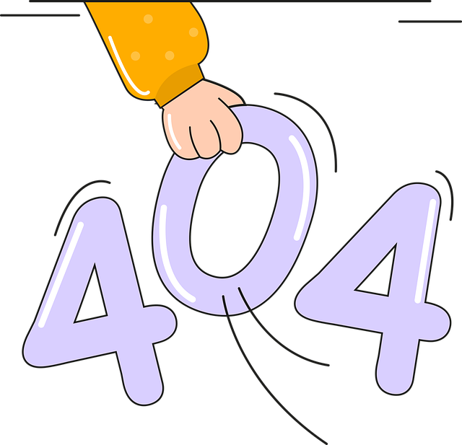
Error, fault, failure
Error (or bug) a deviation from the specification, often caused by the programmer. Errors create faults.
Fault is a condition in the software that causes it to work in an incorrect, unexpected way. Faults cause failures.
Failure is the outcome of the fault, the observed disturbance in the operation of the software, such as incorrect output.
Ohjelmisto 1 ja 2
Metropolia Ammattikorkeakoulu

Slide 5

Costs of Errors
The costs of a programming error can vary significantly.
Sometimes the costs might be zero.
In the worst case, the consequences of errors might lead for a company to go bankrupt or cause great human suffering.
Known examples:
The automated trading system of Goldman Sachs created faulty buy orders and cost the finance company approximately 100 million dollars. (2013)
Therac-25 X-ray machine caused patient to get ill or even die due to unexpectedly high amounts of radiation. The cause of the fault was an error in the processing of time-bound inputs.
A Mars orbiter was destroyed when attempting to enter Mars' atmosphere in 1998. The cause of the fault was that a part of the land operation systems in charge of navigation used imperial units instead of metric units in its calculations.
Ohjelmisto 1 ja 2
Metropolia Ammattikorkeakoulu

Slide 6
How Much Should You Test?
The extent of the testing is a compromise between time, money and quality.
Practically, all software has errors. Making errors is a necessary and normal part of programming.
Approximately 5% of development stage errors remain undiscovered.
Everything cannot be tested.
Rule of thumb: test as early as possible.
The costs of an error are the lower the earlier the error is discovered.
Software 1 & 2
Metropolia University of Applied Sciences

Slide 7

Risk-Based Testing (RBT)
Testing should be targeted where the possible cost of an error is the highest.
Based on risk analysis.
The probabilities and possible costs of errors are evaluated.
The probable cost is the product of the probability for the error to occur and the cost impact.
The basic idea of risk-based testing can be applied on any layer of testing.
Software 1 & 2
Metropolia University of Applied Sciences

Slide 8

Levels of Software Testing
Unit testing
Does an individual part of the program such as a function work correctly?
Integration testing
Does this part of the program work together with other parts?
System testing
Does the system including all its individual parts work correctly?
Acceptance testing
Does the system fulfill its set requirements from the customer's/user's point of view?
Software 1 & 2
Metropolia University of Applied Sciences

Slide 9
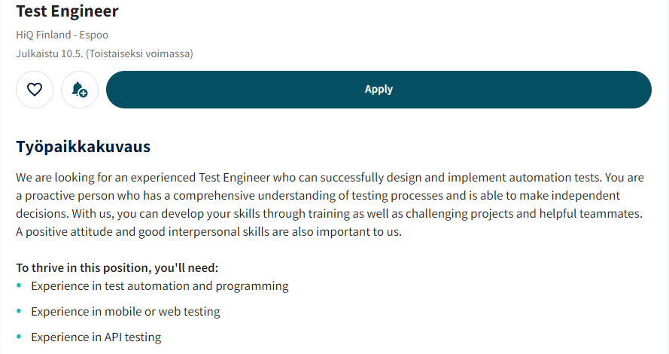
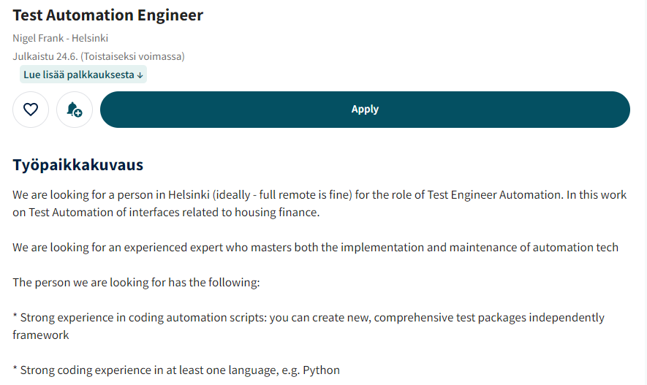
Who Tests Software?
Software testers form their own profession within the IT field
their views differ from software developers.
close co-operation with the development team and customers.
developers also take part in testing.
Testing is a continuing process.
Software 1 & 2
Metropolia University of Applied Sciences
Example job listings: Insinööriliiton työpaikkatori [11.8.2022]

Slide 10
Test Targets
Does the software fulfill the boundary conditions?
Does the software operate correctly?
Feature testing
Operation logic testing
UI testing
Database testing
API testing
Limitation testing
Authentication testing
Performance testing
Load testing
Error condition testing
Configuration testing
Installation testing
Software 1 & 2
Metropolia University of Applied Sciences
Lähteet: Maciaszek, Requirements analysis and System Design, Addison-Wesley, 2001 ja Murch, IT-projektinhallinta, Edita, 2002, muokattu ja täydennetty.

Slide 11
Static and Dynamic Analysis
Static analysis means that no program code is executed
The program code and algorithmic correctness are analyzed.
White-box testing
In Dynamic analysis the program code is executed
Actual output is compared to expected output.
The system under test (SUT) is isolated from the rest of the system with test drivers and stubs.
Black-box testing.
Software 1 & 2
Metropolia University of Applied Sciences

Slide 12
Regression Testing
Error fixes may generate new errors.
Regression testing is testing the system again after changes.
Regression testing tests that:
the prior errors have truly been fixed.
the fix has not produced side effects by breaking something else.
Software 1 & 2
Metropolia University of Applied Sciences

Slide 13
Test Cases
Testing in the development stage is based on limited test cases.
The selection of test cases aims at high coverage.
Each test case that is created in advance is described with:
Baseline
Performed action
Expected result
Observed results are compared with expected results during the tests.
If there is a difference between the actual and expected results, a fault was discovered.
Software 1 & 2
Metropolia University of Applied Sciences

Slide 14
Manual and Automated Testing
There are both manual and automated tests.
Automation uses test tools that:
make testing easier.
visualize performed tests.
produce test reports.
Test automation:
reduces mechanical repetition of tests
is particularly useful in regression testing
Used technologies: Jasmine (JS), Junit (Java), Selenium (web-UI), Robot Framework (general test automation)
Software 1 & 2
Metropolia University of Applied Sciences

Slide 15
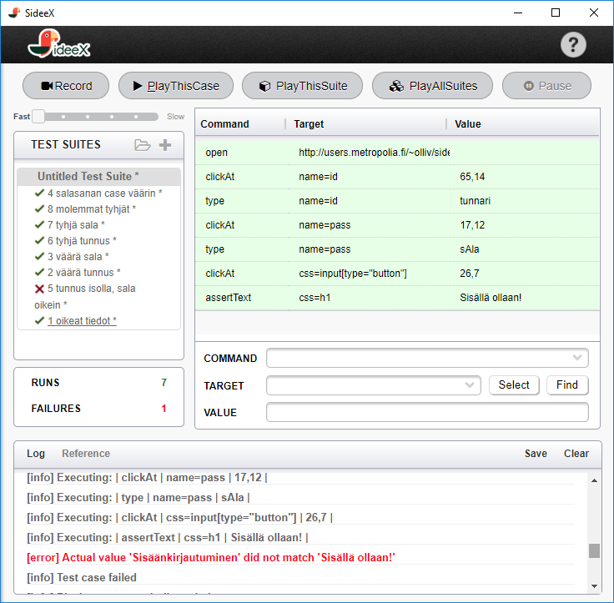
Example of UI Test Automation (Selenium)
Test suite
Test case
Test result
Software 1 & 2
Metropolia University of Applied Sciences

Slide 16
Test Coverage
Coverage metrics are used to make sure that:
all program parts are tested
enough testing is done
For example, statement coverage (0-100%) counts the number of statements in the program that have been executed at least once.
Other metrics:
Decision converage
The tested condition can receive both a true and a false value.
Condition coverage
Each part of a condition can receive both a ture and a false value.kukin ehdon osa saa sekä tosi- että epätosiarvon
Decision/condition coverage covers both
Software 1 & 2
Metropolia University of Applied Sciences

Slide 17
Test Phases and Organizing Tests
Test planning and preparations
Create a test plan.
Create a test model that mimics the production environment.
Ensure adequate resources.
Testing phase
Focus is only on testing and finding errors.
Continuous testing
Especially important in agile software development.
Software 1 & 2
Metropolia University of Applied Sciences

Slide 18
Test-Driven Development (TDD)
In Test-Driven Development test cases define what the code should do before actual code is made
Create test cases for the part of program under development.
Write a stub code as a frame and make sure it does not pass any test cases.
Modify the stub until it passes all tests.
Software 1 & 2
Metropolia University of Applied Sciences

Slide 19

Code Smells
As a part of testing, programs are observed for poor coding practices, smelly code.
These are not actual errors but more like symptoms, showing that the program code should be refactored.
Smelly code increases the probability of programming errors.
Poor coding practices lead to technical debt: the debt must be paid by fixing the code later.
Code smells depend on the programming language. Some examples of bad practices in Python:
Duplicate code
Functions that are too long
Names that are too long, too short, or meaningless
Excessive use of global variables
Software 1 & 2
Metropolia University of Applied Sciences

Slide 20
Release and Deployment
Eventually a data system moves from development to production for the customer.
Release testing/System Acceptance Testing (SAT)
Luovutustestaus / hyväksymistestaus (System Acceptance Testing, SAT)
Conducted in production environment under full load
The customer usually conducts the acceptance testing (or pays for external service).
Ways to make deployment smoothier:
Training, seminars
Manuals, learning material
Last sprint together with the customer
Validation phase between release and deployment is where the released system is tested as part of the customer company's production process.
Software 1 & 2
Metropolia University of Applied Sciences
Lähde: Laatu automaatiossa, Parhaat käytännöt, Suomen automaatioseura (2001).

Slide 21
Software Testing During the Software 1 & 2 Study Modules
The focus is on acceptance testing: Does the program fulfill the set requirements?
Testing is based on test scenarios that are more extensive than test cases and portray an entire use scenario for the end user.
For the game, a scenario could be a full gaming session from start to end.
The events of each scenario are planned in advance.
Also spontaneous events can occur during tests runs, after which the test run continues from the main branch.
Explorative testing: Making observations and raising doubts when using the software.
Software 1 & 2
Metropolia University of Applied Sciences

Slide 22
Acceptance Testing Scenario Example
N1: Core actions, young person: exercises, counters, recommendations, contact
Acceptance testing of the PEILI project – scenarios
Version history
10.12.2020, VO: Created new scenarios based on experiences from system testing.
11.12.2020, SL: Scenario reviewed and formatted.
Description
Young person's typical use scenario, consisting of core activities: completing exercises, viewing counters, viewing recommended services and contacting a service provider.
Pre-Conditions
Activated an exercise called "Survey of Substance Use for Young Persons"
Activated an organization called TEST-Substance. TEST-substance@test.fi / substanceMix
Phases and Expected Result
Actions of the young person
The young person registrers a new account in the system.
The young person finds and completes an exercise.
The exercise is "Survey of Substance Use for Young Persons". The answers of the user indicate severe substance abuse.
The young person reviews their progress from the Mirror of Life.
The health and wellbeing counter shows a low value.
The young person reviews recommended services.
The TEST-Substance organization must show in the recommendations. Their Substance Rehabilitation service must show in the recommendations.
The young person contacts the Substance Rehabilitation service vie email.
The young person requests an email response, enters their email address (fictional address test@test.fi) and writes "Please contact me!" in the message.
The young person logs out from the system.
Actions of the service provider
Service provider Test-Substance logs in to the system.
The service provider reviews their contact requests.
The message from the young person must show on the Contact Requests tab.
An example acceptance test scenario from the PEILI project by Metropolia. (Translated from Finnish)
The next slide shows an example of the test run of the scenario (a raw version of the notes made from the test run. The original test run was recorded and error tickets were created accordingly.)
Software 1 & 2
Metropolia University of Applied Sciences

Slide 23
Actions of young person
1. Young person registrers a new account in the system.
Chrome browser. Relaunched in in-cognito mode. 9:26 Create new account.
Warning for a weak password. Terms of use open on a new tab. Create a new mirror account. Nothing happens. Must fix the password. 9:28 New password given. Ok. Next, … OK
2. Young person finds and completes an exercise.
The exercise is "Survey of Substance Use for Young Persons". The answers of the user indicate severe substance abuse.
9:29 Chrome browser cannot be you to find exercises horizontally. Must press >. Took several seconds for the exercises to show.
# Cannot slide horizontally in Chrome. Chrome specific, escpecially laptop. Does not occur in Chrome mobile.
9:30 Survey started.
# Cannot return to previous. Accidentally selected wrong option. User must start the survey again from the beginning if they select a wrong option.
9:31 Multiple substances (multiple choice)
# No, I have not cannot be chosen if multiple substances are selected. Suggestion: Question should be modified.
9:32 Survey continues… Under the influence, have you … (multiple choice)
# the same as with the previous multiple choice question
How often have you acted as described above?
# What does above mean? Issue in the exercise.
If you consume drugs, why? (multiple choice)
# The same issue again
Feedback: Corresponds to the given answers. Ok.
See recommended services…..
Summary
Horizontal slider in Chrome Desktop/Laptop.
Cannot return to previous questions to change answers. (Accessibility)
3. Young person reviews their progress from the Mirror of Life.
The health and wellbeing counter shows a low value
# 9:35 Counters. It took 5 s to open the counter. Response time set to 2 s in the requirements specification.
# Pressed 1. Health and wellbeing. Slow response time (several seconds)
# Survey -> Starts from the beginning? Were the results supposed to be reviewed? (PEILI-357)
Pressed return button in browser. Returned back to counter.
4. Young person reviews recommended services.
The TEST-Substance organization must show in the recommendations. Their Substance Rehabilitation service must show in the recommendations.
# Improve feed. Phrasing? List exercises on the page. Suggestion: Improve feed -> add exercises.
Feed selected. Services selected. Substance service 80%.
9:38 viewing other service providers. Good Ltd: 74% and 21%. Can minimum value for recommendations?
# Ed Socity – cannot see percentage ball? Apparently some mimimun limit for the percentage has been set, as it does not show in the recommendations. Suggestion: Should not be listed in the recommendations.
Fun Association – No recommendations visible.
5. Young person contacts the Substance Rehabilitation service vie email.
The young person requests an email response, enters their email address (fictional address test@test.fi) and writes "Please contact me!" in the message.
9:40 Selected TEST-Substance organization.
Contact.
Send.
Email. Entered email address. Send. Ok.
Return to start.
6. Young person logs out from the system.
9:42 Your account -> logs out. Ok
Actions of service provider
7. Service provider Test-Substance logs in to the system.
Did not remember the email address. Must go check from strap.
Seeing if it's possible to update the password from Strap. Changed password for the TEST service provider in strap.
8. Service provider reviews their contact requests.
The message from the young person must show on the Contact Requests tab.
9:84 Contact
# Oldest are shown first. Would be better to show latest first. Latest found at the bottom.
Opened message. Message shows correctly.
# Why does it show tech@adventureclub.io(???)
What happens when email address is clicked? Opens email program in browser. Works.
Software 1 & 2
Metropolia University of Applied Sciences

