Slide 1
BlueScan: Boosting Wi-Fi Scanning Efficiency Using Bluetooth Radio
Juheon Yi, Weiping Sun, Jonghoe Koo,
Seongho Byeon, Jaehyuk Choi, and Sunghyun Choi
June 13th, 2018

Slide 2



Introduction
Introduction ●
Proliferation of IEEE 802.11 WLAN (Wi-Fi)
Limited coverage of Wi-Fi Access Points (APs)
Stations need to frequently search for neighboring APs (Wi-Fi scanning)
Inevitable inefficiency: no prior knowledge about neighboring APs
Stations need to search for APs on every Wi-Fi channel
→ Unnecessary energy consumption & delay
Can we make it “smoother” without requiring additional hardware?
?
AP 1
AP 2

Slide 3
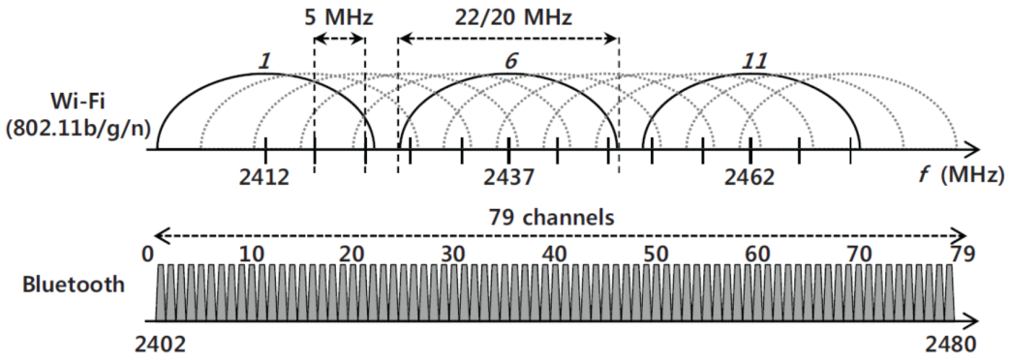

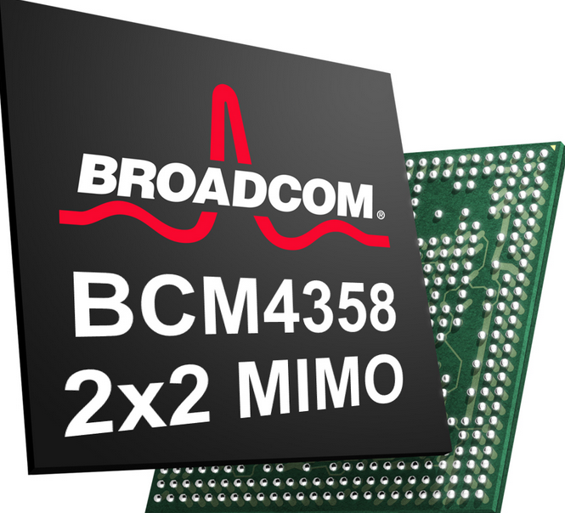
Motivation
Preliminaries ●○
Our approach
Employ Bluetooth radio to detect neighboring APs prior to Wi-Fi scanning
Why Bluetooth?
Low power
Widely available in smartphones (as Wi-Fi & Bluetooth combo chipset)
Is it worth it?
40% of Wi-Fi devices still remain 2.4 GHz only
Most dual band devices connect to 2.4 GHz Wi-Fi networks
Low power
Combo chipset

Slide 4

BlueScan: Overview
Preliminaries ○●
Design philosophy
Bluetooth radio tells “when” and “where” to search for neighboring APs
How can Bluetooth radio detect Wi-Fi APs?
Periodic beacon frames transmitted at Target Beacon Transmission Time (TBTT)
→ 98.6% of Wi-Fi APs employ fixed 102.4 $ms$ beacon period
Overall flow of BlueScan
Choose RSSI sampling channel
Beacon frame detection
Bluetooth
Operating channels
& TBTTs of APs
Covered whole 2.4 GHz?
Yes
No
AP channel pinpointing
Enhanced Wi-Fi scanning
Wi-Fi

Slide 5
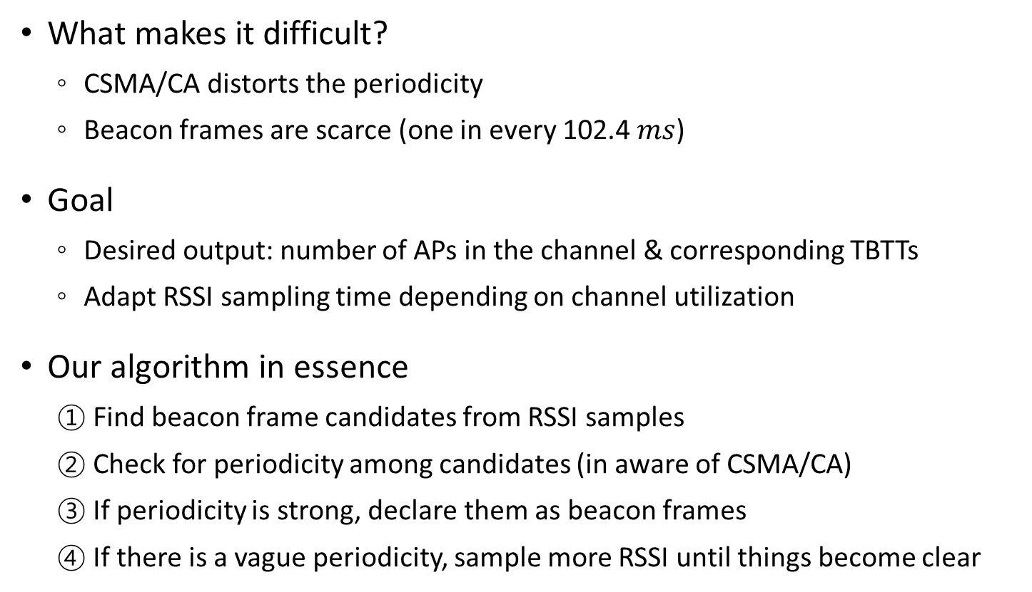
Beacon Frame Detection (1/2)
Proposed Scheme ●○○○
What makes it difficult?
CSMA/CA distorts the periodicity
Beacon frames are scarce (one in every 102.4 $ms$)
Goal
Desired output: number of APs in the channel & corresponding TBTTs
Adapt RSSI sampling time depending on channel utilization
Our algorithm in essence
① Find beacon frame candidates from RSSI samples
② Check for periodicity among candidates (in aware of CSMA/CA)
③ If periodicity is strong, declare them as beacon frames
④ If there is a vague periodicity, sample more RSSI until things become clear

Slide 6

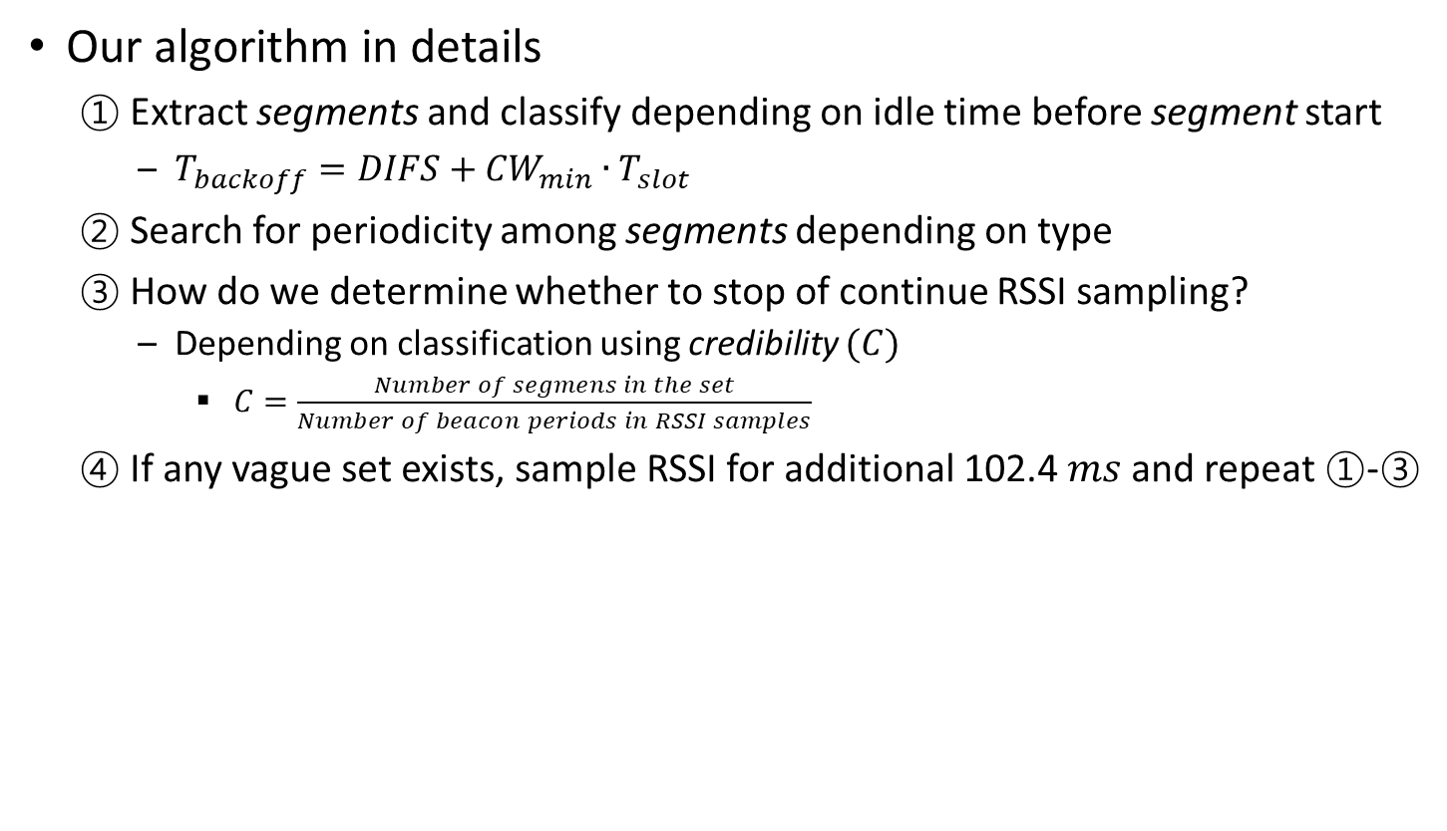






Beacon Frame Detection (2/2)
Proposed Scheme ○●○○
Our algorithm in details
① Extract segments and classify depending on idle time before segment start
$T_{backoff}=DIFS+{CW}_{min}∙T_{slot}$
② Search for periodicity among segments depending on type
③ How do we determine whether to stop of continue RSSI sampling?
Depending on classification using credibility $(C)$
$C=\frac{Number of segmens in the set}{Number of beacon periods in RSSI samples}$
④ If any vague set exists, sample RSSI for additional 102.4 $ms$and repeat ①-③
Type-1 segment
Beacon period
1
C = 3/3 → beacon frame!
C = 2/3 → vague!
Type-2 segment
RSSI samples
2
$$T_{backoff}$$
1
2
2
2
1
1
$$t_{1}$$
TBTT detected!
$$t_{2}$$
$$t_{1}+102.4 ms$$
$$t_{2}+102.4 ms$$
$$t_{1}+204.8 ms$$
$$t_{2}+204.8 ms$$
Time
Notes:
④⑤

Slide 7
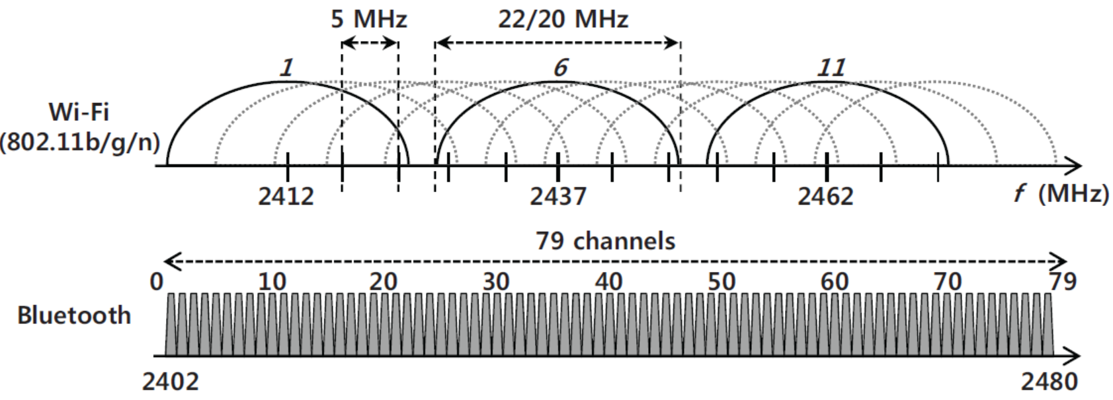

AP Channel Pinpointing
Proposed Scheme ○○●○
Beacon frames can be observed on neighboring channels
However, they will be congruent with respect to modulo 102.4 ($ms$)
Naïve approach
Detect beacon frames on every channel & group congruent ones
→ May incur a long delay

Slide 8
AP Channel Pinpointing
Proposed Scheme ○○●○
Beacon frames can be observed on neighboring channels
However, they will be congruent with respect to modulo 102.4 ($ms$)
Naïve approach
Detect beacon frames on every channel & group congruent ones
→ May incur a long delay
TBTT%102.4
AP at channel 6
Beacon detected
AP at channel 9
AP at channel 3
False positive
1
2
3
4
5
6
7
8
9
10
11
12
13
Channel

Slide 9
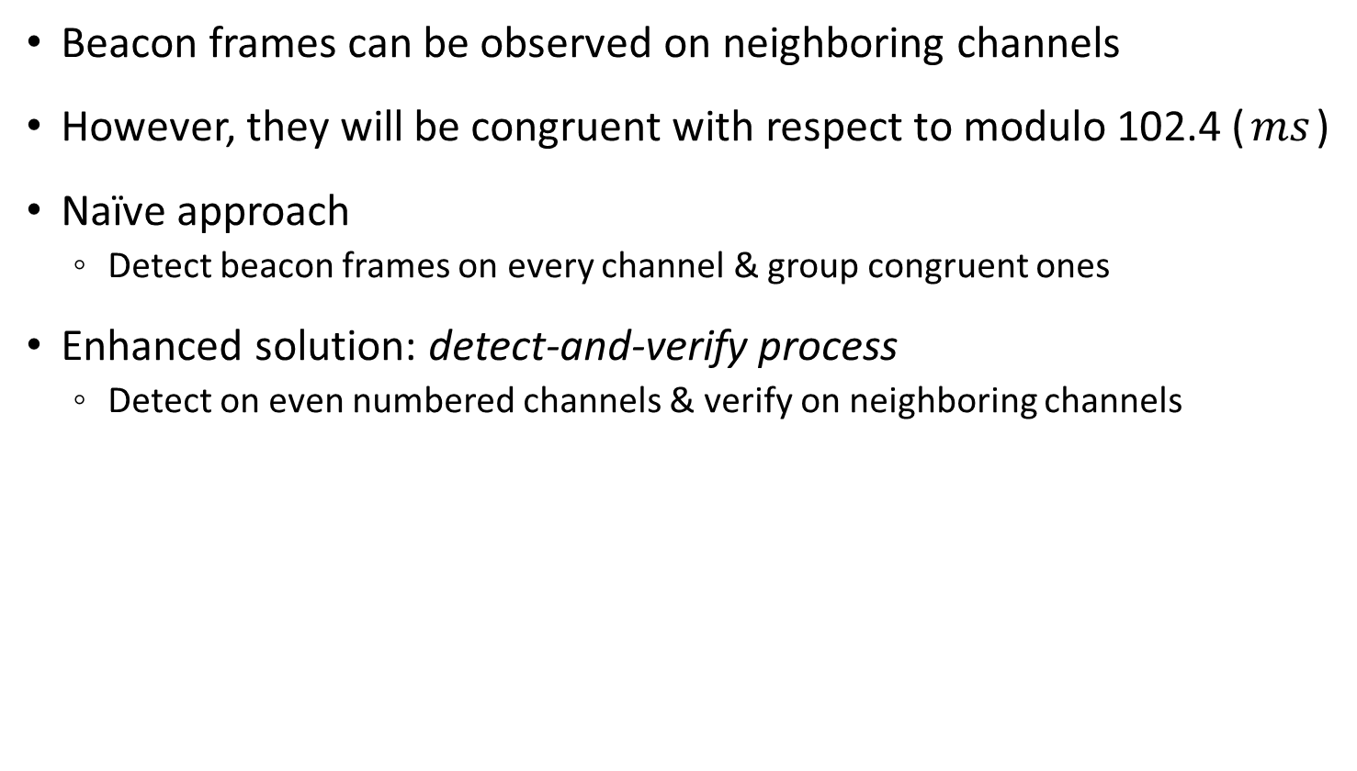
AP Channel Pinpointing
Proposed Scheme ○○●○
Beacon frames can be observed on neighboring channels
However, they will be congruent with respect to modulo 102.4 ($ms$)
Naïve approach
Detect beacon frames on every channel & group congruent ones
Enhanced solution: detect-and-verify process
Detect on even numbered channels & verify on neighboring channels
TBTT%102.4
Ambiguous
Beacon detected
Ambiguous
AP at channel 3
Ambiguous
1
2
3
4
5
6
7
8
9
10
11
12
13
Channel

Slide 10

AP Channel Pinpointing
Proposed Scheme ○○●○
Beacon frames can be observed on neighboring channels
However, they will be congruent with respect to modulo 102.4 ($ms$)
Naïve approach
Detect beacon frames on every channel & group congruent ones
Enhanced solution: detect-and-verify process
Detect on even numbered channels & verify on neighboring channels
TBTT%102.4
AP at channel 6
Beacon detected
✓
?
✓
✓
?
Beacon verified
?
?
AP at channel 9
?
✓
?
AP at channel 3
False positive
?
?
?
1
2
3
4
5
6
7
8
9
10
11
12
13
Channel

Slide 11
Enhanced Wi-Fi Scanning
Proposed Scheme ○○○●
Now we know the channels & TBTTs of neighboring APs
We can choose “when” and “where” to trigger Wi-Fi scanning!
Two options to boost Wi-Fi scanning efficiency
① Selective active scanning
Trigger active scanning only on channels where APs are present
→ Enhanced delay efficiency
② Scheduled passive scanning
Wake up at the TBTT to listen for beacon frame
→ Enhanced energy efficiency

Slide 12
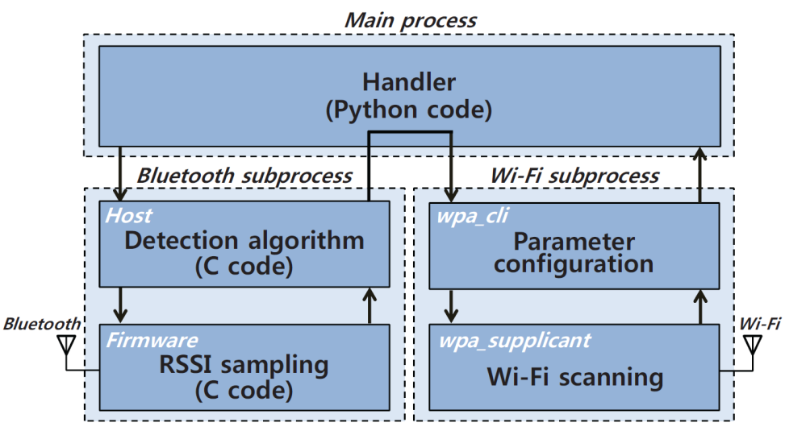
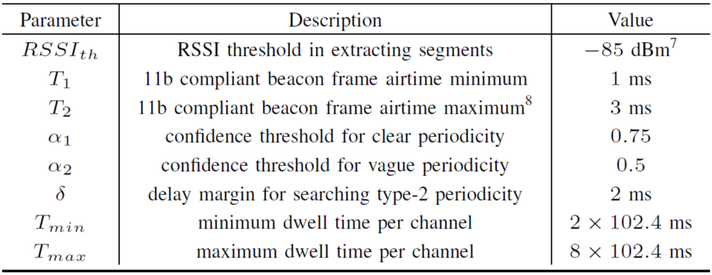
Prototype Implementation
Evaluation ●○○○
Prototype implementation on laptop
Bluetooth radio: Ubertooth-one
Wi-Fi: ath9k (AR9380)
Python subprocess module to manage interaction
Currently, system parameters are determined empirically

Slide 13
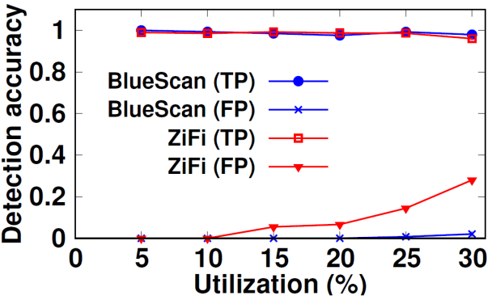
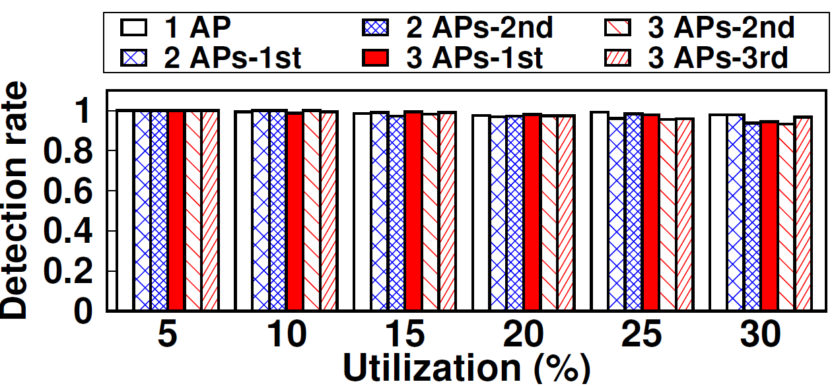
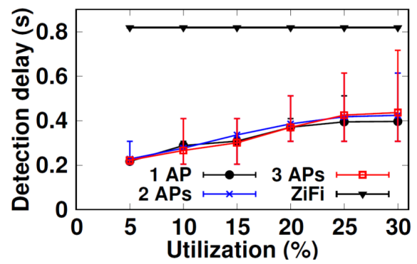
Performance of Beacon Frame Detection
Evaluation ○●○○
Comparison scheme
ZiFi^{[1]} (ZigBee based Wi-Fi AP detector)
Detection accuracy
Single AP scenario
BlueScan achieves both high TP and low FP
Multiple APs scenario
Accuracy invariant to the number of APs
Detection delay
Adaptive to channel utilization
Lower delay compared to ZiFi
[1] R. Zhou et al, “ZiFi: Wireless LAN Discovery via ZigBee Interference Signatures ,” in Proc. ACM MobiCom 2010.

Slide 14
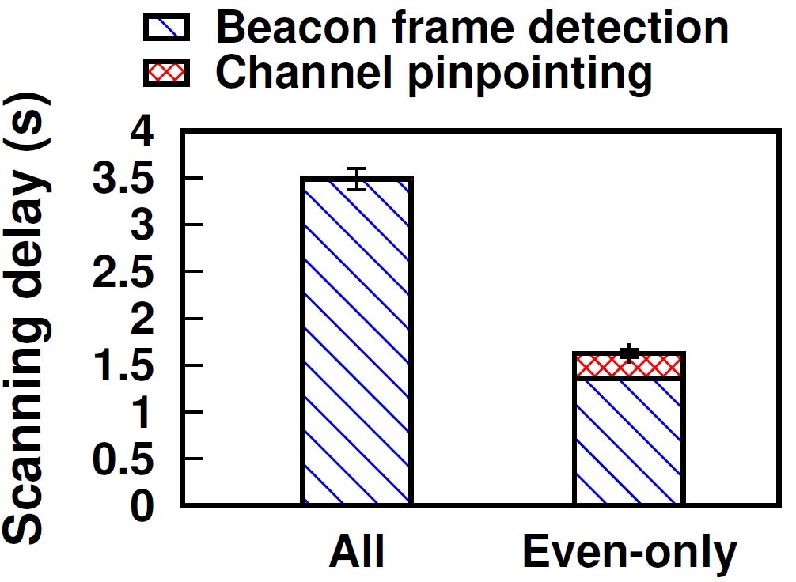
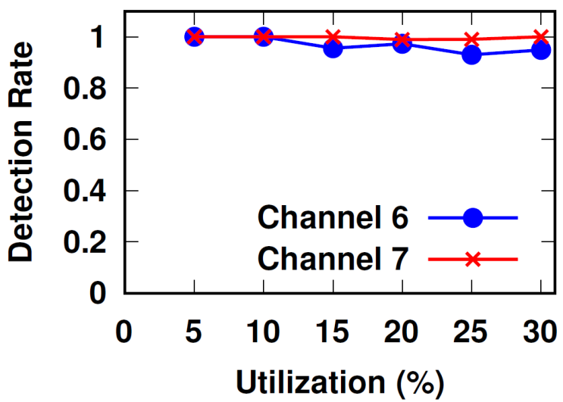
Performance of AP Channel Pinpointing
Evaluation ○○●○
Channel pinpointing delay
3 APs on channel 2, 7, 13
Detect-and-verify process achieves 54% shorter delay
Channel pinpointing accuracy
2 APs on channel 6, 7
Detect-and-verify process causes slight imbalance depending on channel

Slide 15
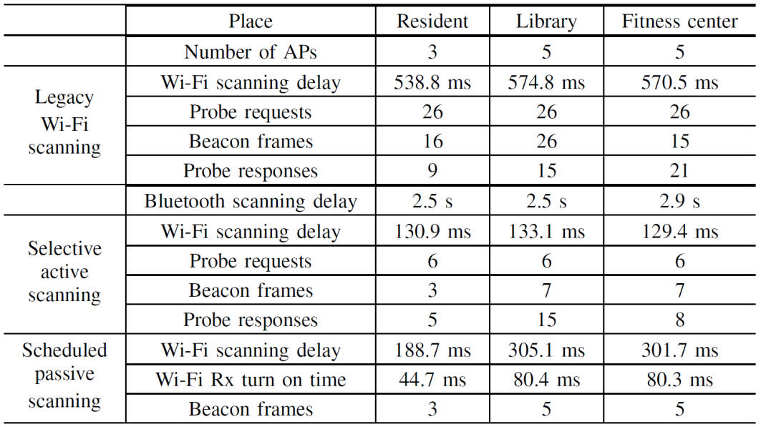
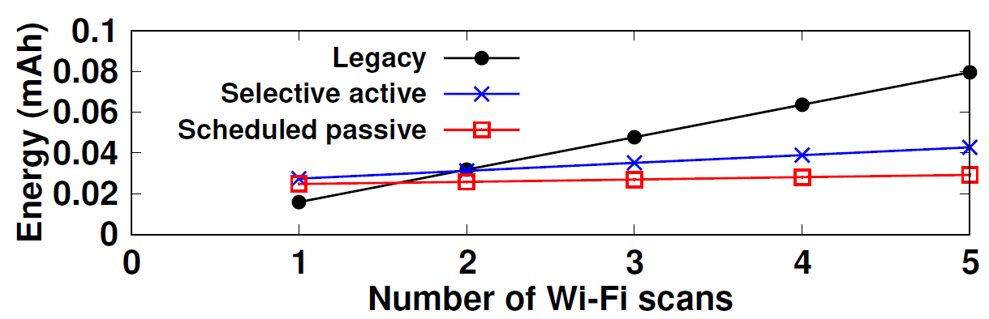
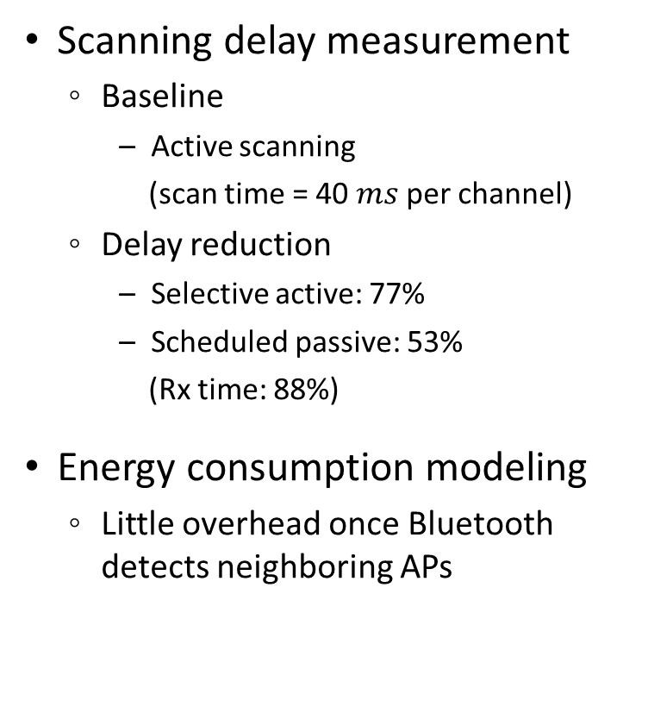
Scanning Delay & Energy Consumption
Evaluation ○○○●
Scanning delay measurement
Baseline
Active scanning
(scan time = 40 $ms$ per channel)
Delay reduction
Selective active: 77%
Scheduled passive: 53%
(Rx time: 88%)
Energy consumption modeling
Little overhead once Bluetooth detects neighboring APs

Slide 16
Summary
Conclusion ●
Proposed Bluetooth aided Wi-Fi scanning scheme
Periodic beacon frame & TBTT detection
AP channel pinpointing
Enhanced Wi-Fi scanning (selective active, scheduled passive scanning)
Performance enhancement
Up to 77% Wi-Fi scanning delay reduction
Future work
Parameter optimization
Evaluation for handoff

Slide 17

!
Thank you for your attention

Slide 18
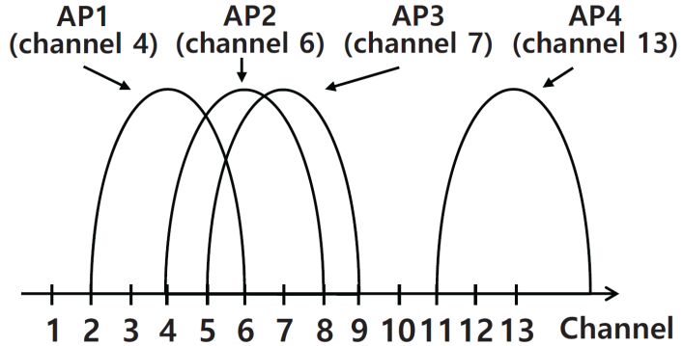
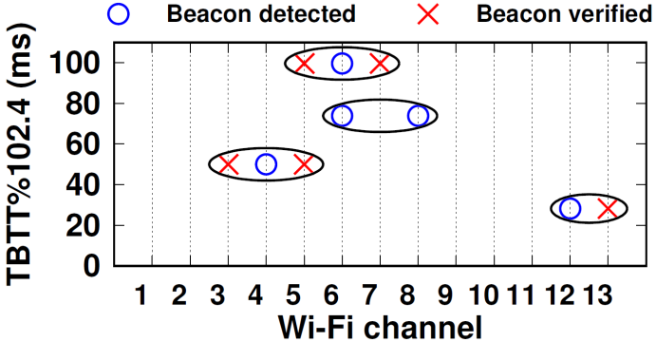
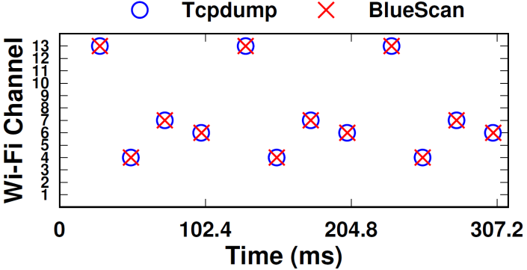
Real World Experiment
Backup Slides
Residential environment
4 APs at channel 4, 6, 7, 13
TBTT acquisition accuracy
Ground truth TBTT is estimated using Tcpdump
BlueScan accurately detects the TBTTs of APs
TBTT acquisition error < 300 μs (mainly due to USB transfer delay)

