Slide 1

ERP SYSTEM FOR COLLEGE MANAGEMENT group-3

Slide 2
Team members
Jyoti Kumari [2504212]
Kotha Sai Ganesh Manikanta [2504239]
K Jitesh [2504087]
Kummitha Sravani [2504058]
Kesanasetti Mahesh Babu [2503100]
Juhi Gunwant Birari [2507298]
Jyoti Rajendra Bhange [2503926]
Kiran Rohidas Rathod [2503378]
Kavvala Hemalatha [2506959]
Kankatala Pulleswara Jayanth[ 2503436]
Front-End
Back-End

Slide 3
CONTENTS
Introduction
Modules for ERP system
Technology Used
Features available
Tools and Languages
Advantages
Disadvantages
Future scope and improvements
References
Conclusion

Slide 4
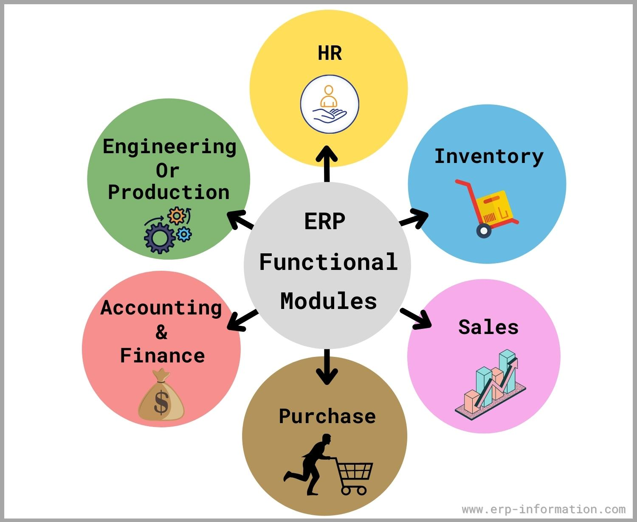
Introduction of ERP
ERP stands for Enterprise Resource Planning.
ERP is a business management software. It is a suite of integrated application that helps users to store and manage data of their business.
The process often integrates accounts payable, stock control systems, order-monitoring systems, and customer databases into one system.

Slide 5

COLLEGE MANAGEMENT SYSTEM
The objective was to propose a design of ERP for college management system is
It provides a simple interface for maintenance of different student, faculties, library and other information.
It can manage daily activities of college which include the management of Faculty, Students, Courses and Library Records, Assignments, Admission Process, Results and Reports, Exams, Attendance, Timetable, Fees and Other Report.

Slide 6
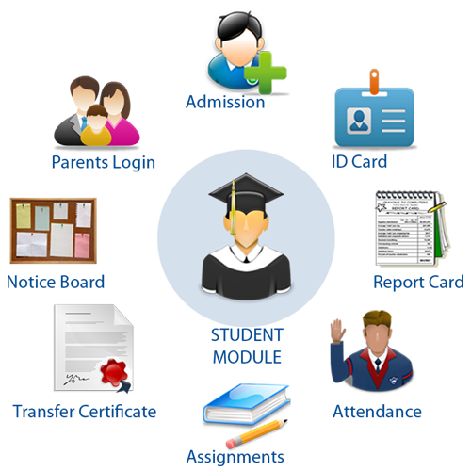
MODULES FOR ERP SYSTEM
Admin
Student
Faculty login
Login
Library login
About us

Slide 7
HOME PAGE
Tabs
Home
Admin
Student
Faculty
Library
About us
Login
Login
Login

Slide 8

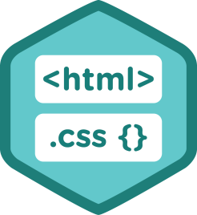


TECHNOLOGIES USED
Front End : Angular
Server-Side : Spring Boot.
Back-End : MYSQL, Hibernate.
Server : Tomcat.

Slide 9

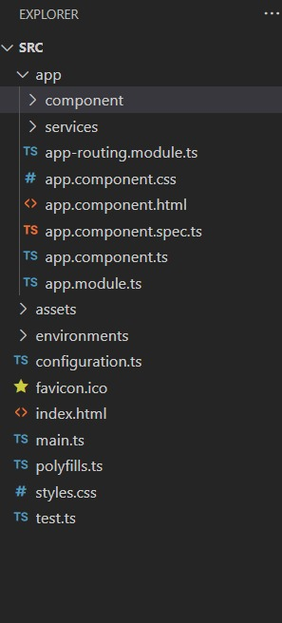
Angular
Angular is primary written in TypeScript. It implements core and optional functional functionality as a set of TypeScript libraries that you import into your applications.
The architecture of a Angular application relies on certain fundamental concepts.The basic building blocks of the angular framework are angular components that are organized into NGModules.
Angular is a platform and framework for building single-page client(SPA) applications using HTML and TypeScript.
Angular helps develop desktop applications for different operating systems.

Slide 10
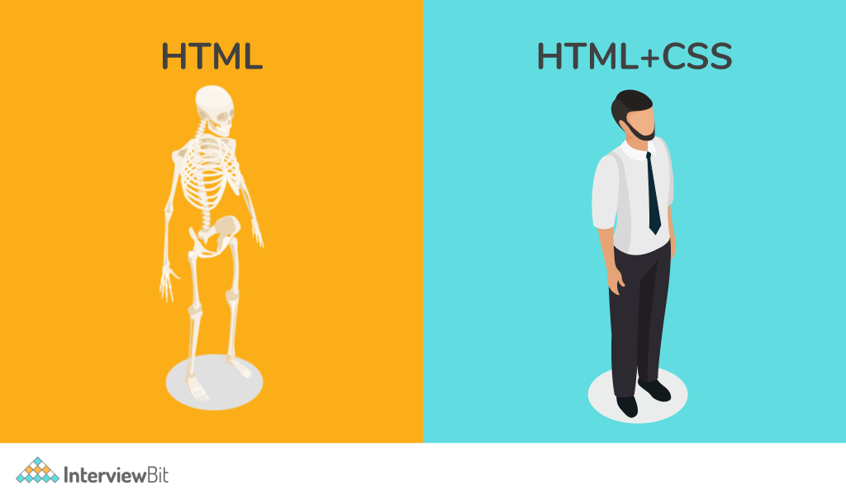
HTML+CSS
HTML stands for Hyper Text Markup Language.
HTML describes the structure of a web page
HTML consists of a series of elements
HTML elements tell the browser how to display the content.
CSS stands for Cascading Style Sheets
CSS describes hoe the HTML elements are to displayed on screen,paper,or in other media
CSS saves a lot of work.It can control the layout of multiple web pages all at onces.

Slide 11
Spring Boot
What to use spring boot?
spring Boot is an open source, microservice-based java web framework.
The spring Boot framework creates a fully production-ready environment that is completely configurable using its prebuilt code within its codebase.
Features of Spring Boot
It provides a flexible way to configure java Beans, XML configuration,and Databace Transactions.
It provides a powerful batch processing and manages REST endpoints.
In Spring Boot, everything is auto configured; no manual configurations are needed.
It offers annotation-based spring application

Slide 12

MySQL
Introduction to Mysql
MySQL is a very popular, open source DBMS
MySQL databases are relational
MySQL is compatible with standard SQL
Why are we using MySQL?
Free (much cheaper than Oracle!)
Multi-user access to a number of databases offered
Easy to use Shell for creating tables, querying tables, etc.
Easy to use with Java JDBC
MySQL is frequently used by PHP and Perl
Commercial version of MySQL is also provided (including technical support)

Slide 13

Apache Tomcat
Apache Tomcat(or Jakarta Tomcat or single Tomcat) is an open source servlet
container developed by the Apache Software Foundation(ASF).
Tomcat implements the Java Servlet and the Java Server Pages (JSP) specifications from sun Micro Systems.
What is Tomcat?
Tomcat is a Servlet container (Web server that interacts with Servlets) developed under the Jakarta Project of Apache Software Foundation
Tomcat implements the Servlet and the Java Server Pages (JSP)

Slide 14

HIBERNATE
Java objects
Hibernate Is a lightweight open source object relational mapping(ORM) framework.
It allows mapping of an object-oriented model to a relational database.
Implements the specifications of java persistence API(JPA).
Sits between java objects and the database server.
Hibernate supports relationships(One-to-One,One-to-Many and many-to-many many-to-one), association, collection, inheritance, annotation and so on.
Hibernate

Slide 15
TOOLS AND LANUAGES REQUIRED
Front End | Back End
Visual Studio | MYSQL
Angular | Hibernate
Html | Eclipse IDES
Css | Spring Boot

Slide 16
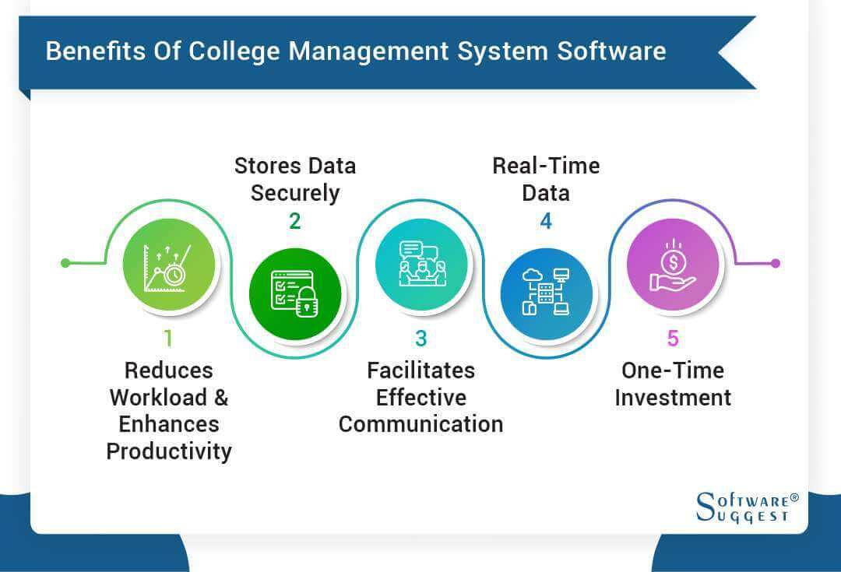
ADVANTAGES

Slide 17
DISADVANTAGES
The installation of the ERP system is costly.
Costs of an ERP Software
Third-party software add-ins
Implementation costs
Maintenance
Initial and continuous training
Complex Data Conversion
Developing a solid data conversion strategy can be difficult
You have to define, examine and analyze data sources
Bad data conversion will cause delays and increased costs

Slide 18
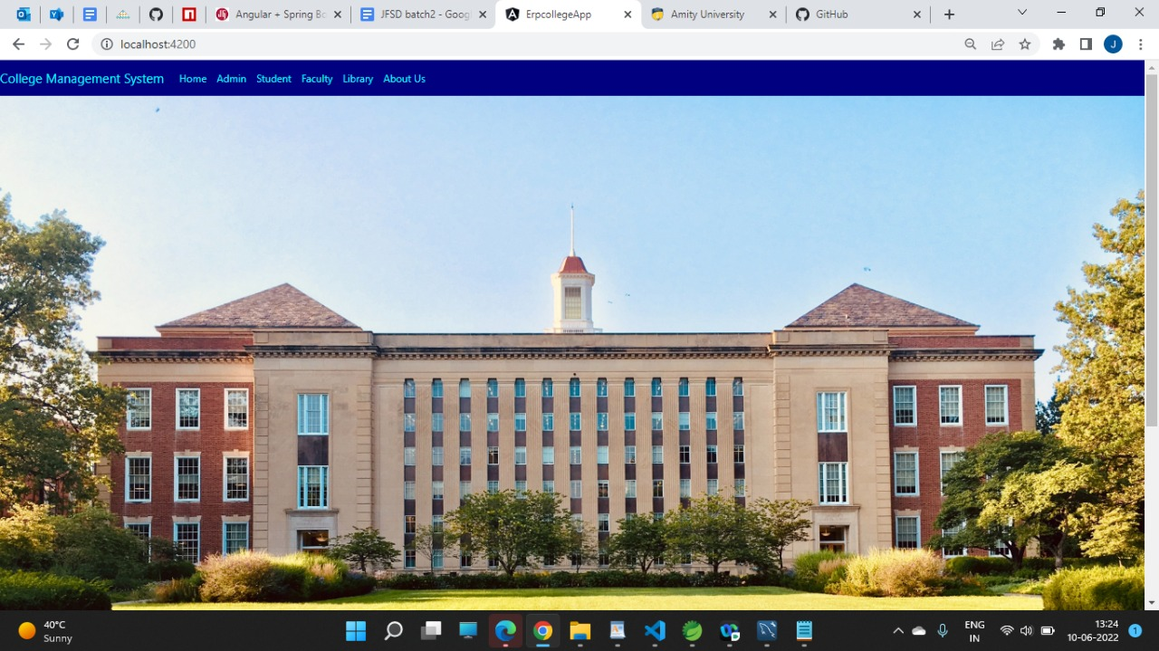
HOME PAGE

Slide 19
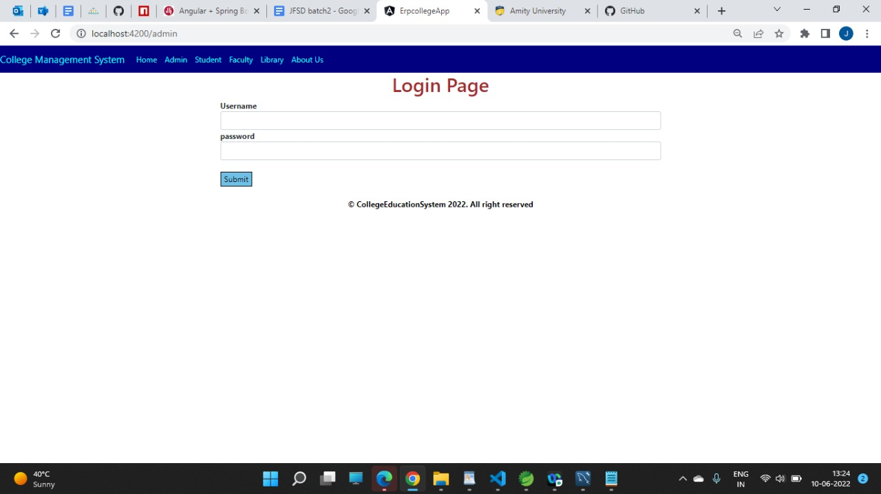
LOGIN PAGE

Slide 20
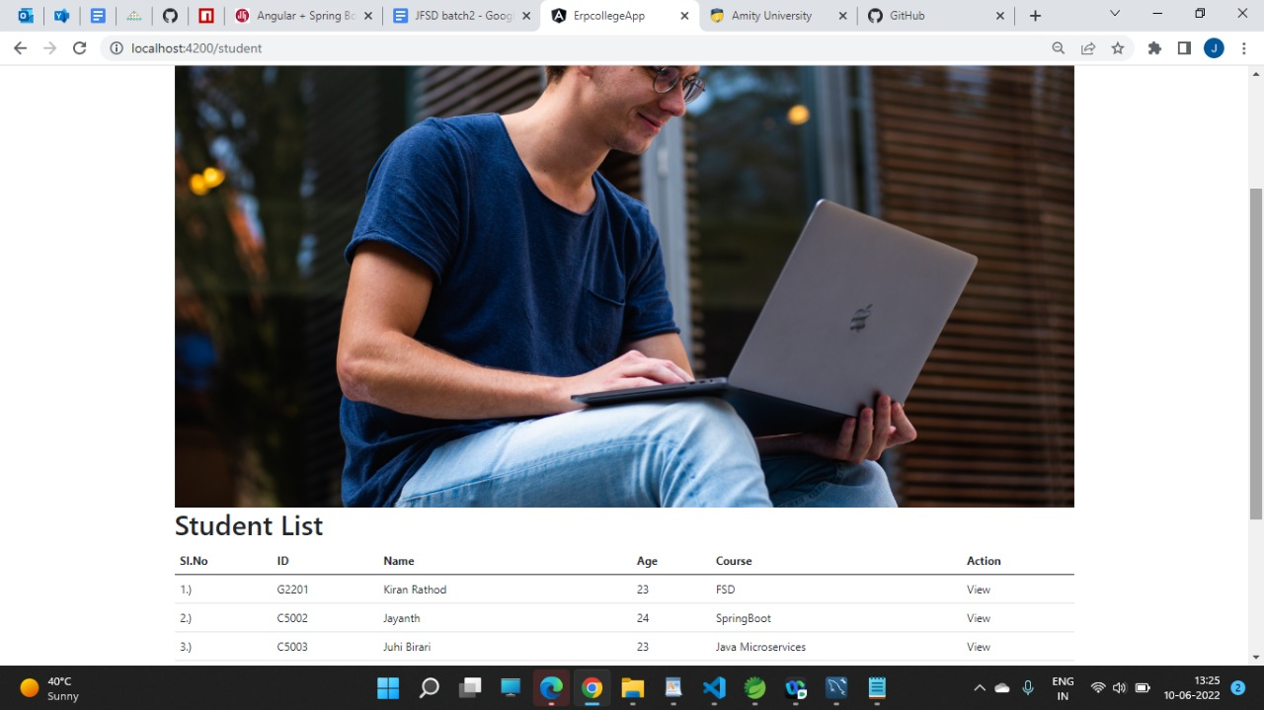
STUDENT

Slide 21
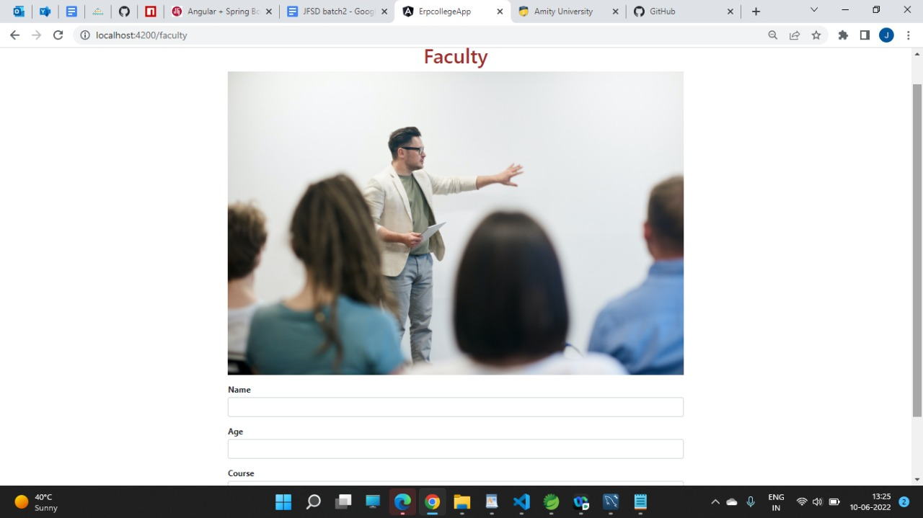
FACULTY

Slide 22
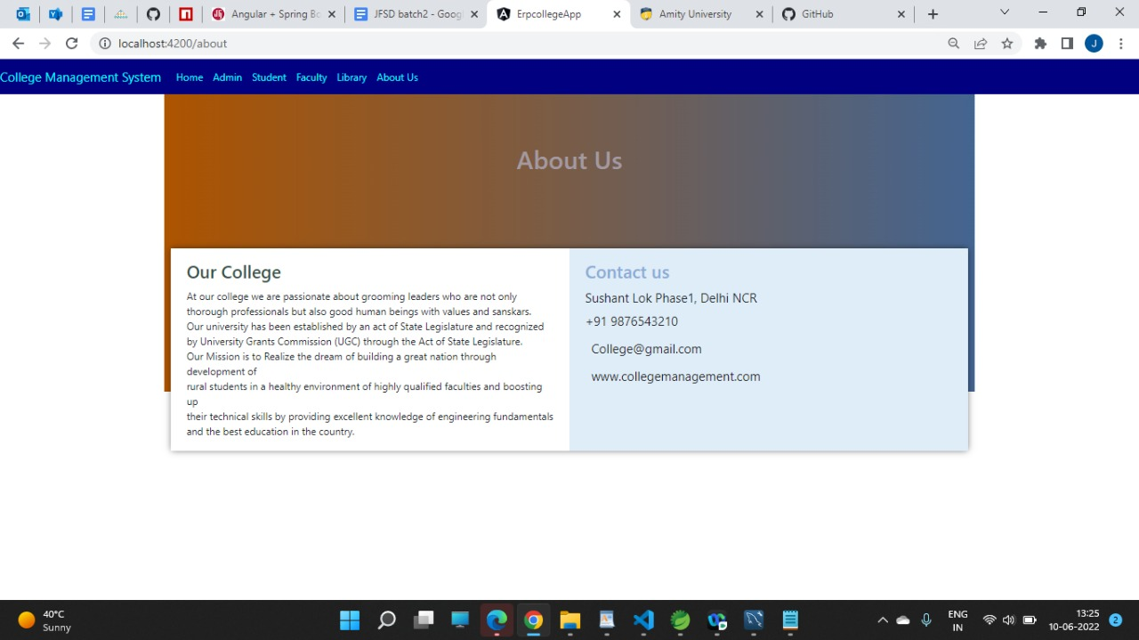
ABOUT US

Slide 23

FUTURE SCOPE AND IMPROVEMENTS
Future Enhancements Make online exam more effective, efficient and more dynamic so that it helps to get a good support from the student.
It has been marking while this application open in other browser due to designing support.
It’s more support to Mozilla as compare to other browser. Online result printing and more user interaction functionality and features need to be developed. Needs to improve more security for the purpose of the safety.

Slide 24
REFERENCES
http://books.google.com
http://sourceforge.net
http://www.gnu.org
http://www.thefreecountry.com

Slide 25

CONCLUSION
The “ERP” system has been developed by us and also done enhancement in application through applying our knowledge gained in class room, referring to certain books, browsing some sites and through the help of external and internal faculties and using our knowledge related to subject it. We are very thankful to all our team members that extended all their support and helped us complete this project successfully

Slide 26


