Slide 1
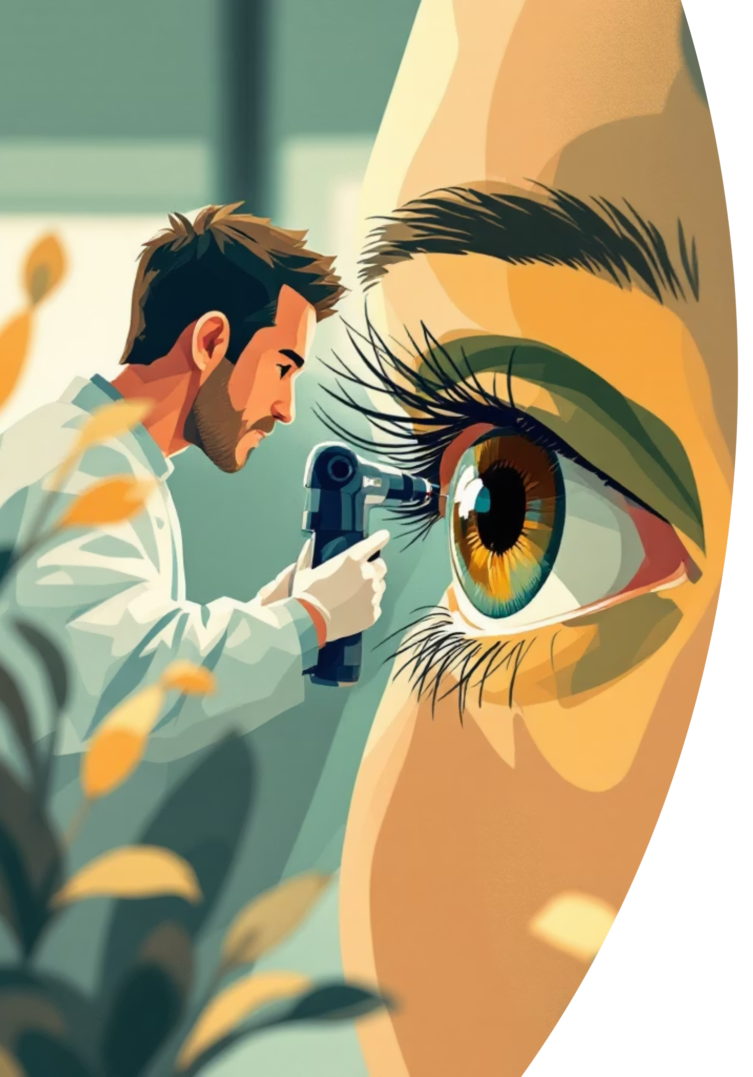
Non-Invasive Anemia Detection Using Conjunctiva Images
A Comparative Study of MobileNet, ResNet-50, and VGG-16
Nandan, Juhi Kumari, Pragati Singh
Department of CSE (AI)
KIET Group of Institutions)

Slide 2
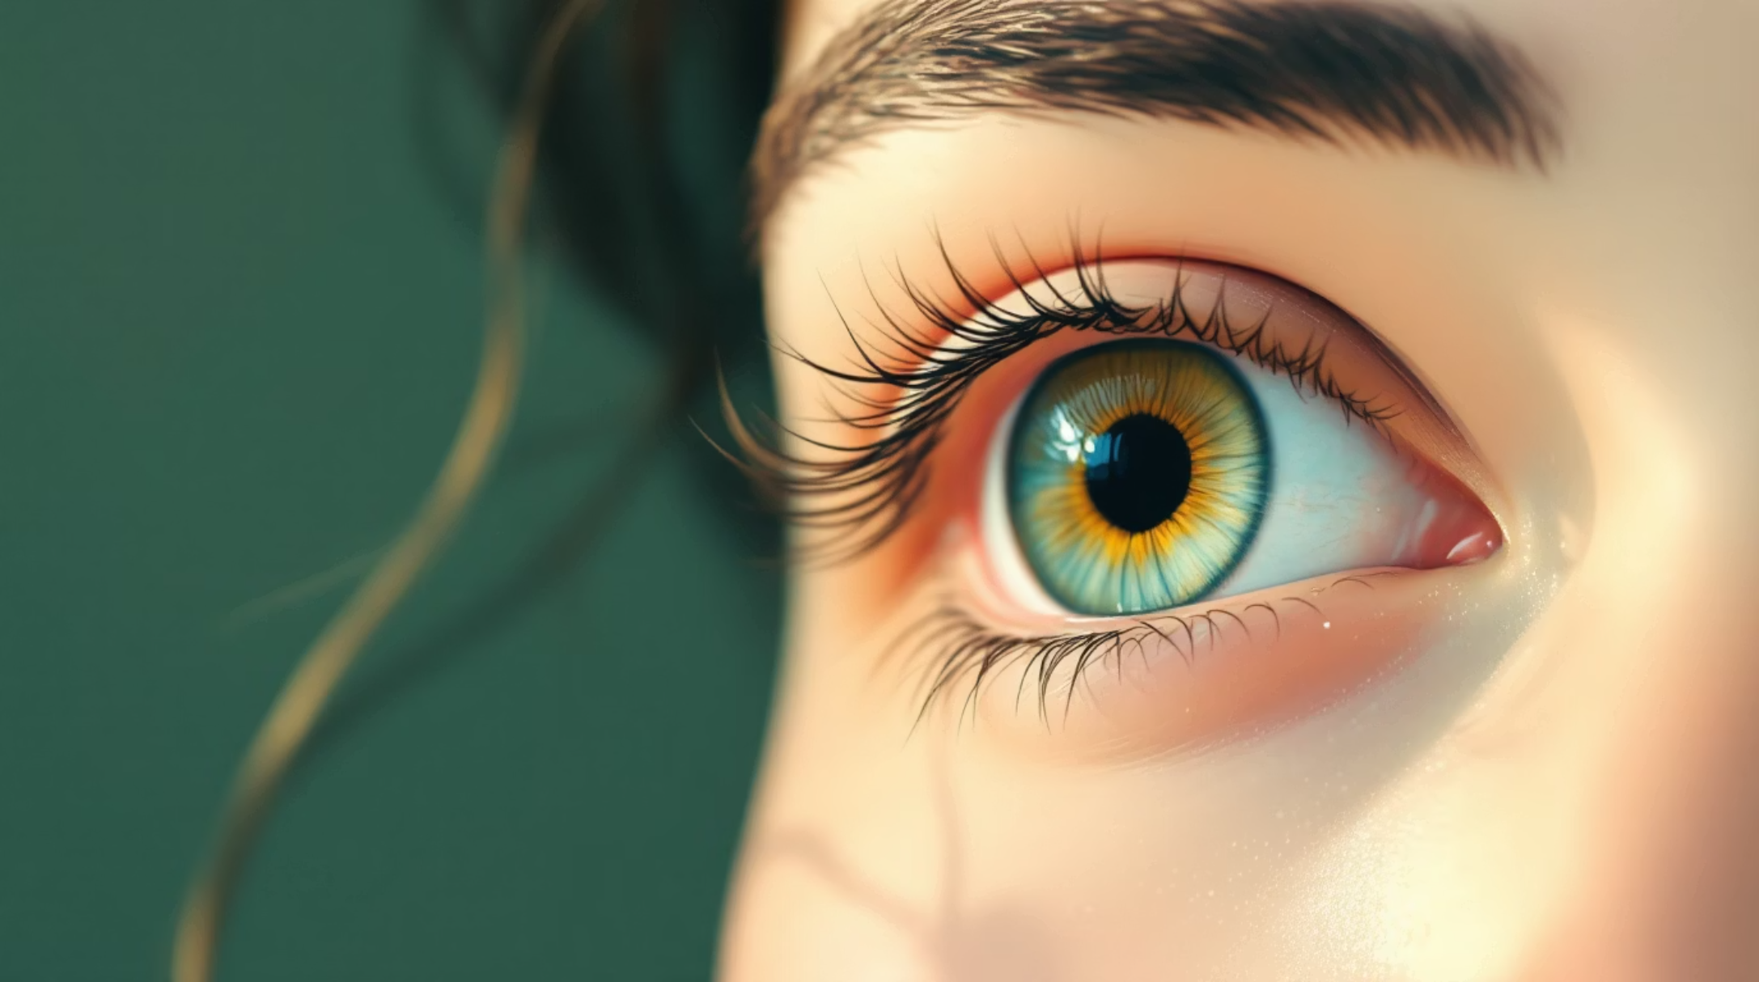
Understanding Anemia
What is Anemia?
Anemia occurs when hemoglobin levels drop, reducing oxygen supply throughout the body. It's particularly prevalent among women and children worldwide.
Common Symptoms
Fatigue and weakness
Pale skin and conjunctiva
Shortness of breath
Dizziness and headaches

Slide 3

Problem Statement
Current Challenges
Traditional blood tests require specialized laboratories, expensive equipment, and trained medical personnel, making them inaccessible in resource-limited settings.
Rural Healthcare Gap
Limited access to diagnostic facilities in rural and remote areas delays early detection and treatment of anemia, leading to worsened health outcomes.
Economic Barriers
Blood tests involve significant costs, time delays, and patient discomfort, creating barriers to regular screening and preventive care.

Slide 4
Proposed Solution
01
02
Image Capture
Color Analysis
Conjunctiva images captured using standard cameras or smartphones
Machine learning analyzes color changes in conjunctival tissue
03
04
Classification
Diagnosis
Deep learning models classify hemoglobin levels from image data
Binary output: Anemic or Non-Anemic prediction with confidence level

Slide 5
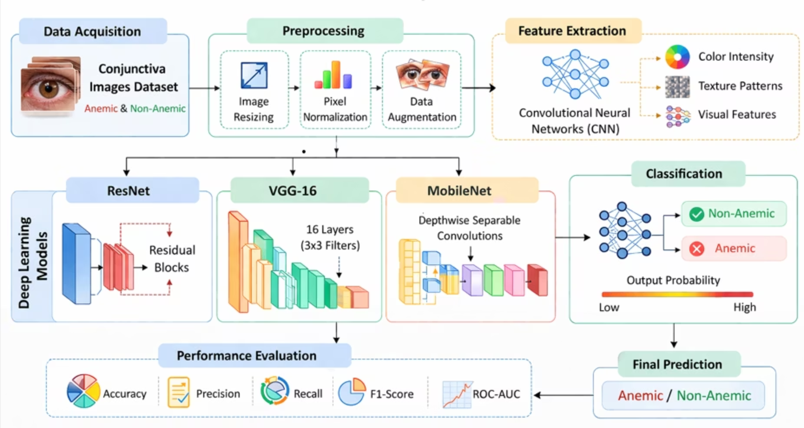
Methodology
Workflow Overview
Our approach combines image processing techniques with deep learning architectures to create a non-invasive diagnostic system.
Key Advantages
Non-invasive procedure
Fast results
Low-cost implementation
Scalable deployment

Slide 6

Deep Learning Architectures
ResNet-50
VGG-16
Best Performance
Strong Baseline
50-layer deep network with skip connections enables better gradient flow and reduced overfitting. Achieves highest accuracy at 78%.
16-layer architecture with consistent 3×3 convolutions. Solid performance with 74% accuracy and reliable feature extraction.
MobileNet
Lightweight Option
Optimized for mobile devices with depthwise separable convolutions. Best recall at 84% with efficient computation.

Slide 7
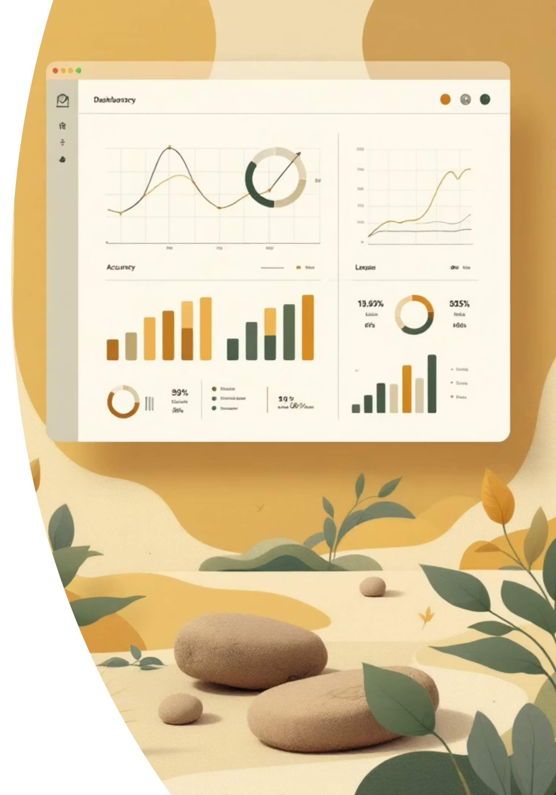
Model Training Details
Technical Specifications
Training Configuration
Input Size: 224 × 224 pixels
Base Model: ResNet-50 (ImageNet weights)
Technique: Transfer Learning with fine-tuning
Optimizer: Adam
Learning Rate: 0.001
Loss Function: Binary Crossentropy
Batch Size: 16-32 images
Epochs: 10-20 iterations
Preprocessing: Normalization & augmentation
Validation: K-fold cross-validation

Slide 8
Performance Comparison
Model
Accuracy
Precision
Recall
F1-Score
ResNet-50
88%
0.80
0.82
0.81
VGG-16
74%
0.76
0.79
0.77
MobileNet
72%
0.75
0.84
0.79
88%
84%
0.81
Best Accuracy
Best Recall
Best F1-Score
ResNet-50 achieved highest overall performance
MobileNet detected most anemic cases
ResNet-50 balanced precision and recall

Slide 9
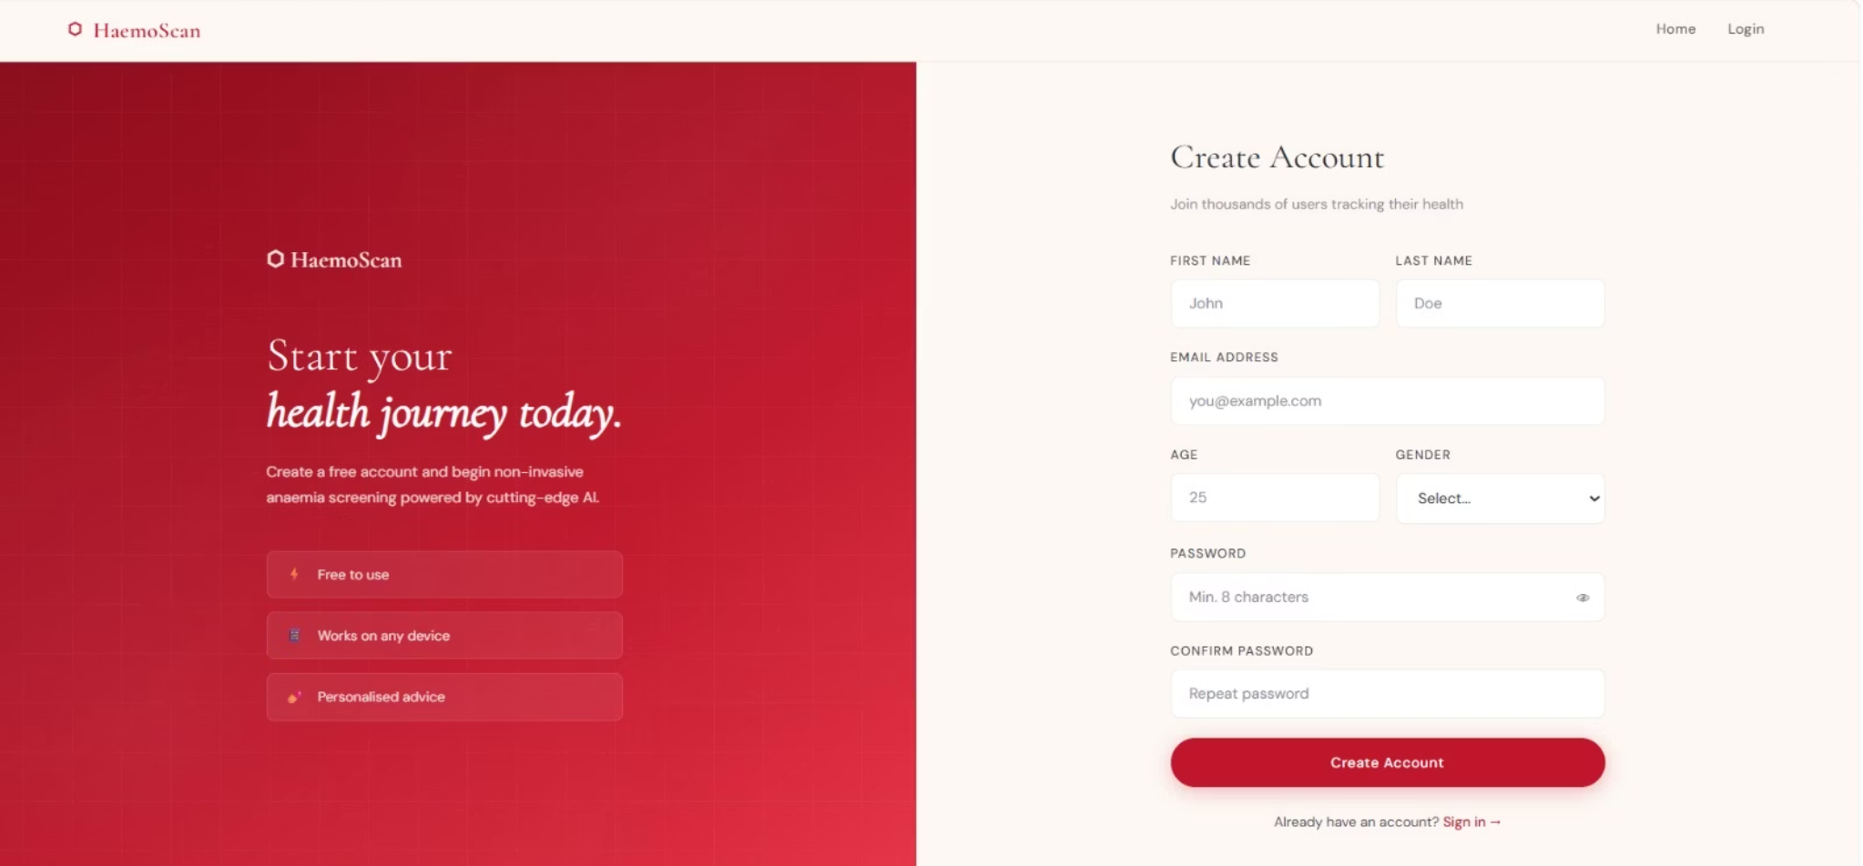
Challenges & Future Applications
Current Limitations
Real-World Applications
Limited Dataset
Small sample size affects model generalization to diverse populations
Image Quality
Lighting conditions and capture quality significantly impact results
Class Imbalance
Uneven distribution affects model training and evaluation
Rural healthcare screening programs
Mobile-based diagnosis platforms
Health camps and telemedicine services
Early detection and preventive care systems
Community health worker assistance
Clinical Validation
Real-world testing required before deployment

Slide 10

Conclusion & Future Work
Key Findings
Future Directions
Our research demonstrates that non-invasive anemia detection using conjunctiva images is feasible with deep learning models. ResNet-50 achieved 78% accuracy, proving superior overall performance while MobileNet offers best recall for sensitive detection.
01
Expand Dataset
Collect larger, diverse samples
02
This approach provides accessible, cost-effective screening alternative to traditional blood tests, particularly valuable for resource-limited settings.
Mobile App
Develop real-time application
03
Clinical Trials
Validate with medical professionals
04
Multi-class Models
Predict hemoglobin levels

