Slide 1
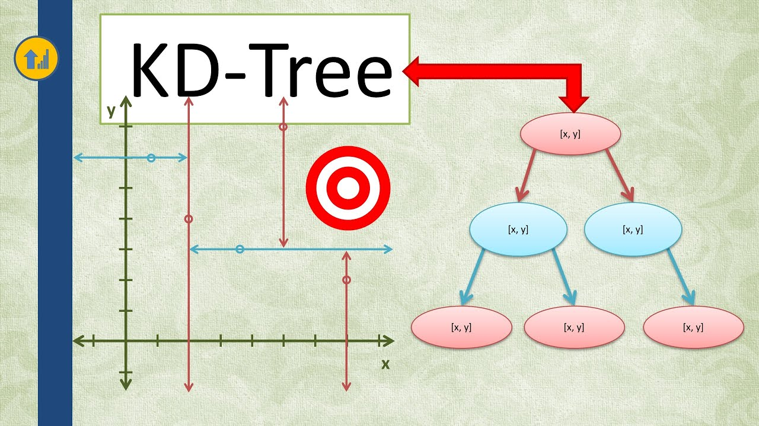
K-dimensional Trees
Presented By :-
Riya J. Rathod 240160510041
Riya I. Senghani 240160510045
Juhi R. Thacker 240160510051
Guided By :-
Dr. Nipa Shah

Slide 2
Introduction to K-dimensional Trees
A specialized data structure is used for organizing points in multi-dimensional space.
The term 'k' represents the number of dimensions or attributes each data point possesses.
Each element in this structure stores a point with multiple coordinates, based on the value of 'k.’
The structure alternates between different attributes when partitioning the data at each level.
It is commonly applied for tasks like finding nearby points and conducting searches within a specified range.
The hyperplane direction is chosen in the following way: every node in the tree is associated with one of the k dimensions, with the hyperplane perpendicular to that dimension's axis. As the number of dimensions increases, the structure's efficiency decreases due to the "curse of dimensionality."

Slide 3

Use of K-dimensional Trees
1
Efficient Spatial Queries
2
High-Dimensional Data
K-d trees excel at performing spatial queries, such as finding the nearest neighbor or retrieving all points within a given range.
They can effectively handle data with multiple dimensions, which is common in many application domains like computer vision and machine learning.
3
Reduced Search Space
K-d trees recursively partition the search space, allowing for quick elimination of irrelevant regions and faster query processing.

Slide 4

Fundamentals of K-dimensional Trees
Binary Tree Structure
Splitting Dimensions
Efficient Queries
K-d trees are a type of binary search tree, where each node represents a data point in the k-dimensional space.
At each level of the tree, the data is split along a different dimension, creating a hierarchical partitioning of the space.
The tree structure allows for efficient nearest neighbor searches and range queries by quickly eliminating irrelevant regions.

Slide 5

Construction of a K-dimensional Tree
Selecting the Split Dimension
1
The dimension with the largest variance is chosen to split the data at each node.
2
Partitioning the Data
The data is divided into two halves based on the median value in the selected dimension.
Recursive Subdivision
3
The process is repeated recursively for the left and right subtrees, creating a hierarchical structure.

Slide 6





Advantages of K-dimensional Trees
Efficient Spatial Queries
High-Dimensional Data
K-d trees enable fast nearest neighbor searches and range queries by quickly eliminating irrelevant regions.
They excel at organizing and querying data with multiple dimensions, which is common in many applications.
Scalability
Visualization
The tree structure allows for efficient insertion and deletion of data points, making it scalable.
K-d trees provide a natural way to visualize and explore high-dimensional data through their hierarchical structure.

Slide 7
Limitations and Challenges of K-dimensional Trees
Curse of Dimensionality
Balancing Challenges
Memory Footprint
The performance of K-d trees can degrade as the number of dimensions increases, a phenomenon known as the "curse of dimensionality."
Maintaining a well-balanced tree can be challenging, especially when dealing with unevenly distributed data or frequent insertions and deletions.
The tree structure can consume a significant amount of memory, especially for large datasets or high-dimensional data.

Slide 8

Applications of K-dimensional Trees
1
Computer Vision
2
Spatial Databases
K-d trees are used for efficient nearest neighbor searches in image processing and object recognition tasks.
They are employed in spatial databases to handle queries involving location-based data, such as geographic information systems.
3
Machine Learning
4
Robotics
K-d trees are leveraged for data partitioning and nearest neighbor searches in various machine learning algorithms.
They are used in robotic path planning and collision detection algorithms to efficiently navigate through complex environments.

Slide 9


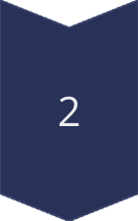
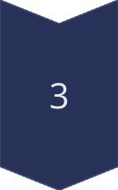
Insertion in a K-dimensional Tree
Traverse the Tree
Start at the root and recursively traverse the tree, comparing the new point's coordinates to the split values at each node.
Find the Insertion Point
Once the appropriate leaf node is reached, the new point is inserted as a child of that node.
Maintain Balance
Balancing the tree may be necessary to ensure efficient performance for future queries.

Slide 10
Example of K-D Tree(k=2)
(6,2),(7,1),(2,9),(3,6),(4,8),(8,4),(5,3),(1,5),(9,5)
6,2
2,9
7,1
3,6
8,4
1,5
4,8
9,5
5,3

Slide 11
Example of K-D Tree(k=3)
(6,5,2) ,(1,8,9), (7,1,1), (7,8,7), (7,3,6), (2,1,4), (1,4,1), (8,7,3), (6,2,8), (2,8,6), (9,1,4), (2,8,3), (8,1,4), (9,4,1), (7,2,9)
6,5,2
1,8,9
7,1,1
2,1,4
9,1,4
7,8,7
1,4,1
6,2,8
8,1,4
7,3,6
7,2,9
8,7,3
2,8,3
2,8,4
9,4,1

Slide 12
Operations of K-dimensional Trees
Insertion
2
Search
3
Deletion
1
K-d trees are used for efficient nearest neighbor searches in image processing and object recognition tasks.
They are employed in spatial databases to handle queries involving location-based data, such as geographic information systems.
K-d trees are leveraged for data partitioning and nearest neighbor searches in various machine learning algorithms.
4
Nearest Neighbour Search (NN)
5
Range Search
They are used in robotic path planning and collision detection algorithms to efficiently navigate through complex environments.
Range Search in a k-d tree is used to find all the points within a specified rectangular range. The algorithm is similar to nearest neighbor search, but instead of finding the closest point, it finds all points that fall within a defined range.

Slide 13
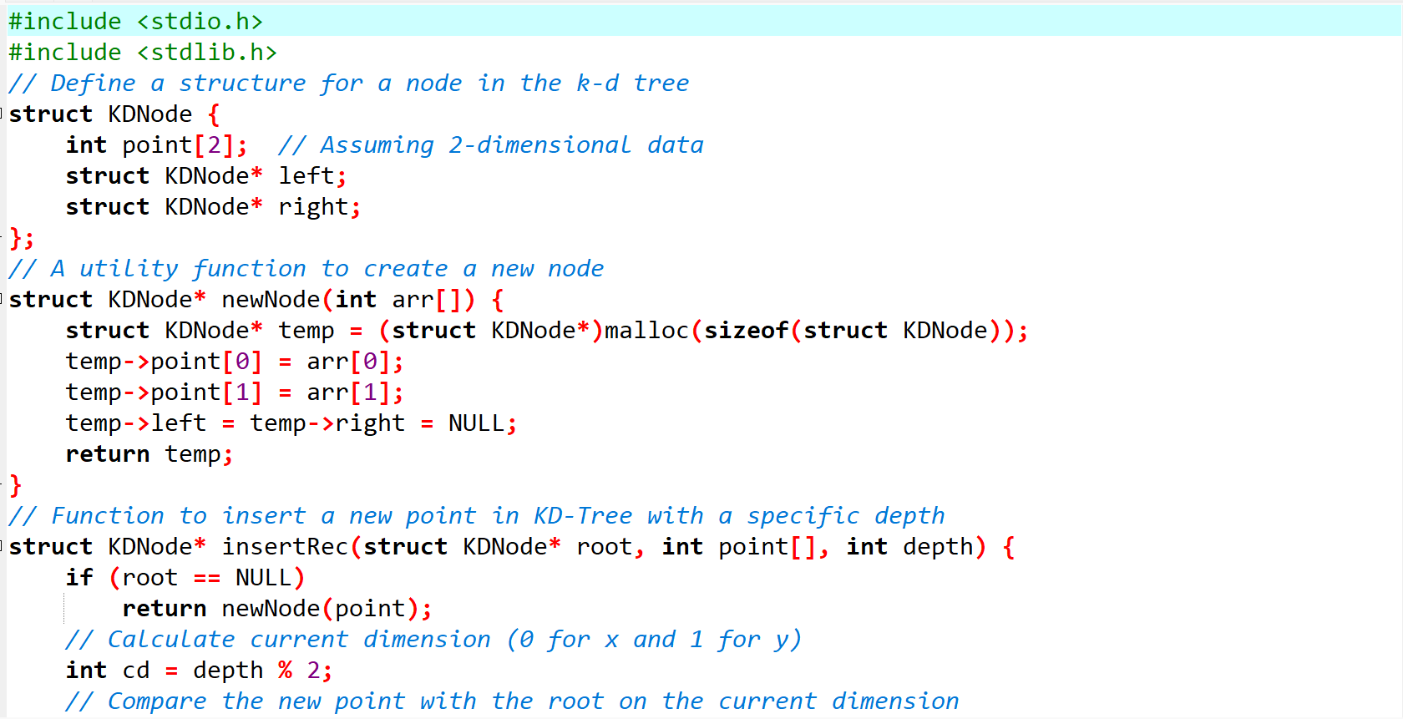
Code for Creating K-dimensional Trees(k=2)

Slide 14
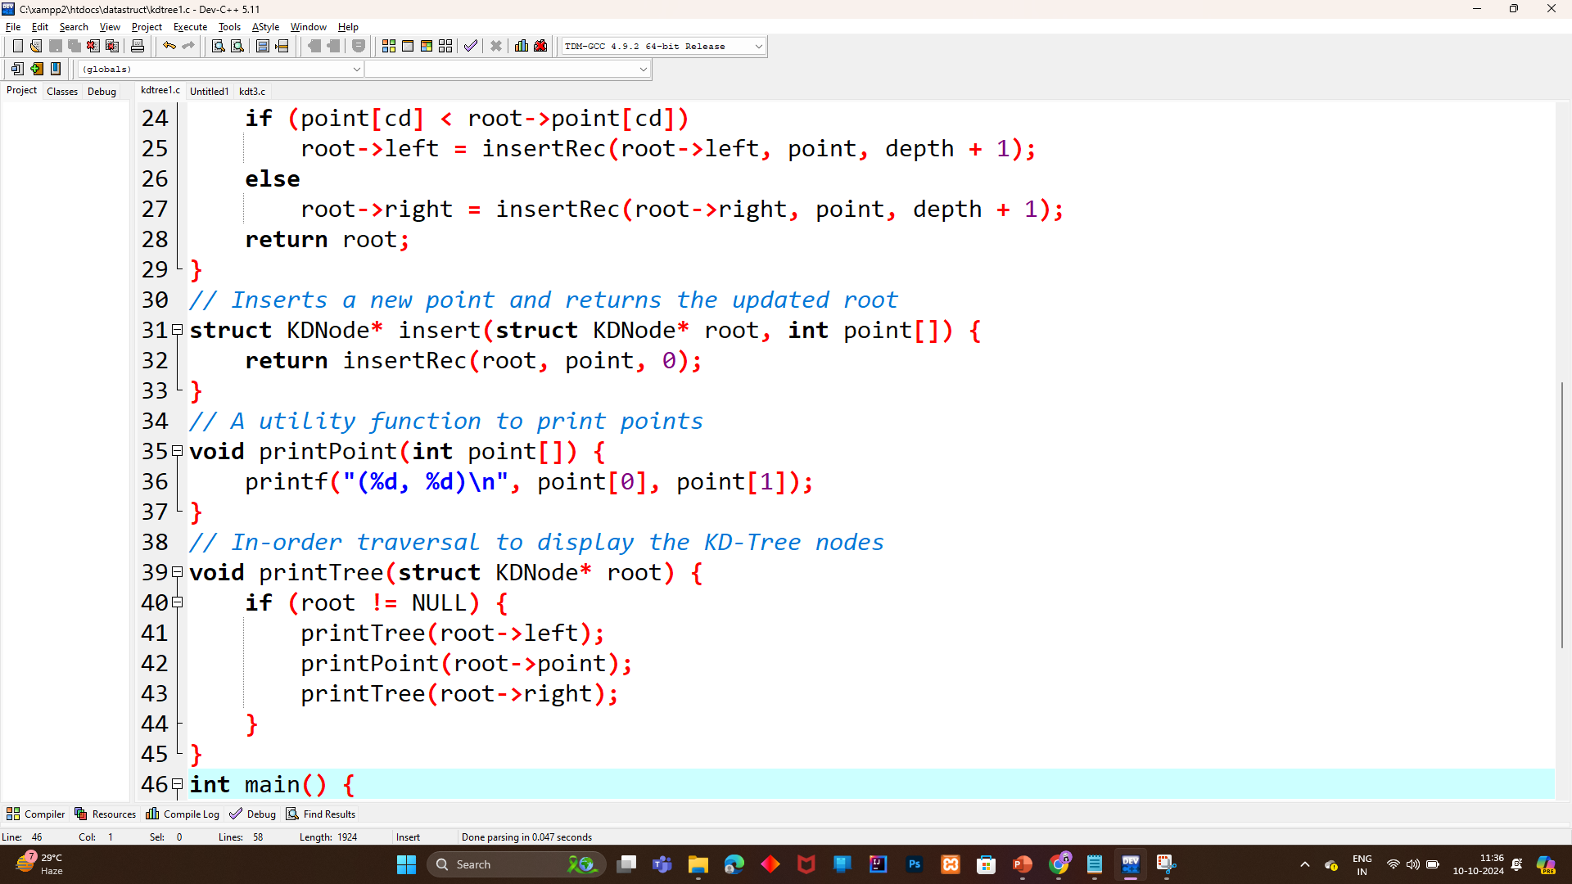

Slide 15
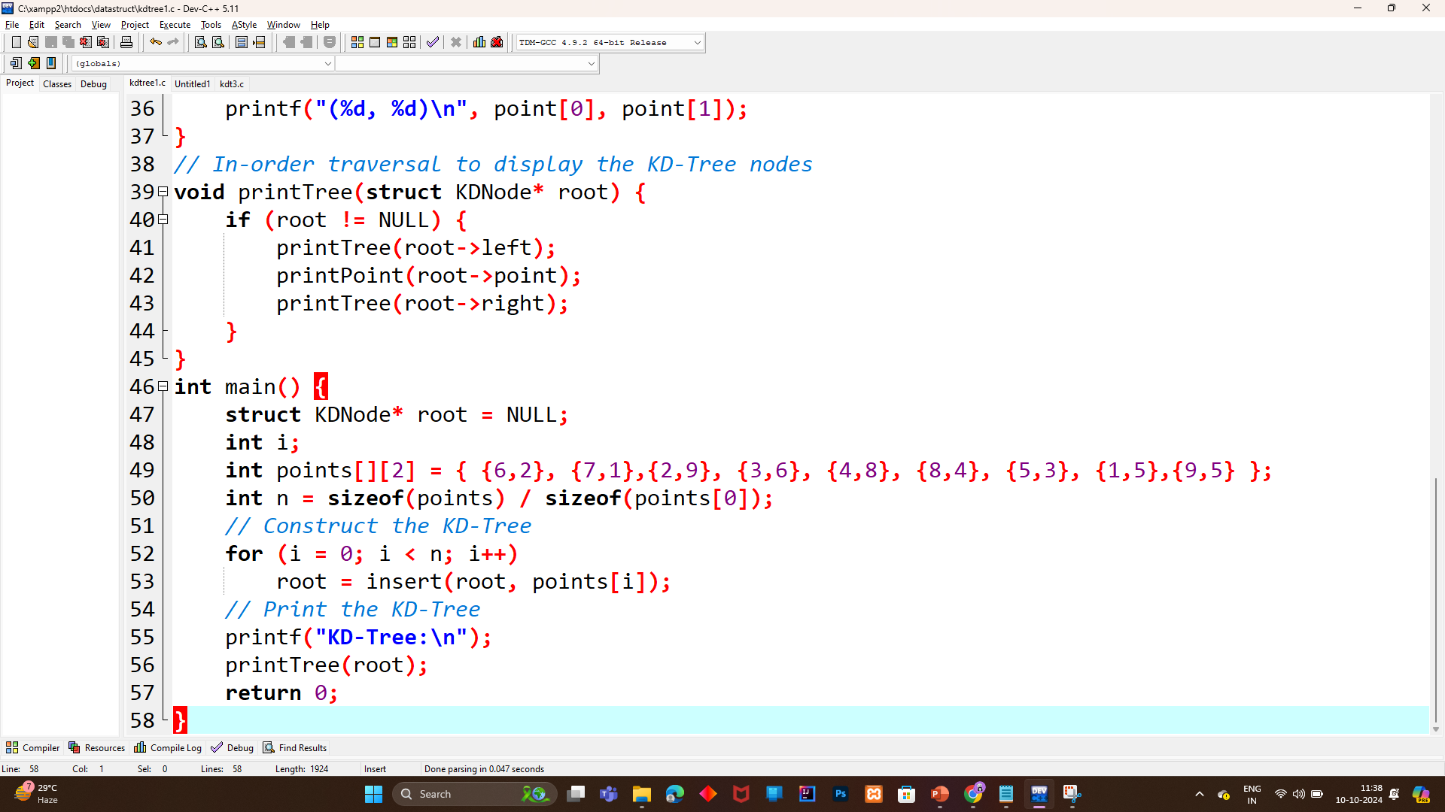

Slide 16
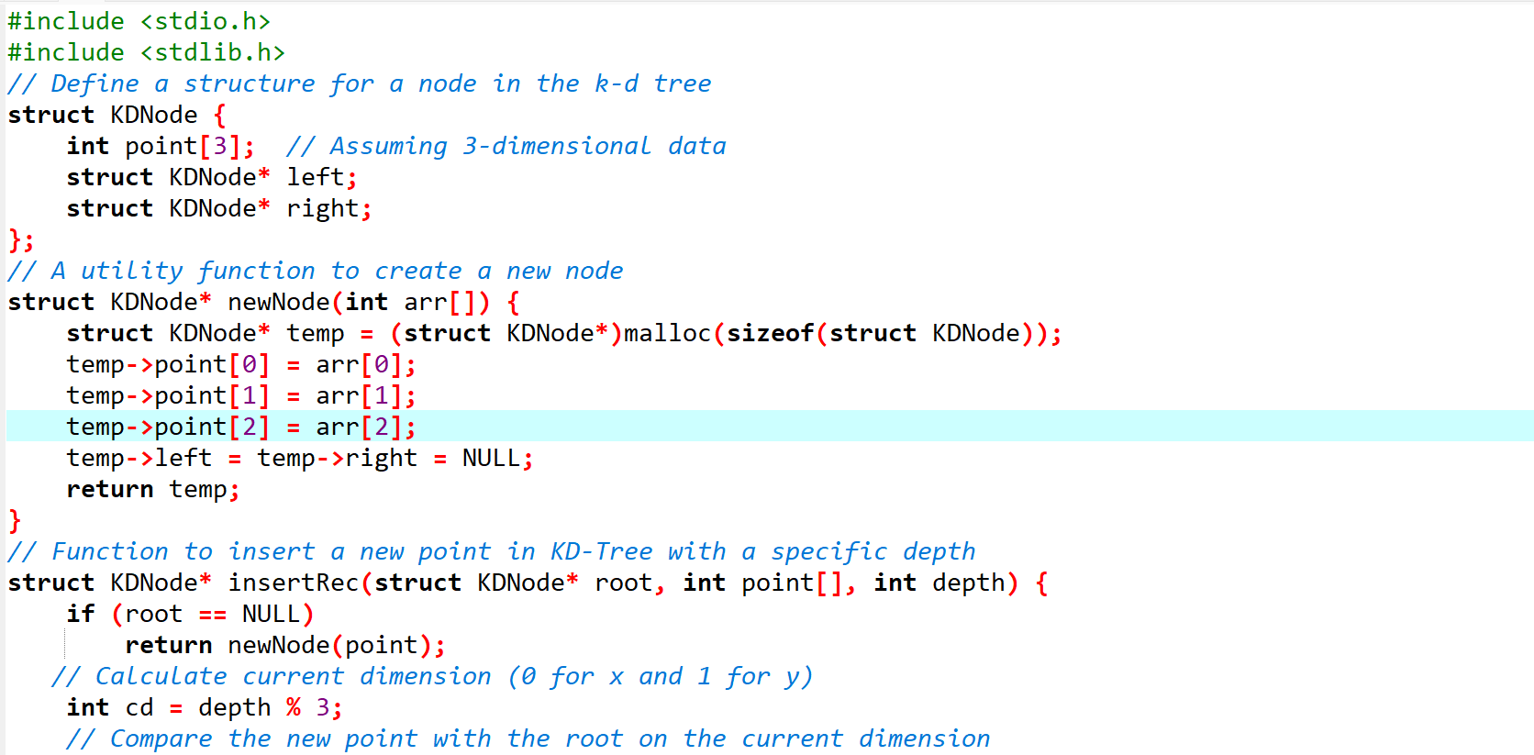
Code for Creating K-dimensional Trees (k=3)

Slide 17
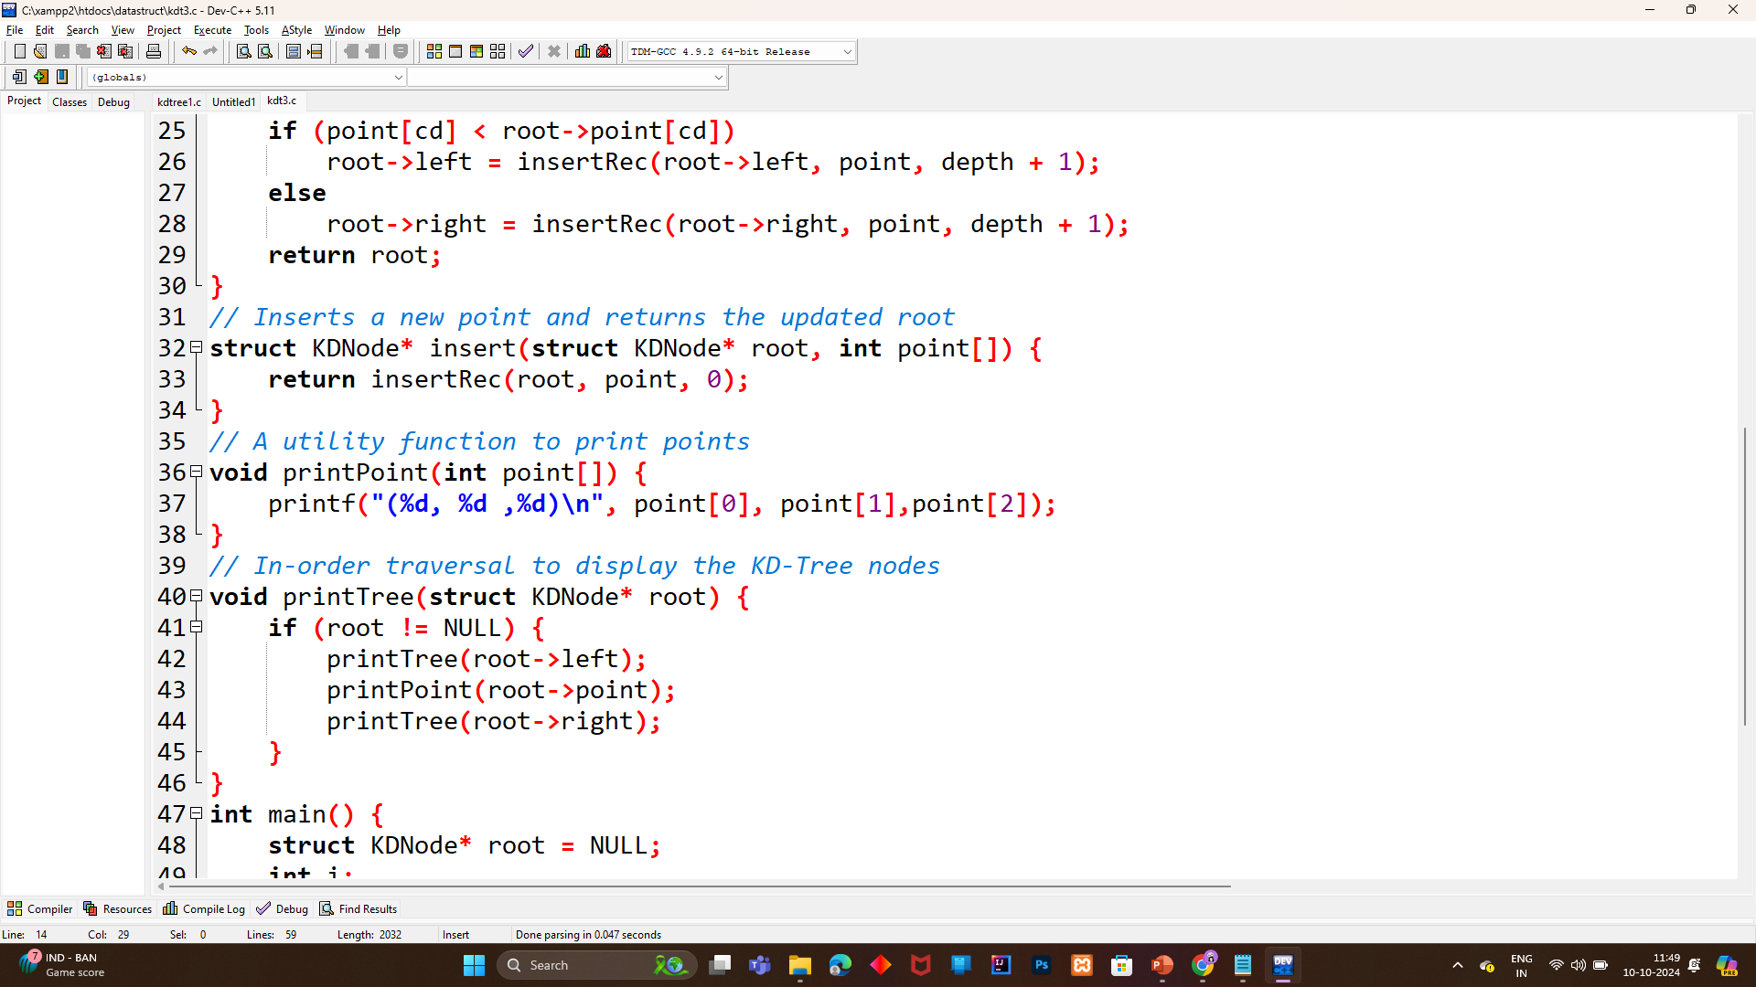

Slide 18
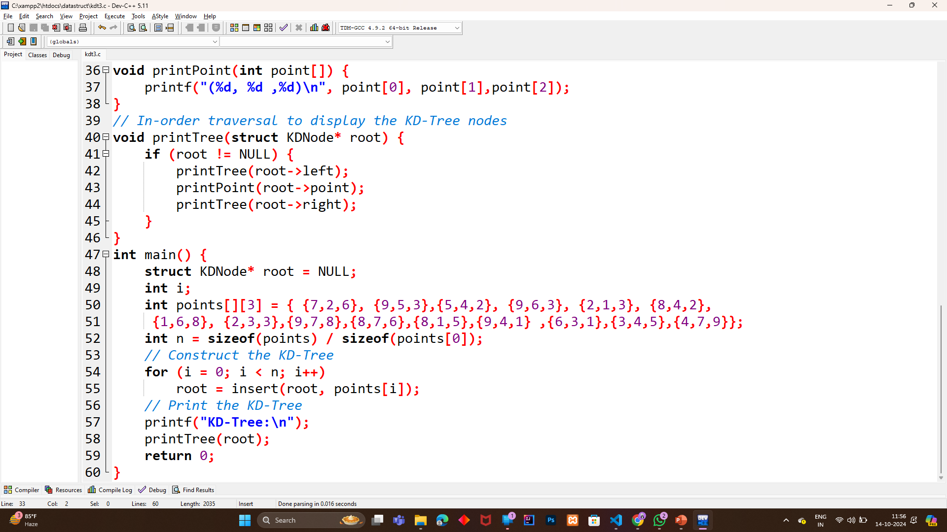

Slide 19
Thank You

