Slide 1
Word and Passage Embeddings
CS728
Soumen Chakrabarti

Slide 2
The company words keep
Finite labeled data, feature sparsity, and out-of-vocabulary (OOV) words/features have always troubled NLP tasks
E.g. we saw car in the training sequences but never sedan, or Shanghai in test data but only other cities in training data
But an unlabeled corpus has enough clues that these are related
A well-established partial fix is word cluster features
First proposed by IBM researchers in 1992
  {car, sedan, EV, convertible, …}₍₅₃₎
  {Shanghai, Beijing, Hong Kong, …}₍₅₅₎
  Cluster IDs 53, 55, etc., used as features
How to cluster? (next)
  “You shall know a word by the company it keeps.” —John Firth, 1957

Slide 3
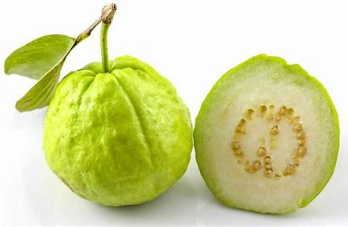


Distributional word bags
Guava contains nutrients such as vitamin C, lycopene and antioxidants.
How to Use Guava Leaves to Control Blood Sugar Level
Man Arrested For Attacking Boy Who Threw Stones At Guava Tree At His Home
For many of us, the guava tree is just a source of delicious and nutritious fruits.
{ nutrients, vitamin, sugar,
tree, delicious, fruits, …}
Sour, unripe mangoes are used in chutneys, pickles, daals and other side dishes
Aamras is a popular thick juice made of mangoes with sugar or milk.
In addition to their juicy tropical flavor, mangoes deliver nutritional value and healthy eating
Studies link mangoes to several health benefits, such as improved immunity and digestion
{chutneys, juice,
sugar, milk,
nutritional, …}
To ensure you receive a genuine Apple battery during a battery replacement…
The new Apple‑designed H2 chip is the force behind AirPods Pro…
Tech giant Apple is reportedly working on a standalone classical music application…
Amazon follows Apple in increasing music streaming prices
{battery, chip, music,
streaming, genuine, …}

Slide 4

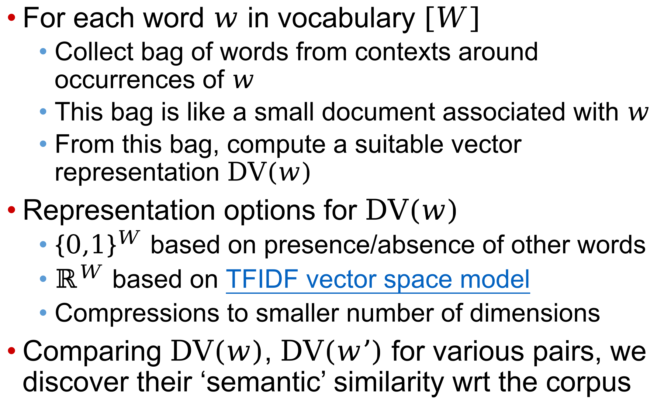
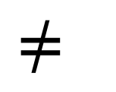
Distributional vectors (DVs)
For each word $w$ in vocabulary $\left[W\right]$
  Collect bag of words from contexts around occurrences of $w$
  This bag is like a small document associated with $w$
  From this bag, compute a suitable vector representation $DV\left(w\right)$
Representation options for $DV\left(w\right)$
  ${\left\{0,1\right\}}^{W}$ based on presence/absence of other words
  $ℝ^{W}$ based on TFIDF vector space model
  Compressions to smaller number of dimensions
Comparing $DV\left(w\right)$, $DV\left(w’\right)$ for various pairs, we discover their ‘semantic’ similarity wrt the corpus
$$≈$$
$$≠$$
$$≠$$

Slide 5
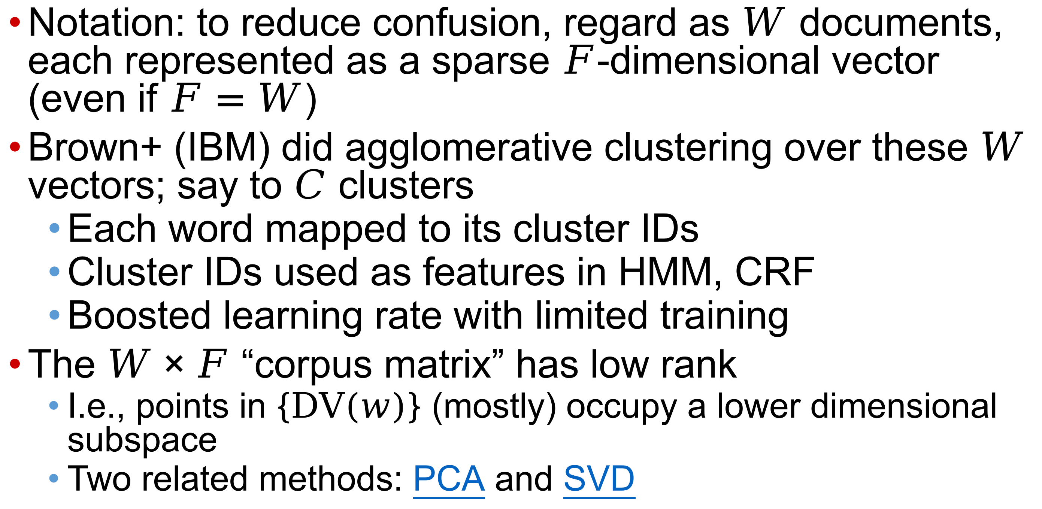
Clustering and rank
Notation: to reduce confusion, regard as $W$ documents, each represented as a sparse $F$-dimensional vector (even if $F=W$)
Brown+ (IBM) did agglomerative clustering over these $W$ vectors; say to $C$ clusters
  Each word mapped to its cluster IDs
  Cluster IDs used as features in HMM, CRF
  Boosted learning rate with limited training
The $W×F$ “corpus matrix” has low rank
  I.e., points in $\left\{DV\left(w\right)\right\}$ (mostly) occupy a lower dimensional subspace
  Two related methods: PCA and SVD

Slide 6
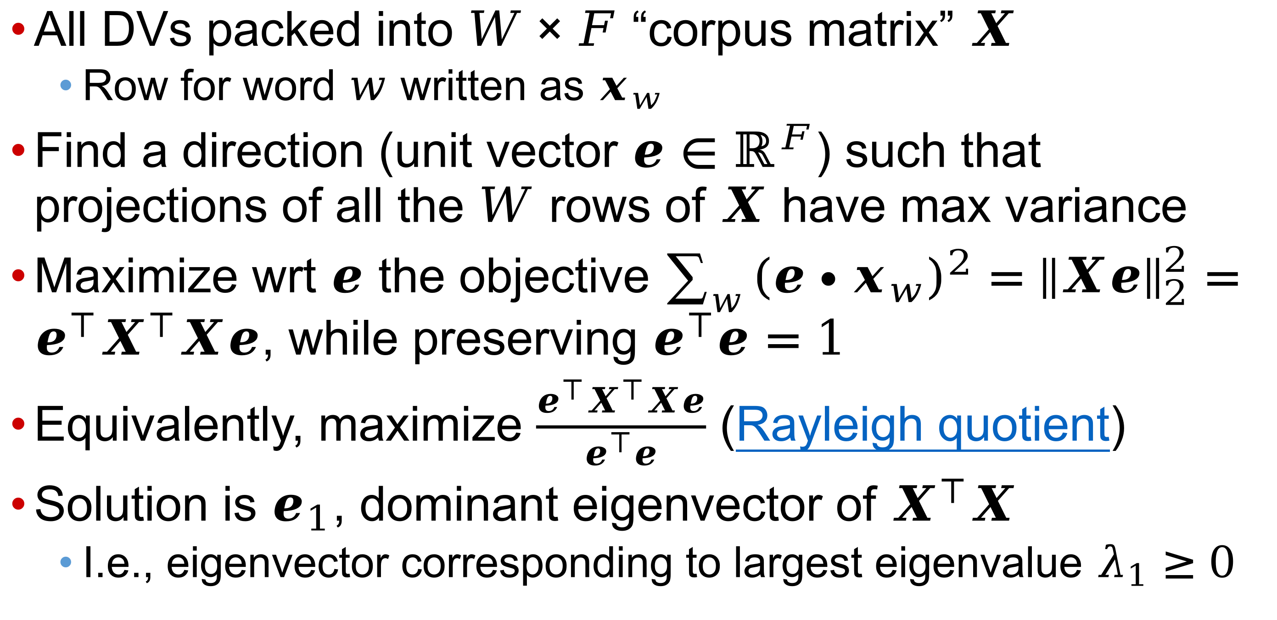
Low-rank structure of DVs
All DVs packed into $W×F$ “corpus matrix” $X$
  Row for word $w$ written as $x_{w}$
Find a direction (unit vector $e∈ℝ^{F}$) such that projections of all the $W$ rows of $X$ have max variance
Maximize wrt $e$ the objective $\sum_{w}{{\left(e∙x_{w}\right)}^{2}}={\left\|Xe\right\|}_{2}^{2}=e^{⊺}X^{⊺}Xe$, while preserving $e^{⊺}e=1$
Equivalently, maximize $\frac{e^{⊺}X^{⊺}Xe}{e^{⊺}e}$ (Rayleigh quotient)
Solution is $e_{1}$, dominant eigenvector of $X^{⊺}X$
  I.e., eigenvector corresponding to largest eigenvalue $λ_{1}≥0$

Slide 7
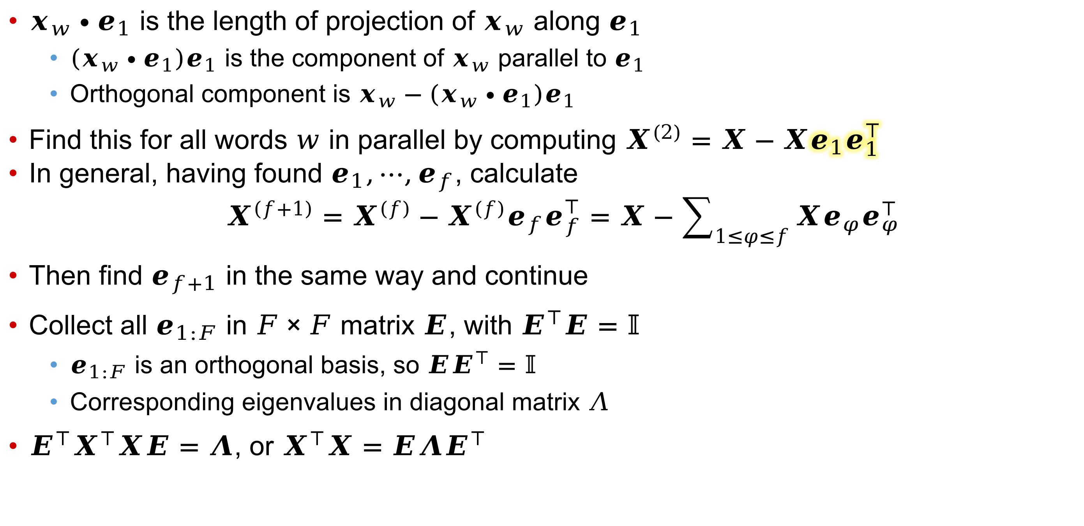
Orthogonal highest variance subspace
$x_{w}∙e_{1}$ is the length of projection of $x_{w}$ along $e_{1}$
  $\left(x_{w}∙e_{1}\right)e_{1}$ is the component of $x_{w}$ parallel to $e_{1}$
  Orthogonal component is $x_{w}−\left(x_{w}∙e_{1}\right)e_{1}$
Find this for all words $w$ in parallel by computing $X^{\left(2\right)}=X−Xe_{1}e_{1}^{⊺}$
In general, having found $e_{1},⋯,e_{f}$, calculate
$X^{\left(f+1\right)}=X^{\left(f\right)}−X^{\left(f\right)}e_{f}e_{f}^{⊺}=X−\sum_{1≤φ≤f}{Xe_{φ}e_{φ}^{⊺}}$
Then find $e_{f+1}$ in the same way and continue
Collect all $e_{1:F}$ in $F×F$ matrix $E$, with $E^{⊺}E=𝕀$
  $e_{1:F}$ is an orthogonal basis, so ${EE}^{⊺}=𝕀$
  Corresponding eigenvalues in diagonal matrix $Λ$
$E^{⊺}X^{⊺}XE=Λ$, or $X^{⊺}X=EΛE^{⊺}$

Slide 8
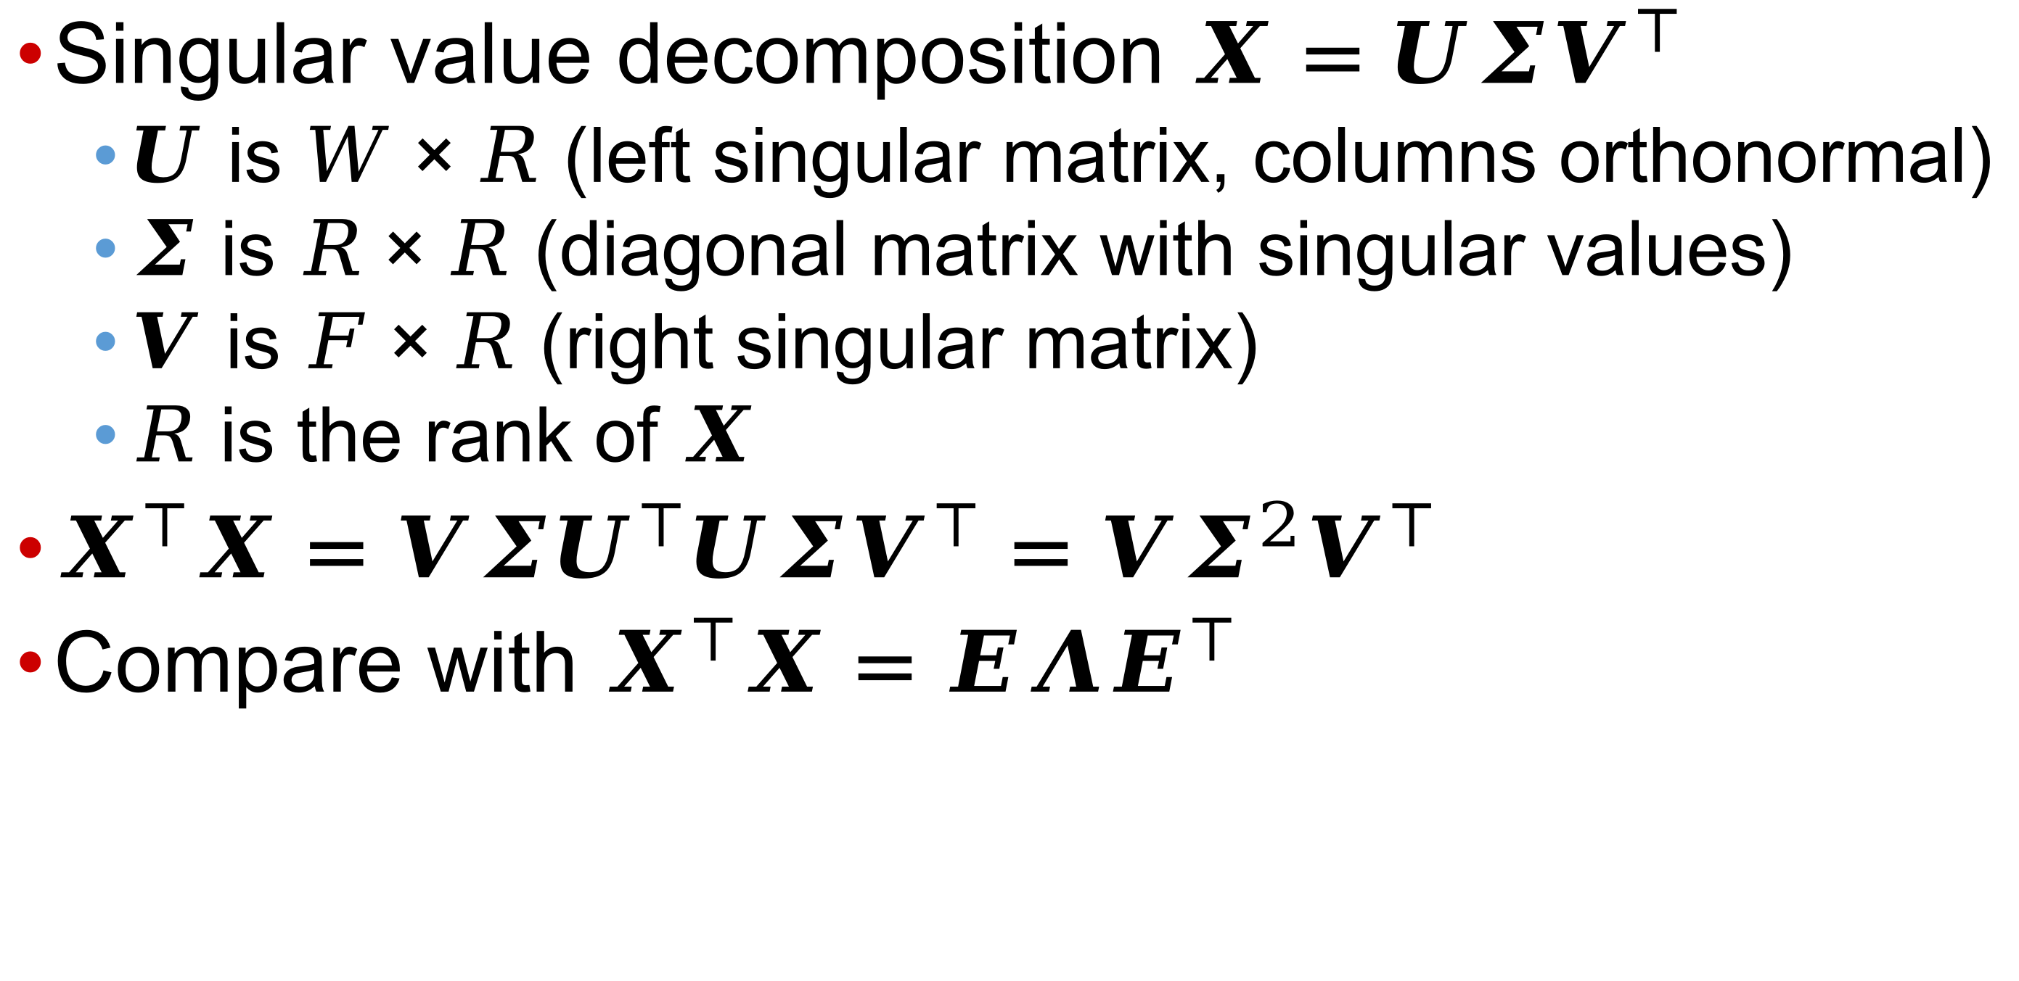
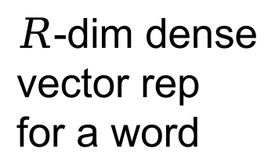

Equivalent decomposition of $X$
Singular value decomposition $X=UΣV^{⊺}$
  $U$ is $W×R$ (left singular matrix, columns orthonormal)
  $Σ$ is $R×R$ (diagonal matrix with singular values)
  $V$ is $F×R$ (right singular matrix)
  $R$ is the rank of $X$
$X^{⊺}X=VΣU^{⊺}UΣV^{⊺}=VΣ^{2}V^{⊺}$
Compare with $X^{⊺}X=EΛE^{⊺}$
Features
$$R$$
$$R$$
Words
$$≈$$
$R$-dim dense
vector rep
for a word

Slide 9
Passage window
In older works (IBM’s clustering, 1992; Bellcore’s Latent Semantic Indexing using SVD, 1993) on embedding words and documents, word-word cooccurrence was at a whole-document level
With word2vec and GloVE, from 2013 onward, cooccurrence was measured using much shorter windows
Structure of analysis of cooccurrence shares a lot between the two families

Slide 10
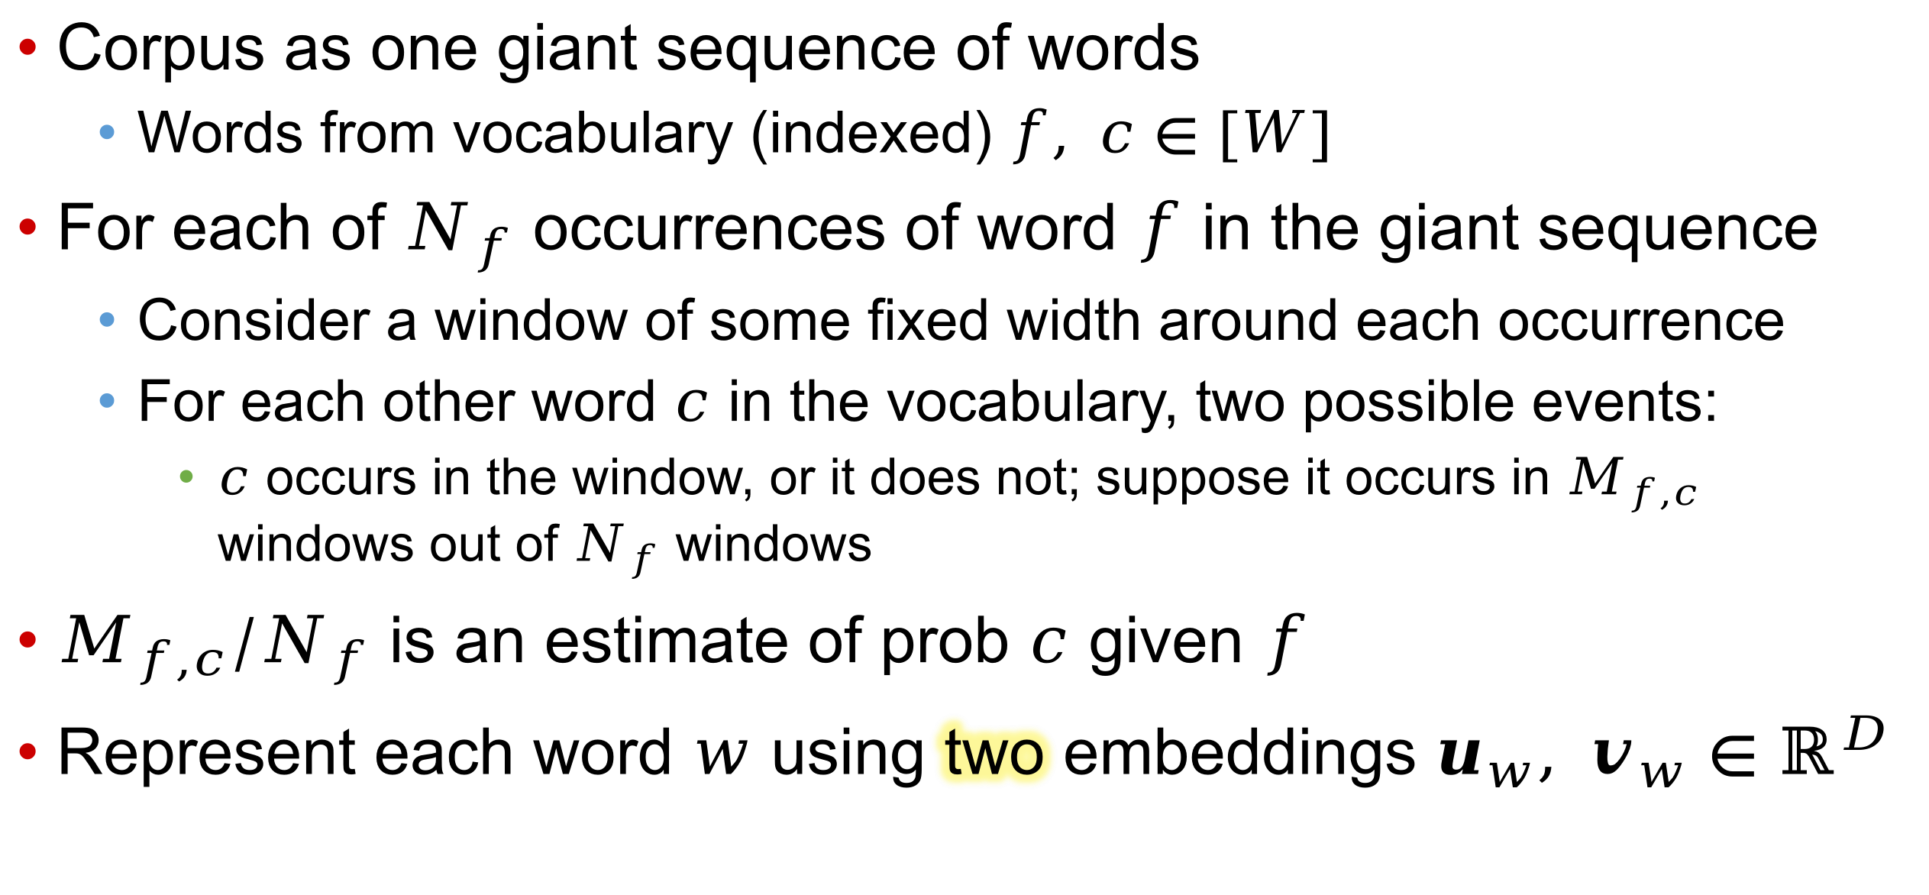

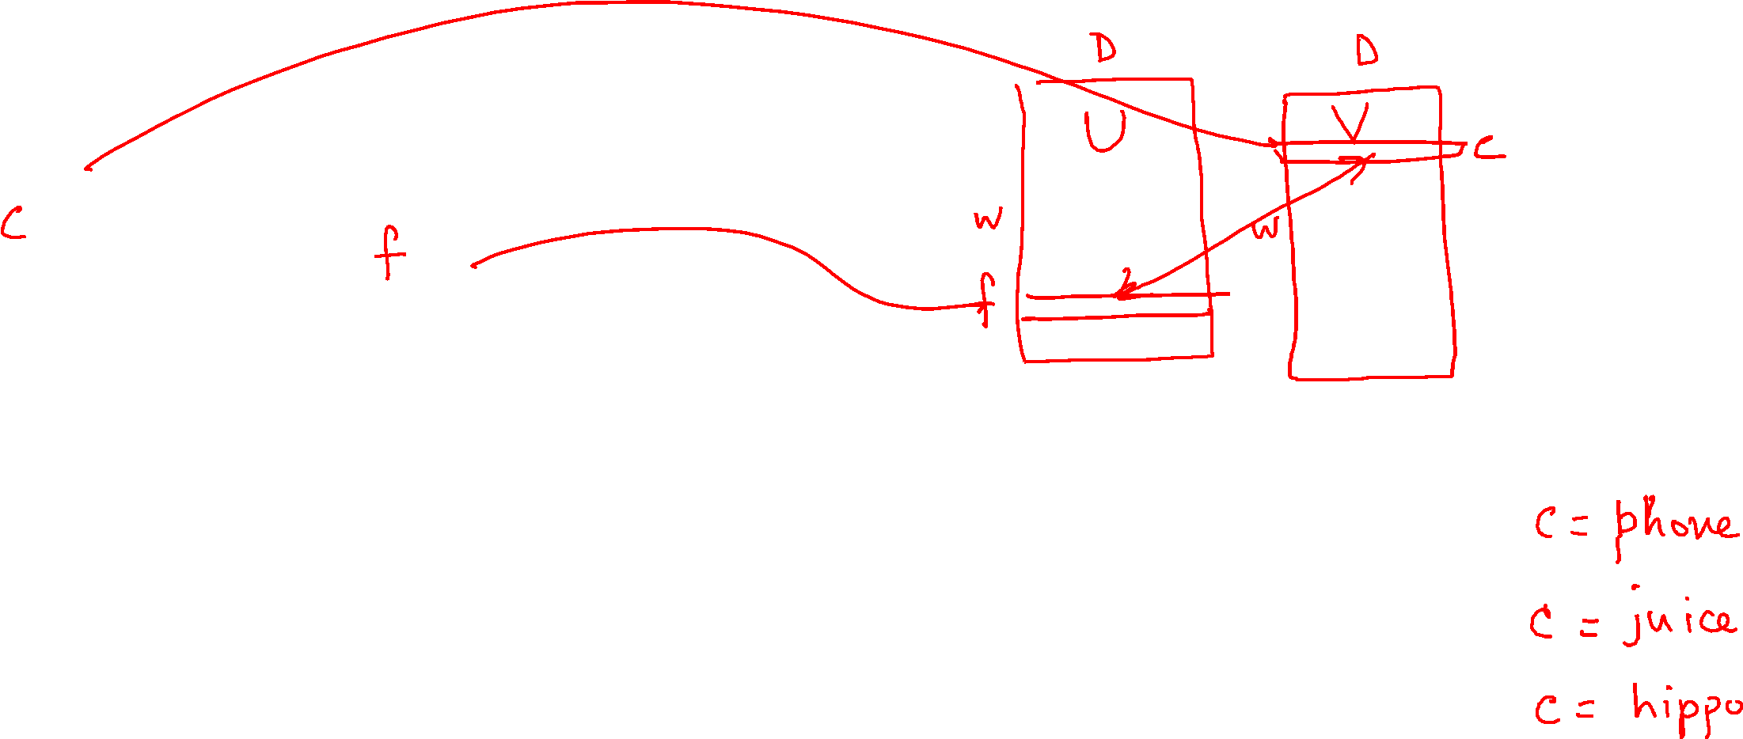
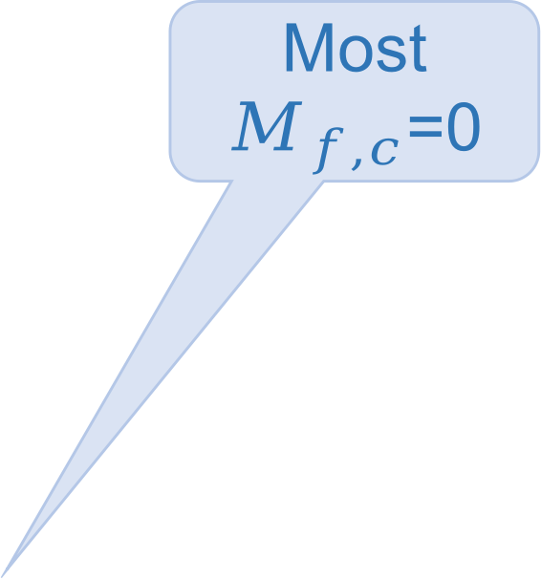
word2vec (2013)
apple
Corpus as one giant sequence of words
  Words from vocabulary (indexed) $f, c∈[W]$
For each of $N_{f}$ occurrences of word $f$ in the giant sequence
  Consider a window of some fixed width around each occurrence
  For each other word $c$ in the vocabulary, two possible events:
    $c$ occurs in the window, or it does not; suppose it occurs in $M_{f,c}$ windows out of $N_{f}$ windows
$M_{f,c}/N_{f}$ is an estimate of prob $c$ given $f$
Represent each word $w$ using two embeddings $u_{w}, v_{w}∈ℝ^{D}$
Most $M_{f,c}$=0
Collectively
$U, V∈ℝ^{W×D}$

Slide 11
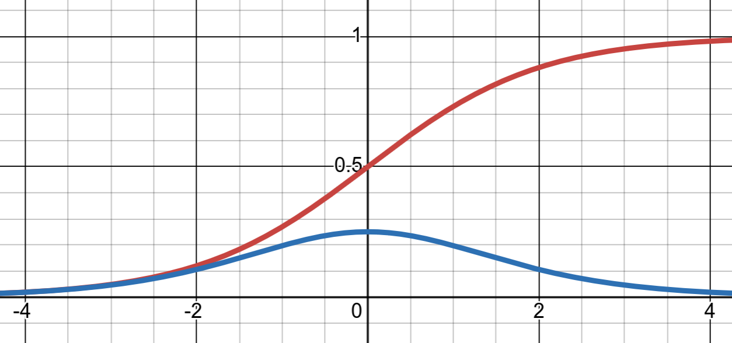
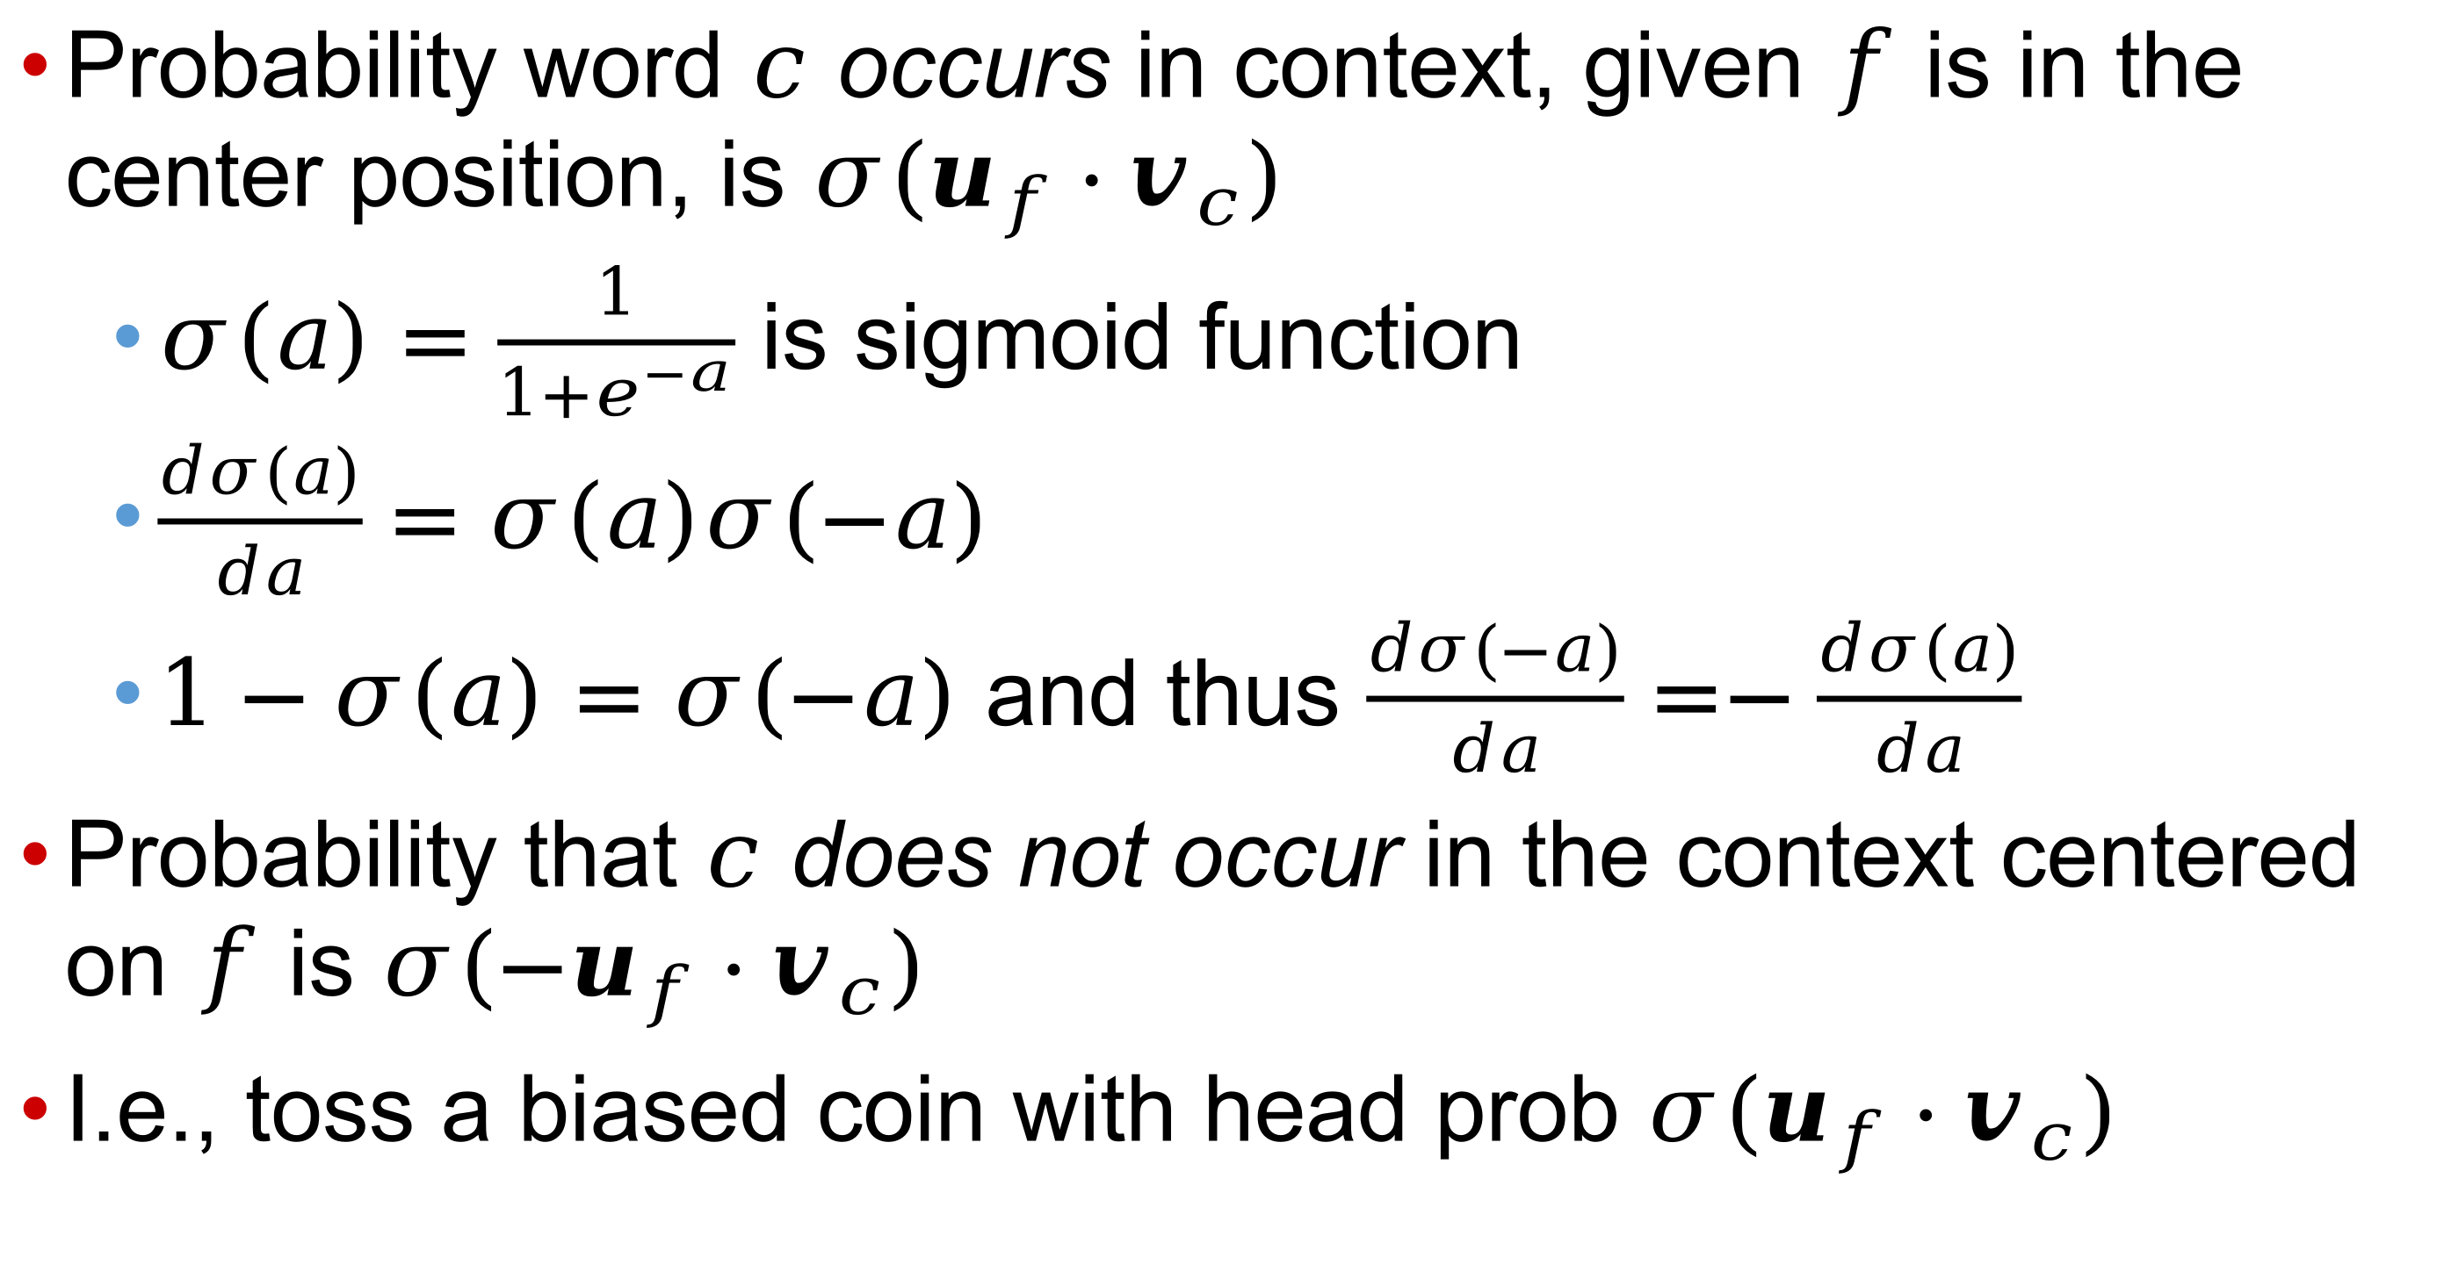

Probability model
Probability word $c$ occurs in context, given $f$ is in the center position, is $σ(u_{f}⋅v_{c})$
  $σ\left(a\right)=\frac{1}{1+e^{−a}}$ is sigmoid function
  $\frac{dσ(a)}{da}=σ\left(a\right)σ(−a)$
  $1−σ\left(a\right)=σ\left(−a\right)$ and thus $\frac{dσ(−a)}{da}=−\frac{dσ(a)}{da}$
Probability that $c$ does not occur in the context centered on $f$ is $σ(−u_{f}⋅v_{c})$
I.e., toss a biased coin with head prob $σ(u_{f}⋅v_{c})$

Slide 12
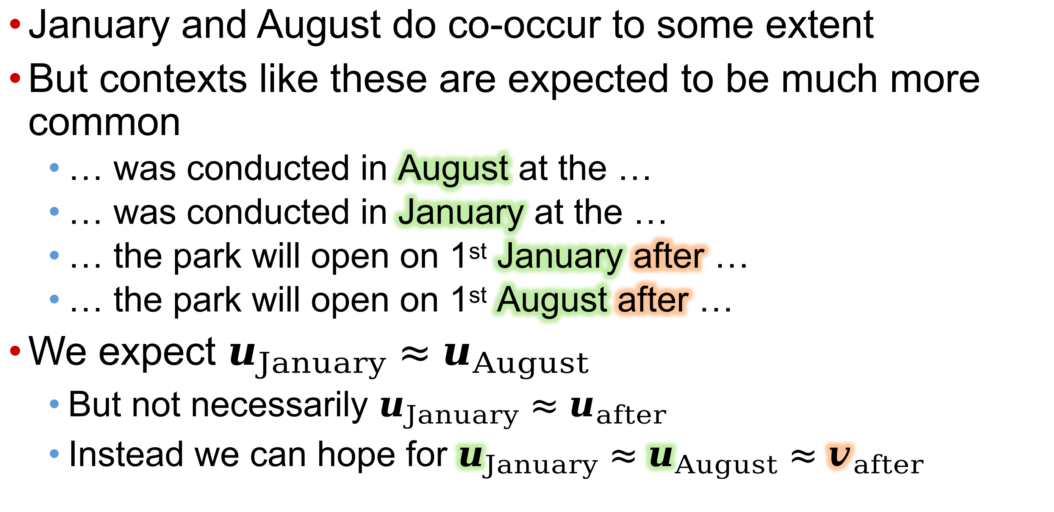
Why two embeddings $u_{w}, v_{w}$per word?
January and August do co-occur to some extent
But contexts like these are expected to be much more common
  … was conducted in August at the …
  … was conducted in January at the …
  … the park will open on 1st January after …
  … the park will open on 1st August after …
We expect $u_{January}≈u_{August}$
  But not necessarily $u_{January}≈u_{after}$
  Instead we can hope for $u_{January}≈u_{August}≈v_{after}$

Slide 13
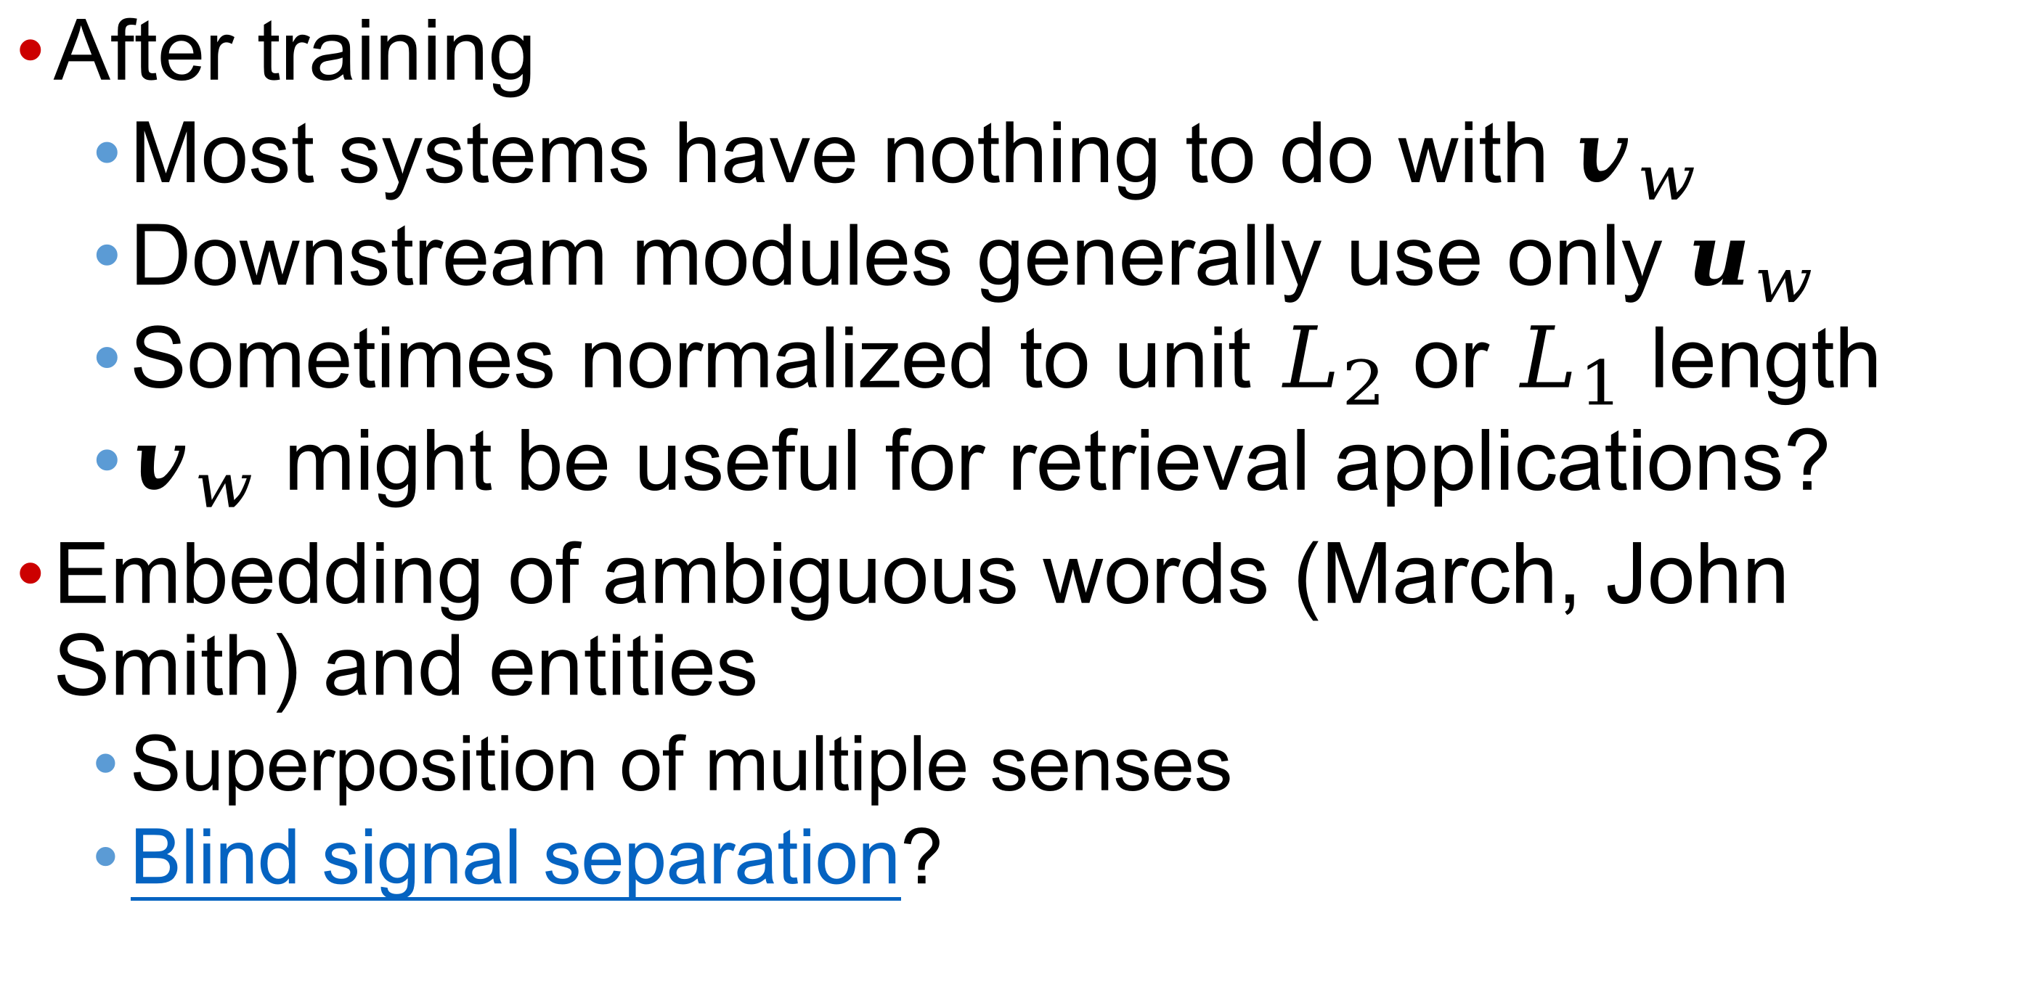
Further comments on $u_{w}, v_{w}$
After training
  Most systems have nothing to do with $v_{w}$
  Downstream modules generally use only $u_{w}$
  Sometimes normalized to unit $L_{2}$ or $L_{1}$ length
  $v_{w}$ might be useful for retrieval applications?
Embedding of ambiguous words (March, John Smith) and entities
  Superposition of multiple senses
  Blind signal separation?

Slide 14
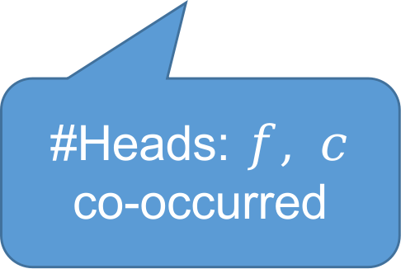
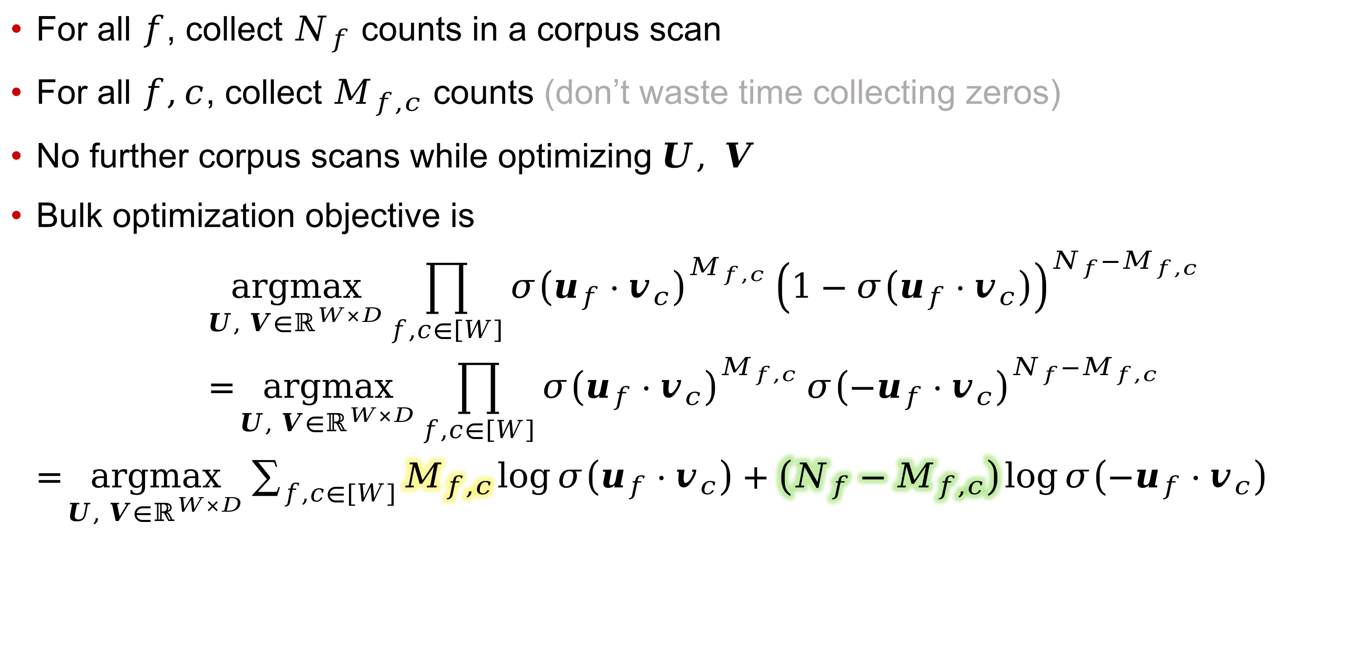
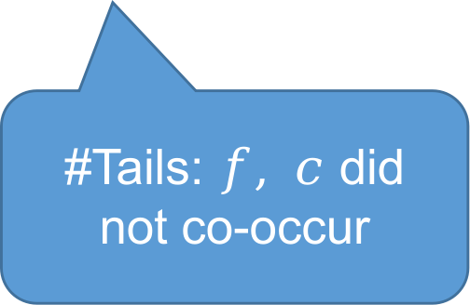
word2vec bulk training
For all $f$, collect $N_{f}$ counts in a corpus scan
For all $f,c$, collect $M_{f,c}$ counts (don’t waste time collecting zeros)
No further corpus scans while optimizing $U, V$
Bulk optimization objective is
$\underset{U, V∈ℝ^{W×D}}{argmax}{\prod_{f,c∈\left[W\right]}{σ{\left(u_{f}⋅v_{c}\right)}^{M_{f,c}}}{\left(1−σ\left(u_{f}⋅v_{c}\right)\right)}^{N_{f}−M_{f,c}}}$
$=\underset{U, V∈ℝ^{W×D}}{argmax}{\prod_{f,c∈\left[W\right]}{σ{\left(u_{f}⋅v_{c}\right)}^{M_{f,c}}}{σ\left({−u}_{f}⋅v_{c}\right)}^{N_{f}−M_{f,c}}}$
$=\underset{U, V∈ℝ^{W×D}}{argmax}{\sum_{f,c∈\left[W\right]}{M_{f,c}\log{σ\left(u_{f}⋅v_{c}\right)+\left(N_{f}−M_{f,c}\right)\log{σ\left({−u}_{f}⋅v_{c}\right)}}}}$
#Heads: $f, c$
co-occurred
#Tails: $f, c$ did
not co-occur

Slide 15
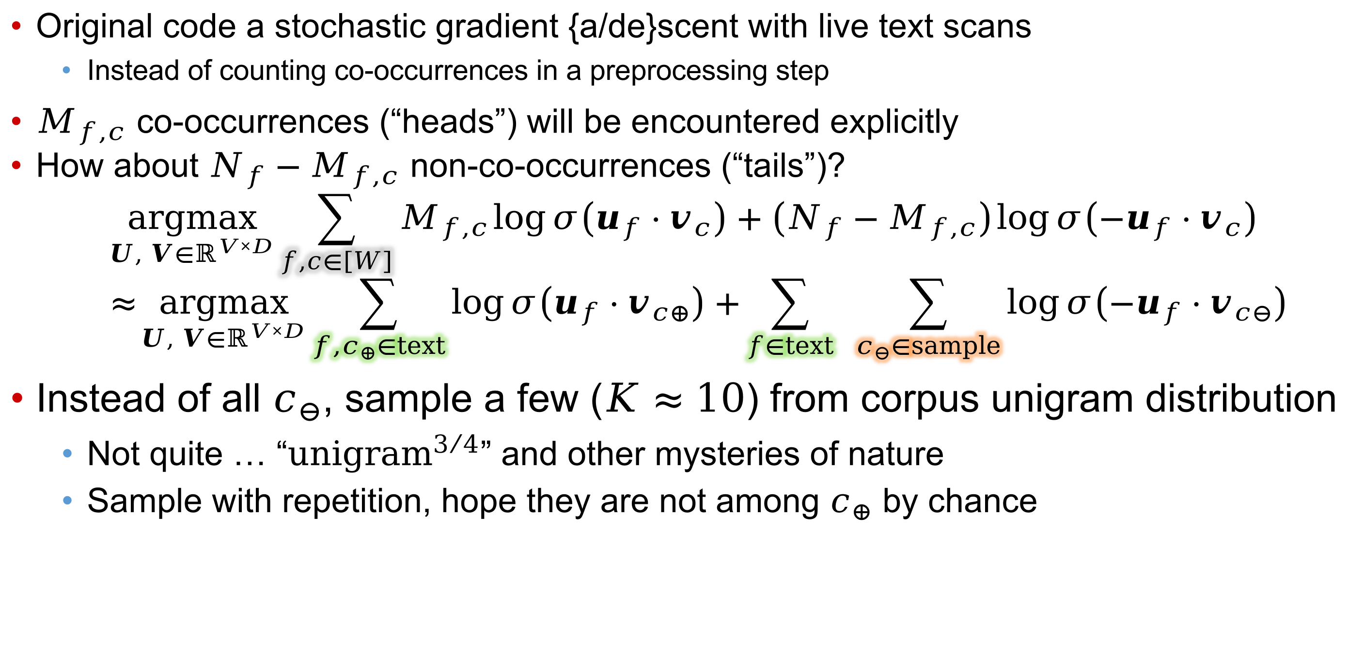
Stochastic gradient ascent
Original code a stochastic gradient {a/de}scent with live text scans
  Instead of counting co-occurrences in a preprocessing step
$M_{f,c}$ co-occurrences (“heads”) will be encountered explicitly
How about $N_{f}−M_{f,c}$ non-co-occurrences (“tails”)?
$\underset{U, V∈ℝ^{V×D}}{argmax}{\sum_{f,c∈\left[W\right]}{M_{f,c}\log{σ\left(u_{f}⋅v_{c}\right)+\left(N_{f}−M_{f,c}\right)\log{σ\left({−u}_{f}⋅v_{c}\right)}}}}$
$≈\underset{U, V∈ℝ^{V×D}}{argmax}{\sum_{{f,c}_{⊕}∈text}{\log{σ\left(u_{f}⋅v_{c⊕}\right)}+}\sum_{f∈text}{ \sum_{c_{⊖}∈sample}{\log{σ\left({−u}_{f}⋅v_{c⊖}\right)}}}}$
Instead of all $c_{⊖}$, sample a few ($K≈10$) from corpus unigram distribution
  Not quite … “${\text{unigram}}^{3/4}$” and other mysteries of nature
  Sample with repetition, hope they are not among $c_{⊕}$ by chance

Slide 16
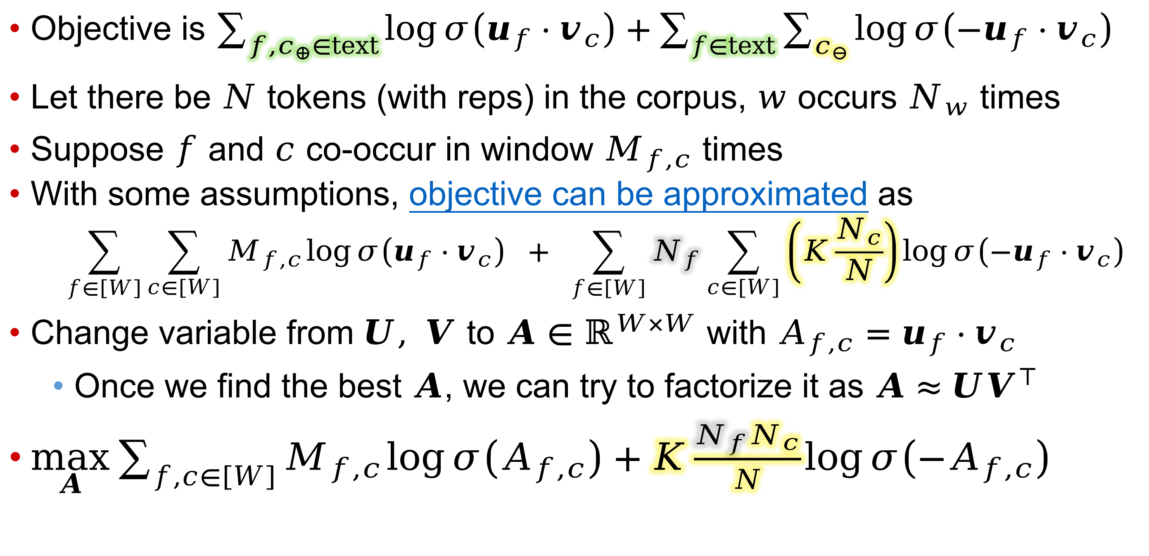
Solution
Objective is $\sum_{{f,c}_{⊕}∈text}{\log{σ\left(u_{f}⋅v_{c}\right)}+}\sum_{f∈text}{\sum_{c_{⊖}}{\log{σ\left({−u}_{f}⋅v_{c}\right)}}}$
Let there be $N$ tokens (with reps) in the corpus, $w$ occurs $N_{w}$ times
Suppose $f$ and $c$ co-occur in window $M_{f,c}$ times
With some assumptions, objective can be approximated as
$\sum_{f∈\left[W\right]}{\sum_{c∈\left[W\right]}{M_{f,c}\log{σ\left(u_{f}⋅v_{c}\right)}}} + \sum_{f∈\left[W\right]}{N_{f}}\sum_{c∈\left[W\right]}{\left(K\frac{N_{c}}{N}\right)\log{σ\left({−u}_{f}⋅v_{c}\right)}}$
Change variable from $U, V$ to $A∈ℝ^{W×W}$ with $A_{f,c}=$ $u_{f}⋅v_{c}$
  Once we find the best $A$, we can try to factorize it as $A≈UV^{⊤}$
$\max_{A}{\sum_{f,c∈\left[W\right]}{M_{f,c}\log{σ\left(A_{f,c}\right)}+K\frac{N_{f}N_{c}}{N}\log{σ\left({−A}_{f,c}\right)}}}$
One way to factorize $A≈UV^{⊤}$, once $A$ is fixed, is to alternately fix $U$ and update $V$, then fix $V$ and update $U$, each via gradient descent (no guarantees)

Slide 17
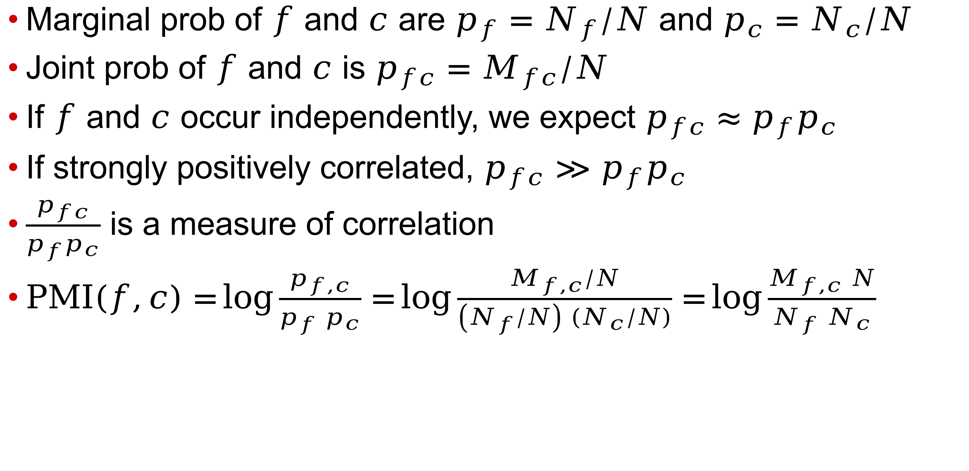
Pointwise mutual information (PMI)
Marginal prob of $f$ and $c$ are $p_{f}=N_{f}/N$ and $p_{c}=N_{c}/N$
Joint prob of $f$ and $c$ is $p_{fc}=M_{fc}/N$
If $f$ and $c$ occur independently, we expect $p_{fc}≈p_{f}p_{c}$
If strongly positively correlated, $p_{fc}≫p_{f}p_{c}$
$\frac{p_{fc}}{p_{f}p_{c}}$ is a measure of correlation
$PMI\left(f,c\right)=\log{\frac{p_{f,c}}{p_{f} p_{c}}}=\log{\frac{M_{f,c}/N}{\left(N_{f}/N\right) \left(N_{c}/N\right)}}=\log{\frac{M_{f,c} N}{N_{f} N_{c}}}$

Slide 18

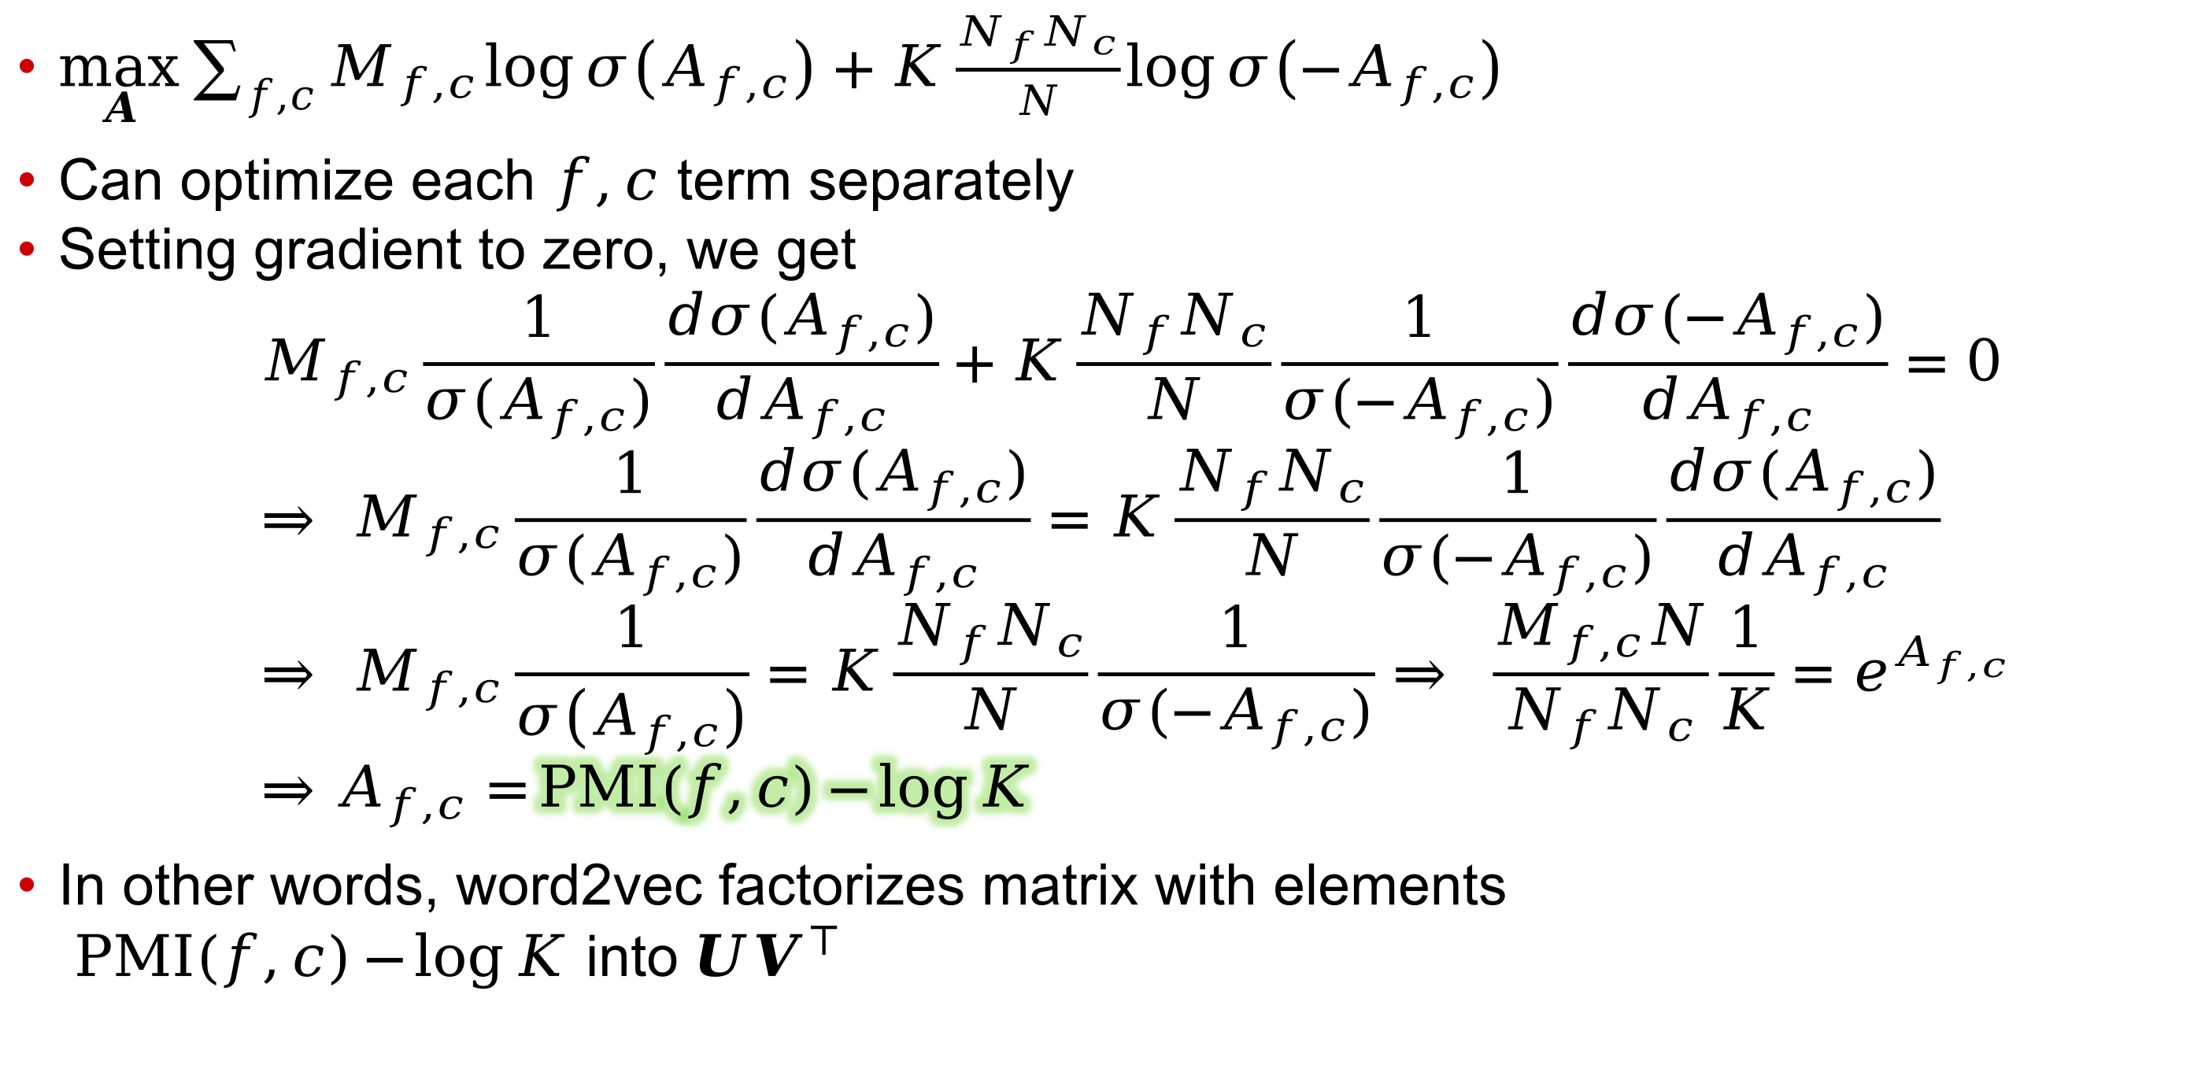
Solution, continued
$\max_{A}{\sum_{f,c}{M_{f,c}\log{σ\left(A_{f,c}\right)}+K\frac{N_{f}N_{c}}{N}\log{σ\left({−A}_{f,c}\right)}}}$
Can optimize each $f,c$ term separately
Setting gradient to zero, we get
$M_{f,c}\frac{1}{σ(A_{f,c})}\frac{dσ(A_{f,c})}{dA_{f,c}}+K\frac{N_{f}N_{c}}{N}\frac{1}{σ({−A}_{f,c})}\frac{dσ({−A}_{f,c})}{dA_{f,c}}=0$
$⇒ M_{f,c}\frac{1}{σ(A_{f,c})}\frac{dσ(A_{f,c})}{dA_{f,c}}=K\frac{N_{f}N_{c}}{N}\frac{1}{σ({−A}_{f,c})}\frac{dσ(A_{f,c})}{dA_{f,c}}$
$⇒ M_{f,c}\frac{1}{σ\left(A_{f,c}\right)}=K\frac{N_{f}N_{c}}{N}\frac{1}{σ({−A}_{f,c})}⇒ \frac{M_{f,c}N}{N_{f}N_{c}}\frac{1}{K}=e^{A_{f,c}}$
$⇒A_{f,c}=PMI\left(f,c\right){−\log{K}}$
In other words, word2vec factorizes matrix with elements
$PMI\left(f,c\right){−\log{K}}$ into $UV^{⊤}$

Slide 19
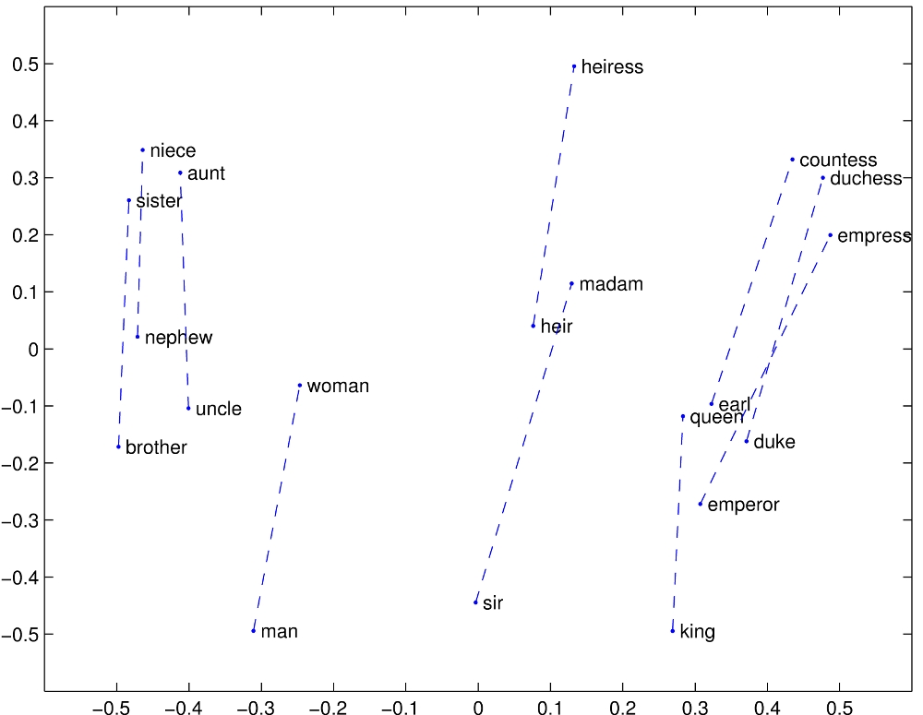
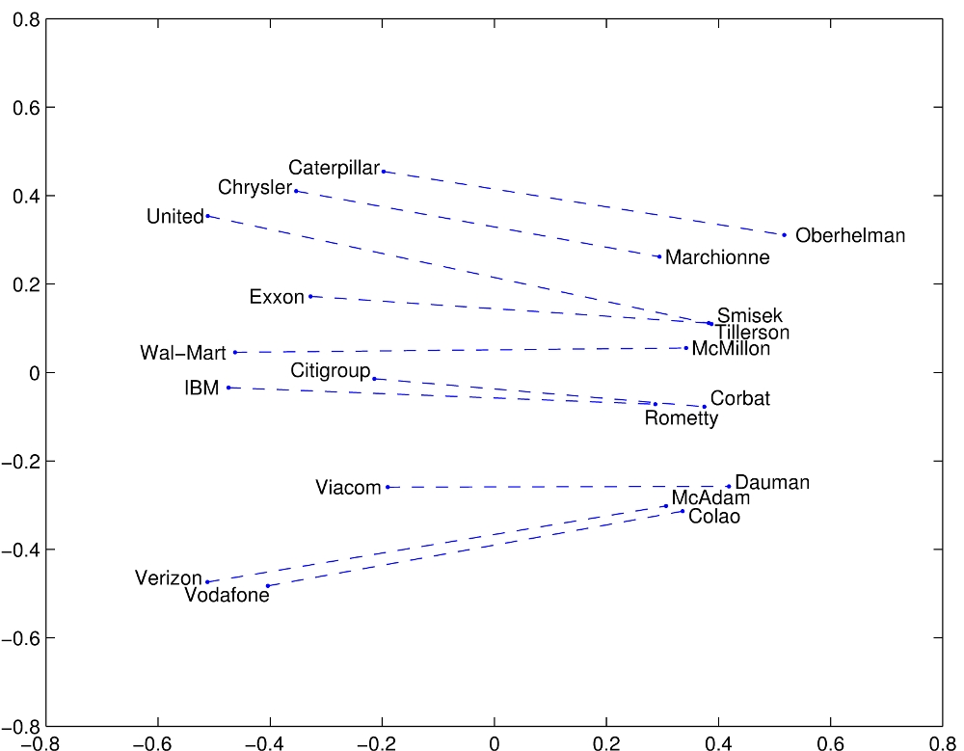
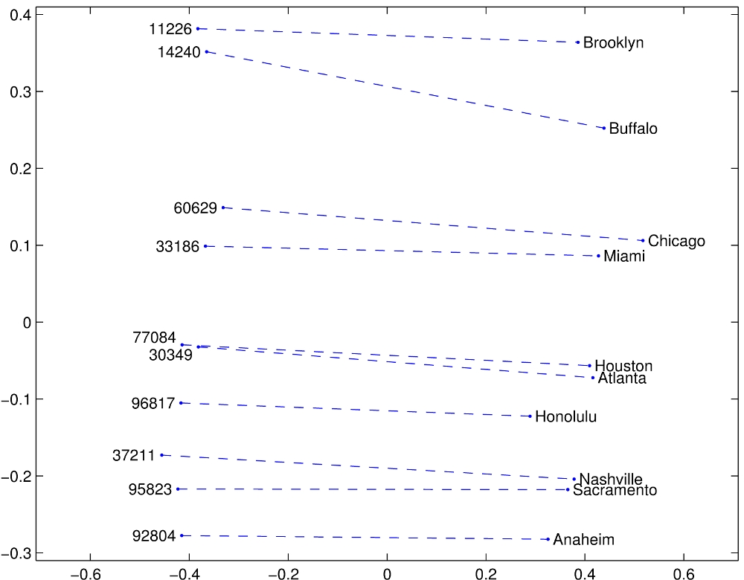
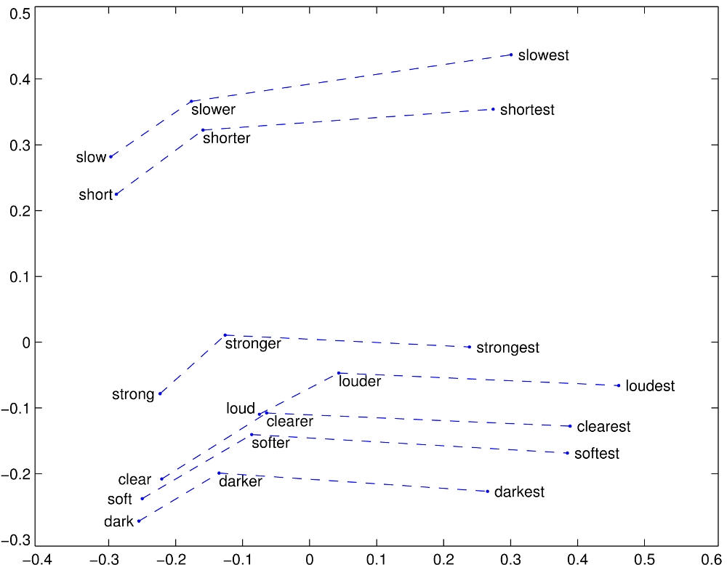
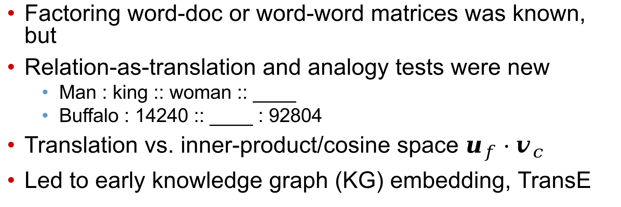
Relation $≈$ linear translation
Factoring word-doc or word-word matrices was known, but
Relation-as-translation and analogy tests were new
  Man : king :: woman :: ____
  Buffalo : 14240 :: ____ : 92804
Translation vs. inner-product/cosine space $u_{f}⋅v_{c}$
Led to early knowledge graph (KG) embedding, TransE
GloVe: Global Vectors for Word Representation (stanford.edu)

Slide 20
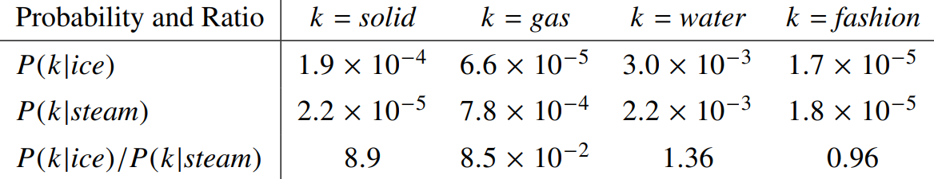

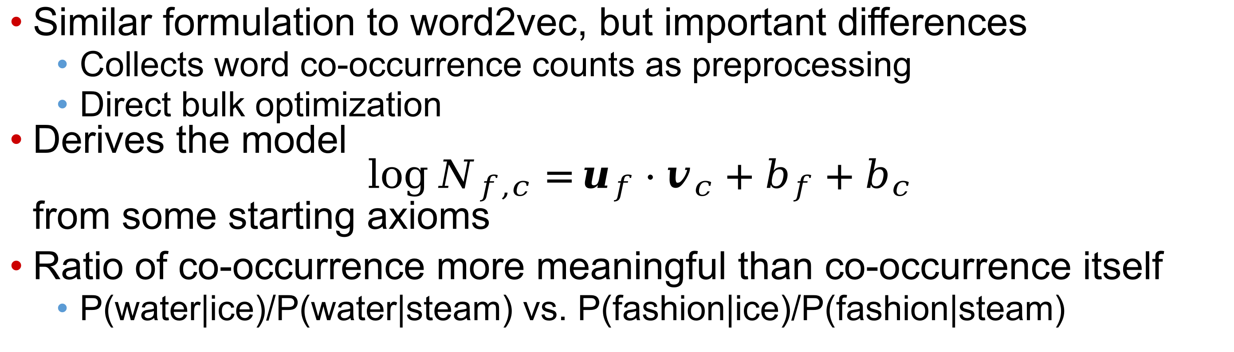
GloVe (Global Vectors)
Similar formulation to word2vec, but important differences
  Collects word co-occurrence counts as preprocessing
  Direct bulk optimization
Derives the model
$\log{N_{f,c}=}u_{f}⋅v_{c}+b_{f}+b_{c}$
from some starting axioms
Ratio of co-occurrence more meaningful than co-occurrence itself
  P(water|ice)/P(water|steam) vs. P(fashion|ice)/P(fashion|steam)
$b_{w}∈ℝ$ is a popularity/bias term for each word

Slide 21
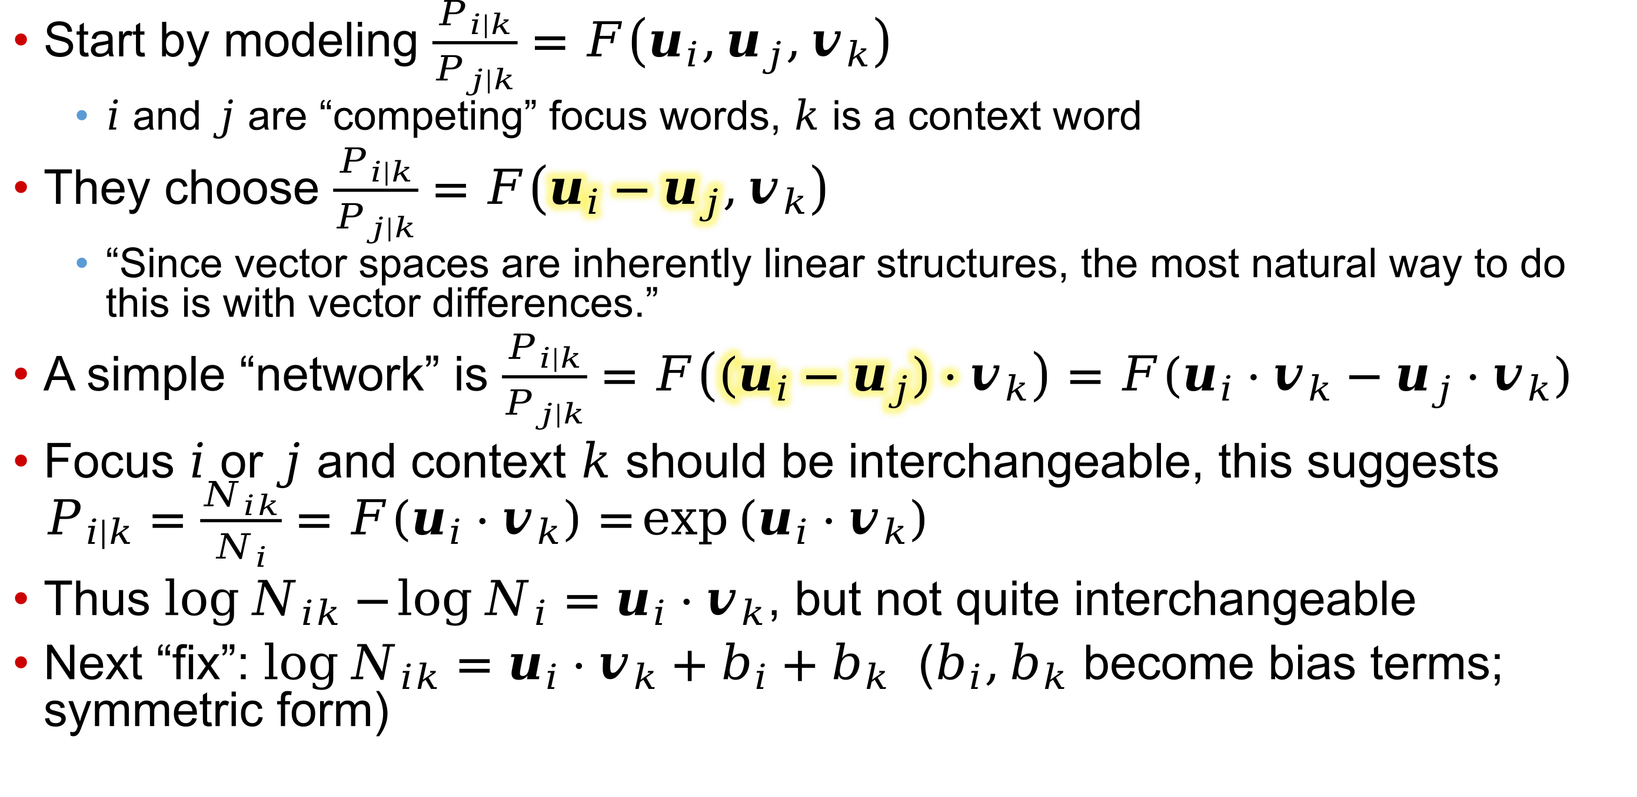
GloVe model design
Start by modeling $\frac{P_{i|k}}{P_{j|k}}=F\left(u_{i},u_{j},v_{k}\right)$
  $i$ and $j$ are “competing” focus words, $k$ is a context word
They choose $\frac{P_{i|k}}{P_{j|k}}=F\left(u_{i}−u_{j},v_{k}\right)$
  “Since vector spaces are inherently linear structures, the most natural way to do this is with vector differences.”
A simple “network” is $\frac{P_{i|k}}{P_{j|k}}=F\left({(u}_{i}−u_{j})⋅v_{k}\right)=F(u_{i}⋅v_{k}−u_{j}⋅v_{k})$
Focus $i$ or $j$ and context $k$ should be interchangeable, this suggests $P_{i|k}=\frac{N_{ik}}{N_{i}}=F\left(u_{i}⋅v_{k}\right)=\exp\left(u_{i}⋅v_{k}\right)$
Thus $\log{N_{ik}}−\log{N_{i}}=$ $u_{i}⋅v_{k}$, but not quite interchangeable
Next “fix”: $\log{N_{ik}}=u_{i}⋅v_{k}+b_{i}+b_{k}$ ($b_{i},b_{k}$ become bias terms; symmetric form)

Slide 22
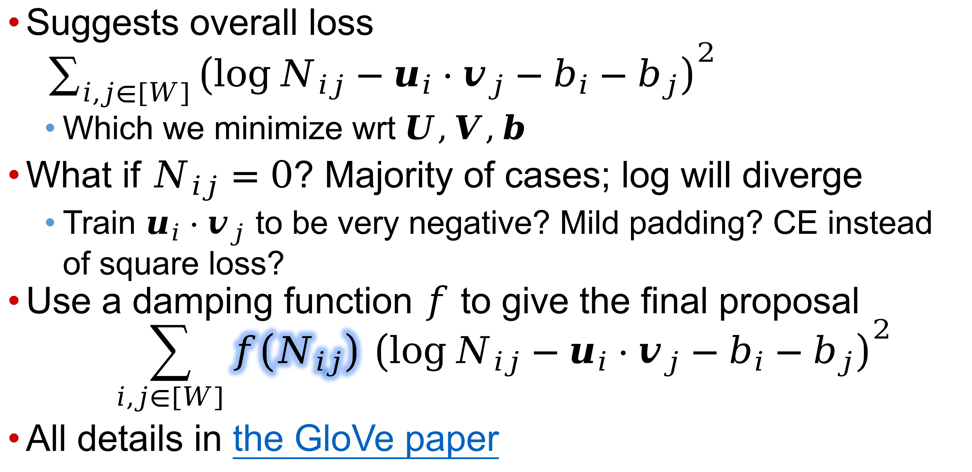
GloVe: finishing up
Suggests overall loss
$\sum_{i,j∈[W]}{{\left(\log{N_{ij}}−u_{i}⋅v_{j}−b_{i}−b_{j}\right)}^{2}}$
  Which we minimize wrt $U,V,b$
What if $N_{ij}=0$? Majority of cases; log will diverge
  Train $u_{i}⋅v_{j}$ to be very negative? Mild padding? CE instead of square loss?
Use a damping function $f$ to give the final proposal
$\sum_{i,j∈[W]}{f\left(N_{ij}\right) {\left(\log{N_{ij}}−u_{i}⋅v_{j}−b_{i}−b_{j}\right)}^{2}}$
All details in the GloVe paper
Also happens in collaborative recommendation

Slide 23
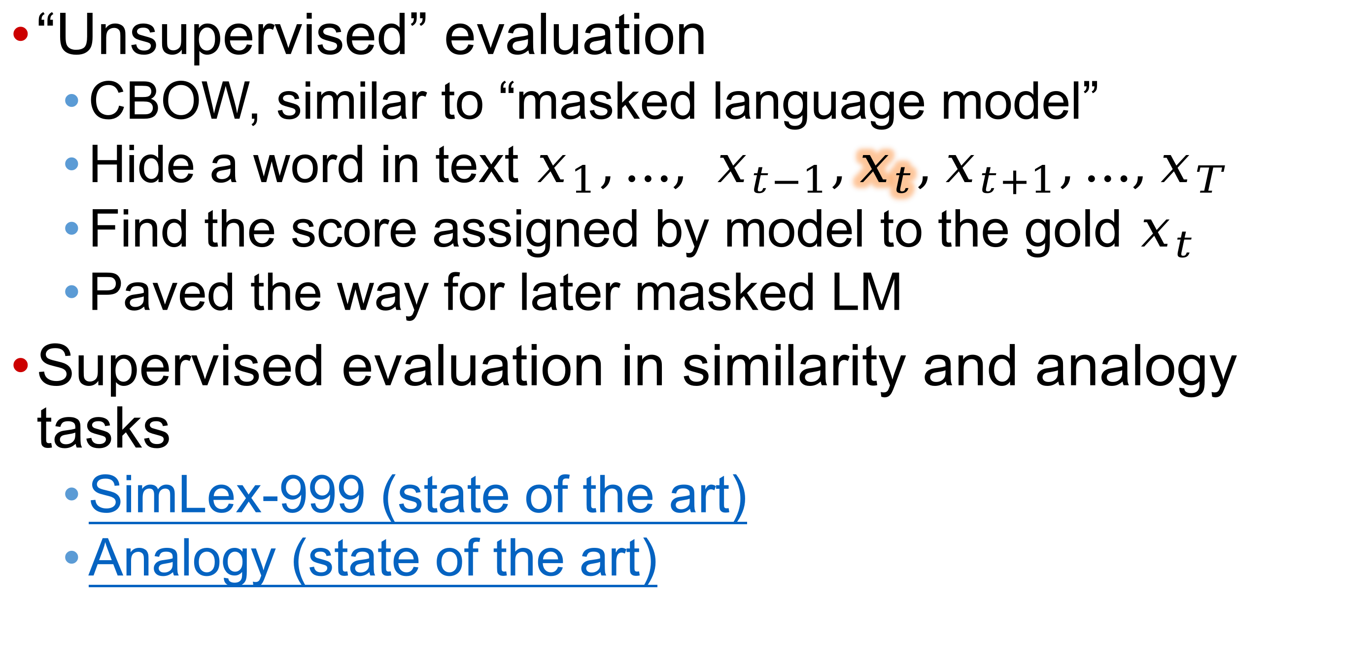
Word vector evaluation (two forms)
“Unsupervised” evaluation
  CBOW, similar to “masked language model”
  Hide a word in text $x_{1},…, x_{t−1},x_{t},x_{t+1},…,x_{T}$
  Find the score assigned by model to the gold $x_{t}$
  Paved the way for later masked LM
Supervised evaluation in similarity and analogy tasks
  SimLex-999 (state of the art)
  Analogy (state of the art)

Slide 24
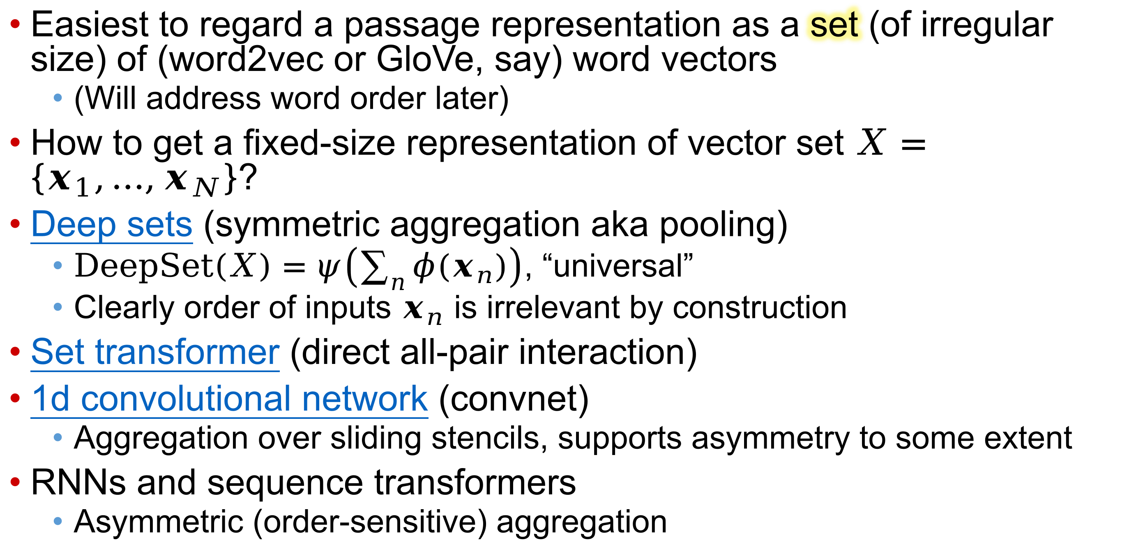
Fixed-size passage vector
Easiest to regard a passage representation as a set (of irregular size) of (word2vec or GloVe, say) word vectors
  (Will address word order later)
How to get a fixed-size representation of vector set $X=\left\{x_{1},…,x_{N}\right\}$?
Deep sets (symmetric aggregation aka pooling)
  $\text{DeepSet}\left(X\right)=ψ\left(\sum_{n}{φ(x_{n})}\right)$, “universal”
  Clearly order of inputs $x_{n}$ is irrelevant by construction
Set transformer (direct all-pair interaction)
1d convolutional network (convnet)
  Aggregation over sliding stencils, supports asymmetry to some extent
RNNs and sequence transformers
  Asymmetric (order-sensitive) aggregation

Slide 25
1d convnet for text
the
cat
sat
on
the
mat
Each row is a word embedding, say in $ℝ^{7}$

Slide 26
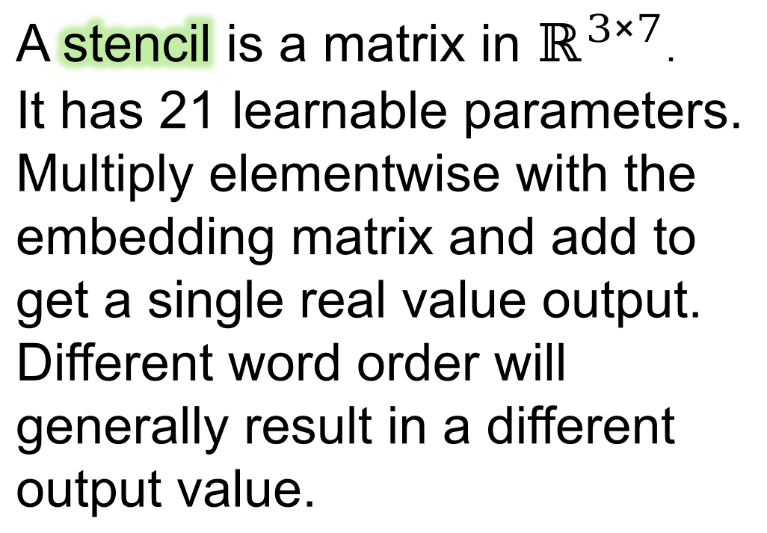
1d convnet for text
A stencil is a matrix in $ℝ^{3×7}$.
It has 21 learnable parameters. Multiply elementwise with the embedding matrix and add to get a single real value output. Different word order will generally result in a different output value.
the
cat
sat
on
the
mat
Each row is a word embedding, say in $ℝ^{7}$

Slide 27
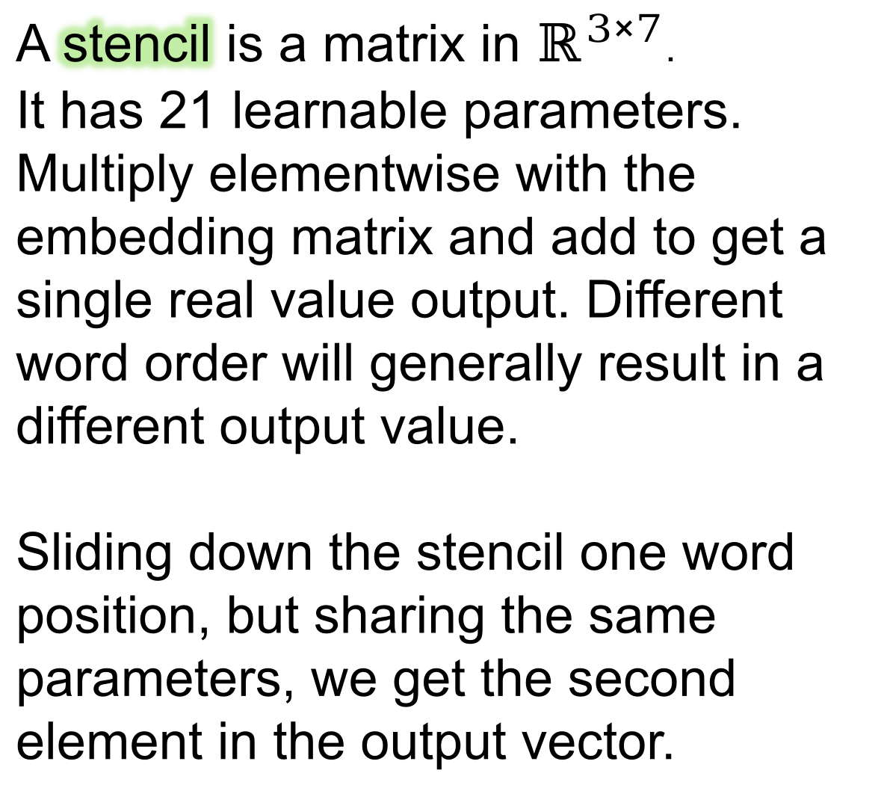
1d convnet for text
A stencil is a matrix in $ℝ^{3×7}$.
It has 21 learnable parameters. Multiply elementwise with the embedding matrix and add to get a single real value output. Different word order will generally result in a different output value.
Sliding down the stencil one word position, but sharing the same parameters, we get the second element in the output vector.
the
cat
sat
on
the
mat
Each row is a word embedding, say in $ℝ^{7}$

Slide 28
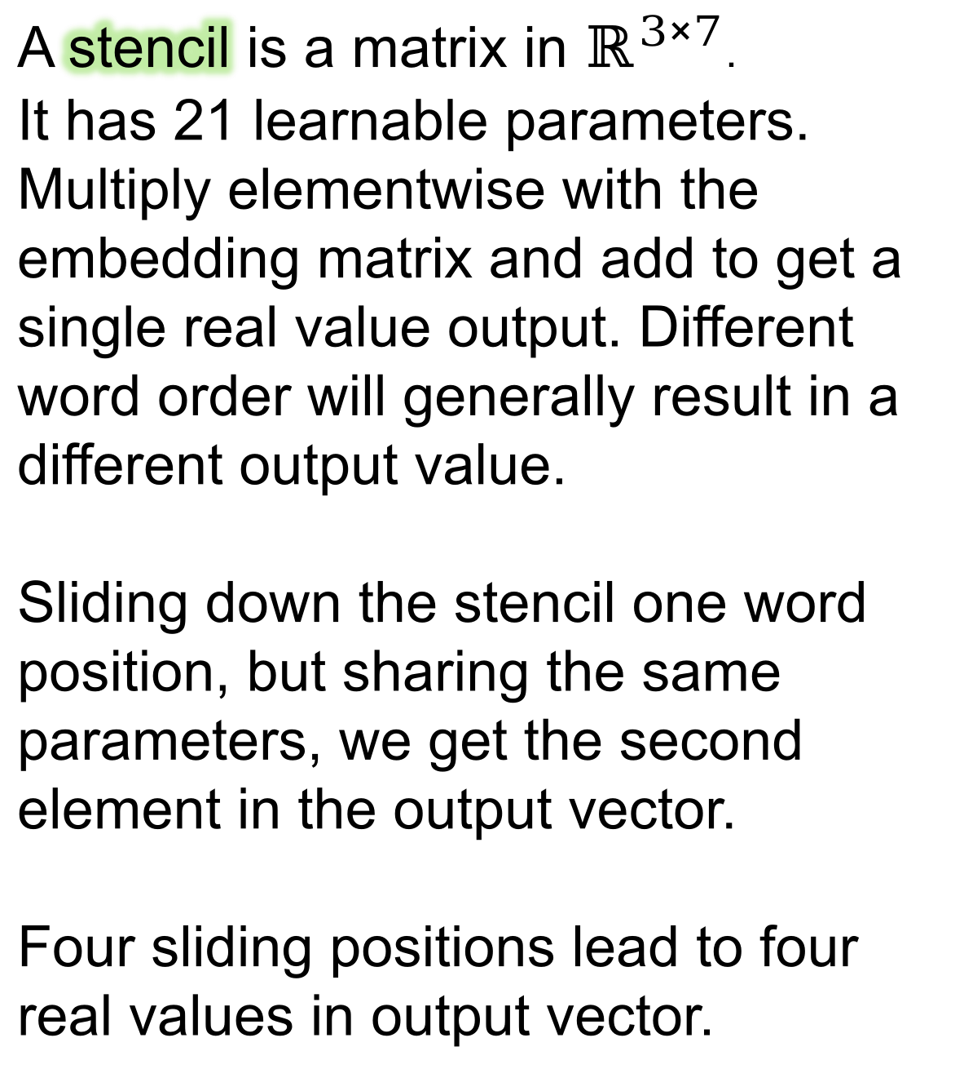
1d convnet for text
A stencil is a matrix in $ℝ^{3×7}$.
It has 21 learnable parameters. Multiply elementwise with the embedding matrix and add to get a single real value output. Different word order will generally result in a different output value.
Sliding down the stencil one word position, but sharing the same parameters, we get the second element in the output vector.
Four sliding positions lead to four real values in output vector.
the
cat
sat
on
the
mat
Each row is a word embedding, say in $ℝ^{7}$

Slide 29
1d convnet for text
Like the green stencil sliding over the text, we can have a blue stencil with 21 more trainable parameters.
the
cat
sat
on
the
mat
Each row is a word embedding, say in $ℝ^{7}$

Slide 30
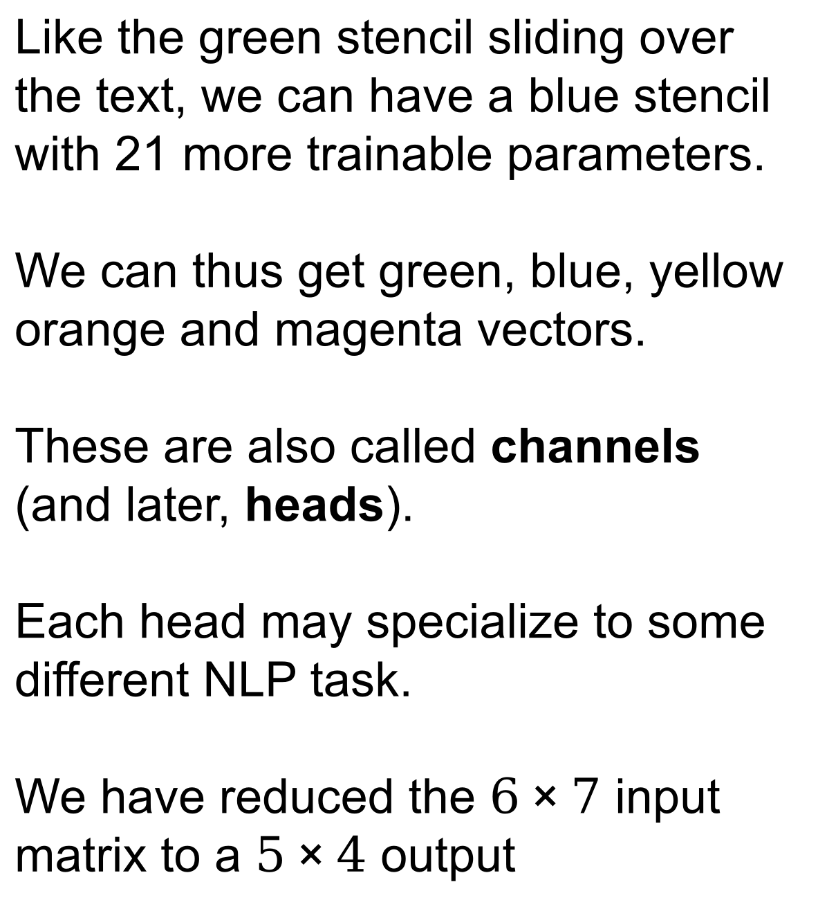
1d convnet for text
Like the green stencil sliding over the text, we can have a blue stencil with 21 more trainable parameters.
We can thus get green, blue, yellow orange and magenta vectors.
These are also called channels (and later, heads).
Each head may specialize to some different NLP task.
We have reduced the $6×7$ input matrix to a $5×4$ output
the
cat
sat
on
the
mat
Each row is a word embedding, say in $ℝ^{7}$

Slide 31
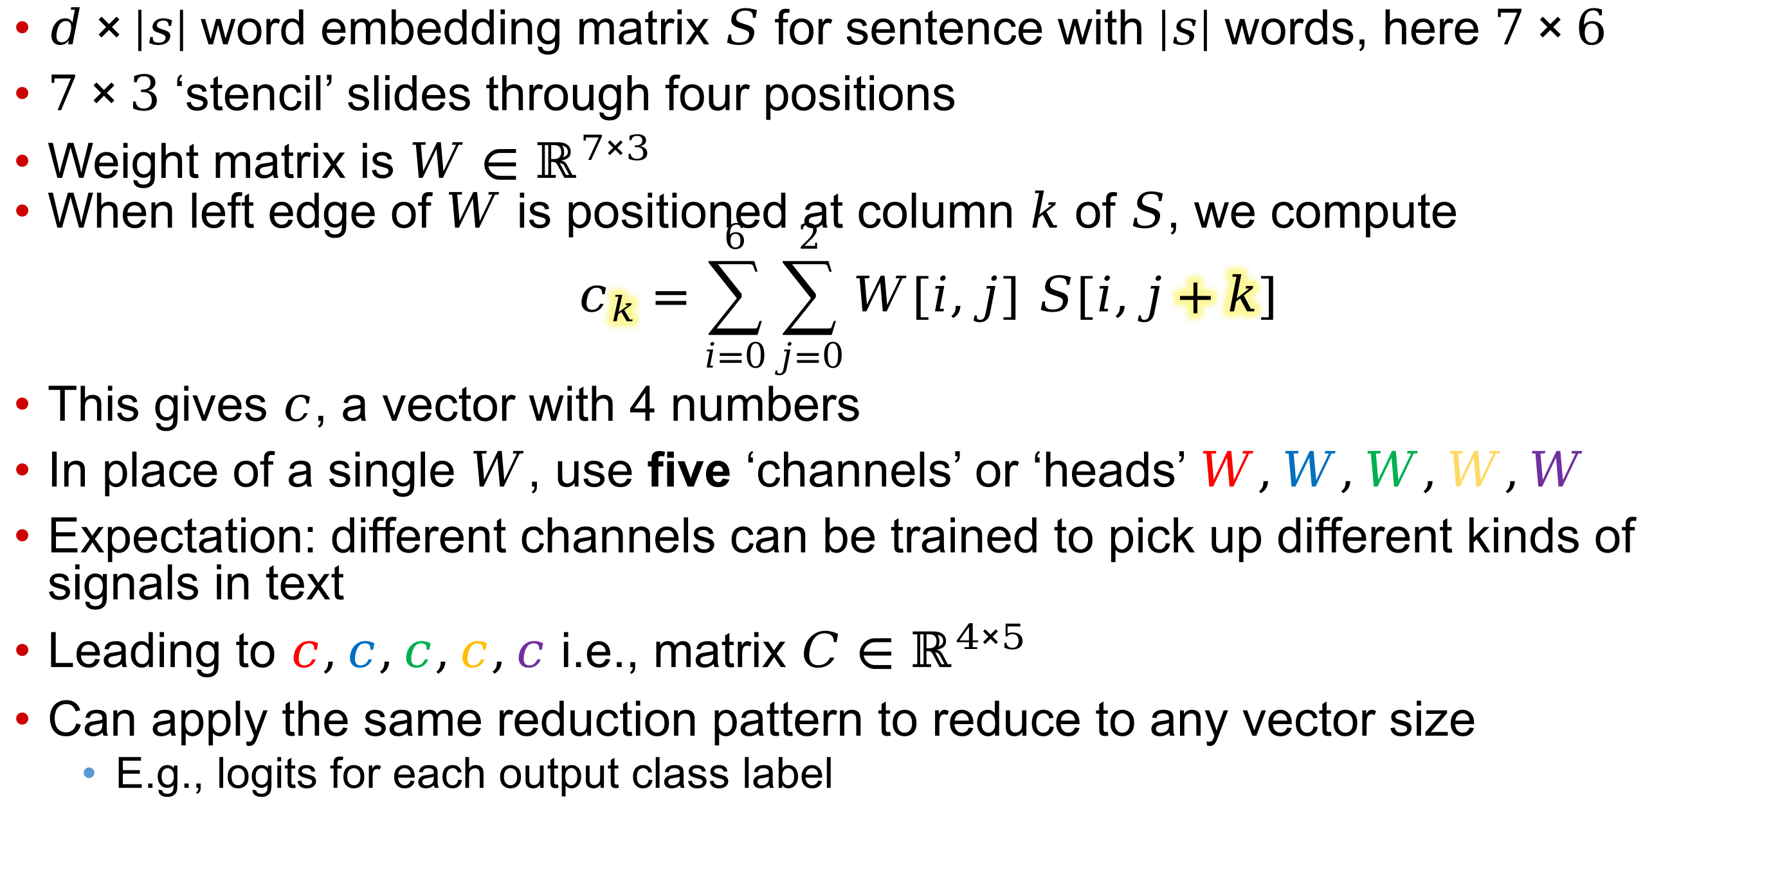
1d convnet, multiple channels/‘heads’
$d×\left|s\right|$ word embedding matrix $S$ for sentence with $\left|s\right|$ words, here $7×6$
$7×3$ ‘stencil’ slides through four positions
Weight matrix is $W∈ℝ^{7×3}$
When left edge of $W$ is positioned at column $k$ of $S$, we compute
$c_{k}=\sum_{i=0}^{6}{\sum_{j=0}^{2}{W[i,j] S[i,j+k]}}$
This gives $c$, a vector with 4 numbers
In place of a single $W$, use five ‘channels’ or ‘heads’ $W,W,W,W,W$
Expectation: different channels can be trained to pick up different kinds of signals in text
Leading to $c,c,c,c,c$ i.e., matrix $C∈ℝ^{4×5}$
Can apply the same reduction pattern to reduce to any vector size
  E.g., logits for each output class label

Slide 32
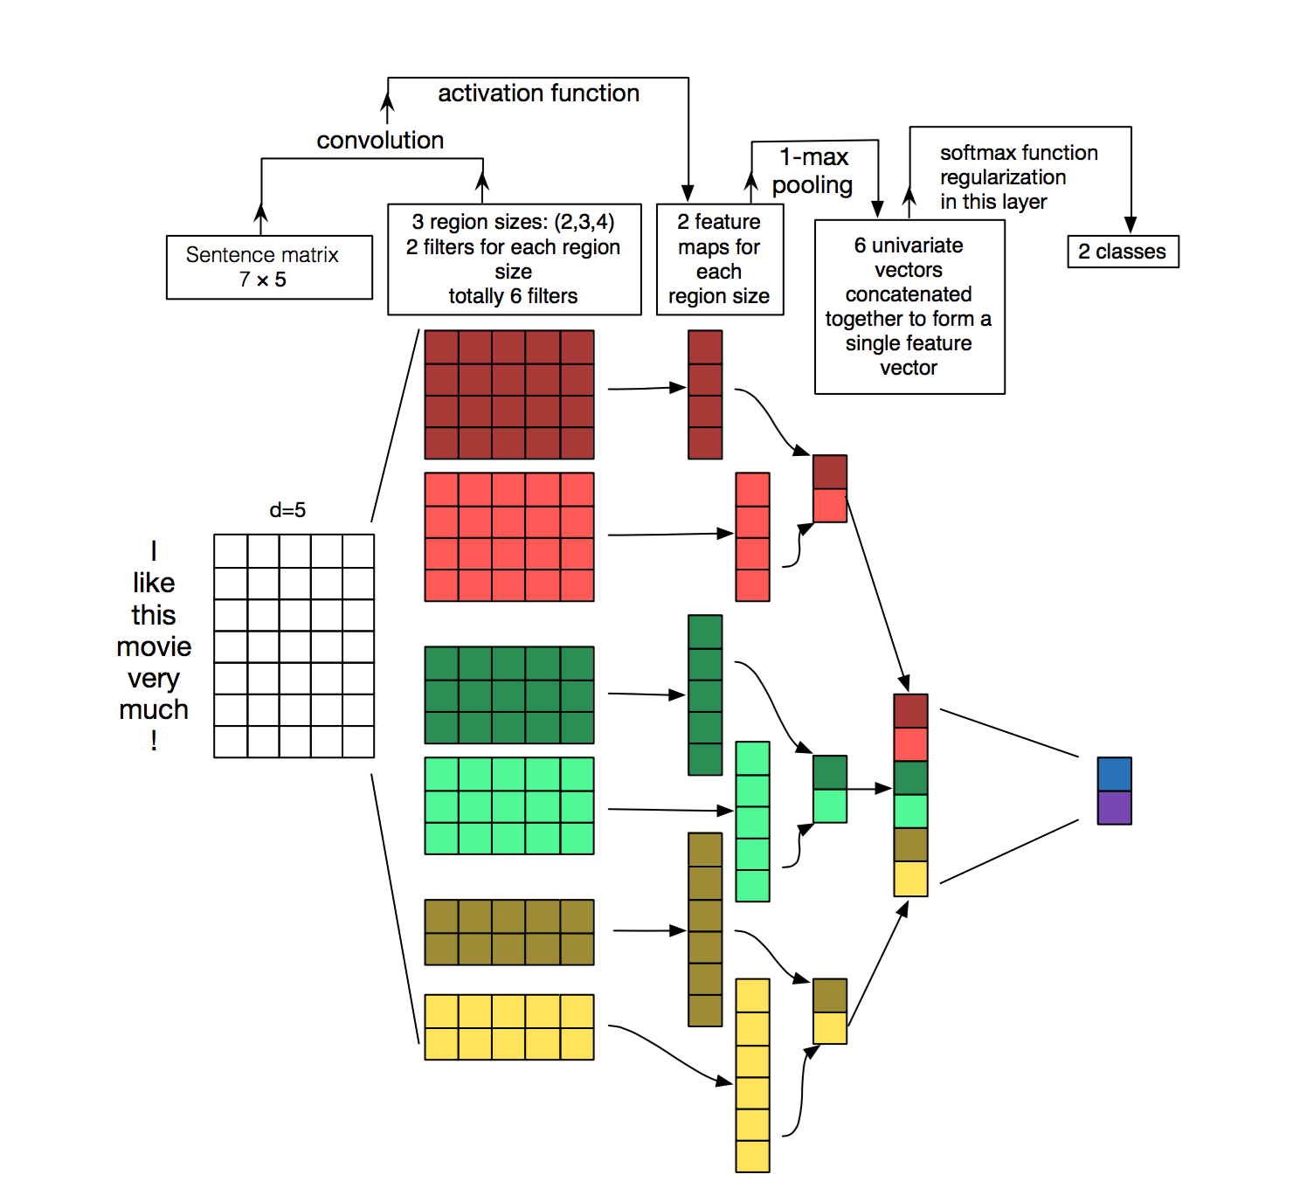
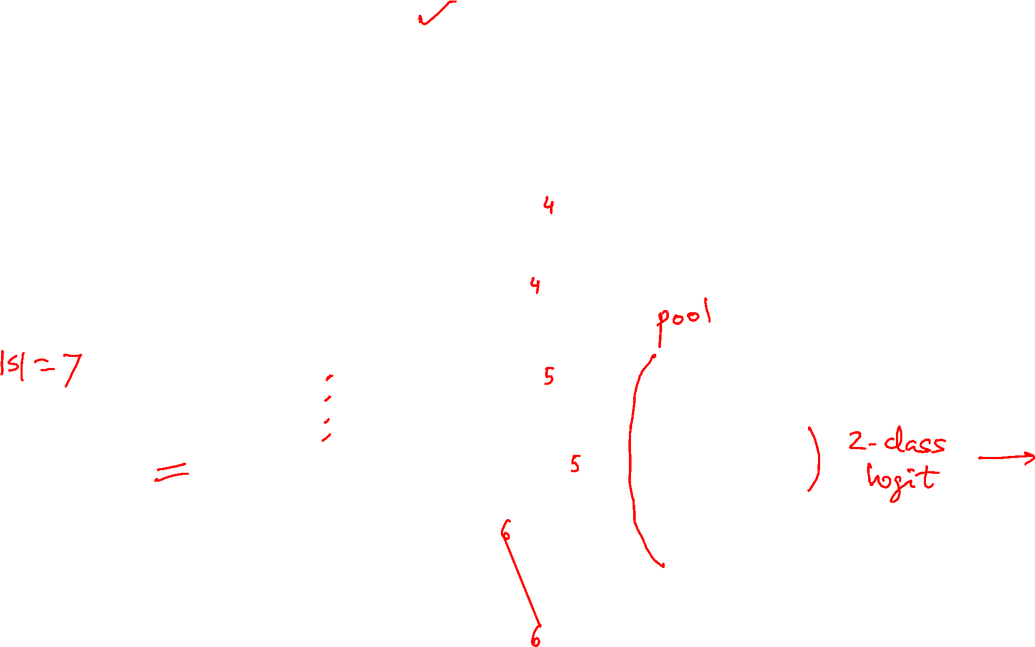
1d convnet, multiple stencils

Slide 33
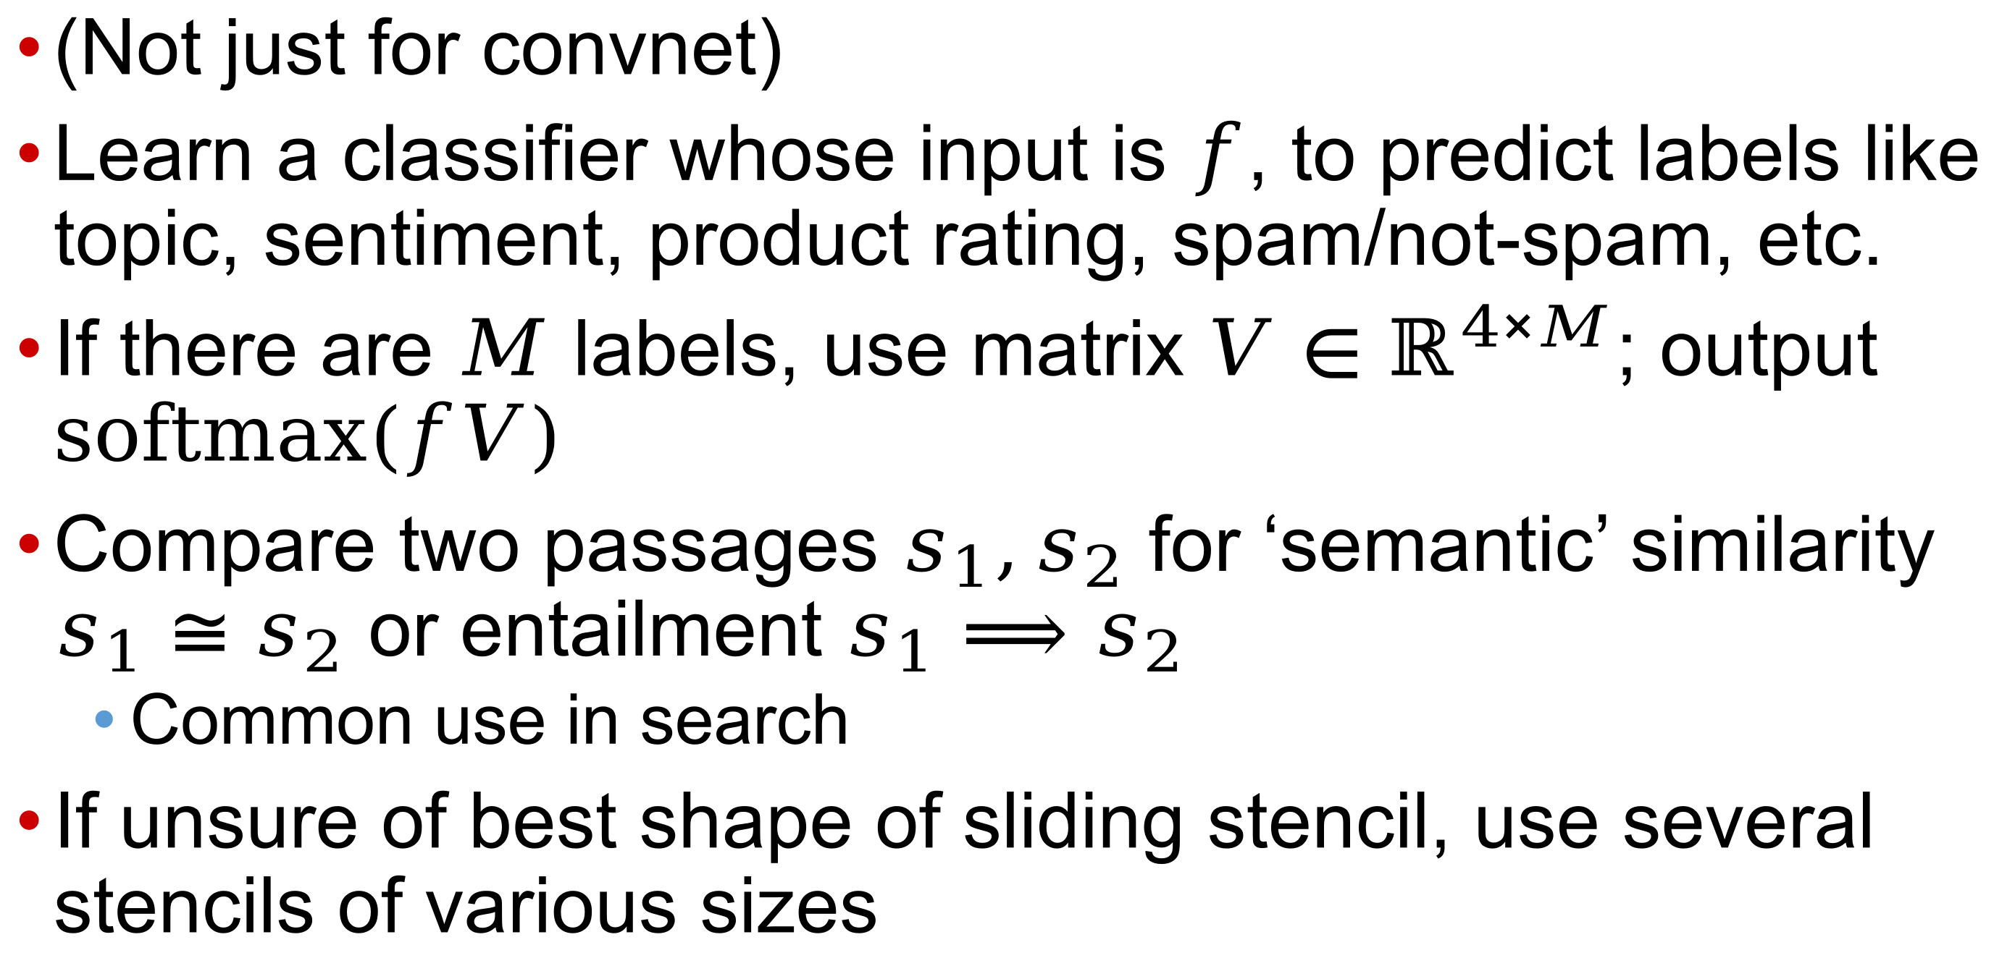
Applications of passage representation
(Not just for convnet)
Learn a classifier whose input is $f$, to predict labels like topic, sentiment, product rating, spam/not-spam, etc.
If there are $M$ labels, use matrix $V∈ℝ^{4×M}$; output $softmax(fV)$
Compare two passages $s_{1},s_{2}$ for ‘semantic’ similarity $s_{1}≅s_{2}$ or entailment $s_{1}⟹s_{2}$
  Common use in search
If unsure of best shape of sliding stencil, use several stencils of various sizes

Slide 34

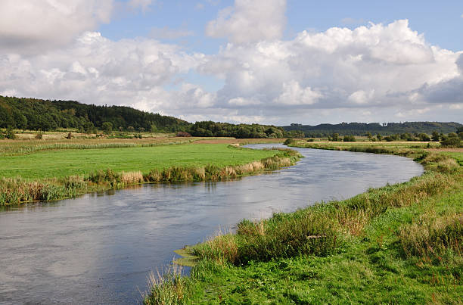
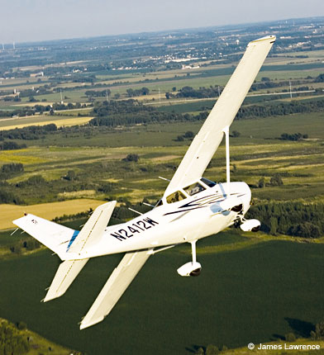
Contextual word embeddings
Word2vec and GloVe compute single embedding per string token
  I went to the bank₁ to open a fixed deposit with high interest rate.
  They swam along the bank₂ where the water current was gentle.
  Do not bank₃ the Cessna during a steep climb or it might stall.
If we could disambiguate and know how many distinct senses bank has, we can train embeddings for each of them
  Ontologically Grounded Multi-sense Representation Learning for Semantic Vector Space Models

Slide 35
Contextualization
The other (better?) option is to regard word2vec or GloVe embeddings as a starting point (aka “base embedding”)
Then compute a context dependent embedding of each word (like bank) that also depends on base embeddings of accompanying words
  “Solving for” a fixpoint?

Slide 36
Contextual word embeddings
He swam near the bank because the current was swift.
‘Encoder’
Collective ‘meaning’ disambiguation
Two paradigms:
Left to right influence (RNN, LSTM)
All to all influence (attention)
His bank offered a low interest on current accounts.
‘Encoder’

Slide 37
Encoding and decoding sequences
Working definition
Encoder turns text sequence into a representation…
…that contains the “meaning” of the input
And can be decoded back to the input
  May be in a different language, different length, …
Two texts with similar meanings encode to similar representations (and vice versa)
  Token order may or may not matter
  Anil bought oranges and apples
  Anil sold his house to buy a car

Slide 38
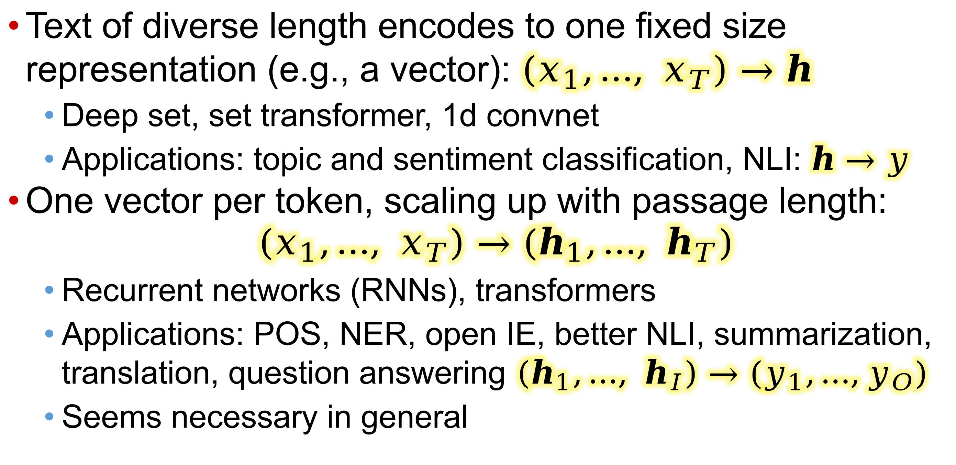
Encoding granularity
Text of diverse length encodes to one fixed size representation (e.g., a vector): $\left(x_{1},…, x_{T}\right)→h$
  Deep set, set transformer, 1d convnet
  Applications: topic and sentiment classification, NLI: $h→y$
One vector per token, scaling up with passage length:
$\left(x_{1},…, x_{T}\right)→(h_{1},…, h_{T})$
  Recurrent networks (RNNs), transformers
  Applications: POS, NER, open IE, better NLI, summarization, translation, question answering$\left(h_{1},…, h_{I}\right)→(y_{1},…,y_{O})$
  Seems necessary in general

Slide 39
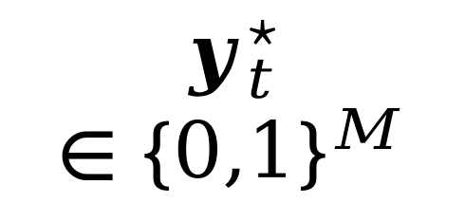

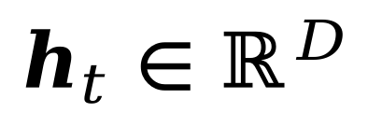
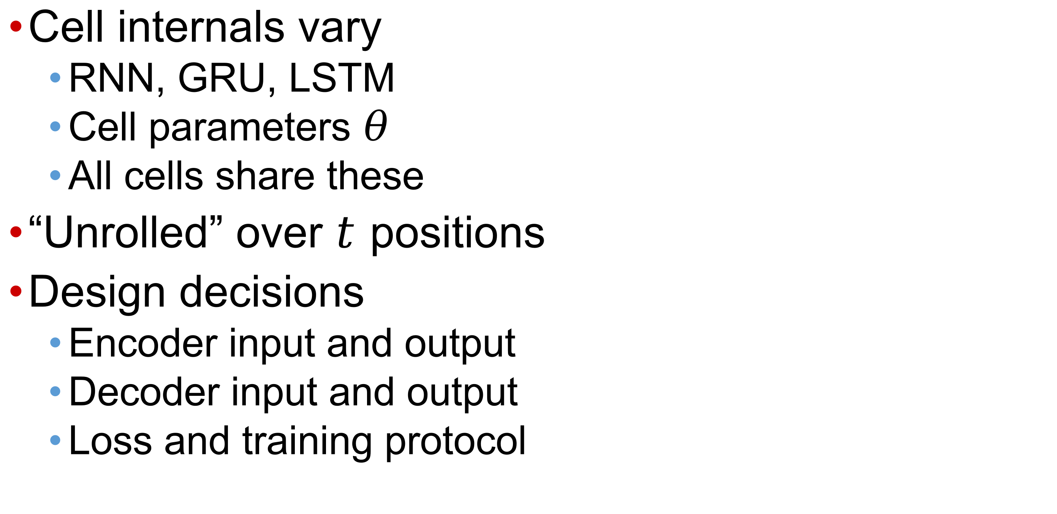
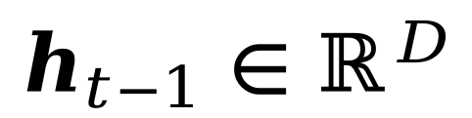
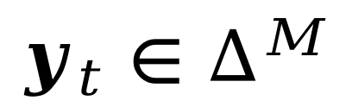
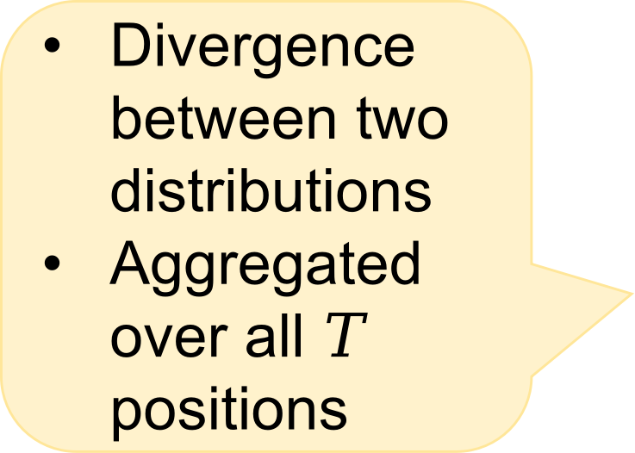


Recurrent network template
$$y_{t}^{⋆}∈{\{0,1\}}^{M}$$
Desired one-
hot output
Cell internals vary
  RNN, GRU, LSTM
  Cell parameters $θ$
  All cells share these
“Unrolled” over $t$ positions
Design decisions
  Encoder input and output
  Decoder input and output
  Loss and training protocol
Divergence between two distributions
Aggregated over all $T$ positions
$${\text{loss}}_{t}$$
Output softmax
$$y_{t}∈∆^{M}$$
Output network
Cell
at $t$
$$h_{t−1}∈ℝ^{D}$$
$$h_{t}∈ℝ^{D}$$
State transition network
$$x_{t}∈ℝ^{I}$$
Symbol embedding matrix

Slide 40

Typical Elman RNN cell design
State transition network
$h_{t}=\tanh\left(x_{t}W_{h}+h_{t−1}U_{h}+b_{h}\right)$
Output emission network (if needed)
$y_{t}=softmax(h_{t}W_{y}+b_{y})$
  $x_{t}∈ℝ^{I},W_{h}∈ℝ^{I×D},h_{t}∈ℝ^{D},U_{h}∈ℝ^{D×D},b_{h}∈ℝ^{D}$
  $W_{y}∈ℝ^{D×M},b_{y}∈ℝ^{M},y_{t}∈∆^{M}$
During training, $y_{t}$ remains continuous
Loss between $y_{t}$ and discrete gold $y_{t}^{⋆}∈{\{0,1\}}^{M}$
For single label of whole text, only $y_{T}$ and $y_{T}^{⋆}$ are used to define loss
In both cases, gradient-descent on loss wrt model weights
$\left\{W_{h},U_{h},b_{h},W_{y},b_{y}\right\}$

Slide 41

Typical Jordan RNN cell
Output emission network as before
$y_{t}=softmax(h_{t}W_{y}+b_{y})∈∆^{M}$ (not discrete)
  Here $h_{t}∈ℝ^{D},W_{y}ℝ^{D×M},b_{y}∈ℝ^{M}$
State transition network changes from
$h_{t}=\tanh\left(x_{t}W_{h}+h_{t−1}U_{h}+b_{h}\right)$ where
$U_{h}∈ℝ^{D×D}$, to $h_{t}=\tanh\left(x_{t}W_{h}+y_{t−1}U_{h}+b_{h}\right)$
  Here $x_{t}∈ℝ^{I},W_{h}∈ℝ^{I×D},U_{h}∈ℝ^{M×D},b_{h}∈ℝ^{D}$
In LLM applications, $M$ is not small
  Often, $M=I$, or they are vocabs in two languages

Slide 42


Vanishing gradient intuition

Slide 43

Vanishing gradient intuition
Chain Rule!

Slide 44

Vanishing gradient intuition
Chain Rule!

Slide 45

Vanishing gradient intuition
Chain Rule!

Slide 46















Vanishing gradient intuition
Vanishing gradient problem: When small, the gradient signal gets smaller and smaller as it backpropagates further
What happens if these are small?

Slide 47





Vanishing gradient proof sketch (linear case)
Recall:
What if σ were the identity function, σ(x) = x ?
Consider the gradient of the loss $J^{\left(i\right)}(θ)$ on step $i$, with respect to the hidden state $h^{(j)}$ on some previous step $j$. Let $l=i−j$
Source: “On the difficulty of training recurrent neural networks”, Pascanu et al, 2013. http://proceedings.mlr.press/v28/pascanu13.pdf (and supplemental materials), at http://proceedings.mlr.press/v28/pascanu13-supp.pdf
If W_{h} is “small”, then this term gets exponentially problematic as $l$ becomes large

Slide 48





Vanishing gradient proof sketch (linear case)
What’s wrong with $W_{h}^{l}$?
Consider if the eigenvalues of $W_{h}$ are all less than 1 :
  $λ_{1},λ_{2}, …,λ_{n}<1$
  $q_{1},q_{2},…,q_{n}$ (eigenvectors)
We can write using eigenvectors of $W_{h}$ as a basis:
sufficient but not necessary
Approaches 0 as $l$ grows, so gradient vanishes
Source: “On the difficulty of training recurrent neural networks”, Pascanu et al, 2013. http://proceedings.mlr.press/v28/pascanu13.pdf (and supplemental materials), at http://proceedings.mlr.press/v28/pascanu13-supp.pdf

Slide 49


Remedy: Extending RNN with gating
Elman RNN state transition
$h_{t}=σ\left(x_{t}W_{h}+h_{t−1}U_{h}+b_{h}\right)$
Gated recurrent unit (GRU)
  Block-state
  $r_{t}=σ\left(x_{t}W_{r}+h_{t−1}U_{r}+b_{r}\right)$
  Combine
  ${\tilde{h}}_{t}=\tanh{(x_{t}W_{h}+\left(r_{t}∘h_{t−1}\right)U_{h}+b_{h})}$
  Update $z_{t}=σ\left(x_{t}W_{z}+h_{t−1}U_{z}+b_{z}\right)$
  Output $h_{t}=\left(1−z_{t}\right)∘h_{t−1}+z_{t}∘{\tilde{h}}_{t}$
Long short-term memory (LSTM) and bi-LSTM

Slide 50


Encoder chained to decoder for seq2seq
RNNs are Turing complete, so the following encoder-decoder sequence should be able to reconstruct text
Distinct encoder (only inputs) and decoder (only outputs) cells
Memorize, translate, summarize, …
RNN “cell”
the
cat
sat
on
the
mat
ENCODER
$$h_{T}=g_{0}$$
$$h_{0}$$
DECODER
the
cat
sat
on
the
mat
Single (fixed-size?) “prompt vector” encoding the meaning of the whole input text

Slide 51
Decoder cannot handle the workload
Decoder cell must do many things:
  Remember all the input
  Remember what part of the input has been processed
  Induce a distribution over outputs
  Evolve current state into next state based on the above
In practice this does not work well
  (At least small, simple) RNN cells need more help
Given the strength of influence, one form of help is to feed the last-emitted output as input to current cell (takes care of ultra short-range influence)

Slide 52



A better chaining of RNN decoder
Give each decoder cell at $t$ one additional input $x_{t}$
  Inputs $x_{t}, g_{t−1}$; outputs $g_{t}$ and distribution over $y_{t}$
  Take argmax over distribution to output discrete $y_{t}$
  But we can also sample the distribution to introduce variation
Decoder not exploiting access to all encoder states $\{h_{t}\}$
the
cat
sat
on
the
mat
[END]
ENCODER
$$h_{0}$$
$$h_{T} \\ =g_{0}$$
the
cat
sat
on
the
mat
[GO]
the
cat
sat
on
the
mat
The encoder is free to look at all input tokens together, not limited to scanning left-to-right
DECODER

Slide 53

Hard decisions in soft networks
Note that decoder cell at $t$ emits a discrete token $y_{t}$, not a distribution over tokens
To feed back to cell at $t+1$, look up base embedding matrix $B$ at row $y_{t}$
  Just like each input token $x_{t}$ is looked up in $B$
Whether $y_{t}$ is via argmax or sampling, it carries no continuous gradient information
  “Straight through” estimator (STE)
  Softmax-weighted (attention?)
  Gumbel softmax

Slide 54
Dropout
Max vs softmax
Straight through
Logistic and Gumbel noise

Slide 55

Improving backprop in the face of sampling
Compare $max⁡\{a,b\}$ with $log⁡(e^{a}+e^{b})$
  $\frac{d max⁡\{a,b\}}{da}=\left\{\begin{matrix}1 & a≥b \\ 0 & o.w.\end{matrix}\right.$
  $\frac{d log⁡(e^{a}+e^{b})}{da}=\frac{e^{a}}{e^{a}+e^{b}}$ … never zero
The problem with discrete latent variables while training neural networks
Demonstrated with mixture of Gaussians

Slide 56

Back to challenges of large output vocabulary
Decoding tricks for large vocabulary
Let $W_{0}$ be an initial “prompt sequence”
By convention, $w_{1:0}=( )$
“Completing the prompt” amounts to
$\max_{w_{1:T}}{\operatorname{Pr}\left(w_{1:T} | W_{0}\right)=\max_{w_{1:T}}{\prod_{1≤t≤T}{\operatorname{Pr}\left(w_{t}|w_{1:t−1};W_{0}\right)}}}$
If the domain of $w_{t}∈[L]$ is small (POS/NER labels), can build a full DP trellis
Otherwise, need to cut corners
Besides, we want to sample the posterior anyway

Slide 57



Greedy decoding
At each step $t$, choose $\underset{w_{t}∈[L]}{argmax}{Pr⁡(w_{t}|w_{1:t−1};W_{0})}$
Easy to get trapped into dead ends
E.g. from GPT2: I enjoy walking with my cute dog, but I'm not sure if I'll ever be able to walk with my dog. I'm not sure if I'll ever be able to walk with my dog. […]
No stochastic variation

Slide 58


Beam search
Always find an output sequence with probability $≥$ greedy search
Not guaranteed to find the most likely output
GPT2: I enjoy walking with my cute dog, but I'm not sure if I'll ever be able to walk with him again.
Deterministic, no stochastic variation
Can sample from surviving beams

Slide 59
Beam size = k = 2.
<START>
Calculate prob
distribution of next word

Slide 60

Beam size = k = 2. Blue numbers =
-0.7 = log P_{LM}(he|<START>)
he
<START>
I
-0.9 = log P_{LM}(I|<START>)
Take top k words and compute scores

Slide 61
Beam size = k = 2. Blue numbers =
-1.7 = log P_{LM}(hit|<START> he) + -0.7
-0.7
hit
he
struck
-2.9 = log P_{LM}(struck|<START> he) + -0.7
<START>
-1.6 = log P_{LM}(was|<START> I) + -0.9
was
I
got
-0.9
-1.8 = log P_{LM}(got|<START> I) + -0.9
For each of the k hypotheses, find
top k next words and calculate scores

Slide 62
Beam size = k = 2. Blue numbers =
-1.7
-0.7
hit
he
struck
-2.9
<START>
-1.6
was
I
got
-0.9
-1.8
Of these k² hypotheses,
just keep k with highest scores

Slide 63
Beam size = k = 2. Blue numbers =
-2.8 = log P_{LM}(a|<START> he hit) + -1.7
-1.7
a
-0.7
hit
he
me
struck
-2.5 = log P_{LM}(me|<START> he hit) + -1.7
-2.9
<START>
-2.9 = log P_{LM}(hit|<START> I was) + -1.6
-1.6
hit
was
I
struck
got
-0.9
-3.8 = log P_{LM}(struck|<START> I was) + -1.6
-1.8
For each of the k hypotheses, find
top k next words and calculate scores

Slide 64
Beam size = k = 2. Blue numbers =
-2.8
-1.7
a
-0.7
hit
he
me
struck
-2.5
-2.9
<START>
-2.9
-1.6
hit
was
I
struck
got
-0.9
-3.8
-1.8
Of these k² hypotheses,
just keep k with highest scores

Slide 65
Beam size = k = 2. Blue numbers =
tart
-2.8
pie
-1.7
a
-0.7
hit
-3.4
he
me
-3.3
struck
-2.5
with
-2.9
<START>
-2.9
on
-1.6
hit
-3.5
was
I
struck
got
-0.9
-3.8
-1.8
For each of the k hypotheses, find
top k next words and calculate scores

Slide 66
Beam size = k = 2. Blue numbers =
tart
-2.8
pie
-1.7
a
-0.7
hit
-3.4
he
me
-3.3
struck
-2.5
with
-2.9
<START>
-2.9
on
-1.6
hit
-3.5
was
I
struck
got
-0.9
-3.8
-1.8
Of these k² hypotheses,
just keep k with highest scores

Slide 67
Beam size = k = 2. Blue numbers =
-4.0
-4.8
tart
in
-2.8
pie
with
-1.7
a
-0.7
hit
-3.4
-4.5
he
me
-3.3
-3.7
struck
-2.5
with
a
-2.9
<START>
-2.9
on
one
-1.6
hit
-3.5
-4.3
was
I
struck
got
-0.9
-3.8
-1.8
For each of the k hypotheses, find
top k next words and calculate scores

Slide 68
Beam size = k = 2. Blue numbers =
-4.0
-4.8
tart
in
-2.8
pie
with
-1.7
a
-0.7
hit
-3.4
-4.5
he
me
-3.3
-3.7
struck
-2.5
with
a
-2.9
<START>
-2.9
on
one
-1.6
hit
-3.5
-4.3
was
I
struck
got
-0.9
-3.8
-1.8
Of these k² hypotheses,
just keep k with highest scores

Slide 69
Beam size = k = 2. Blue numbers =
-4.0
-4.8
tart
in
-2.8
-4.3
pie
with
-1.7
a
pie
-0.7
hit
-3.4
-4.5
he
me
-3.3
-3.7
tart
struck
-2.5
with
a
-4.6
-2.9
<START>
-2.9
on
one
-5.0
-1.6
hit
pie
-3.5
-4.3
was
I
struck
tart
got
-0.9
-3.8
-5.3
-1.8
For each of the k hypotheses, find
top k next words and calculate scores

Slide 70
Beam size = k = 2. Blue numbers =
-4.0
-4.8
tart
in
-2.8
-4.3
pie
with
-1.7
a
pie
-0.7
hit
-3.4
-4.5
he
me
-3.3
-3.7
tart
struck
-2.5
with
a
-4.6
-2.9
<START>
-2.9
on
one
-5.0
-1.6
hit
pie
-3.5
-4.3
was
I
struck
tart
got
-0.9
-3.8
-5.3
-1.8
This is the top-scoring hypothesis!

Slide 71
Beam size = k = 2. Blue numbers =
-4.0
-4.8
tart
in
-2.8
-4.3
pie
with
-1.7
a
pie
-0.7
hit
-3.4
-4.5
he
me
-3.3
-3.7
tart
struck
-2.5
with
a
-4.6
-2.9
<START>
-2.9
on
one
-5.0
-1.6
hit
pie
-3.5
-4.3
was
I
struck
tart
got
-0.9
-3.8
-5.3
-1.8
Backtrack to obtain the full hypothesis

Slide 72



The importance of exploration (sampling)
Given $W_{0}$ or $g_{0}$, fate of decoder is sealed for ever
Decoder cell is poorly trained in the beginning
Start with garbage-in, continue with garbage-out
Loss gradient signal will take a long time to fix this
Teacher forcing vs. “let student learn by making mistakes”
Die
Katze
saß
auf
der
Matte
ENCODER
Mary
hatte
ein
kleines
lamm
[END]
$$h_{0}$$
$$h_{T} \\ =g_{0}$$
the
cat
sat
on
the
mat
[GO]
hatte
ein
kleines
lamm
Mary

Slide 73

Sampling
We might sample a less likely next word, which then “changes the course of history”
I enjoy walking with my cute dog for the rest of the day, but this had me staying in an unusual room and not going on nights out with friends (which will always be wondered for a mere minute or so at this point).
Temperature going from logits to multinomial via softmax
I enjoy walking with my cute dog, but I don't like to chew on it. I like to eat it and not chew on it. I like to be able to walk with my dog.“ So how did you decide
Still pretty weird

Slide 74



Top-$K$ sampling (GPT2)
Can use temperature here too, to change level of skew:
$$\operatorname{Pr}\left(w_{t} | w_{<t}\right)∝exp⁡(τ⋅ logit)$$
Retain only those words for the next position with probability among the highest $K$
(Scale probabilities to make valid multinomial distribution)
Sample from only these candidates
I enjoy walking with my cute dog for the rest of the day, but this time it was hard for me to figure out what to do with it. (One reason I asked this for a few months back is that I had a

Slide 75




Arbitrary $K$ to nucleus sampling
Adapt $K$ to the level of skew in the output distribution
Need large $K$
Need small $K$
I enjoy walking with my cute dog for the rest of the day, but this had me staying in an unusual room and not going on nights out with friends (which will always be my yearning for such a spacious screen on my desk
Better, but still weird

Slide 76
RNN (and transformer) network topologies
Next, we will discuss how to generalize RNNs into bidirectional RNNs in (typically encoding) situations where right context can be exploited
Finally, we will lay out a nomenclature for various network topologies around RNNs (and for later use, transformers)

Slide 77

Multi-layer and bidirectional RNNs
Bidirectional can be used in encoder-only mode
Collects both left and right context at each token

Slide 78




Sentence pair tasks
Pair classification (e.g. implication, next sentence)
Translation (primed generation)
Question answering (can be regarded as either classification or generation)

Slide 79


Sequence network nomenclature
Classification/tagging, generation, translation
Encoder can look ahead, decoder cannot

Slide 80
Summary and outlook
A passage can be encoded by looking up context-independent word2vec or GloVE vectors of each token
Lack of contextualization is a serious limitation, particularly for ambiguous words
Contextualization entails some form of aggregation
Order-independent aggregation is weak
We looked at two mechanisms: CNN and RNN
Single, fixed-length encoding of passage may not be good enough
RNNs can be used also as decoders
But this can complicate training
Chaining encoder to decoder places heavy burden on fixed-length state
Can make use of all encoder states in decoder … attention (next)

