Slide 1
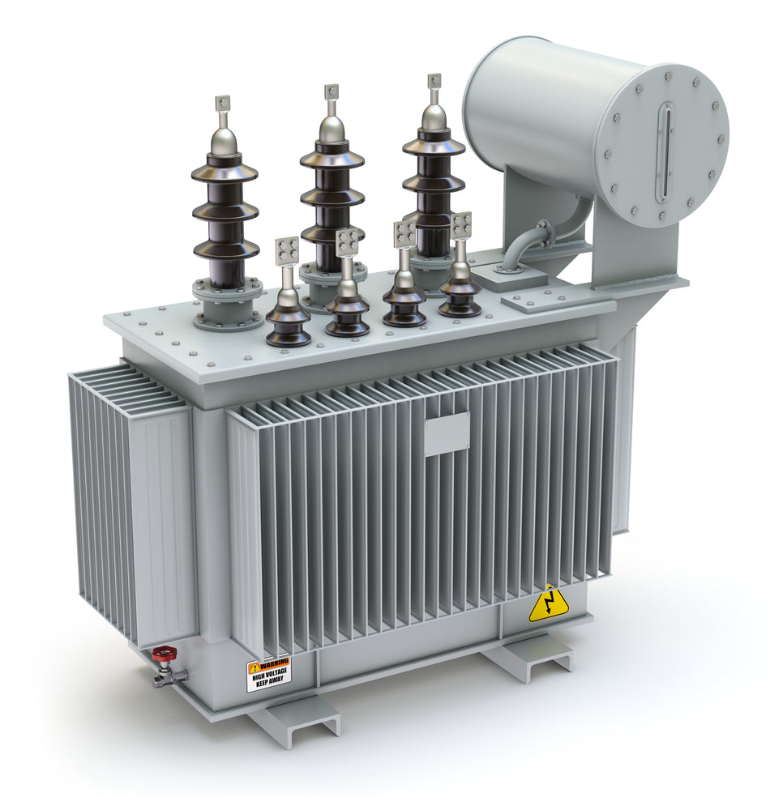
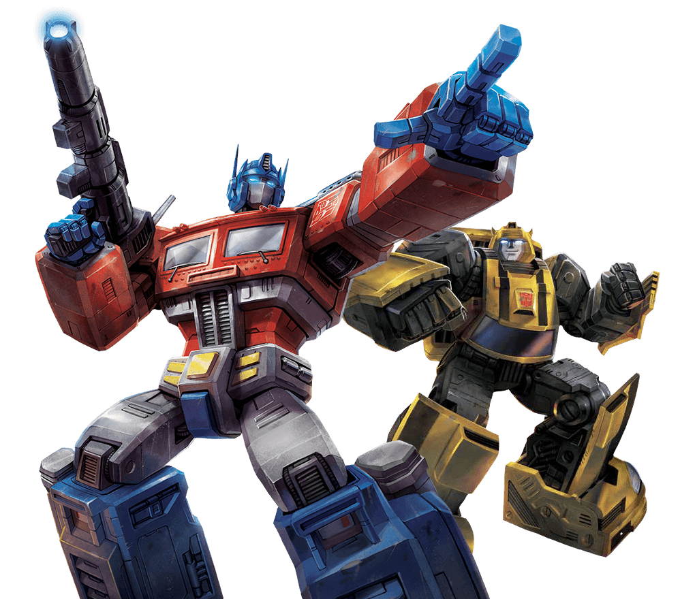
Attention and Transformers
CS728
Soumen Chakrabarti

Slide 2
Encoding and decoding sequences
Working definition
Encoder turns text sequence into a representation…
…that contains the “meaning” of the input
And can be decoded back to the input or another useful output
  May be in a different language, different length, …
Two texts with similar meanings encode to similar representations (and vice versa)
  Token order may or may not matter
  Anil bought oranges and apples
  Anil sold his house to buy a car

Slide 3
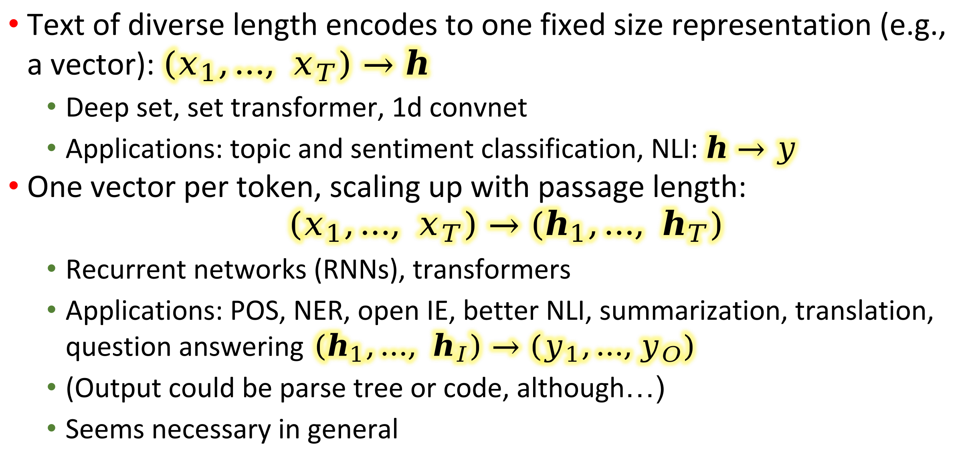
Encoding granularity
Text of diverse length encodes to one fixed size representation (e.g., a vector): $\left(x_{1},…, x_{T}\right)→h$
  Deep set, set transformer, 1d convnet
  Applications: topic and sentiment classification, NLI: $h→y$
One vector per token, scaling up with passage length:
$$\left(x_{1},…, x_{T}\right)→(h_{1},…, h_{T})$$
  Recurrent networks (RNNs), transformers
  Applications: POS, NER, open IE, better NLI, summarization, translation, question answering$\left(h_{1},…, h_{I}\right)→(y_{1},…,y_{O})$
  (Output could be parse tree or code, although…)
  Seems necessary in general

Slide 4
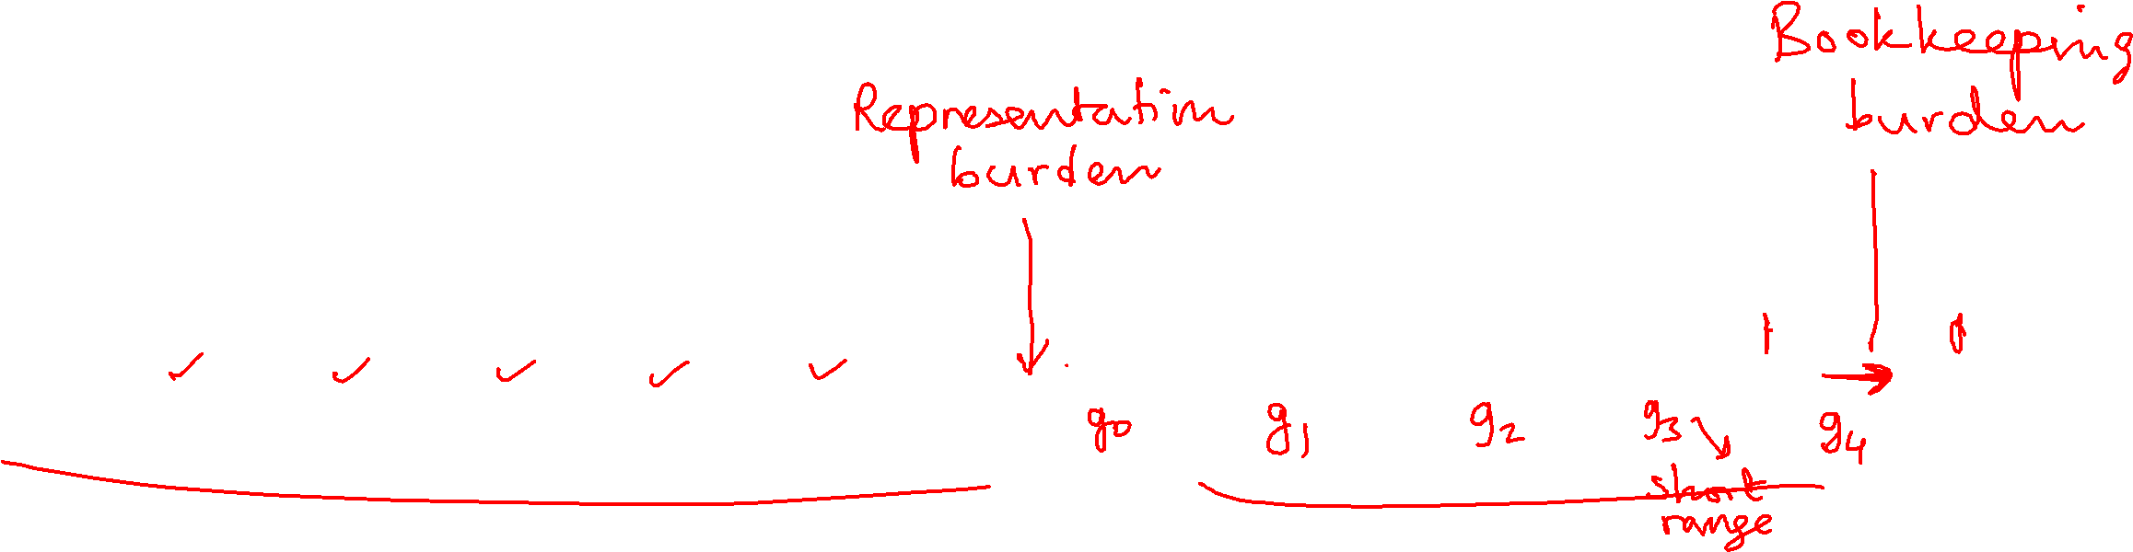
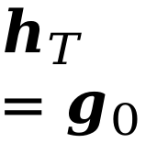

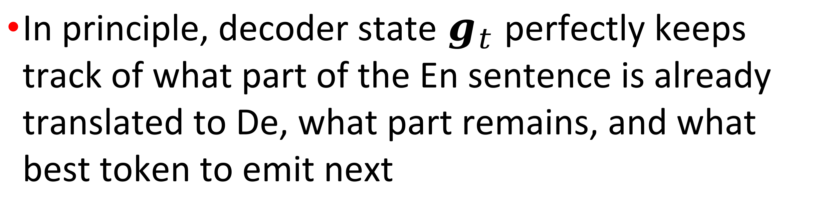
Need for attention in seq2seq
In principle, decoder state $g_{t}$ perfectly keeps track of what part of the En sentence is already translated to De, what part remains, and what best token to emit next
ENCODER
Die
katze
saß
auf
der
matte
$$h_{0}$$
$$h_{T} \\ =g_{0}$$
the
cat
sat
on
the
mat
[GO]
Die
katze
saß
auf
der

Slide 5
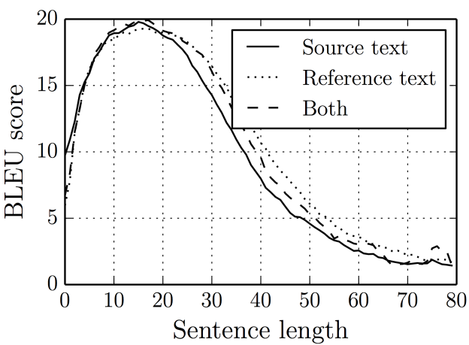
In practice…
As sentence length increases, quality of translation worsens
Fixed length RNN state encoding is not sufficient for bookkeeping needed

Slide 6
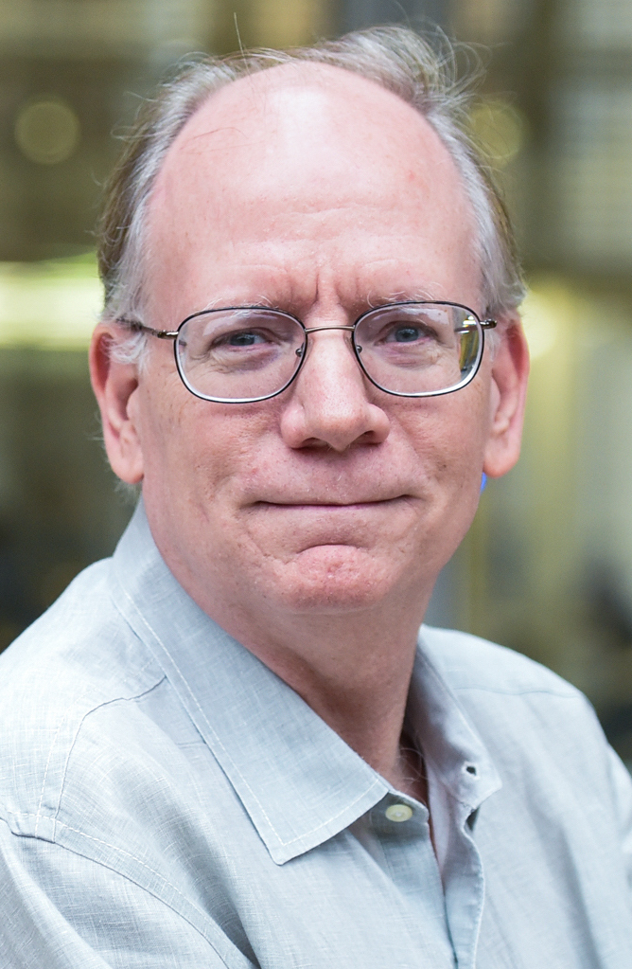
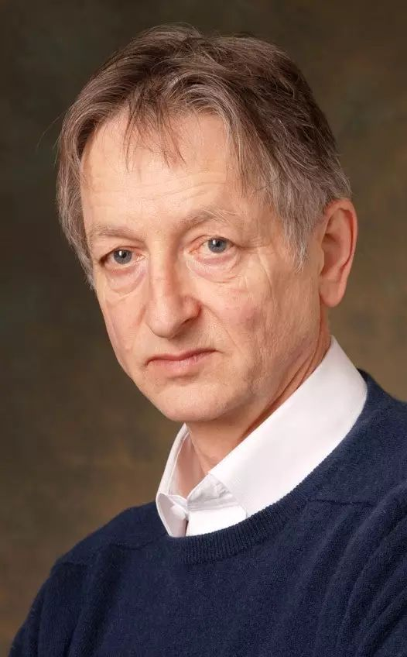
Quotable quotes
“You can’t cram the meaning of a whole %&!$# sentence into a single $&!#* vector!”
— Ray Mooney (2014)
“The pooling operation used in convolutional neural networks is a big mistake and the fact that it works so well is a disaster.”
—Geoffrey Hinton (2014)

Slide 7
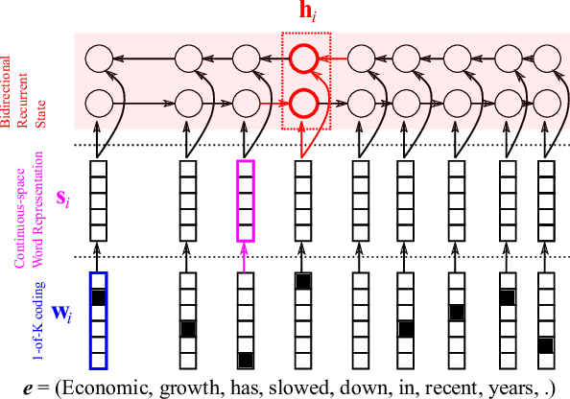
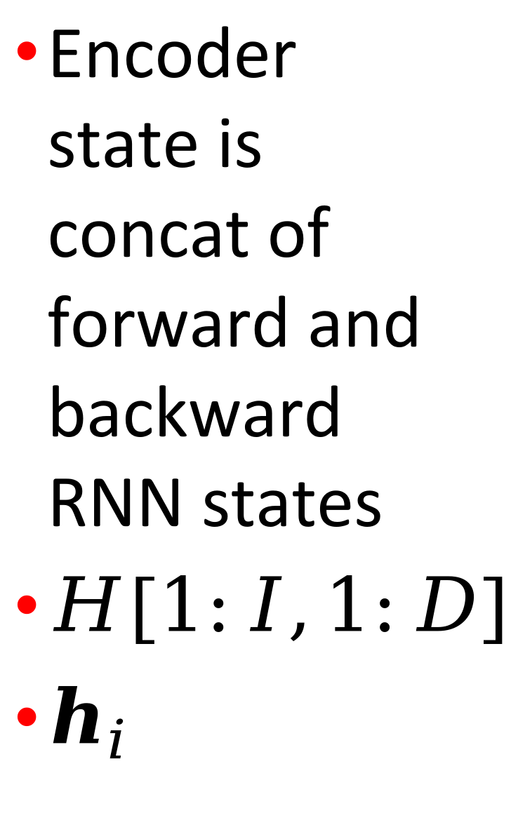
Encoding the source sentence
Encoder state is concat of forward and backward RNN states
$H[1:I,1:D]$
$h_{i}$

Slide 8
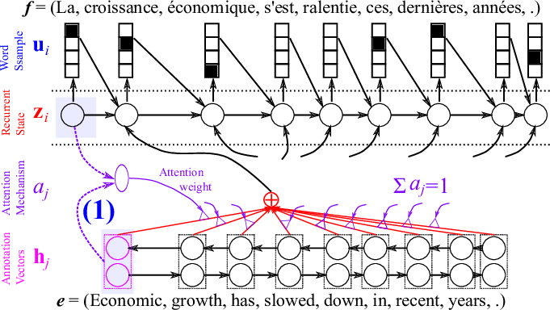
Attention from each target position

Slide 9
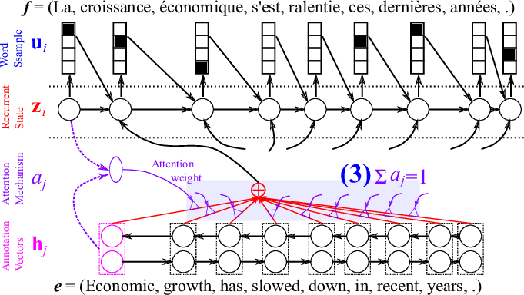
Attention-weighted avg source state

Slide 10



























Attention example
mignon chiot
Un
<START> A
cute
puppy

Slide 11












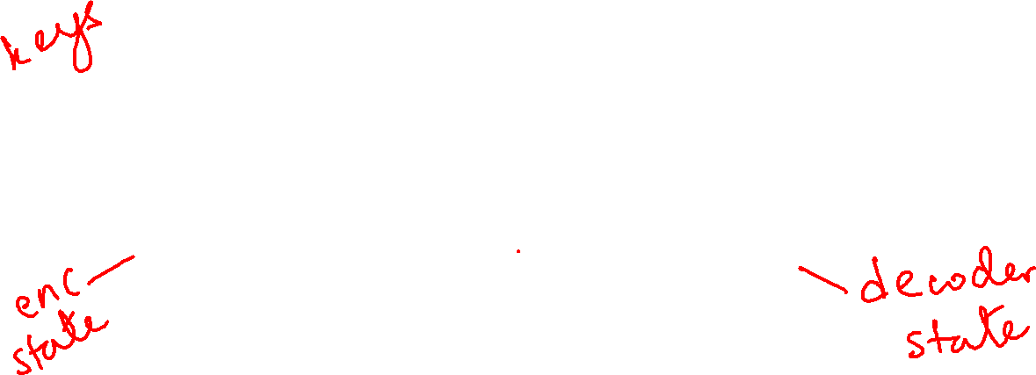
Attention example
mignon chiot
Un
<START> A
cute
puppy

Slide 12

Attention example
If we have attention, do we even need recurrent connections?
Can we transform our RNN into a purely attention-based model?
Attention can access all time steps simultaneously, potentially doing everything that recurrence can, and even more.
But encoder has no temporal/causal dependencies … positional embedding (soon)
mignon chiot
Un
<START> A
cute
puppy

Slide 13
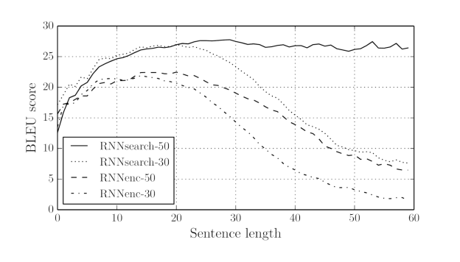
Attention improves translation
Neural machine translation by jointly learning to align and translate
But note the one-sidedness of the “alignment”

Slide 14
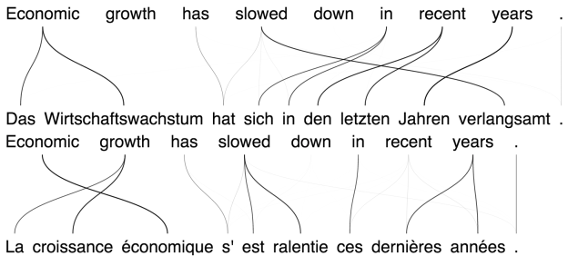
Attention strength examples
Wirtschafts means economic
Wirtschaftswachstum means economic growth
Note the missing line from growth
Also, derniѐres means latest, faint link to recent
Should allow many-to-many ‘fractional’ links in general

Slide 15
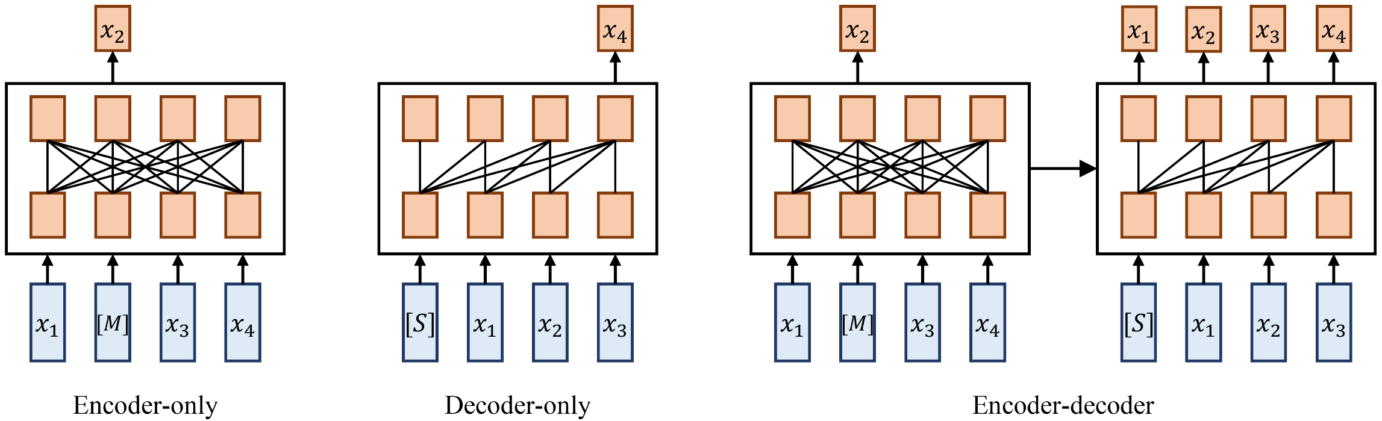
Sequence network nomenclature
Classification/tagging, generation, translation
Encoder can look ahead, decoder cannot

Slide 16







Self-Attention
shared weights at all time steps

Slide 17





Self-Attention
shared weights at all time steps

Slide 18

Self-Attention
shared weights at all time steps

Slide 19

Self-Attention
shared weights at all time steps

Slide 20

Self-Attention
shared weights at all time steps

Slide 21


Self-Attention
shared weights at all time steps

Slide 22


Self-Attention
shared weights at all time steps

Slide 23




Self-Attention
shared weights at all time steps

Slide 24

Self-Attention
shared weights at all time steps

Slide 25
Self-Attention
shared weights at all time steps

Slide 26
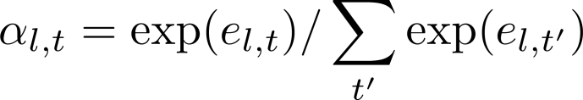
Self-Attention
shared weights at all time steps

Slide 27
Self-Attention
shared weights at all time steps

Slide 28



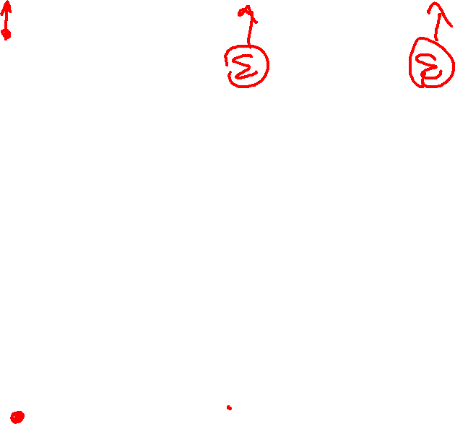
Self-Attention
shared weights at all time steps

Slide 29
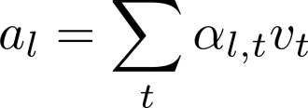
Self-Attention
shared weights at all time steps

Slide 30

Self-Attention
shared weights at all time steps

Slide 31



Self-Attention

Slide 32





Self-Attention

Slide 33
Self-Attention
self-attention “layer”

Slide 34





Self-Attention
self-attention “layer”

Slide 35
Self-Attention
self-attention “layer”
self-attention “layer”

Slide 36
Self-Attention
self-attention “layer”
self-attention “layer”

Slide 37
Self-Attention
Keep repeating
self-attention “layer”
self-attention “layer”

Slide 38
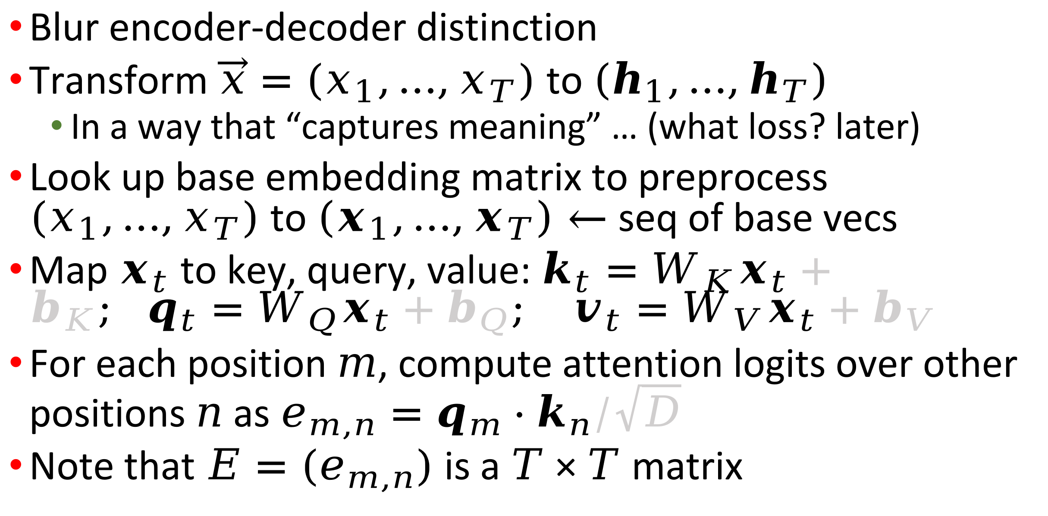
“Self-attention”
Blur encoder-decoder distinction
Transform $\vec{x}=(x_{1},…,x_{T})$ to $\left(h_{1},…,h_{T}\right)$
  In a way that “captures meaning” … (what loss? later)
Look up base embedding matrix to preprocess $(x_{1},…,x_{T})$ to $\left(x_{1},…,x_{T}\right)←$ seq of base vecs
Map $x_{t}$ to key, query, value: $k_{t}=W_{K}x_{t}+b_{K}; q_{t}=W_{Q}x_{t}+b_{Q}; v_{t}=W_{V}x_{t}+b_{V}$
For each position $m$, compute attention logits over other positions $n$ as $e_{m,n}=q_{m}⋅k_{n}/\sqrt{D}$
Note that $E=(e_{m,n})$ is a $T×T$ matrix

Slide 39
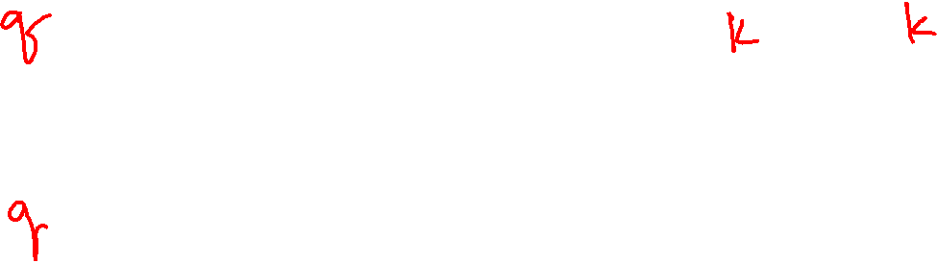
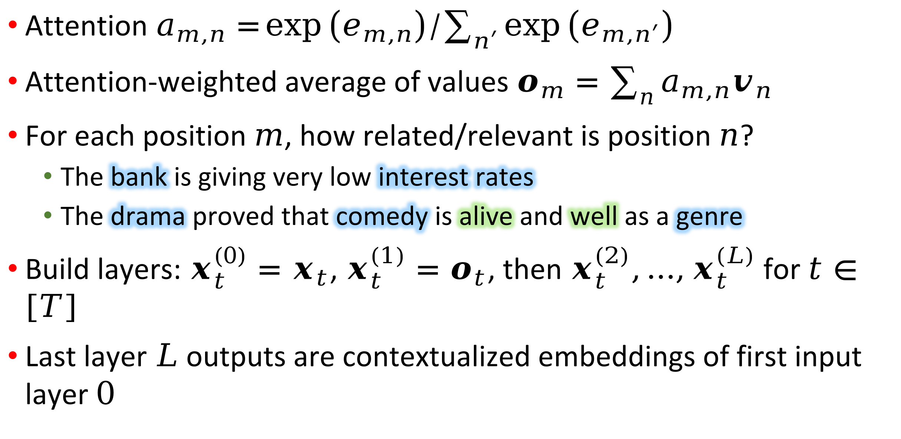
Self-attention, continued
Attention $a_{m,n}=\exp\left(e_{m,n}\right)/\sum_{n^{′}}{\exp\left(e_{m,n^{′}}\right)}$
Attention-weighted average of values $o_{m}=\sum_{n}{a_{m,n}v_{n}}$
For each position $m$, how related/relevant is position $n$?
  The bank is giving very low interest rates
  The drama proved that comedy is alive and well as a genre
Build layers: $x_{t}^{\left(0\right)}=x_{t}$, $x_{t}^{(1)}=o_{t}$, then $x_{t}^{(2)},…,x_{t}^{(L)}$ for $t∈\left[T\right]$
Last layer $L$ outputs are contextualized embeddings of first input layer $0$
Multiple (bi-)LSTMs had been layered before Transformer was proposed

Slide 40
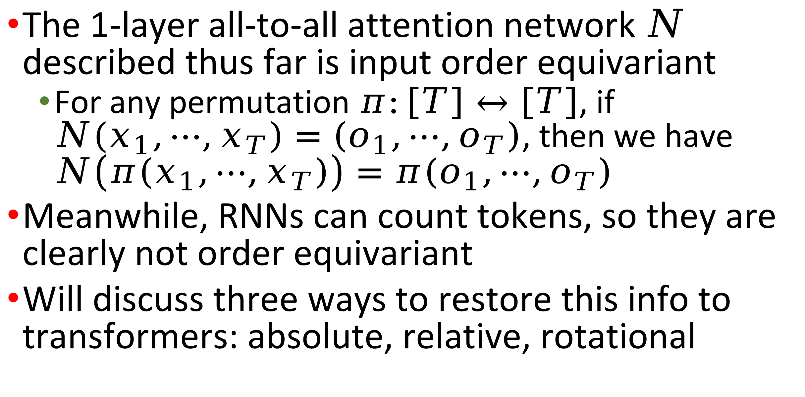
Positional encoding
The 1-layer all-to-all attention network $N$ described thus far is input order equivariant
  For any permutation $π:\left[T\right]↔\left[T\right]$, if $N(x_{1},⋯,x_{T})=\left(o_{1},⋯,o_{T}\right)$, then we have $N\left(π\left(x_{1},⋯,x_{T}\right)\right)=π\left(o_{1},⋯,o_{T}\right)$
Meanwhile, RNNs can count tokens, so they are clearly not order equivariant
Will discuss three ways to restore this info to transformers: absolute, relative, rotational

Slide 41

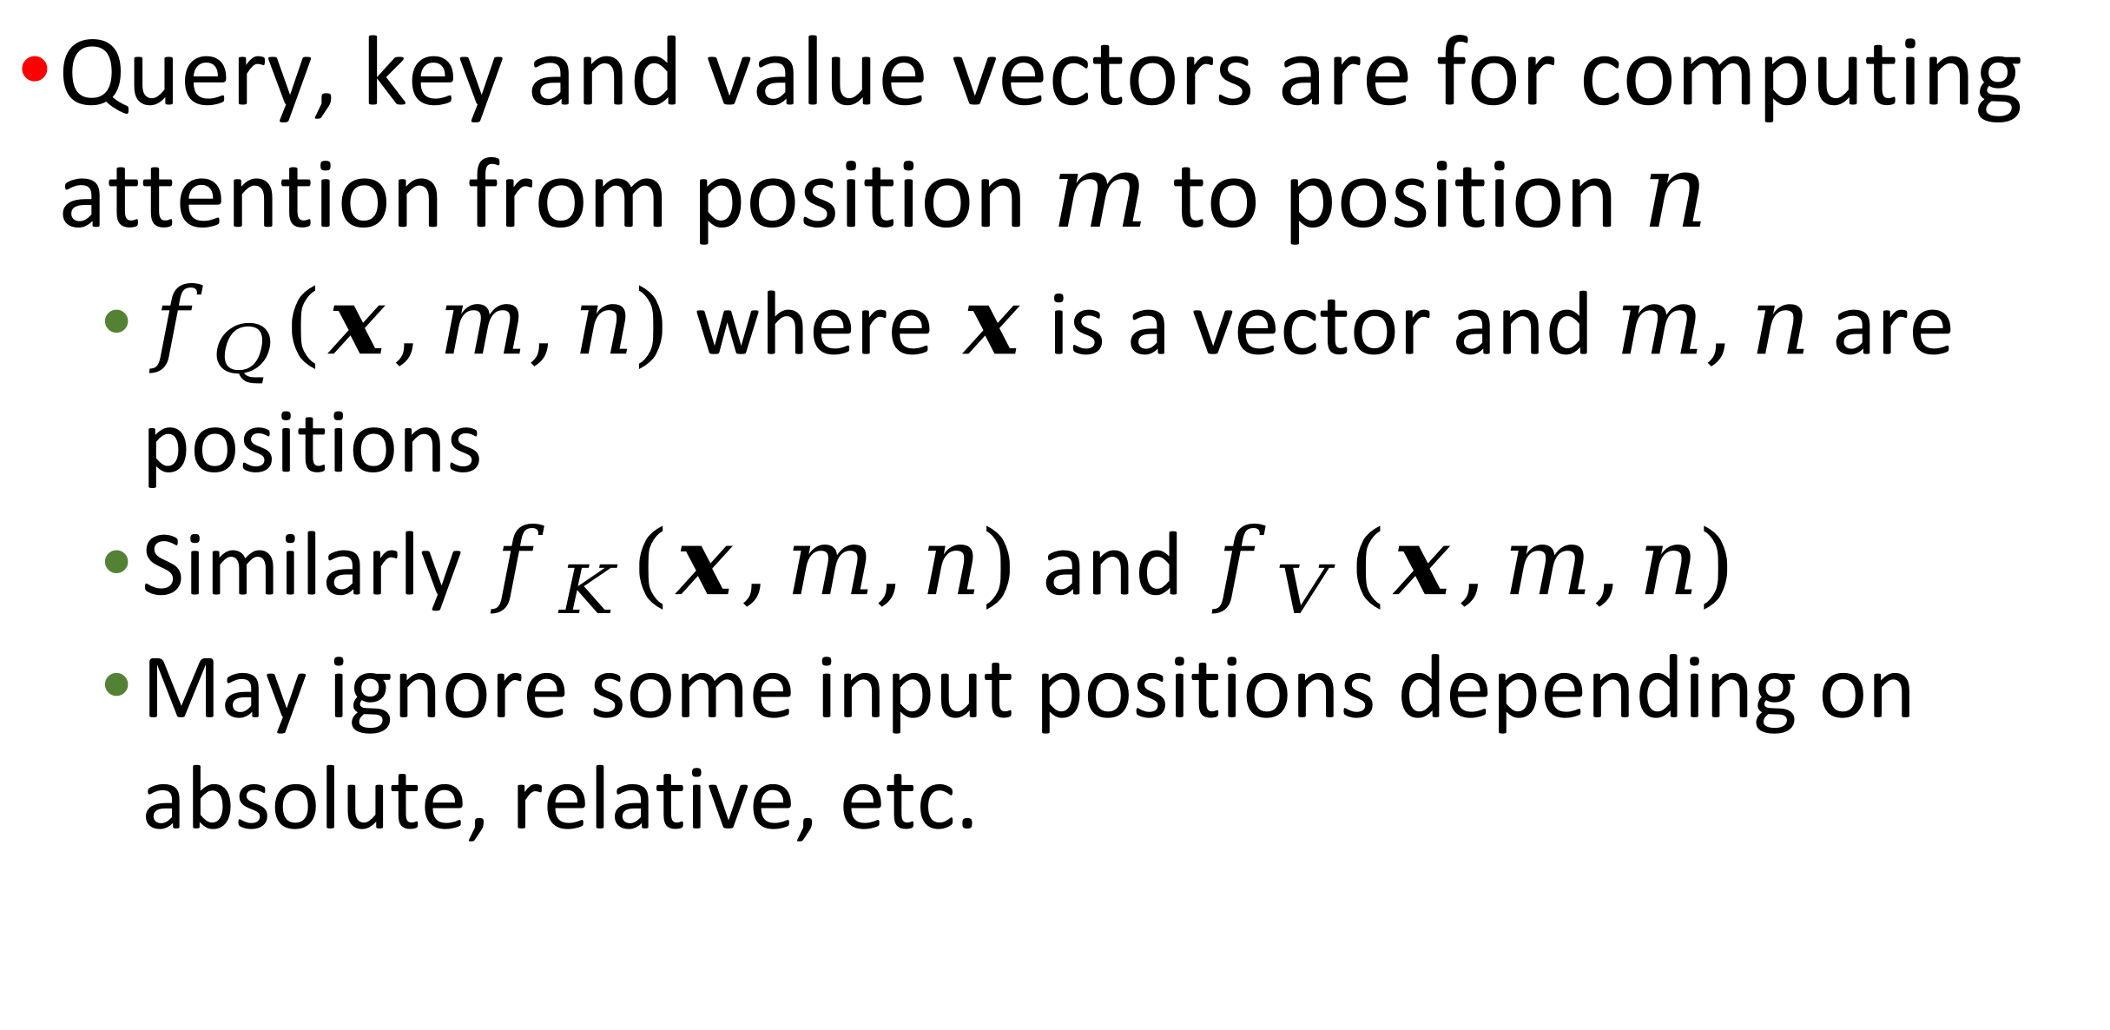
Notation for positional embeddings
Query, key and value vectors are for computing attention from position $m$ to position $n$
  $f_{Q}\left(x,m,n\right)$ where $x$ is a vector and $m,n$ are positions
  Similarly $f_{K}\left(x,m,n\right)$ and $f_{V}\left(x,m,n\right)$
  May ignore some input positions depending on absolute, relative, etc.

Slide 42
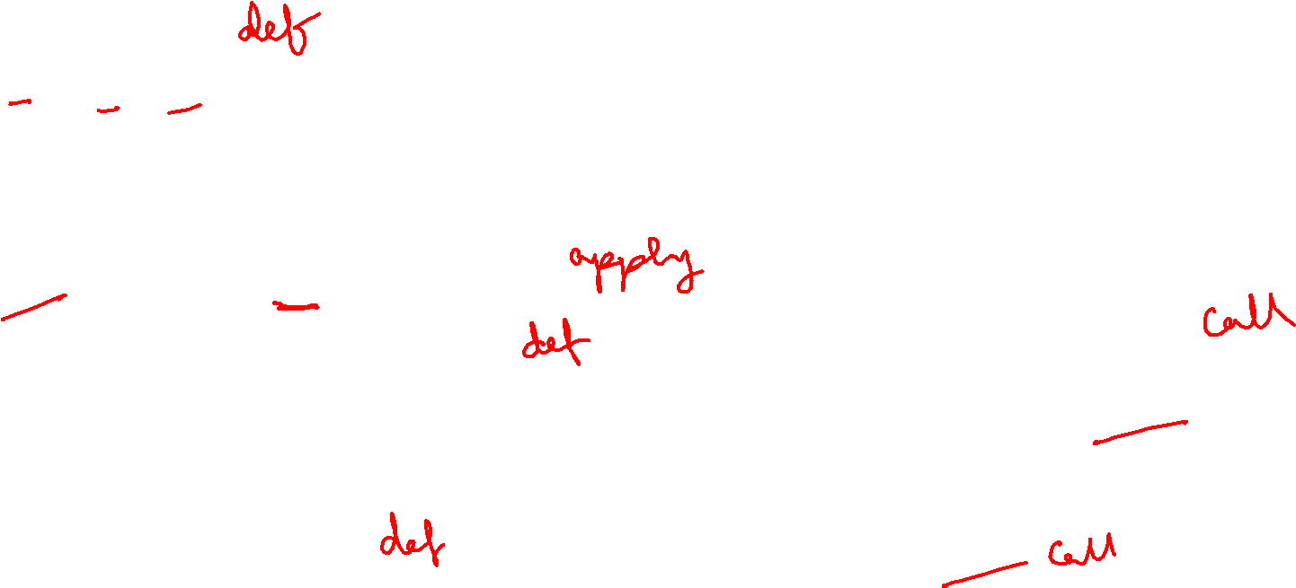
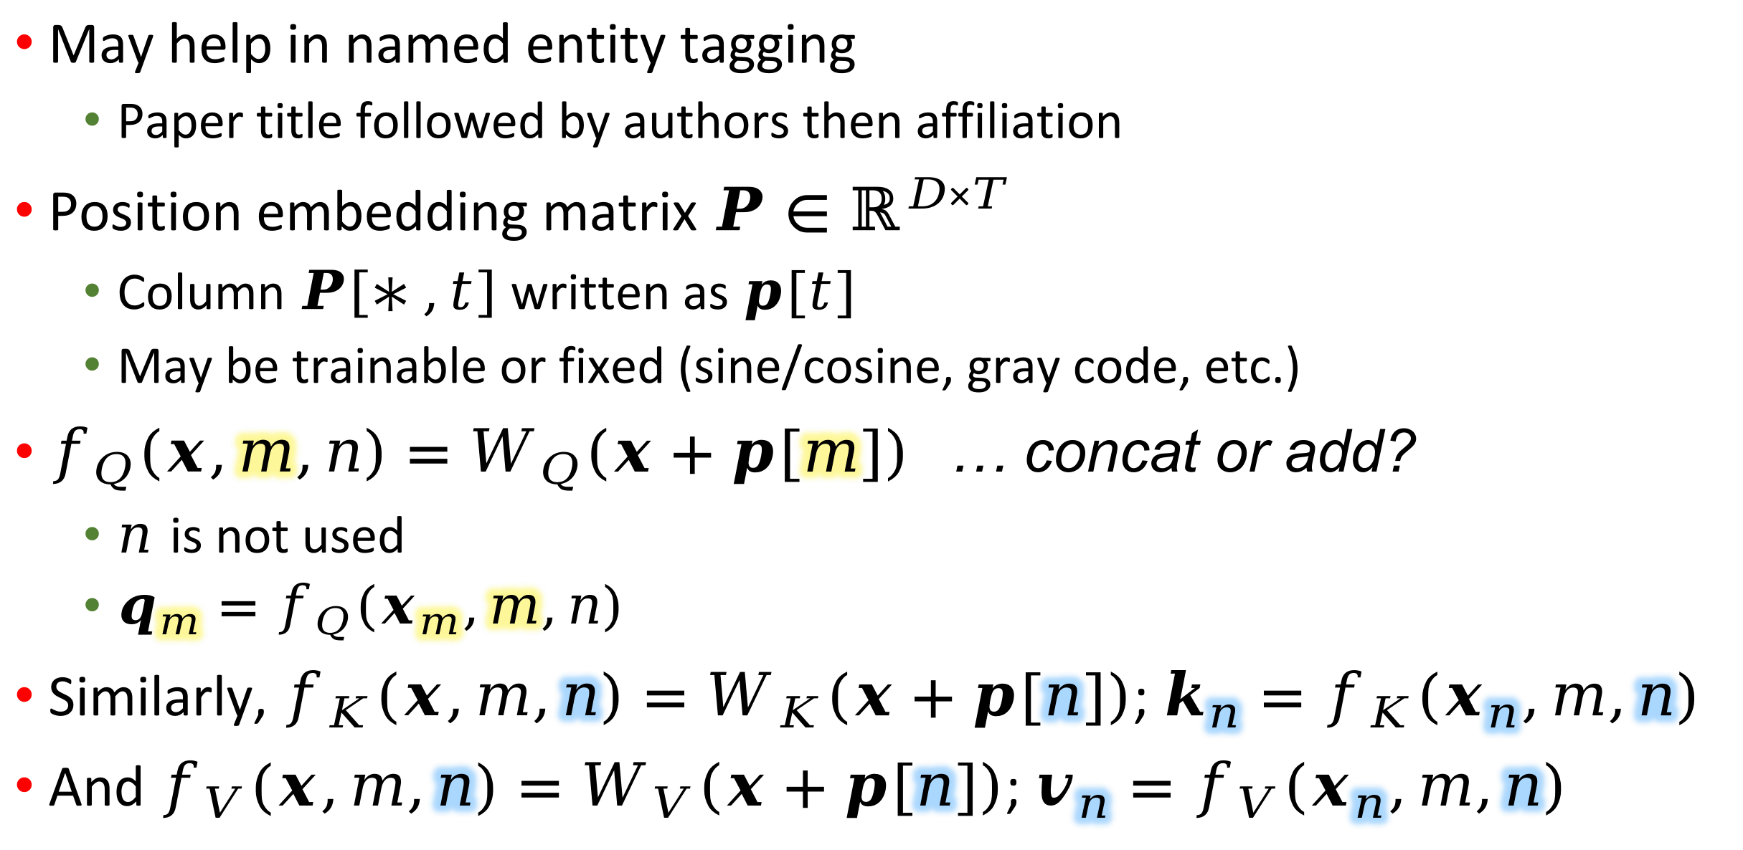
Absolute positional encoding
May help in named entity tagging
  Paper title followed by authors then affiliation
Position embedding matrix $P∈ℝ^{D×T}$
  Column $P\left[∗,t\right]$ written as $p[t]$
  May be trainable or fixed (sine/cosine, gray code, etc.)
$f_{Q}\left(x,m,n\right)=W_{Q}\left(x+p[m]\right)$ … concat or add?
  $n$ is not used
  $q_{m}=f_{Q}\left(x_{m},m,n\right)$
Similarly, $f_{K}\left(x,m,n\right)=W_{K}\left(x+p[n]\right)$; $k_{n}=f_{K}\left(x_{n},m,n\right)$
And $f_{V}(x,m,n)=W_{V}\left(x+p[n]\right)$; $v_{n}=f_{V}\left(x_{n},m,n\right)$

Slide 43

In deep learning, specifically transformers, it is common to add the positional embedding vector to the base word embedding, rather than concatenate. Additive superposition may destroy one or both signal, yet it seems to work fine in practice. Are there papers comparing the two approaches to combine word and position information, or providing theories as to why simple vector sum is good enough?
https://chatgpt.com/share/698ed551-5ae4-8002-945b-4cf0dc4def83

Slide 44
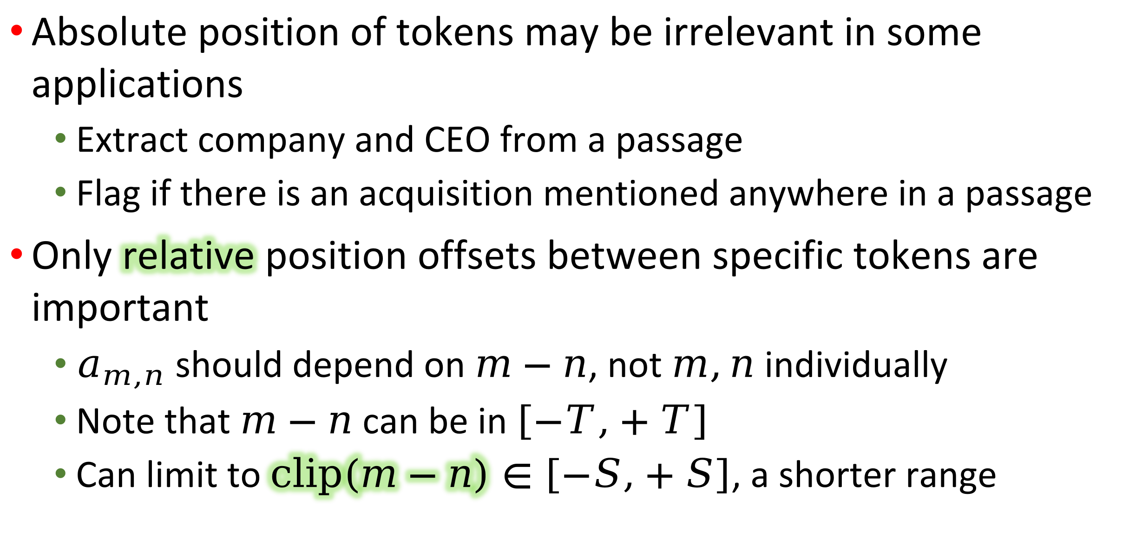
Relative positional embedding
Absolute position of tokens may be irrelevant in some applications
  Extract company and CEO from a passage
  Flag if there is an acquisition mentioned anywhere in a passage
Only relative position offsets between specific tokens are important
  $a_{m,n}$ should depend on $m−n$, not $m,n$ individually
  Note that $m−n$ can be in $\left[−T,+T\right]$
  Can limit to $clip\left(m−n\right)∈\left[−S,+S\right]$, a shorter range

Slide 45

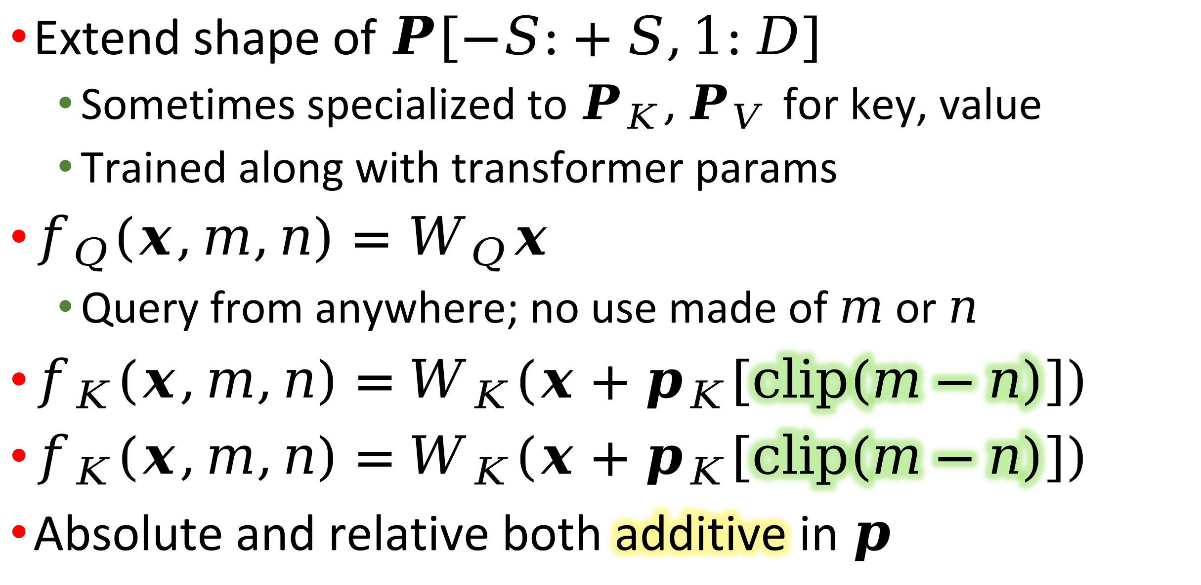
Relative positional embedding
Extend shape of $P\left[−S:+S,1:D\right]$
  Sometimes specialized to $P_{K},P_{V}$ for key, value
  Trained along with transformer params
$f_{Q}\left(x,m,n\right)=W_{Q}x$
  Query from anywhere; no use made of $m$ or $n$
$f_{K}\left(x,m,n\right)=$ $W_{K}\left(x+p_{K}\left[clip\left(m−n\right)\right]\right)$
$f_{K}\left(x,m,n\right)=$ $W_{K}\left(x+p_{K}\left[clip\left(m−n\right)\right]\right)$
Absolute and relative both additive in $p$

Slide 46
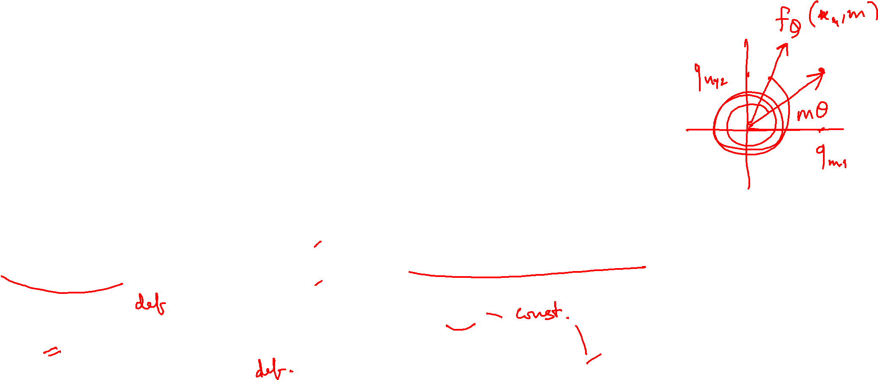
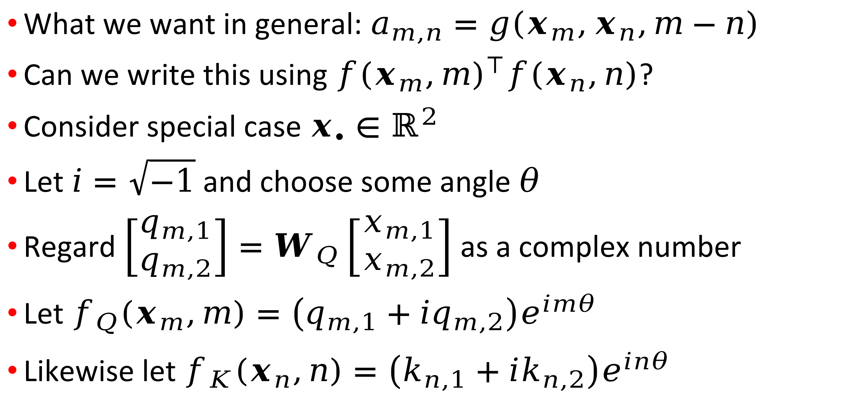
Rotary position embedding
What we want in general: $a_{m,n}=g\left(x_{m},x_{n},m−n\right)$
Can we write this using ${f\left(x_{m},m\right)}^{⊺}f\left(x_{n},n\right)$?
Consider special case $x_{∙}∈ℝ^{2}$
Let $i=\sqrt{−1}$ and choose some angle $θ$
Regard $\left[\begin{matrix}q_{m,1} \\ q_{m,2}\end{matrix}\right]=W_{Q}\left[\begin{matrix}x_{m,1} \\ x_{m,2}\end{matrix}\right]$ as a complex number
Let $f_{Q}\left(x_{m},m\right)=\left(q_{m,1}+iq_{m,2}\right)e^{imθ}$
Likewise let $f_{K}\left(x_{n},n\right)=\left(k_{n,1}+ik_{n,2}\right)e^{inθ}$

Slide 47
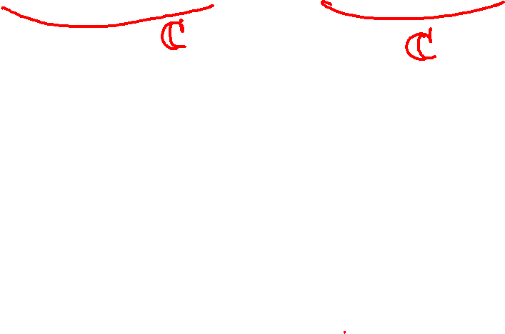
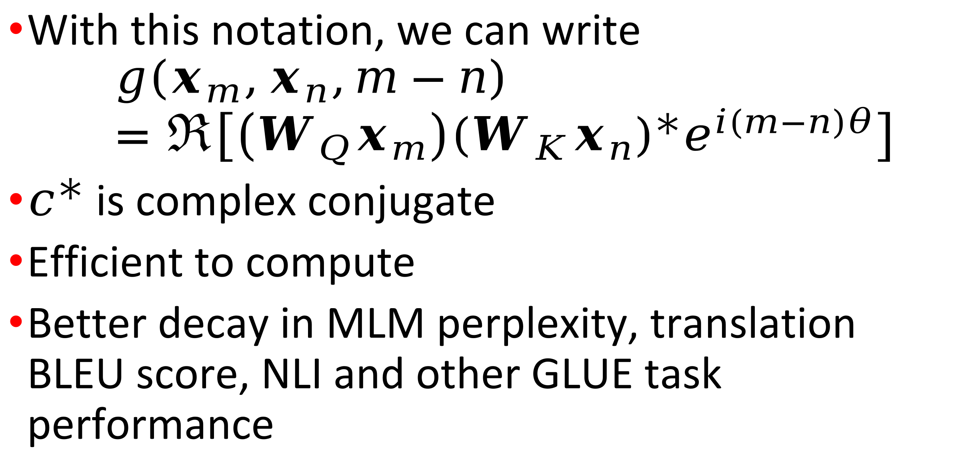
Rotary position, continued
With this notation, we can write
$$g\left(x_{m},x_{n},m−n\right)=ℜ\left[\left(W_{Q}x_{m}\right){\left(W_{K}x_{n}\right)}^{∗}e^{i(m−n)θ}\right]$$
$c^{∗}$ is complex conjugate
Efficient to compute
Better decay in MLM perplexity, translation BLEU score, NLI and other GLUE task performance

Slide 48
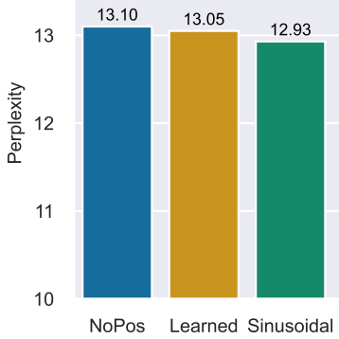
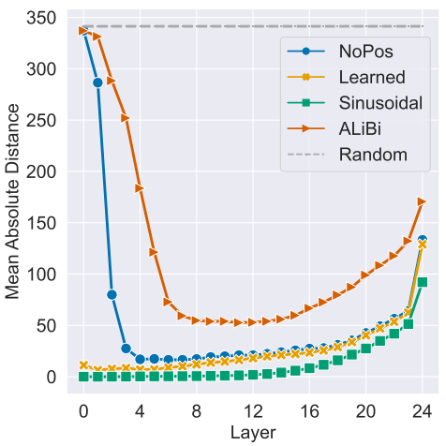
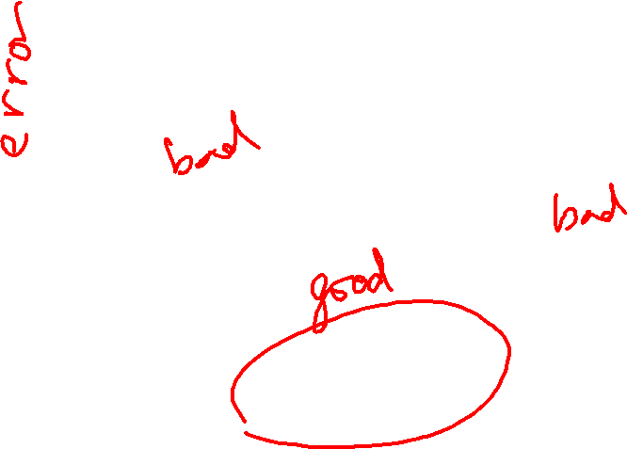
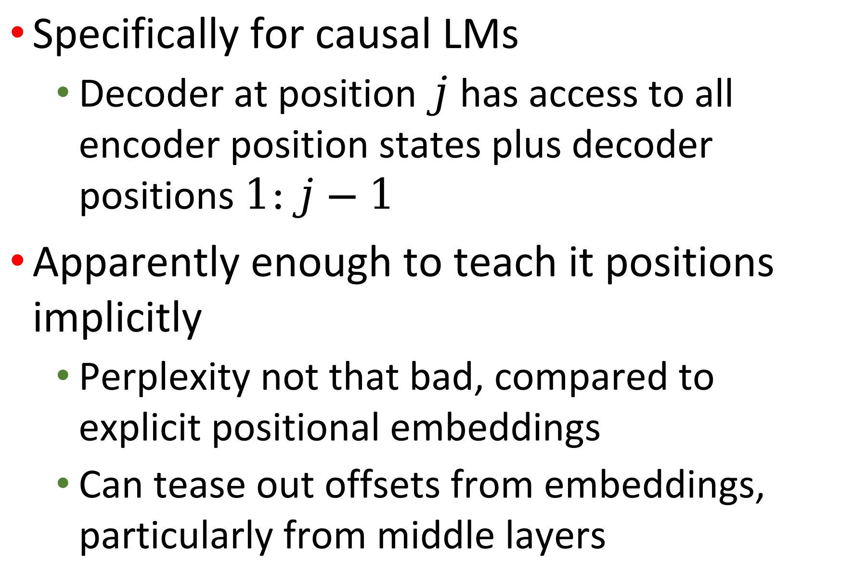
Positional embeddings necessary?
Specifically for causal LMs
  Decoder at position $j$ has access to all encoder position states plus decoder positions $1:j−1$
Apparently enough to teach it positions implicitly
  Perplexity not that bad, compared to explicit positional embeddings
  Can tease out offsets from embeddings, particularly from middle layers

Slide 49
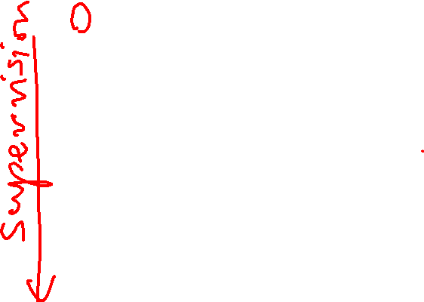
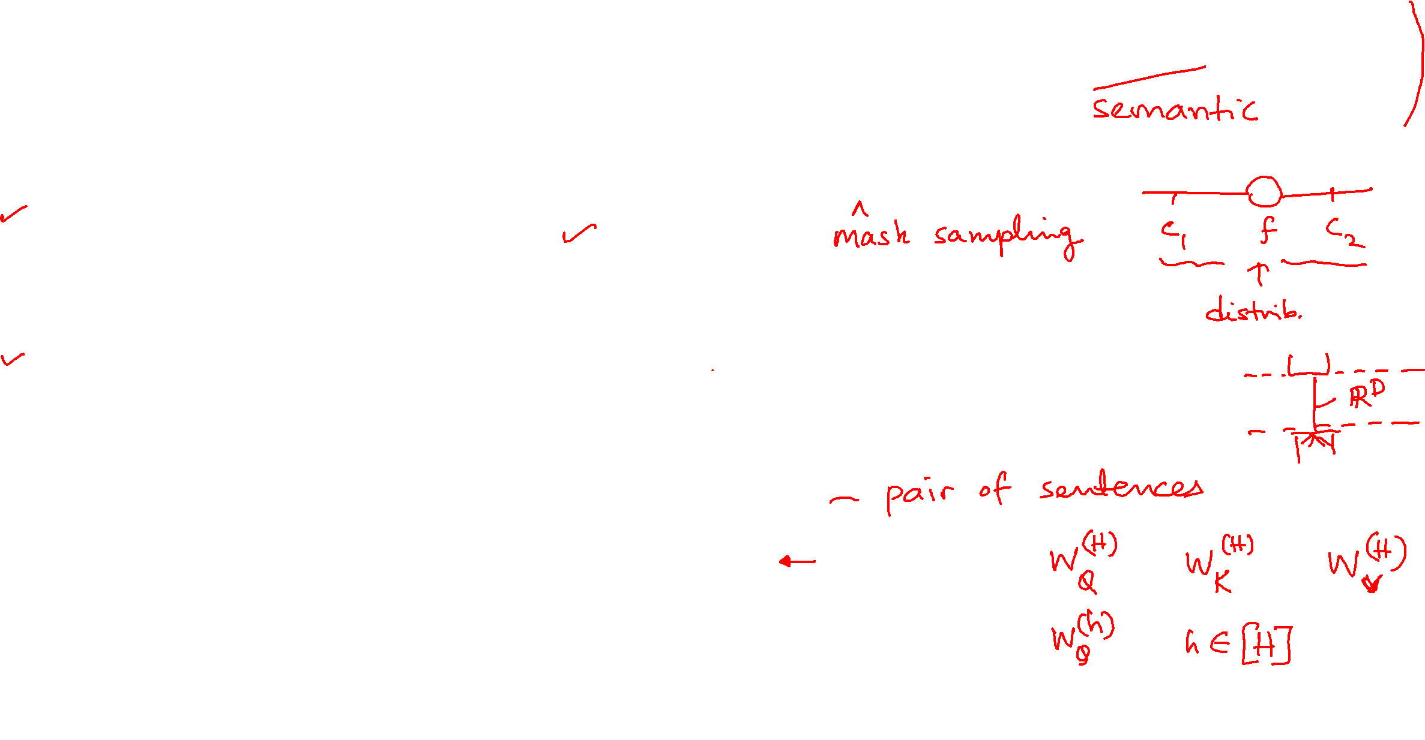
What’s the objective/loss?
GLUE tasks (also see SuperGLUE)
  Multi-genre NLI, Quora Question Pair equivalence, variants of question answering, sentiment, linguistic acceptability (CoLA), textual similarity, etc.
Masked word reconstruction (elaborate protocol)
  Inspired from word2vec
  Collects signals for sentiment, CoLA
Next sentence prediction (QA, NLI)
  Given two sentences, 2-class classification problem
  Does sentence #2 follow sentence #1?
  Useful for NLI, QA, sentence similarity
These two objectives used in BERT
Multiple attention heads for diverse tasks

Slide 50
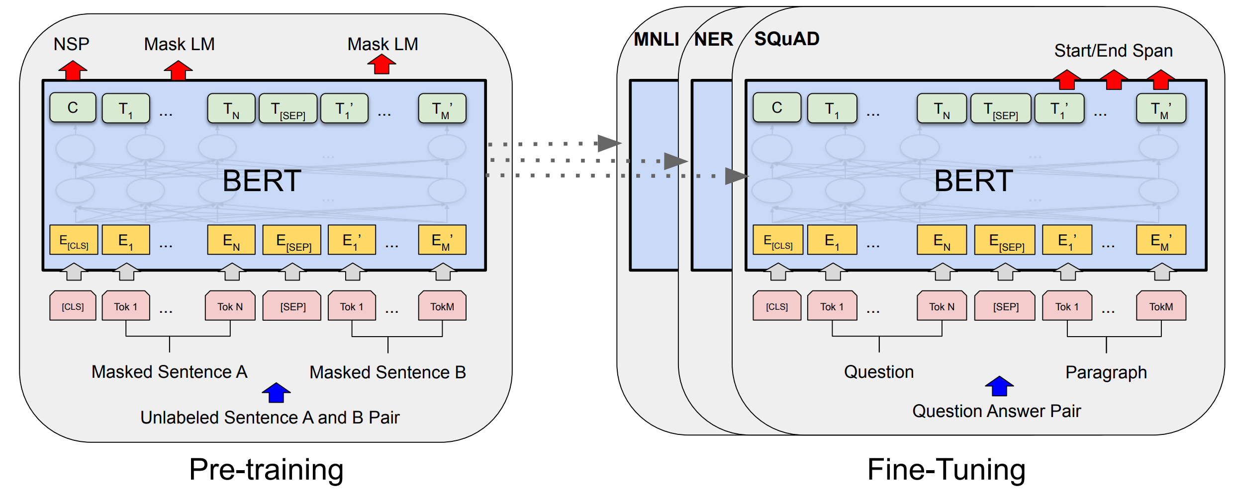
BERT (“Encoder only”)

Slide 51
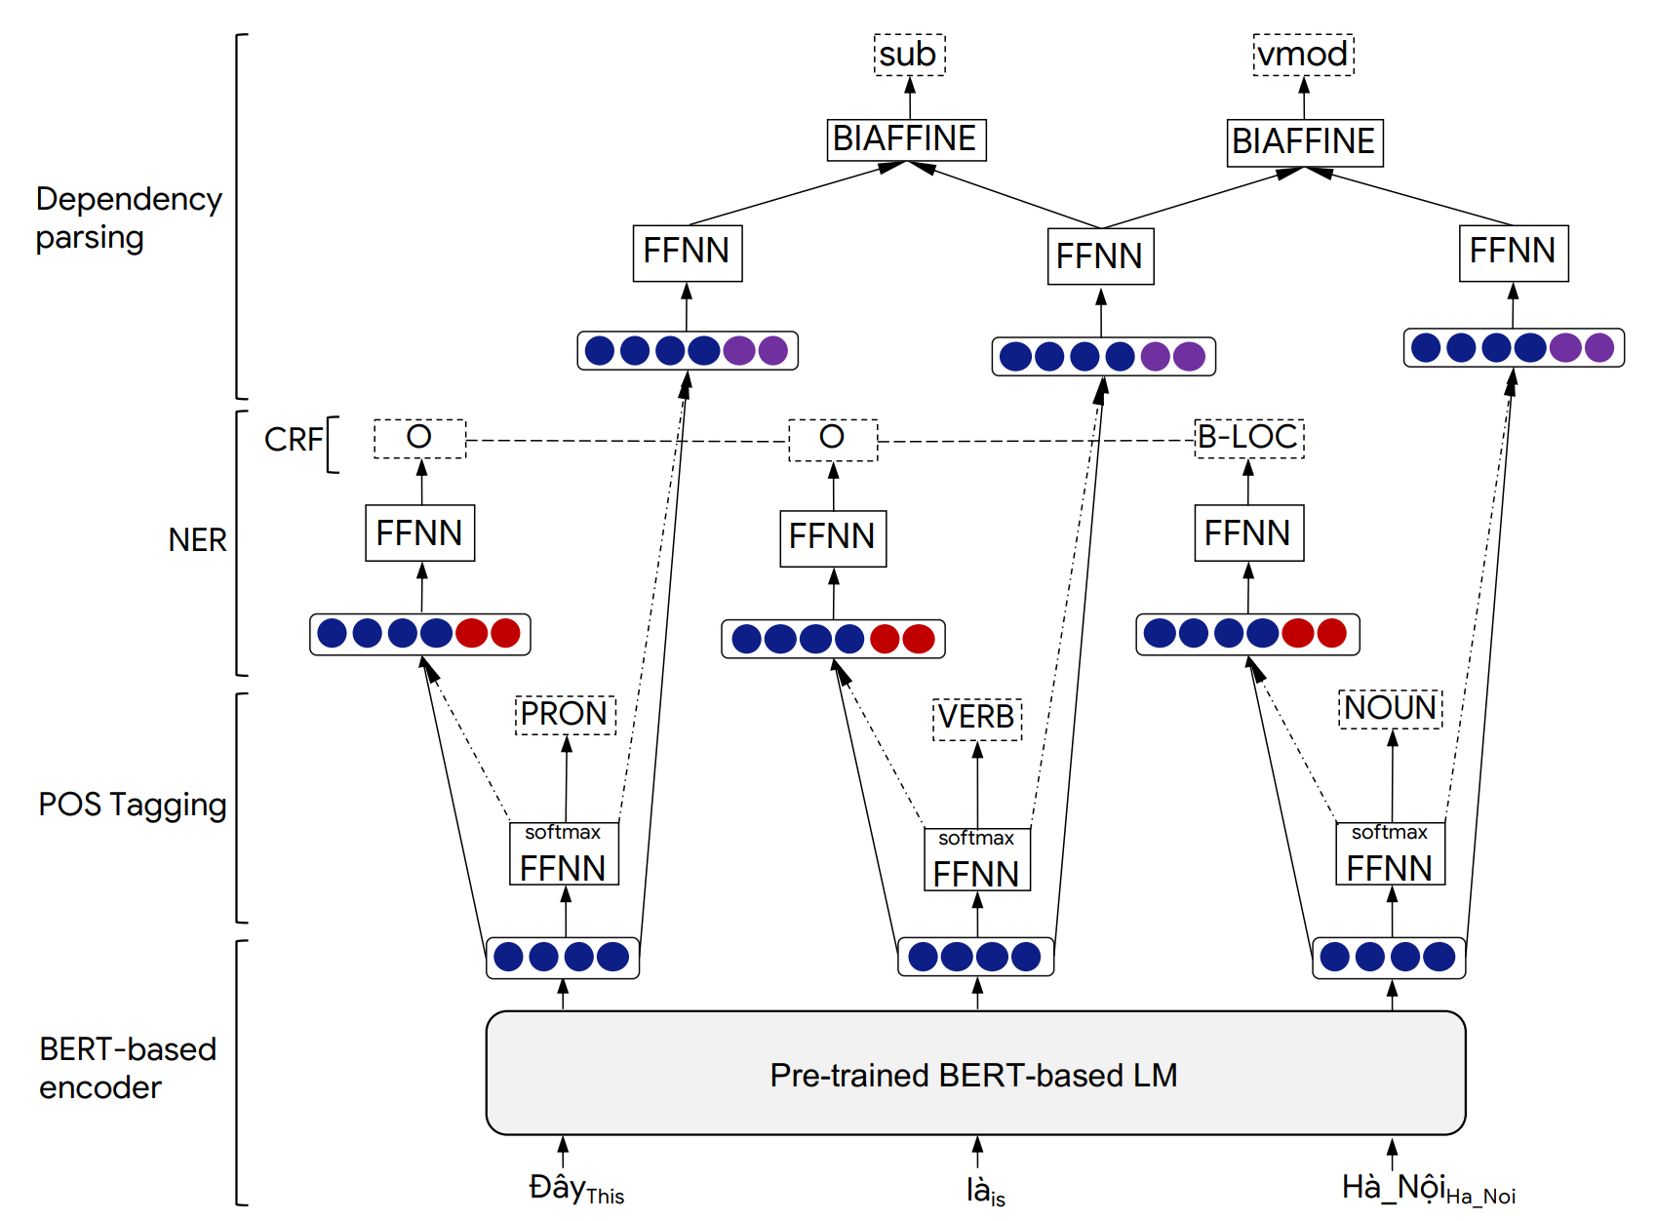
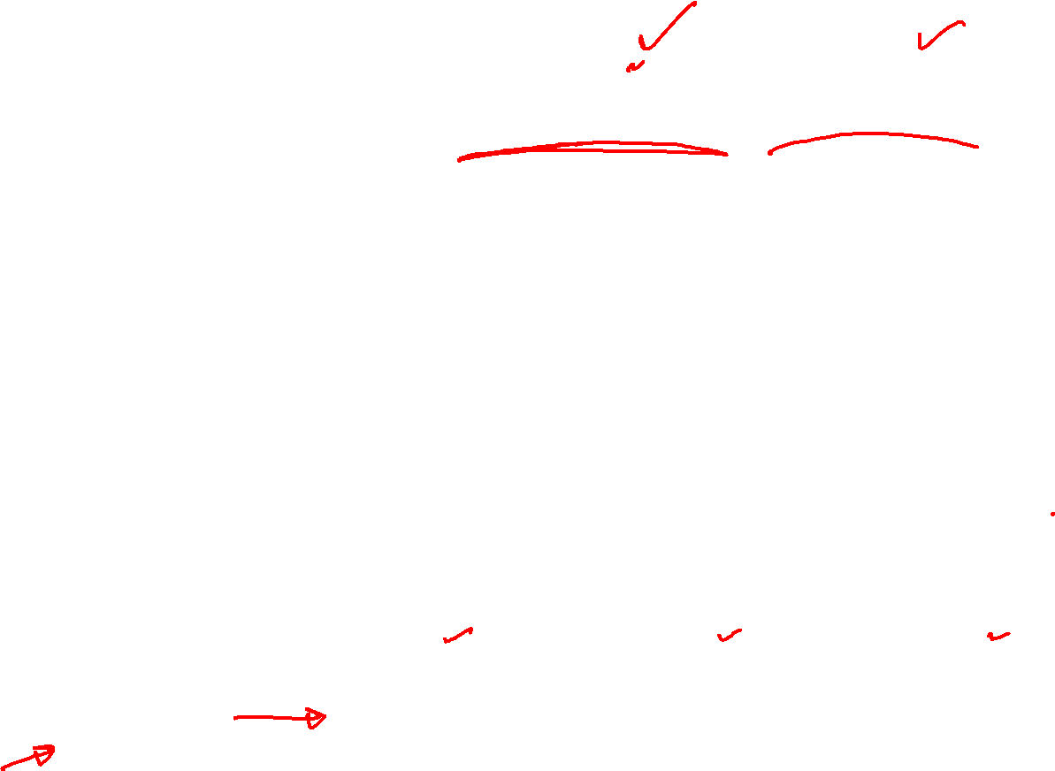
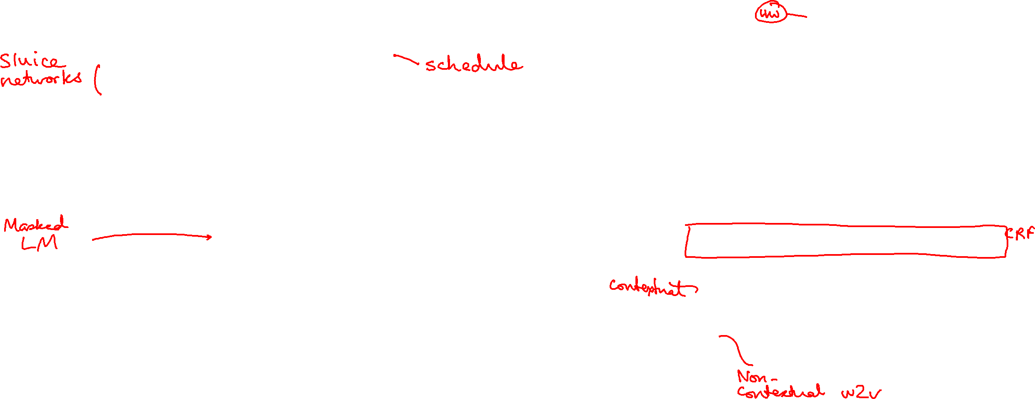
Tasks and losses
Multi-task learning
  Shared initial representation layers
  Later layers diversified to several tasks
  Loss is usually weighted sum
  All-to-all synergy possible
  Training data of all tasks needed throughout
  Easier to stabilize performance across tasks
Pre-train then fine-tune
  Tasks highly unbalanced in training cost
  Costly “generic tasks” expected to help many “downstream tasks”
  Generic pre-training tasks help downstream tasks, not other way
  Danger of “refusing to learn” vs “catastrophic forgetting”
https://github.com/VinAIResearch/PhoNLP

Slide 52
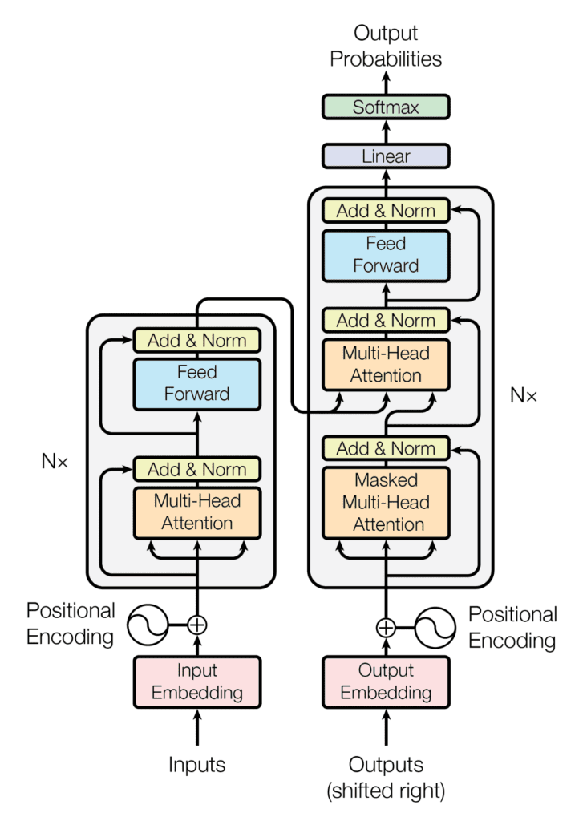
“Encoder-decoder” (BART, T5)

Slide 53
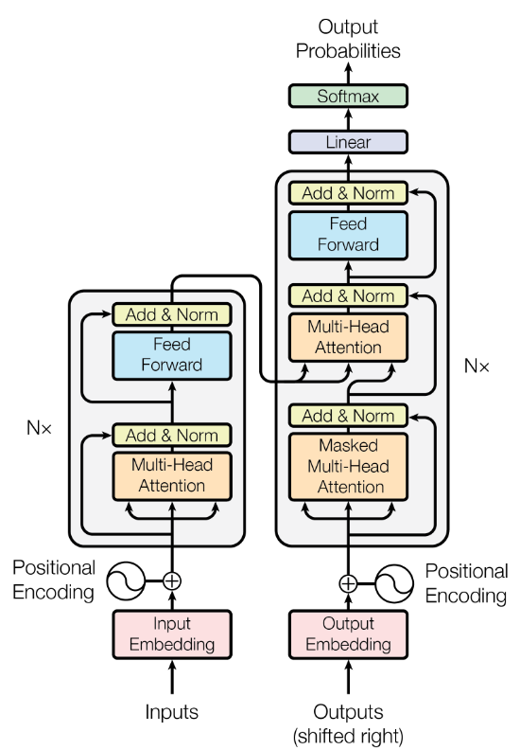
Transformer
Architecture
Decoder
Encoder
Source of Image : Attention is all you need (Vaswani t al., 2017)

Slide 54
Transformer
Architecture
Position embeddings are added to each word embedding. Otherwise, since we have no recurrence, our model is unaware of the position of a word in the sequence!

Slide 55
Transformer
Architecture
Residual connections, which mean that we add the input to a particular block to its output, help improve gradient flow

Slide 56
Transformer
Architecture
A feed-forward layer on top of the attention- weighted averaged value vectors allows us to add more parameters / nonlinearity

Slide 57
Transformer
Architecture
We stack as many of these Transformer blocks on top of each other as we can (bigger models are generally better given enough data!)

Slide 58
Transformer
Architecture
Moving onto the decoder, which takes in English sequences that have been shifted to the right (e.g., <START> schools opened their)

Slide 59
Transformer
Architecture
We first have an instance of masked self attention. Since the decoder is responsible for predicting the English words, we need to apply masking as we saw before.

Slide 60
Transformer
Architecture
Now, we have cross attention, which connects the decoder to the encoder by enabling it to attend over the encoder’s final hidden states.
Source of Image : Attention is all you need (Vaswani et al., 2017)

Slide 61
Transformer
Architecture
After stacking a bunch of these decoder blocks, we finally have our familiar softmax layer to predict the next English word.

Slide 62
Transformer
Architecture
Reduces covariance shift and makes the system stable
Adding non-linearities
Allows querying multiple positions at each layer
Prevents attention lookups into the future while decoding
Adds positional information
Source of Image : Attention is all you need (Vaswani et al., 2017)

Slide 63
Transformer resources
MicroGPT by Karpathy
  ~260 lines of dependence-free Python
Illustrated transformer

Slide 64
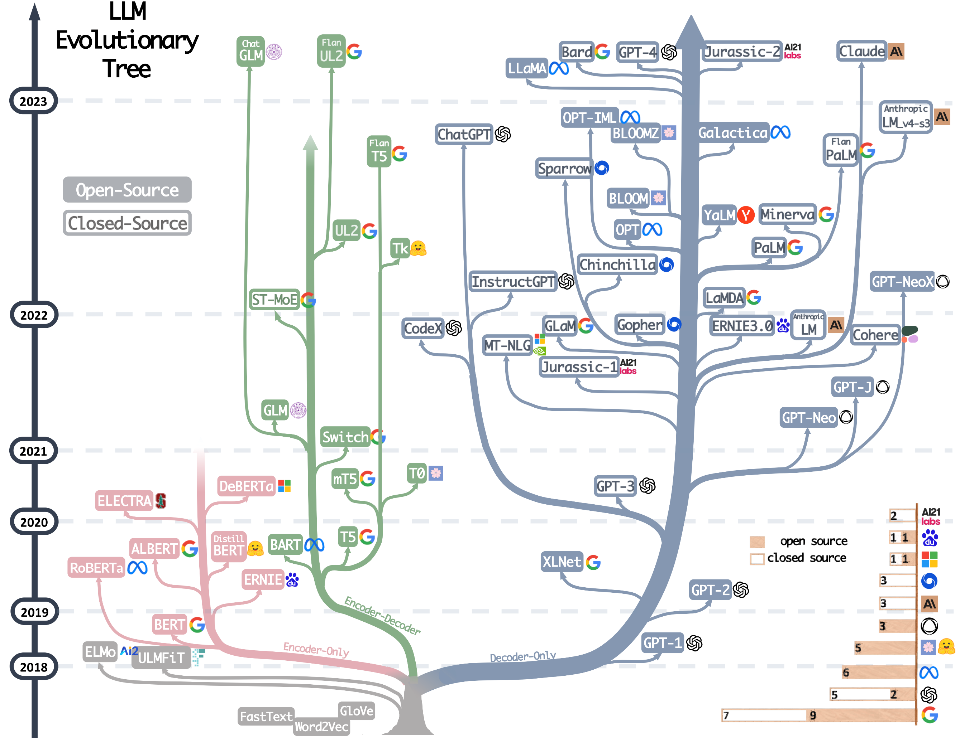
Language model phylogeny: “Not overwhelming at all!”

Slide 65
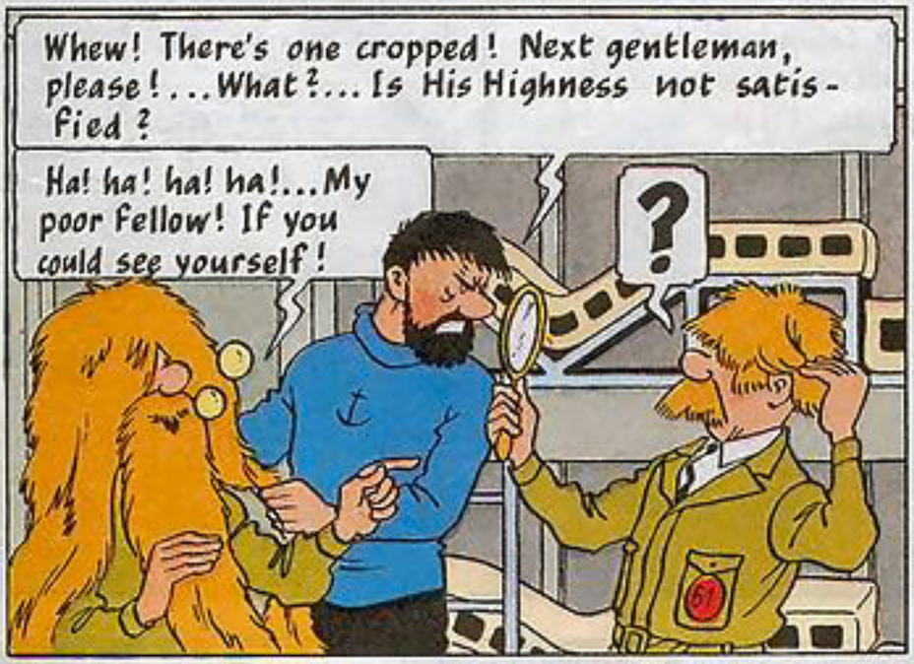

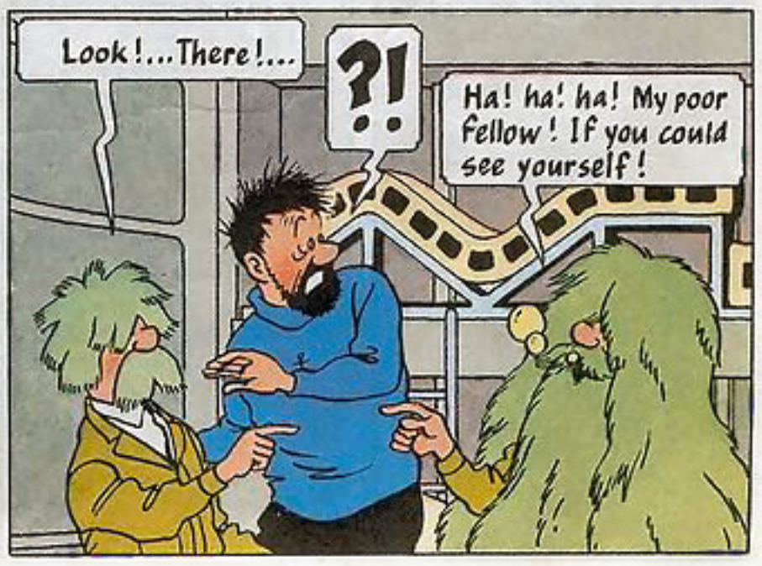
Grows faster than you can prune

Slide 66
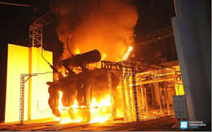
Transformers overloaded
GPT (“Decoder-only” Generative Pre Training)
BERT (Bidirectional Encoder Representation
From Transformers)
XLNet (Generalized Autoregressive Pretraining)
GPT2
RoBERTa (Robustly Optimized BERT)
DistilBERT (40% smaller, 97% performance, 60% faster)
GPT3 (2048-token context, also see this) then 4, 4.5, 5, …
T5 (Text-to-Text Transfer Transformer; English op-codes)
BLOOM (176B-parameter open-access multilingual LM)
PaLM (540B), InstructGPT
Adapters, retrieval augmented LM

Slide 67
Milestones
BERT, GPT and close variations
T5 (first use of task-specific instruction “prompt” in NL)
In-context learning
Chain of thoughts (CoT)
ChatGPT (interaction with ‘alignment’)

