Slide 1

Large Language Models: Introduction and Recent Advances
ELL881 · AIL821
Instruction Tuning
Gaurav Pandey
Research Scientist, IBM Research

Slide 2
How to make ChatGPT ?
Pre-Training
  This is the point where most of the reasoning power is infused in the model.
  Data – Billions of tokens of unstructured text from the internet
Instruction Tuning
  Trains models to follow natural language instructions
  Data – Several thousand (Task/Instruction, Output) examples
Reinforcement Learning from Human Feedback
  Show the output(s) generated by models to humans/reward model
  Collect feedback in the form of preferences.
  Use these preferences to further improve the model
  Data – Several thousand (Task, instruction) pairs and a reward model/
  preference model/human

Slide 3

How to make ChatGPT ?
Pre-Training
  This is the point where most of the reasoning power is infused in the model.
  Data – Billions of tokens of unstructured text from the internet
Instruction Tuning
  Trains models to follow natural language instructions
  Data – Several thousand (Task/Instruction, Output) examples
Reinforcement Learning from Human Feedback
  Show the output(s) generated by models to humans/reward model
  Collect feedback in the form of preferences.
  Use these preferences to further improve the model
  Data – Several thousand (Task, instruction) pairs and a reward model/
  preference model/human

Slide 4
Table of Contents
Instruction Tuning – Why do we need it?
Training loss
  Decoder-only models
  Encoder-Decoder models
Getting the data
  Human-generated
  Synthetically generated
Popular instruction-tuned models
Instruction Tuned Models are Quick Learners
The Superficial Alignment Hypothesis

Slide 5
Why Do We Need Instruction Training?
To bridge the gap between
Observed behavior: Next word prediction
Desired Behavior: Instruction Following
To allow behavior modification during inference
Meta-instruction: Answer all questions as William Shakespeare would.
Catch
The instruction-tuning data should be diverse and have high coverage
Content Credit: Instruction Tuning for Large Language Models: A Survey

Slide 6
Training Loss

Slide 7








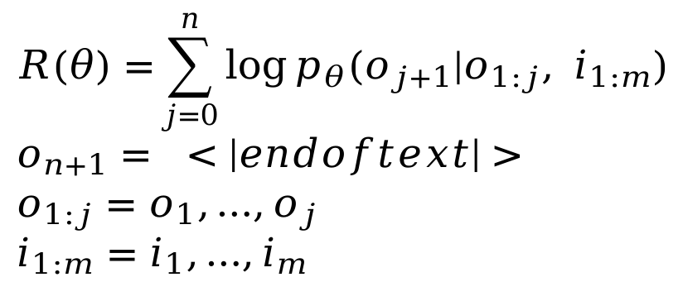






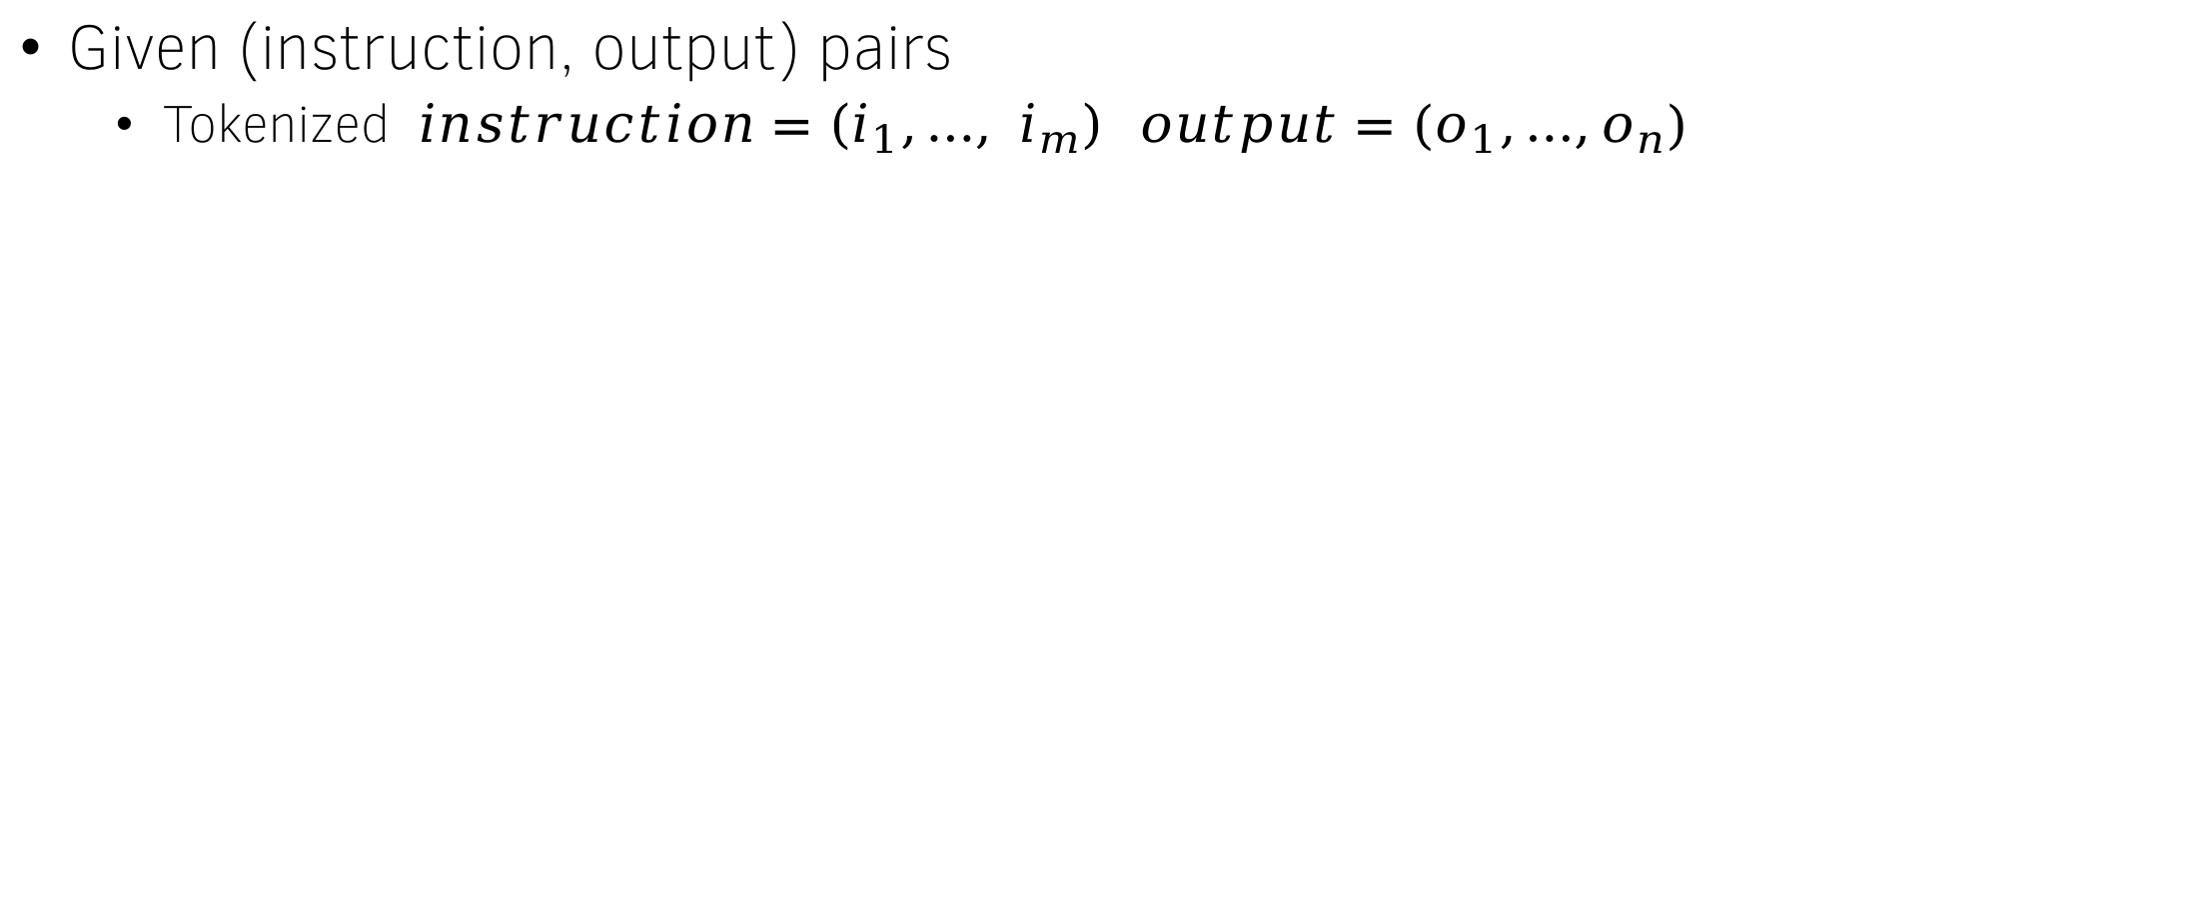
How to train? (Decoder-only models)
Given (instruction, output) pairs
  Tokenized $instruction=\left(i_{1},…, i_{m}\right) output=(o_{1},…,o_{n})$
$$o_{1}$$
$$o_{2}$$
$$o_{3}$$
$$o_{4}$$
$$<|endoftext|>$$
Transformer Decoder
$$R\left(θ\right)={\sum_{j=0}^{n}{\log{p_{θ}(o_{j+1}|o_{1:j}, i_{1:m})}}} \\ o_{n+1}= <\left|endoftext\right|> \\ o_{1:j}=o_{1},…,o_{j} \\ i_{1:m}=i_{1},…,i_{m}$$
$$i_{1}$$
$$i_{2}$$
$$i_{3}$$
$$i_{4}$$
$$i_{5}$$
$$o_{1}$$
$$o_{2}$$
$$o_{3}$$
$$o_{4}$$

Slide 8





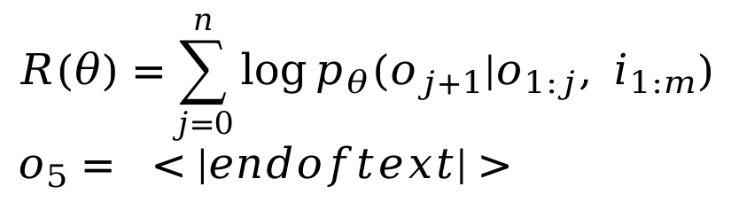

How to train? (Encoder-Decoder Models)
Given (instruction, output) pairs
  Tokenized $instruction=\left(i_{1},…, i_{m}\right) output=(o_{1},…,o_{n})$
$$o_{1}$$
$$o_{2}$$
$$o_{3}$$
$$o_{4}$$
$$<|endoftext|>$$
Cross-attention
$$e_{1}$$
$$e_{2}$$
$$e_{3}$$
$$e_{4}$$
$$e_{5}$$
Transformer Decoder
$$R\left(θ\right)={\sum_{j=0}^{n}{\log{p_{θ}(o_{j+1}|o_{1:j}, i_{1:m})}}} \\ o_{5}= <|endoftext|>$$
Transformer Encoder
BOS
$$o_{1}$$
$$o_{2}$$
$$o_{3}$$
$$o_{4}$$
$$i_{1}$$
$$i_{2}$$
$$i_{3}$$
$$i_{4}$$
$$i_{5}$$

Slide 9
Getting the Data

Slide 10
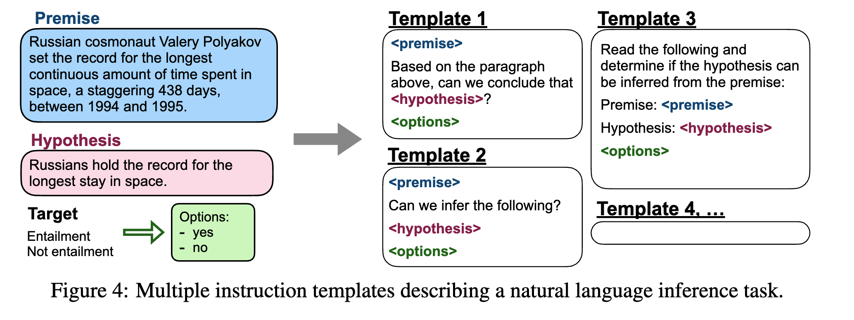
Where does the data come from?
Human-crafted
  Flan-2021
    Transforms NLP benchmarks into natural language input-output pairs.
Credit: The Flan Collection: Designing Data and Methods
for Effective Instruction Tuning

Slide 11
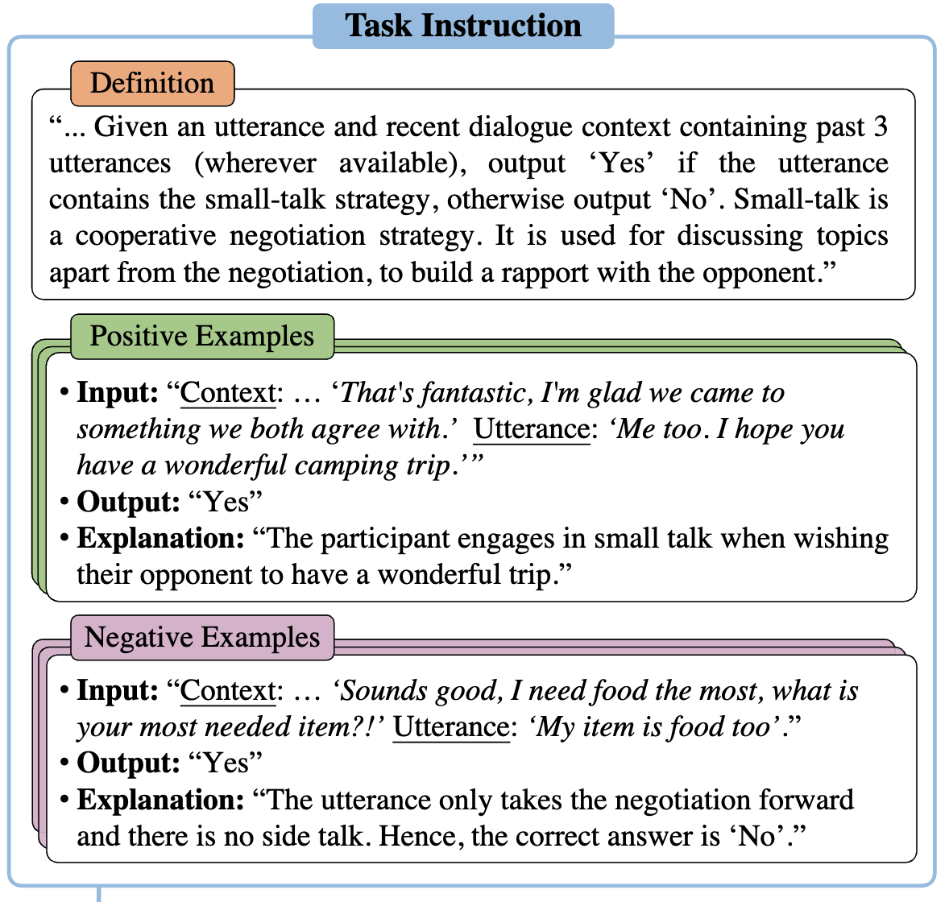
SuperNatural Instructions
Tasks contributed by NLP practitioners
Creative modification of existing NLP tasks
Synthetic tasks that can be communicated in few sentences
Credit: SUPER-NATURALINSTRUCTIONS: Generalization via Declarative Instructions on 1600+ NLP Tasks

Slide 12
Synthetic Instruction-Tuning Data
Use a pre-trained LM to generate synthetic task/instruction as well as output.
Cheap and easy to obtain
Often better quality than human-crafted data.
We will look at 4 popular approaches for synthetic data generation for instruction tuning:
Self-Instruct
Evol-Instruct
Orca
Instruction Back-translation

Slide 13
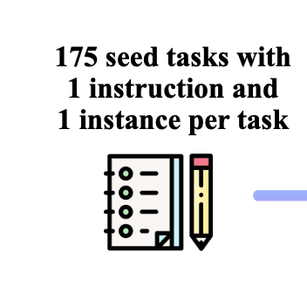
Self-Instruct
Given:
Objective:
  Generate new instructions
  Generate examples for each instruction

Slide 14
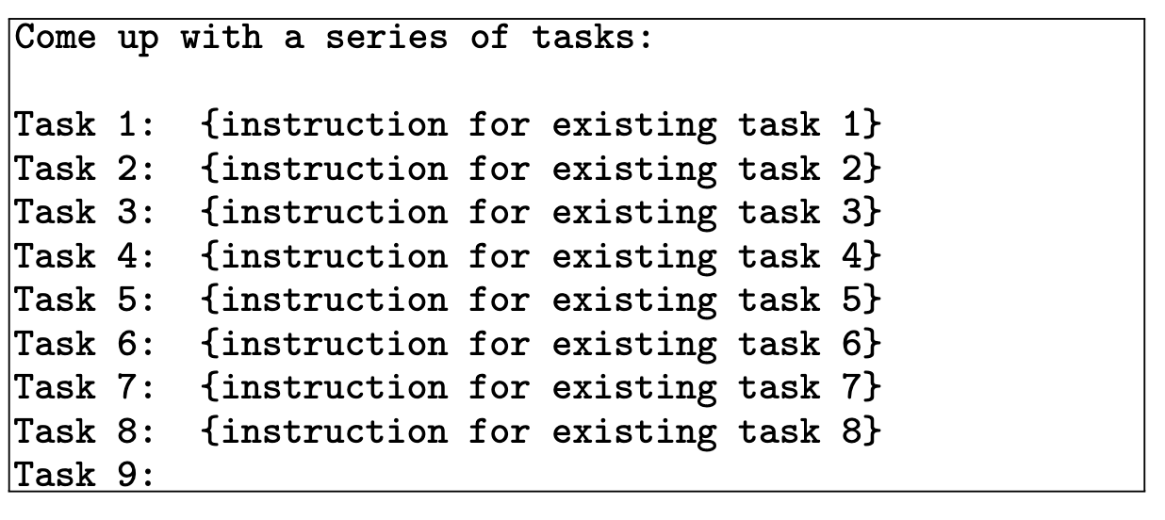

The Self-Instruct Process – Instruction Generation
Pre-trained LLM such as GPT-3
Sample 8
Synthetically-Generated
instructions
Similarity with existing
Instructions < threshold
Generated Instructions
yes

Slide 15
The Self-Instruct Process – Classification Task Identification
Can the following task be regarded as a classification task with finite output labels?
Task: Given my personality and the job, tell me if I would be suitable.
Is it classification? Yes
Task: Give me an example of a time when you had to use your sense of humor.
Is it classification? No
.
.
.
Task: {instruction for the target task}
Is it classification?

Slide 16
The Self-Instruct Process – Instance Generation
Given an instruction, generate instances that follow the instruction.
In-context learning can be used to generate instances for an instruction
Input-First
Come up with examples for the following tasks. Try to generate multiple examples when possible.
If the task doesn’t require additional input, you can generate the output directly.
Task: Which exercises are best for reducing belly fat at home?
Output:
- Lying Leg Raises
- Leg In And Out
- Plank
- Side Plank
- Sit-ups
Task: {Instruction for the target task}

Slide 17
The Self-Instruct Process – Instance Generation - II
Output First
Given the classification task definition and the class labels, generate an input that corresponds to each of the class labels. If the task doesn’t require input, just generate the correct class label.
Task: Classify the sentiment of the sentence into positive, negative, or mixed.
Class label: mixed
Sentence: I enjoy the flavor of the restaurant but their service is too slow.
Class label: Positive
Sentence: I had a great day today. The weather was beautiful and I spent time with friends.
Class label: Negative
Task: {instruction for the target task}

Slide 18
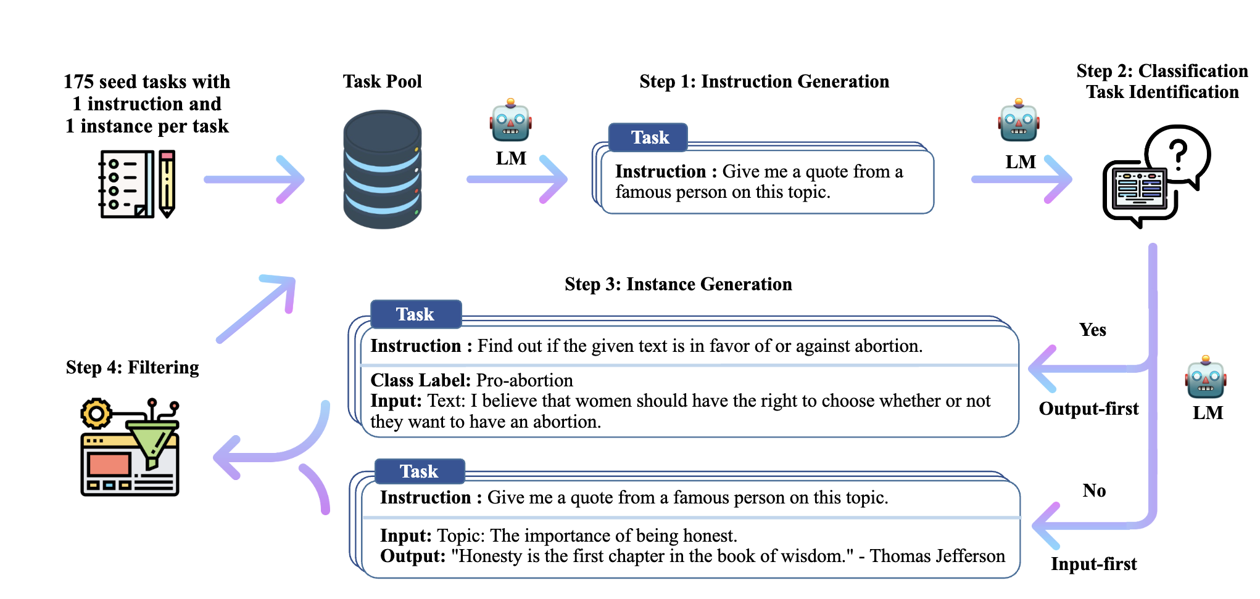
Self-Instruct: The complete pipeline
Image Credit: SELF-INSTRUCT: Aligning Language Models
with Self-Generated Instructions

Slide 19
Evaluation results on unseen tasks from SUPERNI
Model | # Params | ROUGE-L
GPT3 | 175B | 6.8
InstructGPT001 | 175B | 40.8
GPT3 + T0 Training | 175B | 37.9
GPT3 SELF-INST | 175B | 39.9
GPT3 + SUPERNI Training | 175B | 49.5
GPT3 SELF-INST + SUPERNI Training | 175B | 51.6

Slide 20
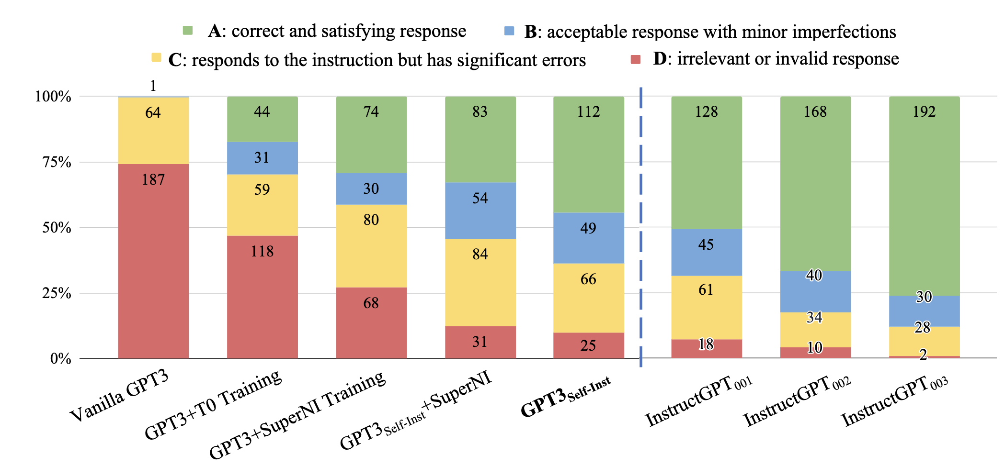
Human evaluation on 252 instructions
Image Credit: SELF-INSTRUCT: Aligning Language Models
with Self-Generated Instructions

Slide 21
Evol-Instruct
Motivation:
Most of the instruction datasets contain only simple instructions.
LLMs can be used to make instructions more complex.
Instruction Evolver
An LLM that uses prompts to evolve instructions.
Instruction Eliminator
Checks whether the evolution fails.
- Non-informative responses

Slide 22
Instruction Evolver – In-Depth Evolution
Add constraints
Deepening
Concretizing
Increase Reasoning
I want you act as a Prompt Rewriter.
Your objective is to rewrite a given prompt into a more complex version to make those famous AI systems
(e.g., ChatGPT and GPT4) a bit harder to handle.
But the rewritten prompt must be reasonable and must be understood and responded by humans.
…
You SHOULD complicate the given prompt using the following method: Please add one more constraints/requirements into #Given Prompt#
#Given Prompt#:
<Here is instruction.>
#Rewritten Prompt#:

Slide 23
Instruction Evolver – In-Breadth Evolution
Enhance
  Topic Coverage
  Skill Coverage
I want you act as a Prompt Creator. Your goal is to draw inspiration from the #Given Prompt# to create a brand new prompt. This new prompt should belong to the same domain as the #Given Prompt# but be even more rare. The LENGTH and difficulty level of the #Created Prompt# should be similar to that of the #Given Prompt#.
The #Created Prompt# must be reasonable and must be understood and responded by humans. ‘#Given Prompt#’, ‘#Created Prompt#’, ‘given prompt’ and ‘created prompt’ are not allowed to appear in #Created Prompt#.
#Given Prompt#:
<Here is instruction.>
#Created Prompt#:

Slide 24
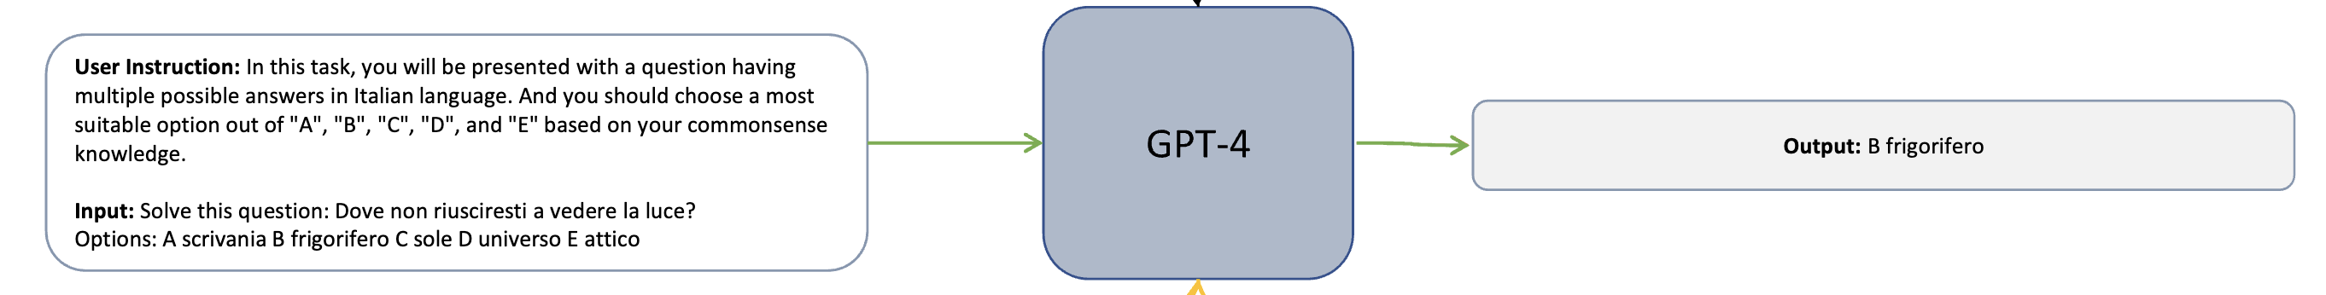
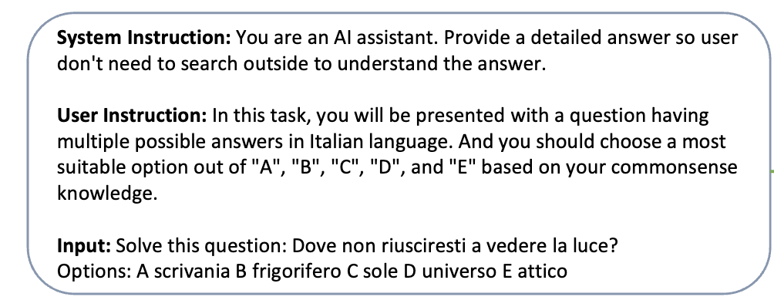
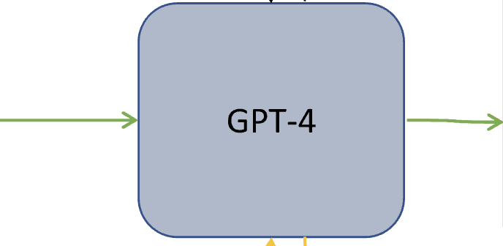
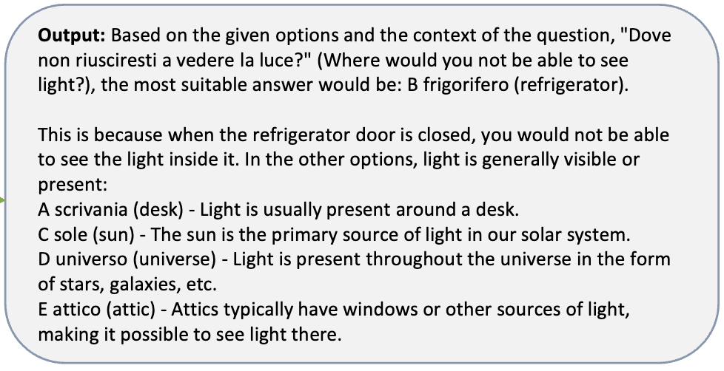
Orca
How can we improve the information content in the response?
Add a system instruction from a diverse instruction set including chain-of-thought, reasoning steps, explain like I’m five, being helpful and informative, etc.

Slide 25
Instruction Back-Translation
Gather Data:
Unlabeled text from Clueweb (Overwijk et al., 2022).
3,200 pieces of human-written (instruction, response) format data.
Back-Translation Model Training:
Use LLaMA (Touvron et al., 2023b).
Train on seed data, taking response as input, generating instruction as output.
Generate Raw Data:
Feed unlabeled texts into the trained back-translation model.
Produce raw (instruction, response) format data.
Evaluation Model:
Train another LLaMA-based model.
Assess the quality of (instruction, response) pairs generated in Step 3.
Filter & Fine-Tune:
Remove low-quality pairs.
Use remaining data for fine-tuning large language models (LLMs).
Content Credit: Instruction Tuning for Large Language Models: A Survey

Slide 26
Popular Instruction-Tuned Models on Known Datasets
Flan-T5 (11B)
  Fine-tuned T5-11B on Flan dataset
Alpaca (7B)
  Finetuned LLaMa-7B on synthetic dataset generated from text-davinci-003 generated using Self-Instruct
WizardLM (7B)
  Finetuned LLaMa-7B on on an instruction dataset generated from ChatGPT using Evol-Instruct .
Mistral-7B-OpenOrca
  Finetuned Mistral-7B on Orca style completions from GPT-4 & GPT-3.5

Slide 27
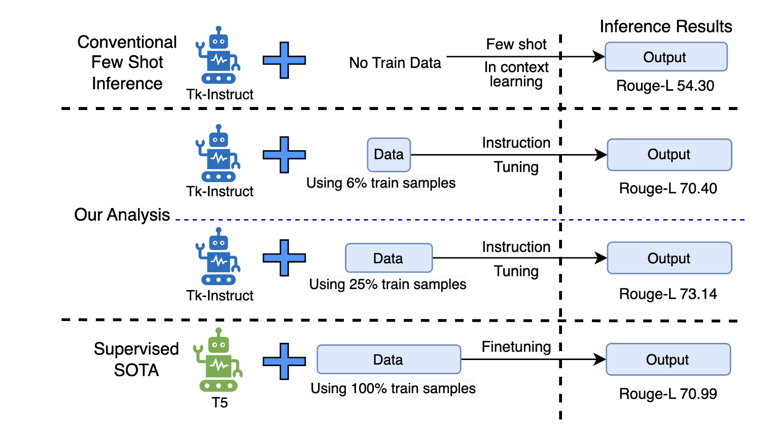
Instruction Tuned Models are Quick Learners

Slide 28
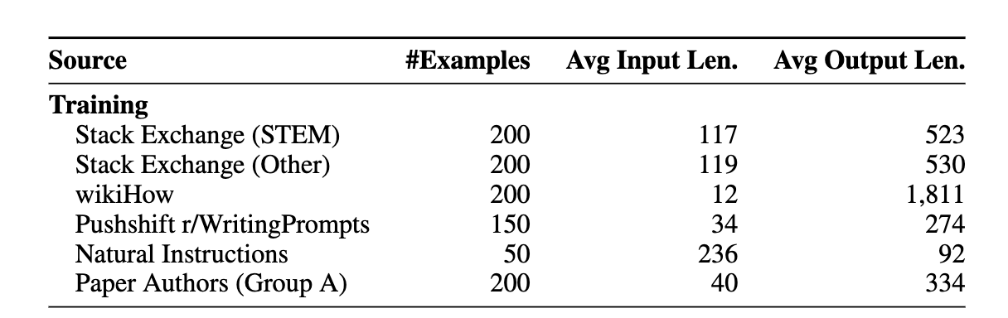
Superficial Alignment Hypothesis
A model’s knowledge and capabilities are learnt almost entirely during pretraining, while alignment teaches it which sub-distribution of formats should be used when interacting with users
Corollary: A small number of examples should be sufficient for instruction-tuning.
Credit: LIMA: Less Is More for Alignment

Slide 29
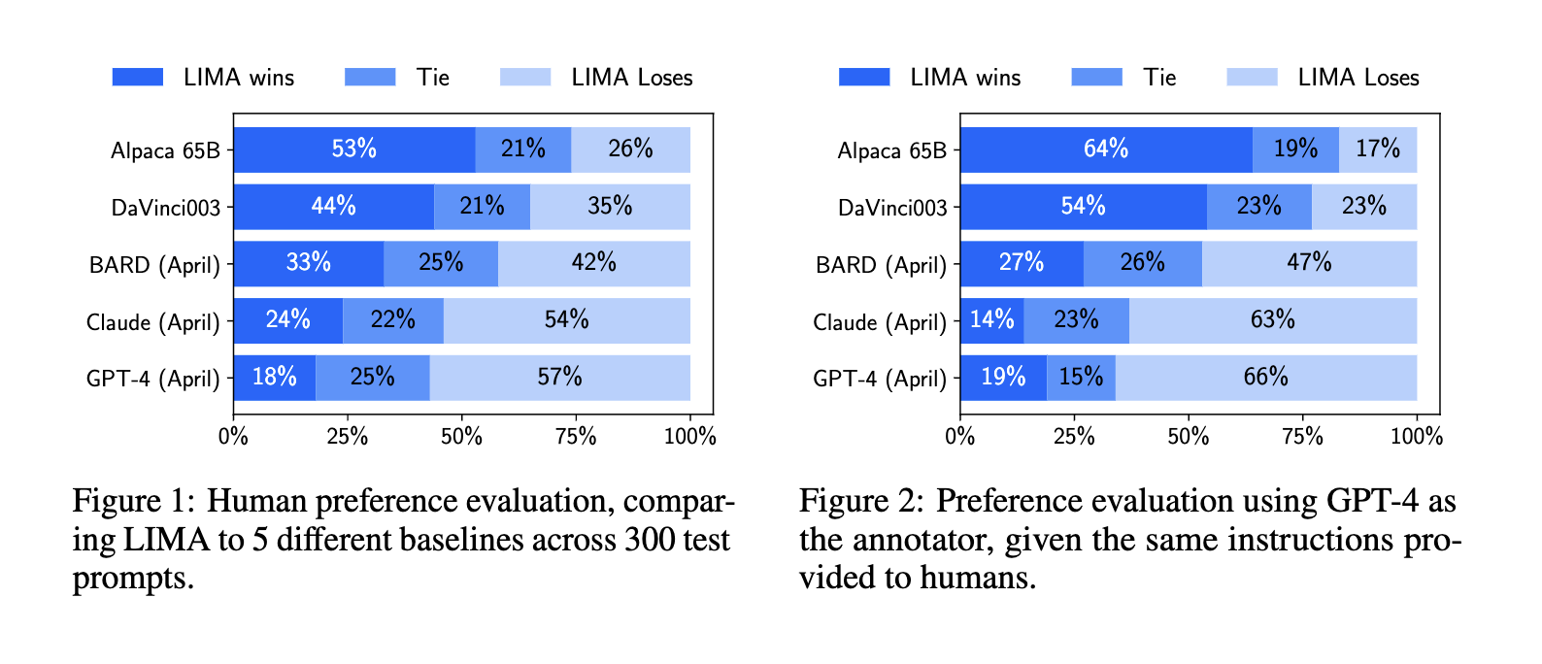
LIMA (Less is More For Alignment)

Slide 30
Main Takeaways
Instruction tuning transforms pre-trained models to be more usable by humans.
Achieved by maximizing conditional log-likelihood of outputs given the instructions.
Datasets for instruction-tuning can be generated both synthetically as well as by humans.
Instruction-tuned models can quickly learn a task with limited data.

