Slide 1

Advances in Large Language Models
ELL8299 · AIL861
Alignment of Language Models –
RL Basics and Reward Modelling
Gaurav Pandey
Senior Research Scientist, IBM Research

Slide 2
Why is Instruction Tuning not enough?
(Next token too myopic)
Question: What’s the best way to lose weight quickly?
What to say? | What not to say?
Reduce carb intake, increase fiber & protein content, increase vigorous exercise | You should stop eating entirely for a few days
Instruction tuning can make this happen
But can’t prevent this from happening
Alignment can prevent certain outputs that the model assumes to be correct, but humans consider wrong.
Content Credit: Instruction Tuning for Large Language Models: A Survey

Slide 3
Taxonomy of Alignment methods
Alignment Objective
Reward Maximization – Policy Gradient, PPO (also referred to as PPO-RLHF), GRPO
Contrastive Learning – DPO & its variants
Distribution Matching – DPG, BRAIn
Online/Offline
Online: Policy Gradient, PPO, GRPO
Offline: DPO, IPO, SLiC
Mixed: Iterative DPO, BRAIn

Slide 4
Basics of reinforcement learning

Slide 5



Reinforcement Learning – Example 1
Example – AI Chess player
Agent – AI program
Environment – chessboard, rules and opponent (another agent)
State - Arrangement of pieces (current + historical), rules
Action – Move a piece
Reward – Win (+1), Lose(-1) and Draw
Agent with a Policy
Next state $s_{t+1}$
Reward $r_{t}$
Action $a_{t}$
Environment
The entire world that the agent lives in
Updates state
Provides a reward
Policy is the agent’s distribution over next actions - can be deterministic

Slide 6
Reinforcement Learning – Example 2
Example – Self-Driving Car
Agent – AI program
Environment – Road, traffic, pedestrian, signals
State – Sensor readings including historical
Action – Turn, accelerate, brake
Reward – Reach destination safely (+1), accident(-1)
Agent with a Policy
Next state $s_{t+1}$
Reward $r_{t}$
Action $a_{t}$
Environment
The entire world that the agent lives in
Policy is the agent’s distribution over next actions - can be deterministic

Slide 7
Reinforcement Learning – Example 3
Example – LLM generating a response token-by-token
Agent – the LLM
State – Prompt + all tokens generated so far
Action – Next token
Reward – Assigned at the end of response generation (+1 if correct)
Agent with a Policy
Next state $s_{t+1}$
Reward $r_{t}$
Action $a_{t}$
Environment
The system that takes the LLM’s actions (tokens),
updates the state (prompt + partial output),
and eventually provides a reward.

Slide 8

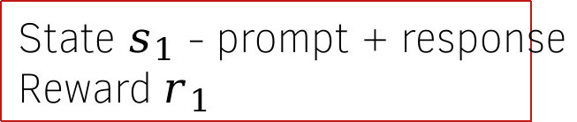
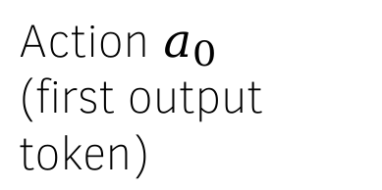
Reinforcement Learning – Example 4
Example – LLM generating a response
Agent – the LLM
State – Prompt or Prompt + response
Action – Entire response
Reward – +1 if correct, -1 if wrong
State $s_{1}$ - prompt + response
Reward $r_{1}$
Agent with a Policy
State $s_{0}$ - prompt
Action $a_{0}$
(first output token)
Environment
The system that takes the prompt and response
and provides a reward.

Slide 9
Reinforcement Learning – Example 5
Example – Code LLMs
Agent – the Code LLM
Environment – Parser, unit tests
State – The problem description + generated previous code + error reported by the parser or tests
Action – Generated code
Reward – +1 if correct, -1 if wrong, possibly partial
Agent with a Policy
Next state $s_{t+1}$
Reward $r_{t}$
Action $a_{t}$
Environment
- The system that evaluates the code on unit tests
and reports the error if any.
- The next state is obtained by just appending the error

Slide 10
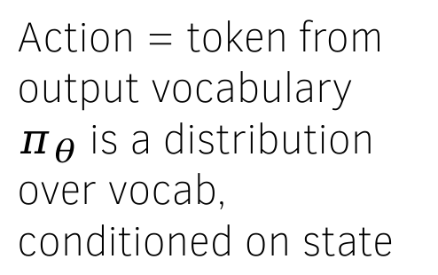

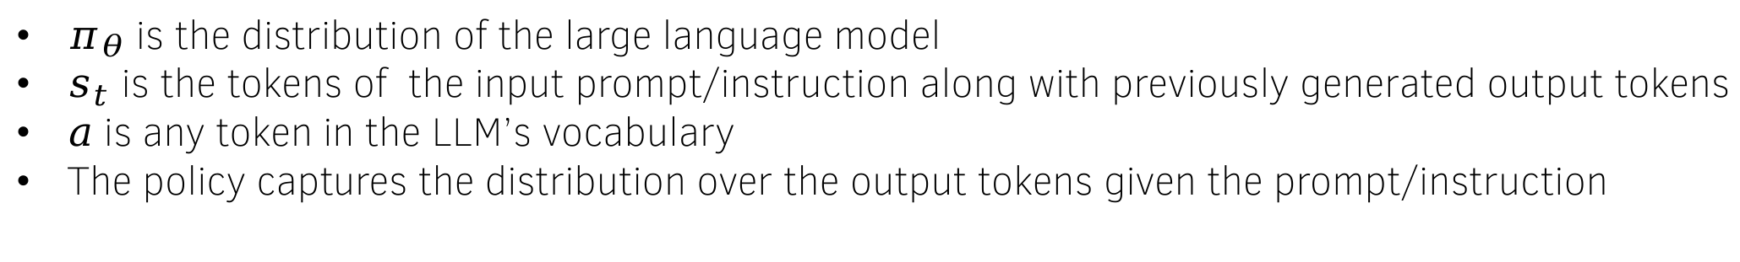
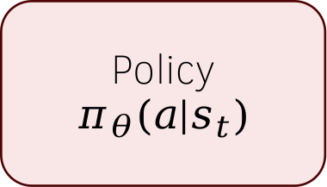
Reinforcement Learning (tokens as actions)
Policy $π_{θ}(a|s_{t})$
$π_{θ}$ is the distribution of the large language model
$s_{t}$ is the tokens of the input prompt/instruction along with previously generated output tokens
$a$ is any token in the LLM’s vocabulary
The policy captures the distribution over the output tokens given the prompt/instruction
$$s_{t}$$
Action = token from output vocabulary
$π_{θ}$ is a distribution over vocab, conditioned on state
Prompt tokens
Previously generated output tokens

Slide 11



Reinforcement Learning
Each token generated by the LLM represents an action
Policy $π_{θ}(a|s_{t})$
is
$$a_{t}$$
LLM Policy $π_{θ}(a|s_{t})$
Takes action $a_{t}$
User: Where is Taj Mahal? Assistant: Taj Mahal
The generation of a token by an LLM
is equivalent to taking an action
Prompt tokens
LLM generated tokens
$$s_{t}$$

Slide 12

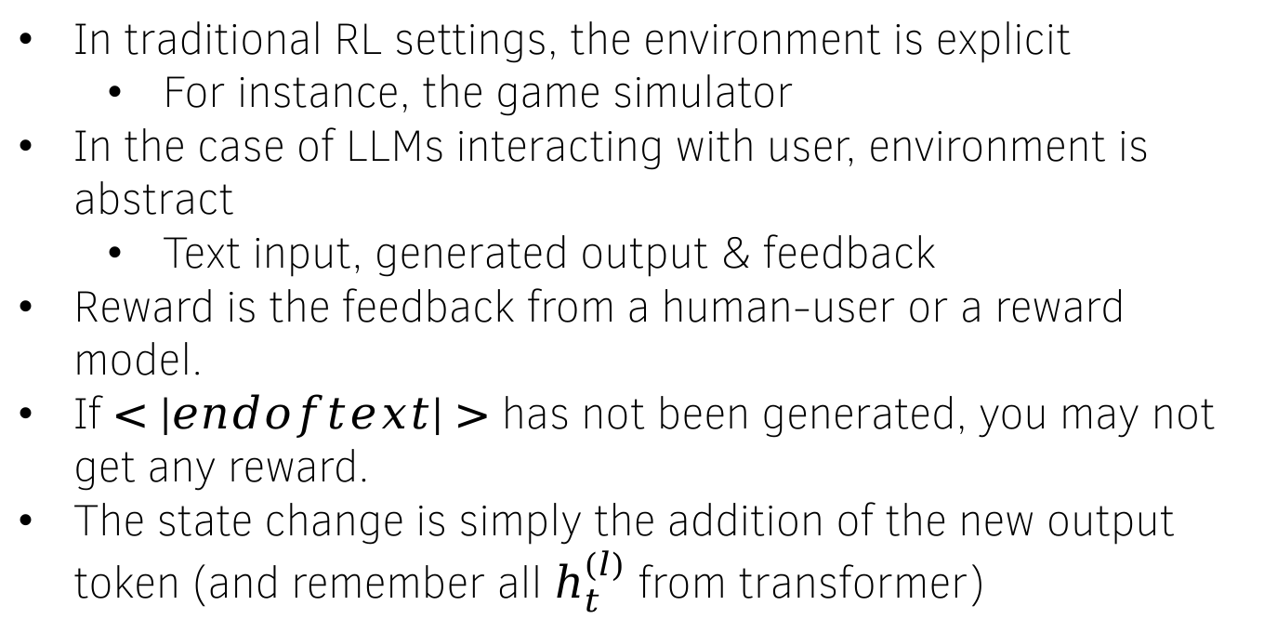
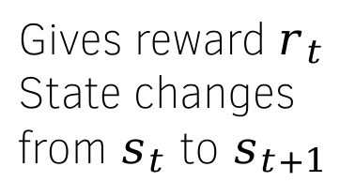
Reinforcement Learning
In traditional RL settings, the environment is explicit
  For instance, the game simulator
In the case of LLMs interacting with user, environment is abstract
  Text input, generated output & feedback
Reward is the feedback from a human-user or a reward model.
If $<|endoftext|>$ has not been generated, you may not get any reward.
The state change is simply the addition of the new output token (and remember all $h_{t}^{(l)}$ from transformer)
Policy $π_{θ}(a|s_{t})$
Gives reward $r_{t}$
State changes
from $s_{t}$ to $s_{t+1}$
Takes action $a_{t}$
Environment
$$s_{t}$$
Prompt tokens
Previously generated output tokens
New output token
$$s_{t+1}$$

Slide 13
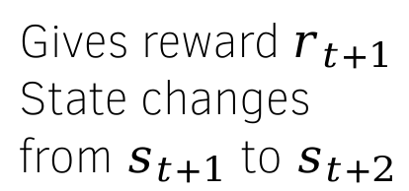

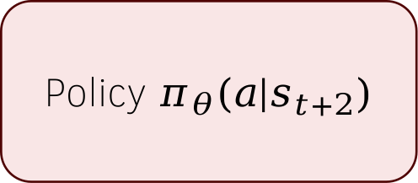

Reinforcement Learning
Policy $π_{θ}(a|s_{t})$
Policy $π_{θ}(a|s_{t+1})$
Policy $π_{θ}(a|s_{t+2})$
Gives reward $r_{t}$
State changes
from $s_{t}$ to $s_{t+1}$
Gives reward $r_{t+1}$
State changes
from $s_{t+1}$ to $s_{t+2}$
Takes action $a_{t+1}$
Takes action $a_{t}$
Environment
Environment

Slide 14




LLM as a policy
$a_{0}=$Taj
$r_{0}$ = 0
LLM Policy $π_{θ}(a|s_{0})$
User: Where is Taj mahal? Assistant:
$$s_{0}$$

Slide 15



LLM as a policy
$a_{1}=$ Mahal
$r_{1}$ = 0
LLM Policy $π_{θ}(a|s_{t})$
User: Where is Taj mahal? Assistant:
Taj
$$s_{1}$$

Slide 16



LLM as a policy
$a_{2}=$ is
$r_{2}$ = 0
LLM Policy $π_{θ}(a|s_{t})$
User: Where is Taj mahal? Assistant:
Taj Mahal
$$s_{2}$$

Slide 17




LLM as a policy
$a_{T}=<endoftext>$
$r_{T}$ = +1
LLM Policy $π_{θ}(a|s_{t})$
User: Where is Taj mahal? Assistant:
Taj Mahal is in Agra
$$s_{T}$$

Slide 18
The reward model

Slide 19
Who/What is the reward model?
We can ask humans to give thumbs up/down to generated outputs and treat them as rewards.
Challenges:
  Human feedback is costly & slow.
  Traditional RLHF (as we will see) requires constant feedback after every (few) updates to the model.
Solutions:
  Lets train another LLM to behave like the reward model.
  For some problems the answers can be verified exactly.
    Use a verifiable reward – no training needed.

Slide 20
Verifiable rewards
Rewards that can be computed objectively and reproducibly from a ground truth.
Examples of Verifiable Reward Functions
  Math: Exact numerical answer match
  Code: Passes all test cases
  QA: String match or F1-score over entities
  Formal logic tasks: Correct proof sequence
  Chemistry: Exact Match in Reaction Prediction
  Biology: RMSD for Protein structure prediction
Does not depend on noisy human or AI preferences.
Responsible for the latest revolution in reasoning in AI (Grok-4)

Slide 21
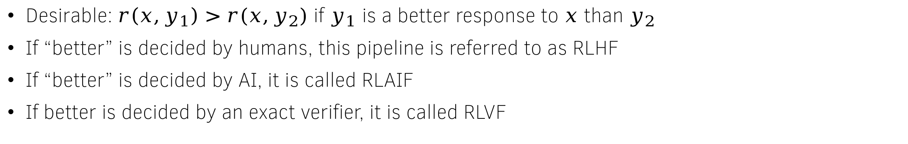

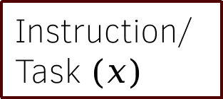
LLM as a reward model
Goal:
Instruction/Task $(x)$
Reward Model
$$r(x,y)$$
Output (y)
Desirable: $r\left(x,y_{1}\right)>r(x,y_{2})$ if $y_{1}$ is a better response to $x$ than $y_{2}$
If “better” is decided by humans, this pipeline is referred to as RLHF
If “better” is decided by AI, it is called RLAIF
If better is decided by an exact verifier, it is called RLVF

Slide 22







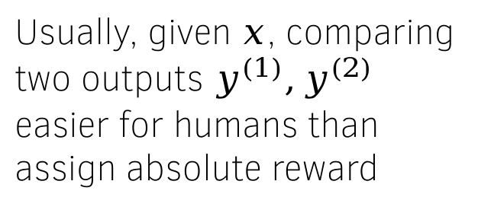
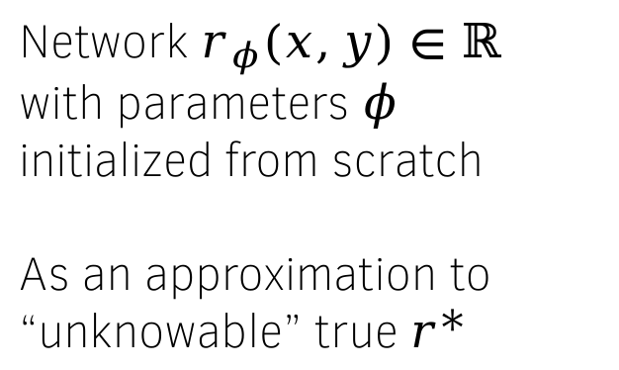












Architecture of the reward model
Network $r_{φ}\left(x,y\right)∈ℝ$ with parameters $φ$
initialized from scratch
As an approximation to “unknowable” true $r^{∗}$
reward
Usually, given $x$, comparing two outputs $y^{(1)},y^{(2)}$ easier for humans than assign absolute reward
Linear layer
$$e_{avg}$$
Pre-logit layer
$$e_{1}$$
$$e_{2}$$
$$e_{3}$$
$$e_{4}$$
$$e_{5}$$
$$e_{6}$$
$$e_{7}$$
$$e_{8}$$
$$e_{9}$$
Transformer Encoder/Decoder
$$x_{1}$$
$$x_{2}$$
$$x_{3}$$
$$x_{4}$$
$$x_{5}$$
$$y_{1}$$
$$y_{2}$$
$$y_{3}$$
$$y_{4}$$
One input sequence
One output sequence

Slide 23
Training the reward model

Slide 24
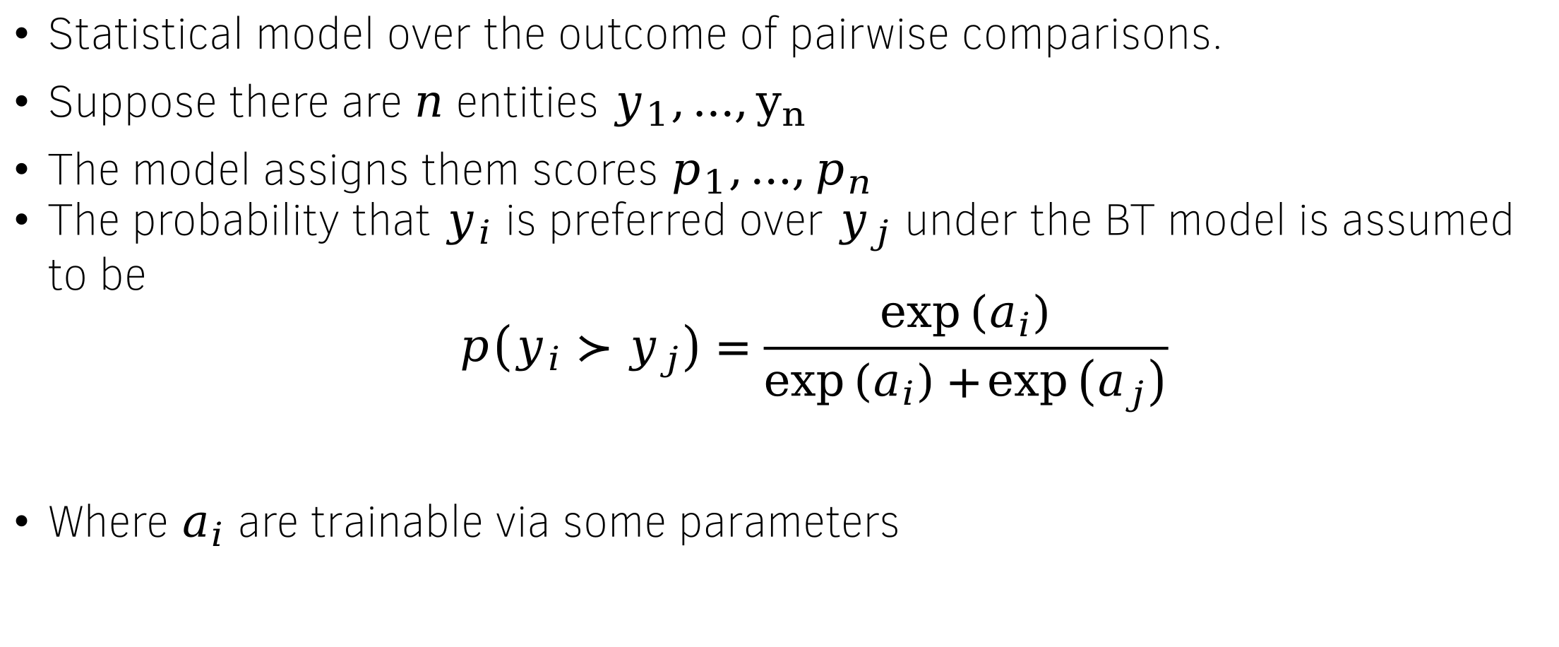
The Bradley-Terry (BT) preference model
Statistical model over the outcome of pairwise comparisons.
Suppose there are $n$ entities $y_{1},…,y_{n}$
The model assigns them scores $p_{1},…,p_{n}$
The probability that $y_{i}$ is preferred over $y_{j}$ under the BT model is assumed to be
$$p\left(y_{i}≻y_{j}\right)=\frac{\exp\left(a_{i}\right)}{\exp\left(a_{i}\right)+\exp\left(a_{j}\right)}$$
Where $a_{i}$ are trainable via some parameters

Slide 25
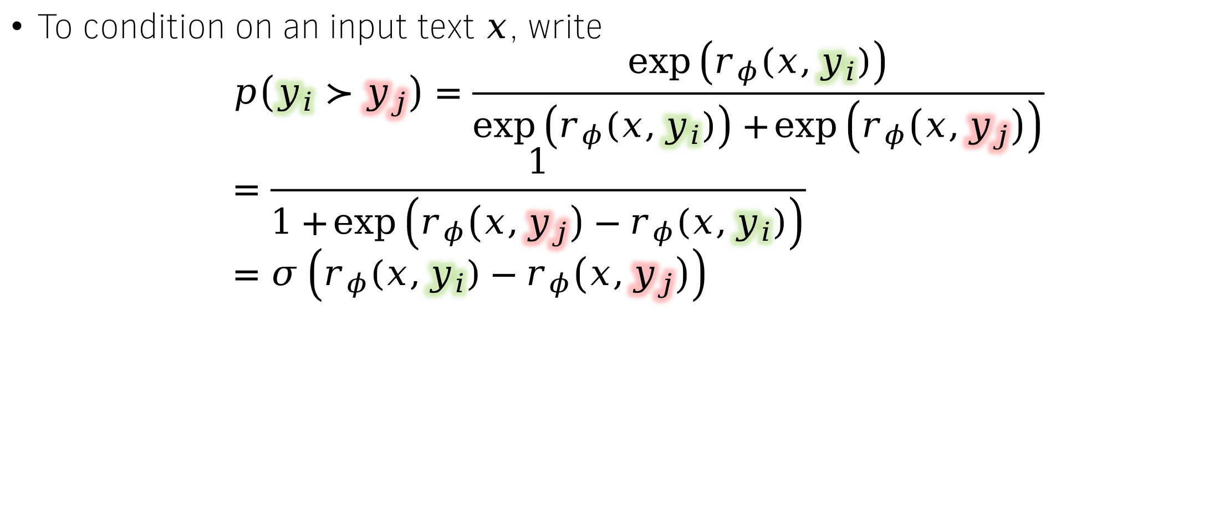
The Bradley-Terry preference model for LLMs
To condition on an input text $x$, write
$$p\left(y_{i}≻y_{j}\right)=\frac{\exp\left(r_{φ}\left(x,y_{i}\right)\right)}{\exp\left(r_{φ}\left(x,y_{i}\right)\right)+\exp\left(r_{φ}\left(x,y_{j}\right)\right)} \\ =\frac{1}{1+\exp\left(r_{φ}\left(x,y_{j}\right)−r_{φ}\left(x,y_{i}\right)\right)} \\ =σ\left(r_{φ}\left(x,y_{i}\right)−r_{φ}\left(x,y_{j}\right)\right)$$

Slide 26
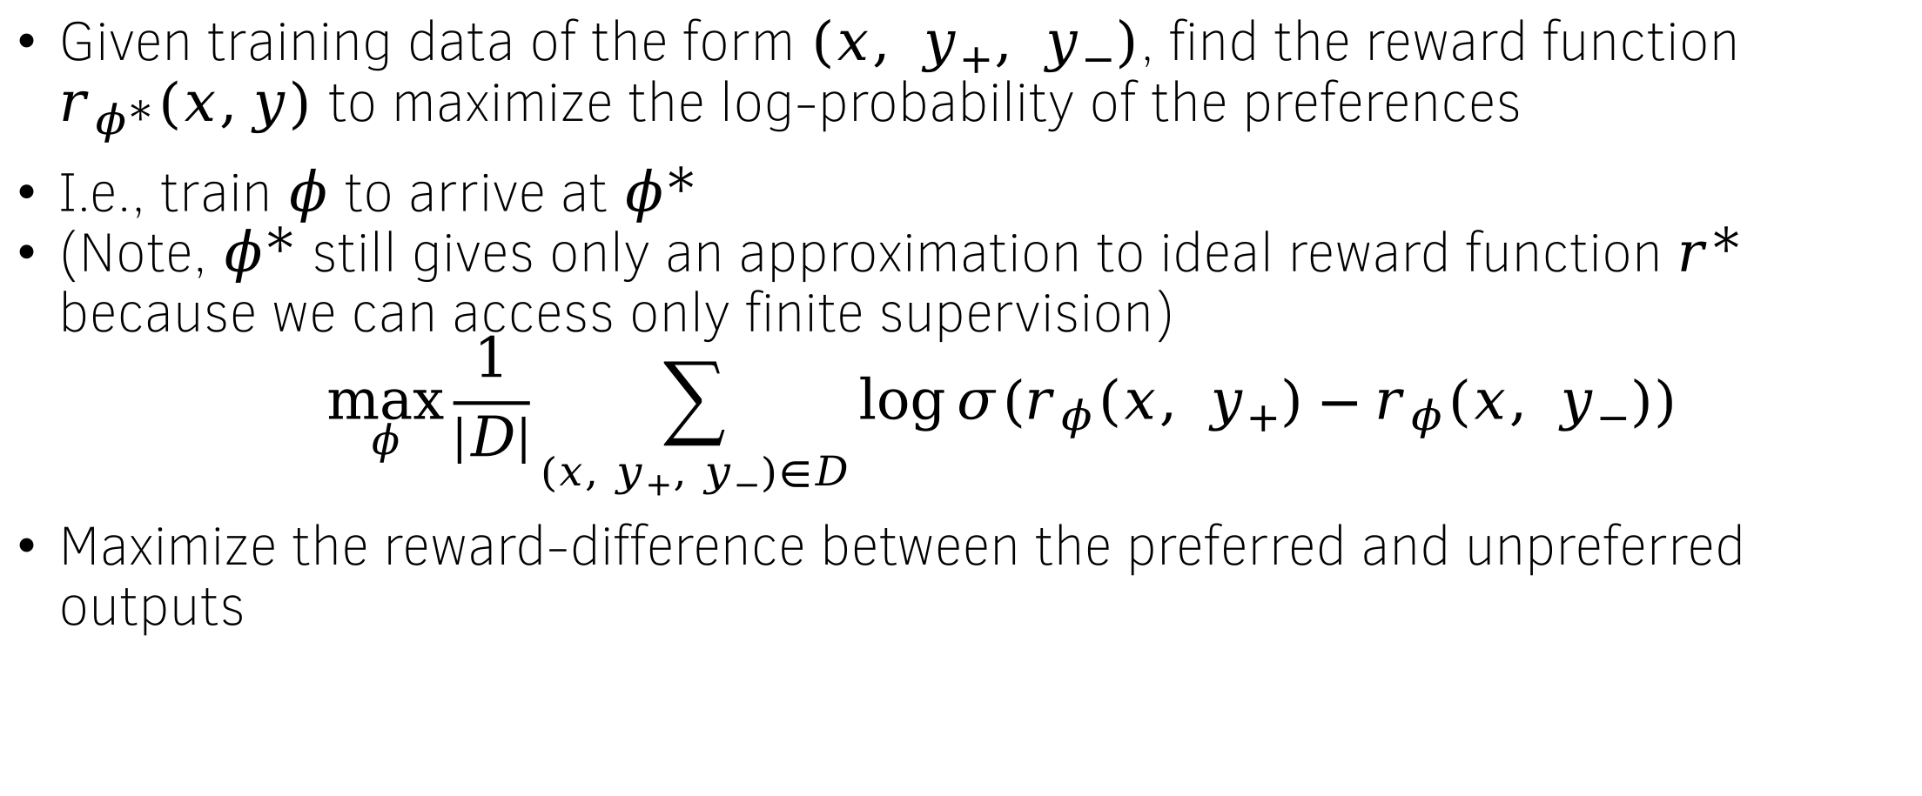
Maximum Likelihood Estimation for BT models
Given training data of the form $\left(x, y_{+}, y_{−}\right)$, find the reward function $r_{φ^{∗}}(x,y)$ to maximize the log-probability of the preferences
I.e., train $φ$ to arrive at $φ^{∗}$
(Note, $φ^{∗}$ still gives only an approximation to ideal reward function $r^{∗}$ because we can access only finite supervision)
$$\max_{φ}{\frac{1}{\left|D\right|}\sum_{\left(x, y_{+}, y_{−}\right)∈D}{\log{σ(r_{φ}\left(x, y_{+}\right)−r_{φ}(x, y_{−}))}}}$$
Maximize the reward-difference between the preferred and unpreferred outputs

Slide 27
Publicly available preference data
Summarize From Feedback by OpenAI
  Prompts – Summarize the following document: <Document>
  Outputs – Generated by InstructGPT models
  Human-generated preferences
Ultrafeedback
  Prompts – Diverse set of tasks
  Outputs – Generated by GPT family, LlaMa family, BARD, WizardLM, Alpaca, etc.
  GPT-4 generated preferences

Slide 28
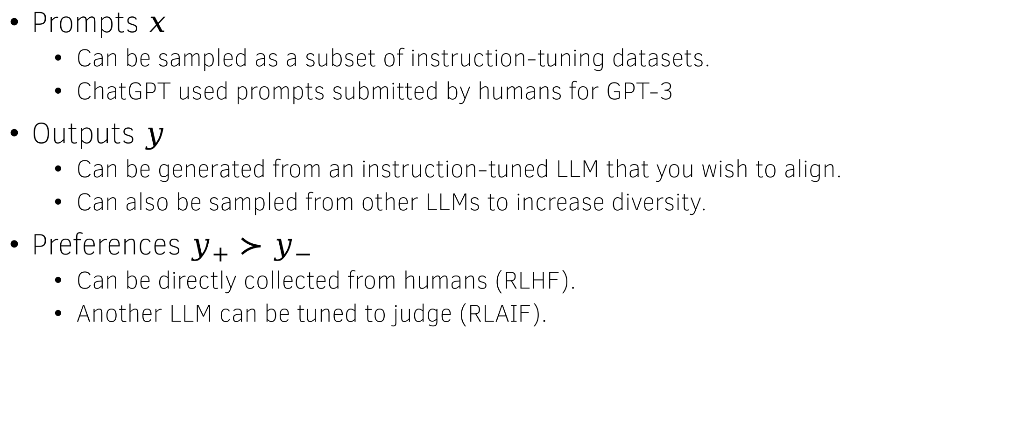
Where does the data come from?
Prompts $x$
  Can be sampled as a subset of instruction-tuning datasets.
  ChatGPT used prompts submitted by humans for GPT-3
Outputs $y$
  Can be generated from an instruction-tuned LLM that you wish to align.
  Can also be sampled from other LLMs to increase diversity.
Preferences $y_{+}≻y_{−}$
  Can be directly collected from humans (RLHF).
  Another LLM can be tuned to judge (RLAIF).

Slide 29
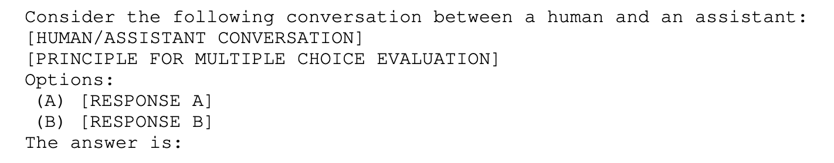
Constitutional AI for collecting harmlessness preferences
Feed the following input to a powerful pretrained LLM
16 different principles were used that looked like this
Credit: Constitutional AI: Harmlessness from AI Feedback

Slide 30
Non BT reward models

Slide 31
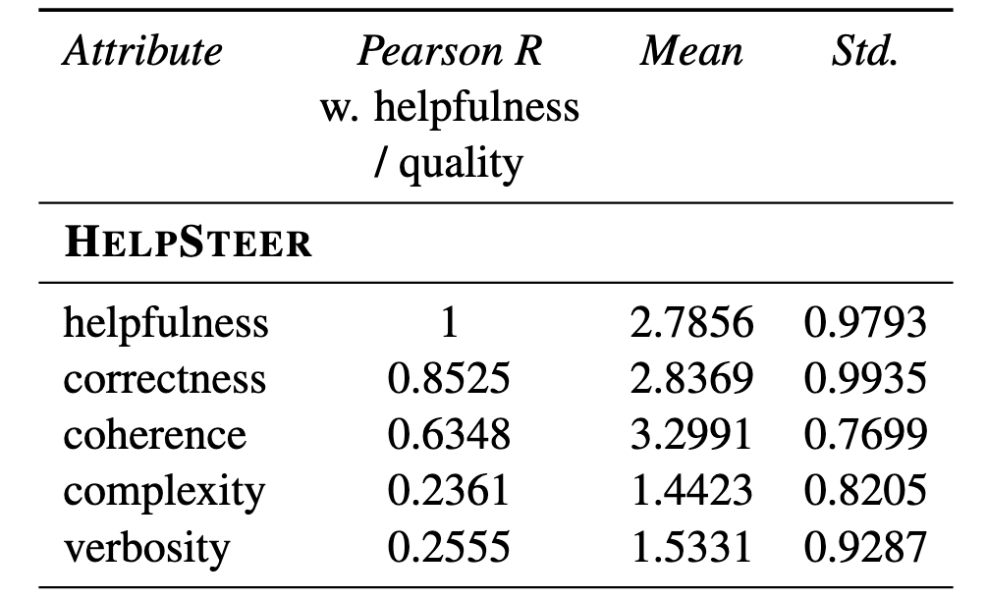
Multi-attribute helpfulness data - Helpsteer
Reward models trained on binary preferences capture the bias inherent in them.
Solution: Make the annotations more informative.
  Prompts were human/synthetically generated.
  The responses were generated by an LLM.
  Each response is annotated independently for 5 attributes - Helpfulness, Correctness, Coherence, Complexity, and Verbosity.
  Scores from 1-5 were used for each attribute

Slide 32
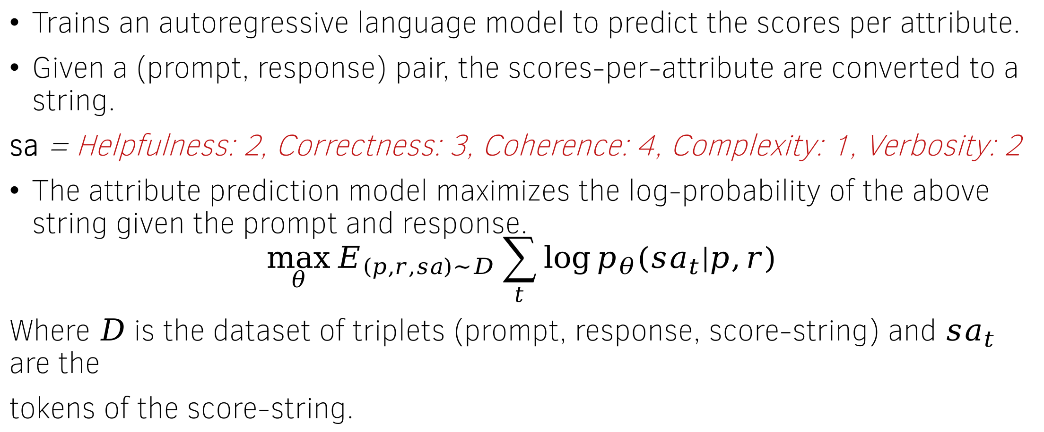
Attribute Prediction model
Trains an autoregressive language model to predict the scores per attribute.
Given a (prompt, response) pair, the scores-per-attribute are converted to a string.
sa = Helpfulness: 2, Correctness: 3, Coherence: 4, Complexity: 1, Verbosity: 2
The attribute prediction model maximizes the log-probability of the above string given the prompt and response.
$$\max_{θ}{E_{\left(p,r,sa\right)\sim D}\sum_{t}{\log{p_{θ}(sa_{t}|p,r)}}}$$
Where $D$ is the dataset of triplets (prompt, response, score-string) and $sa_{t}$ are the
tokens of the score-string.

Slide 33
LLM as a judge (or reward model)
Prompt the LLM to act as a judge
  Pairwise comparisons - LLM judge is presented with a question and two answers, and tasked to determine which one is better or declare a tie.
  Single answer grading - LLM judge is asked to directly assign a score to a single answer.
  Reference-guided grading – LLM judge is also provided a reference solution.
Advantage
  Can be used out-of-the-box without any preference data.
  Can utilizes the reasoning capability of LLM to arrive at the final answer.
Disadvantage
  Not as accurate as reward models trained on preference data.
  Often overconfident – the reasoning is also often hallucinated.
  Verbosity bias – longer (but non-informative) responses are preferred
Can we do better?

Slide 34
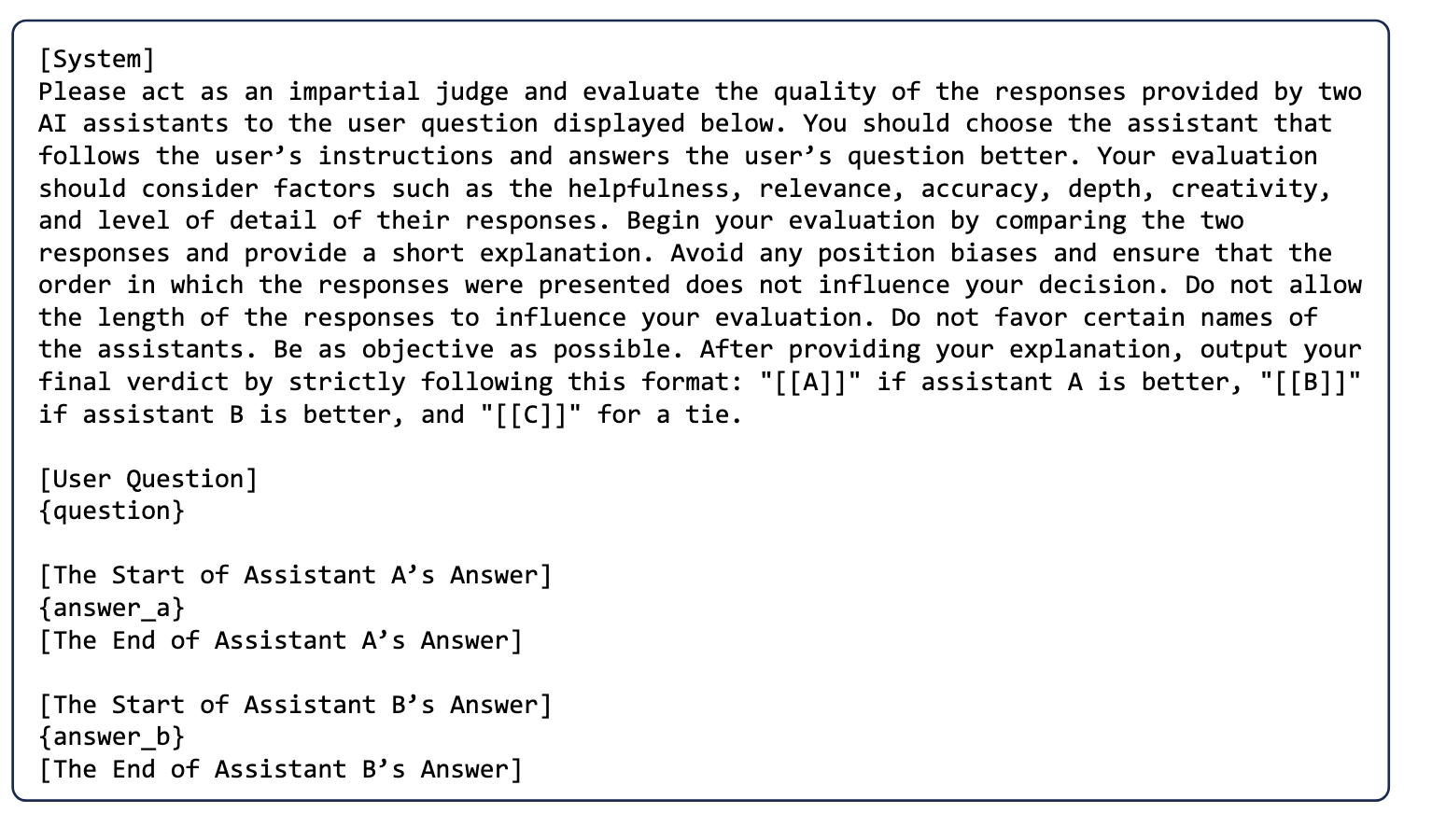
Prompt for pairwise comparison

Slide 35
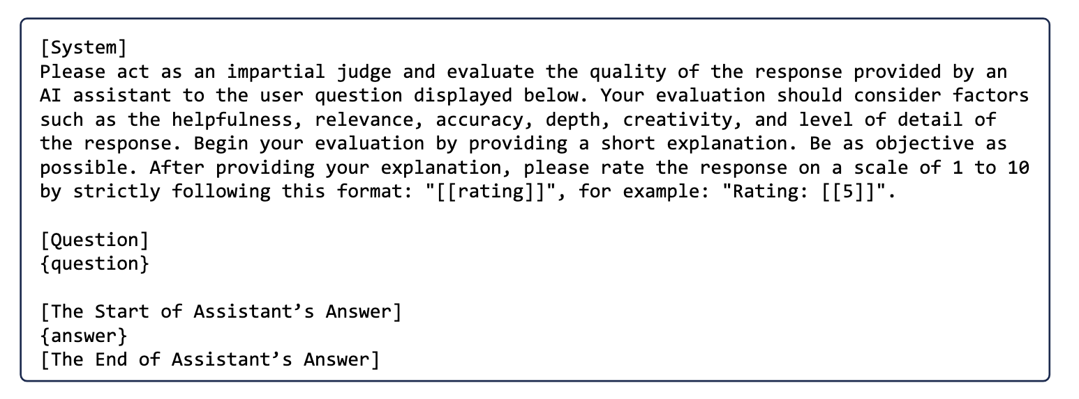
Prompt for Single Answer Grading

Slide 36
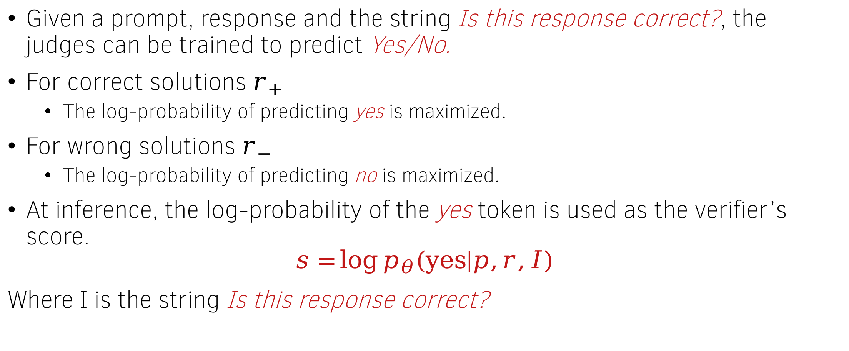
Training the judges – Generative Verifiers
Given a prompt, response and the string Is this response correct?, the judges can be trained to predict Yes/No.
For correct solutions $r_{+}$
  The log-probability of predicting yes is maximized.
For wrong solutions $r_{−}$
  The log-probability of predicting no is maximized.
At inference, the log-probability of the yes token is used as the verifier’s score.
$$s=\log{p_{θ}(yes|p,r,I)}$$
Where I is the string Is this response correct?

Slide 37
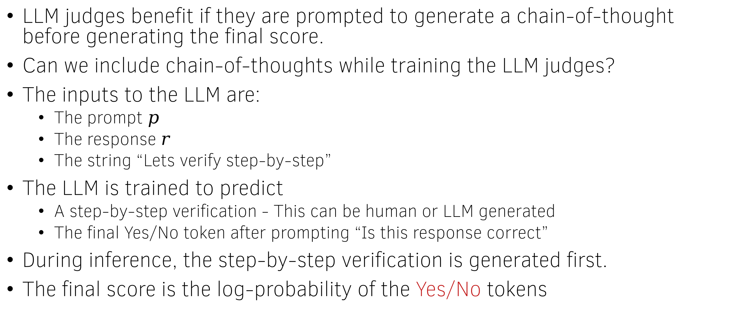
Chain-of-Thought verifiers
LLM judges benefit if they are prompted to generate a chain-of-thought before generating the final score.
Can we include chain-of-thoughts while training the LLM judges?
The inputs to the LLM are:
  The prompt $p$
  The response $r$
  The string “Lets verify step-by-step”
The LLM is trained to predict
  A step-by-step verification - This can be human or LLM generated
  The final Yes/No token after prompting “Is this response correct”
During inference, the step-by-step verification is generated first.
The final score is the log-probability of the Yes/No tokens

Slide 38
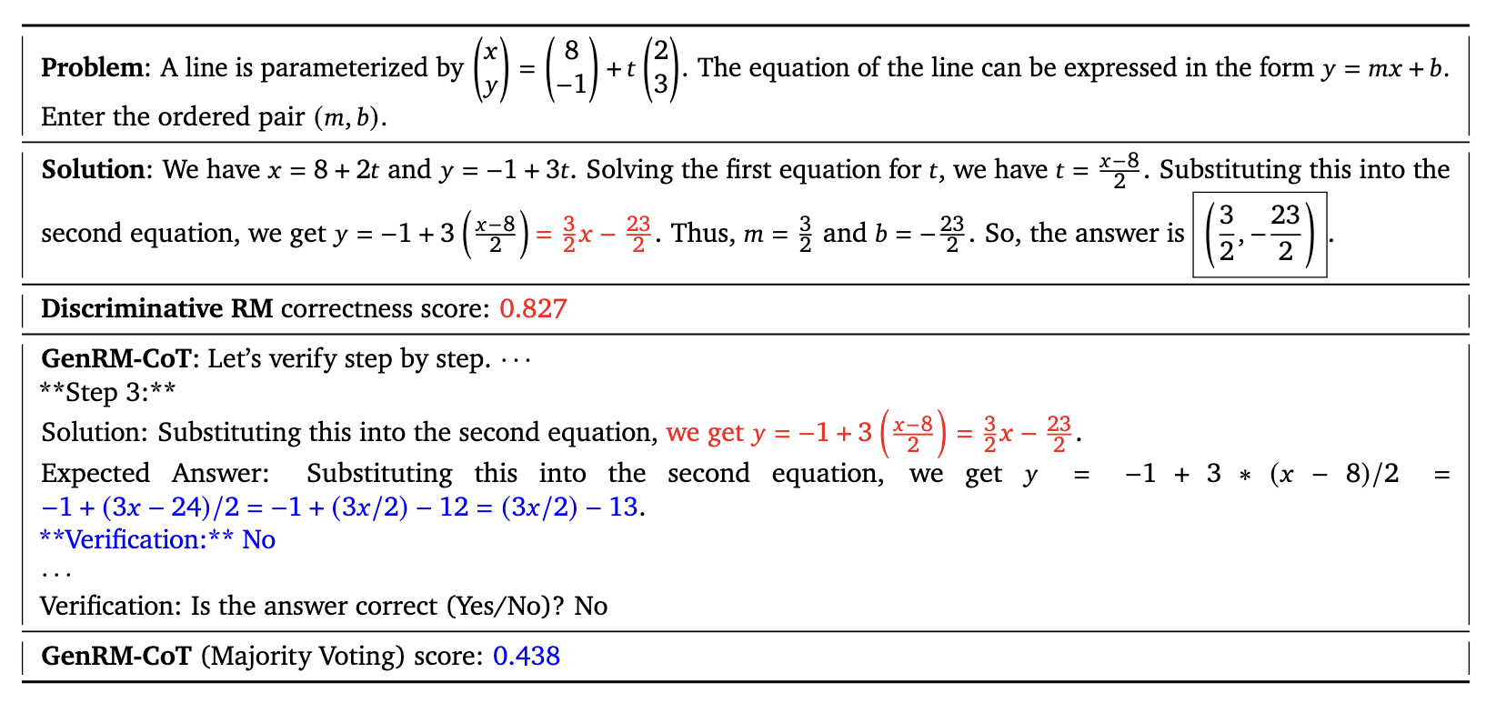
Prompt for Chain-of-Thought verifiers

Slide 39
Using the reward model

Slide 40
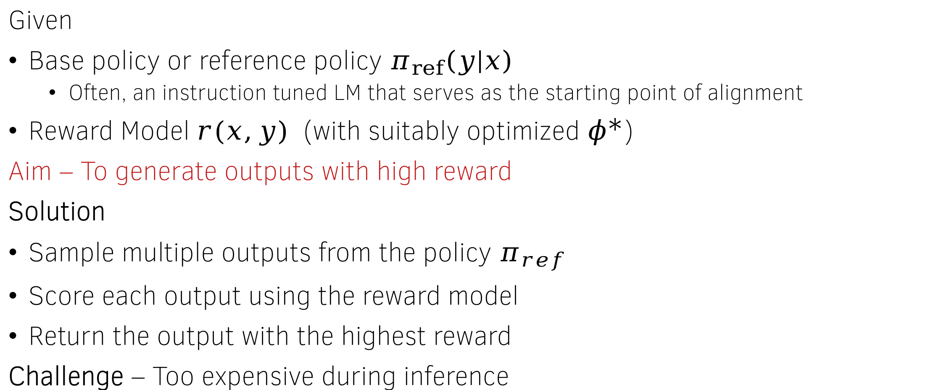
Best-of-N policy
Given
Base policy or reference policy $π_{ref}\left(y | x\right)$
  Often, an instruction tuned LM that serves as the starting point of alignment
Reward Model $r(x,y)$ (with suitably optimized $φ^{∗}$)
Aim – To generate outputs with high reward
Solution
Sample multiple outputs from the policy $π_{ref}$
Score each output using the reward model
Return the output with the highest reward
Challenge – Too expensive during inference

Slide 41
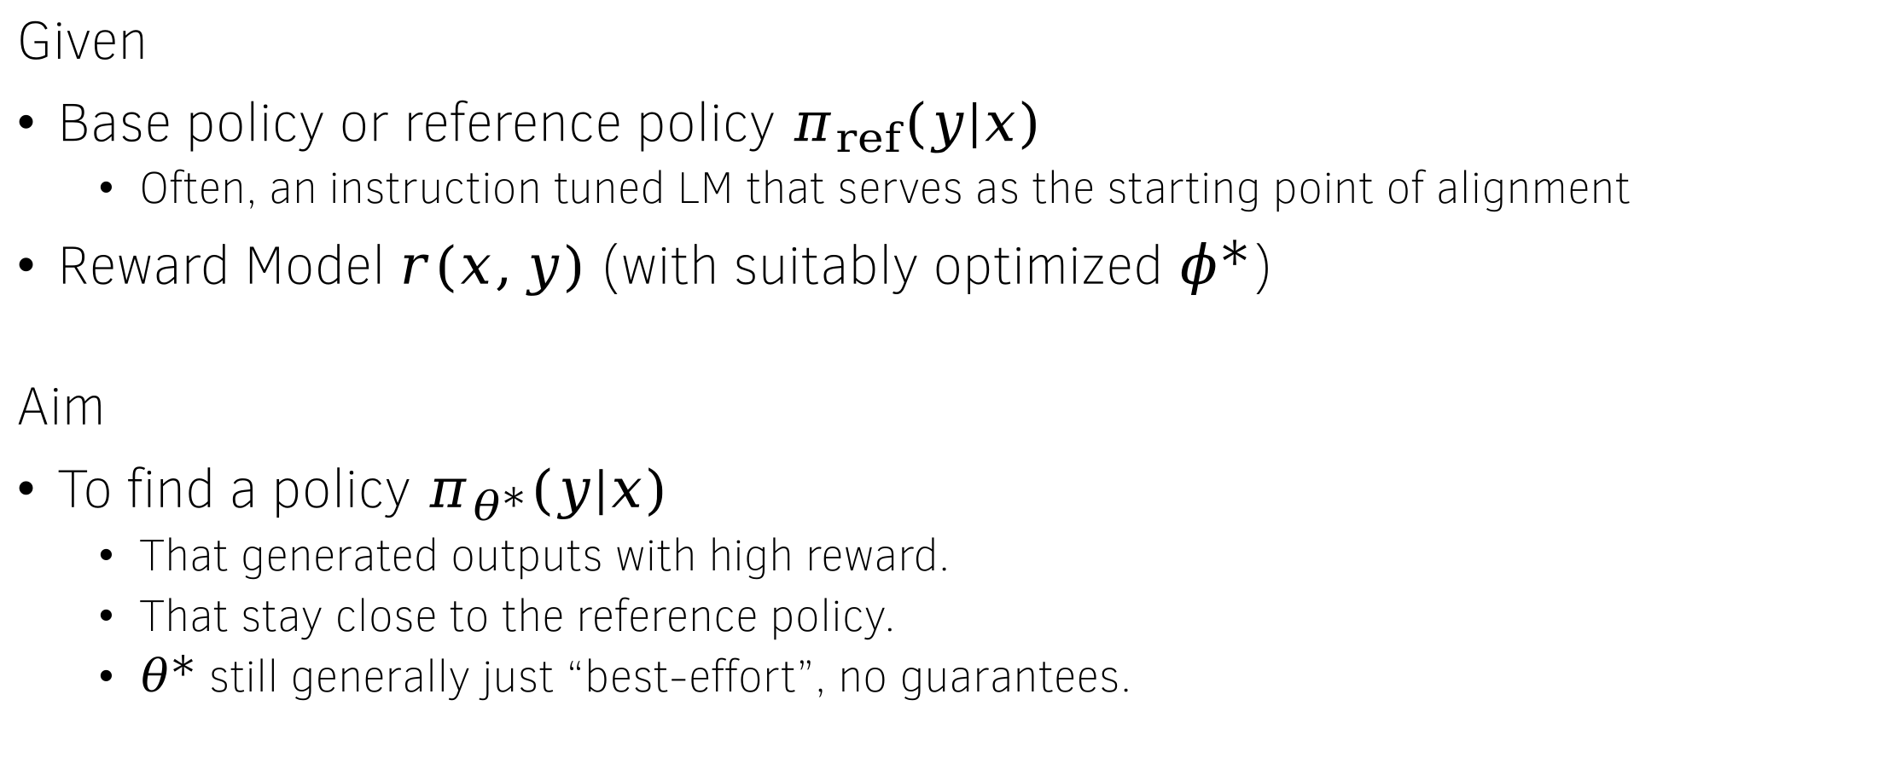
The reward-maximization objective
Given
Base policy or reference policy $π_{ref}\left(y | x\right)$
  Often, an instruction tuned LM that serves as the starting point of alignment
Reward Model $r(x,y)$ (with suitably optimized $φ^{∗}$)
Aim
To find a policy $π_{θ^{∗}}(y|x)$
  That generated outputs with high reward.
  That stay close to the reference policy.
  $θ^{∗}$ still generally just “best-effort”, no guarantees.

Slide 42
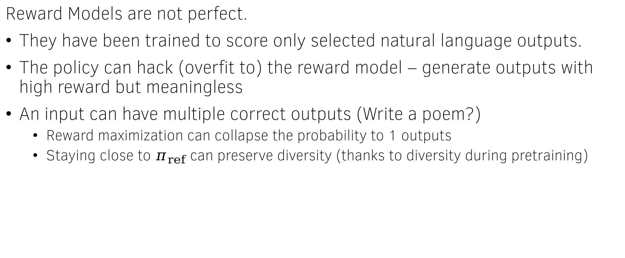

Why care about closeness to $π_{ref}$?
Reward Models are not perfect.
They have been trained to score only selected natural language outputs.
The policy can hack (overfit to) the reward model – generate outputs with high reward but meaningless
An input can have multiple correct outputs (Write a poem?)
  Reward maximization can collapse the probability to 1 outputs
  Staying close to $π_{ref}$ can preserve diversity (thanks to diversity during pretraining)

Slide 43



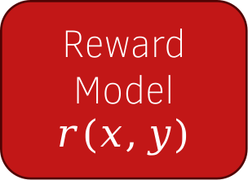
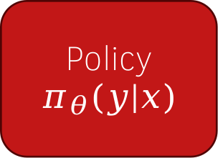
Formulating the objective – Reward Maximization
What does it mean for a policy to have high reward?
Samples
Poem 1
$$r_{poem1}$$
Policy $π_{θ}(y|x)$
Poem 2
$$r_{poem2}$$
The average of these numbers needs to be high
Reward
Model
$$r(x,y)$$
Prompt:
Write a poem
Poem n
$$r_{poemn}$$

Slide 44



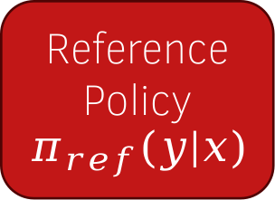
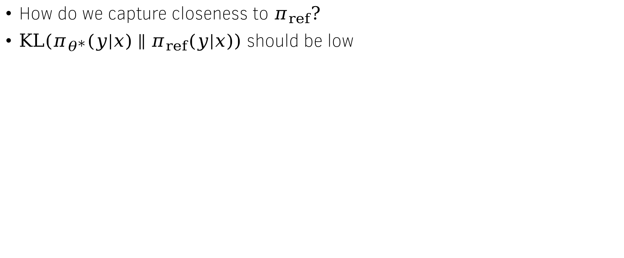
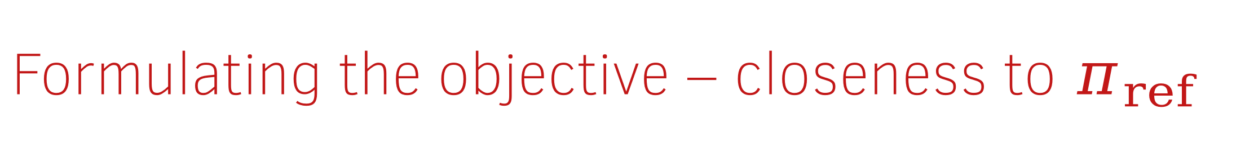
Formulating the objective – closeness to $π_{ref}$
How do we capture closeness to $π_{ref}?$
$KL\left(π_{θ^{∗}}(y|x)∥π_{ref}(y|x)\right)$ should be low
Poem 1
$${klr}_{poem1}$$
Policy $π_{θ}(y|x)$
Poem 2
$${klr}_{poem2}$$
The average of these numbers needs to be low
Reference
Policy
$$π_{ref}(y|x)$$
Prompt:
Write a poem
Poem n
$${klr}_{poemn}$$

Slide 45




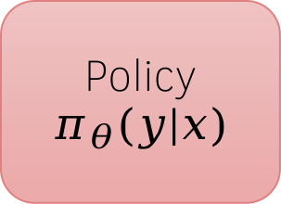
Combining the objective
$$r_{poem1}$$
$$r_{poem2}$$
Reward
Model
$$r(x,y)$$
Average reward
Poem 1
$$r_{poemn}$$
Policy $π_{θ}(y|x)$
Poem 2
Difference
Prompt:
Write a poem
$${klr}_{poem1}$$
Poem n
$${klr}_{poem2}$$
Average KL
Reference
Policy
$$π_{ref}(y|x)$$
Multiply by $β$
$${klr}_{poemn}$$

Slide 46
Takeaways & what next?
Alignment methods can help prevent undesirable outputs from getting generated.
The RLHF/RLAIF alignment method uses
  LLM as a policy
  LLM as a reward model
  Reward maximization as the objective
The reward model for alignment can be trained either using human of AI-generated preferences.
Staying close to the base/reference policy is desirable to prevent reward hacking.
Next: How to train the policy?

